Slide 1
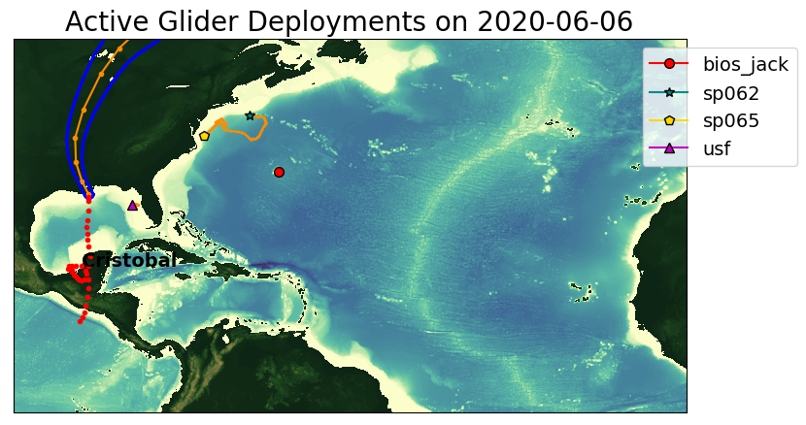
Test Case: Cristobal

Slide 2
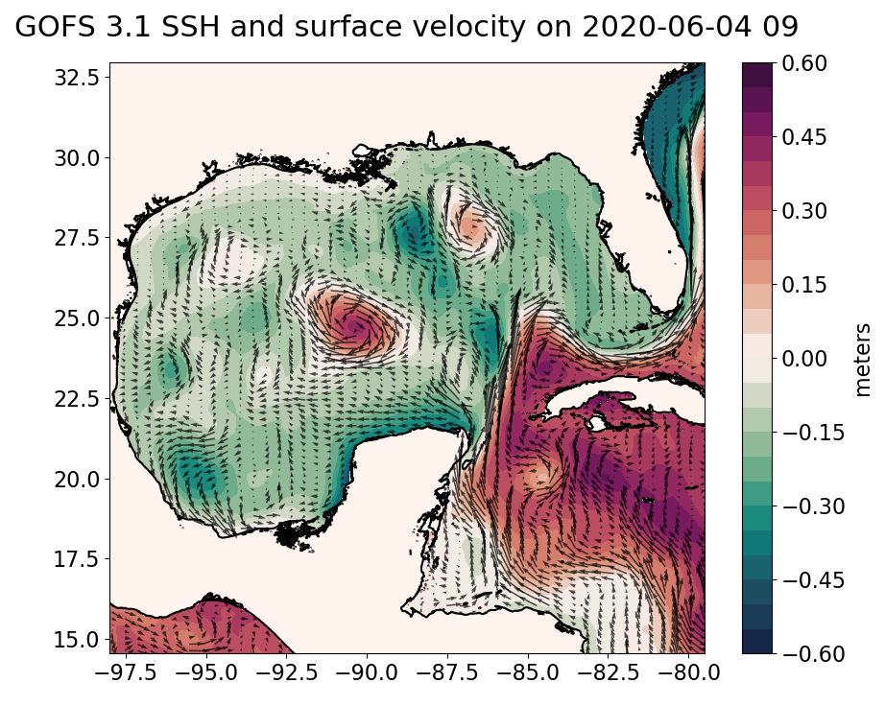
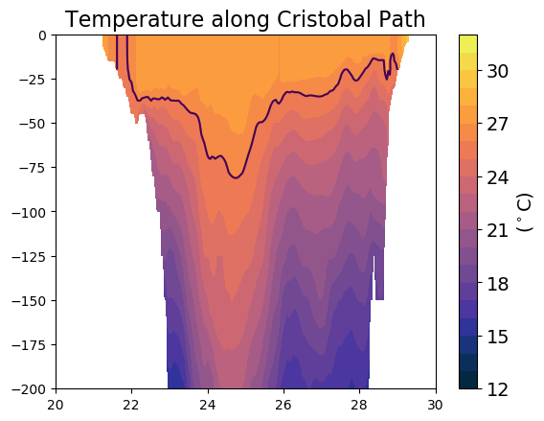

Slide 3
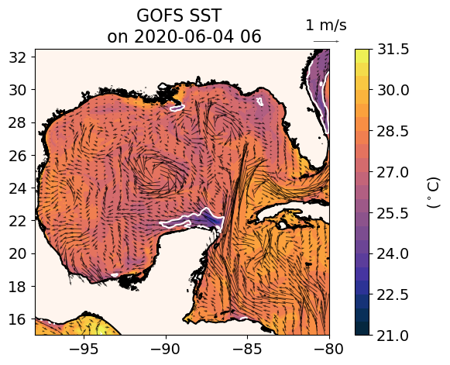
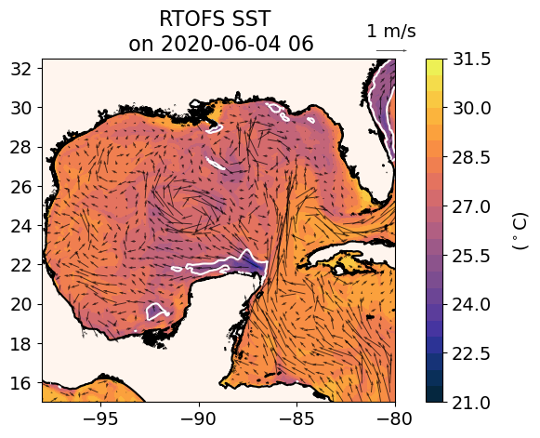
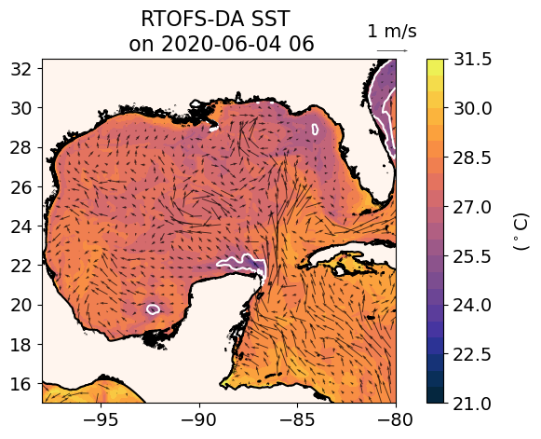
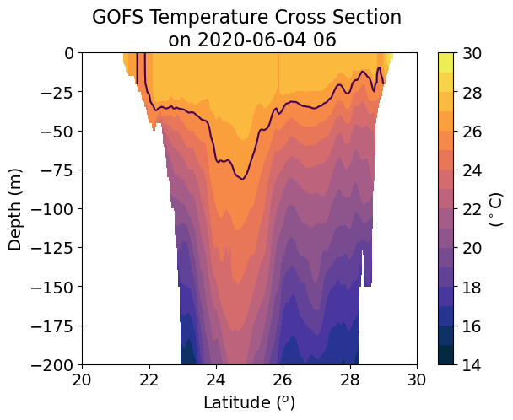
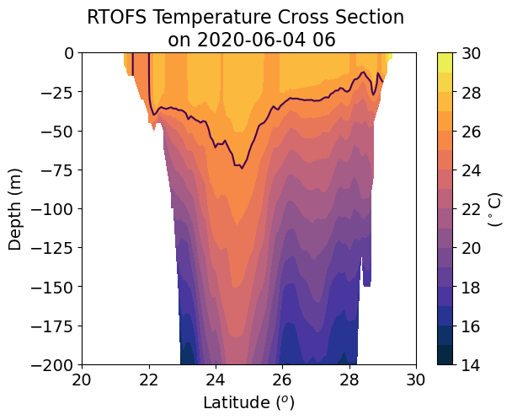
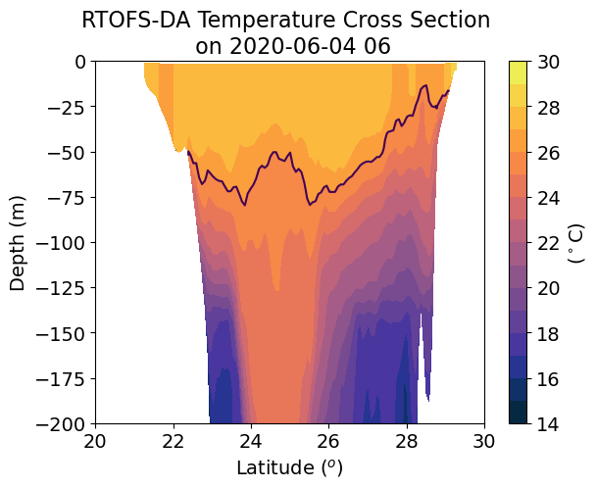
26º
26º
26º
Different subsurface temperature structure
of a warm anticyclonic eddy between GOFS and RTOFS-DA

Slide 4
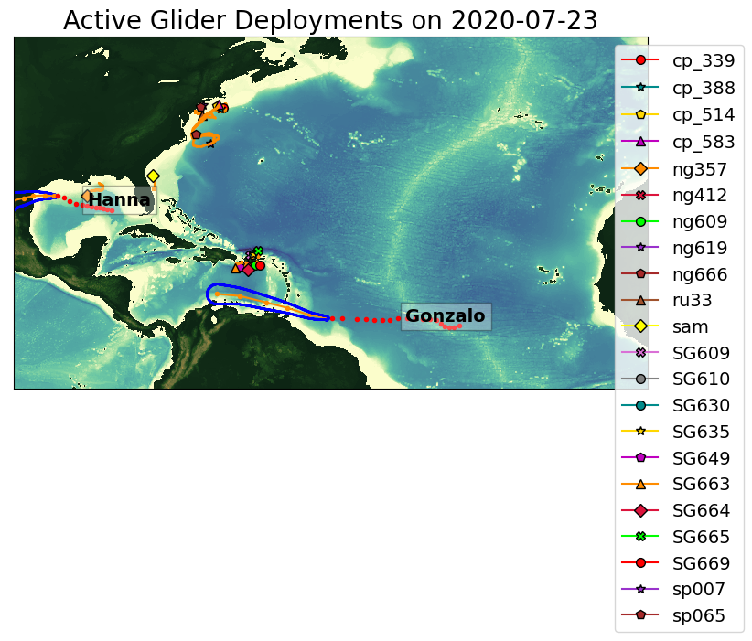
Hanna

Slide 5
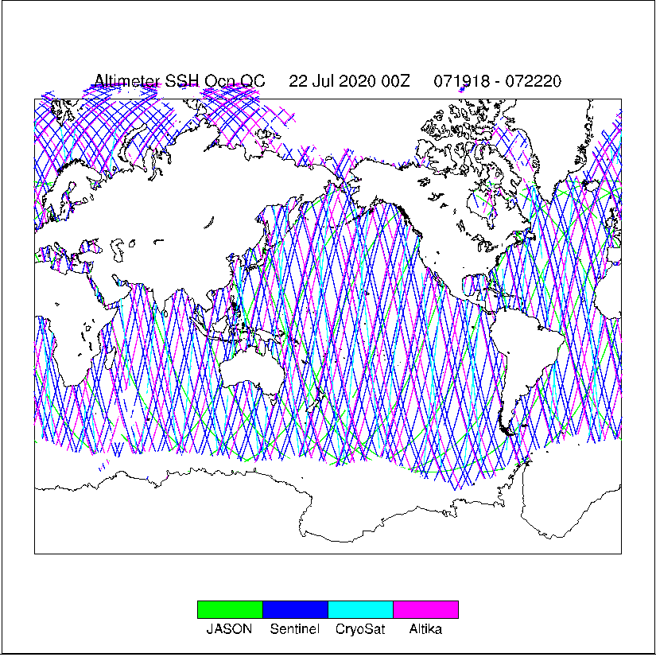

Slide 6



Slide 7
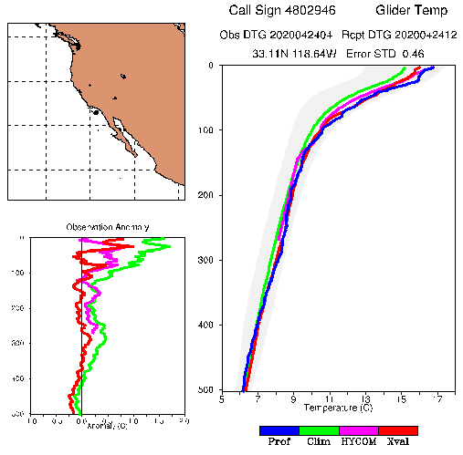
Glider Profiles QC from RTOFS-DA
Assimilation cycle 2020042500
From Zulema:
The analysis takes all the glider profiles that arrived to the tank up to 2020042512,
centered at 2020042500 and going back 5 days (confirm with Jim Cummings!) for profiles
Including gliders, to allow the data to arrive to the tank
Prof : glider
Clim: long term climatology
HYCOM: RTOFS-DA
Xval: running mean climatology of
nearby observations, which is
computed on the run by ncoda

Slide 8
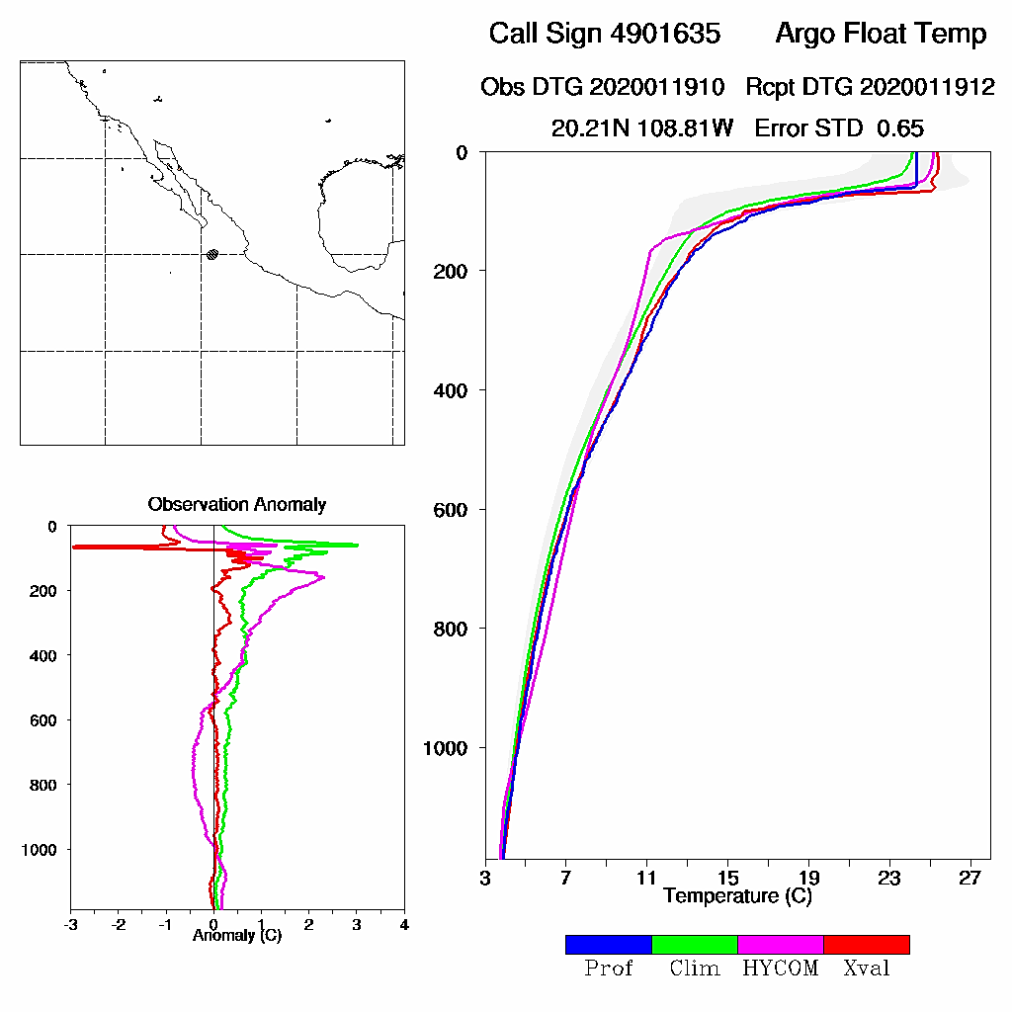
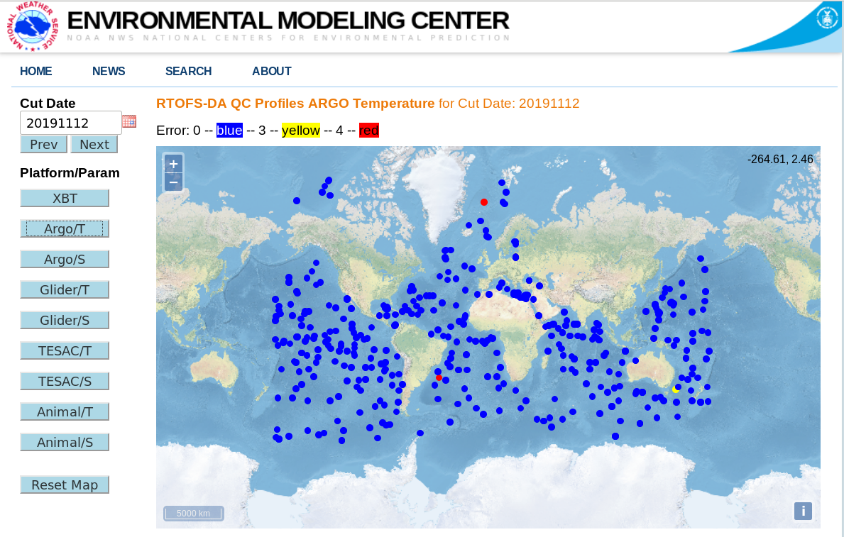
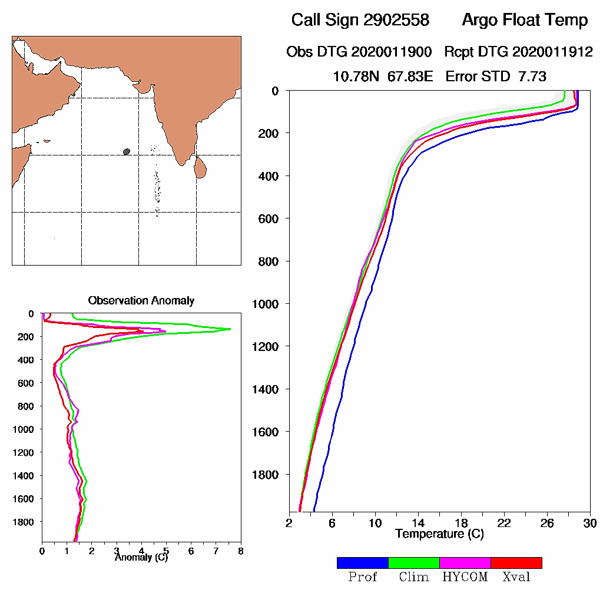
From Zulemas’s presentation
RTOFS-DA: Profile QC
Profile QC outcomes available on the web in real-time
accepted (blue), rejected (red), marginal (yellow)
Shows background fields and anomalies used to make QC decision (climate, cross validation, model forecast)
accepted:
error < 3
https://polar.ncep.noaa.gov/develop/RTOFS-DA/
login: rtofseval passwd: eval2007
rejected:
error > 4

Slide 9
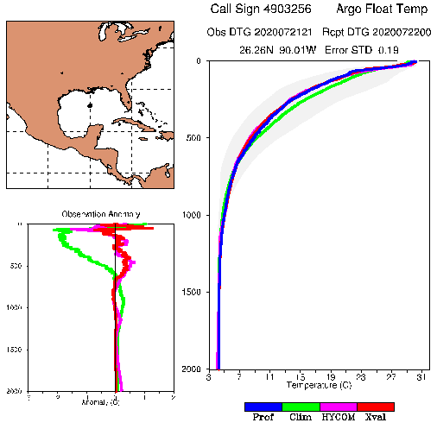
For a profile to be assimilated,
The accepted error has to be less 3 for all the
Three: Clim, HYCOM and Xval, or only for HYCOM?

Slide 10
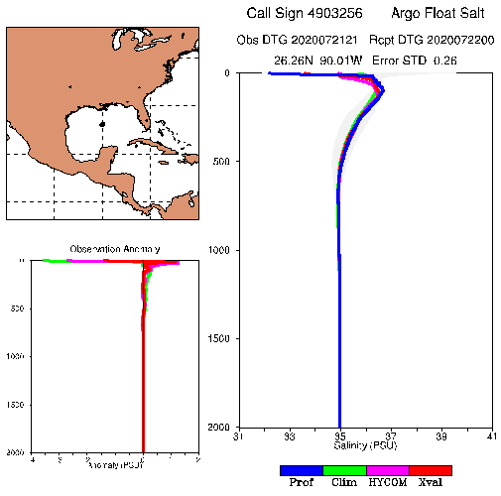

Slide 11
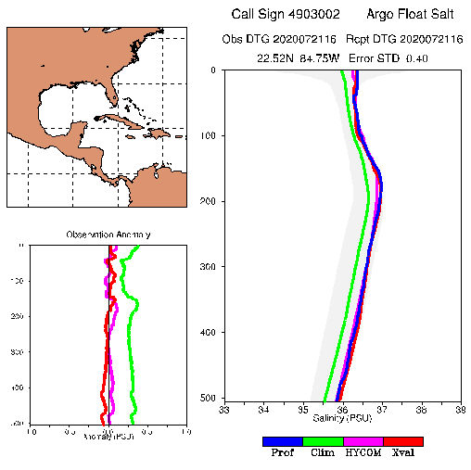

Slide 12
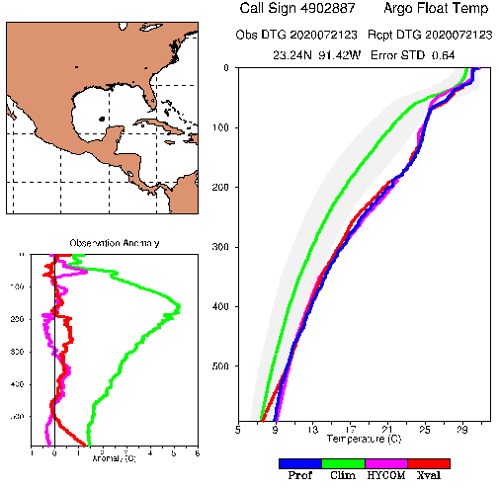

Slide 13
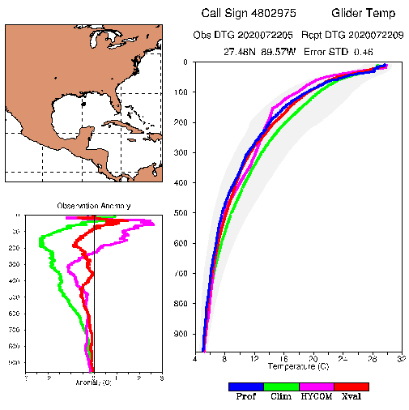
ng357

Slide 14
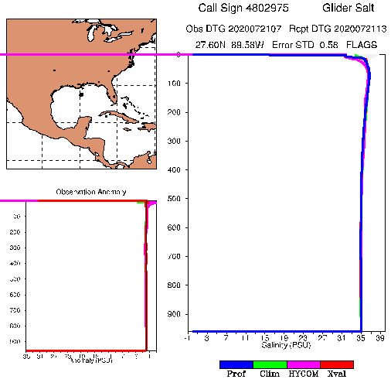
ng357

Slide 15
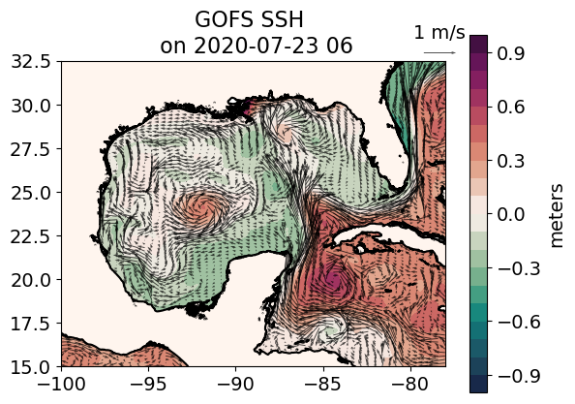

Slide 16
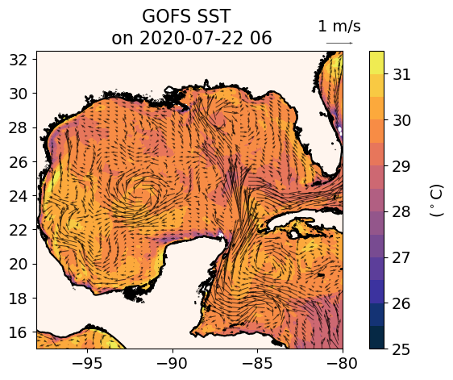
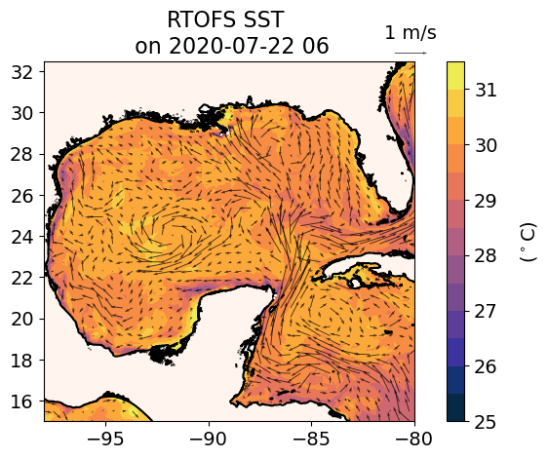
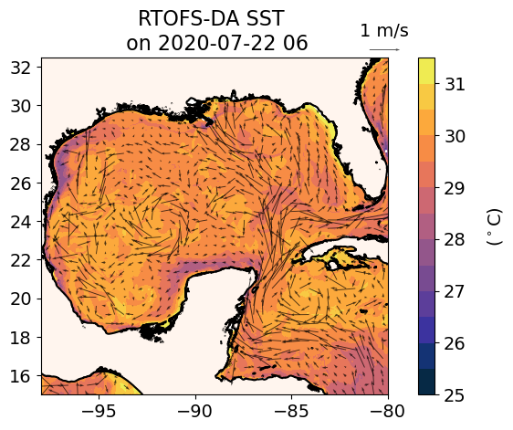
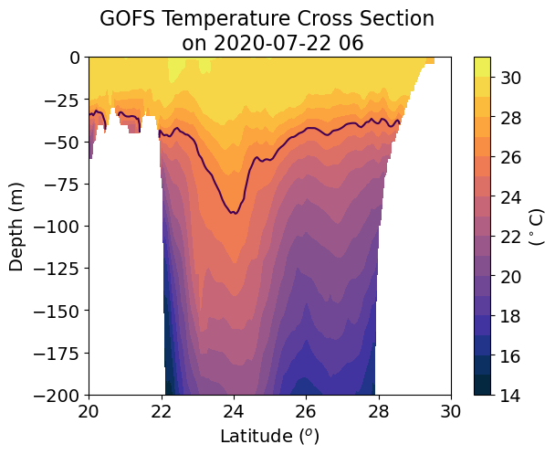
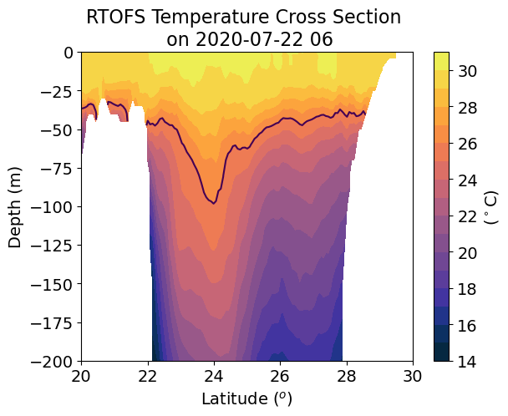
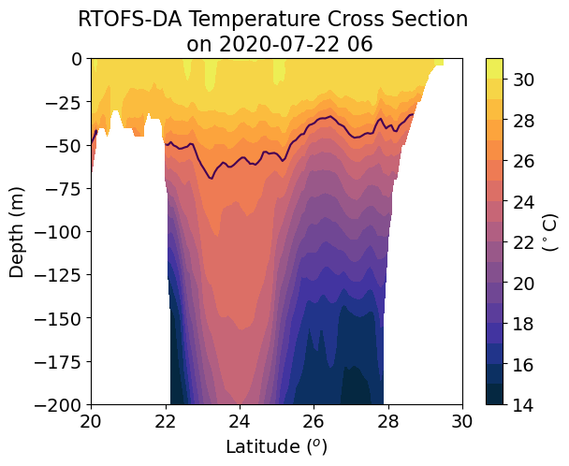
Assimilation cycle 20200723
-92
26º
26º
26º
23
Different subsurface temperature structure
of a warm anticyclonic eddy between GOFS and
RTOFS-DA

Slide 17
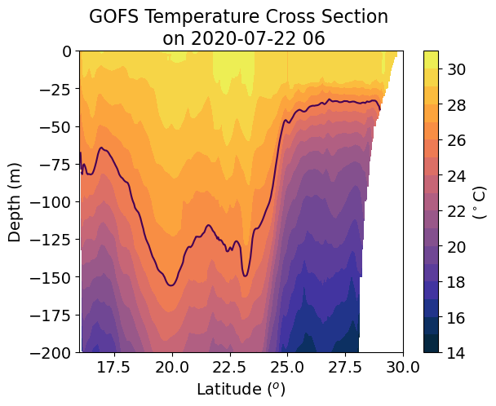
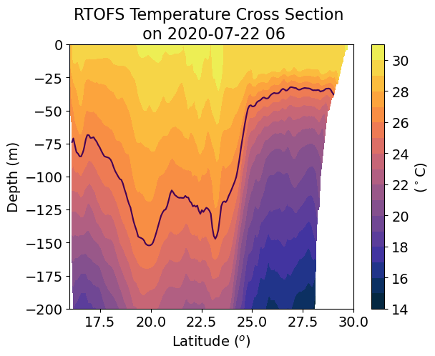
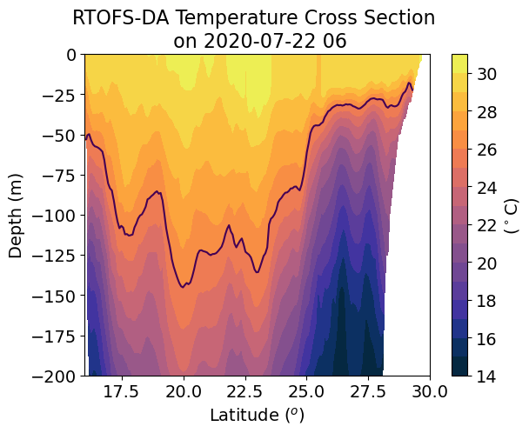
Assimilation cycle 20200723

Slide 18
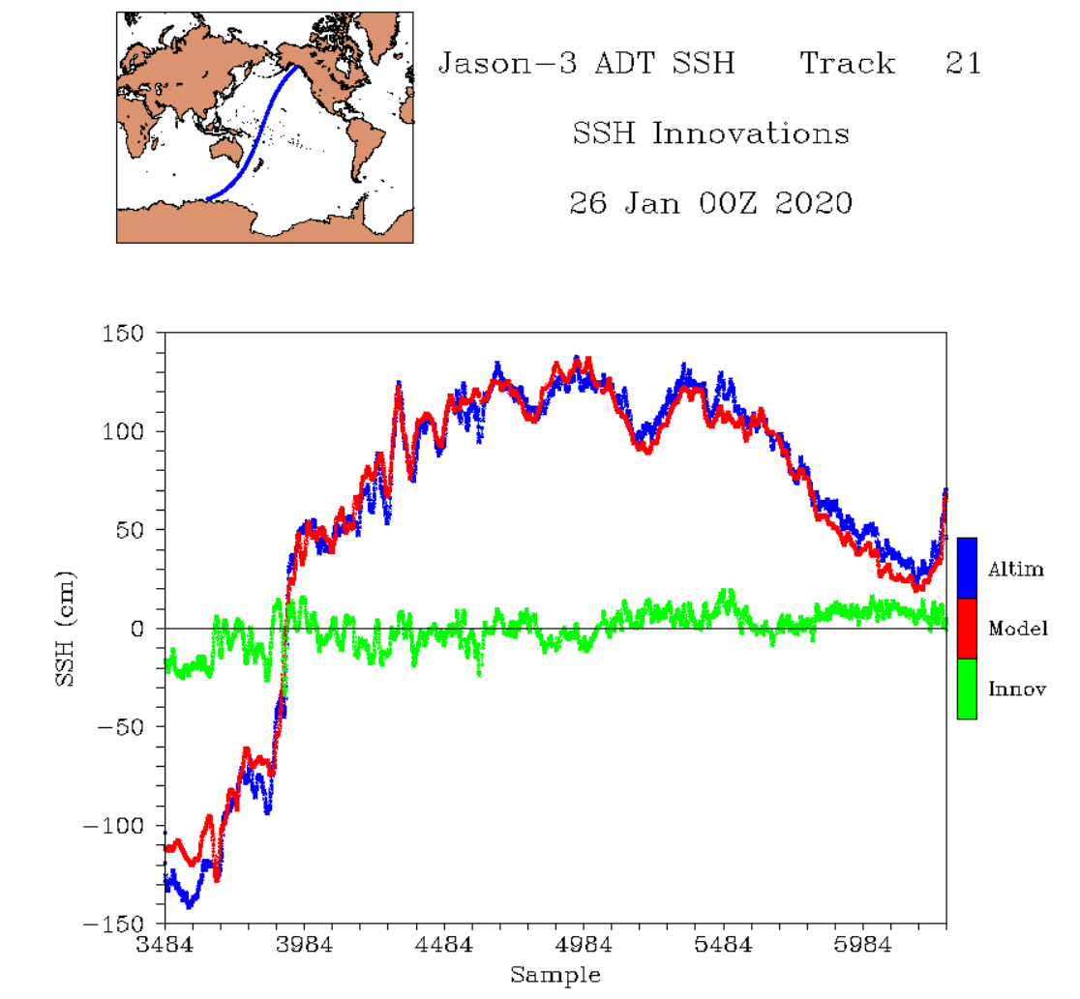
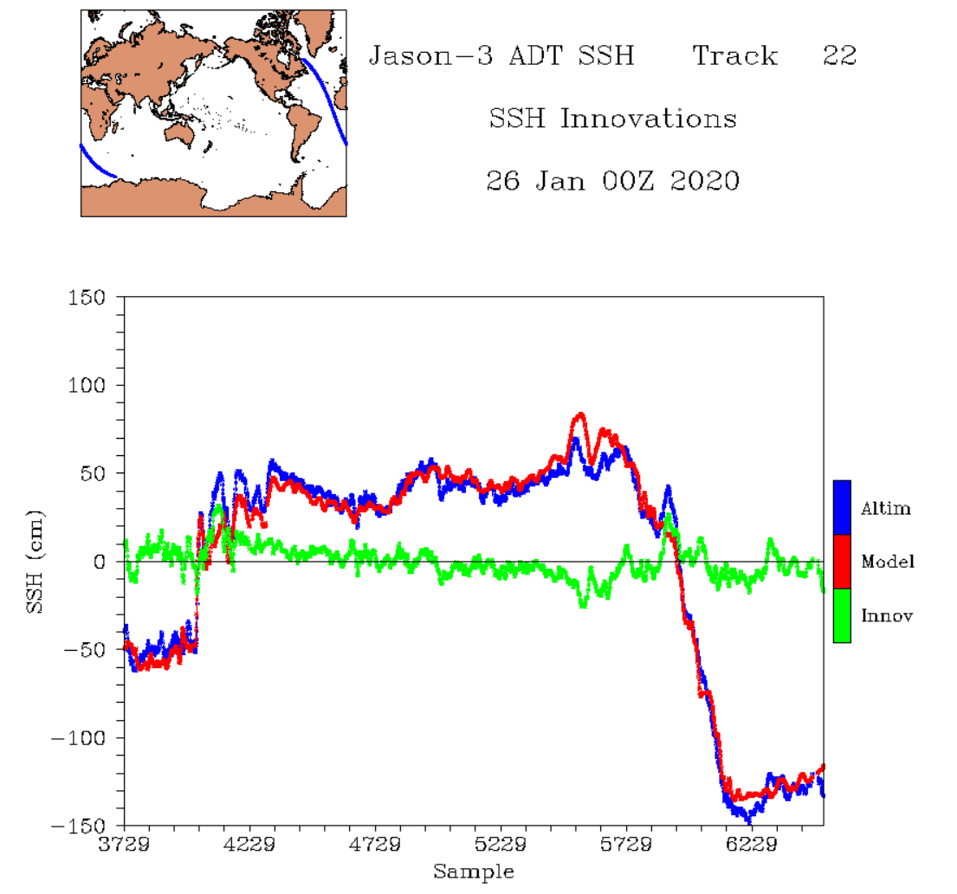
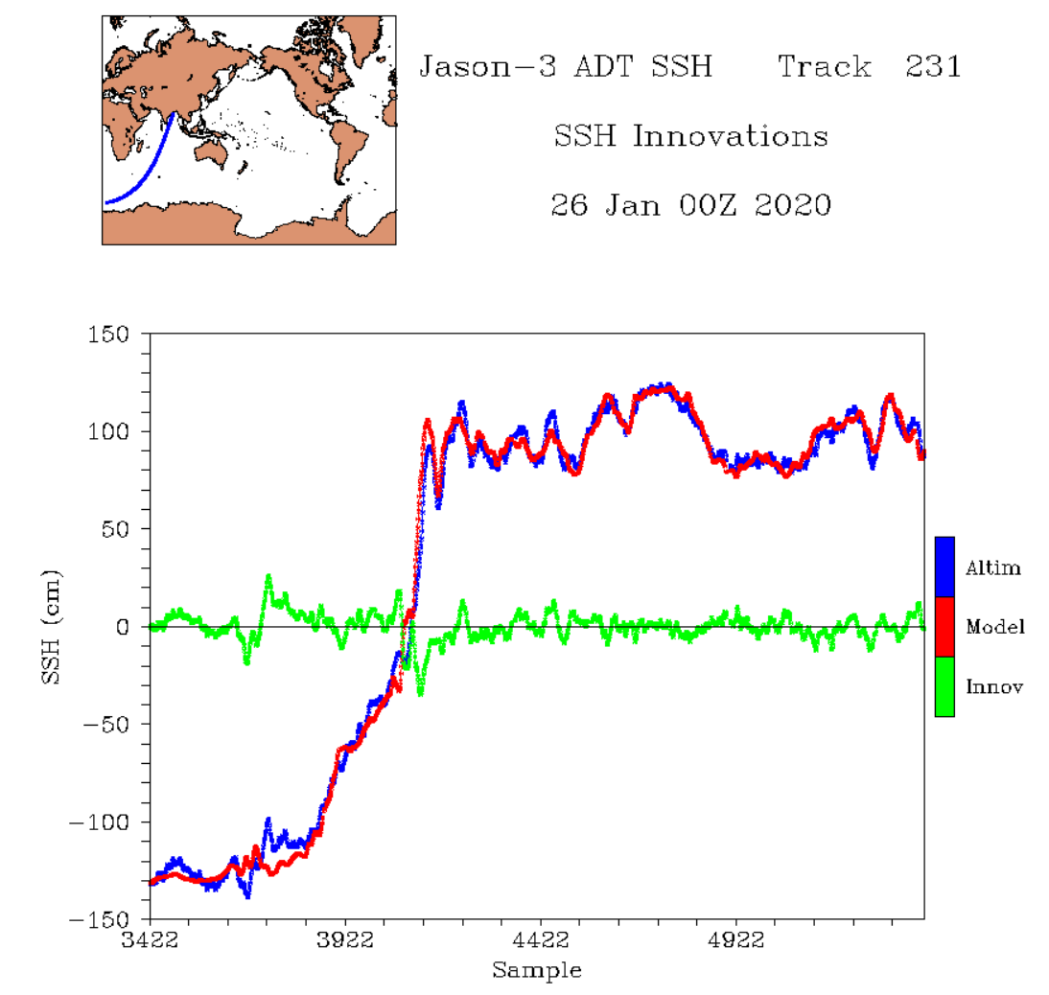
From Zulemas’s presentation
Altimeter Absolute Dynamic Topography (ADT) Assimilation
Pacific
Atlantic
Altimeter tracks of ADT, HYCOM ADT, and ADT-HYCOM innovations in 3 ocean basins
Good agreement between ADT observations and HYCOM 24-hr ADT forecasts
HYCOM ADT bias corrected along altimeter tracks: corrections nearly constant (~50 cm) for all tracks and for all satellites
Indian

Slide 19
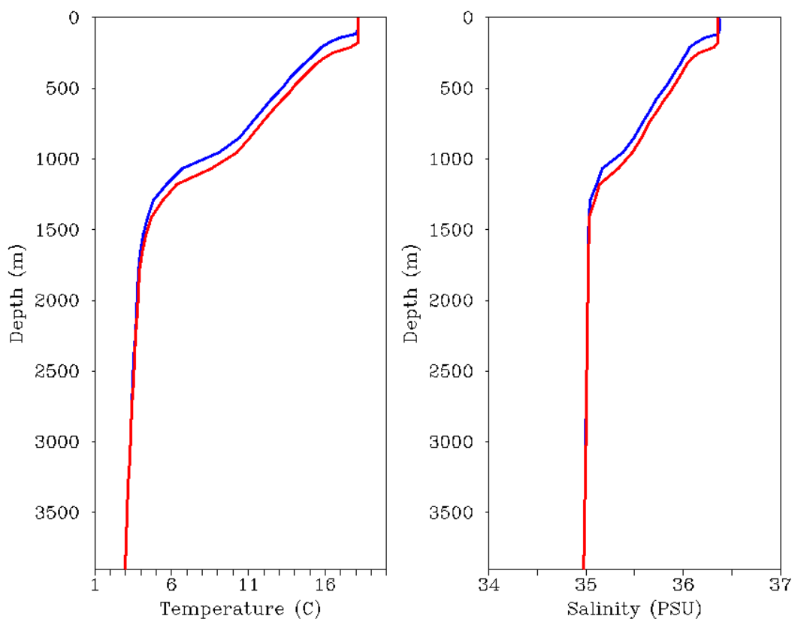
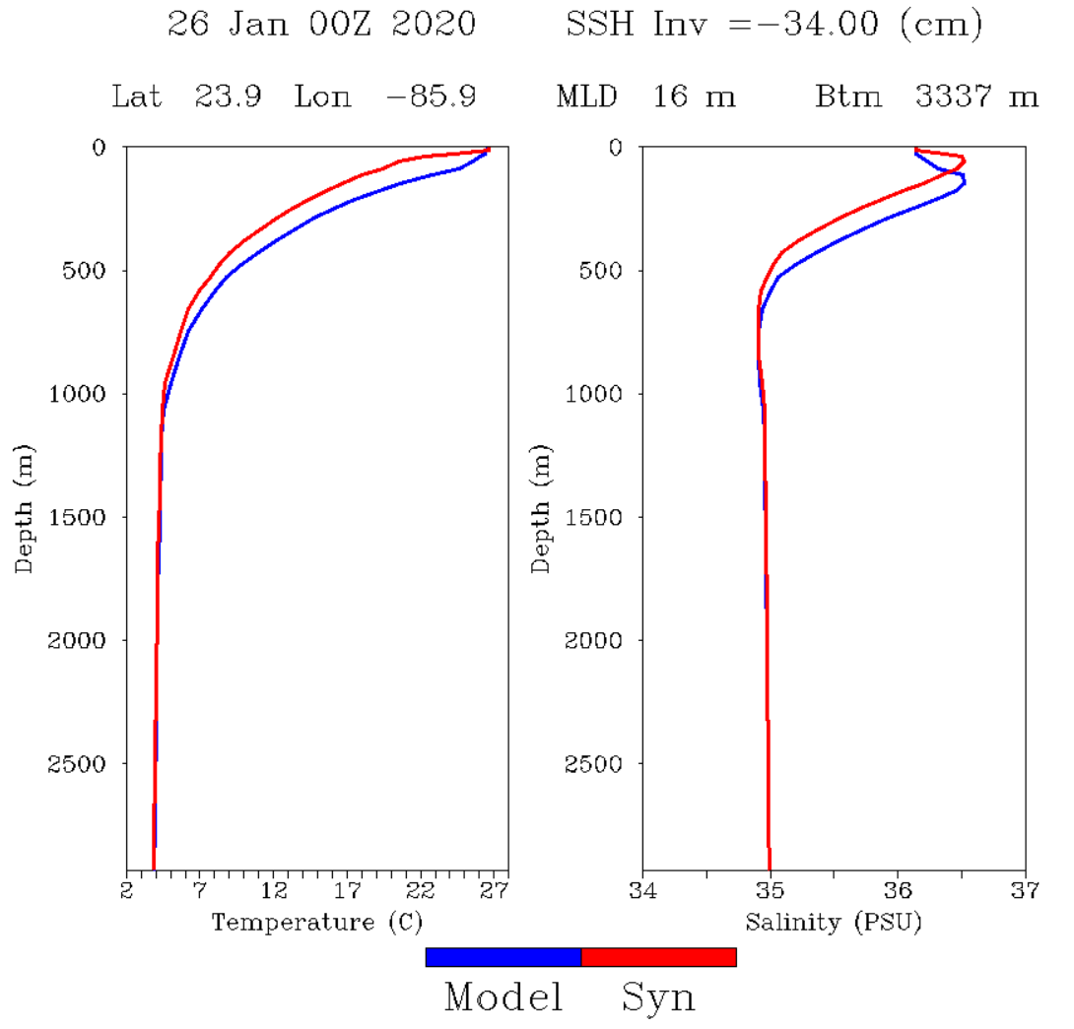
From Zulemas’s presentation
Altimeter Absolute Dynamic Topography (ADT) Assimilation
δADT=+16 cm
Forecast Corrected
δADT=-34 cm
Assimilation corrects forecast model layers to be consistent with δADT
  - layers are lowered when δADT > 0; layers are raised when δADT < 0
Solution conserves model TS relationships and is constrained by SST, SSS, MLD

Slide 20
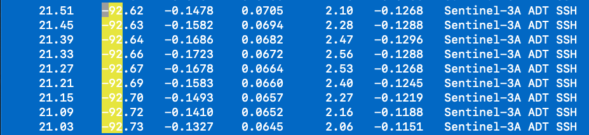
From hycom_var.2020072200.ssh
Innov < 0, layers are raised
Zulema, Do you think this can explain the
Differences between GOFS and RTOFS-DA
Shown in slide 16 and 17?

Slide 21

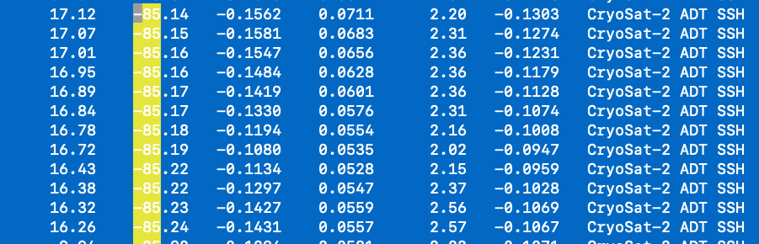
From hycom_var.2020072200.ssh
Innov < 0, layers are raised

Slide 22
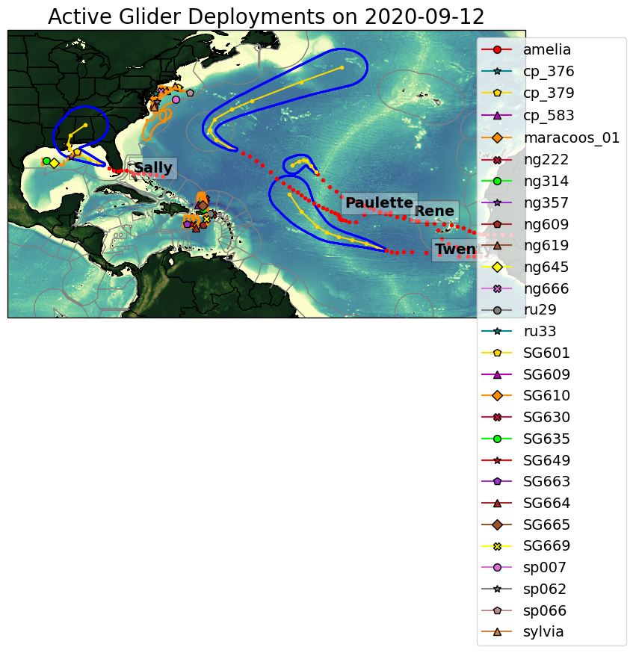
Sally

Slide 23
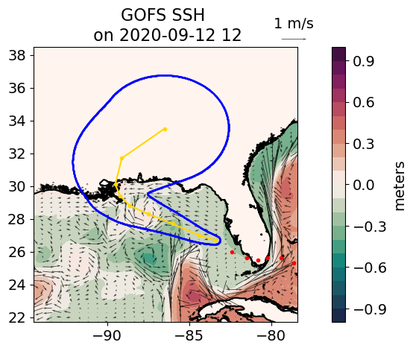
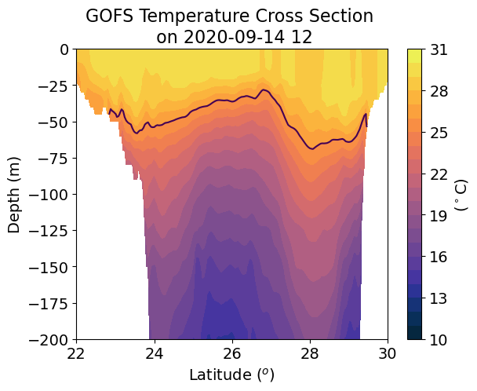
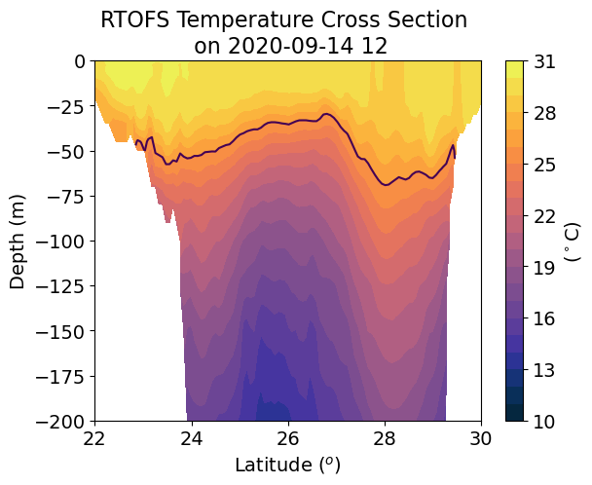
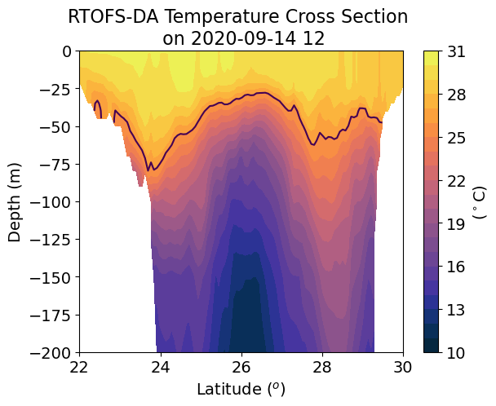
-88
Assimilation cycle 20200915
There are some differences in the subsurface temperature structure, but overall there is better
Agreement than in slides 16 and 17

Slide 24
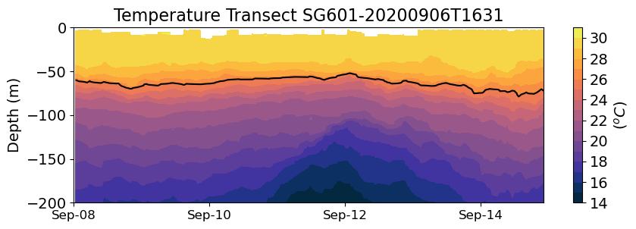
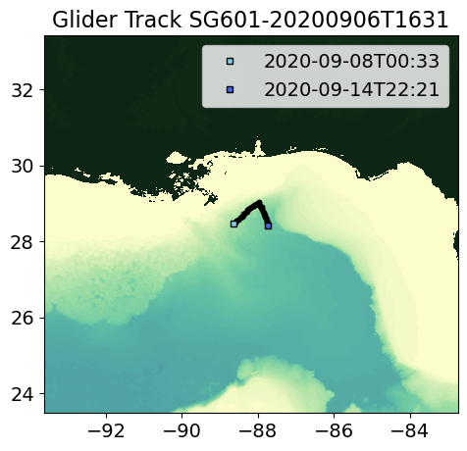
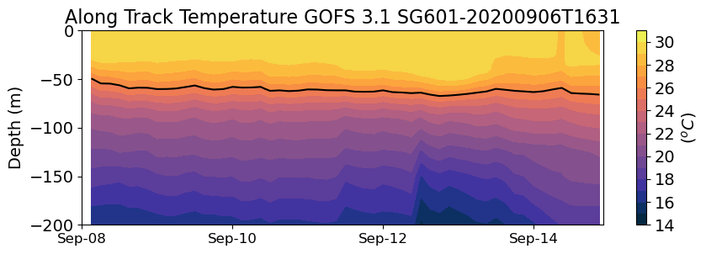
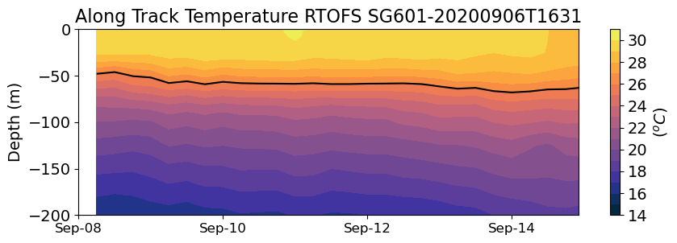
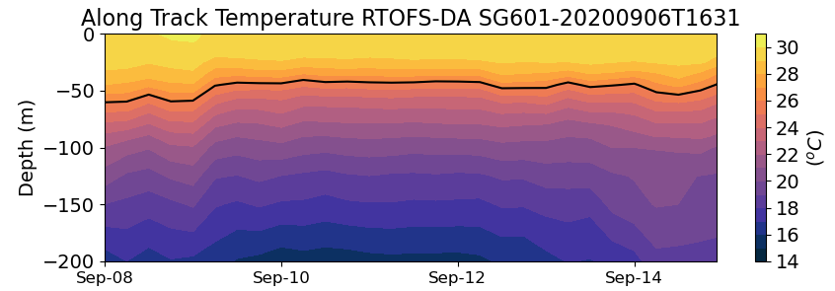
SG601

Slide 25
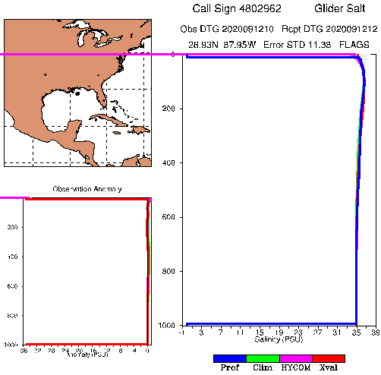
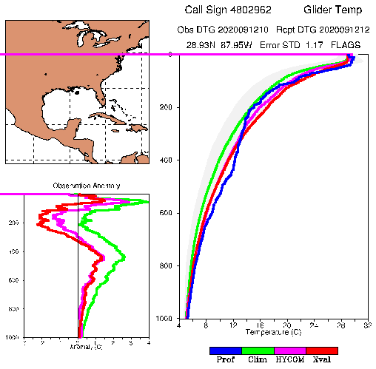
SG601

Slide 26


SG601

Slide 27


SG601
Zulema, do you think that the better agreement in this case is due to the fact that the profiles
From glider SG601 were being assimilated by RTOFS-DA? This glider was trying to specifically
Capture the subsurface structure of the eddy

Slide 28


SG601

Slide 29


Slide 30

From hycom_var.2020091400.ssh
Innov > 0, layers are lowered
In this case the innovations will tend to lower the temperature profile, however we see
From slide 23 that the isothermals in RTOFS-DA were raised in the middle of the eddy,
Better resembling the temperature structure shown by the glider observations (slide 24
Top figure). Do you know if there are in-situ profiles (glider or Argos), the NCODA algorithm
is RTOFS-DA chooses the vertical adjustment from the in-situ profile over the adjustment from
The absolute dynamic topography? Or the final adjustment is some combination of both?
Thanks!

Slide 31

Aug 31 2020
SSH from Copernicus

Slide 32



Slide 33







Slide 34




Slide 37



