Slide 1
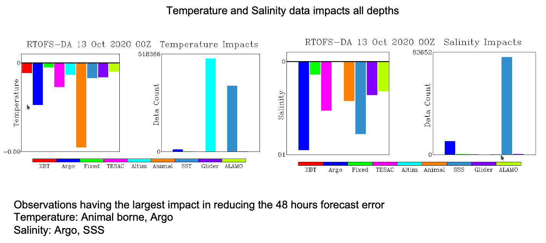
Work by Zulema Garraffo and Jim Cummings
Impact of the assimilation of ocean observations
on reducing the 48 hours forecast error in RTOFS-DA
Observation impacts obtained using the adjoint sensitivity method
The impact is normalized by the number of observations
TESAC (CTD) (temperature, salinity and current report from a sea station)

Slide 2
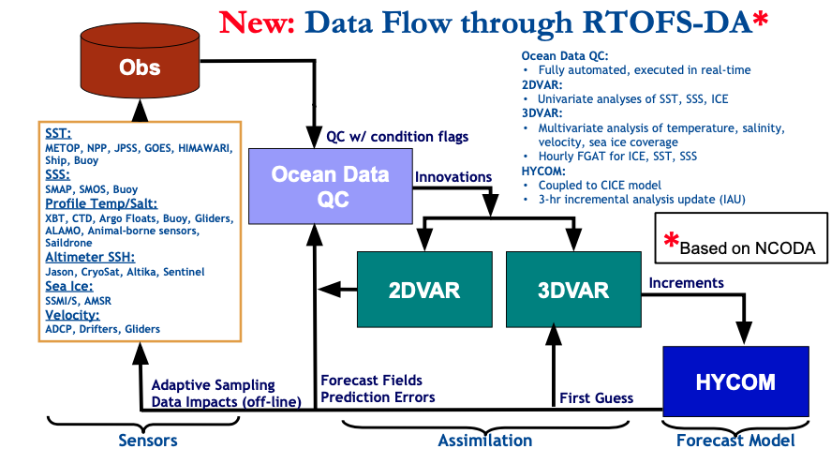
Courtesy of Avichal Mehra

Slide 4
NOAA Hurricane Forecasting Models
HWRF/HYCOM
HMON/HYCOM
HWRF/MPIPOM
West/South Pacific, South/North Indian Ocean
North Atlantic,
East/Central Pacific
North
Atlantic
East/Central
Pacific
IC come from climatology and the POM (w/ feature model only in the GoM)
IC and BC from
Global RTOFS spun up from the global
GOFS 3.1/NCODA
IC from Global RTOFS nowcast
Operational model until July 2020

Slide 5
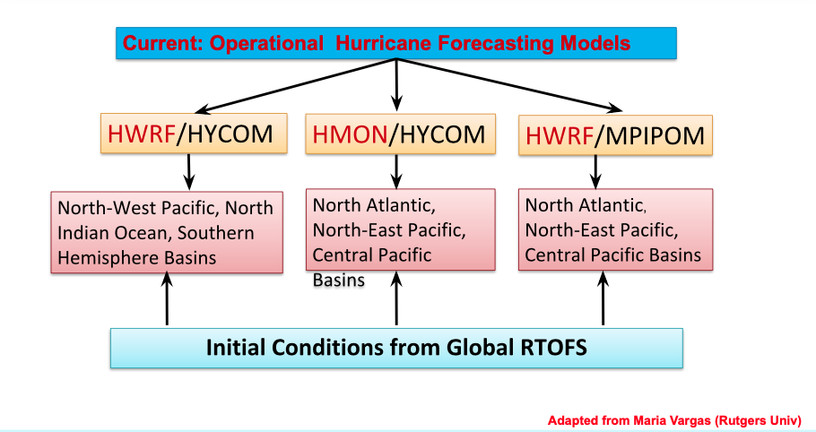

Slide 6
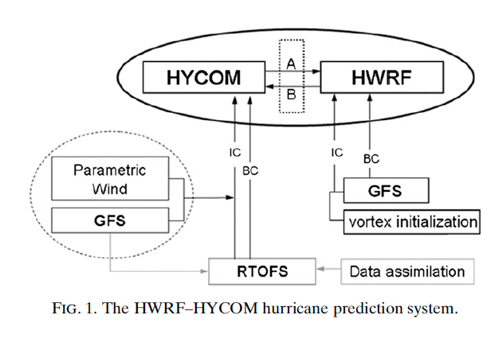
Hurricane Forecasting System
Forecasting Model: HWRF-HYCOM System
Kim et al. 2014
NOAA operational
Ocean model
IC
IC
Navy operational
Ocean model
GOFS/NCODA
RTOFS – Real Time Ocean Forecasting System
GFS – Global Forecasting System
GOFS –Global Ocean Forecasting System
Notes:
This is a schematic of the workflow for the HWRF/HYCOM system. The right side shows the atmospheric component and the left side is the oceanic component. The IC and BC for the regional HYCOM come from the global RTOFS, that is the NOAA operational ocean model. At the same time, the IC for the global RTOFS comes from Global Ocean Forecasting System GOFS that is the Navy operational ocean model and implements data assimilation though NCODA that is the Navy coupled ocean data assimilations system. So in its current state, the NOAA hurricane forecasting models incorporates ocean data assimilation through the IC to their own global ocean model. NCEP is currently working to implement data assimilation directly into RTOFS.

Slide 7
Hurricane Forecasting System
Forecasting Model: HWRF-HYCOM System
Kim et al. 2014
NOAA operational
Ocean model
IC
RTOFS/DA
IC
Navy operational
Ocean model
GOFS/NCODA
RTOFS – Real Time Ocean Forecasting System
GFS – Global Forecasting System
GOFS –Global Ocean Forecasting System
Notes:
This is a schematic of the workflow for the HWRF/HYCOM system. The right side shows the atmospheric component and the left side is the oceanic component. The IC and BC for the regional HYCOM come from the global RTOFS, that is the NOAA operational ocean model. At the same time, the IC for the global RTOFS comes from Global Ocean Forecasting System GOFS that is the Navy operational ocean model and implements data assimilation though NCODA that is the Navy coupled ocean data assimilations system. So in its current state, the NOAA hurricane forecasting models incorporates ocean data assimilation through the IC to their own global ocean model. NCEP is currently working to implement data assimilation directly into RTOFS.

Slide 8
Taken from Avichal Mehra

Slide 9
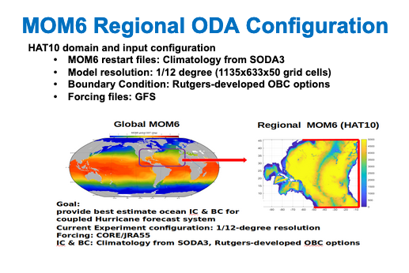
Taken from Avichal Mehra

Slide 10
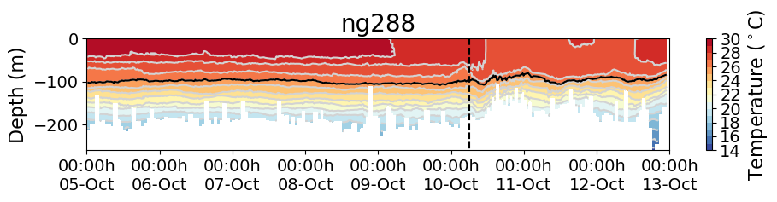
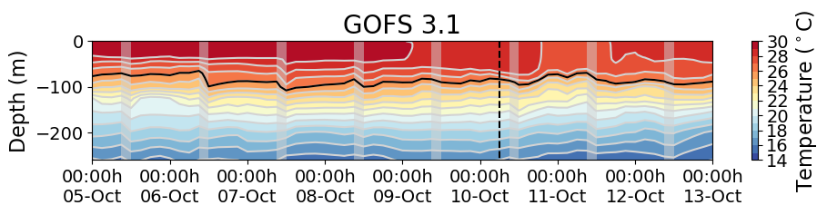
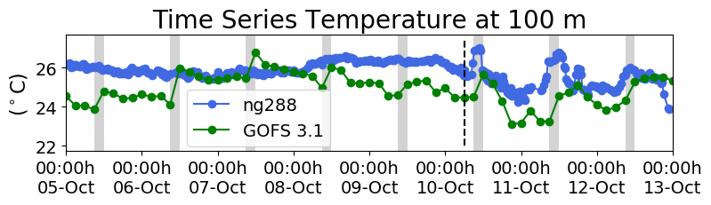
Hurricane Michael
Increments
Insertion Window
Increments
Insertion Window
Increments
Insertion Window
The assimilation of glider data days ahead of Michael corrected
the position of the thermocline
Notes:
This is the temperature transect from ng288 and we also have the temperature transect form the GOFS 3.1 following ng288 glider track. When we look back 5 days before the passage of Michael, we observe that in GOFS 3.1 after every increment insertion window, the thermocline is pulled down to match the depth of the thermocline from the glider data until it settles down at the right depth. This highlights the importance of having a continuous glider presence so when a storm strikes, the model ocean has a most realistic vertical stratification.

Slide 11
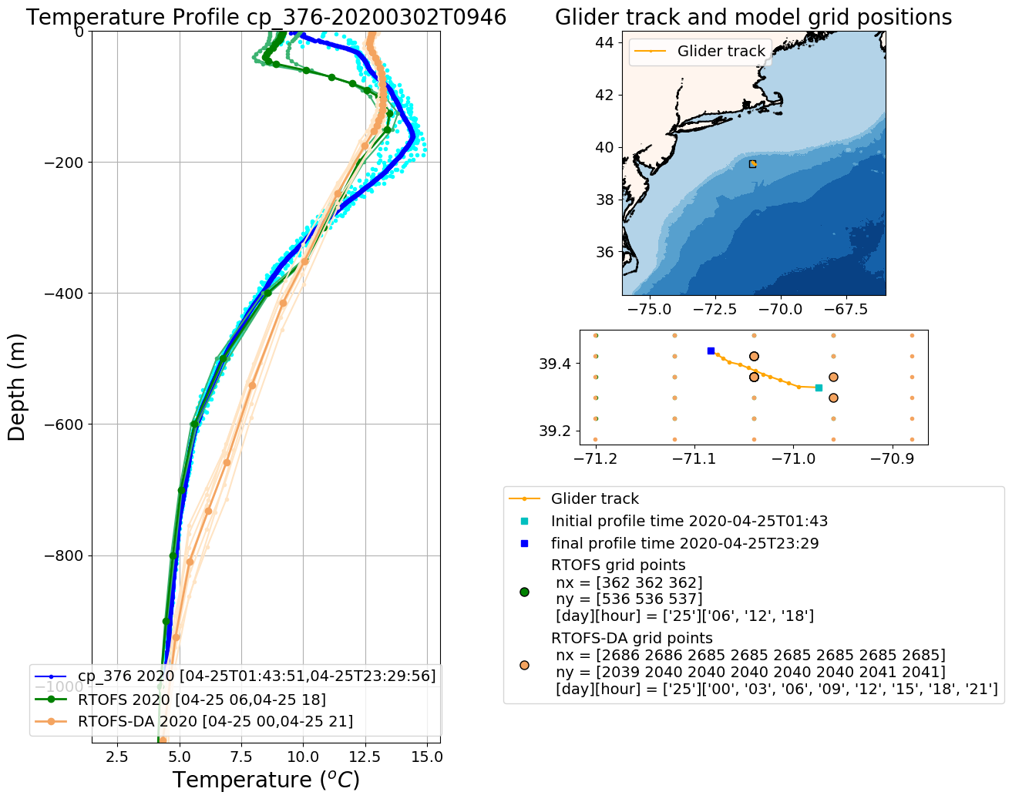
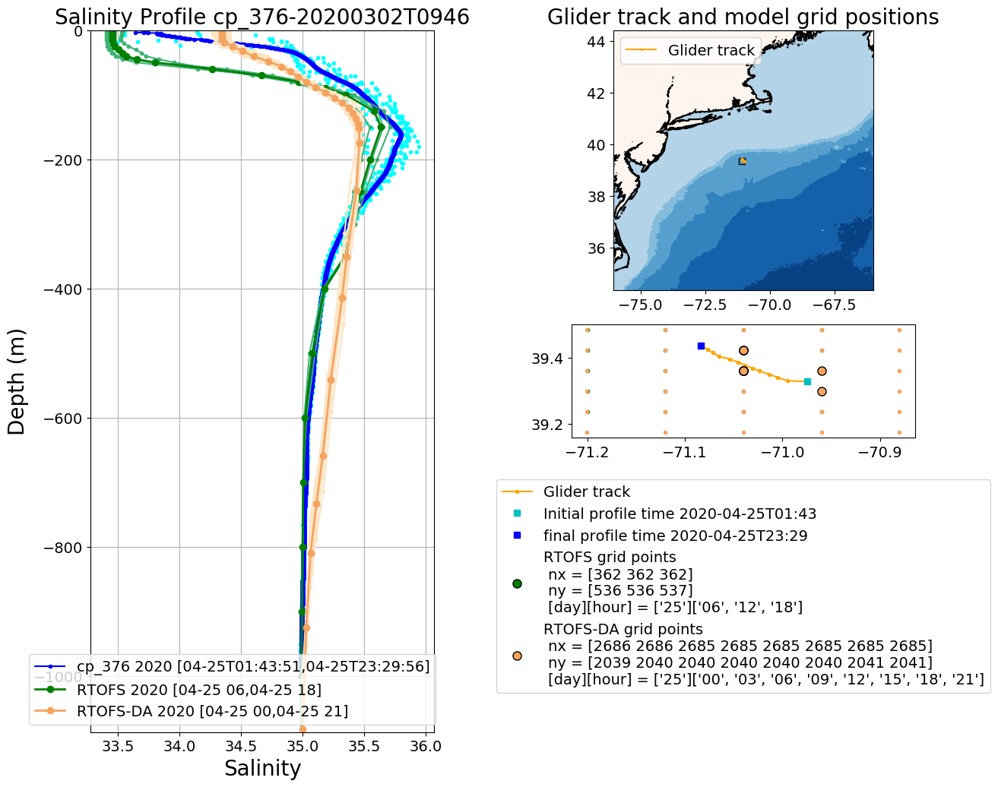
Operational RTOFS vs RTOFS-DA
2020042500

Slide 12
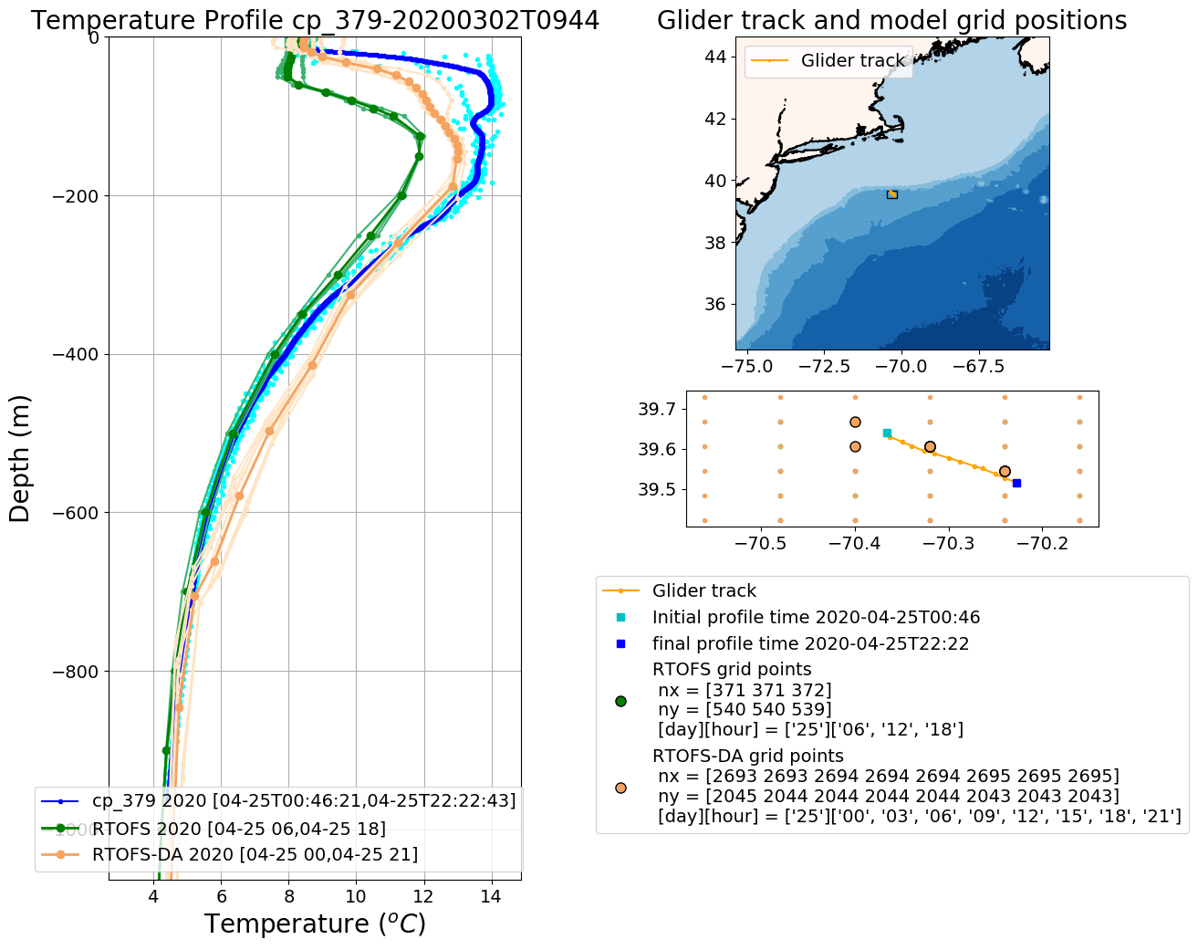
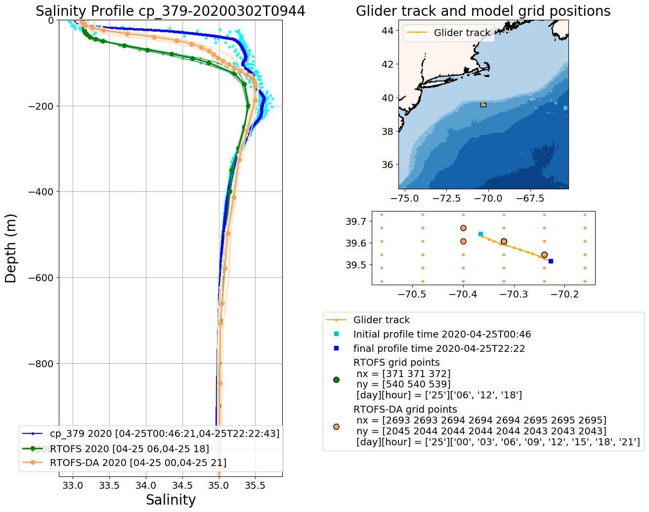
Operational RTOFS vs RTOFS-DA
2020042500

Slide 13
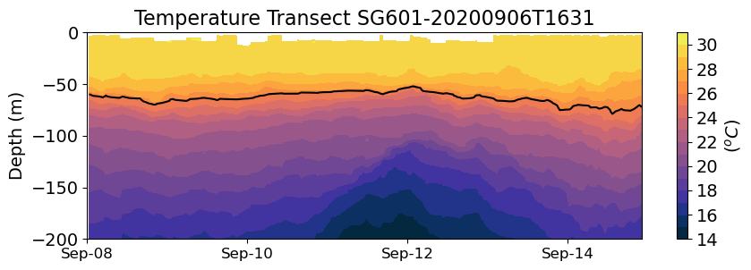
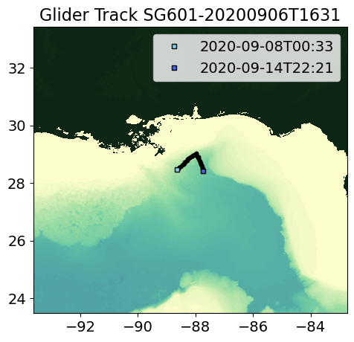
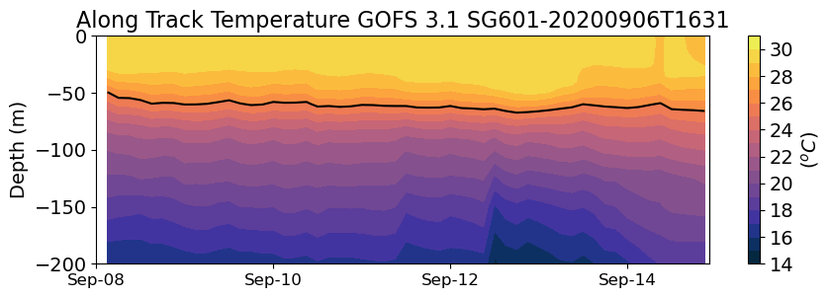
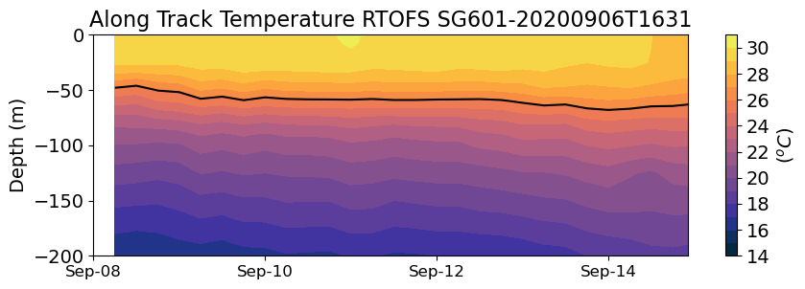
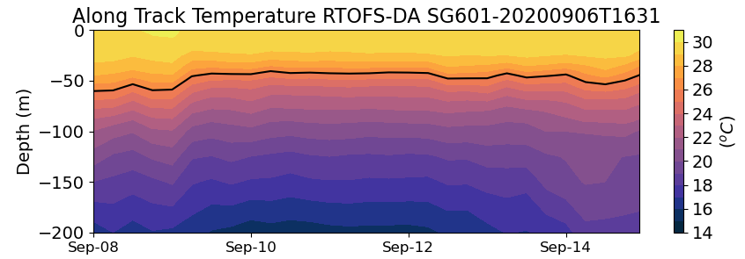
SG601

Slide 15
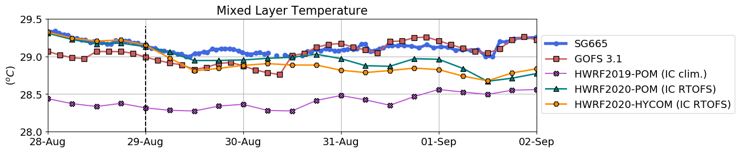
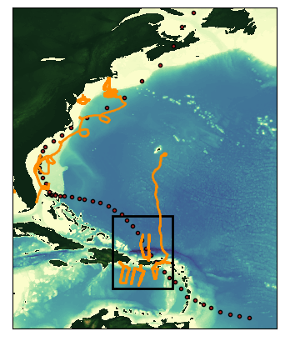
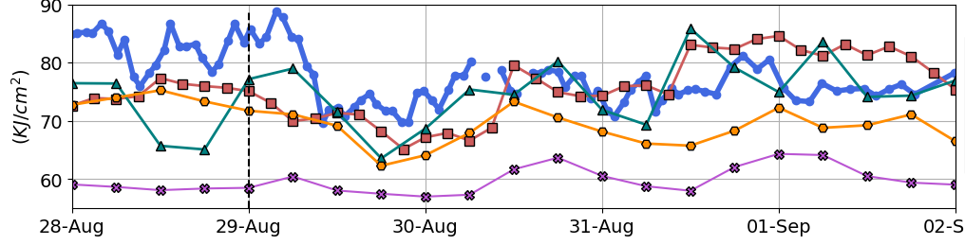
Hurricane Dorian 2019
Glider Data
Operational Navy Ocean Model
Operational NOAA Hurricane Model 2019
Experimental NOAA Hurricane Model
Experimental NOAA Hurricane Model
Sea Surface Temperature
One of NOAA’s operational hurricane forecasting model in 2019 has
sea surface temperature that is significantly colder than temperature
from glider observations.
Ocean Heat Content
As a consequence, the ocean heat content of the operational model is
much lower than the observed value and below the threshold value for
intensification of tropical cyclones.

Slide 16
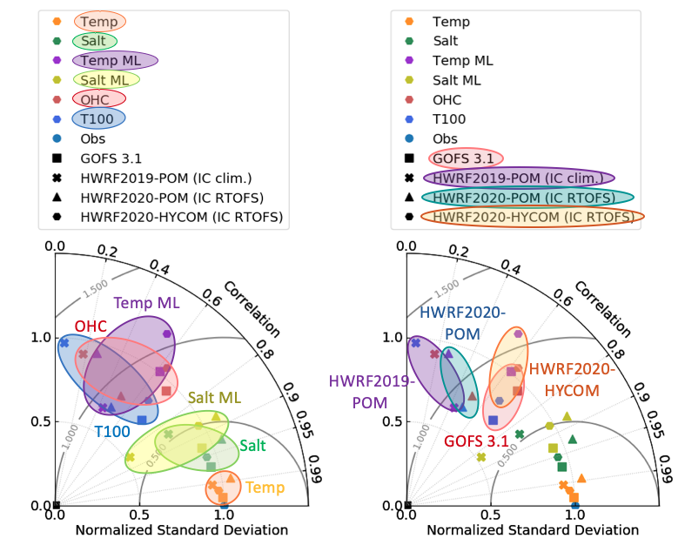
Model’s Skill

