Slide 1
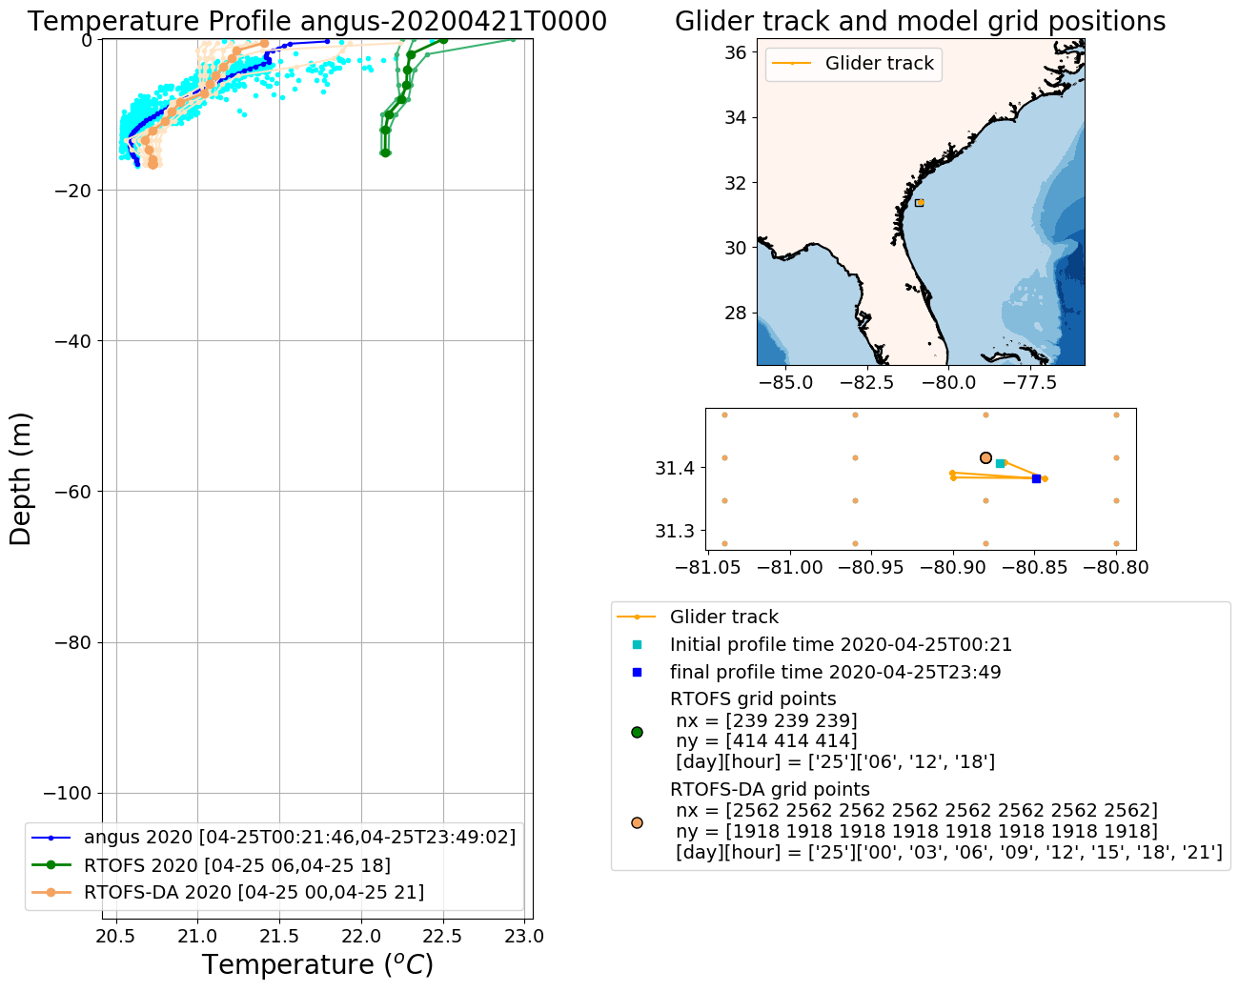
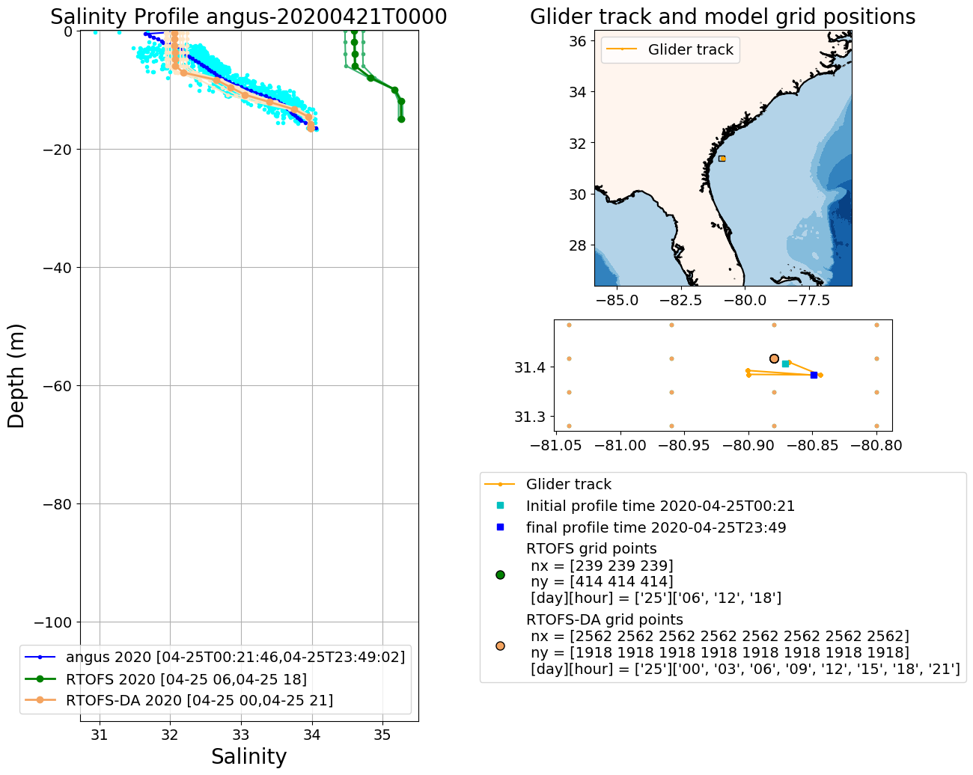
Operational RTOFS vs RTOFS-DA
2020042500

Slide 2
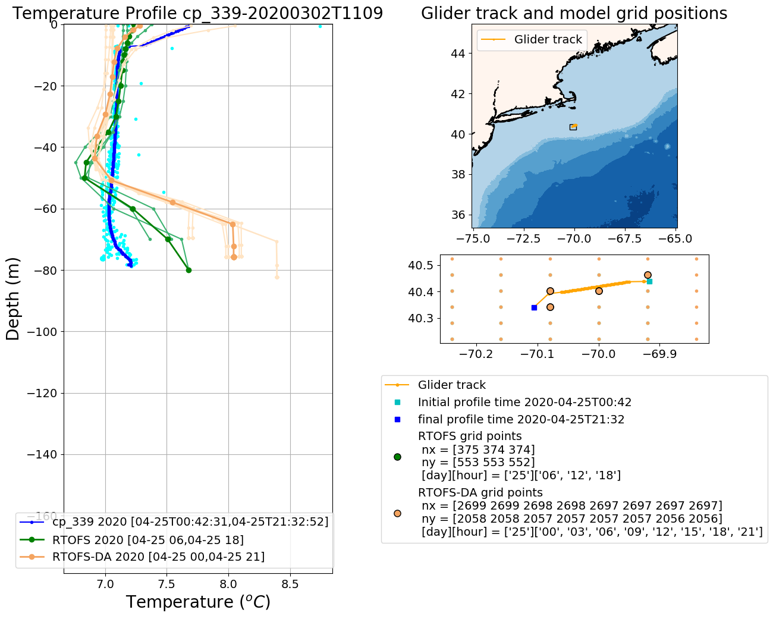
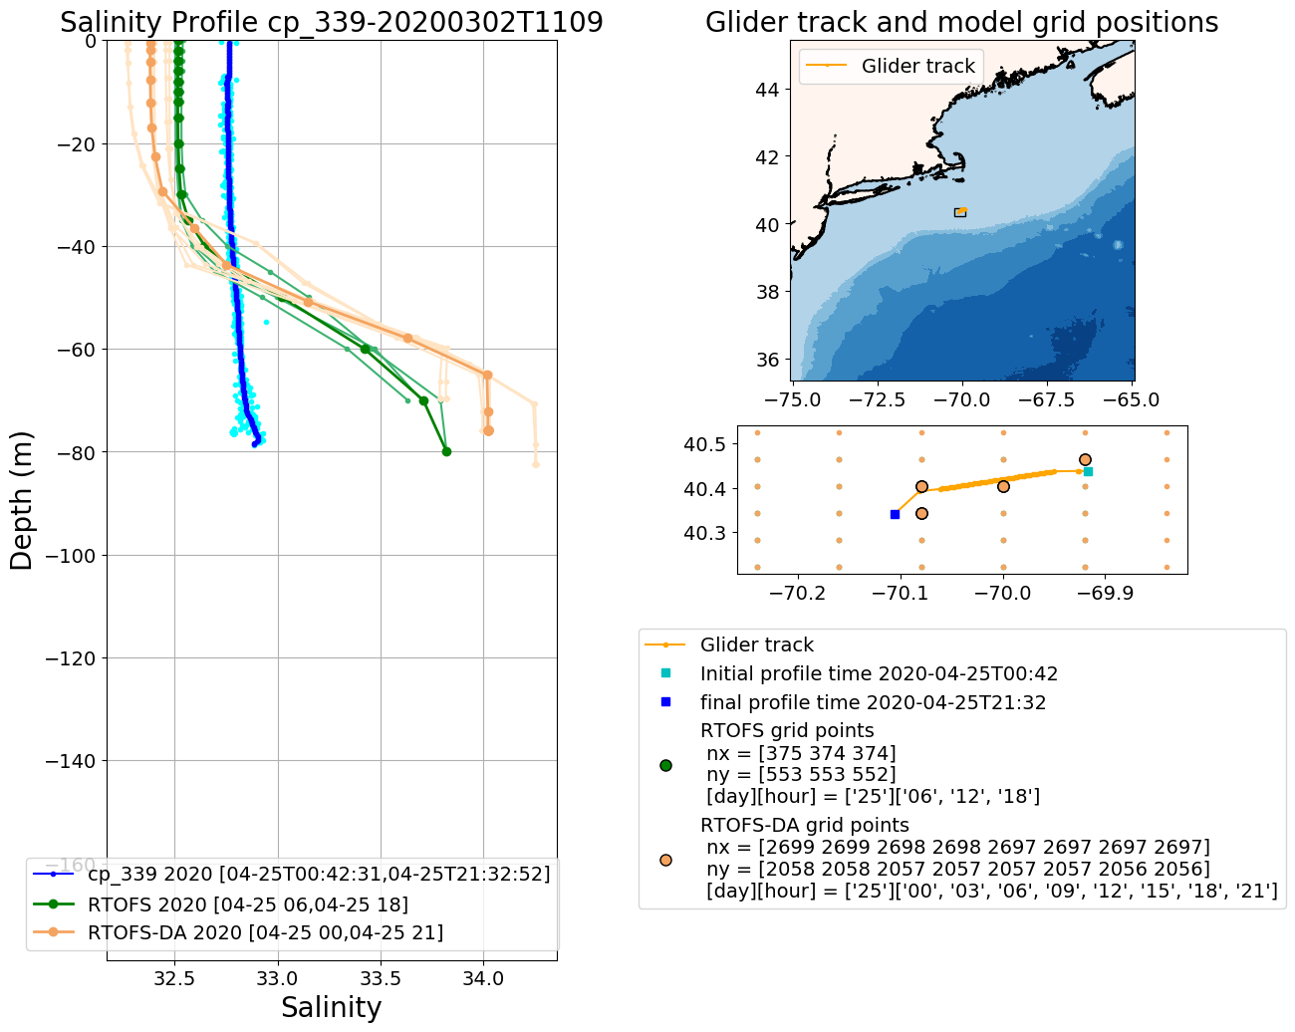
Operational RTOFS vs RTOFS-DA
2020042500

Slide 3
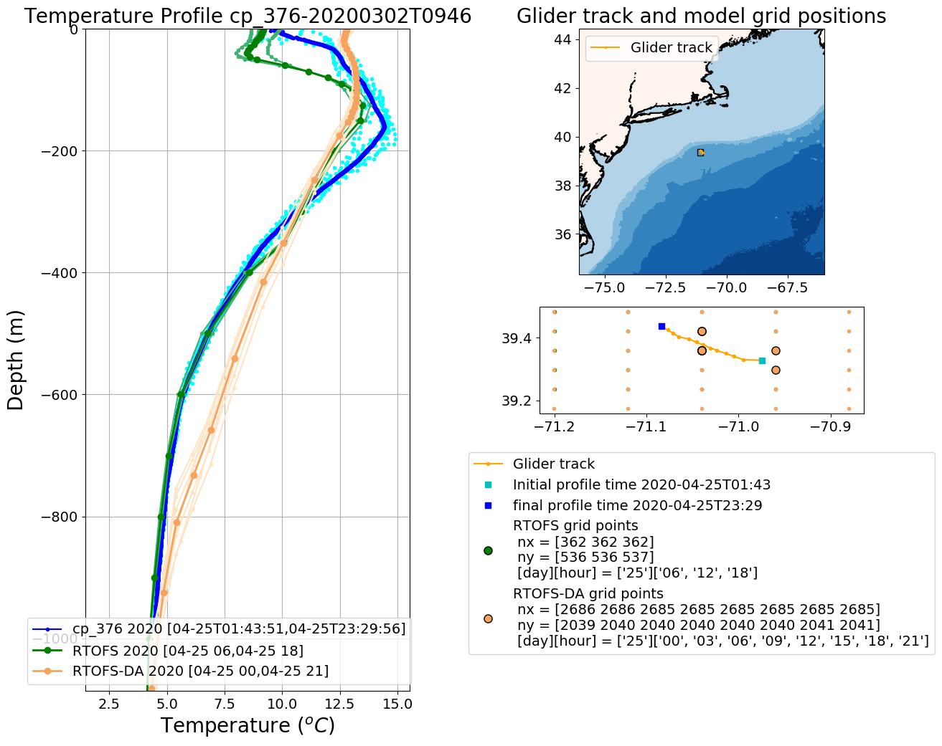
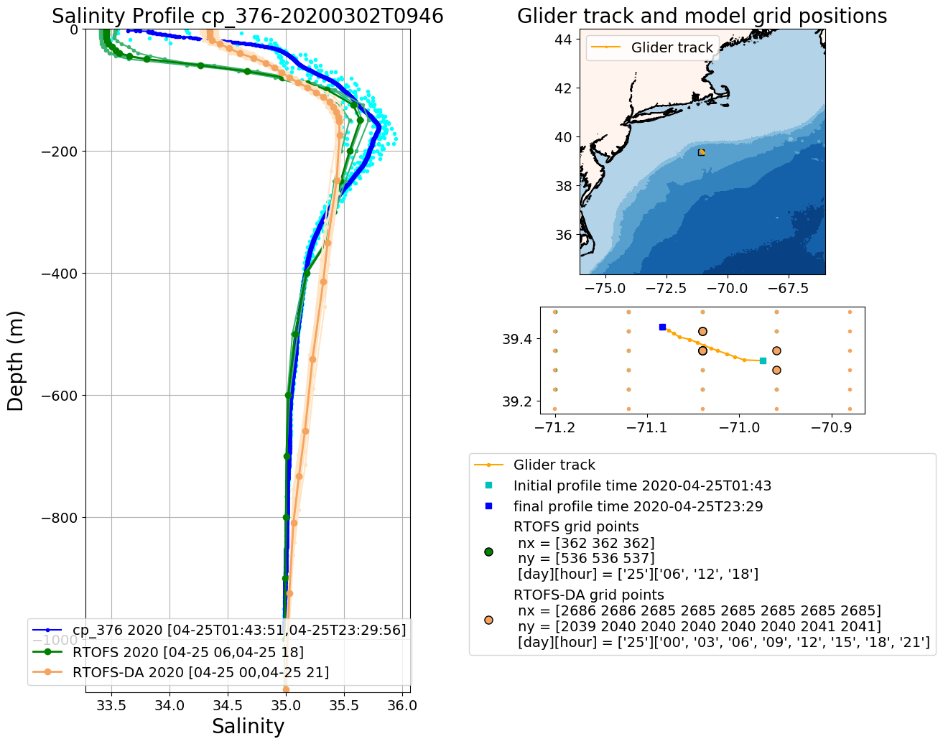
Operational RTOFS vs RTOFS-DA
2020042500

Slide 4
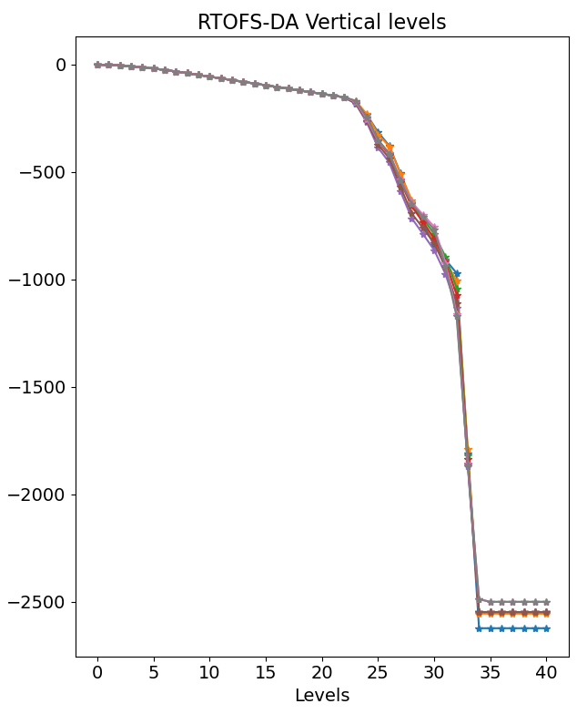
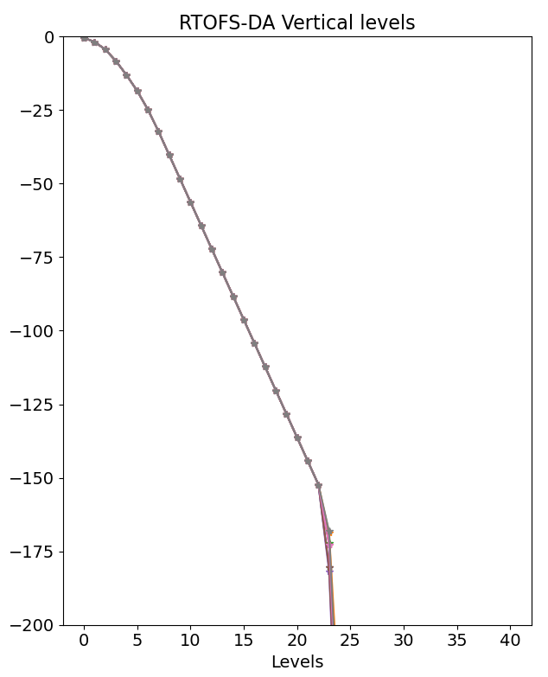
[0.50, 1.90,
4.42, 8.38,
13.2, 18.5,
24.9, 32.3,
40.3, 48.3,
56.3, 64.3,
72.3, 80.3,
88.3, 96.3,
104.3, 112.3,
120.3, 128.3,
136.3, 144.3,
152.3]
-152.3 m
“Number of vertical layers has been increased to 41 from 32 hybrid layers, with extra iso-level coordinate layers in the upper ~200m.” (Mehra et al. 2015)

Slide 5
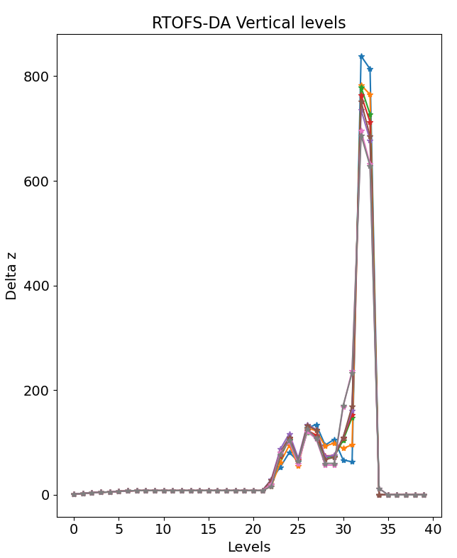
Delta z =
[1.40, 2.52, 3.96, 4.8, 5.37, 6.34, 7.43, 8.00,
8.00, 8.00, 8.00, 8.00, 8.00, 8.00, 8.00, 8.00,
8.00, 8.00, 8.00, 8.00, 8.00, 8.00, 28.2, 53.0,
80.8, 63.6, 128.1, 134.0, 94.8, 105.9, 66.6,
62.8,8, 813.7, 0, 0, 0, 0, 0, 0]
22

Slide 6
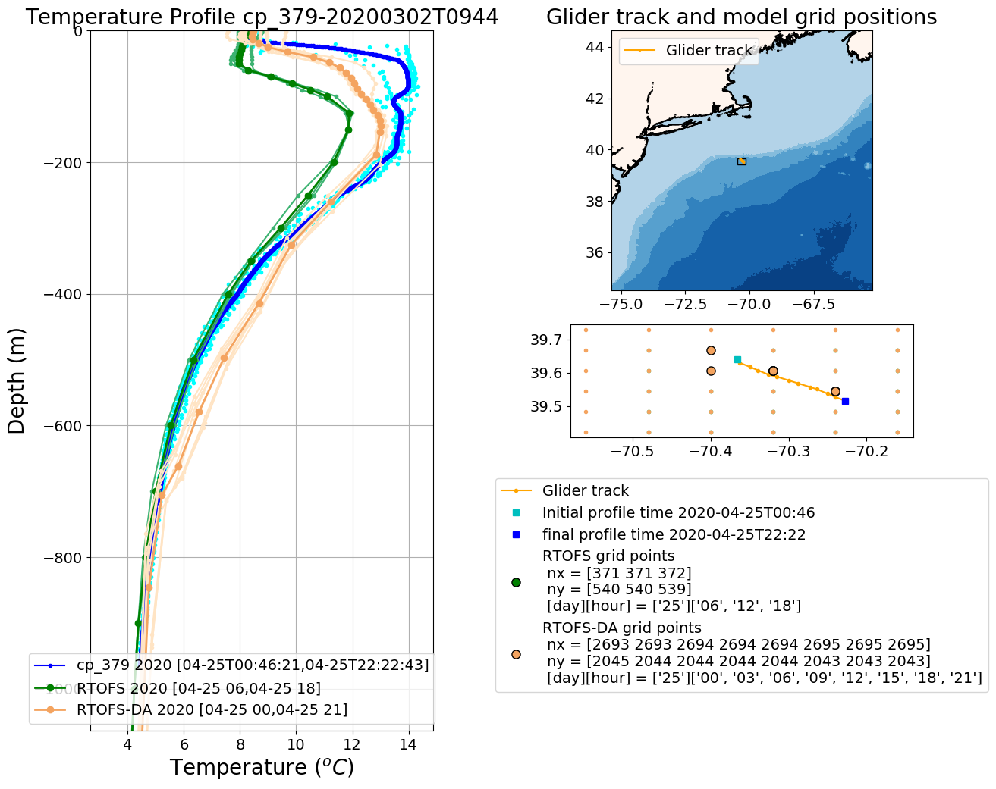
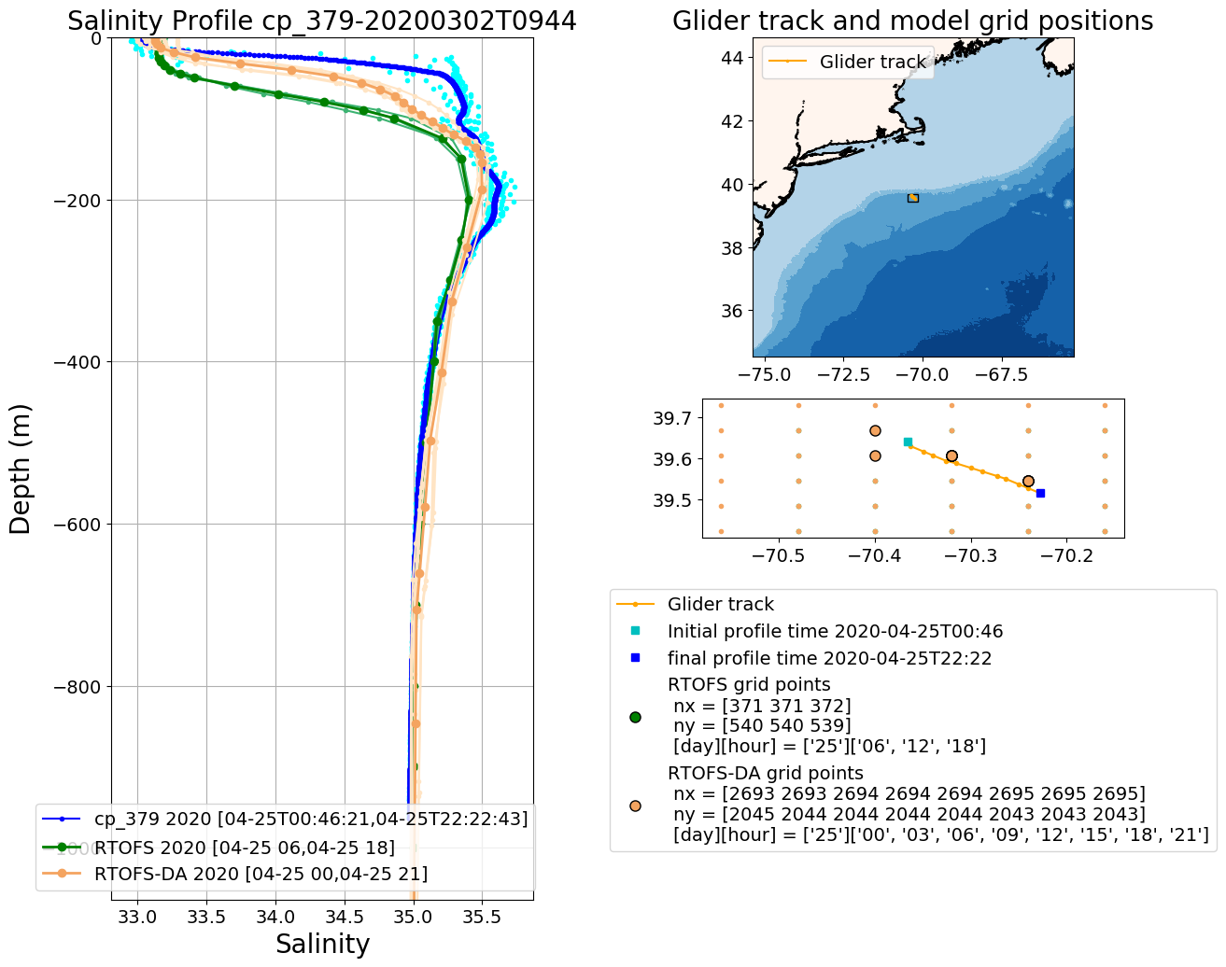
Operational RTOFS vs RTOFS-DA
2020042500

Slide 7
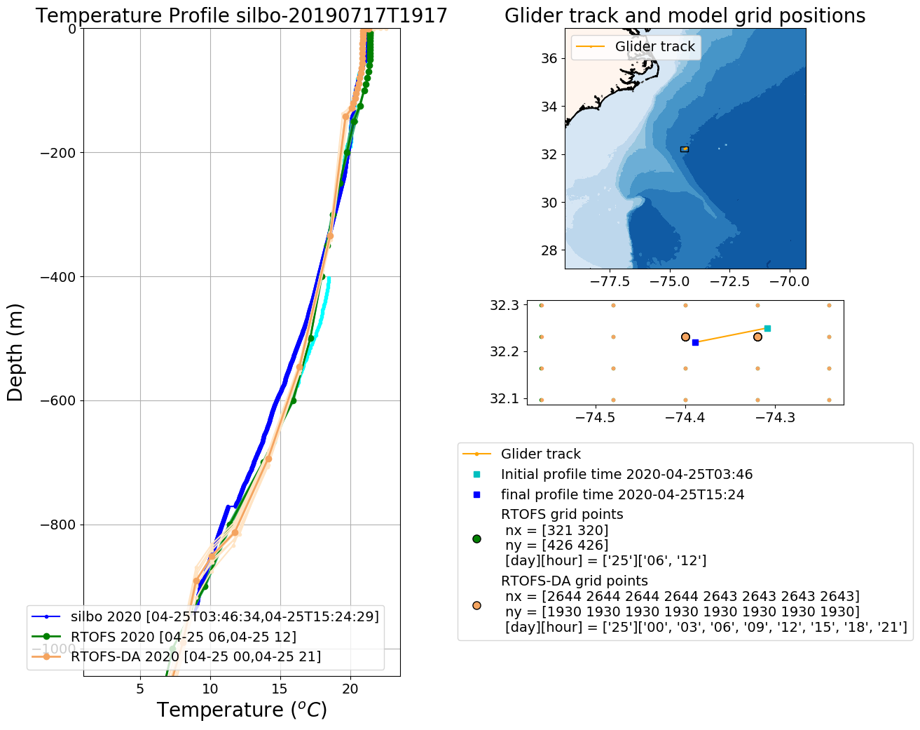
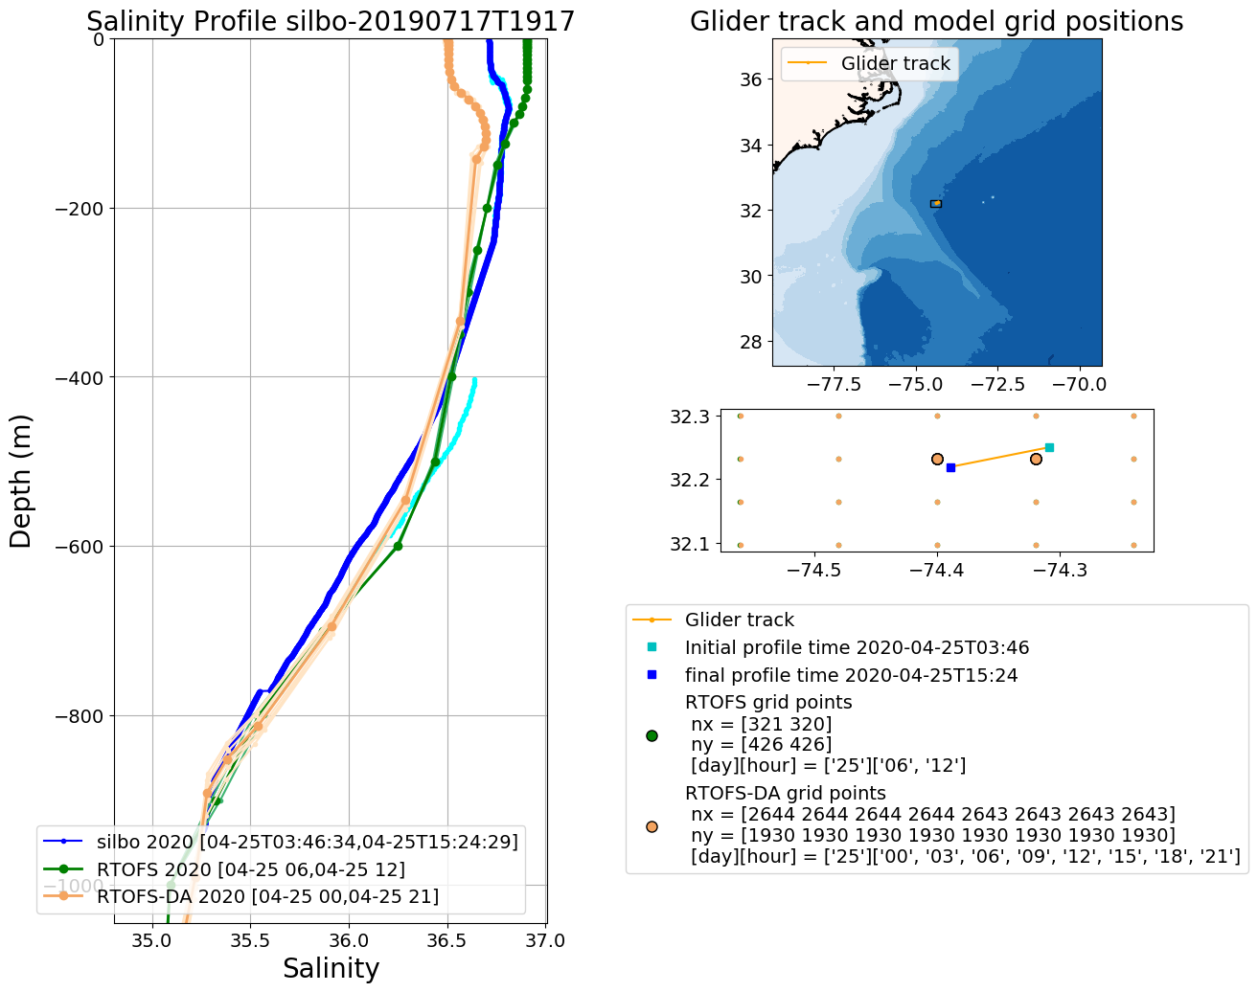
Operational RTOFS vs RTOFS-DA
2020042500

Slide 8
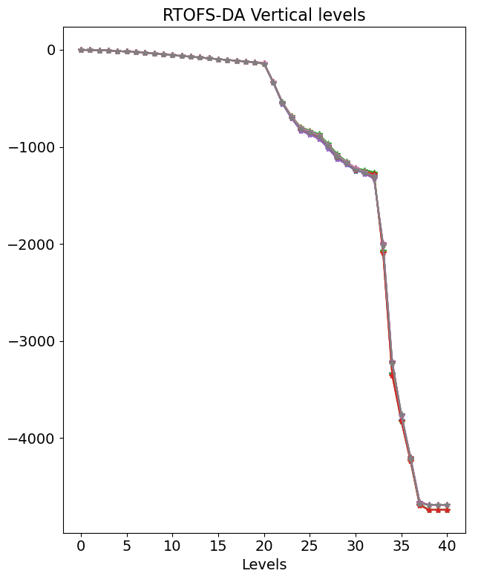
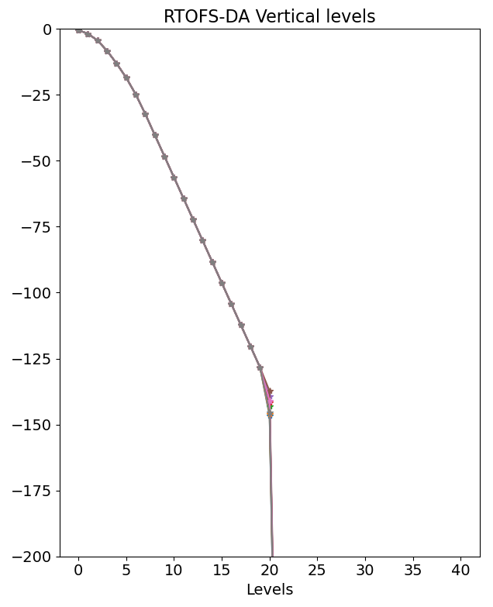
[0.50, 1.90,
4.42, 8.38,
13.2, 18.5,
24.9, 32.3,
40.3, 48.3,
56.3, 64.3,
72.3, 80.3,
88.3, 96.3,
104.3, 112.3,
120.3, 128.3]
-128.3 m

Slide 9
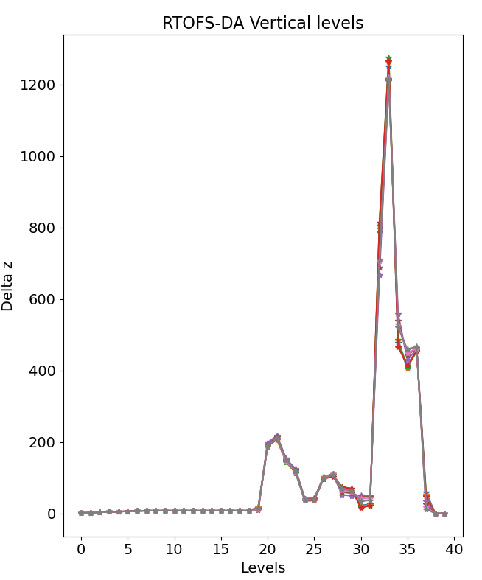
Delta z =
[1.40, 2.52, 3.96, 4.8, 5.37, 6.34, 7.43, 8.00,
8.00, 8.00, 8.00, 8.00, 8.00, 8.00, 8.00, 8.00,
8.00, 8.00, 8.00, 18.4, …, 0]
19

Slide 10
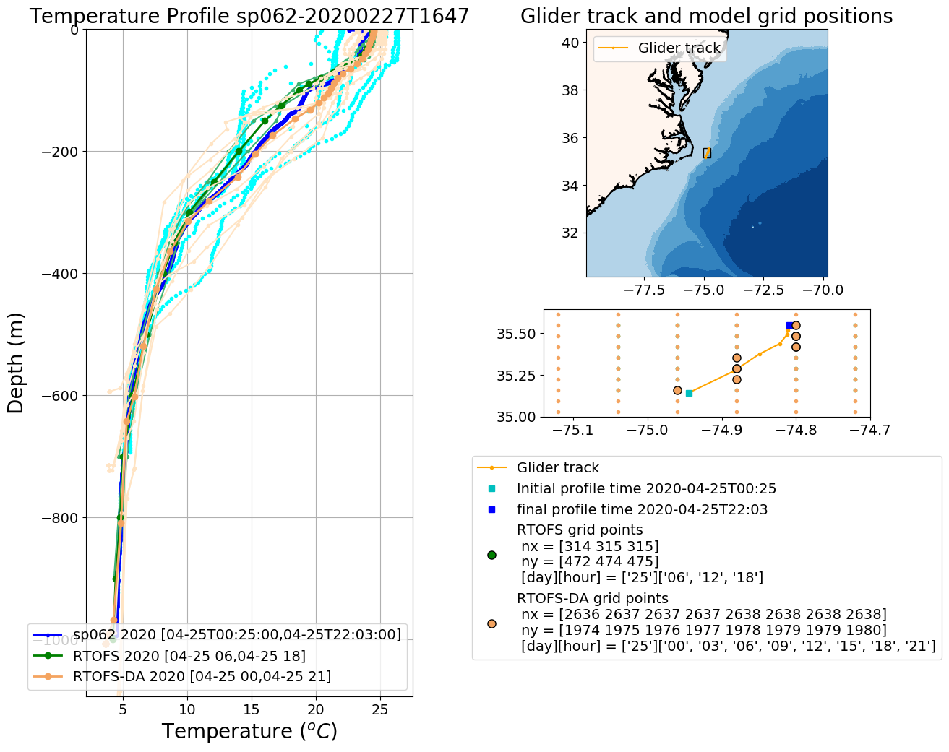
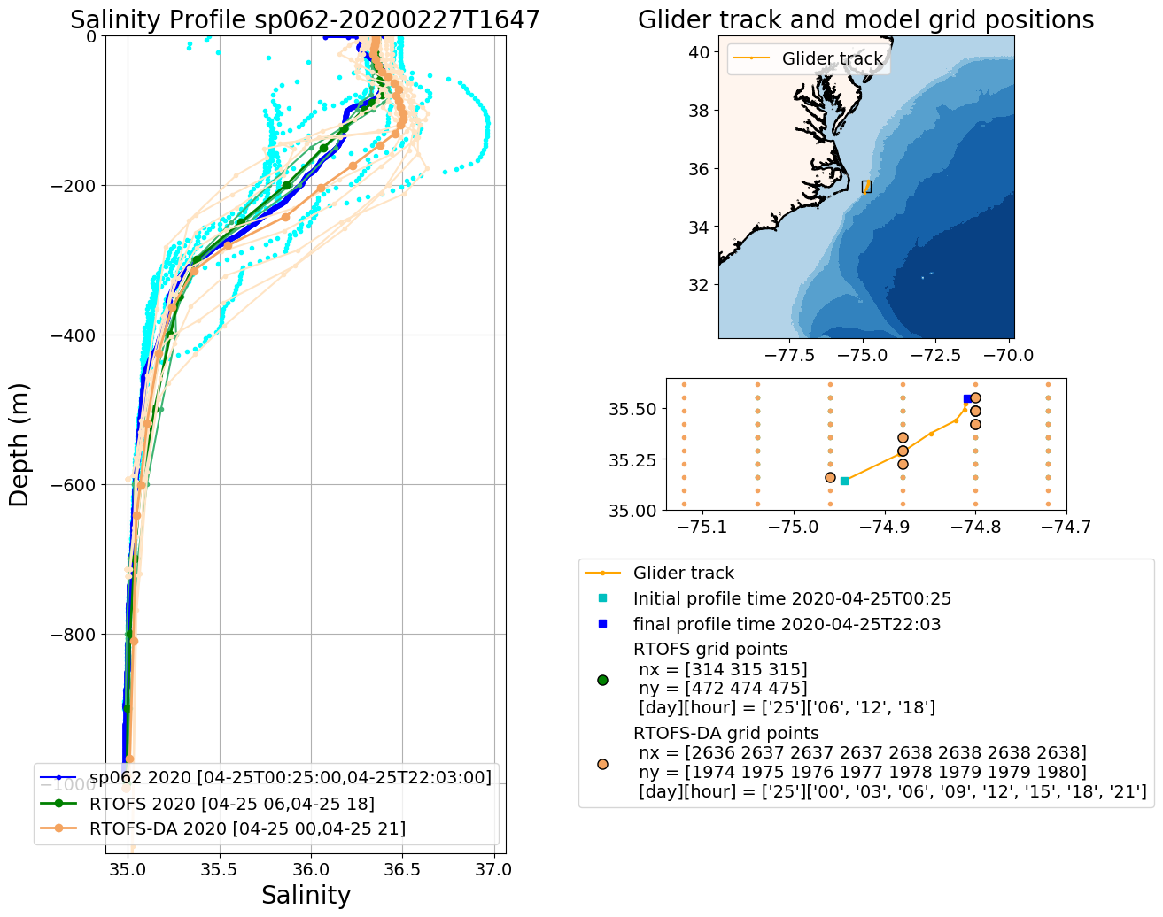
Operational RTOFS vs RTOFS-DA
2020042500

Slide 11
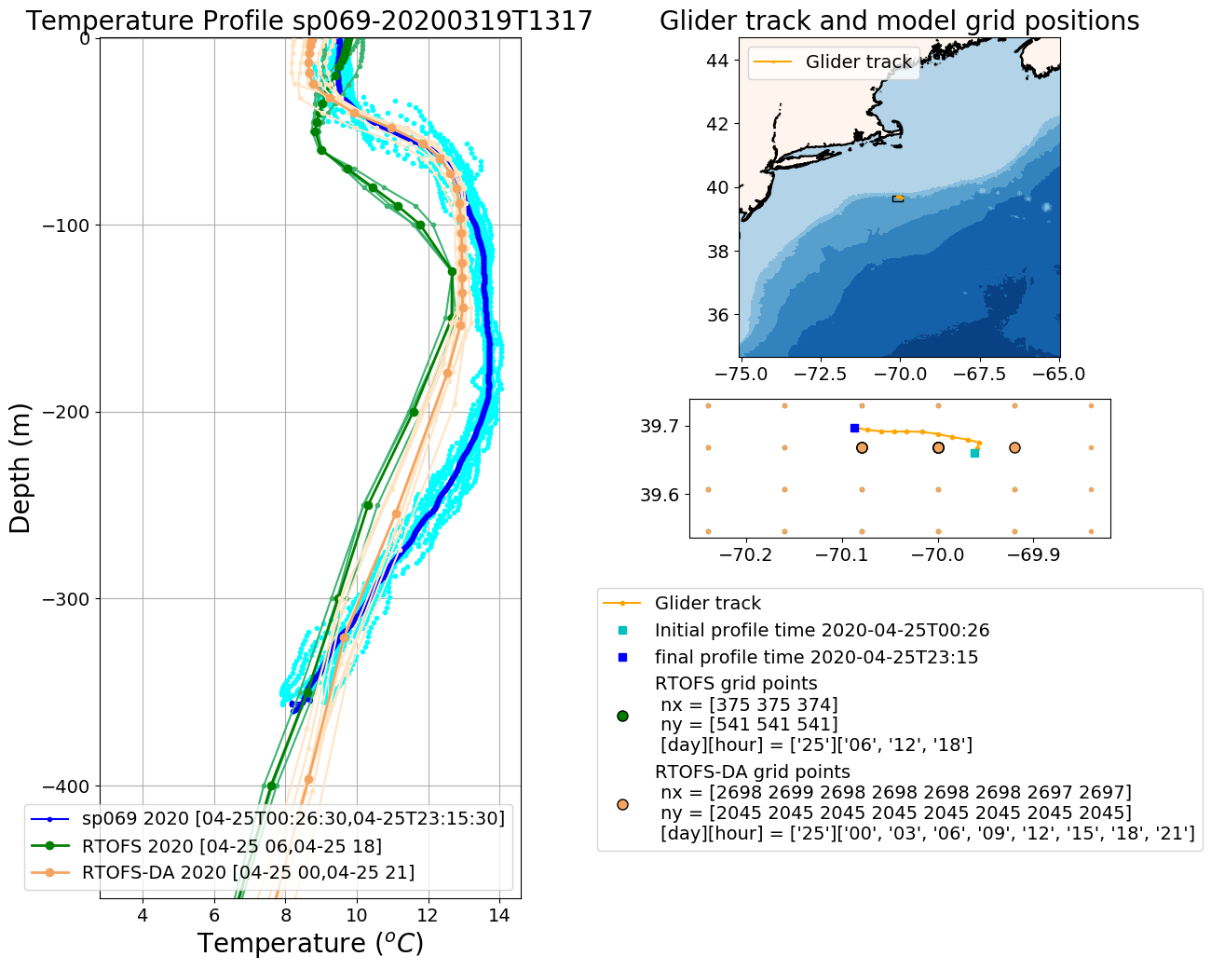
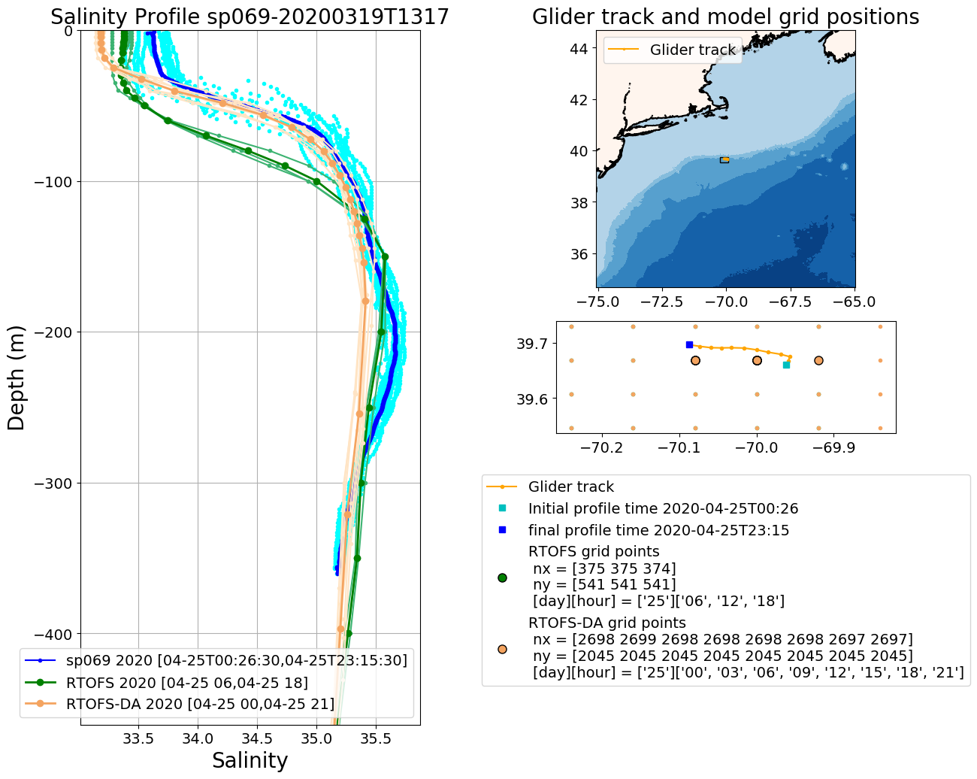
Operational RTOFS vs RTOFS-DA
2020042500

Slide 12
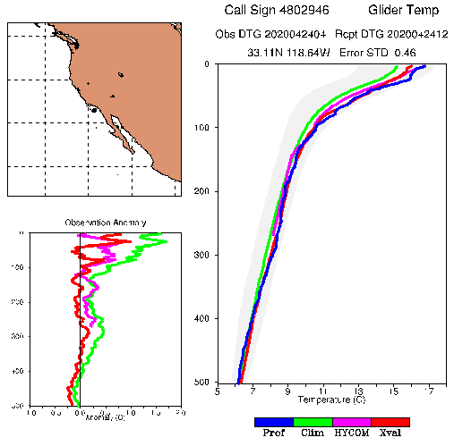
Glider Profiles QC from RTOFS-DA
Assimilation cycle 2020042500
From Zulema:
The analysis takes all the glider profiles that arrived to the tank up to 2020042512,
centered at 2020042500 and going back 5 days (confirm with Jim Cummings!) for profiles
Including gliders, to allow the data to arrive to the tank
Prof : glider
Clim: long term climatology
HYCOM: RTOFS-DA
Xval: running mean climatology of
nearby observations, which is
computed on the run by ncoda

Slide 13
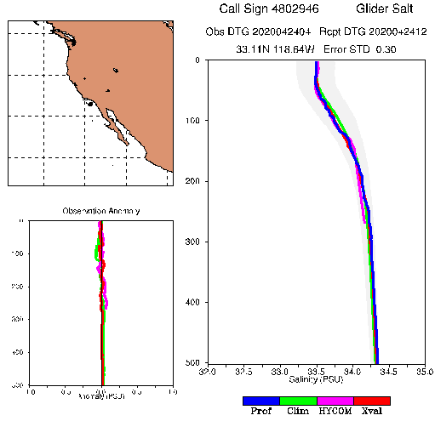
Glider Profiles QC from RTOFS-DA, Assimilation cycle 2020042500
4802946
2020/04/24/(04-07-09-12-18-21)
2020/04/25/(00)
7 profiles

Slide 14
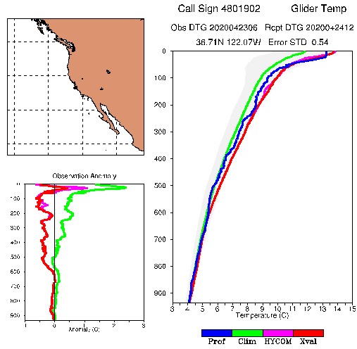
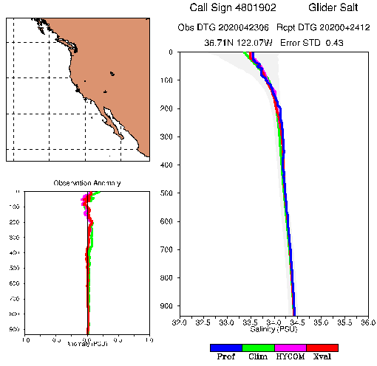
Glider Profiles QC from RTOFS-DA, Assimilation cycle 2020042500
4801902
2020/04/24/(06)
1 profiles

Slide 15
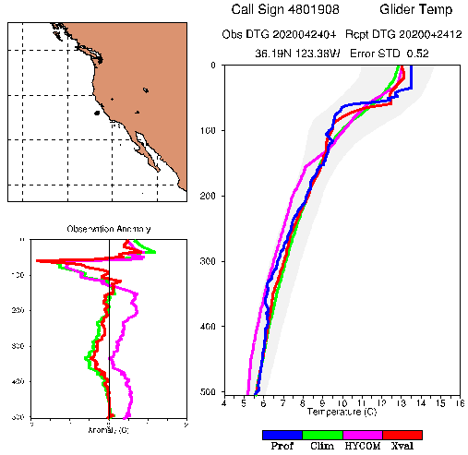
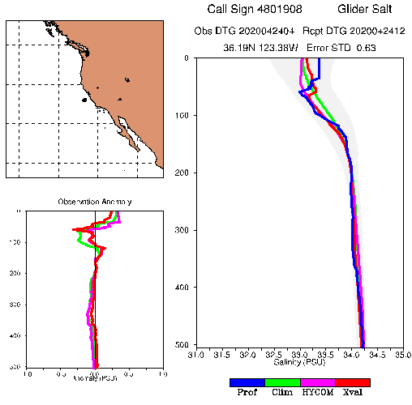
Glider Profiles QC from RTOFS-DA, Assimilation cycle 2020042500
4801908
2020/04/24/(04-07-10-13-16-19-21-22)
2020/04/25/(01)
9 profiles

Slide 16
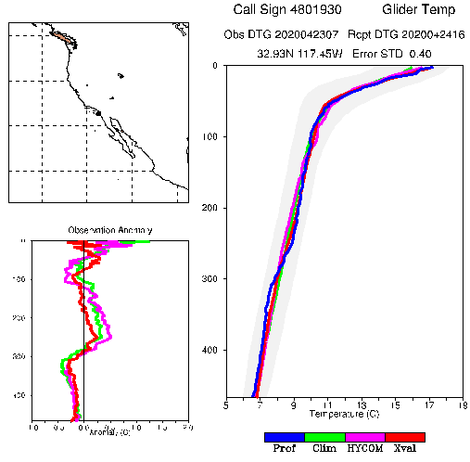
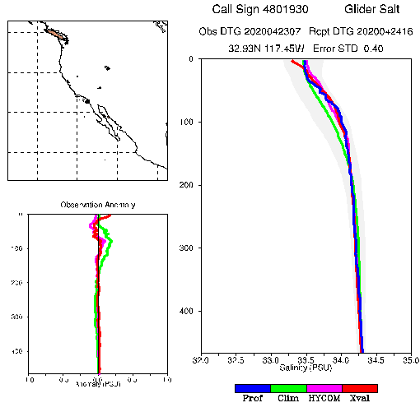
Glider Profiles QC from RTOFS-DA, Assimilation cycle 2020042500
4801930
2020/04/23/(07)
1 profiles

Slide 17
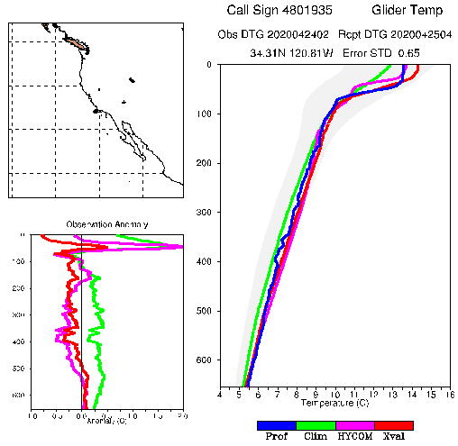
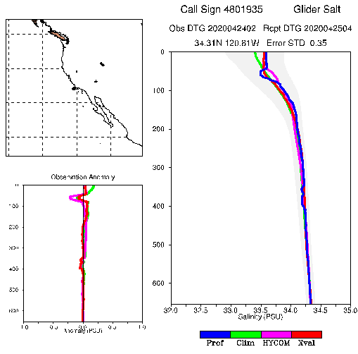
Glider Profiles QC from RTOFS-DA, Assimilation cycle 2020042500
4801935
2020/04/24/(02)
1 profiles

Slide 18
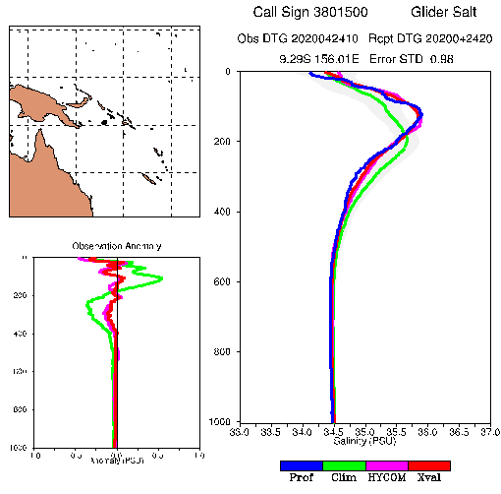
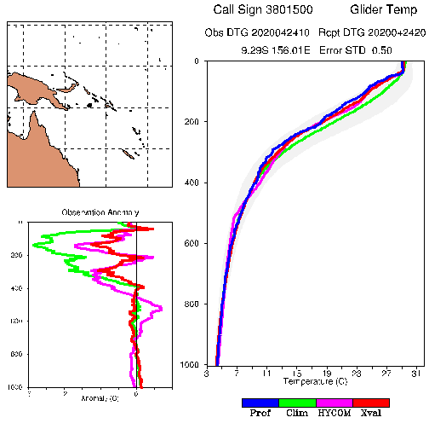
Glider Profiles QC from RTOFS-DA, Assimilation cycle 2020042500
3801500
2020/04/24/(10-15-21)
3 profiles

Slide 19
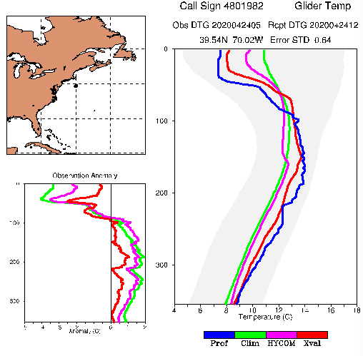
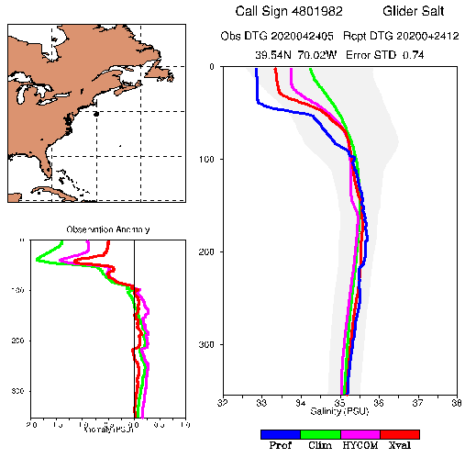
Glider Profiles QC from RTOFS-DA, Assimilation cycle 2020042500
CP_379
4801982
2020/04/24/(05-08-10-12-14-16-18-20-22)
2020/04/25/(00-02)
11 profiles

Slide 20
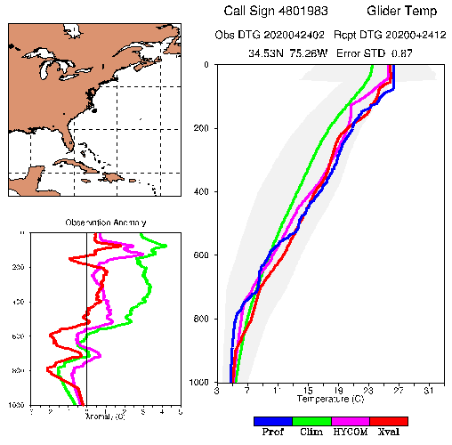
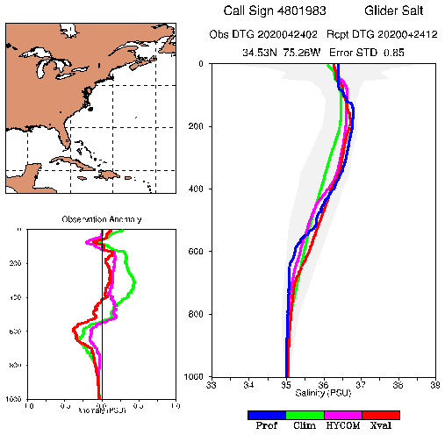
Glider Profiles QC from RTOFS-DA, Assimilation cycle 2020042500
Silbo
4801983
2020/04/24/(02-07-13-18)
4 profiles

Slide 21
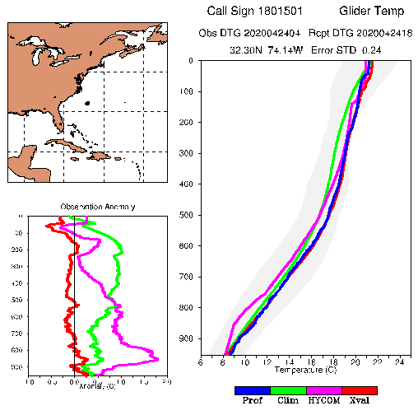
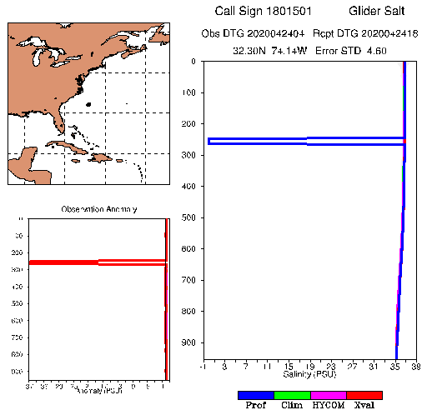
Glider Profiles QC from RTOFS-DA, Assimilation cycle 2020042500
???
1801501
2020/04/24/(04-16)
2 profiles

Slide 22
CP_379

Slide 23
Silbo

