Slide 1
Navy Gliders Deployments in the MAB 2019

Slide 2
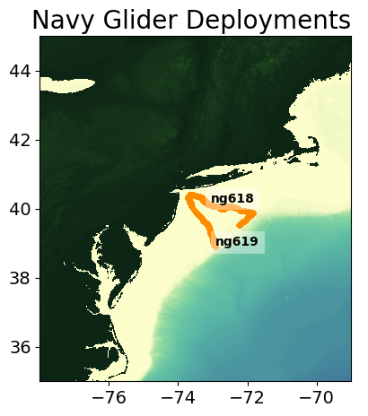
ng618 and ng619 Tracks

Slide 3
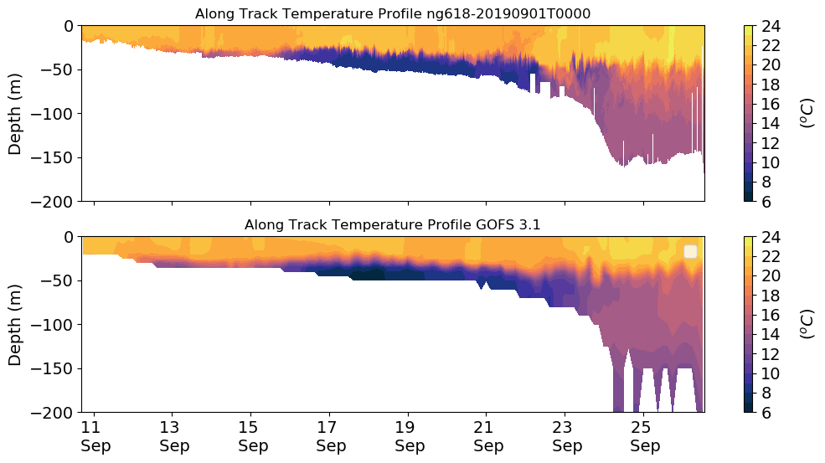
ng618 Temperature Transect

Slide 4
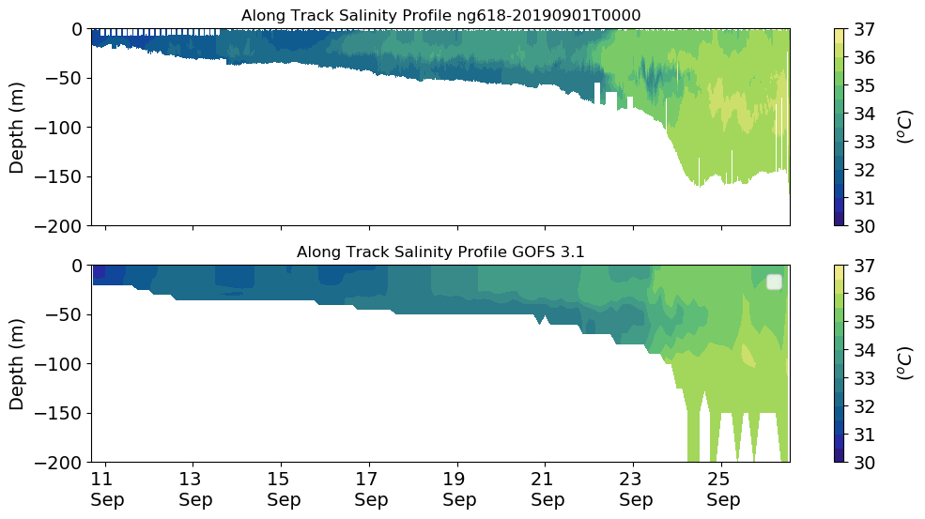
ng618 Salinity Transect

Slide 5
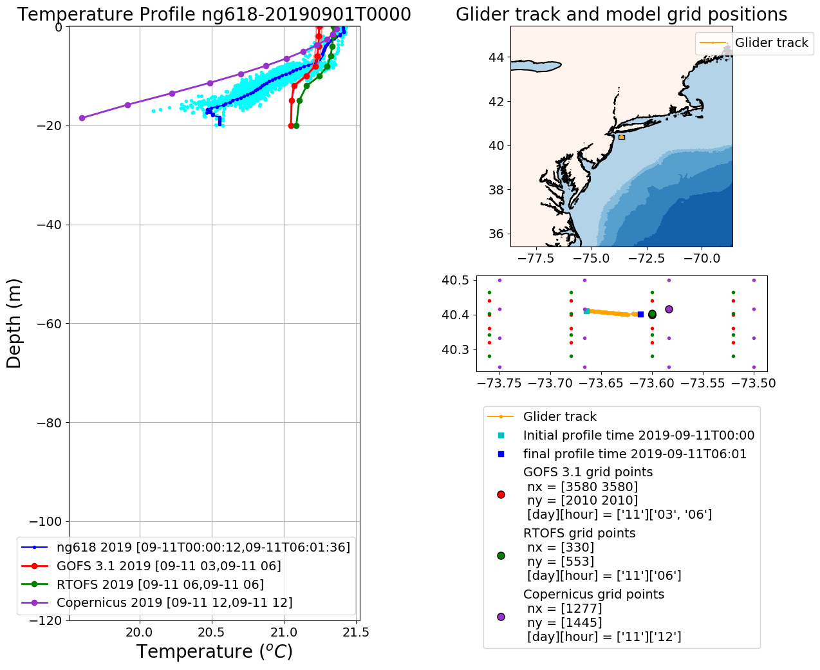
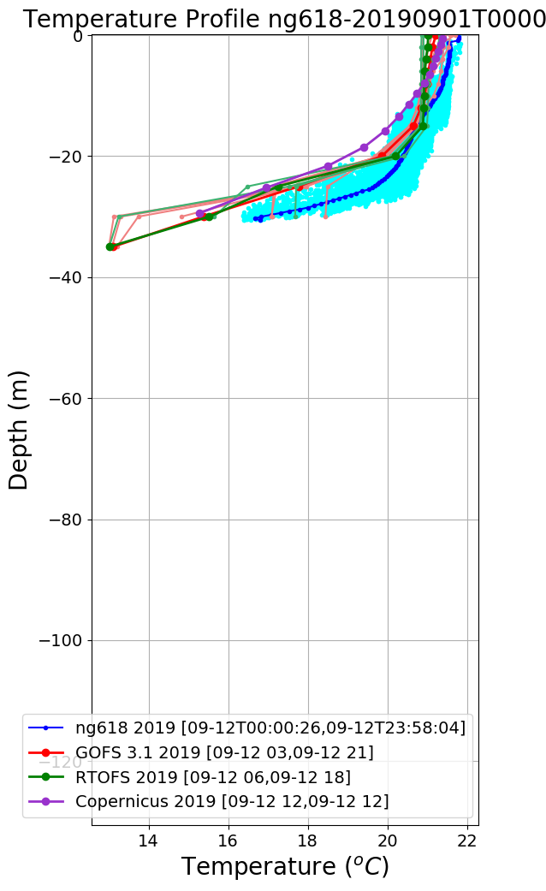
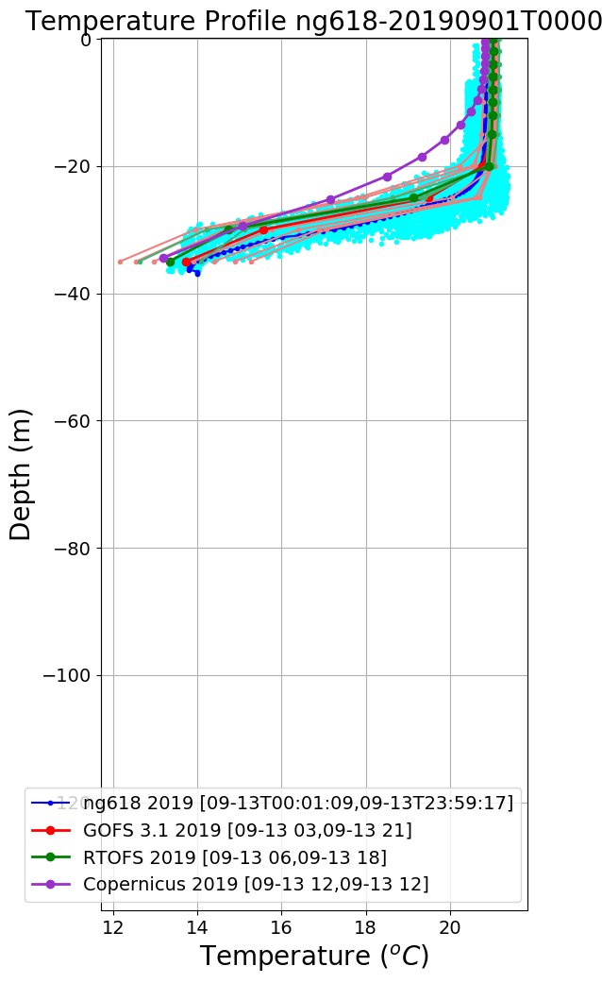
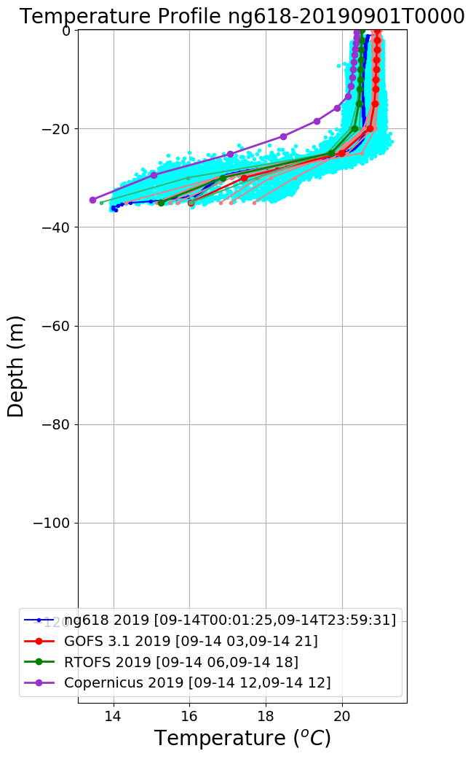
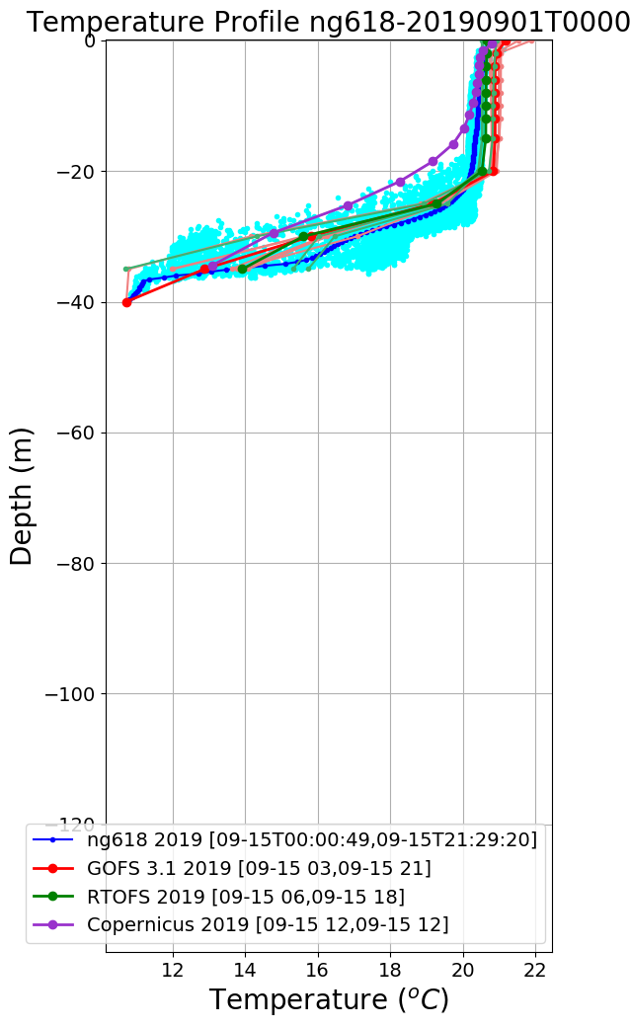
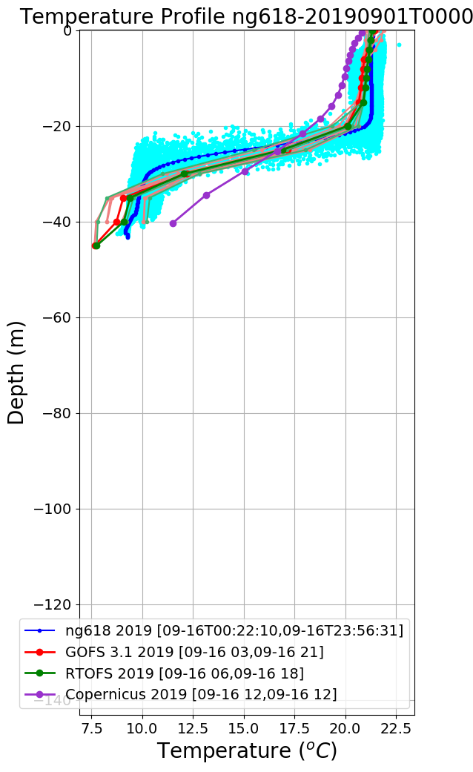
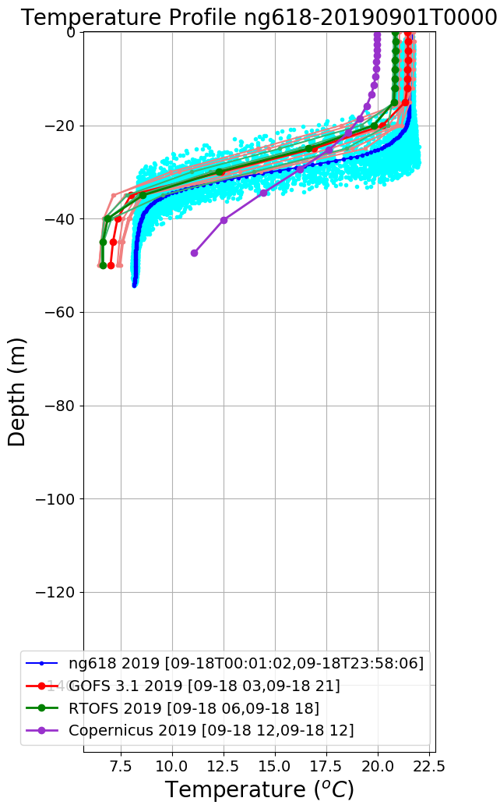
ng618 Temperature Profiles
Sep 11
Sep 12
Sep 13
Sep 14
Sep 15
Sep 16
Sep 17
Sep 18

Slide 6
ng618 Salinity Profiles
Sep 11
Sep 12
Sep 13
Sep 14
Sep 15
Sep 16
Sep 17
Sep 18

Slide 7
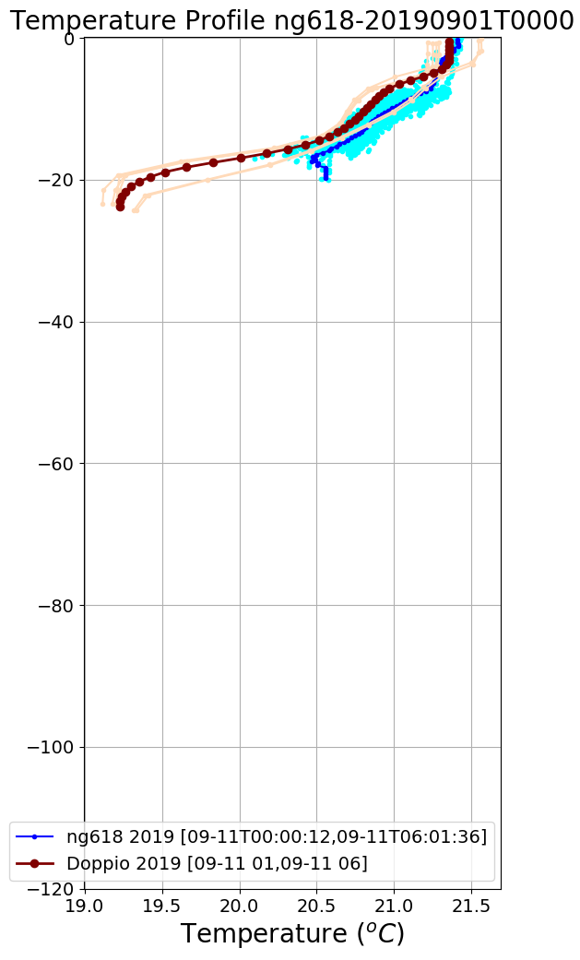
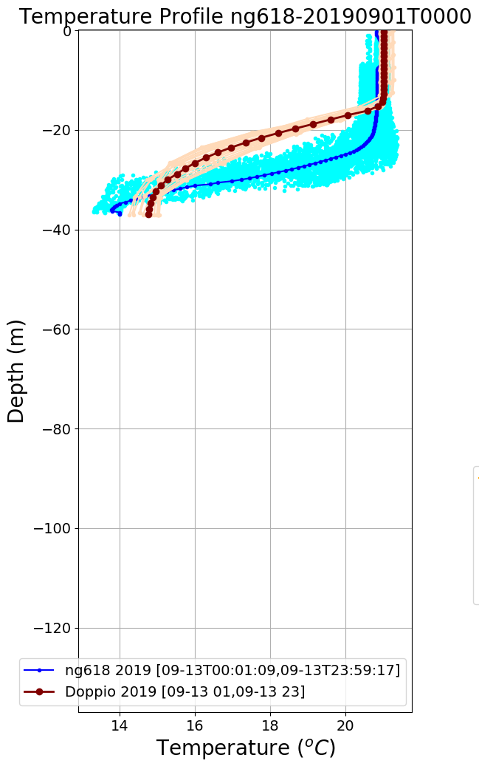
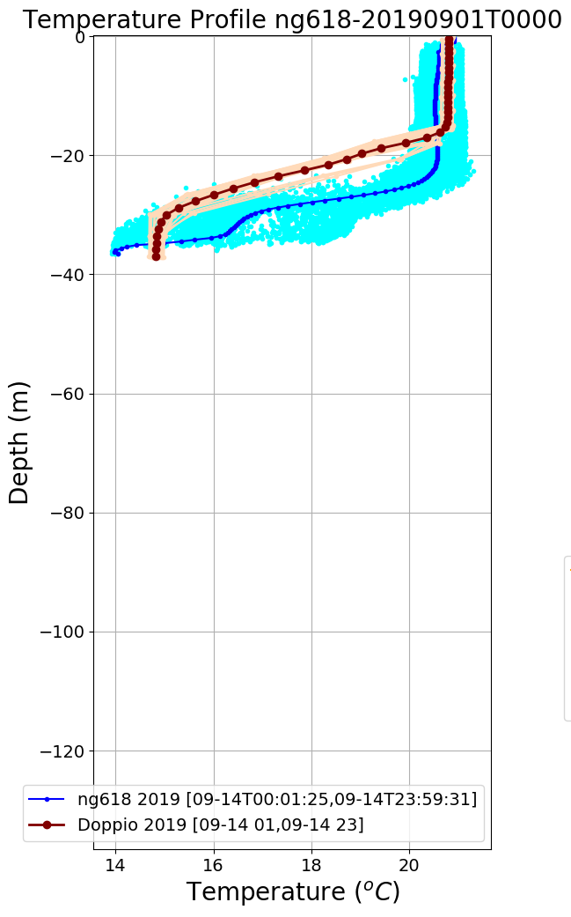
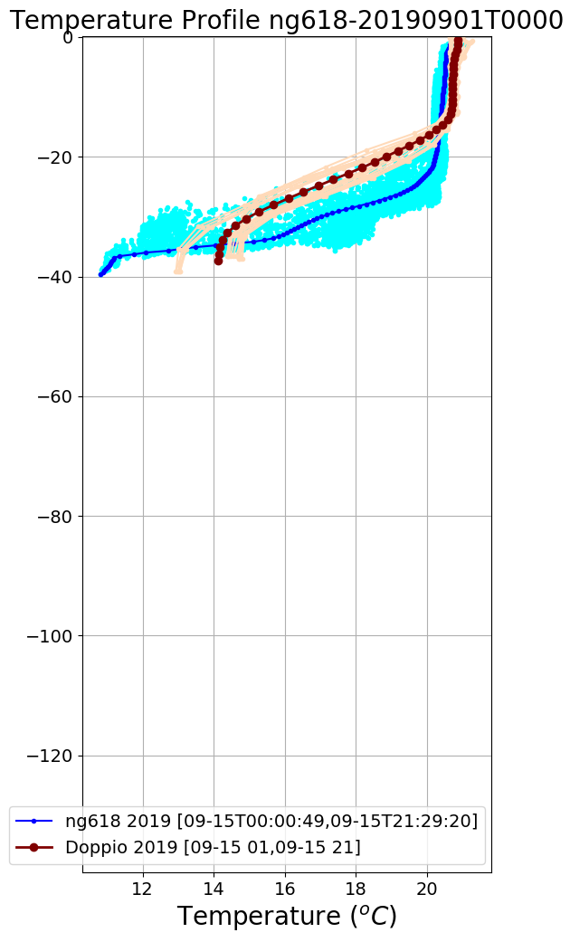
ng618 Temperature Profiles Doppio
Sep 11
Sep 12
Sep 13
Sep 14
Sep 15
Sep 16
Sep 17
Sep 18

Slide 8
ng618 Salinity Profiles Doppio
Sep 11
Sep 12
Sep 13
Sep 14
Sep 15
Sep 16
Sep 17
Sep 18

Slide 9
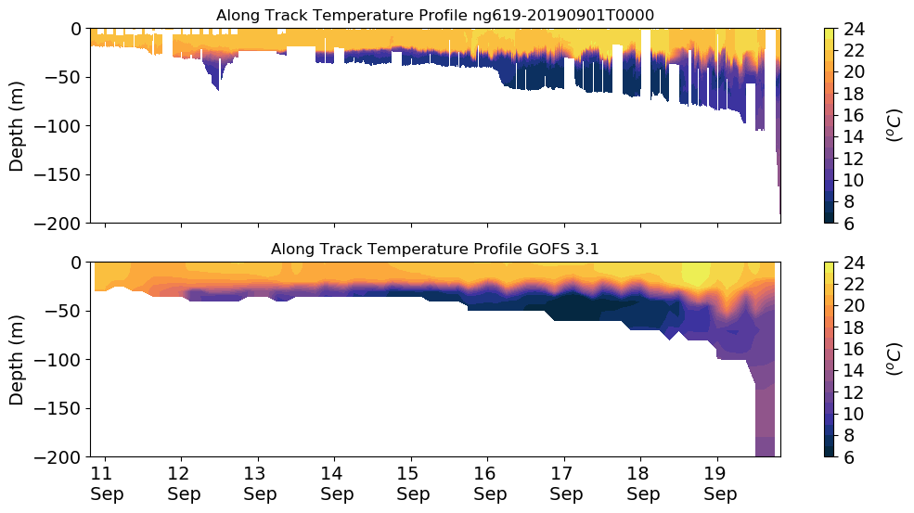
ng619 Temperature Transect

Slide 10
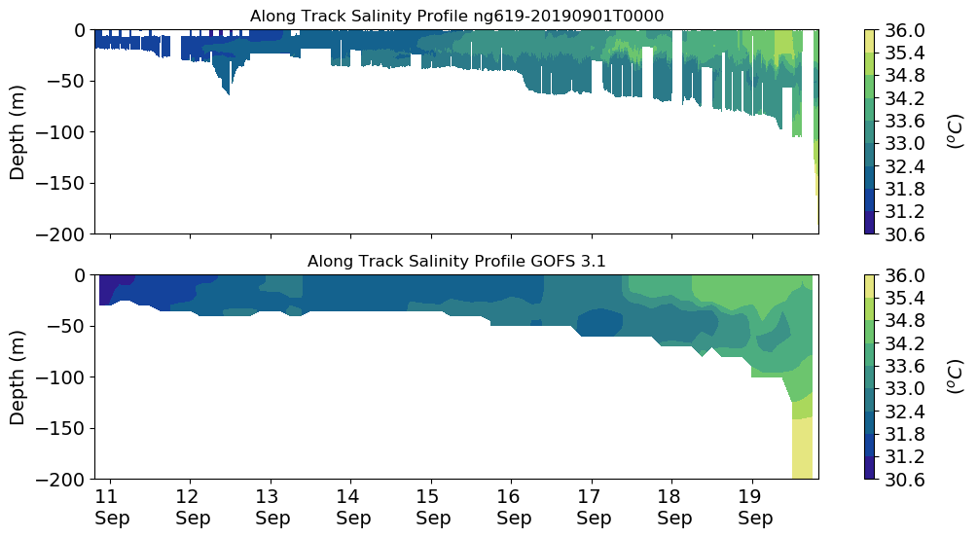
ng619 Salinity Transect

Slide 11
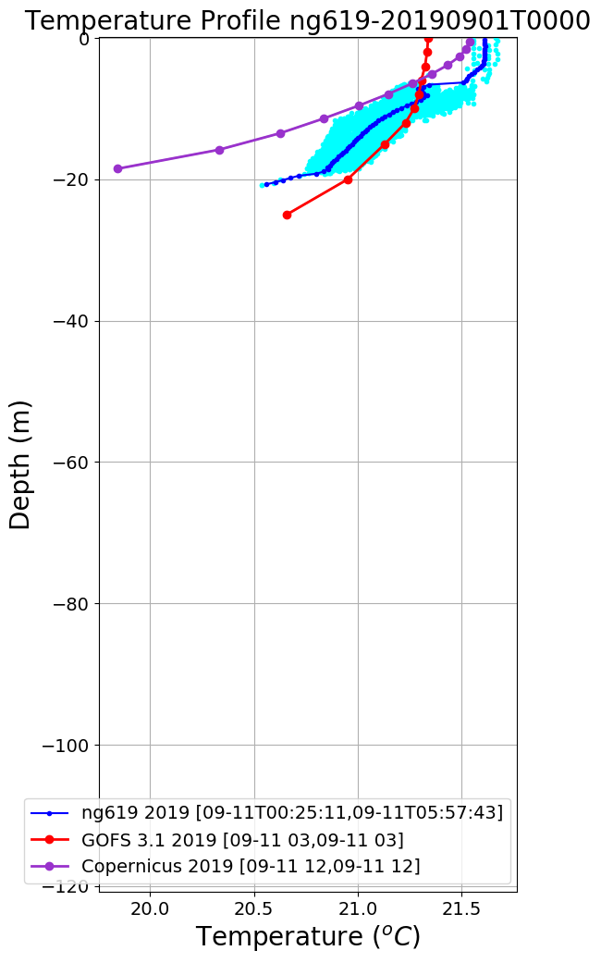
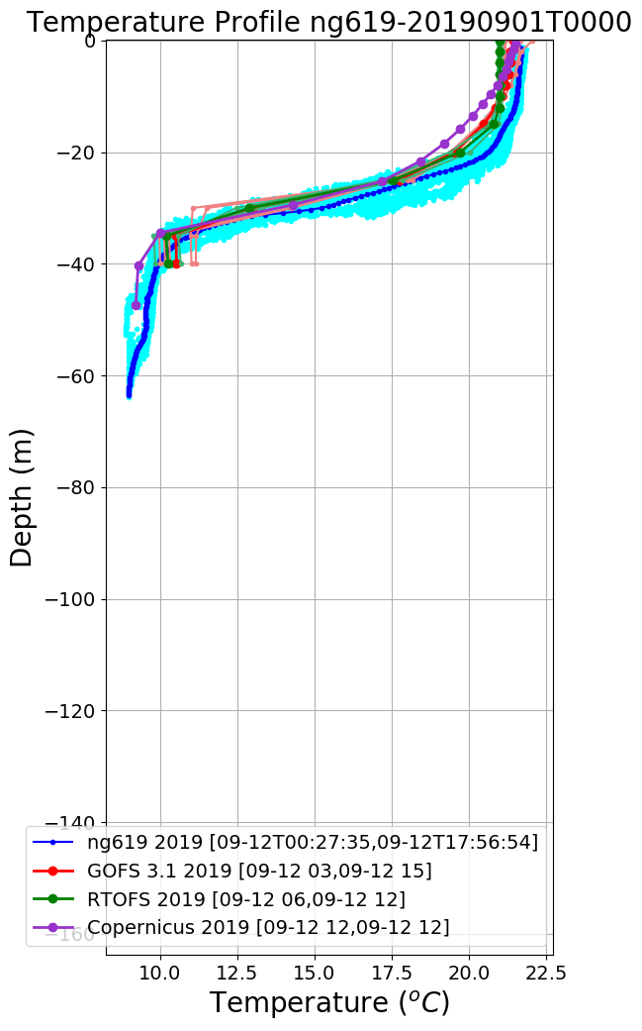
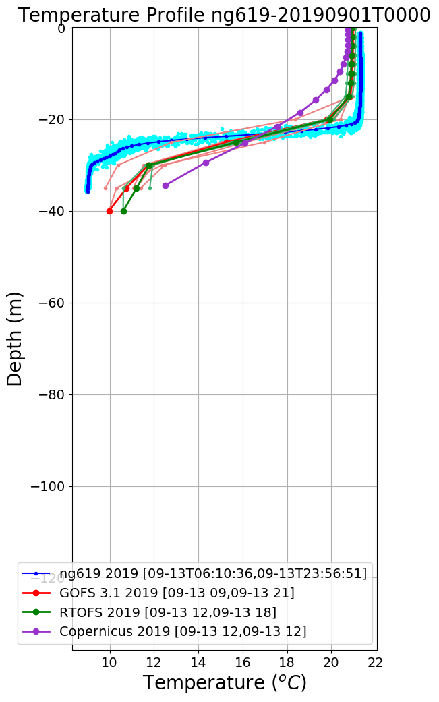
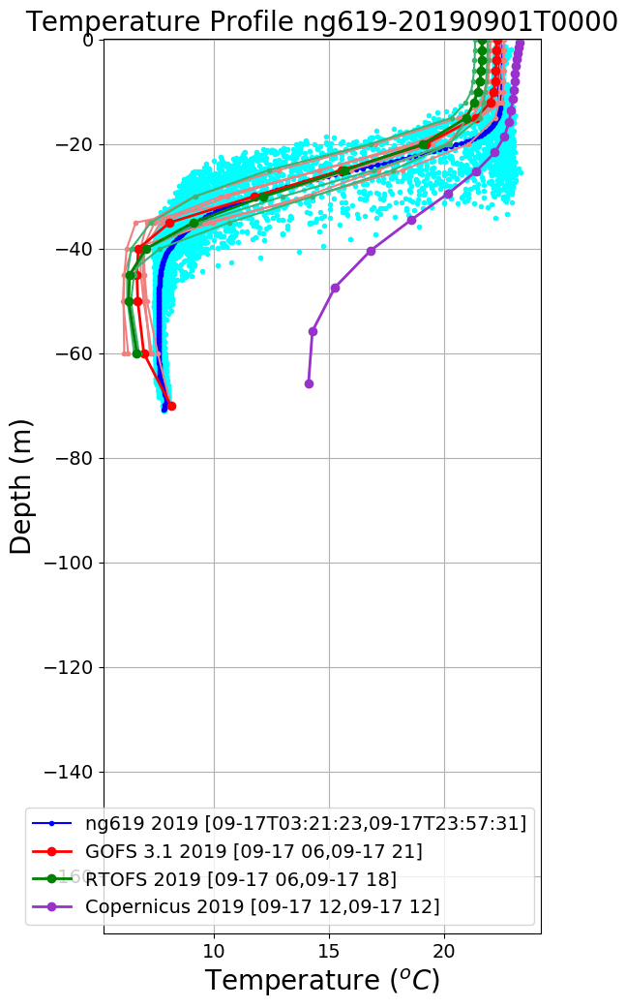
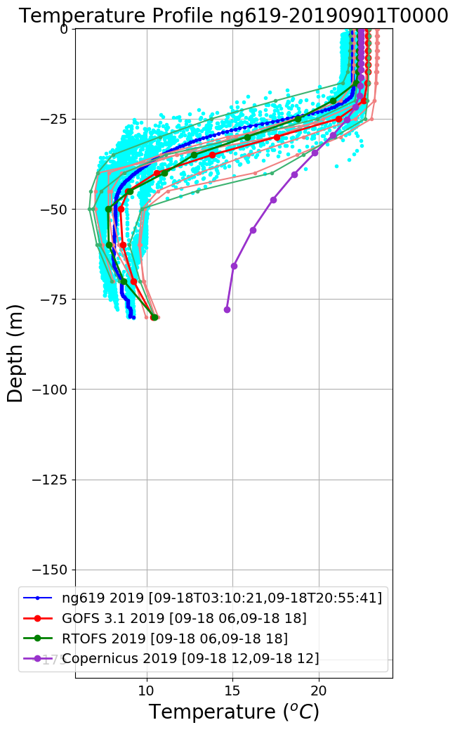
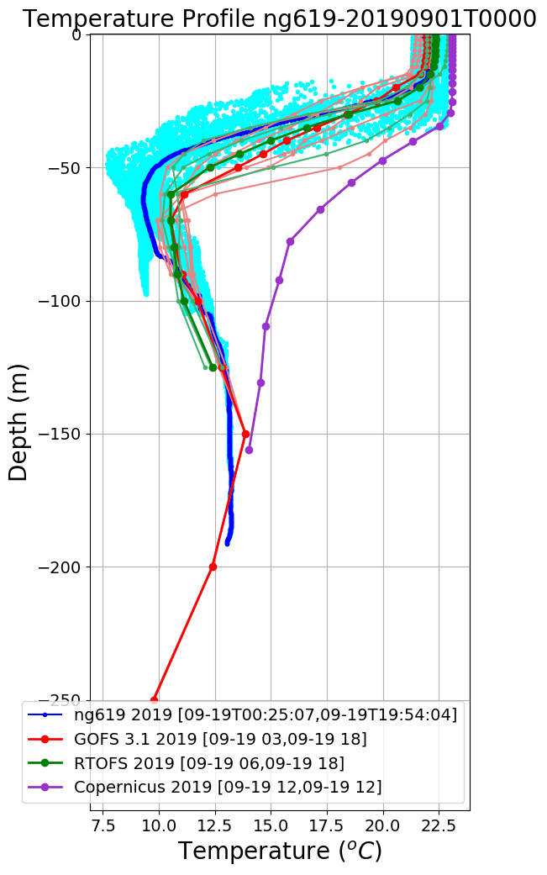
ng619 Temperature Profiles
Sep 11
Sep 12
Sep 13
Sep 14
Sep 16
Sep 17
Sep 18
Sep 19

Slide 12
ng619 Salinity Profiles
Sep 11
Sep 12
Sep 13
Sep 14
Sep 16
Sep 17
Sep 18
Sep 19

Slide 13
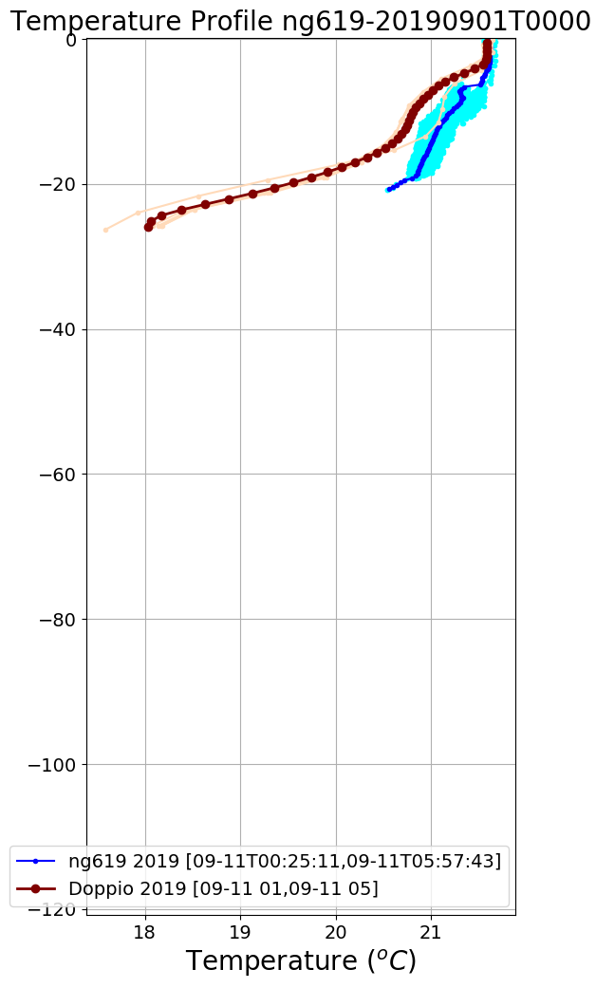
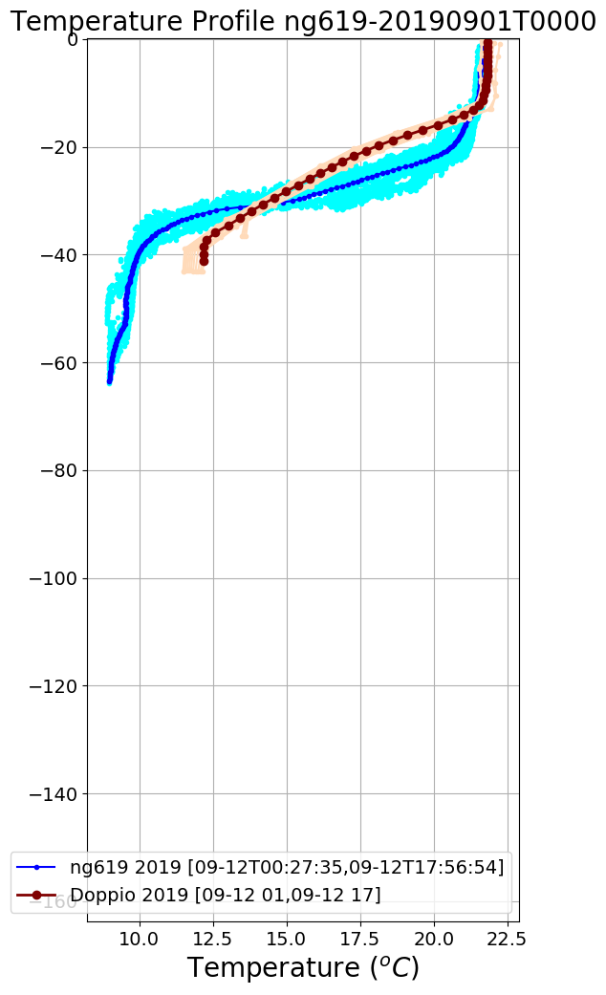
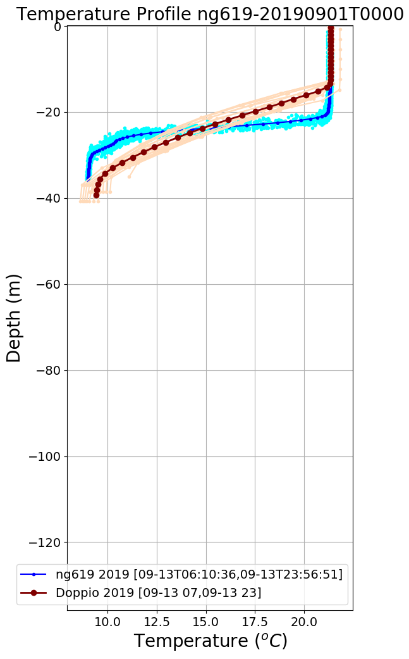
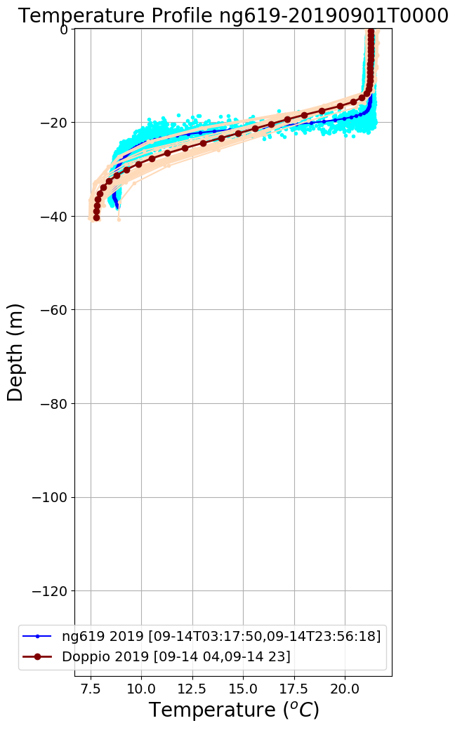
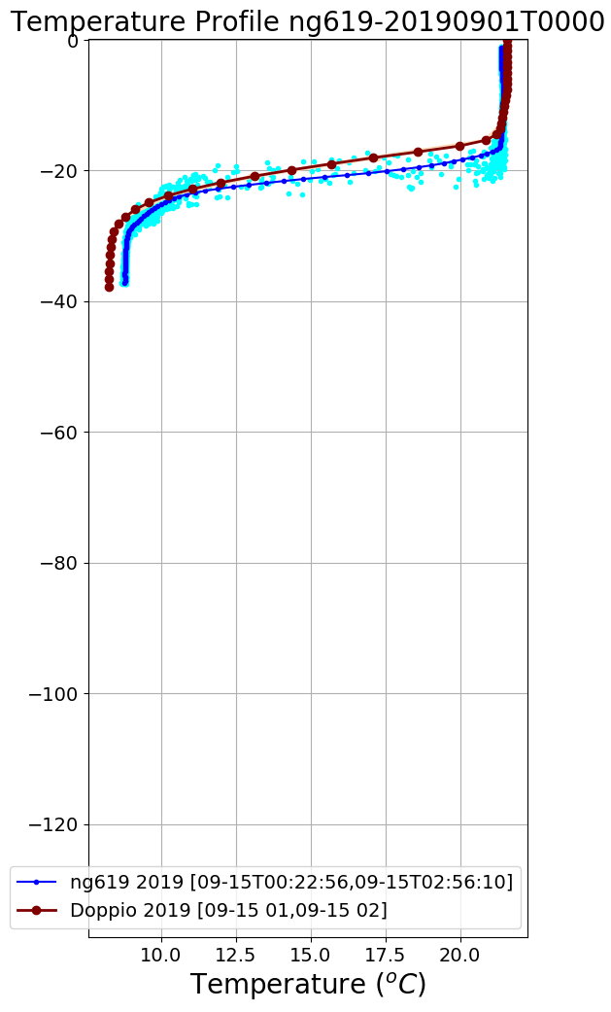
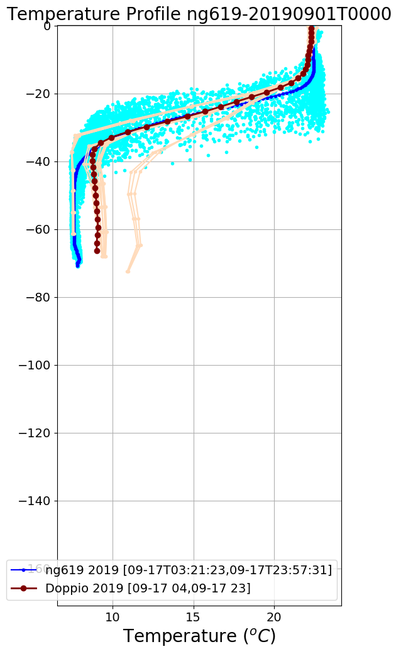
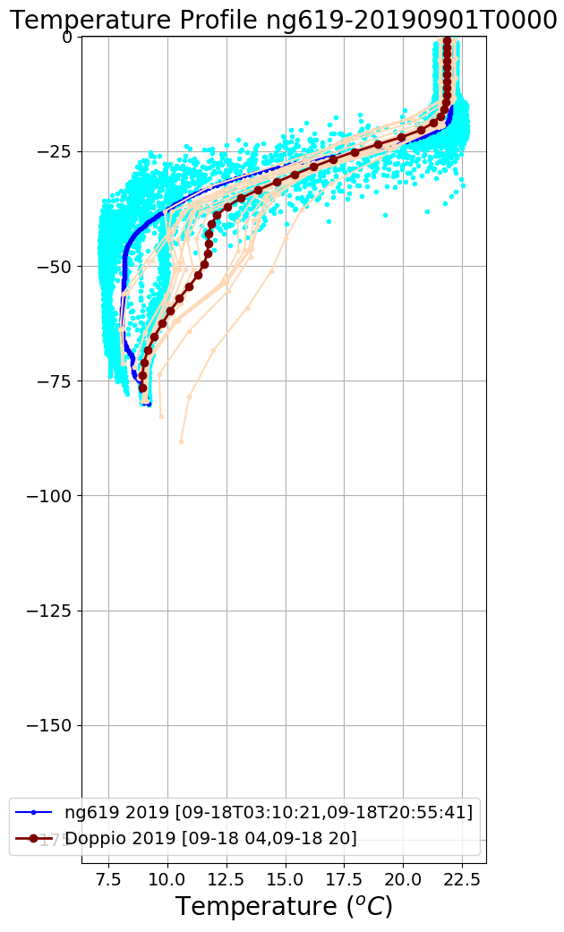
ng619 Temperature Profiles Doppio
Sep 11
Sep 12
Sep 13
Sep 14
Sep 15
Sep 16
Sep 17
Sep 18

Slide 14
ng619 Salinity Profiles Doppio
Sep 11
Sep 12
Sep 13
Sep 14
Sep 15
Sep 16
Sep 17
Sep 18

