Slide 1
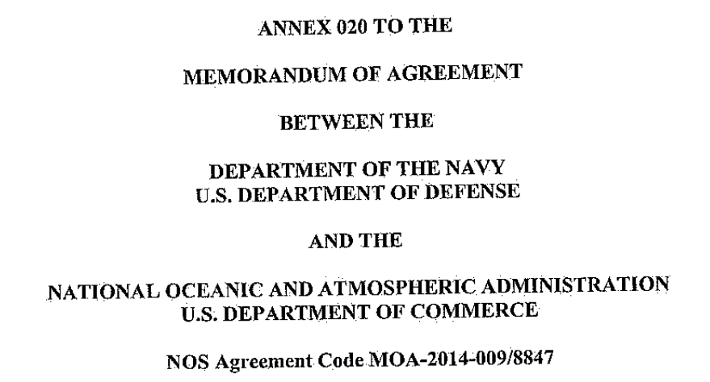
Hurricane Sentinel Glider Fleet: Initial Results
Scott Glenn
(Rutgers, MARACOOS, IOOS, CINAR…)
Gustavo Goni (AOML)

Slide 2
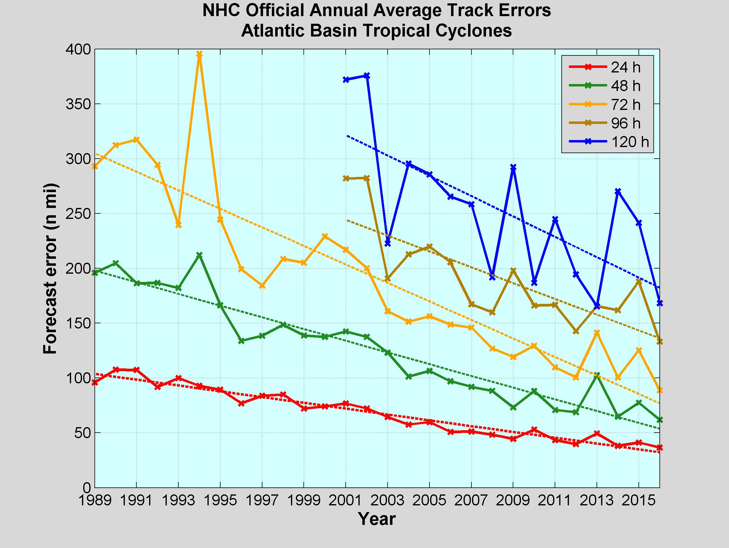
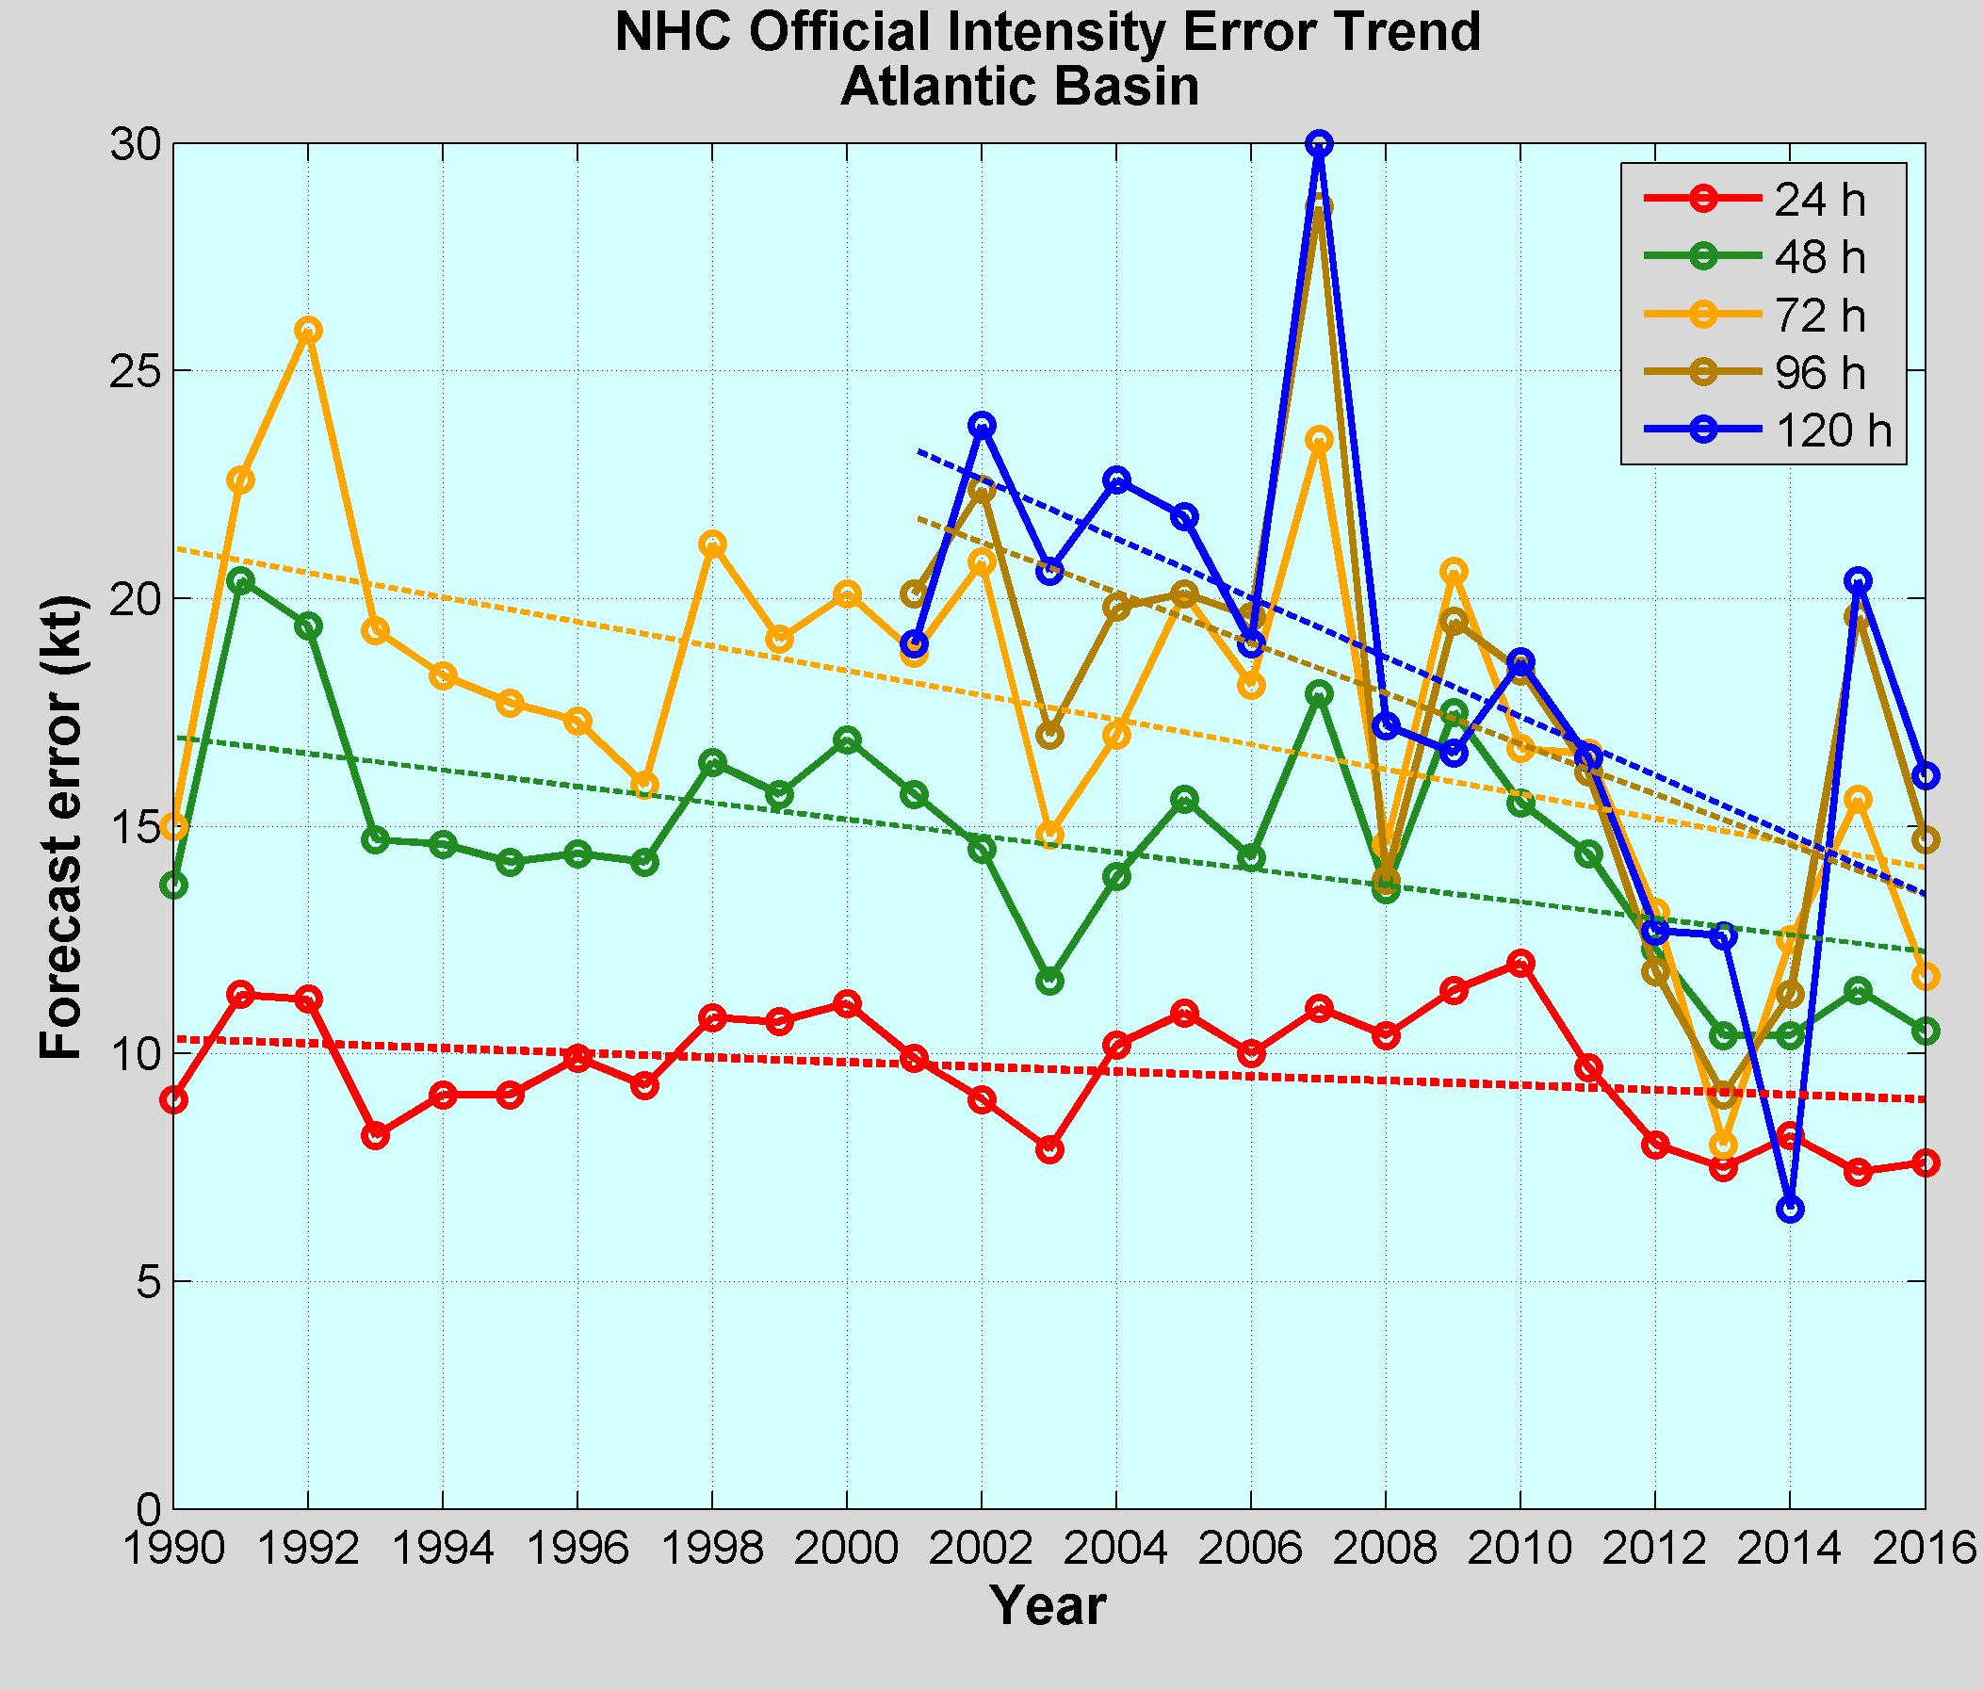
NOAA Annual Operational Suite Review
Average Track Errors:
Atlantic Basin
Average Intensity Errors:
Atlantic Basin
Factor of 2-4 improvement
20%-30% improvement
Limitations on Hurricane Intensity Improvement
Computing resources and model resolution (Rotunno et al., 2009)
Poor understanding of the atmospheric boundary layer (Nolan et al., 2009; Andreas et al., 2015)
Difficulty in modeling the upper ocean response to storm forcing (Yablonsky and Ginis, 2009).
Cangialosi and Franklin 2017

Slide 3
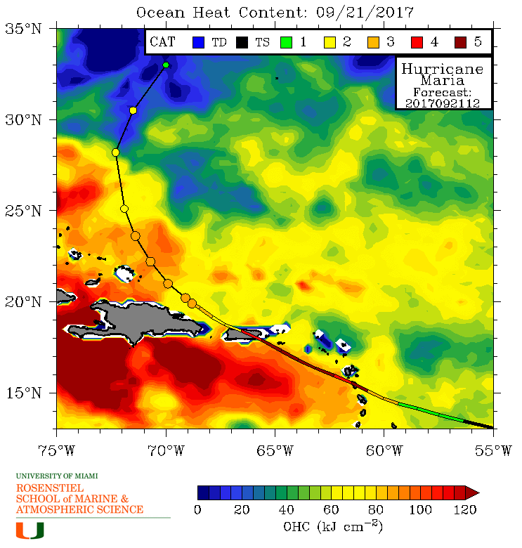
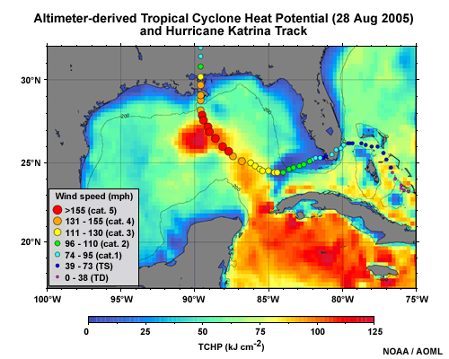
Rapid intensification of Hurricanes Katrina & Maria
Ocean’s impact on Intensity through the upper ocean heat content (model initial condition) and the transfer of heat across the air-sea interface (model response and feedback)

Slide 5
Navy Coupled Ocean Data Assimilation
Data Assimilation once per day
Satellite SST Maps
Satellite Altimetry – through ISOP
CTD profiles – numerous sources and rules

Slide 6
NOAA Historical Hurricane Tracks: 1851 - previous season

Slide 7
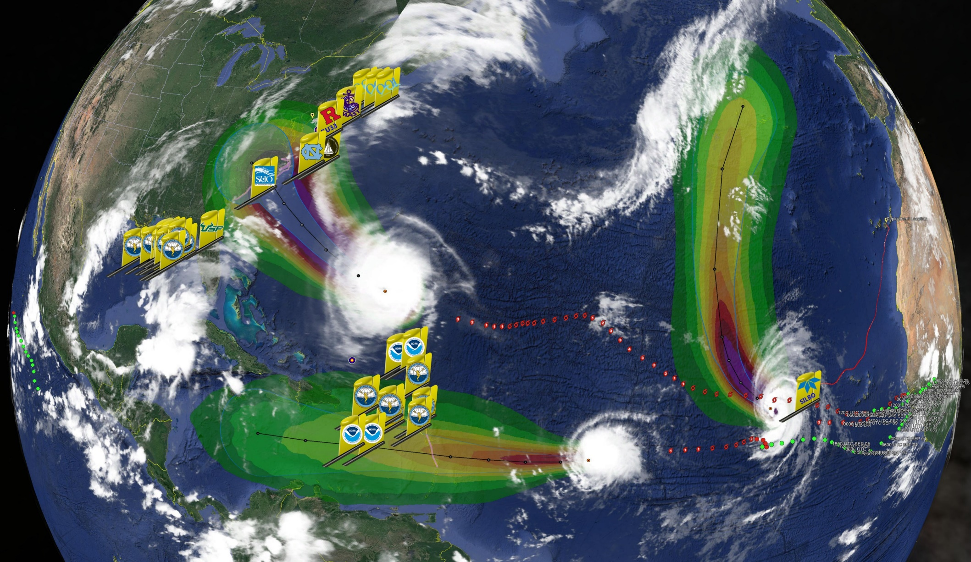
Hurricane Sentinel Gliders deployed in 3 Picket Lines
Florence
Helene
Isaac
>30 Hurricane Sentinel Gliders from the Navy, NOAA, NSF, Academic & Industry Partners
reporting ocean conditions through the U.S. IOOS Glider Data Assembly Center (DAC)
ahead of Hurricanes Florence, Isaac and Helene on September 11, 2018.

Slide 8
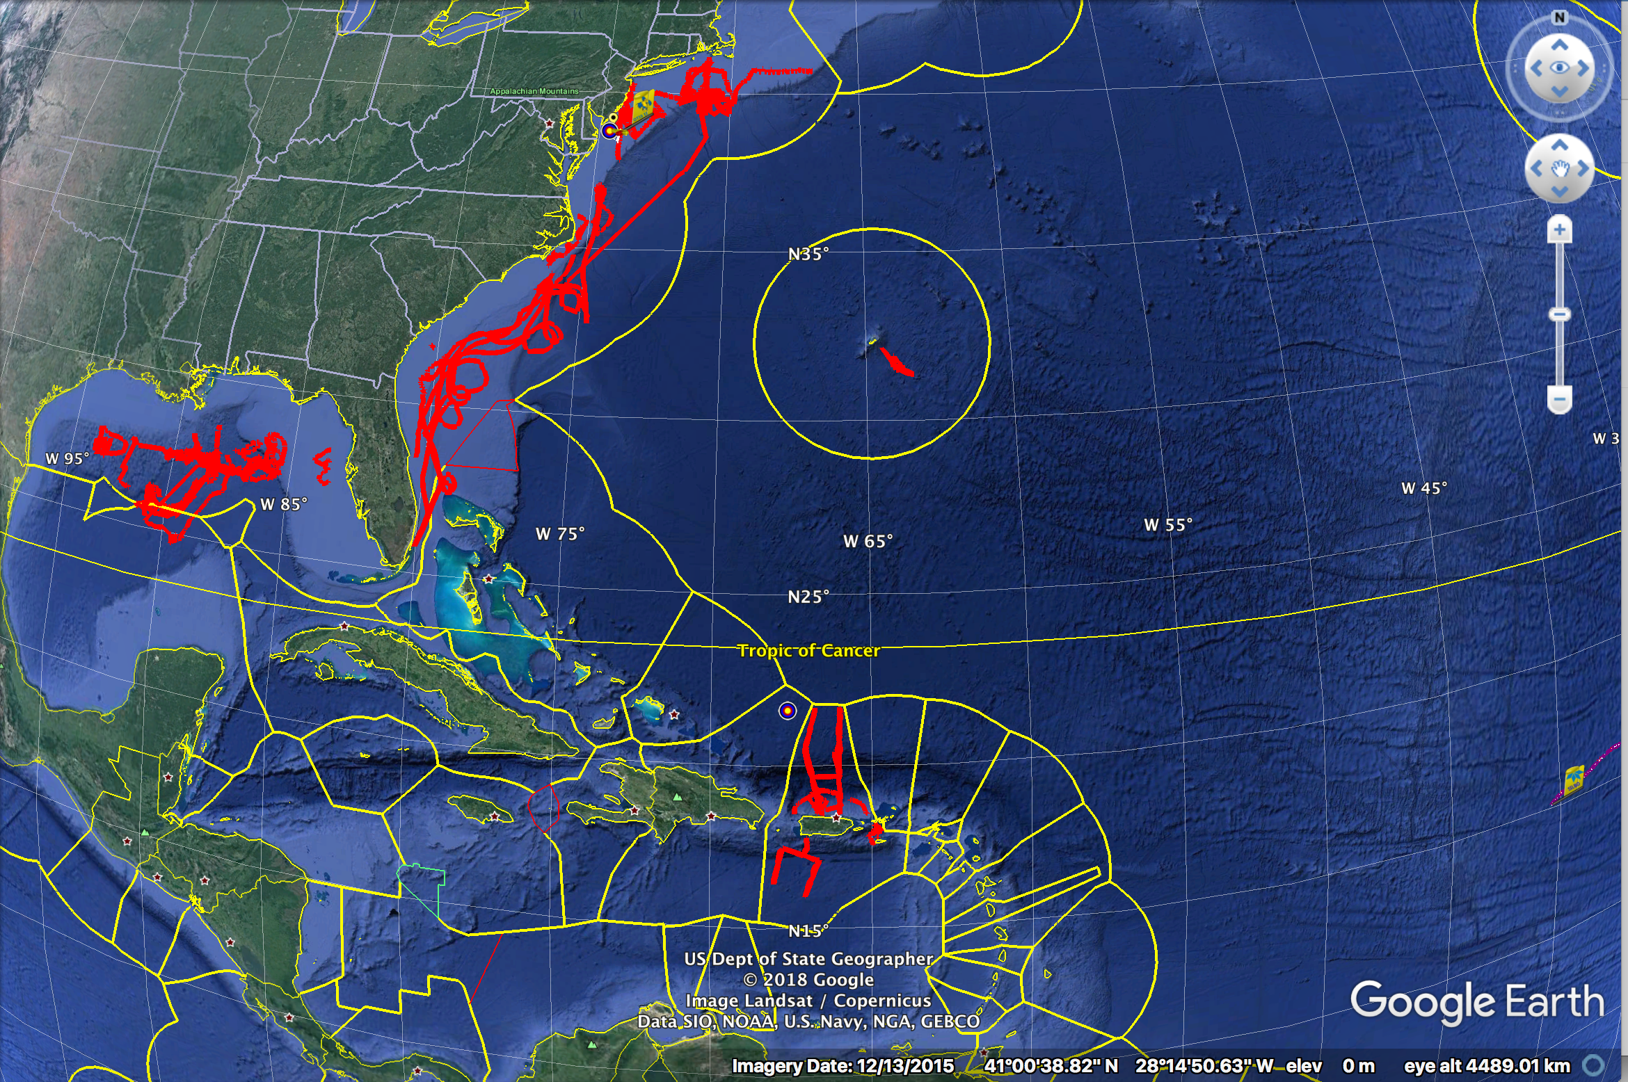
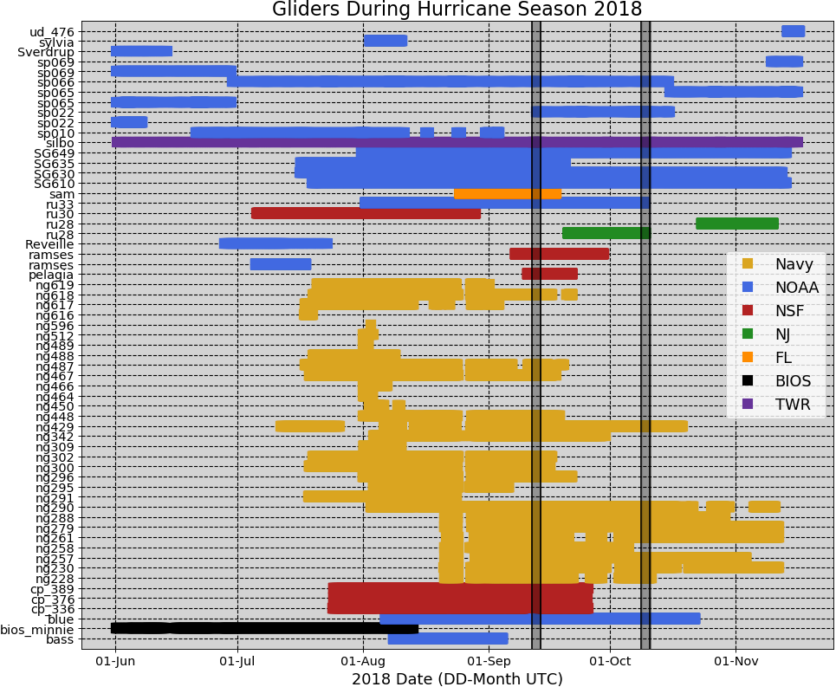
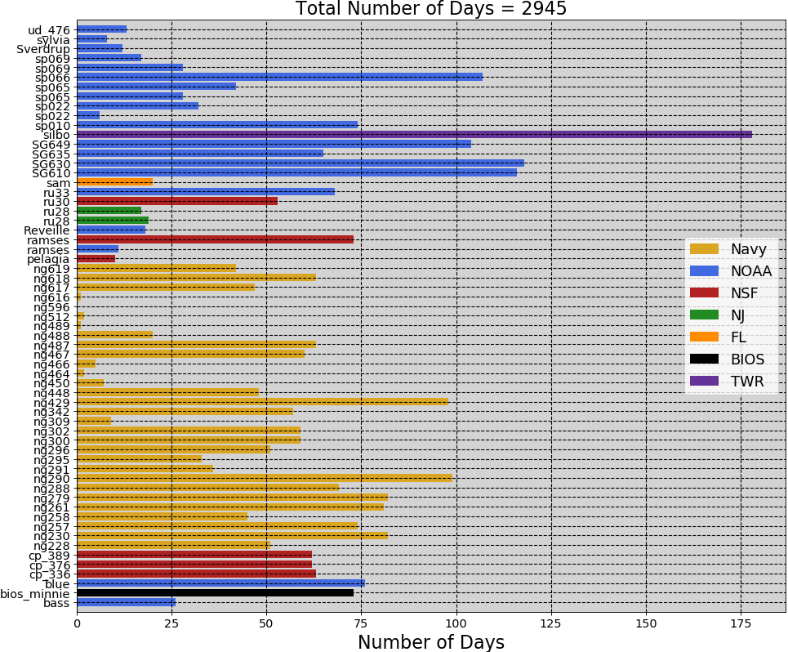
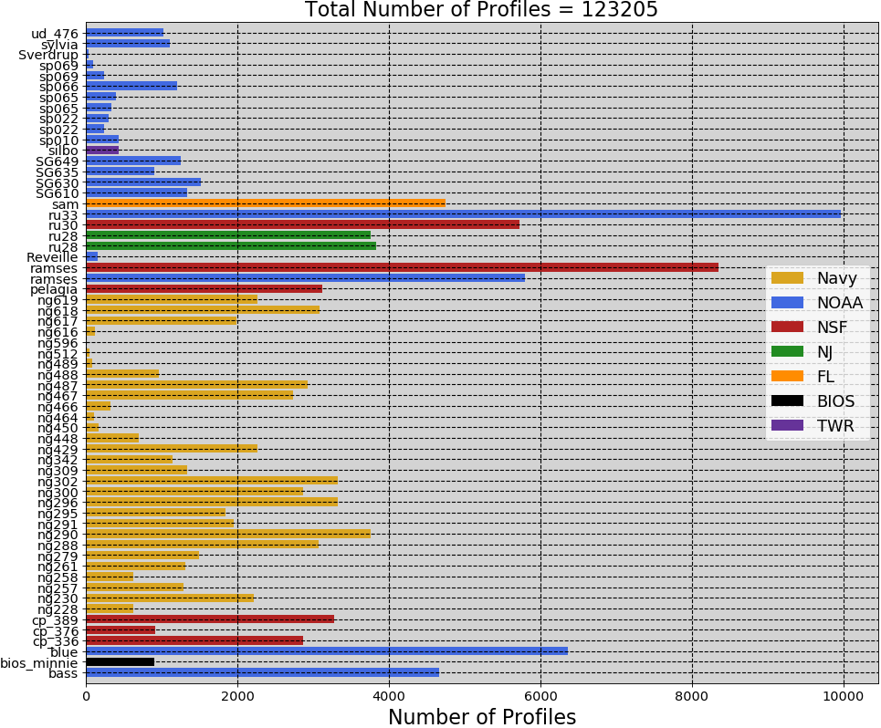
2018 Hurricane Season – 61 Gliders in IOOS Glider DAC

Slide 9
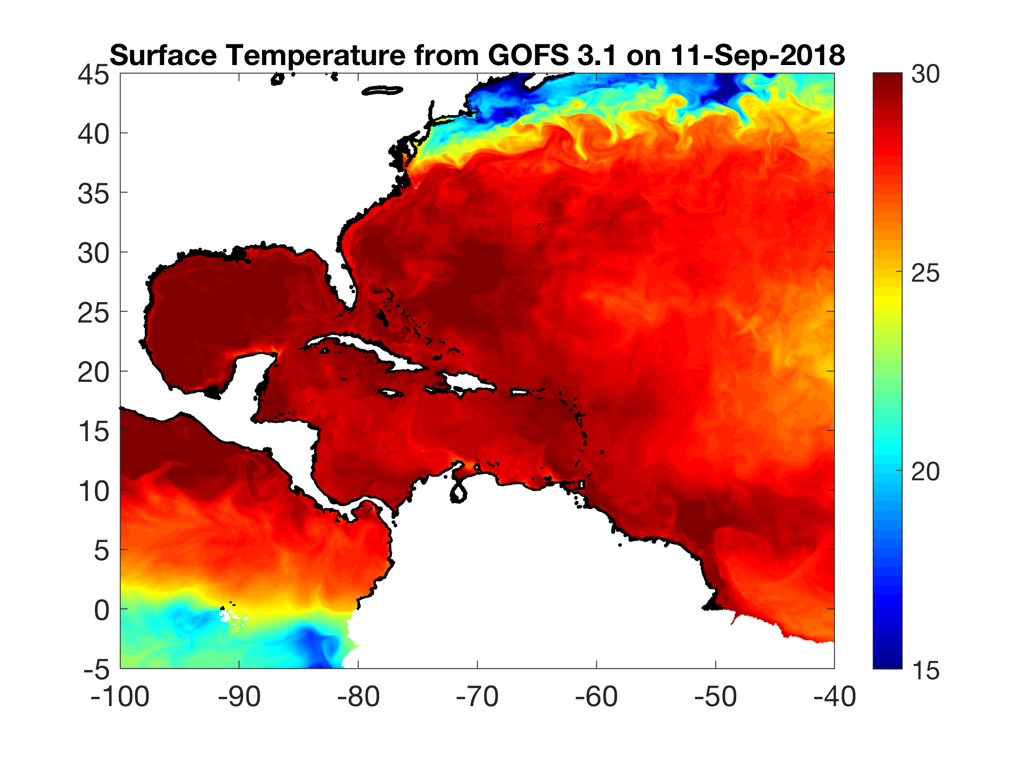
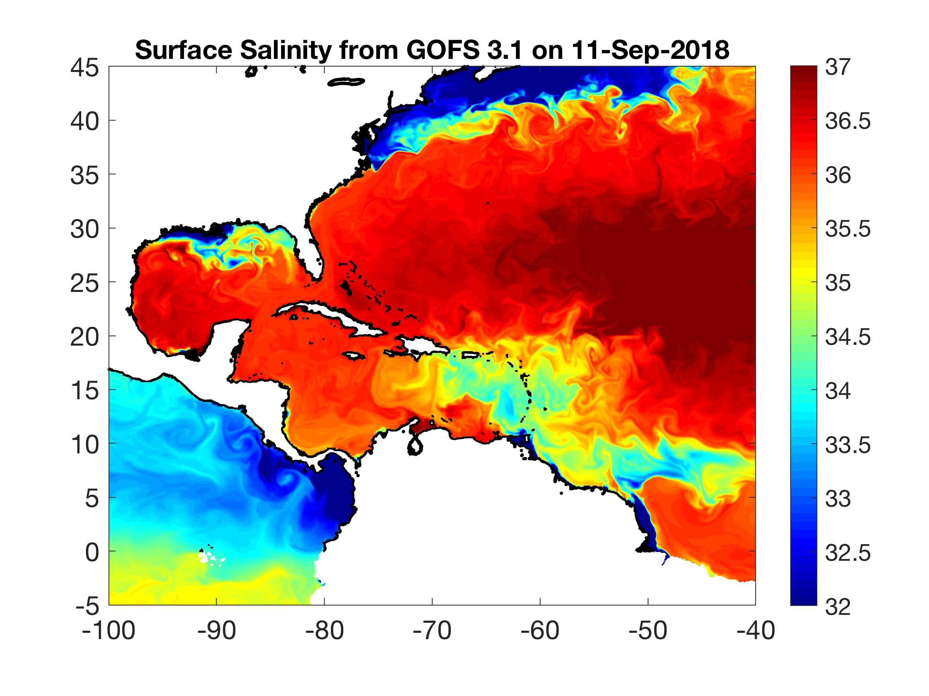
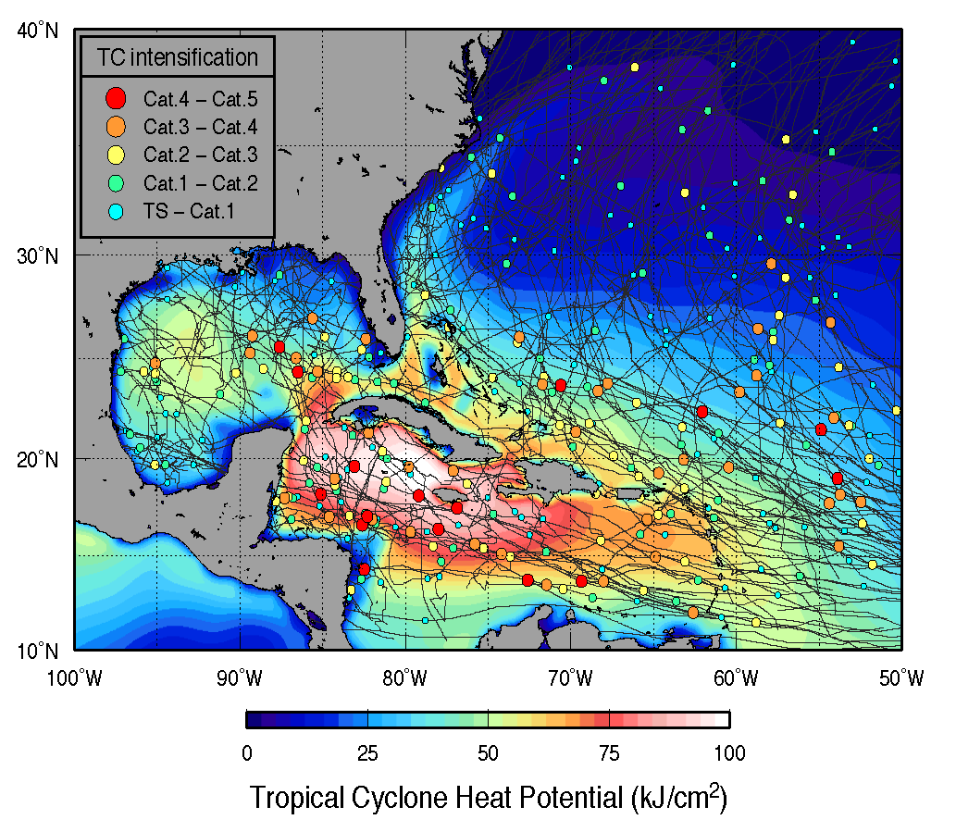
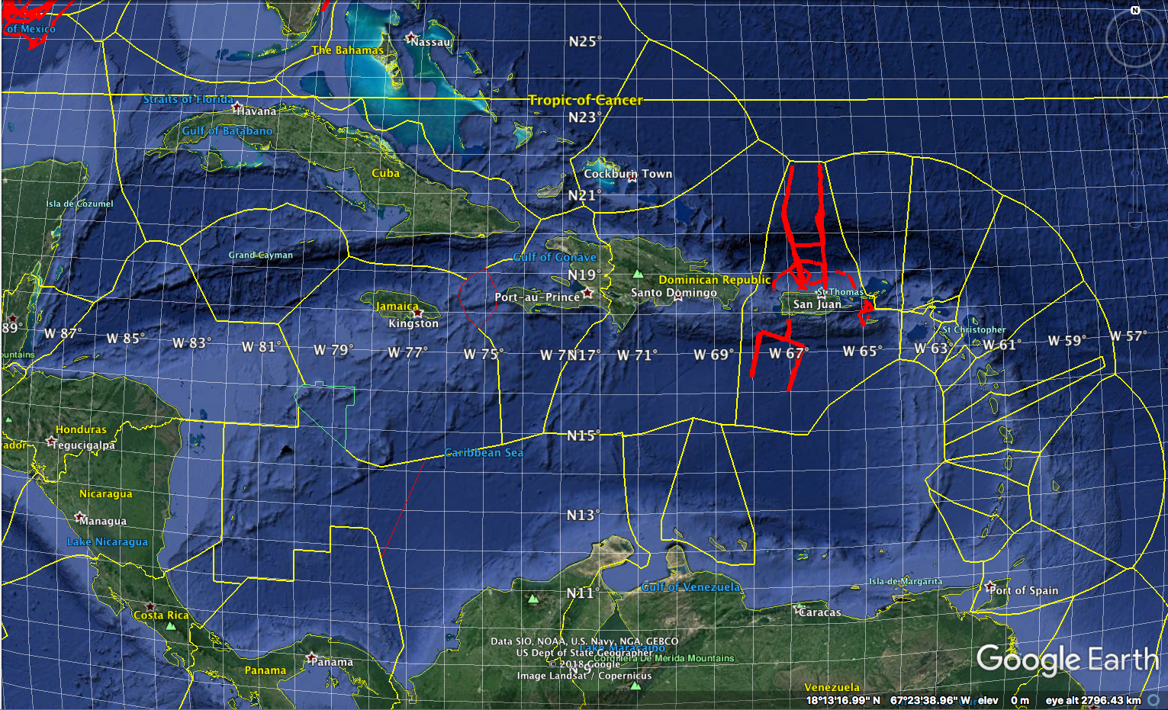
SST, SSS, Upper Ocean Heat Potential and Caribbean Glider Deployments

Slide 10
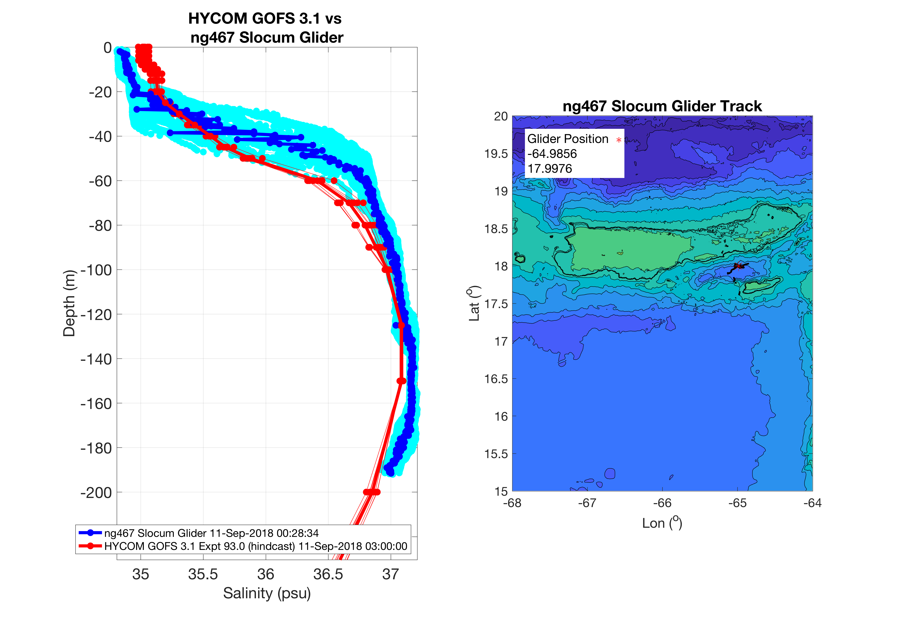
USVI Gliders - NG467 – Temperature & Salinity

Slide 11
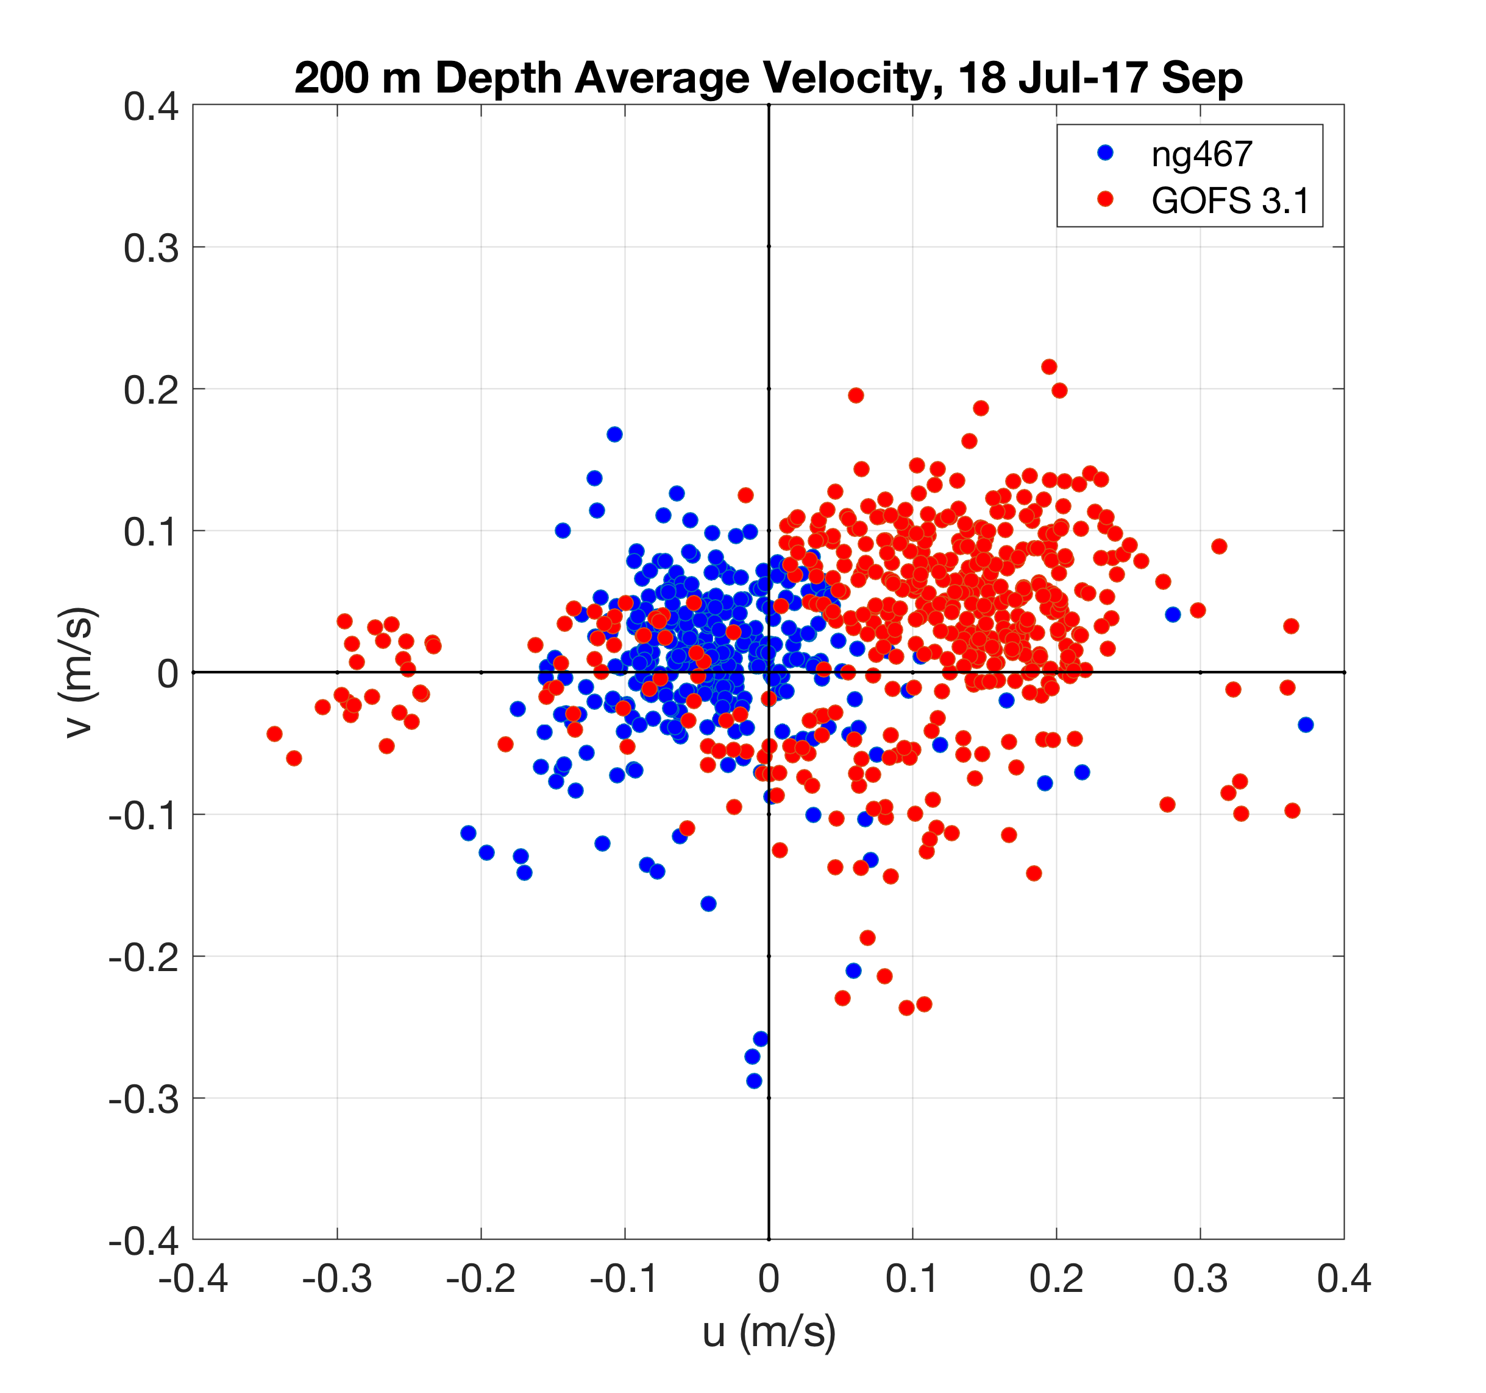
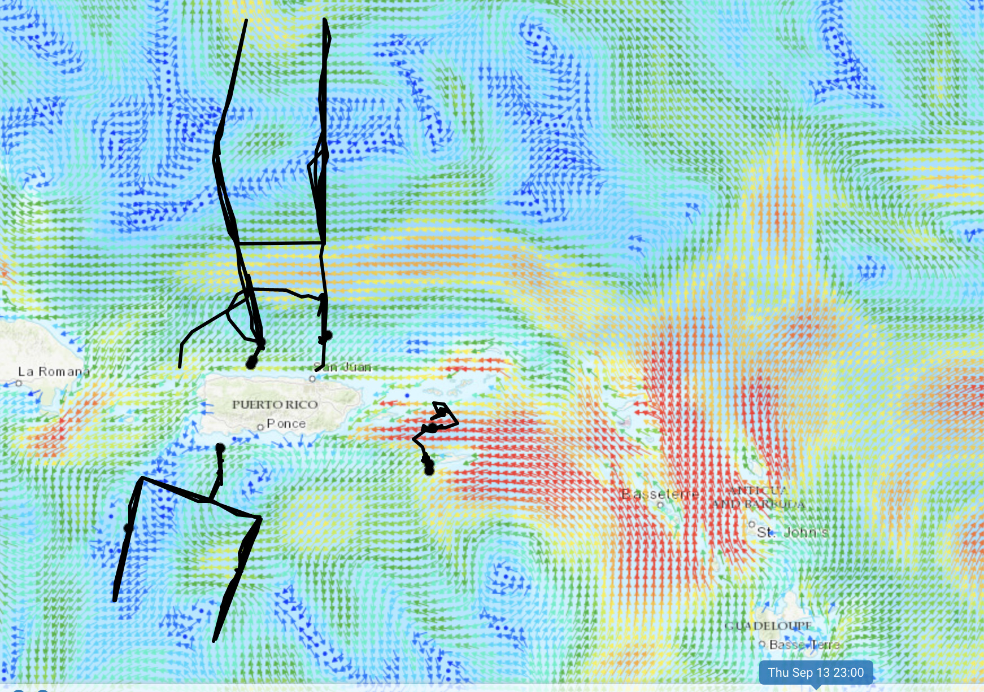
USVI Gliders - NG467 - Currents

Slide 12
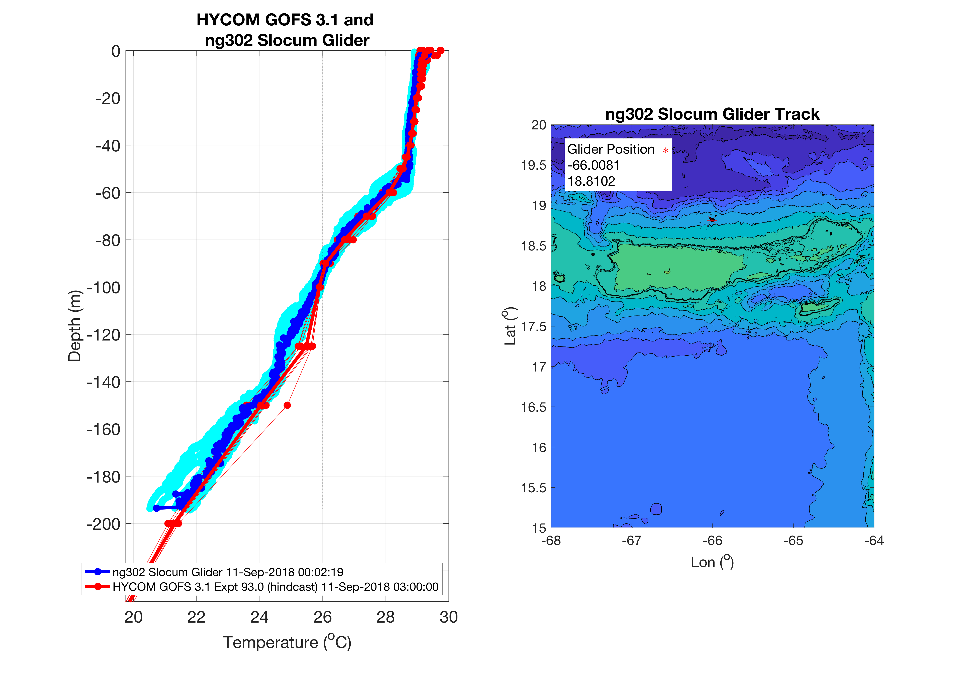
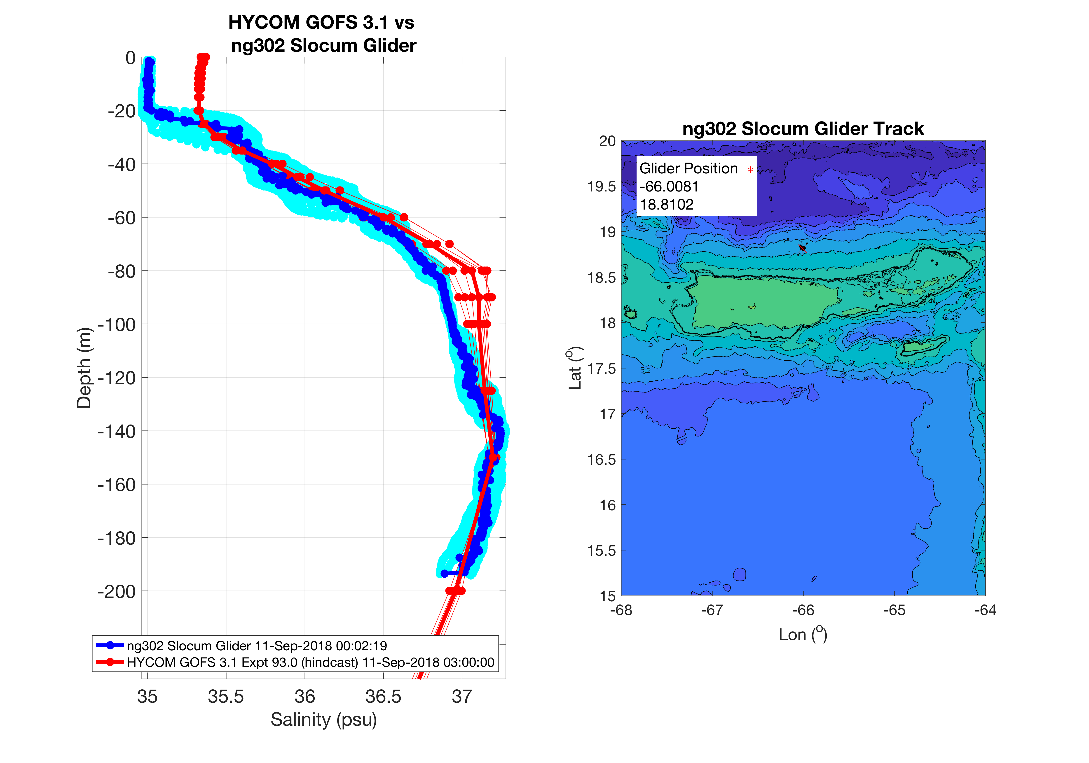
USVI Gliders - NG302 – Temperature & Salinity

Slide 13
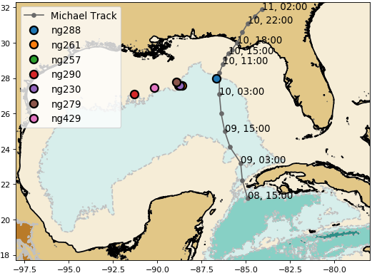
Hurricane Michael – NG288

Slide 14
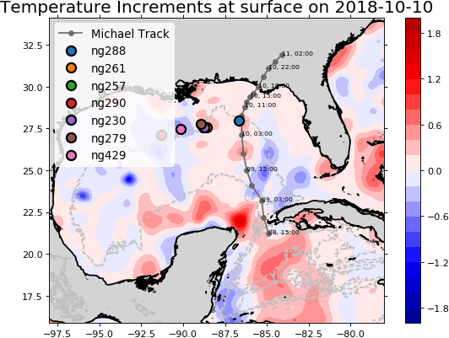
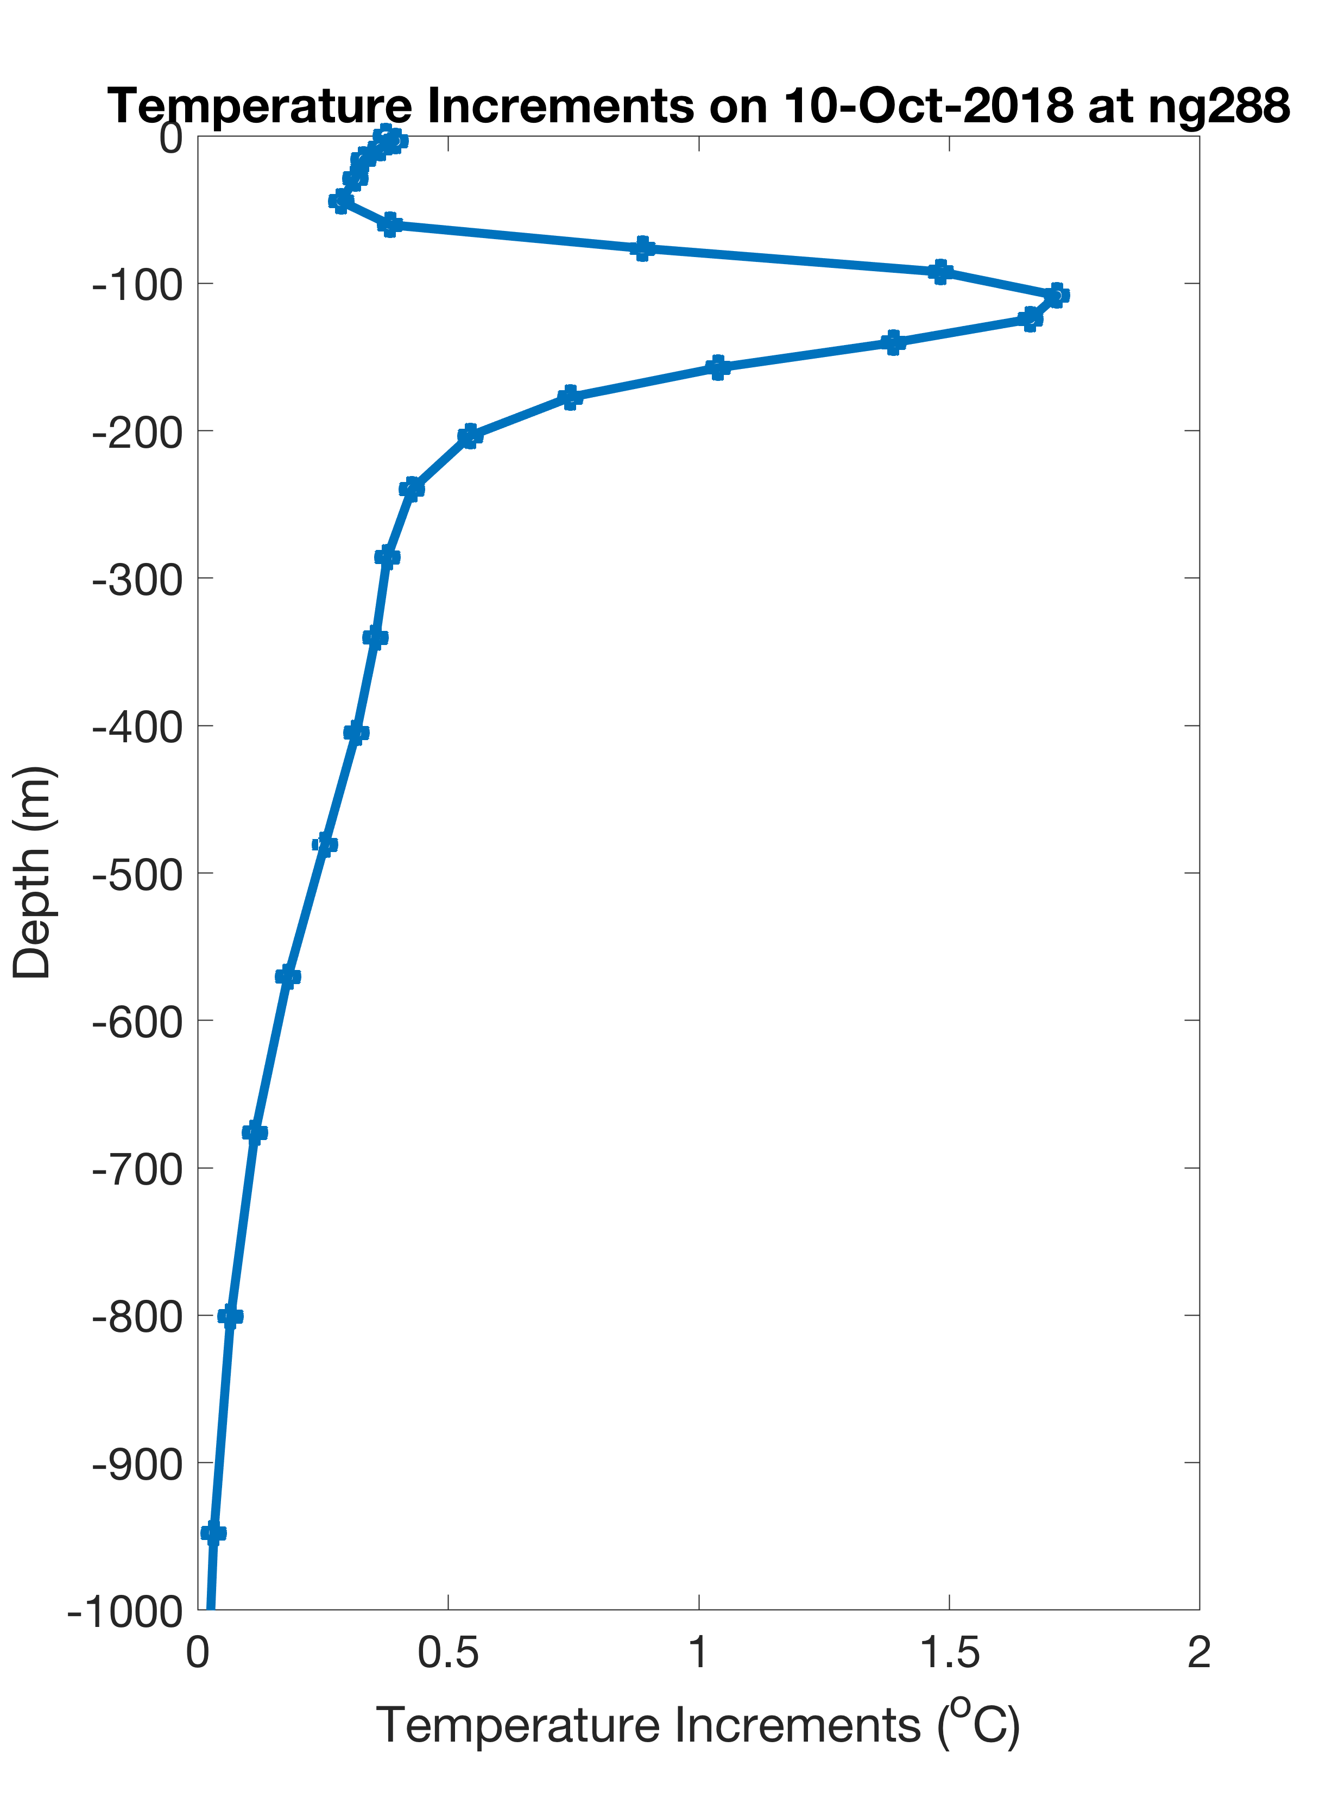
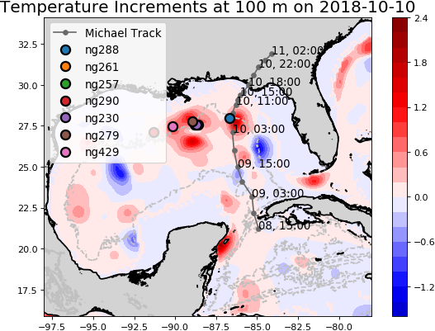
Hurricane Michael – NG288 - Temperature Increments
From NCODA

Slide 15
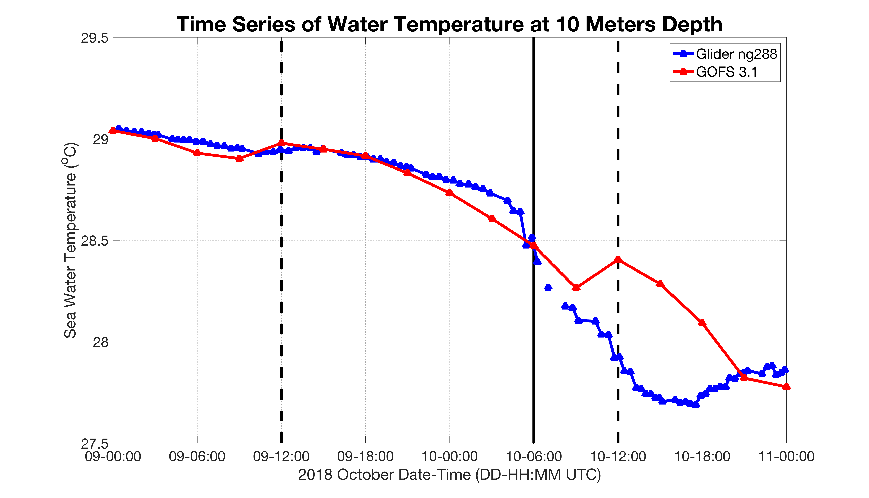
Hurricane Michael – NG288 vs GOFS 3.1
DRAFT

Slide 16
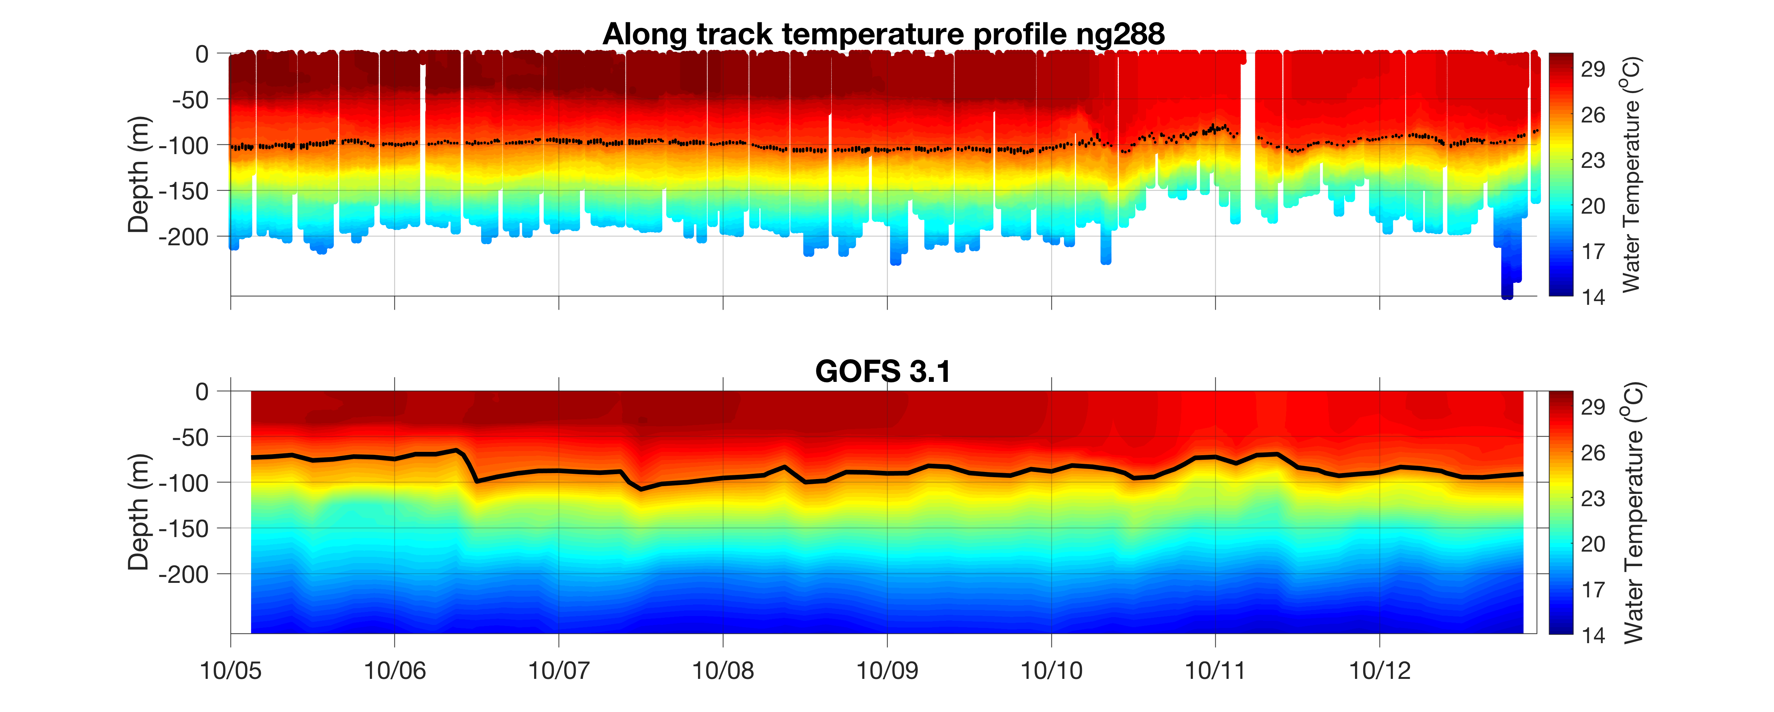
Hurricane Michael – NG288 - Assimilation Windows

Slide 17
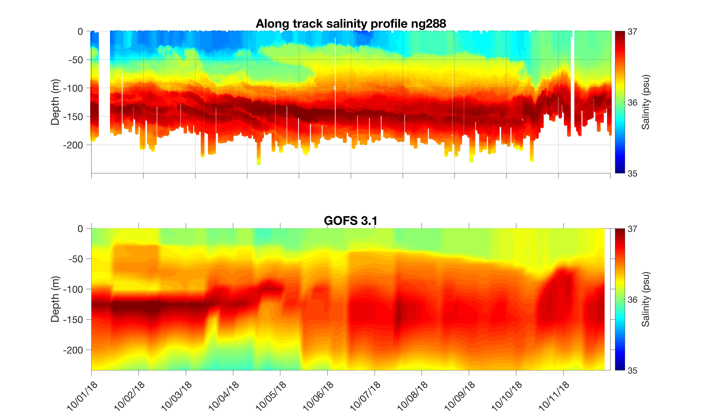
Hurricane Michael – NG288 - Salinity

Slide 18
Next Steps – Now through Start of 2019 Hurricane Season
Questions:
What is the impact of the gliders on the NCODA/GOFS/RTOFS ocean forecast? The hurricane track and intensity forecast? The hurricane impact forecast?
Can we propose changes to improve NCODA for Operational Forecasting?
Where do we want to deploy gliders in the 2019 Hurricane Season?
Partnership Approach:
Deploy/Recover Gliders – 2018 Hurricane Season - Completed
Model/Data Comparisons – Fall - Ongoing
Collaborative Deep Dive into Critical Components – Winter
Joint Recommendations for 2019 Hurricane Season - Spring
In-person Tiger Team events with
NOAA/Navy (Silver Spring, Stennis) - 29 Nov
Navy Scientists (NRL Stennis, NRL Monterey) - Ongoing
NOAA Operational Center (NCEP – College Park) – Winter
Research Centers (AOML, GFDL, VIMS, UMiami) - Winter
HFIP/OMITT/NHC (Miami) – Spring
EGO Global Glider Meeting (Rutgers) - May

Slide 19
Next Steps – Now through Start of 2019 Hurricane Season
What we need:
Actual data-denial assimilation experiments with the operational modeling suite
Move from a volunteer Interagency Tiger Team to a resourced Interagency Tiger Team for data assimilation (NCODA updates, 3DVAR to 4DVAR, …)
Joint funding for NOPP-style partnerships
Transition through HFIP consistent with WRFIA
Increased funding for the IOOS Glider DAC.
Expanded NOAA & Navy support for Hurricane Sentinel glider fleet operations in the Hurricane-Impacted IOOS Regions (Caribbean, Gulf, SAB, MAB, …)
Permission for gliders to roam the Caribbean – Through GOOS/IOCARIBE

