Slide 1
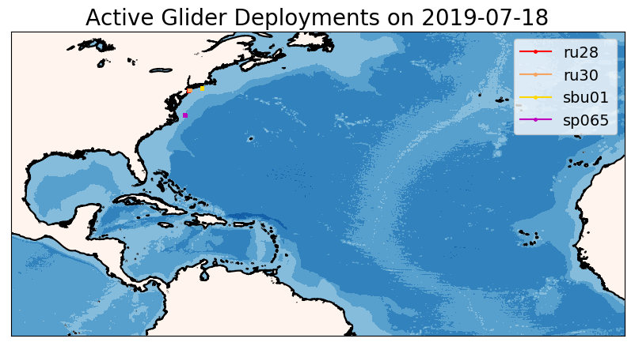
Glider/Operational Ocean Models
Comparisons
Hurricane Season 2019
https://rucool.marine.rutgers.edu/hurricane/Hurricane_season_2019/Jul-18/

Slide 2
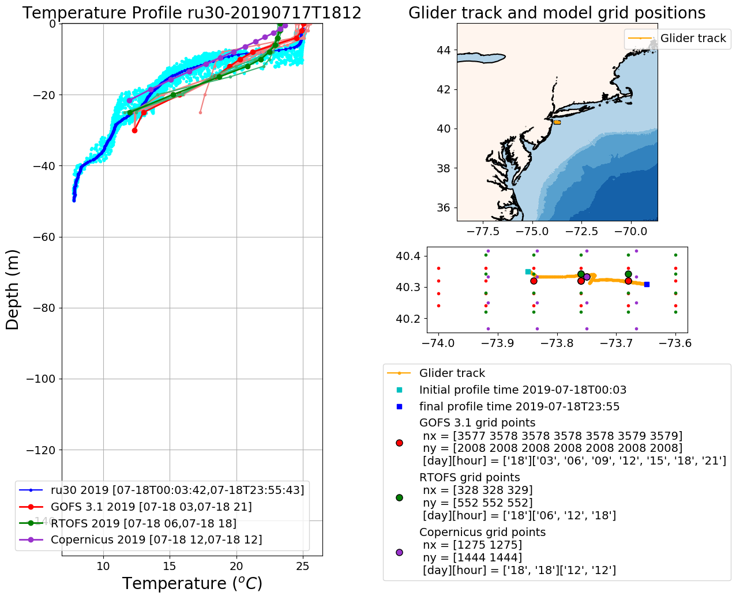

Slide 3
Models Description
GOFS 3.1 Global
Analysis: ‘http://tds.hycom.org/thredds/dodsC/GLBv0.08/expt_93.0/ts3z’.
Hycom + Ncoda
3 hourly
40º S < lat < 40º N … 0.08º , Poleward of 40º … 0.04º
41 vertical levels
RTOFS North Atlantic domain
Forecast: ‘ftp.ncep.noaa.gov/pub/data/nccf/com/rtofs/prod/’
Hycom
6 hourly
40º S < lat < 40º N … 0.08º , Poleward of 40º … 0.04º
41 vertical levels
Copenicus Global
Forecast: 'http://nrt.cmems-du.eu/motu-web/Motu’
Nemo
Daily average at 12Z
0.08º horizontal resolution
50 vertical levels

Slide 4
RTOFS North Atlantic domain
Forecast: ‘ftp.ncep.noaa.gov/pub/data/nccf/com/rtofs/prod/’
'rtofs_glo_3dz_f006_6hrly_hvr_US_east.nc'
'rtofs_glo_3dz_f012_6hrly_hvr_US_east.nc’
'rtofs_glo_3dz_f018_6hrly_hvr_US_east.nc'
'rtofs_glo_3dz_f024_6hrly_hvr_US_east.nc'
Copenicus Global
Forecast: 'http://nrt.cmems-du.eu/motu-web/Motu’
The Operational Mercator global ocean analysis and forecast system
The atmospheric fields forcing the ocean model are taken from the ECMWF
(European Centre for Medium-Range Weather Forecasts) Integrated Forecast
System.

Slide 5
Develop metrics to quantify the performance of the operational ocean models with respect to glider observations. Examples of metrics are: absolute error of SST, T100, ocean heat content, d rho/dz. These metrics have relevance for the heat fluxes from the ocean to the atmosphere during storms

Slide 6
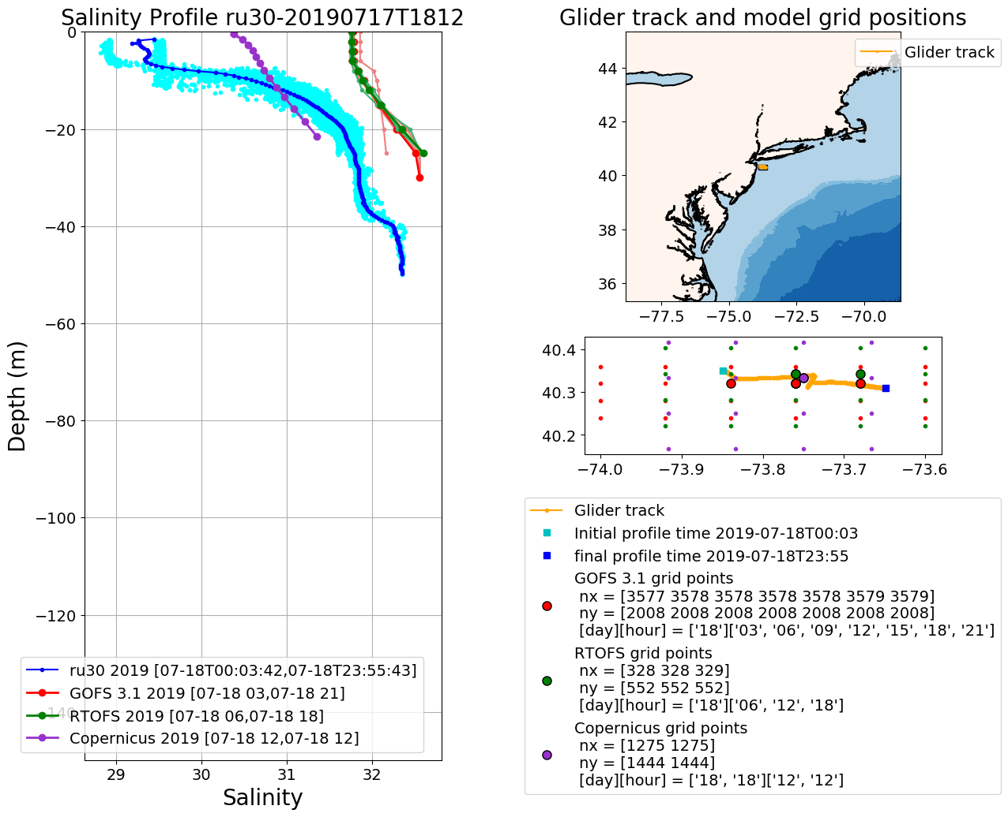

Slide 7
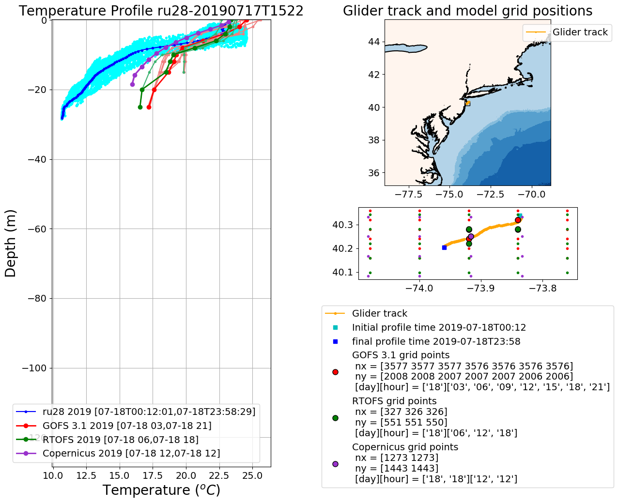

Slide 8
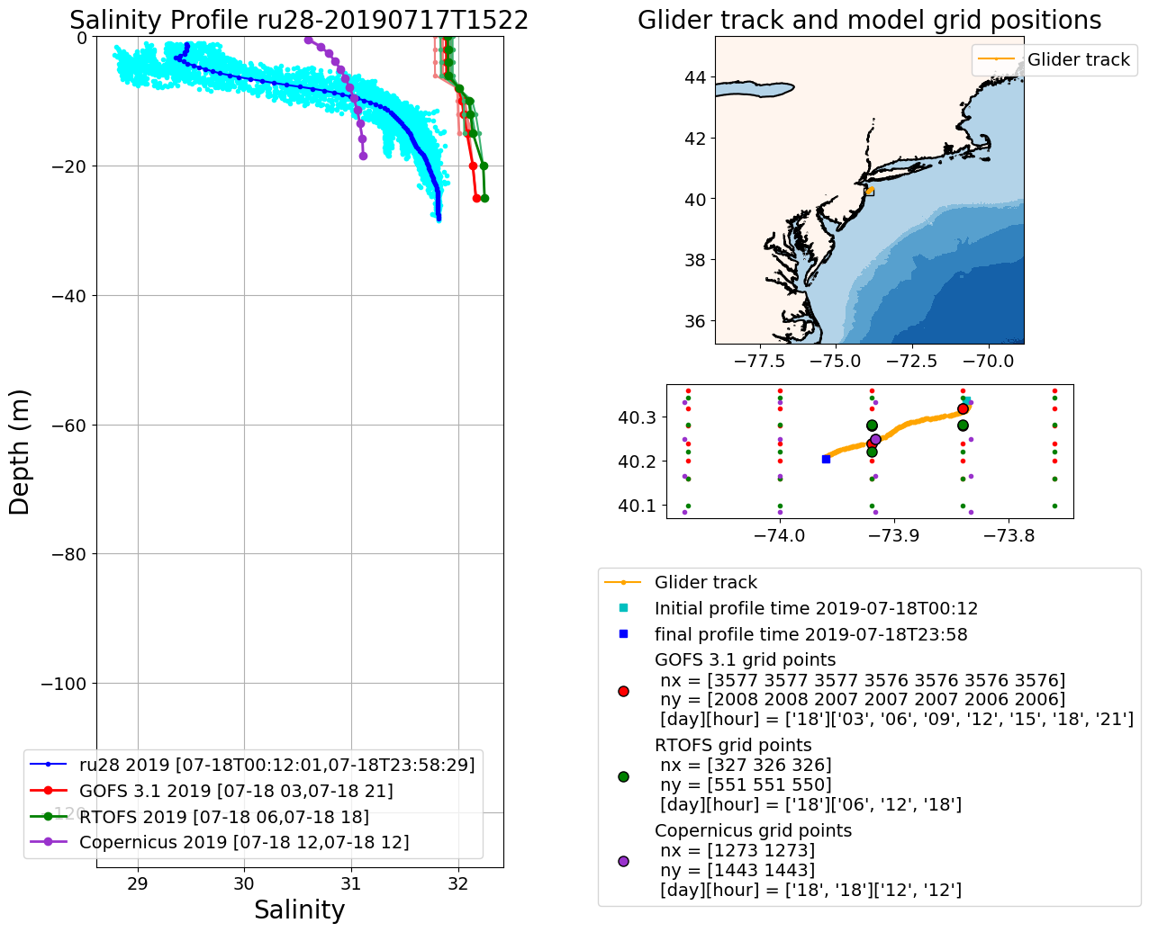

Slide 9
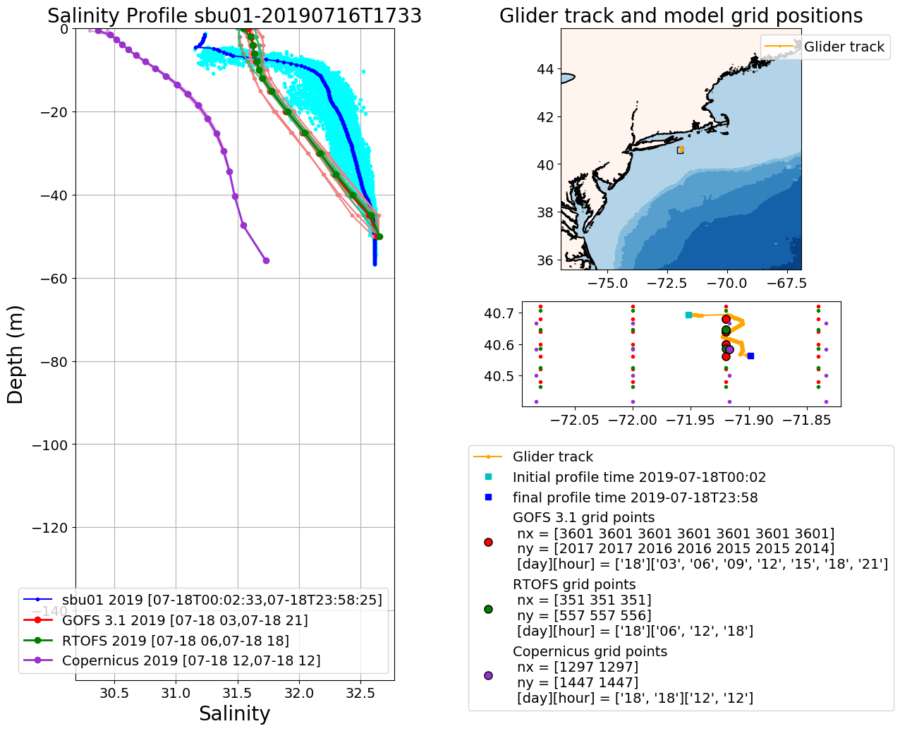

Slide 10
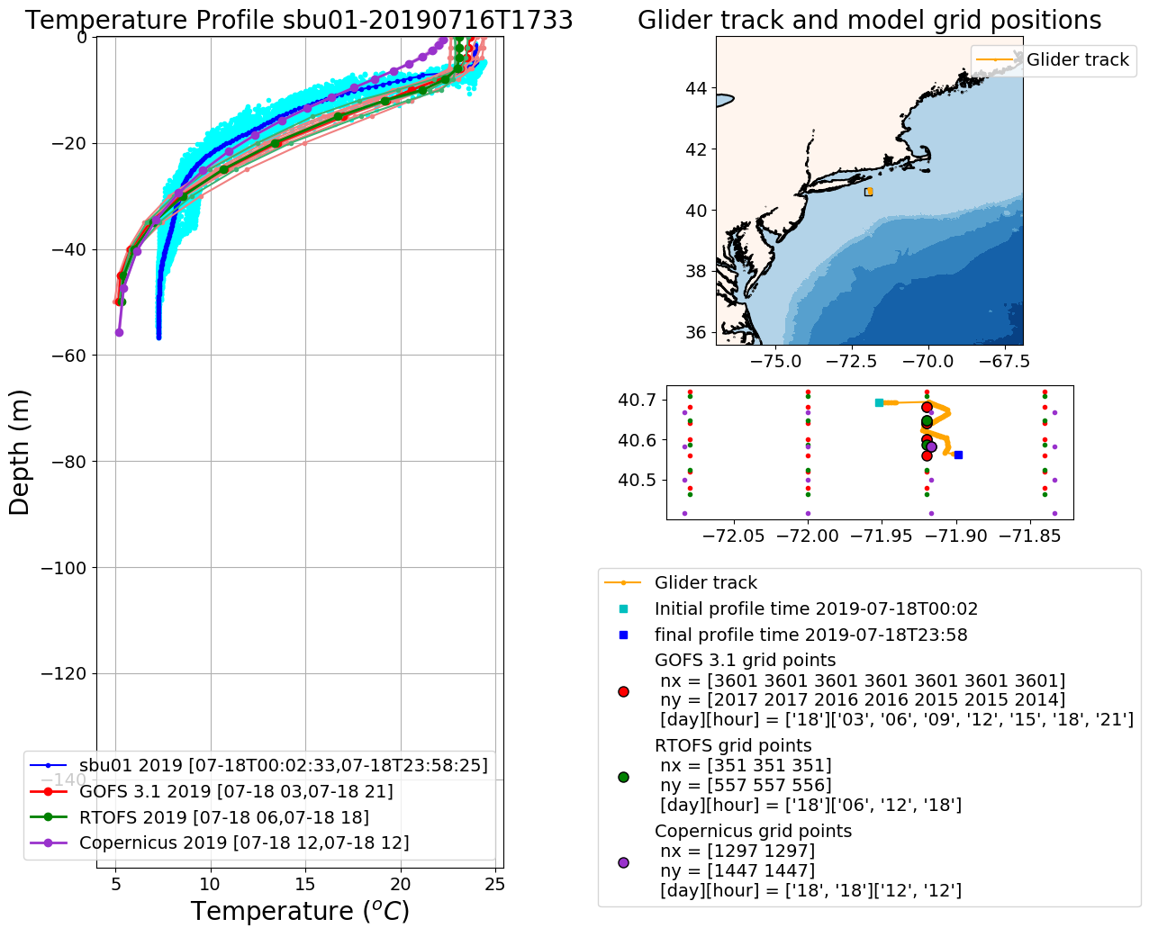

Slide 11
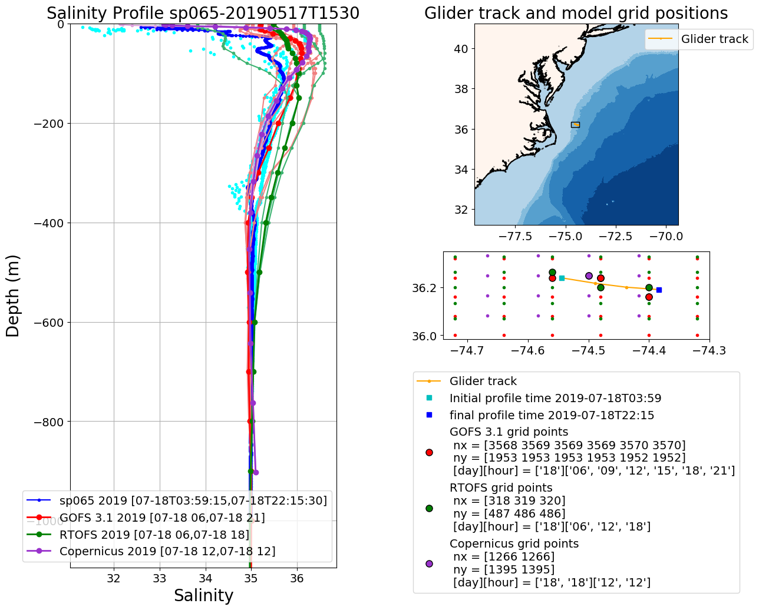

Slide 12
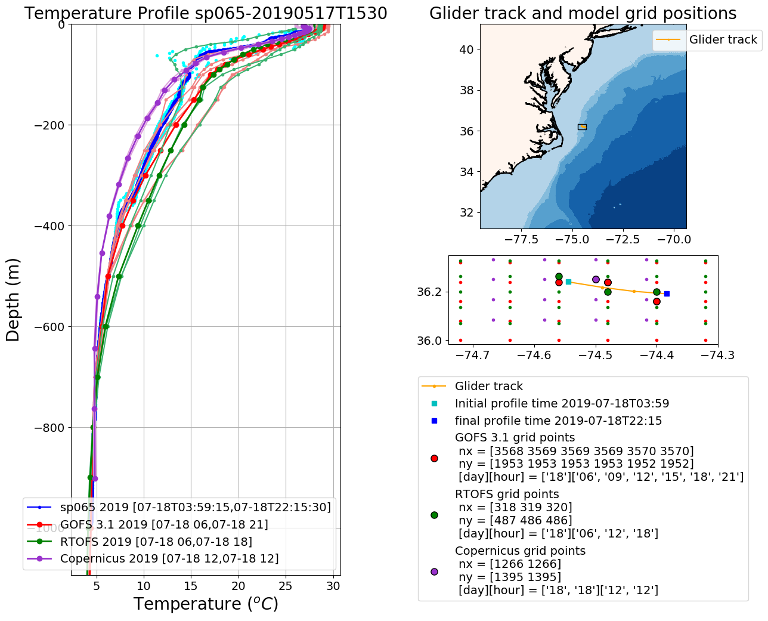

Slide 13
Work Flow HMON/HYCOM and HWRF/HYCOM
Global GOFS 3.1/NCODA System
Nowcast
7-day frcst
0Z
12Z
0Z
Nowcast
1-day frcst
7-day frcst
0Z
12Z
0Z
0Z
0Z
12Z
0Z
0Z
0Z
Nowcast
1-day frcst
2-day frcst
7-day frcst
0Z
12Z
0Z
0Z
0Z
Global
RTOFS
NCODA Incremental Insertion Window

Slide 14
Work Flow HWRF/POM
Global GOFS 3.1/NCODA System
Nowcast
7-day frcst
0Z
12Z
0Z
Nowcast
1-day frcst
7-day frcst
0Z
12Z
0Z
0Z
0Z
12Z
0Z
0Z
0Z
Nowcast
1-day frcst
2-day frcst
7-day frcst
0Z
12Z
0Z
0Z
0Z
day -2
day 0
day 1
IC from Global
GOFS 3.1/NCODA
Global
RTOFS
0Z
6Z
12Z
18Z
0Z
Forcing EMC GDAS
Forcing GFS
IC, BC
Regional
HWRF/POM
IC
IC
NCODA Incremental Insertion
Window
IC

