Slide 1
NOAA Hurricane Forecasting Models
HWRF/HYCOM
HMON/HYCOM
HWRF/POM
West/South Pacific, South/North Indian Ocean
North Atlantic,
East/Central Pacific
North
Atlantic
East/Central
Pacific
IC come from climatology and the POM (w/ feature model only in the GoM)
IC and BC from
Global RTOFS spun up from the global
GOFS 3.1/NCODA
IC from Global RTOFS nowcast
BC ?

Slide 2
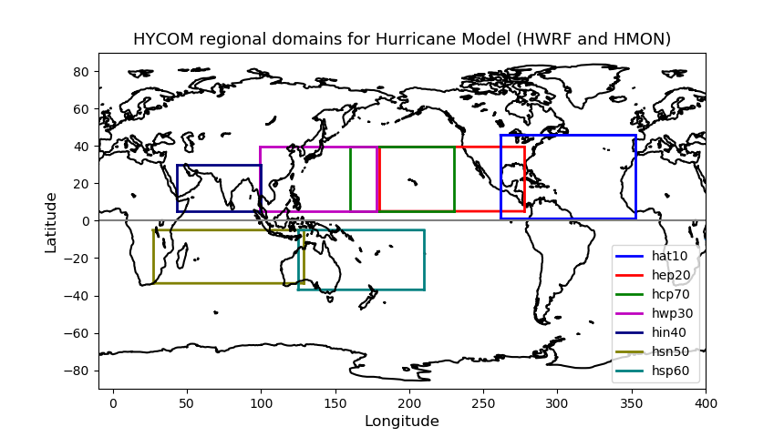
NOAA Hurricane Forecasting Models
HWRF/HYCOM
HMON/HYCOM
HWRF/POM
West
Pacific
Central
Pacific
East
Pacific
North
Atlantic
North
Indian
South
Indian
South
Pacific

Slide 3
NOAA Hurricane Forecasting Models
HWRF/HYCOM
HMON/HYCOM
HWRF/POM
West/South Pacific, South/North Indian Ocean
North Atlantic,
East/Central Pacific
North
Atlantic
East/Central
Pacific
IC come from climatology and the POM (w/ feature model only in the GoM)
IC and BC from
Global RTOFS spun up from the global
GOFS 3.1/NCODA
IC from Global RTOFS nowcast

Slide 4
Avichel asked us not to share outside MARACOOS until official release
FY2018 HWRF/HMON Configuration
(maintain diversity for future)
Note: Items in Red are different
 | HWRF | HMON
Dynamic core | Non-hydrostatic, NMM-E | Non-hydrostatic, NMM-B
Nesting | 13.5/4.5/1.5 km; 77°/18°/6°; 75 vertical levels; Full two-way moving | 18/6/2 km; 75°/12°/8°; 51 vertical levels; Full two-way moving
Data Assimilation and Initialization | Vortex relocation & adjustment, Self-cycled hybrid EnKF-GSI with inner core DA (TDR) | Modified vortex relocation & adjustment, no DA
Physics | Updated surface (GFDL), GFS-EDMF PBL, Updated Scale-aware SAS, NOAH LSM, Modified RRTM, Ferrier | Surface (GFDL), GFS-EDMF PBL, Scale-aware SAS, NOAH LSM, RRTM, Ferrier
Coupling | MPIPOM/HYCOM, RTOFS/GDEM, WaveWatch-III | HYCOM, RTOFS/NCODA, No waves
Post-processing | NHC interpolation method, Updated GFDL tracker | NHC interpolation method, GFDL tracker
NEMS/NUOPC | No | Yes with moving nests
Computation cost for forecast job | 81 nodes in 98 mins | 26 nodes in 95 mins

Slide 5
Global RTOFS
day -2
day 0
day 1
IC from Global
GOFS 3.1/NCODA
0Z
6Z
12Z
18Z
0Z
Forcing EMC GDAS
Forcing GFS
IC, BC
IC
Regional
HMON/HYCOM
HWRF/HYCOM
IC
IC
IC

Slide 6
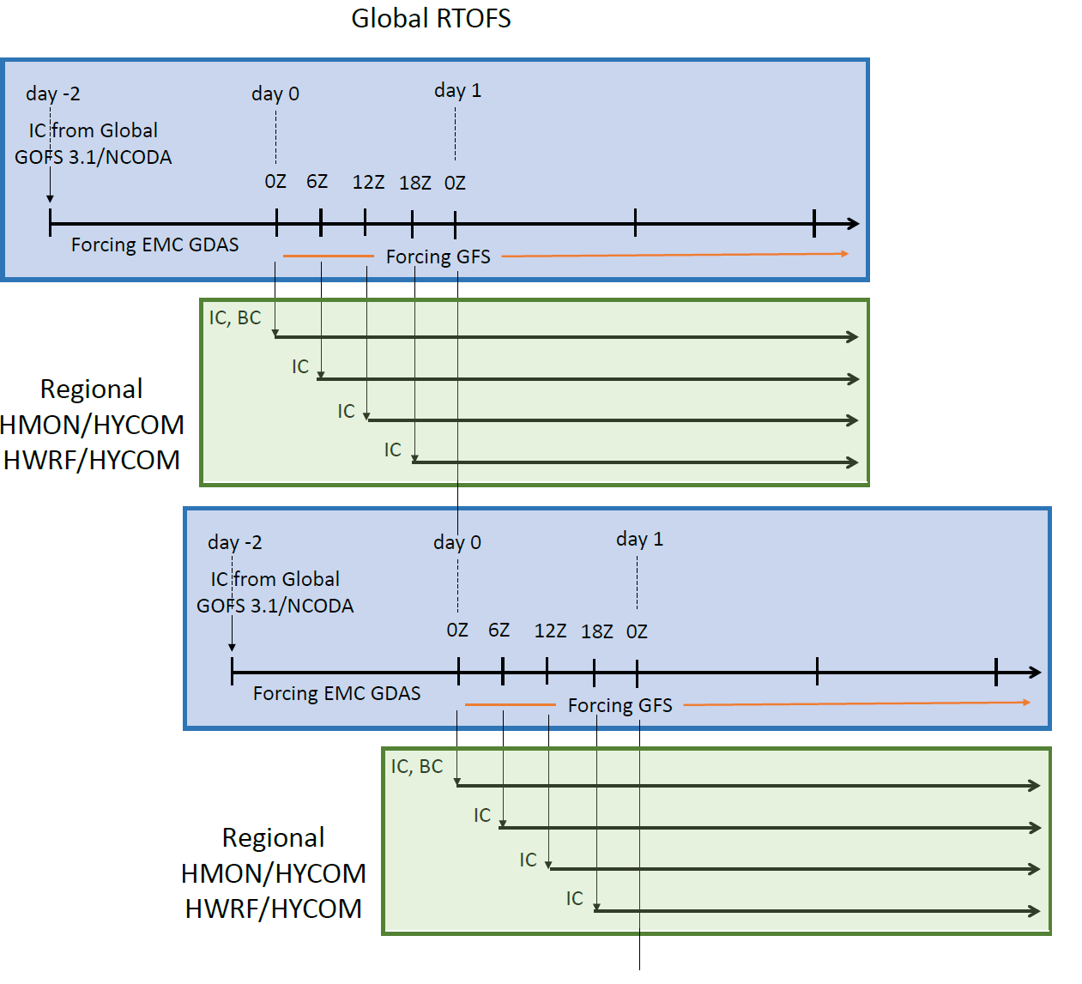

Slide 7
What about HWRF/POM?

Slide 8
Hurricane Forecasting Models by Regions
Gulf of Mexico
HWRF/POM: initialized from climatology and/or feature models.
HMON/HYCOM: initialized from RTOFS. RTOFS
Initializes from GOFS 3.1/NCODA 2 days prior (initial
conditions ) forced by EMC GDAS (Global data
assimilation system) forcing.

Slide 9
HWRF runs in 7 individual basins
JTWC (joint typhoon weather center) basins:
West Pacific, South Pacific, Southern Indian Ocean,
Northern Indian Ocean.
In all these basins HWRF is Coupled to HYCOM
using IC/BC from global RTOFS
NHC (National Hurricane Center) basins:
HWRF Coupled to POM In the North Atlantic. Initial
conditions come from climatology and feature
model. Feature model only for the GOM but not the
Gulf Stream.
Eastern Pacific and Central Pacific. IC come from
global RTOFS

Slide 10
HMON runs only in NHC basins
HMON is coupled to HYCOM. IC come from
global RTOFS
Global RTOFS
It is HYCOM, the same as GOFS 3.1 but uses GDAS
forcing
In the different basins, HYCOM is a subset of the global
RTOFS. Regional HYCOM uses initial conditions (IC) and
boundary conditions (BC) from global global RTOFS initialized
from GOFS3.1/NCODA
Validations to the global RTOFS are done daily in the EMC website:
https://polar.ncep.noaa.gov/global/

Slide 11
The output provided by Hyun-Sook is the 5th cycle
The experimental system is HWRF/HYCOM in NHC basins
Hyun-Sook will run experimental HWRF/HYCOM for
Michael and provide us with output so the three models
can be compared vs glider data

Slide 12
Front Eddy Analysis
It is only done in GOM
NHC gives NCEP the location of the Loop Current and warm core rings based on SST and SSH. This information is sent daily
The locations of Loop Currents and warm core rings go into POM and modifies the climatology of temperature and salinity (subsurface profiles). This modified climatology becomes the IC for POM
There are Netcdf files that are created with the modified climatology: pom.ts_initial.nc
pom.uv_initial.nc (geostrophy)
pom.el_initial.nc (initial elevation)

Slide 13
(There are files). You should have them. They came with runs from HWRF/HYCOM with FV3
If the Loop Current and warm core file are not provided, then POM initializes from climatology

