Slide 1
NOAA Hurricane Forecasting Models
HWRF/RTOFS HYCOM
HMON/RTOFS
HYCOM
HWRF/POM
West/South Pacific, Southern/Northern Indian Ocean
North Atlantic,
Eastern/Central Pacific
North
Atlantic
Eastern/Central
Pacific
IC come from climatology and the POM (w/ feature model only in the GoM)
IC and BC from
Global RTOFS spunup from the global
GOFS 3.1/NCODA
IC from global GOFS3.1/
NCODA
Global RTOFS nowcast
BC ?

Slide 2
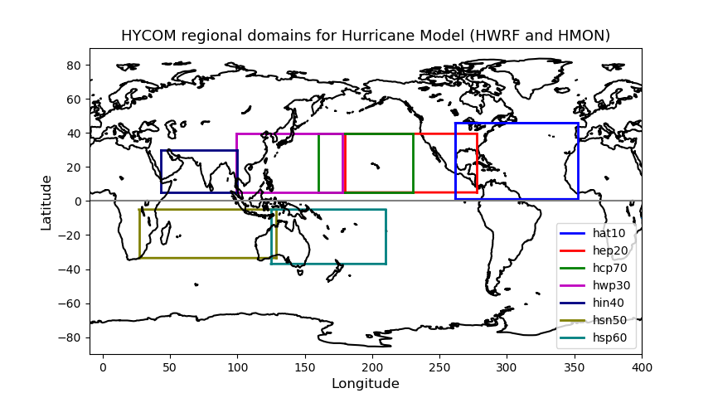

Slide 3
Avichel asked us not to share outside MARACOOS until official release
FY2018 HWRF/HMON Configuration
(maintain diversity for future)
Note: Items in Red are different
 | HWRF | HMON
Dynamic core | Non-hydrostatic, NMM-E | Non-hydrostatic, NMM-B
Nesting | 13.5/4.5/1.5 km; 77°/18°/6°; 75 vertical levels; Full two-way moving | 18/6/2 km; 75°/12°/8°; 51 vertical levels; Full two-way moving
Data Assimilation and Initialization | Vortex relocation & adjustment, Self-cycled hybrid EnKF-GSI with inner core DA (TDR) | Modified vortex relocation & adjustment, no DA
Physics | Updated surface (GFDL), GFS-EDMF PBL, Updated Scale-aware SAS, NOAH LSM, Modified RRTM, Ferrier | Surface (GFDL), GFS-EDMF PBL, Scale-aware SAS, NOAH LSM, RRTM, Ferrier
Coupling | MPIPOM/HYCOM, RTOFS/GDEM, WaveWatch-III | HYCOM, RTOFS/NCODA, No waves
Post-processing | NHC interpolation method, Updated GFDL tracker | NHC interpolation method, GFDL tracker
NEMS/NUOPC | No | Yes with moving nests
Computation cost for forecast job | 81 nodes in 98 mins | 26 nodes in 95 mins

Slide 4
Operational Time line for HWRF/RTOFS and HMON/RTOFS
GOFS 3.1/NCODA
0Z
Is it the same for
HWRF/POM?
5 day forecast
every 6 hours
IC, BC
Cycle 1
RTOFS
HMON/HYCOM
HWRF/HYCOM
-2 days
Present
+6 hours
GOFS 3.1/NCODA
0Z
5 day forecast
every 6 hours
IC, BC
EMC
Forcing
RTOFS
HMON/RTOFS
HWRF/RTOFS
Cycle 2
-2 days
Present
+6 hours

Slide 7
Hurricane Forecasting Models by Regions
Gulf of Mexico
HWRF/POM: initialized from climatology and/or feature models.
HMON/RTOFS HYCOM: initialized from RTOFS using.
Initializes from GOFS 3.1/NCODA 2 days prior (initial conditions ) forced by EMC GDAS (Global data
assimilation system) forcing.

Slide 8
HWRF runs in 7 individual basins
JTWC (joint typhoon weather center) basins:
West Pacific, South Pacific, Southern Indian Ocean,
Northern Indian Ocean.
In all these basins HWRF is Coupled to RTOFS HYCOM using IC/BC from global RTOFS
NHC (National Hurricane Center) basins:
HWRF Coupled to POM
In the North Atlantic Initial conditions come from
climatology and feature model. Feature model only
for the GOM but not the Gulf Stream.
Eastern Pacific and Central Pacific, IC come from
global RTOFS or Global GOFS 3.1?

Slide 9
HMON runs only in NHC basins
HMON is coupled to RTOFS HYCOM
Global RTOFS
It is HYCOM, the same as GOFS 3.1 but uses GDAS
forcing
In the different basins, HYCOM RTOFS is a subset of the global
GOFS 3.1 RTOFS
Uses initial conditions (IC) and boundary conditions (BC)
from global GOFS 3.1/NCODA global RTOFS
initialized from GOFS3.1/NCODA
There is not check for reaching steady state after GDAS
forcing is applied to RTOFS (Validations are done daily
in the EMC website: https://polar.ncep.noaa.gov/global/?)

Slide 10
The output provided by Hyun-Sook is the 5th cycle
The experimental system is HWRF/HYCOM in NHC basins
Hyun-Sook will run experimental HWRF/HYCOM for
Michael and provide us with output so the three models
can be compared vs glider data

Slide 11
Front Eddy Analysis
It is only done in GOM
NHC gives NCEP the location of the Loop Current and warm core rings based on SST and SSH. This information is sent daily
The locations of Loop Currents and warm core rings go into POM and modifies the climatology of temperature and salinity (subsurface profiles). This modified climatology becomes the IC for POM
There are Netcdf files that are created with the modified climatology: pom.ts_initial.nc
pom.uv_initial.nc (geostrophy)
pom.el_initial.nc (initial elevation)

Slide 12
For the Michael runs, NHC did not provide the Loop Current and warm core file. Hyun-Sook does not know why (There are files). You should have them. They came with runs from HWRF/HYCOM with FV3
If the Loop Current and warm core file are not provided, then POM initializes from climatology

