Slide 1
NOAA Hurricane Forecasting Models
HWRF/HYCOM
HMON/HYCOM
HWRF/POM
West/South Pacific, South/North Indian Ocean
North Atlantic,
East/Central Pacific
North
Atlantic
East/Central
Pacific
IC come from climatology and the POM (w/ feature model only in the GoM)
IC and BC from
Global RTOFS spun up from the global
GOFS 3.1/NCODA
IC from Global RTOFS nowcast

Slide 2
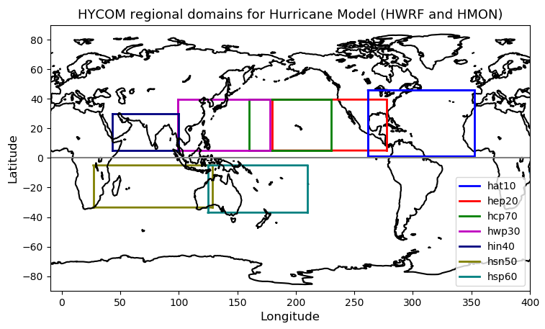
NOAA Hurricane Forecasting Models
HWRF/HYCOM
HMON/HYCOM
HWRF/POM
West
Pacific
Central
Pacific
East
Pacific
North
Atlantic
North
Indian
South
Indian
South
Pacific
HWRF – Hurricane Weather Research Forecasting Model
HYCOM – Hybrid Coordinate Ocean Model
HMON - Hurricanes in a Multi-scale Ocean-coupled Non- hydrostatic model
POM – Princeton Ocean Model
Notes:
Currently NOAA has there different coupled ocean-atmosphere hurricane models that operate in different regions. In the North Atlantic there are two model: the HMON/HYCOM and the HWRF/POM.

Slide 3
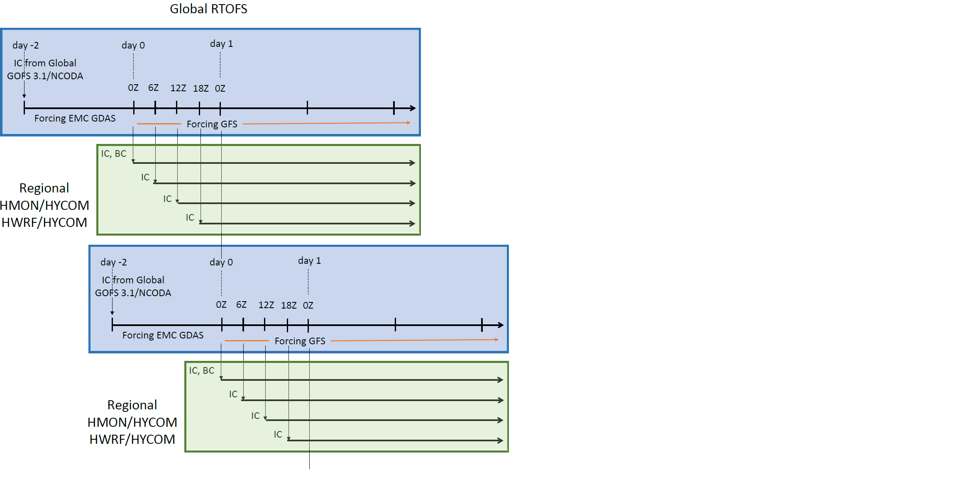

Slide 4
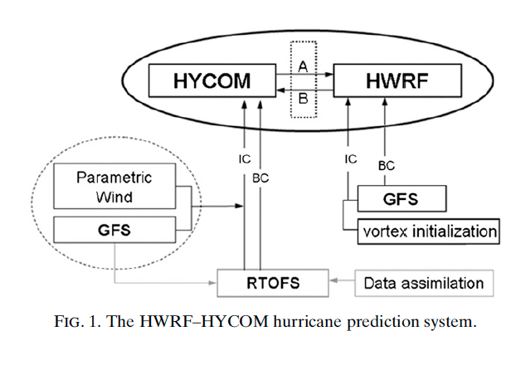
Forecasting Model: HWRF-HYCOM System
IC
IC
Kim et al. 2014
GOFS/NCODA
RTOFS – Real Time Ocean Forecasting System
GFS – Global Forecasting System
Notes:
This is a schematic of the workflow for the HWRF/HYCOM system. The right side shows the atmospheric component and the left side is the oceanic component. The IC and BC for the regional HYCOM come from the global RTOFS, that is the NOAA operational ocean model. At the same time, the IC for the global RTOFS comes from Global Ocean Forecasting System GOFS that is the Navy operational ocean model and implements data assimilation though NCODA that is the Navy coupled ocean data assimilations system. So in its current state, the NOAA hurricane forecasting models incorporates ocean data assimilation through the IC to their own global ocean model. NCEP is currently working to implement data assimilation directly into RTOFS.

Slide 5
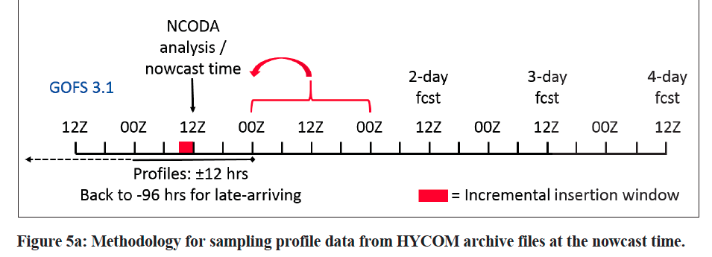
Time of NCODA increments ?
FGAT: First Guess at Appropriate Time

Slide 6
GOFS 3.1:
HYCOM version 2.2.99DH
Horizontal resolution: ~9km at equator, ~7km mid-latitude and ~3.5km at the North Pole
40 layers in the vertical. top 14 levels are sigma-z layers: Water shallower than 84 m is always in fixed depth coordinates. The top layer is 1 meter think everywhere
Wind forcing: reads in 10 m winds (from where?) and calculates the wind stress using HYCOM SST and HYCOM surface currents
Initialized from GDEM (Generalized Digital Environment Model) 4 climatology and uses GDEM 4.2 sea surface salinity (SSS) as its SSS climatology

Slide 7
Work Flow HMON/HYCOM and HWRF/HYCOM
Global GOFS 3.1/NCODA System
Nowcast
7-day frcst
0Z
12Z
0Z
Nowcast
1-day frcst
7-day frcst
0Z
12Z
0Z
0Z
0Z
12Z
0Z
0Z
0Z
Nowcast
1-day frcst
2-day frcst
7-day frcst
0Z
12Z
0Z
0Z
0Z
Global
RTOFS
NCODA Incremental Insertion Window

Slide 8
Work Flow HWRF/POM
Global GOFS 3.1/NCODA System
Nowcast
7-day frcst
0Z
12Z
0Z
Nowcast
1-day frcst
7-day frcst
0Z
12Z
0Z
0Z
0Z
12Z
0Z
0Z
0Z
Nowcast
1-day frcst
2-day frcst
7-day frcst
0Z
12Z
0Z
0Z
0Z
day -2
day 0
day 1
IC from Global
GOFS 3.1/NCODA
Global
RTOFS
0Z
6Z
12Z
18Z
0Z
Forcing EMC GDAS
Forcing GFS
IC, BC
Regional
HWRF/POM
IC
IC
NCODA Incremental Insertion
Window
IC

Slide 9
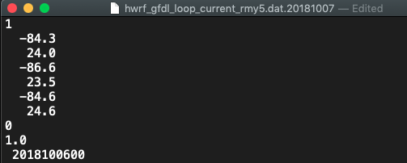
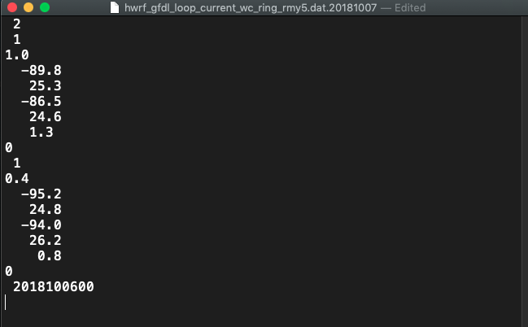
Input to POM feature model

Slide 10
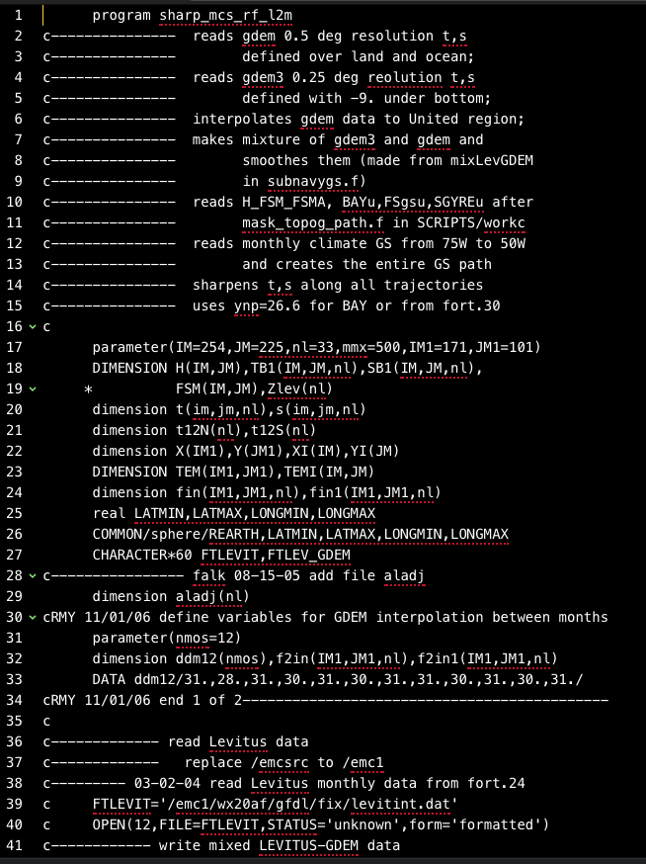

Slide 11
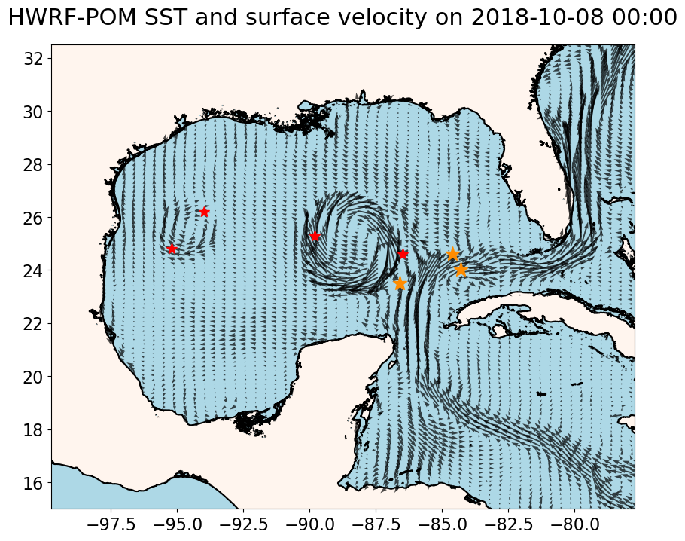
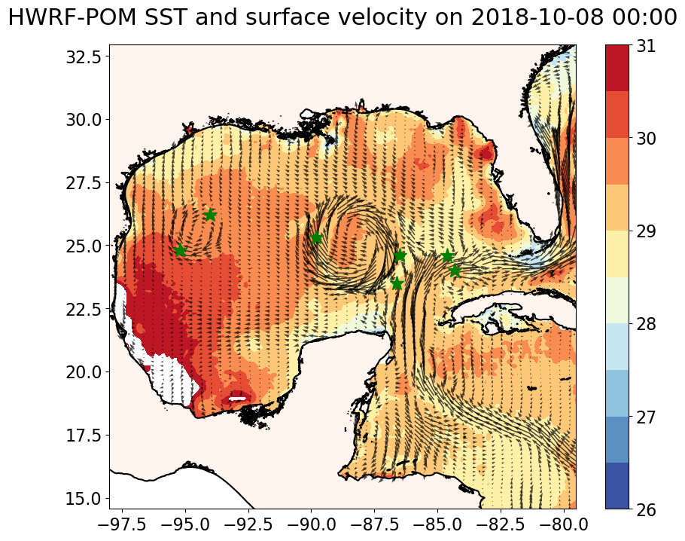
Input to feature models from loop current files (slide 9)

