Slide 1
NAVY-NOAA Hurricane Glider Hotwash

Slide 2
Project Overview
Dr. Gustavo Goni

Slide 3
Use of Gliders for Hurricane Intensity Forecasts
Gustavo Goni
National Oceanic and Atmospheric Administration Atlantic Oceanographic and Meteorological Laboratory Miami, Florida
NOAA NAVO Hurricane Glider Discussions Stennis Space Center, MS, Nov 2 2018

Slide 4
Role of the ocean in tropical cyclone intensification
The upper ocean heat content matters.
The upper ocean temperature, salinity, density matters.
Ocean numerical models that represent the ocean conditions assimilate T(z) and S(z).
Hurricane Katrina (2005)
Hurricane Katrina
Ocean observations allow to correctly represent the ocean conditions within a numerical model.

Slide 5
Reduction of errors in track and intensity forecasts
400
30
5
50
1990
2017
1990
2017
In average, error in intensity forecast has remained almost unchanged (for 48hs or less) and larger than 15 knots (for 72hs or more) during last 25 years
In average, these errors may represent one category above or below the actual hurricane intensity

Slide 6
Towards Better Intensity Predictions of Atlantic Tropical Cyclones
Objectives
Assess the impact of hurricane force winds on upper ocean density structure, and
Assess impact of ocean profile data in operational hurricane intensity forecasts.
2014 hurricane season
2015
2016
2017 2018
urricane Gonzalo (October, 2014)
H
TS Bertha (August, 2014)

Slide 7
Glider observations and ocean conditions during Hurricane Gonzalo (2014)
Pre-storm temperature conditions
Pre-storm salinity conditions
Observation (glider)
No data
HYCOM with no data assimilated
Observations
HYCOM with only glider data assimilated
With glider data
Dong et al, 2017
Barrier layer is only represented in numerical model fields when glider data are assimilated

Slide 8
Glider observations, ocean conditions, and intensity forecast during Hurricane Gonzalo (2014)
Hurricane Gonzalo (2014)
Assimilation of underwater glider data along with other ocean observations reduced the error on Hurricane Gonzalo intensity forecast in approximately 50% using the next generation ocean-atmosphere coupled HYCOM – HWRF model.
Minimum Pressure
No data
All ocean data
Observations
Maximum sustained winds
Observations
Current work: Assess the impact of ocean data in 2017 Atlantic hurricanes
All ocean data
No data
Dong et al, 2017

Slide 9
Use of Gliders for Hurricane Intensity Forecasts
The ocean is important to forecast intensification or weakening of tropical cyclones;
All ocean data, in situ or from remote sensing, have an impact;
It is key to detect ocean warm features, barrier layers, deep cold waters in coastal areas;
It is key to correctly represent the temperature and salinity in the upper (~150m) of the ocean in operational forecast models;
All data have to be assimilated into forecast models. We need to assess what data (and why) are not assimilated into numerical models;
We need to assess the impact of each individual observing platform to better represent the upper ocean conditions;
This is a multi-platform, multi-institutional (government, academic, private industry) effort;
Need to assess all assets that will be available during upcoming hurricane seasons.

Slide 10
Use of Gliders for Hurricane Intensity Forecasts

Slide 11
Mid-Atlantic Bight
Dr. Travis Miles

Slide 12
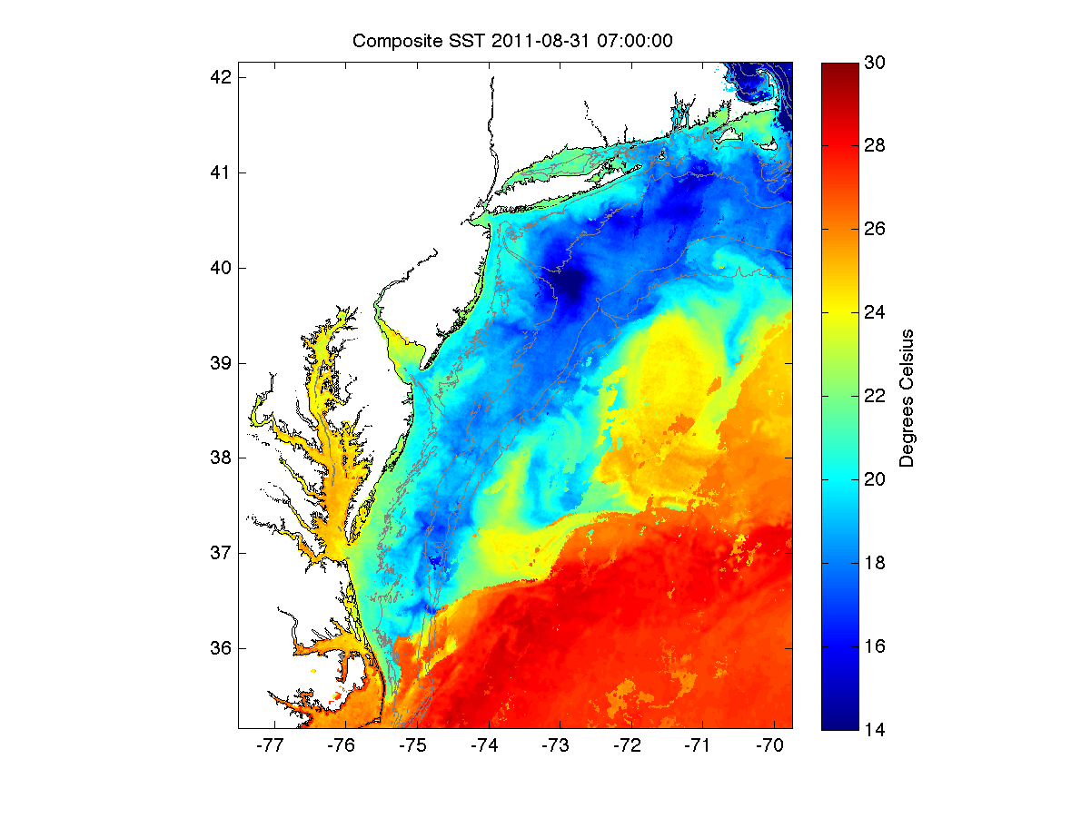
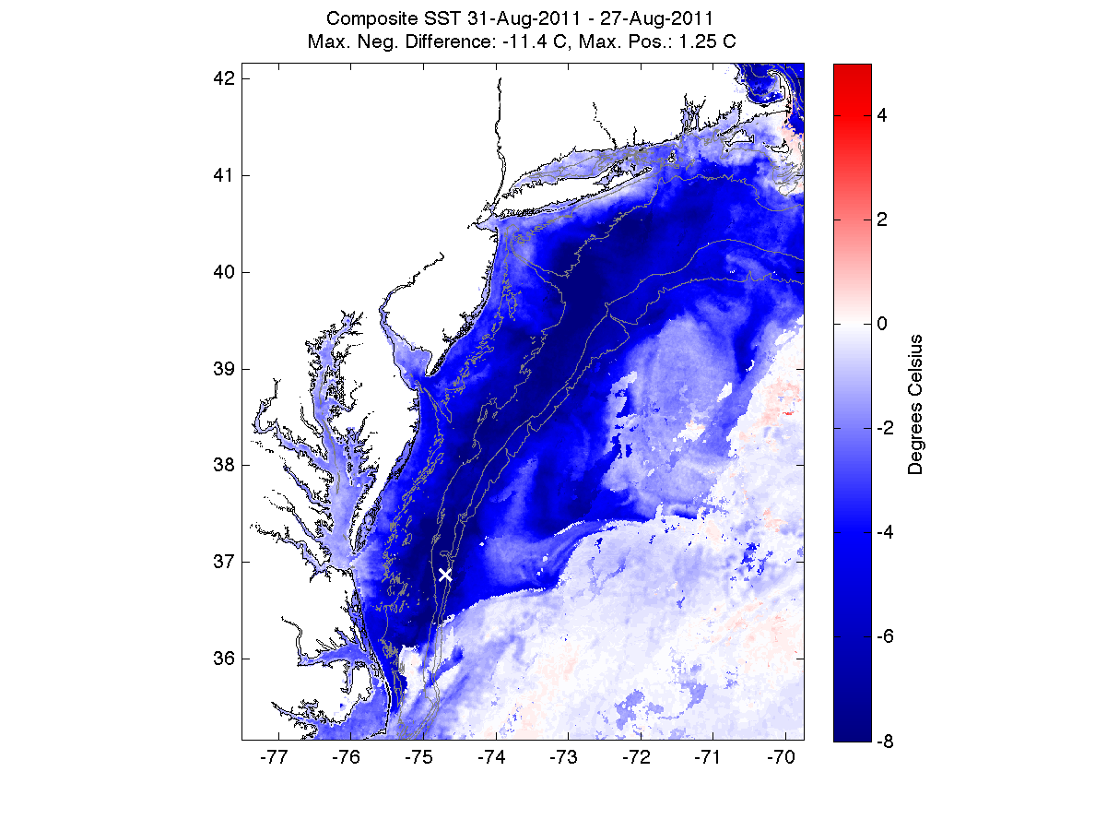
Pre-Irene
Post-Irene
Difference
11C max Cooling
Satellite
SST
Lentz et al., 2017
August Cold Pool Temperature Climatology
August Cold Pool Temperature Climatology
COSEEnow.net
Nature Communications (2016)

Slide 13
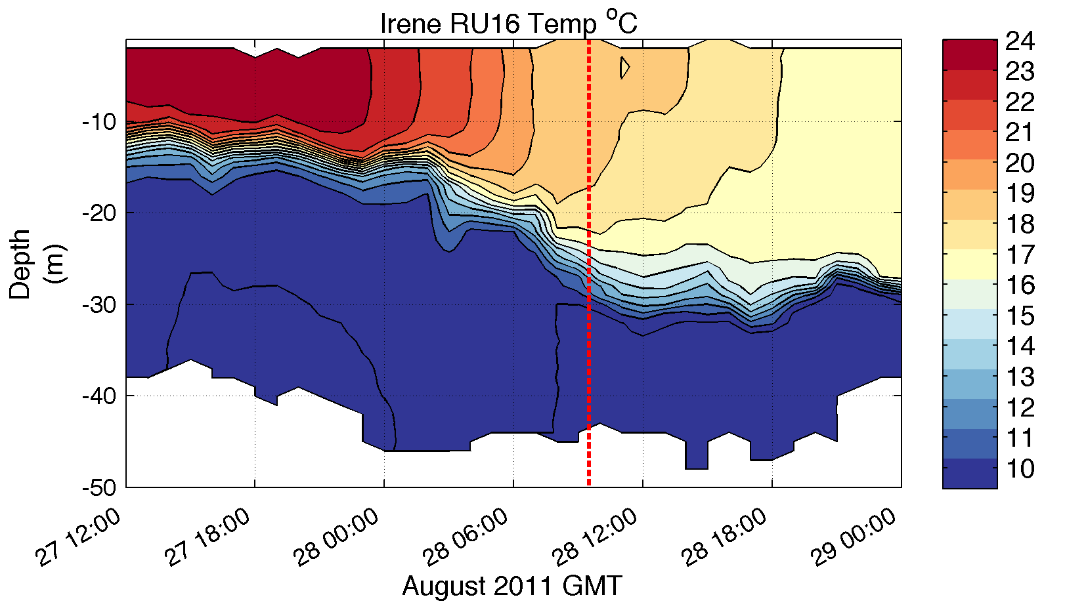
Essential Ocean Feature - Mid-Atlantic’s Cold Pool
WHAT?
11C max Cooling
Satellite
SST
Pre-Irene
Post-Irene
Difference
WHEN? Glider Temperature
WHY?
HF Radar
Currents
Eye Passage

Slide 14
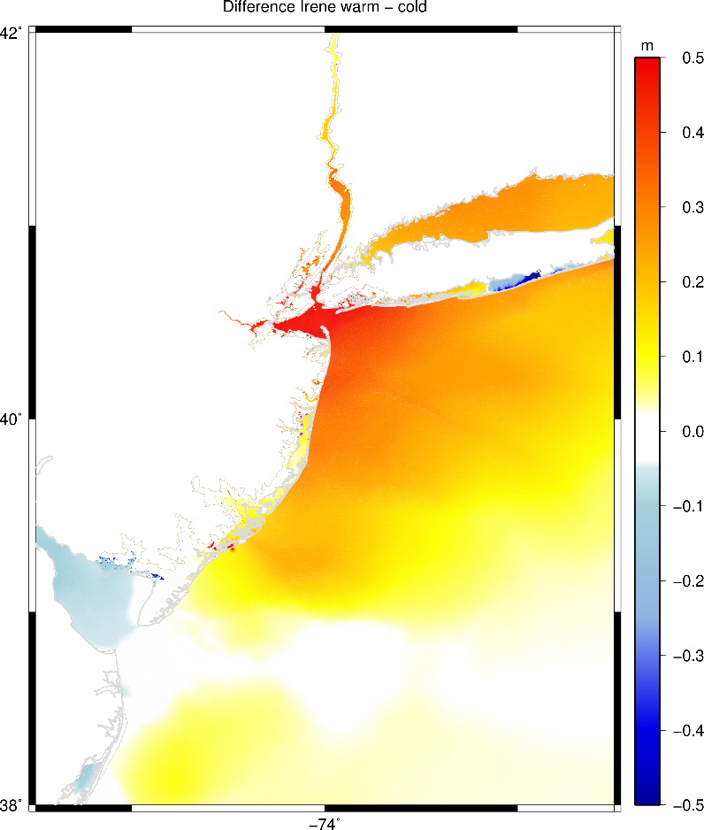
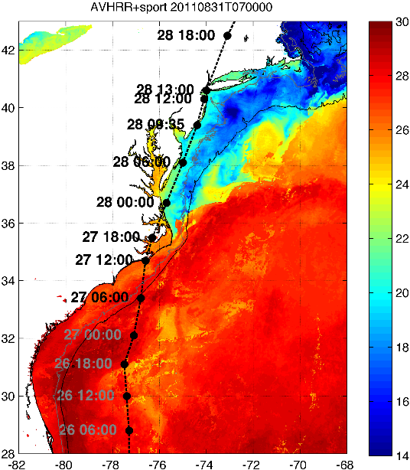
WRF Atmospheric Forecast Sensitivity Study – >130 tests
ADCIRC Storm Surge Model Sensitivity
0.5 Meter Difference in forecast for > 20 million people

Slide 15
South Atlantic Bight
Dr. Catherine Edwards

Slide 16
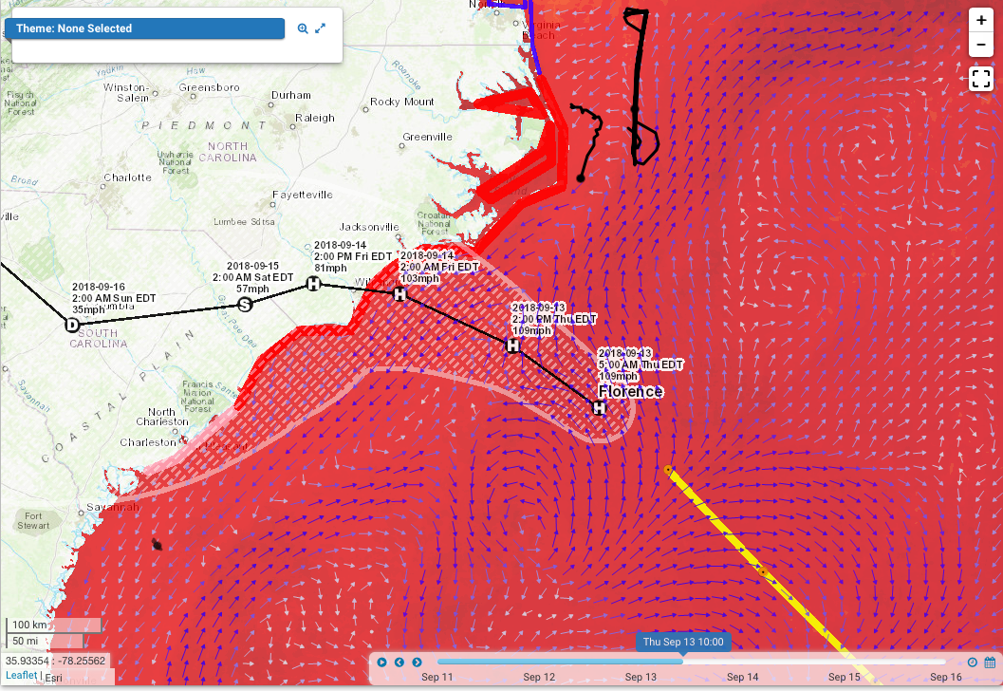
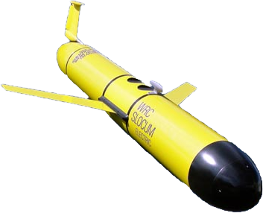
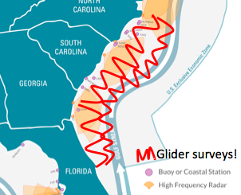
South Atlantic Bight shelf gliders
Projected path, deployed gliders as of 10am September 13 (~24 hours before landfall)
Ramses summary: GOFS 3.0, 3.1 way overpredict stratification, T/S stratification GOFS 3.1 >>> GOFS 3.0
Glider: Ramses, deployed Friday 9/7 off Cape Hatteras
Glider: Pelagia, deployed Monday 9/10 off Hilton Head
Pelagia summary: GOFS 3.0, 3.1 overpredict thermal stratification, overall salinity GOFS 3.1 > GOFS 3.0
16

Slide 17
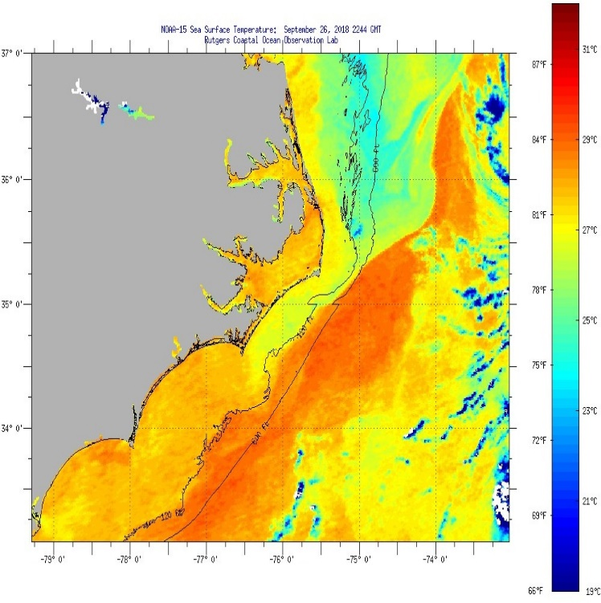
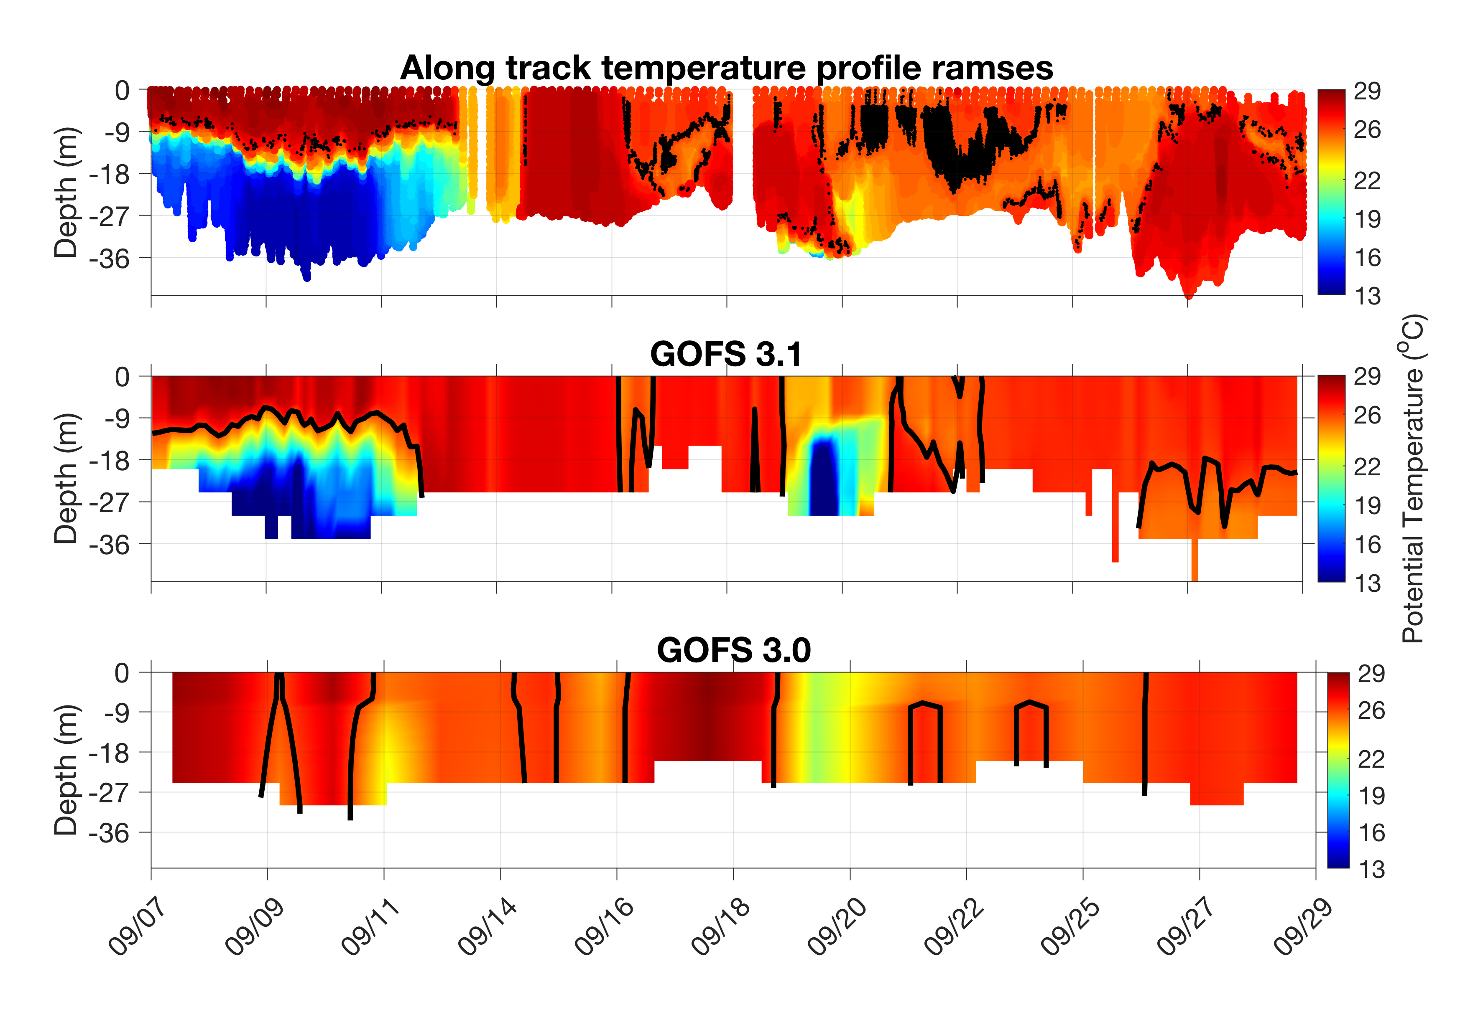
Capturing sharp T/S fronts
SST, 9/26
Along track temperature, deg C
courtesy M. Aristizabal Vargas, Rutgers
Along track salinity
Improved frontal representation Small scale spatial variability difficult to resolve Opportunity for validation using PEACH mooring array data, SECOORA/PEACH assets
max glider ΔS=13psu

Slide 18
Puerto Rico
Dr. Julio Morell

Slide 19
REGIONAL OCEAN FEATURES THAT MAY DRIVE HURRICANE INTENSIFICATION
Density driven barrier layers
River plumes
Warm water “blobs”
Eddies

Slide 20
RIVERINE INPUT
10/31/2018. Dr. Hu, USF
Optical Oceanography Lab.

Slide 21
EDDIES

Slide 22
BOTH!!

Slide 23
WARM WATER BLOBS

Slide 24
US Virgin Islands
Doug Wilson

Slide 25
NAVY/NOAA Hurricane Glider Activities – USVI
Hot Wash 2 November 2018 Naval Oceanographic Office, Stennis Space Center, MS
Presented by Doug Wilson, CARICOOS - OCOVI

Slide 26
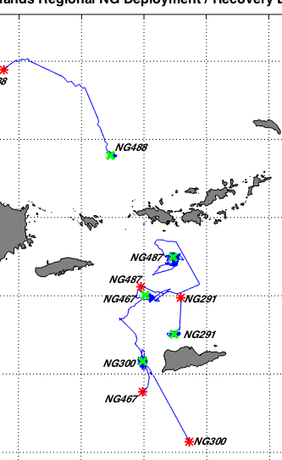
VI Glider Tracklines
Glider ID:
NG488-STT North
NG487-STT South
NG300-STT West
NG467-VI Basin West
NG291-STX North
Green X = Glider Deployment Site
Red * = Glider Recovery Site

Slide 27
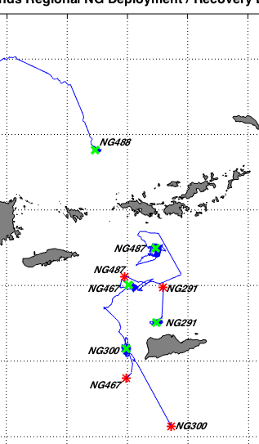
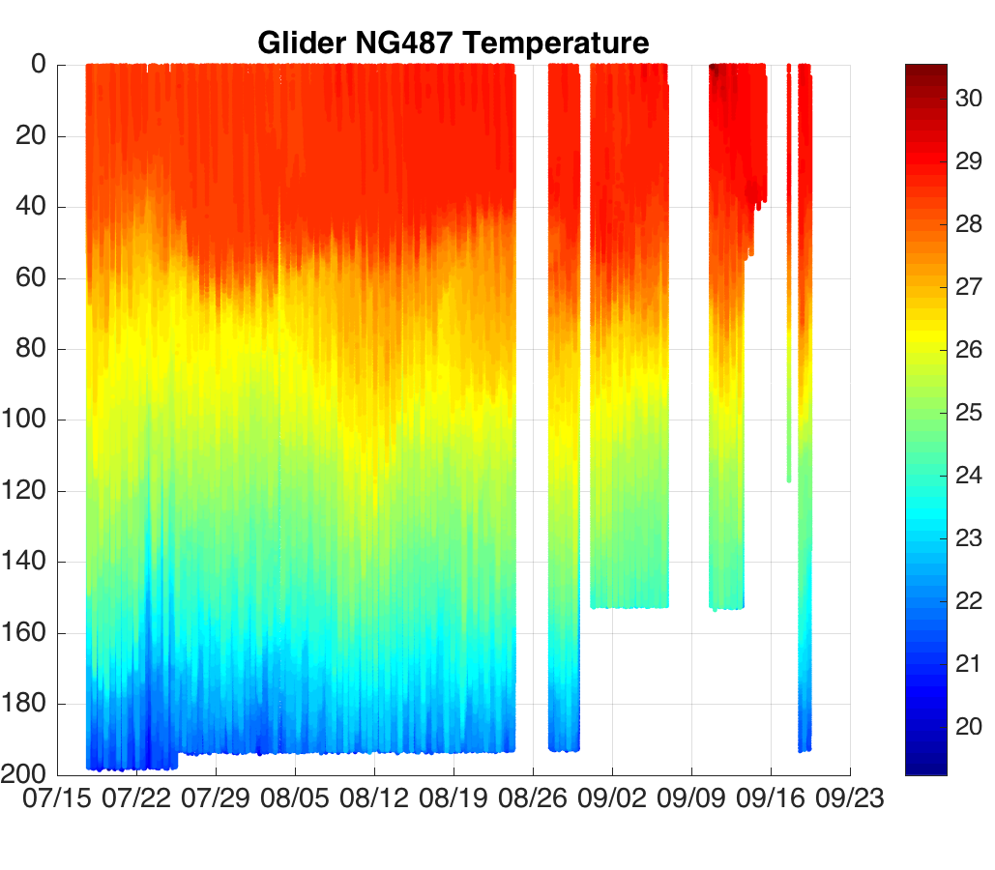
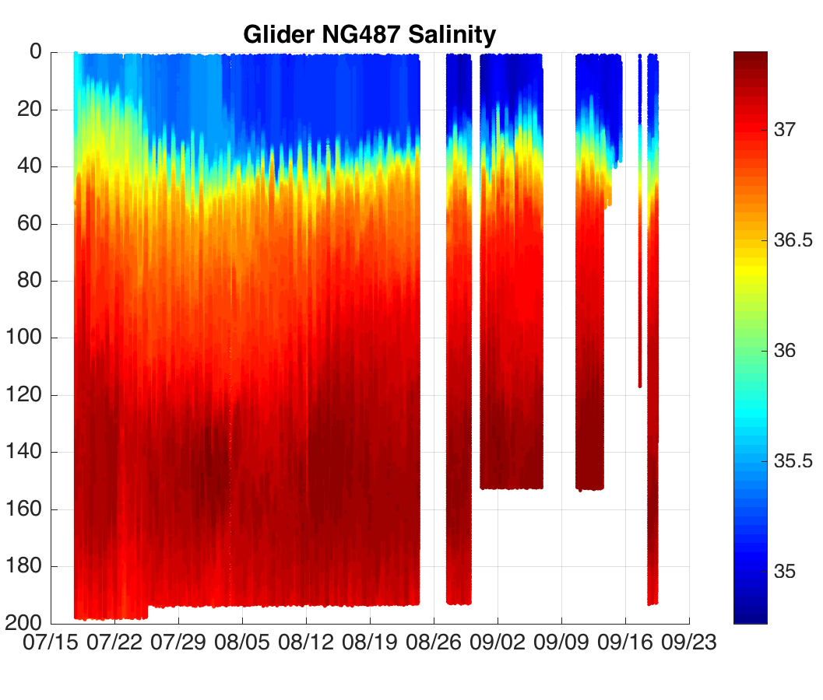
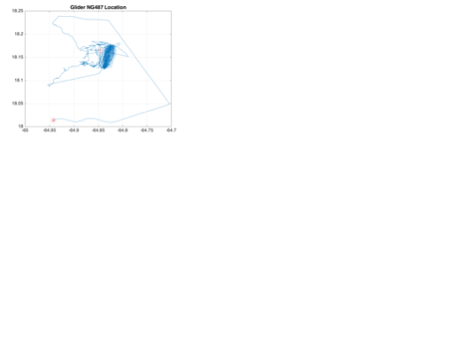
NG487 (STT-S) Glider Track
Glider deployment duration = 64 days
✻

Slide 28
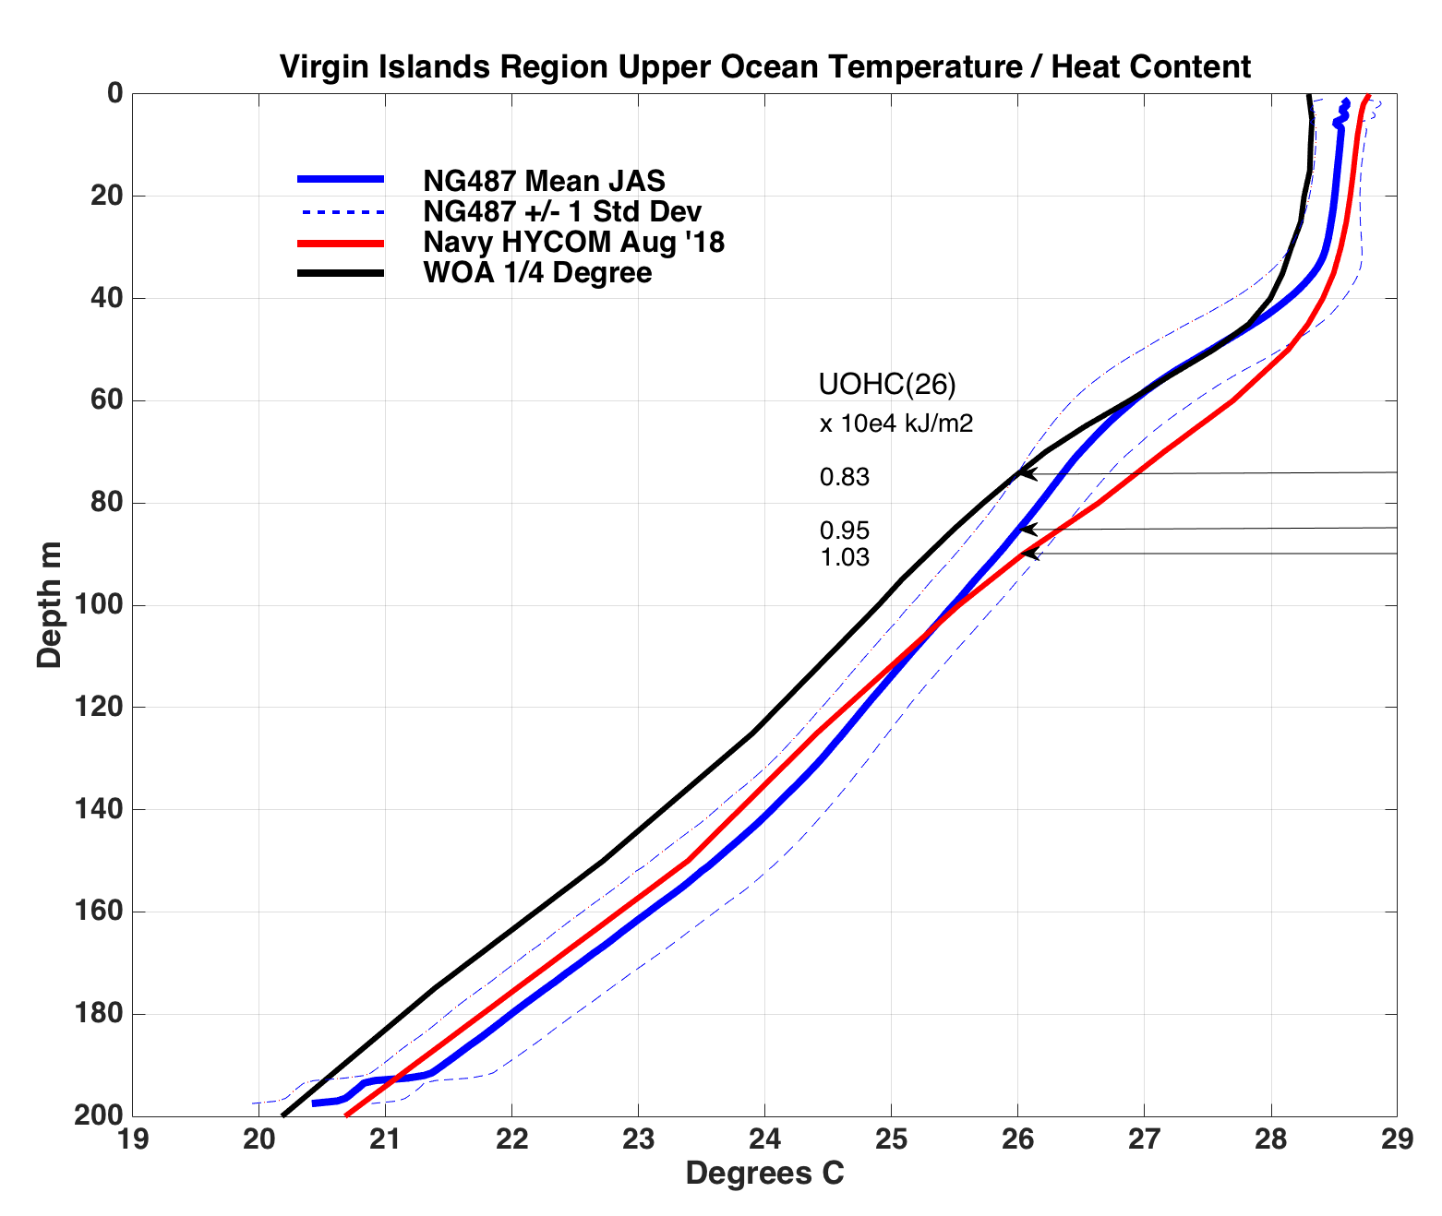
NG487 Temperature and Upper Ocean Heat Content (UOHC)
Compared to Regional Means of:
NAVY GHYCOM @ 1/12 °
World Ocean Atlas (WOA) ¼ °)
UOHC (Surface to 26° , x10⁴ kJ/m²⁾
NG487 (Blue) = 0.95
GHYCOM (Red) = 1.03
WOA (Black) = 0.83

Slide 29
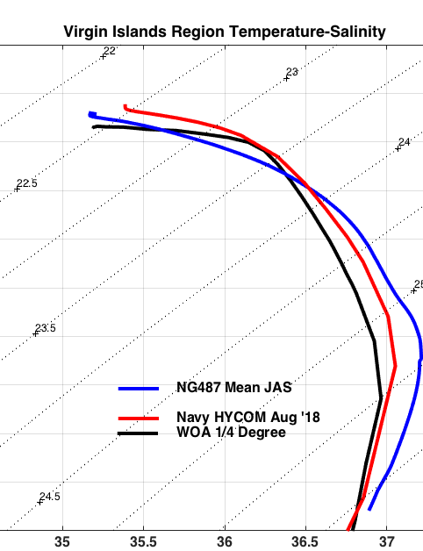
NG487 Mean
Temperature - Salinity
Compared to Regional Means of:
NAVY GHYCOM @ 1/12 °
World Ocean Atlas (WOA) ¼ °)
Model and WOA underestimate
Observed Subtropical Underwater Salinity maximum

Slide 30
2018 Hurricane Season Report
NAVY Focus

Slide 31
Puerto Rico Report

Slide 32
Use of Gliders for Hurricane Intensity Forecasts 2018 NOAA NAVO Hurricane Glider Operations
Gustavo Goni
National Oceanic and Atmospheric Administration Atlantic Oceanographic and Meteorological Laboratory Miami, Florida
Work by scientists, engineers, science support, students from: NAVO, NOAA/AOML, University of Miami, IOOS Regional Associations, Rutgers University, Univ. Virgin Islands, University of Puerto Rico, ….
NOAA NAVO Hurricane Glider Discussion Stennis Space Center, MS, Nov 2 2018

Slide 33
Towards Improving Intensity Forecasts of Atlantic Tropical Cyclones
Objective
Increase number of in situ observations of upper ocean thermal and salinity profiles in the tropical Atlantic Ocean and Caribbean Sea during the 2018 Atlantic hurricane season

Slide 34
Glider Observations in the Tropical Atlantic and Caribbean Sea During 2018 Hurricane Season
Navy: Slocum G3 (200m deep) NOAA: Seaglider (1000m deep)

Slide 35
NOAA/AOML – CARICOOS and NAVO Observations in the Tropical Atlantic and Caribbean Sea During 2018
hurricane season
ID | Deployment |  | Recovery |  | Days at sea | Total number or profiles
 | Location | Date | Location | Date
NG616 | 18° 48.000'N; 66° 45.000'W | 07/17/ 2018 | 18° 47.827'N; 66° 44.187'W | 07/20/ 2018 | 3 | 119
NG617 | 18° 48.000'N; 66° 45.000'W | 07/17/ 2018 | 18° 56.495'N; 65° 53.542'W | 09/06/ 2018 | 51 | 1991
NG618 | 18° 47.475'N; 66° 00.487'W | 07/19/ 2018 | 19° 02.119'N; 67° 14.319'W | 09/24/ 2018 | 67 | 3086
NG619 | 18° 47.827'N; 66° 44.187'W | 07/20/ 2018 | 18° 29.337'N; 65° 59.252'W | 09/06/ 2018 | 48 | 2259
NG302 | 18° 47.475'N; 66° 00.487'W | 07/19/ 2018 | 19° 09.432'N; 66° 16.924'W | 09/19/ 2018 | 62 | 3315
 |  |  |  | Total | 231 | 10,770

Slide 36
NOAA/AOML – CARICOOS and Navy Glider observations in the tropical Atlantic and Caribbean Sea during 2018
hurricane season
Navy gliders totals:270 (USVI), 231 (PR) = 501 days; approx.
23,000 shallow profiles
NOAA gliders totals: ~100 days (still underway); approx. 4,000 deep profiles

Slide 38
Towards Improving Intensity Forecasts of Atlantic Tropical Cyclones
(GTS) In situ ocean observations during July 1
– September 30, 2018
Gliders provided more than 99% of profile observations.
The number of non-glider observations have no impact in the representation of the ocean in the models during hurricane season.

Slide 39
Towards Better Intensity Forecasts of Atlantic Tropical Cyclones
Partnership between NOAA and US Navy significally increased (by
~20,000) the number of profiles obtained in the tropical Atlantic and Caribbean Sea.
Logistics were put rapidly in place: glider port, storage, vessels, personnel, students, ….
Excellent communications between NOAA and NAVO GOC
Data inserted into GTS, publicly available to scientists and data centers

Slide 40
USVI Report

Slide 41
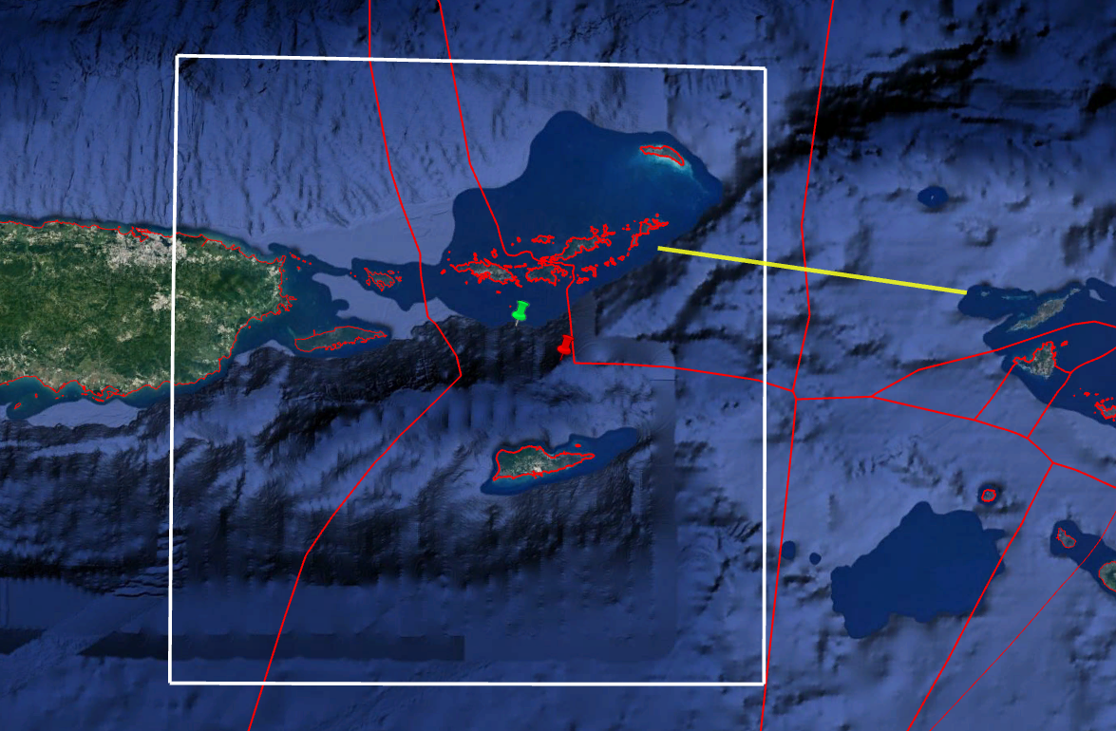
VI Glider Deployment OPAREA
Showing
Relevant EEZ boundaries
Bounding box for G-HYCOM and WOA means
NG487 (STT_S) Deployment and Recovery Locations
Anegada Passage, principal connection between VI Basin and Atlantic Ocean
US
PR
NG88 Deploy
Anegada Passage
Anguilla (UK)
STT
NG487 Deploy
BVI (UK)
N467 Deploy
NG487 Recover
NG291 Deploy
NG300 Deploy
STX
Saba
(Netherlands)
US USVI

Slide 42
VI Glider Tracklines
Glider ID:
NG488-STT North
NG487-STT South
NG300-STT West
NG467-VI Basin West
NG291-STX North
Green X = Glider Deployment Site
Red * = Glider Recovery Site

Slide 43
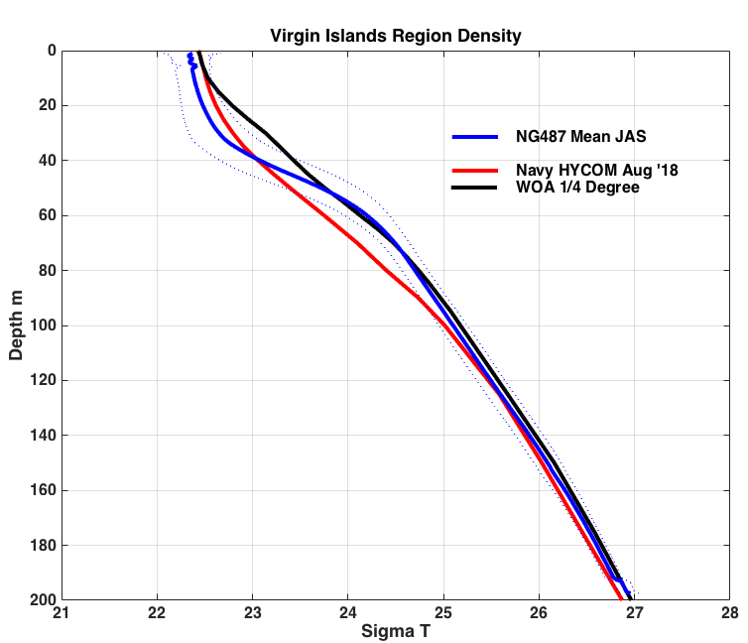
NG487 Mean Density
(Sigma-T)
Compared to Regional Means of:
NAVY GHYCOM @ 1/12 °
World Ocean Atlas (WOA) ¼ °)

Slide 44
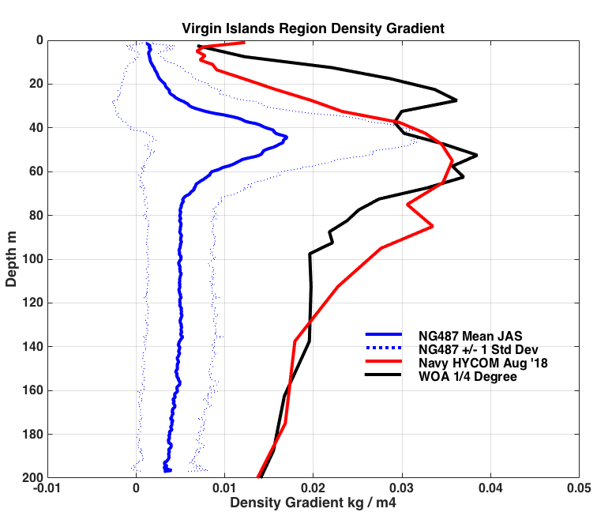
NG487 Mean Density Gradient
kg m⁻⁴
Compared to Regional Means of:
NAVY GHYCOM @ 1/12 °
World Ocean Atlas (WOA) ¼ °)
45m

Slide 45
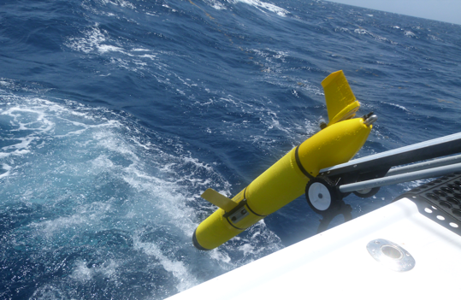
Summary
One glider NG488 (STT N) mission terminated due to broken Digi-Fin
Two gliders dropped weights and were recovered drifting
NG291, STX N, no tickle (16 hr?) what is setting?
NG300, STX W
Two gliders were held at surface and recovered due to ‘diving difficulties’
NG467, VI Basin W
NG487, STT S
For USVI, total cost was about $20K, most of which went to deployments, recoveries, logistics (Private Sector, University of the Virgin Islands). Thank you US IOOS!
Broken Digi-Fin NG488
Glider Launch in USVI
Photo Belize Saunders, UVI

Slide 46
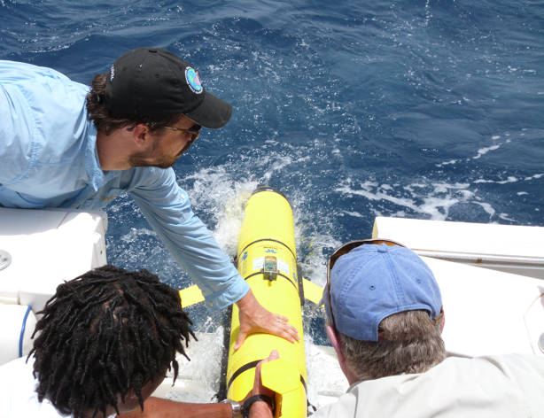
Summary
Established local procedures and support, with OCOVI/UVI commitment to further glider projects. Let’s do it again!
Engaged public through outreach, 8 UVI (HBCU) students involved
Dramatically increased available data in VI Region
(WOD archive over last 20 years has only 18 CTD/Float profiles!)
Bonus applications to ongoing research (see extra slides)
How can we improve longevity? (full battery life, full hurricane season)
Can we get full data sets, including data missed by IOOS Glider DAC?
Glider Launch in USVI
Photo Belize Saunders, UVI

Slide 47
Gulf of Mexico Report

Slide 48
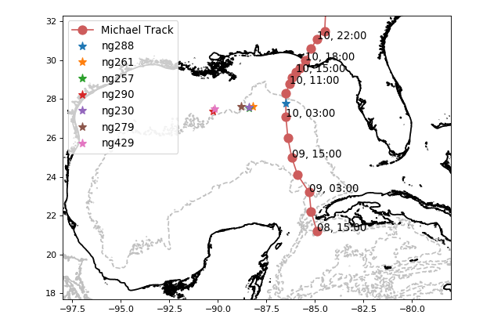
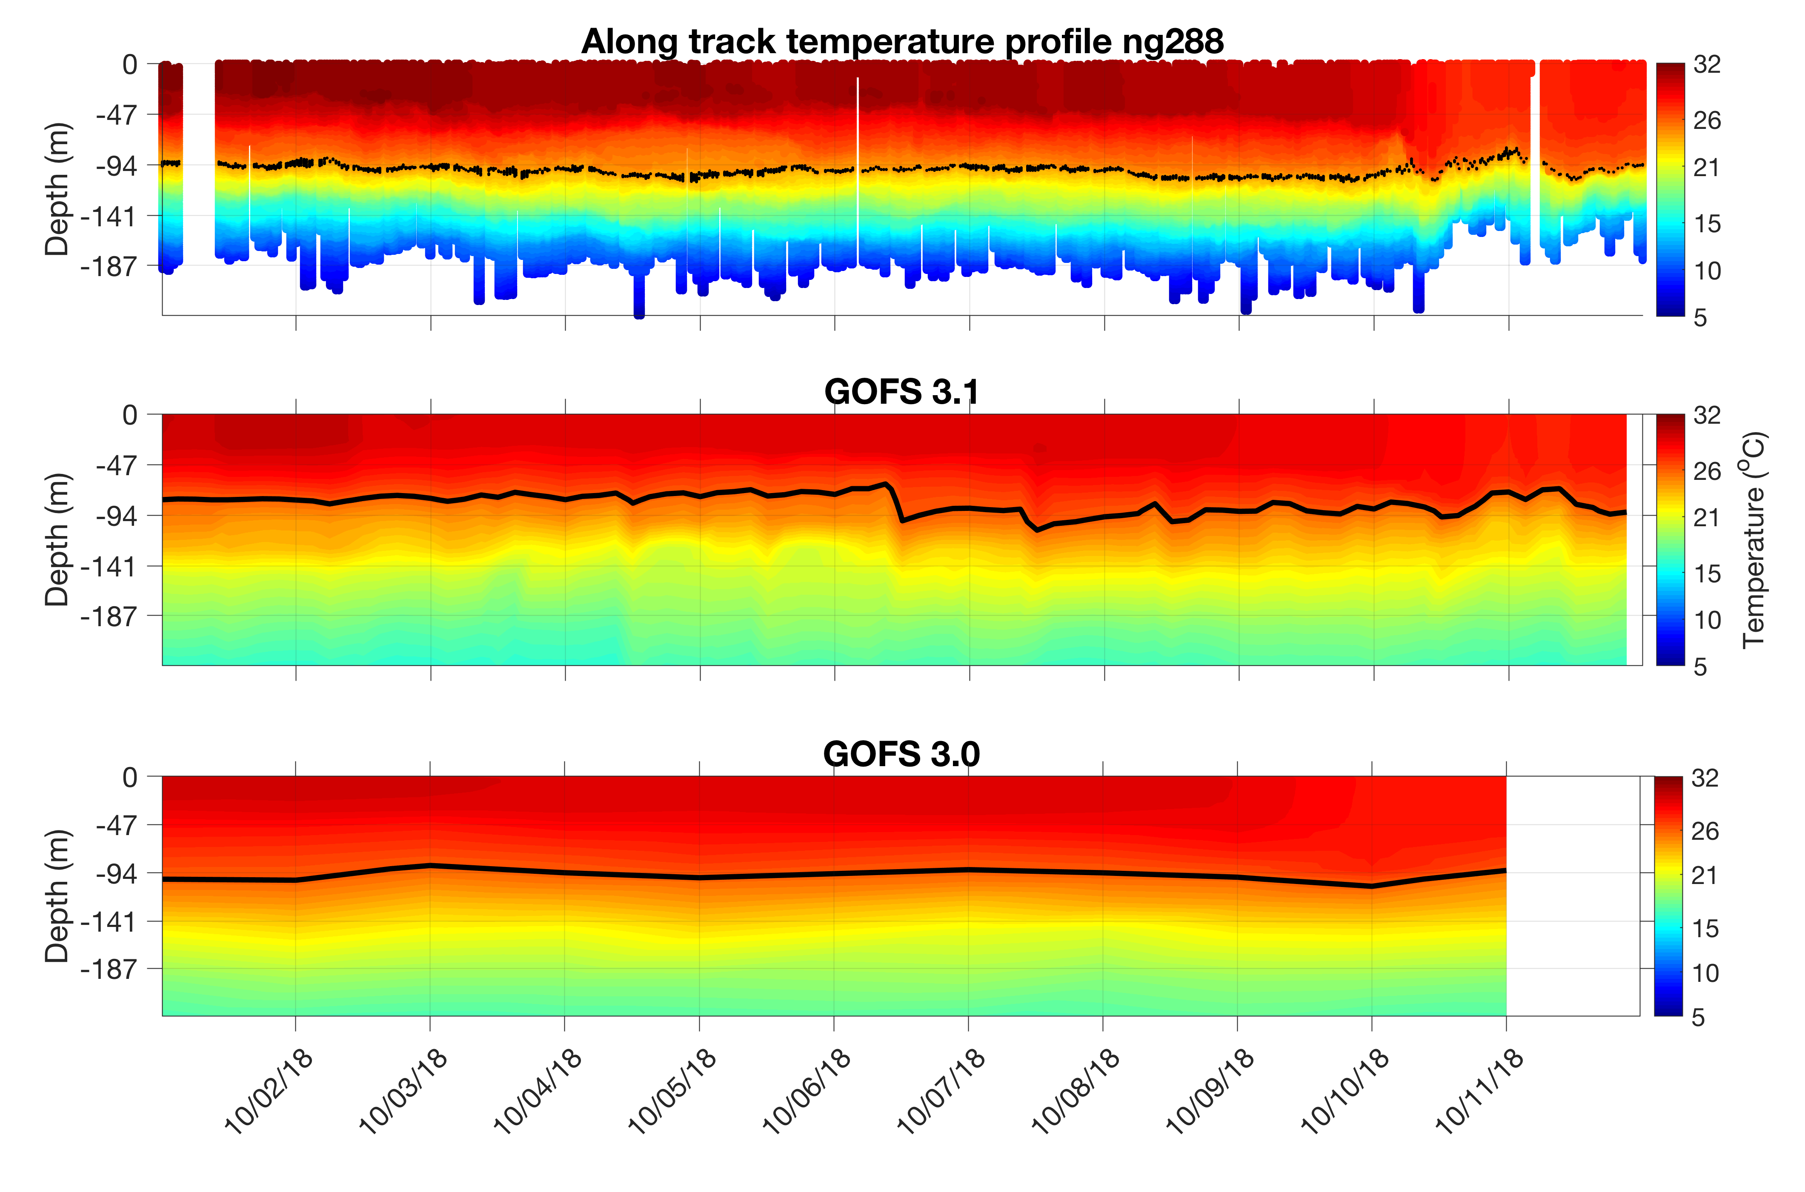
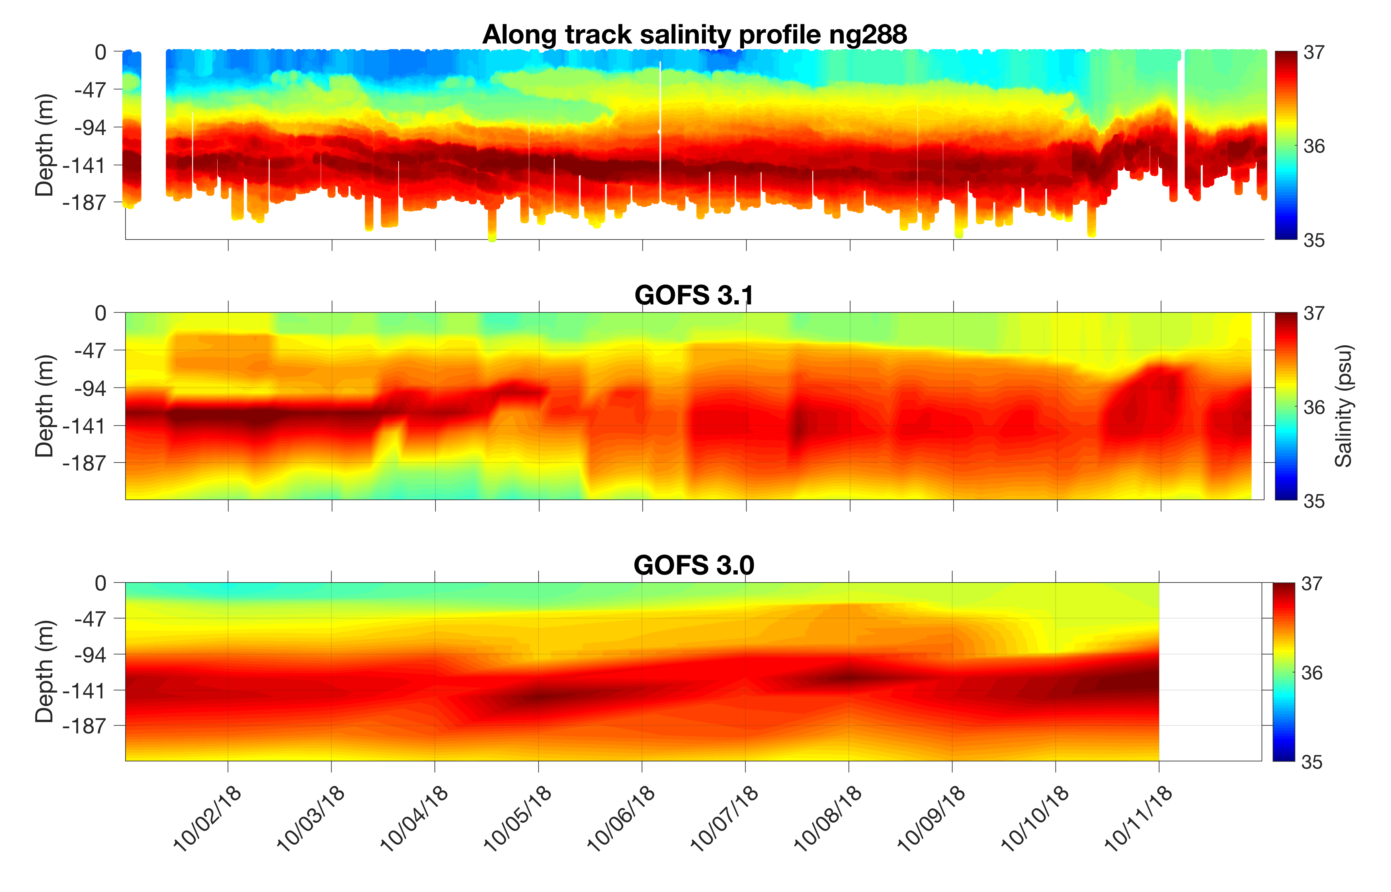
Hurricane Michael - 2018
Michael

Slide 49
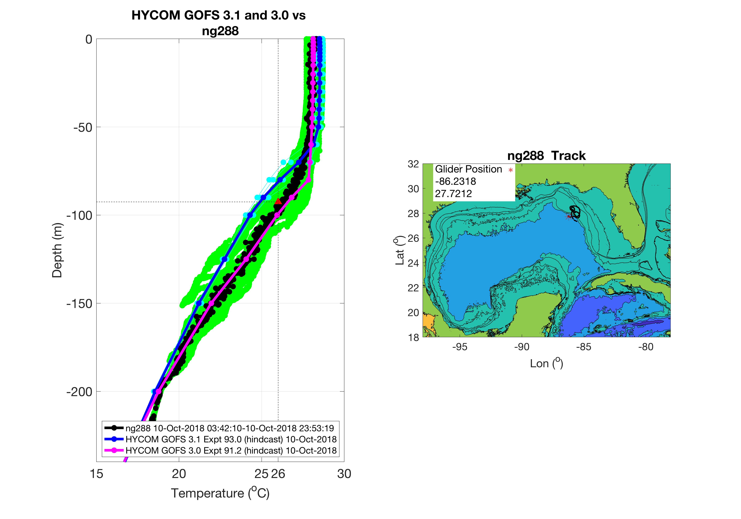
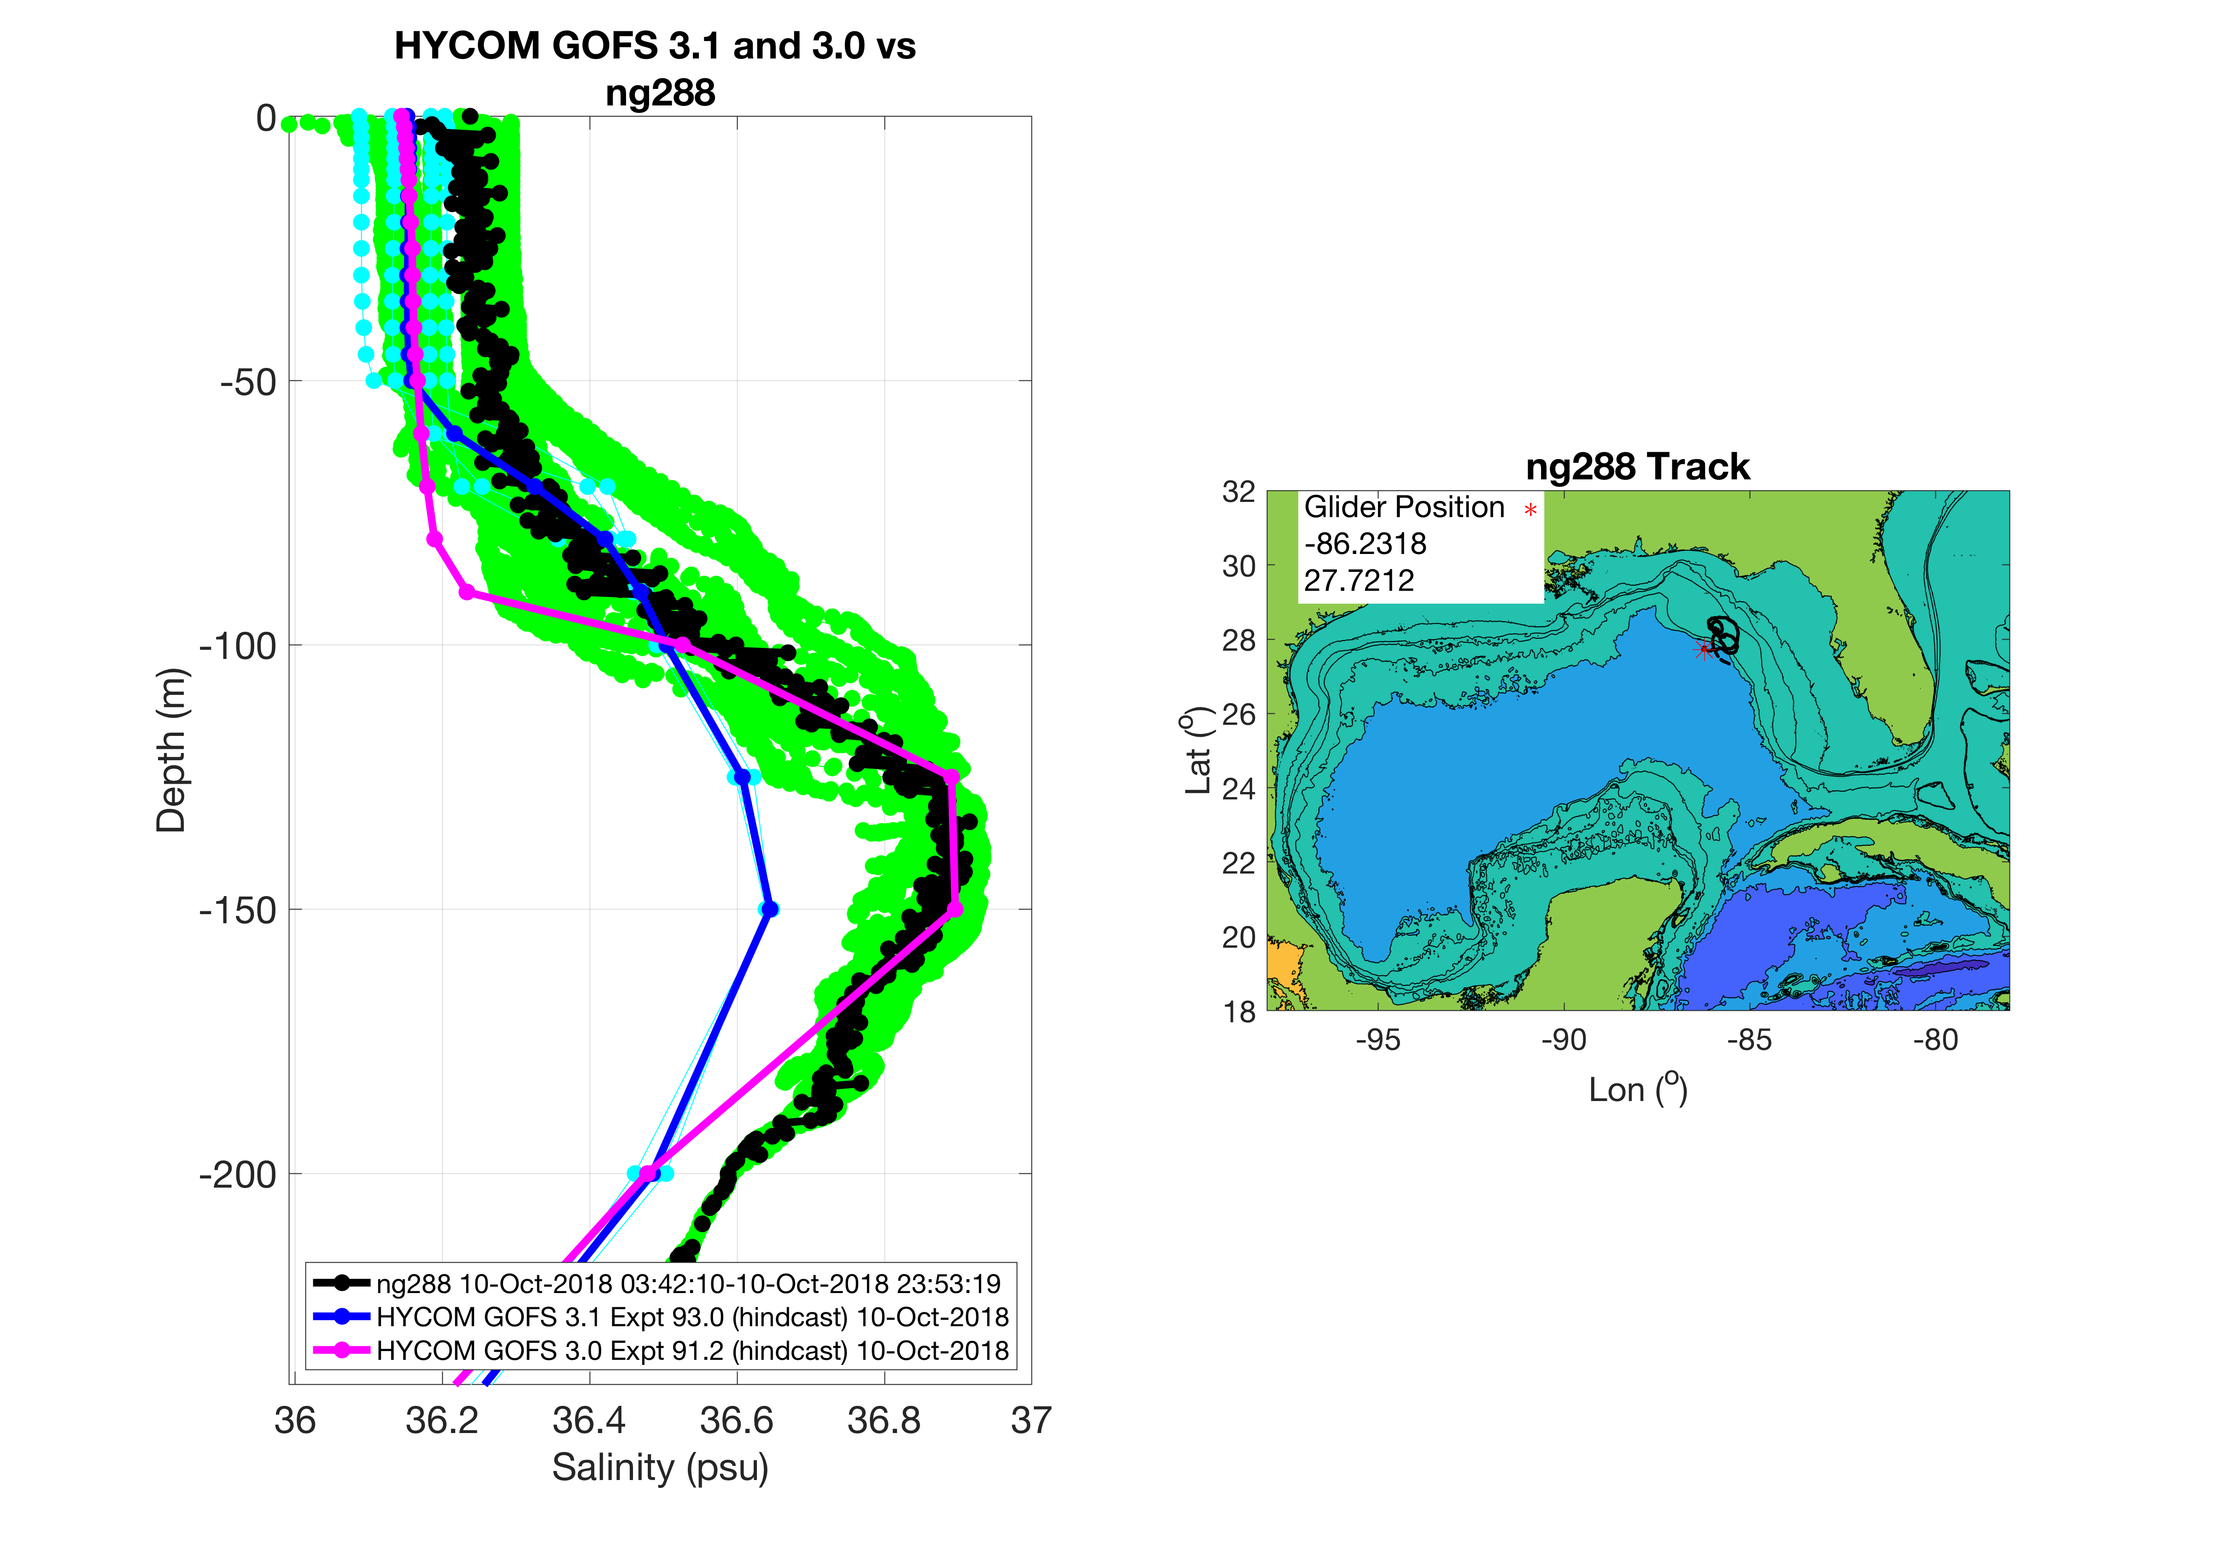
Hurricane Michael - 2018
Sep 10
Notes:
Both models accurately estimate surface temperate and the depth of the surface mixed layer. GOFS 3.1 underestimates the depth of the 26 degrees isothermal
Both models closely estimate surface salinity but there are discrepancies in the vertical profile at depth

Slide 50
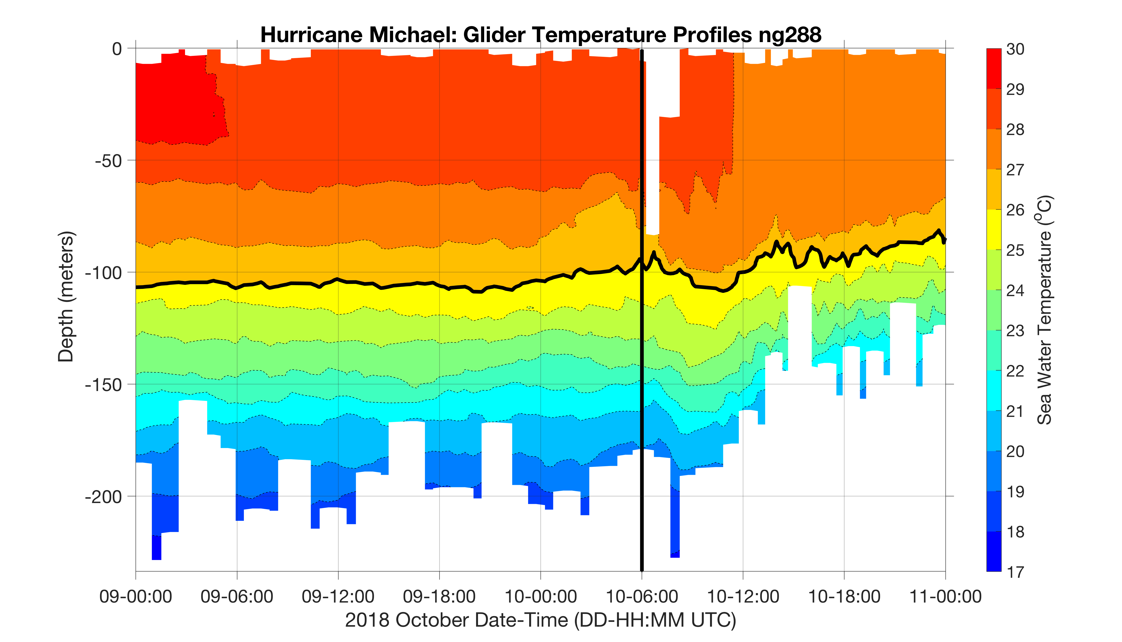
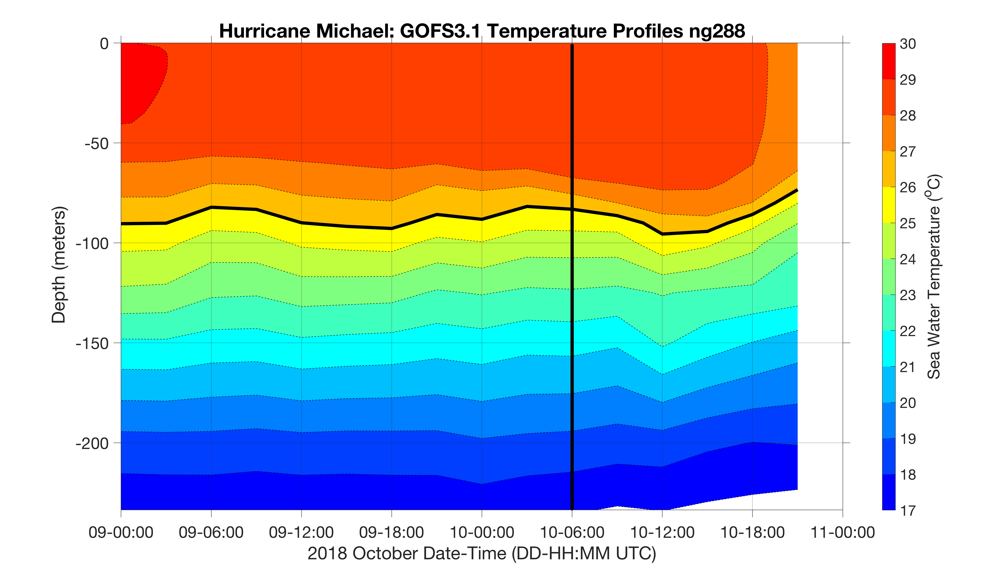
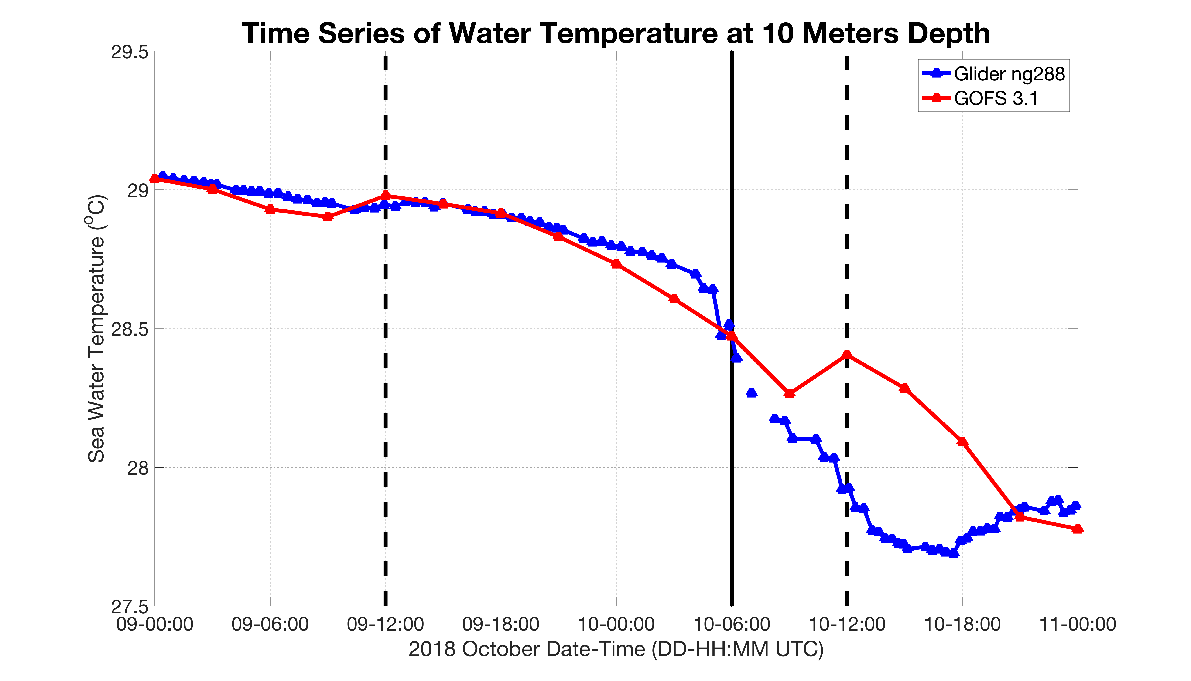
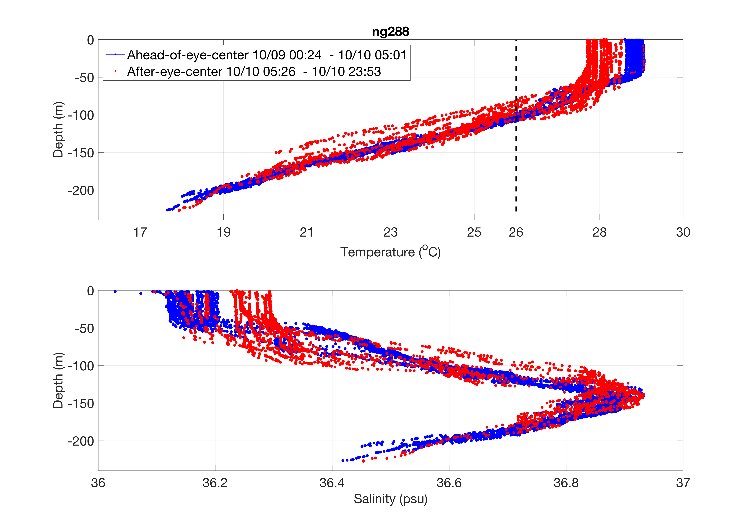
Hurricane Michael - 2018
Notes:
After the eye passage, there is a cooling (~ 0.8 degrees) and deepening (~ 30 meters) of the surface layer. GOFS 3.1 estimates closely the surface temperature and the cooling rate ahead-of-eye-center, but underestimates the magnitude of the cooling after the eye passage

Slide 51
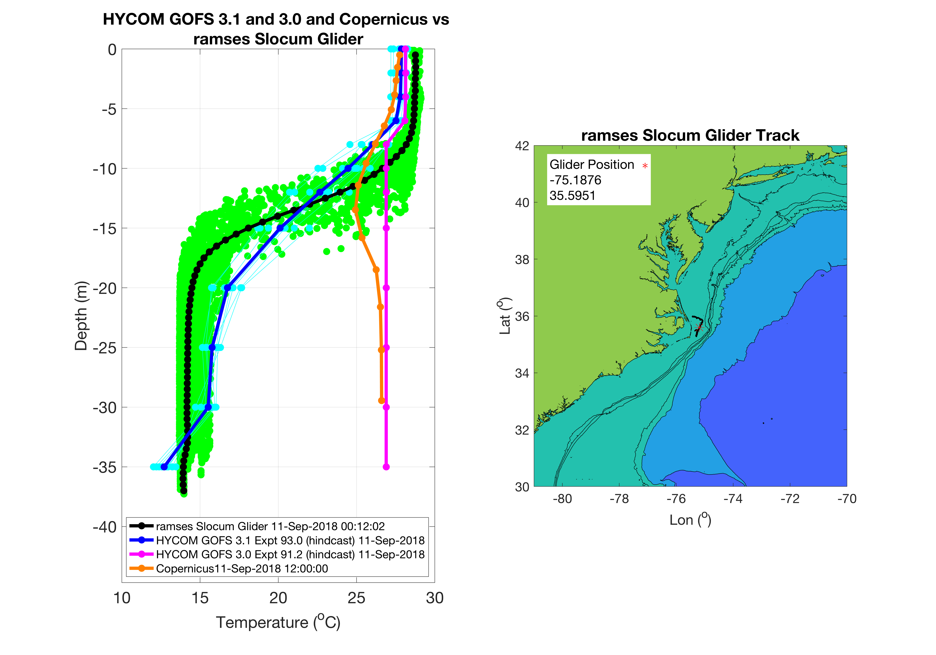
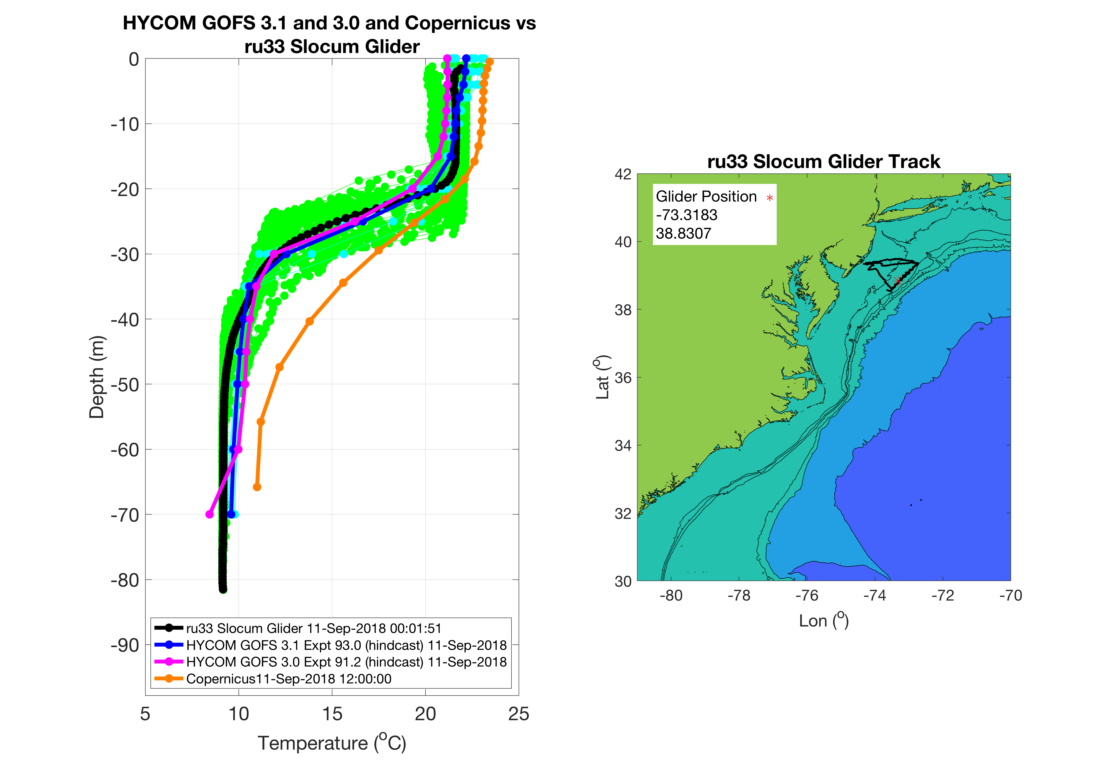
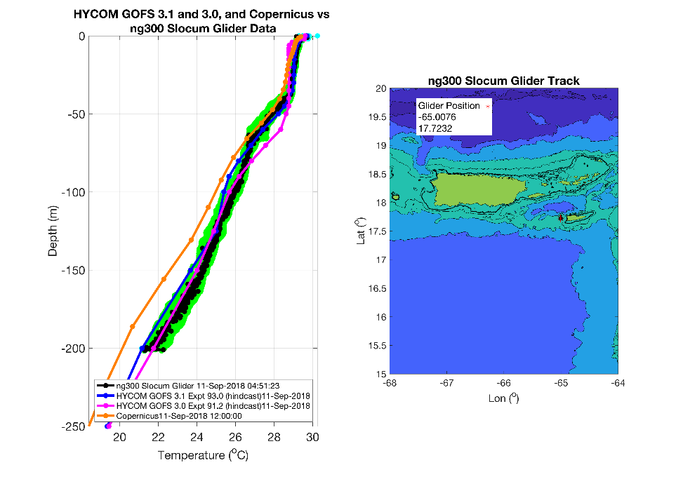
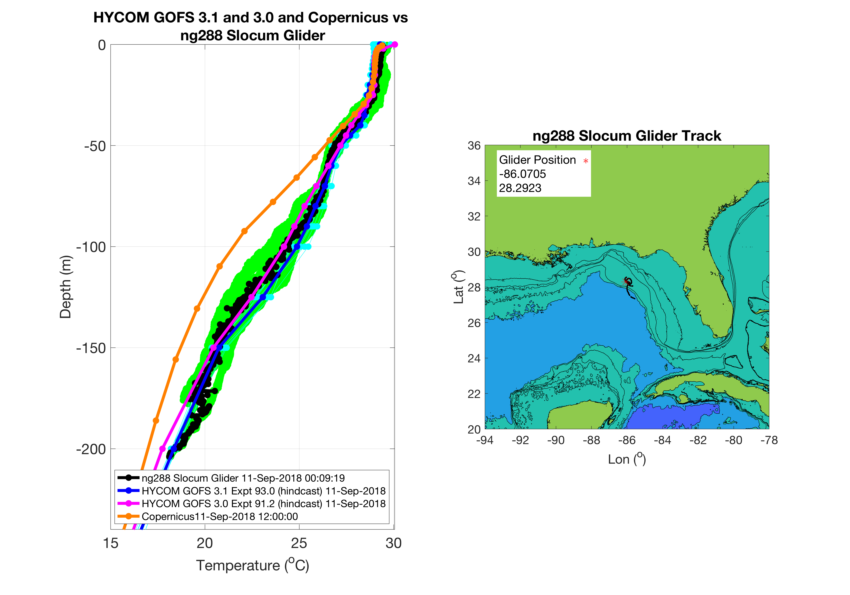
Evaluating Essential Ocean Features
Cape Hatteras Fronts
MAB Cold Pool
Caribbean Passages
Gulf of Mexico Loop Current

Slide 52
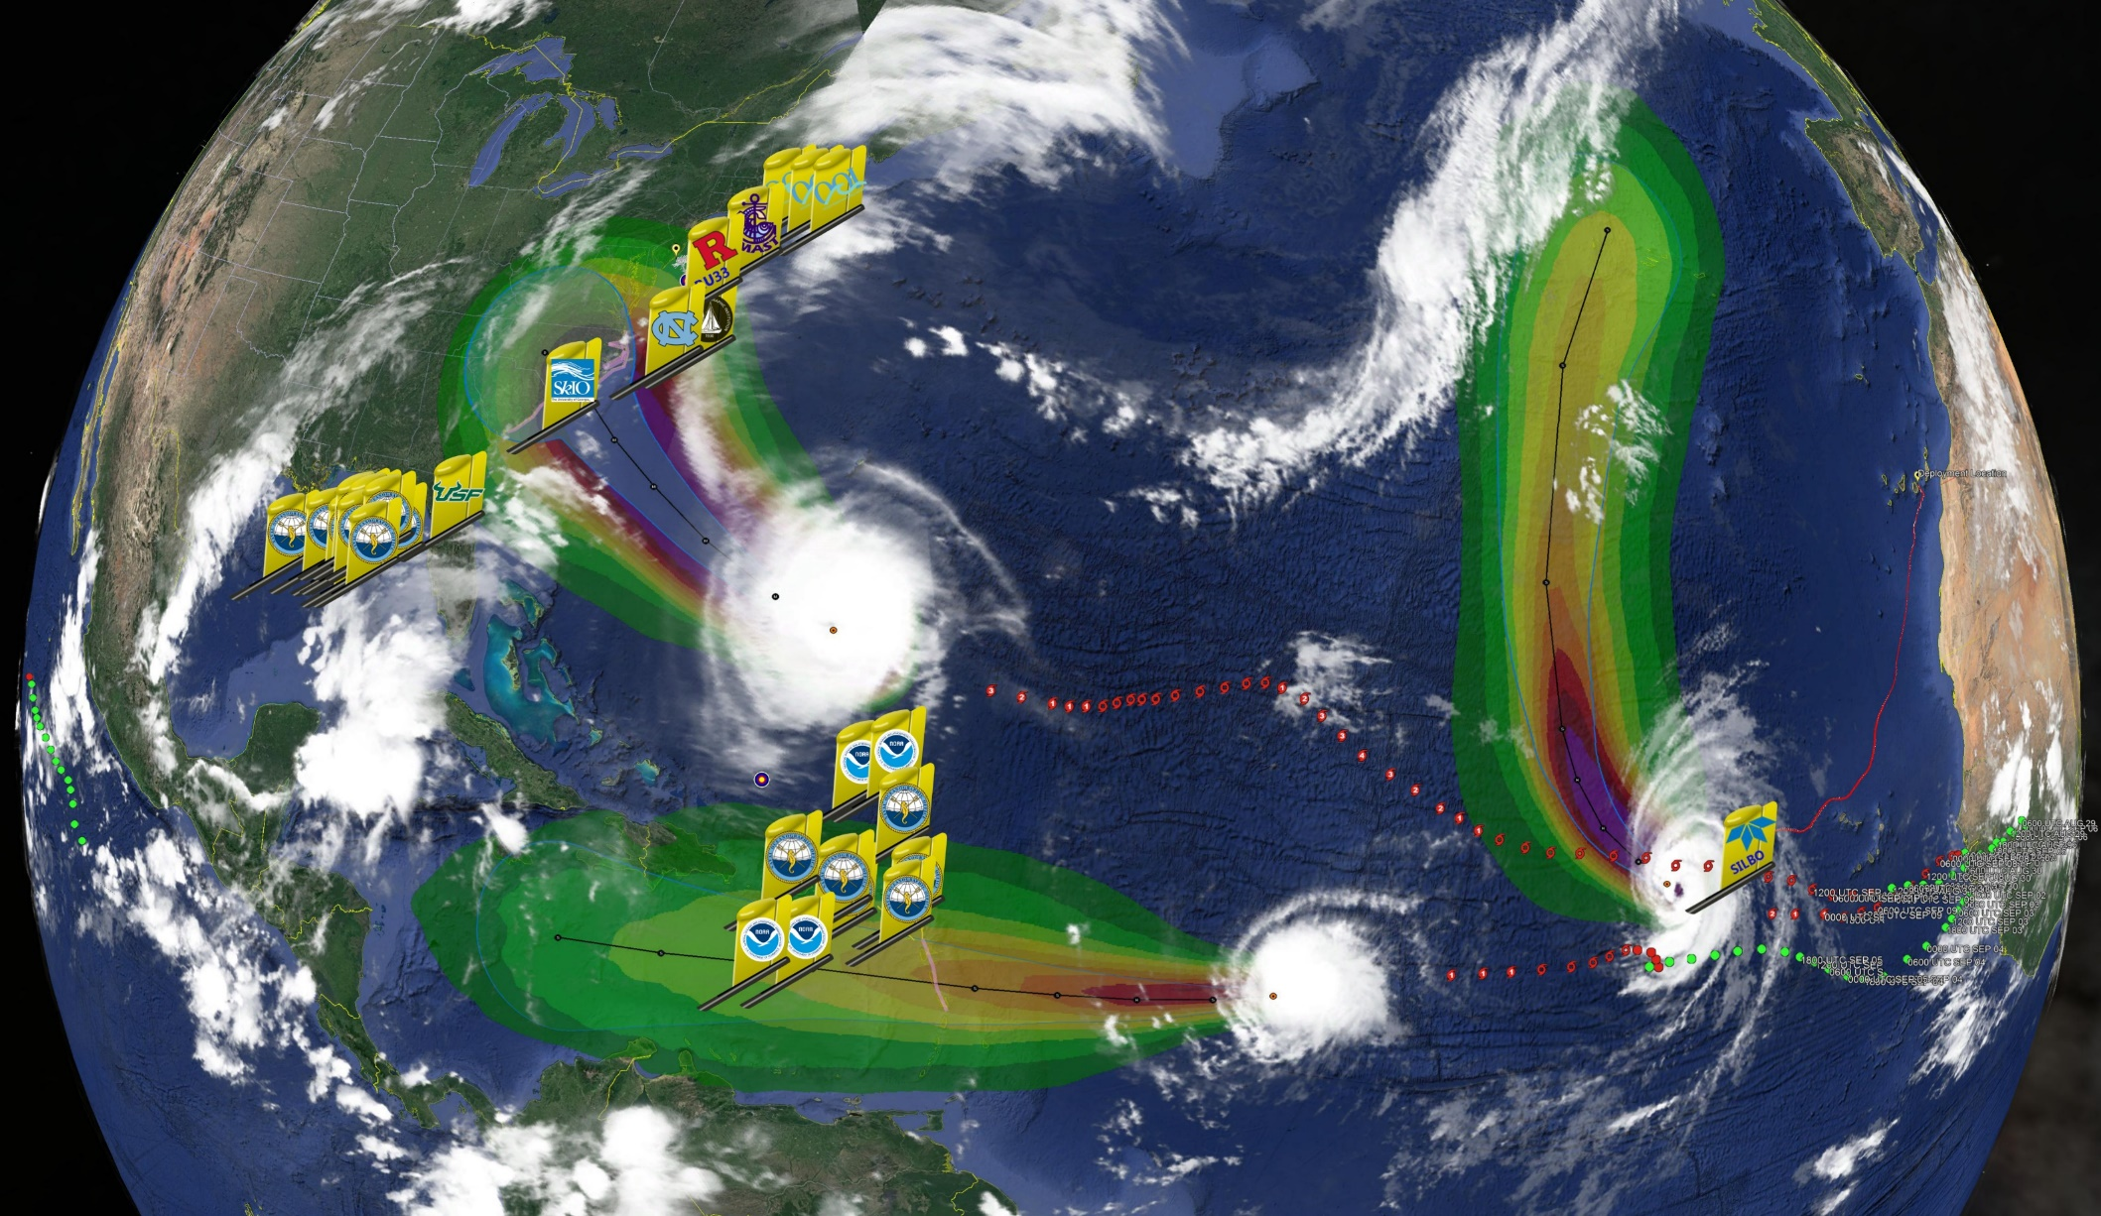
Florence
Helene
Isaac
>30 Hurricane Sentinel Gliders from the Navy, NOAA, NSF, Academic & Industry Partners
reporting ocean conditions through the U.S. IOOS Glider Data Assembly Center (DAC)
ahead of Hurricanes Florence, Isaac and Helene on September 11, 2018.

Slide 53
2019 Season Planning

Slide 54
NOAA NAVO 2019 Hurricane Glider Plan
Gustavo Goni
National Oceanic and Atmospheric Administration Atlantic Oceanographic and Meteorological Laboratory Miami, Florida
Objective
Explore possibility of continuing in the 2019 Atlantic hurricane season the partnership started in 2018
NOAA NAVO Hurricane Glider Discussion Stennis Space Center, MS, Nov 2 2018

Slide 55
Potential hurricane glider observations in the tropical Atlantic and Caribbean Sea during 2019 hurricane season

Slide 56
Plan: A Picket Fence/Line of (30-35) Gliders for Atlantic Hurricane Intensity Forecasts
NOAA/AOML, NAVO, IOOS, Rutgers U, U of Miami, CARICOOS, MARACOOS,
SECORA, IOOS, and additional partners

Slide 57
2019 NOAA NAVO Hurricane Glider Plan Topics of discussion:
2019 Area of survey
Number of gliders
Potential piloting along predetermined transects
NOAA pilots ?
Failure rate, earlier recoveries
Early reporting of potential problems, needs for recoveries
Emergency recoveries; potential US Coast Guard help
Data transmission
Financial support for deployments and recoveries
Planning meeting
Shipping and storage guidelines, including removal and storage of batteries
ITAR issues
EEZs

