Slide 1
Hurricane Michael
Increments
Insertion Window
Increments
Insertion Window
Increments
Insertion Window
The assimilation of glider data days ahead of Michael corrected
the position of the thermocline

Slide 2
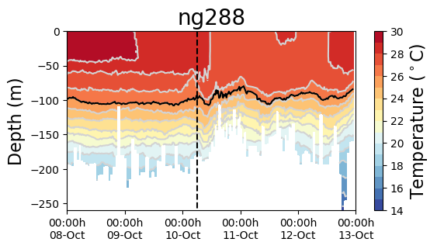
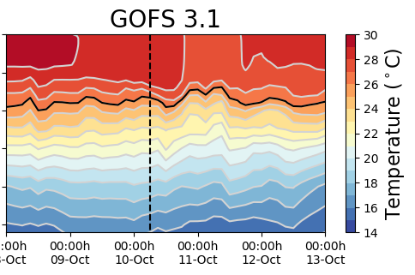
Hurricane Michael
Increments
Insertion Window
Increments
Insertion Window
The modeled SST increased after the passage of Michael: the ocean response is faster than the 1-day assimilation cycle

