Slide 1
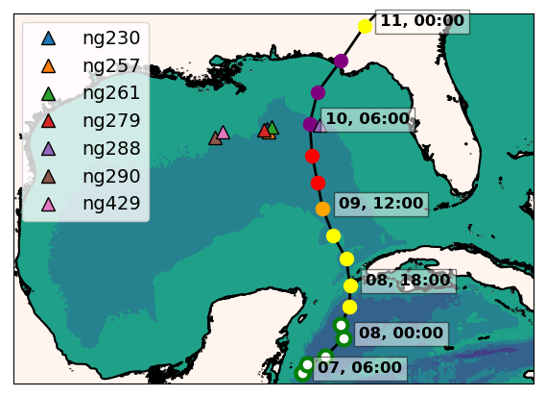
Hurricane Michael (2018)
ng288
Seven Navy gliders reporting to the glider DAC
in the GoM during hurricane Michael
Ng288 was at 36 km from the eye
of hurricane Michael

Slide 2
Impact of Glider Data Assimilation on the Navy Operational Ocean Model
Incremental
Insertion Window
Increments
Insertion Window
Increments
Insertion Window
The assimilation of glider data days ahead of Michael corrected
the position of the thermocline
Notes:
This is the temperature transect from ng288 and we also have the temperature transect form the GOFS 3.1 following ng288 glider track. When we look back 5 days before the passage of Michael, we observe that in GOFS 3.1 after every increment insertion window, the thermocline is pulled down to match the depth of the thermocline from the glider data until it settles down at the right depth. This highlights the importance of having a continuous glider presence so when a storm strikes, the model ocean has a most realistic vertical stratification.
Incremental insertion window is the period when the analysis increments are incorporated into the model in a gradual way.
The IAU (incremental analysis updating) process incorporates analysis increments into a model integration in a gradual manner. It does this by using analysis increments as constant forcings in a model's prognostic equations over a 6-h period centered on an analysis time. (Bloom, S.C., L.L. Takacs, A.M. da Silva and D. Ledvina. 1996. Data assimilation using incremental analysis updates. Mon. Wea. Rev. 124:1256–1271. )

