Slide 1
Metrics of Atmosphere-Ocean Interaction during Hurricanes
Ocean Heat Content (Leipet and Volgenau 1972, Hong et al. 1999, Shay et al. 1999, Goni and Trinanes 2003)
Depth Average Temperature over the top 100 m (Price 2009)
Depth Average Temperature from Surface to Depth of Maximum Mixing (Price 2009 and Price 1980)
Potential Energy Anomaly (Simpson 1980)
Potential Energy Anomaly Non Dimensional (Cliff and Travis)

Slide 2
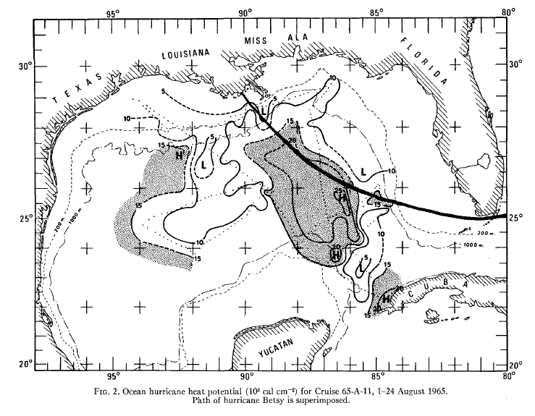
Ocean Heat Content
Or Hurricane Heat Potential
Leipet and Volgenau 1972
Why 26 degrees?
It is minimum sea temperature for hurricane formation (Byers 1959)
It is the surface air temperature for the mean tropical atmosphere during hurricane season

Slide 3
Main Characteristics
It has been used for 45 years and it was first proposed in the Gulf of Mexico
The motivation for this metric was that not only sea surface temperature is important but also the temperature of the upper ocean layers
It has been used extensively with good results (high OHC correlates with hurricane intensification) in the Gulf of Mexico, ……….
This metric has no meaning is cool ocean regions where hurricanes are not generated but where they continue their path like the MAB

Slide 4
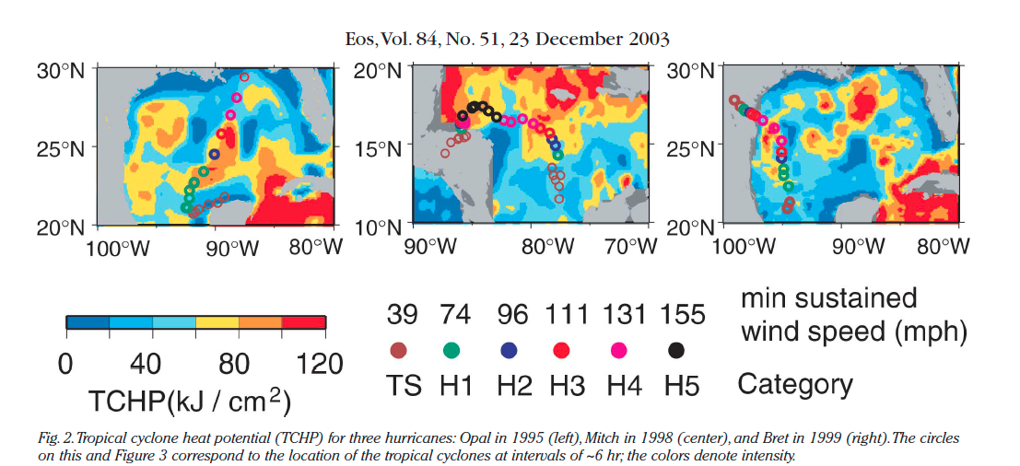
Goni and Trinanes 2003

Slide 5
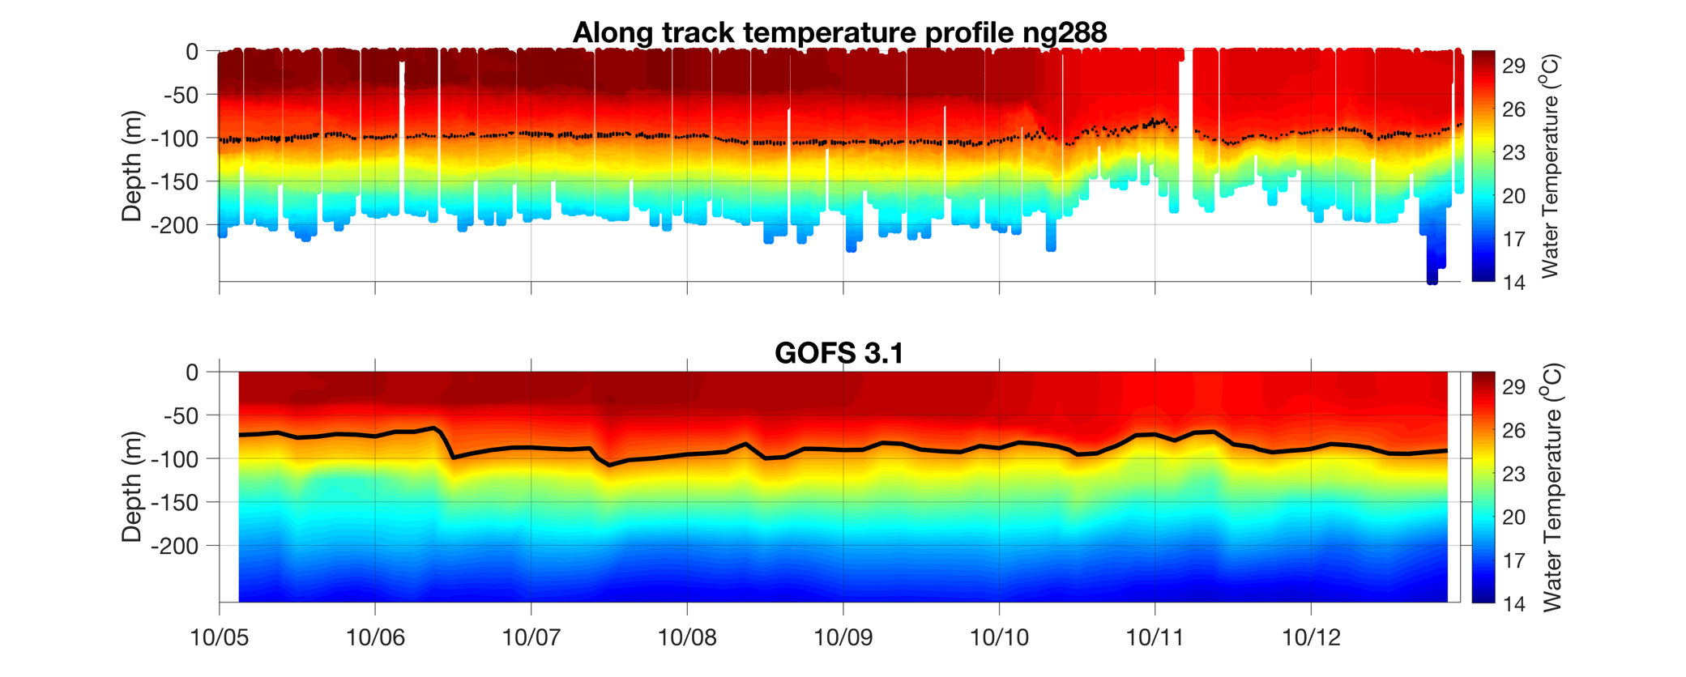
Michael

Slide 7
Florence

Slide 8
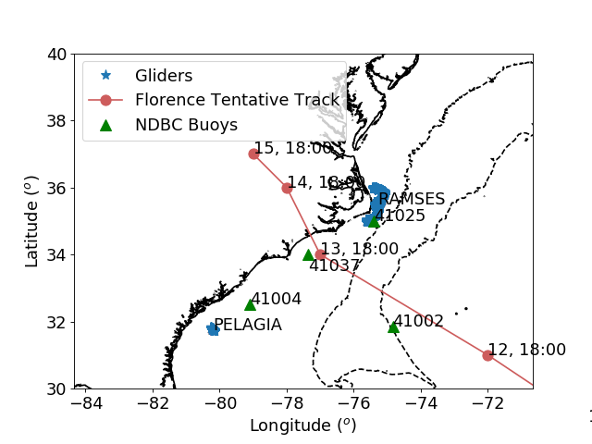

Slide 9
Heat Fluxes Bulk Formulas
Sensible
Latent

Slide 10
Calculations of heat fluxes

Slide 11
MAB
OHC makes no sense for RU33 and Blue

Slide 12
Caribbean

Slide 14
Calculate power spectrum for temperature ng467

Slide 15
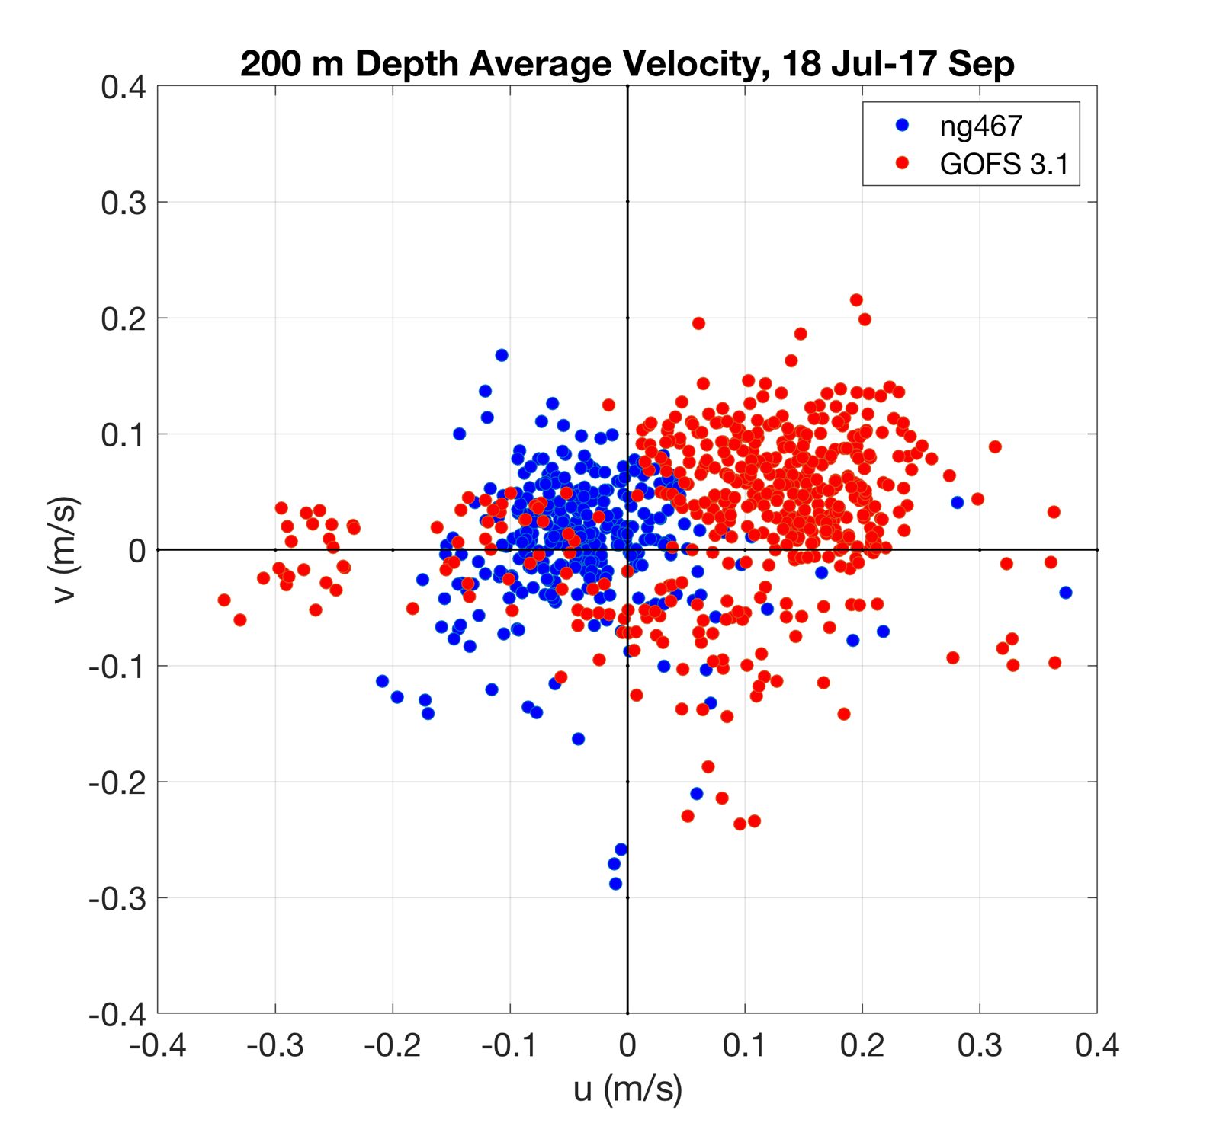

Slide 16
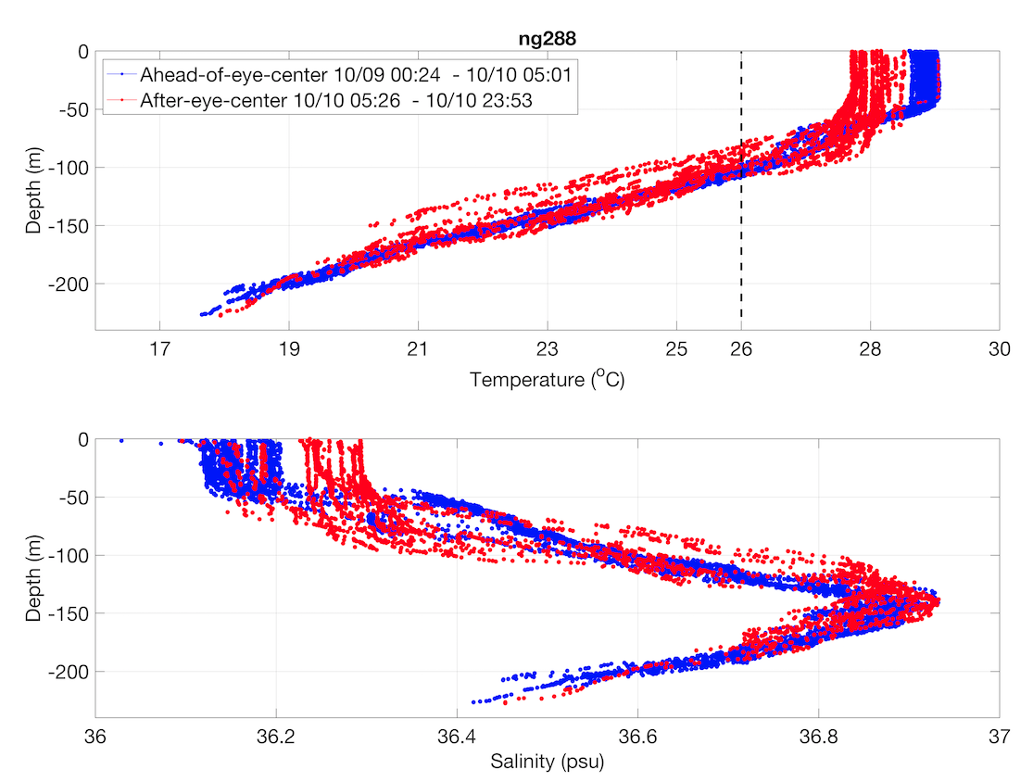
Depth average temperature over the to 100 m or up the entire water column if depth is shallower than 100 m (Price 2009).
Why 100 m ? Typical depth of vertical mixing of a cat. 3 hurricane.
This metric captures the potential change is SST due to the vertical mixing caused by the hurricane winds. It represents the minimum temperature of the water columns if it mixes completely down to 100 m.

Slide 20
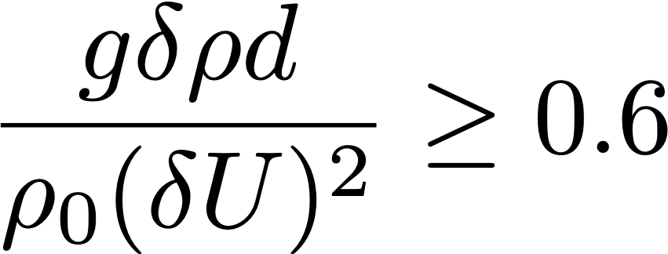
Depth Average Temperature from Surface to Depth of Maximum Mixing

Slide 22
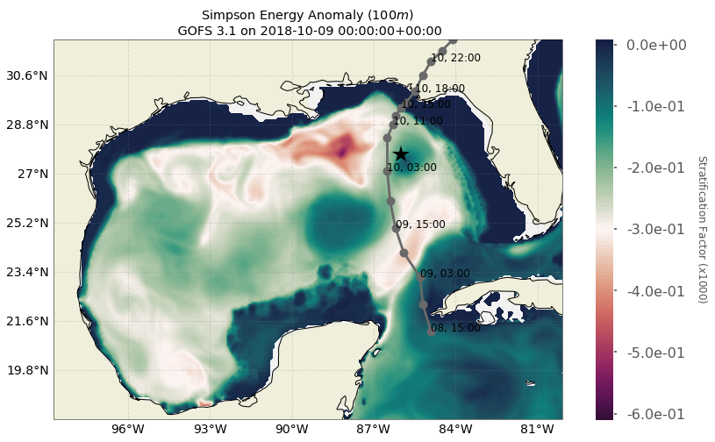
Non-dimensional Potential Energy Anomaly (100 m or less)
Michael

Slide 23
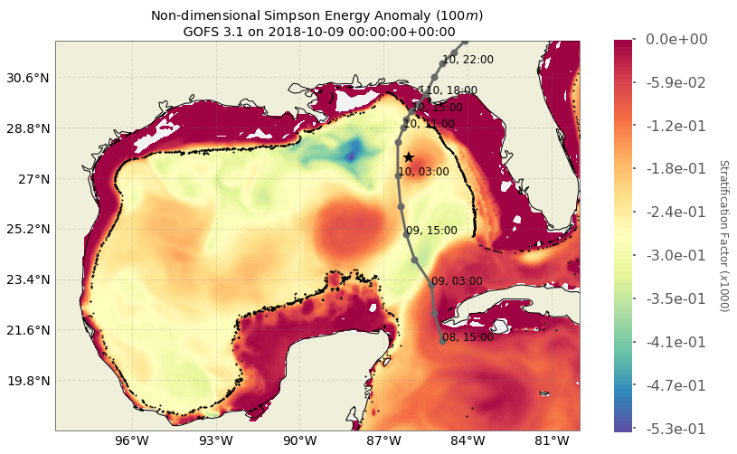
Positive
Values
Ng288
100m

Slide 24
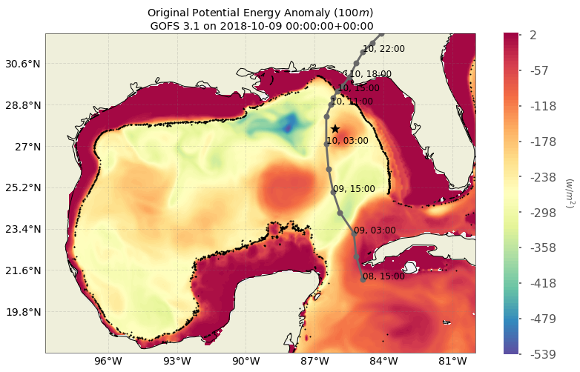
100m
j/m^3

Slide 25
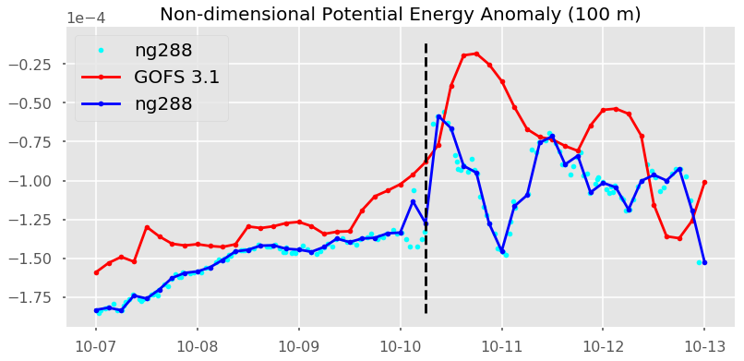
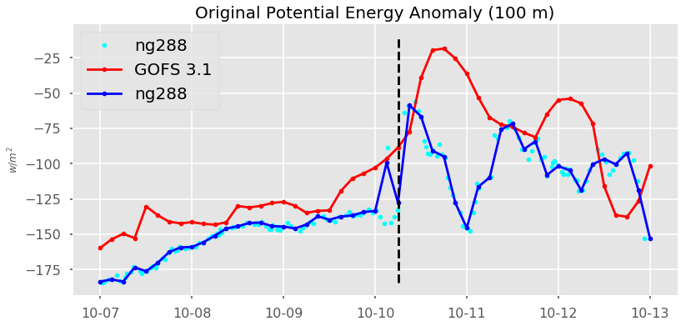
j/m^3

Slide 26
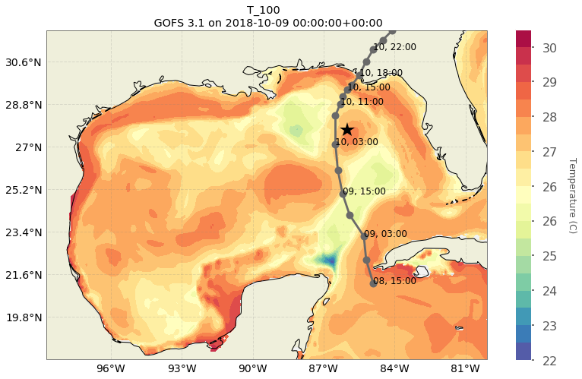
Depth Average Temperature down to 100 m or bottom

Slide 27
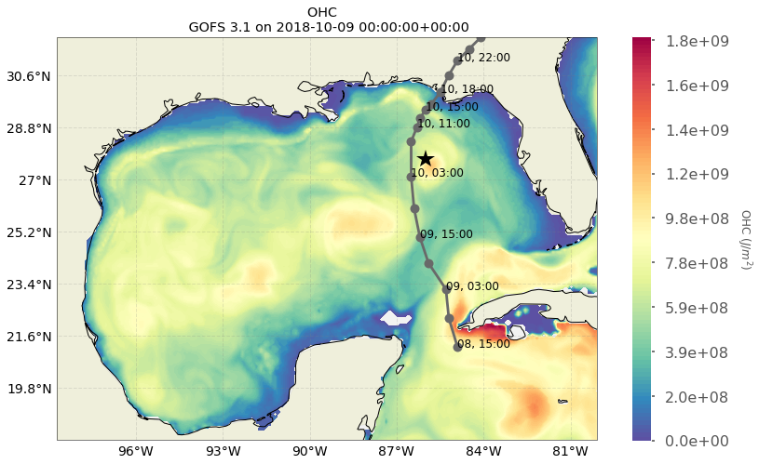
Ocean Heat Content

Slide 28
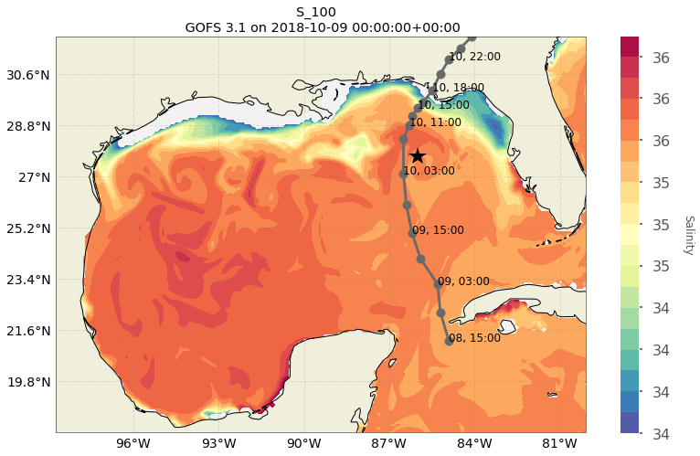

Slide 29
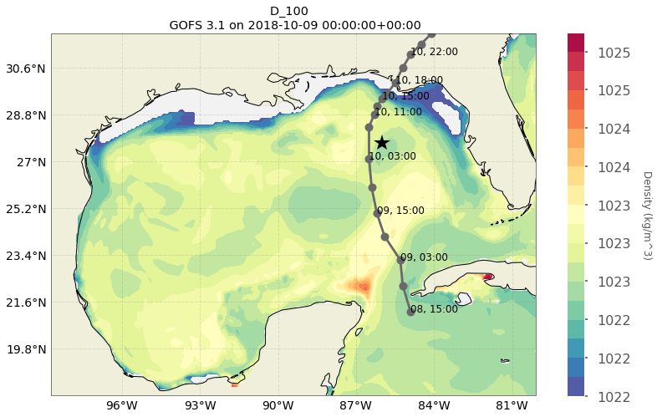

Slide 30
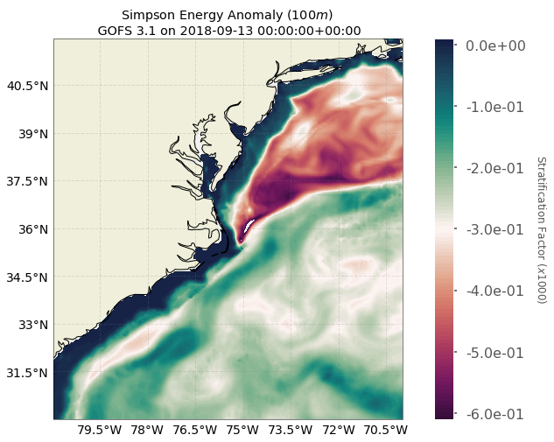
Non-dimensional Potential Energy Anomaly
Plot 200 m isobath
Florence

Slide 31
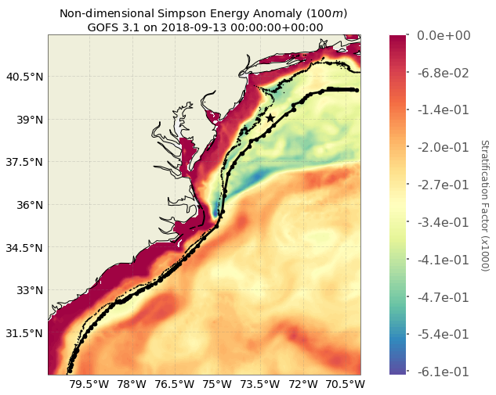
Ru33
50m
200m

Slide 32
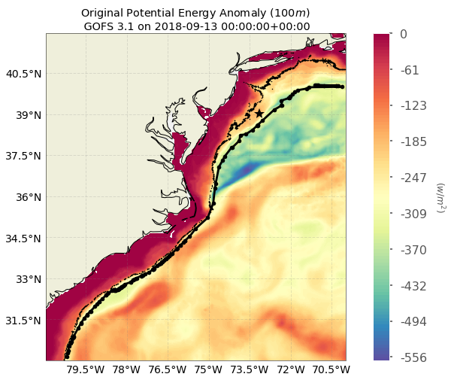
50m
200m
j/m^3

Slide 33
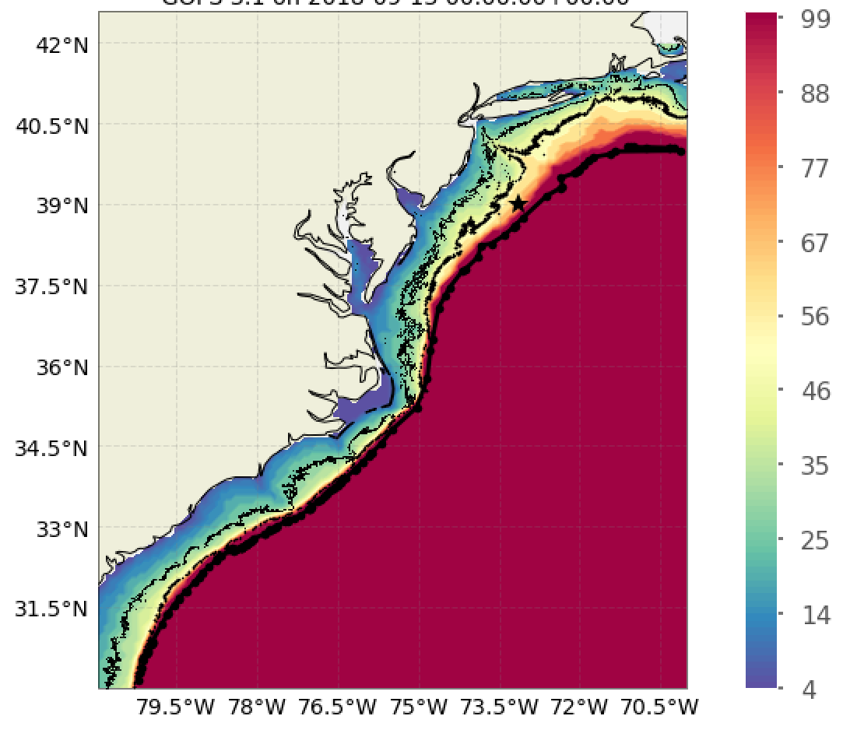
Depth (m)
j/m^3

Slide 34
j/m^3

Slide 35
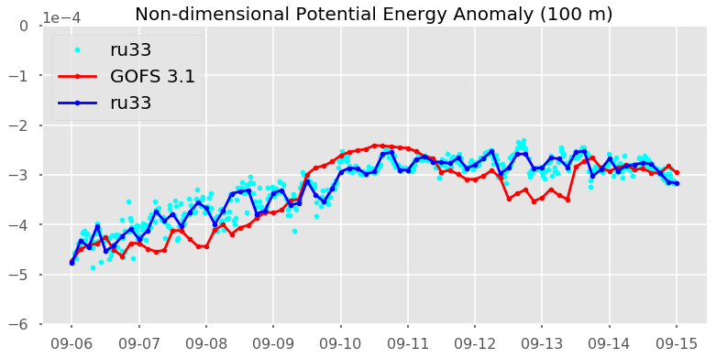
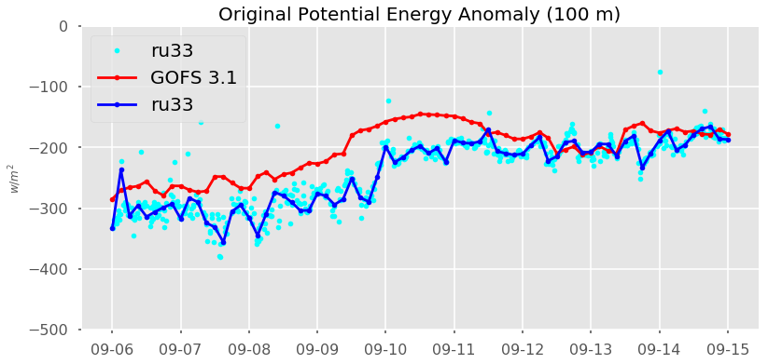
Plot of depth vs time for GOFS 3.1 and glider
j/m^3

Slide 36
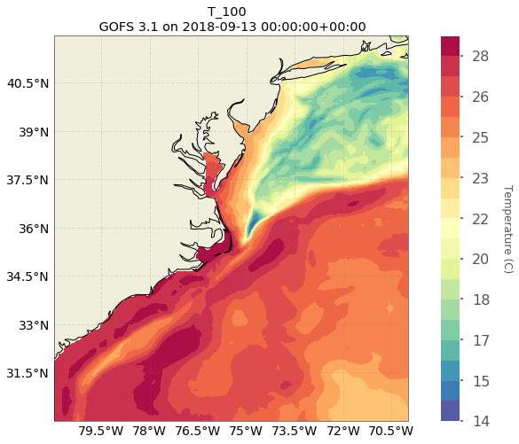
Depth Average Temperature down to 100 m or bottom

Slide 37
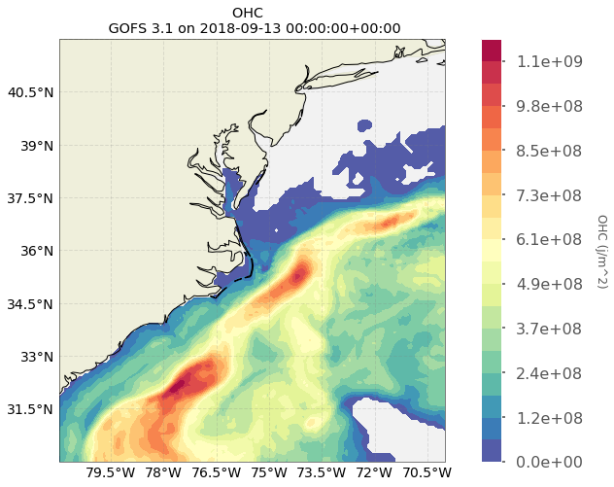
Ocean Heat Content

Slide 38
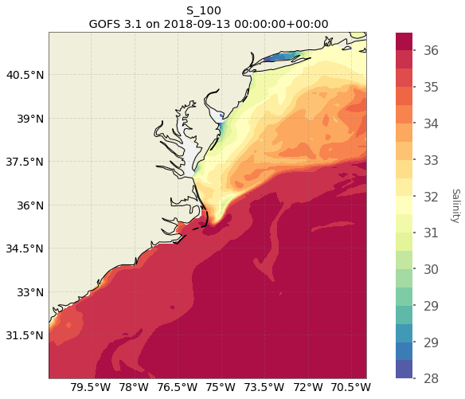

Slide 39
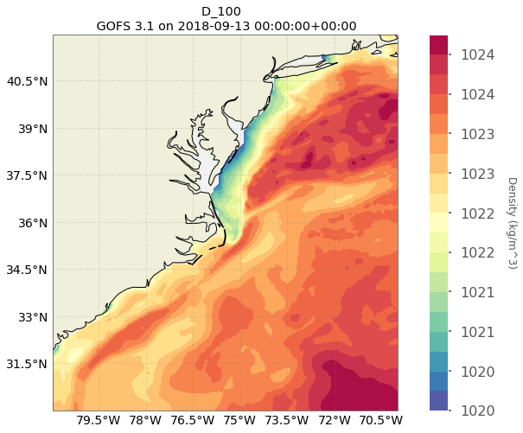

Slide 40
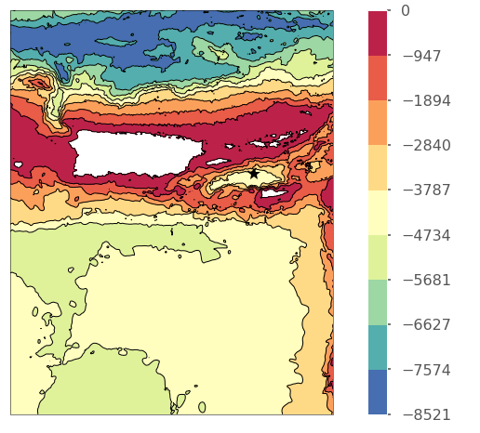
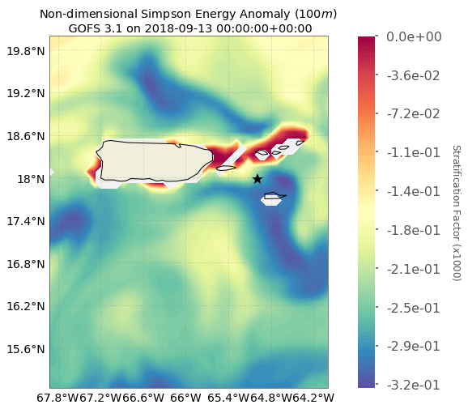
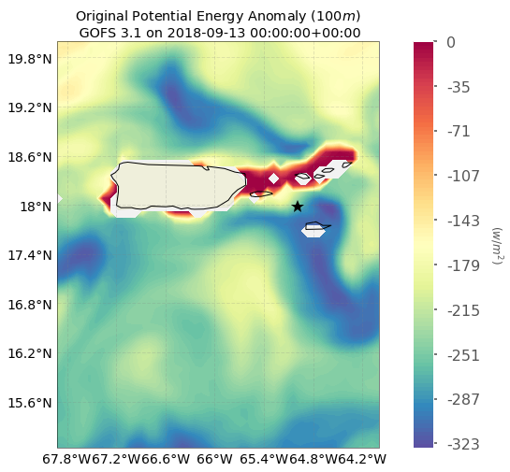
Caribbean
j/m^3

Slide 41
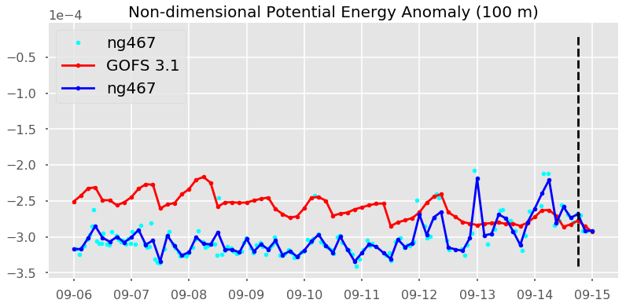
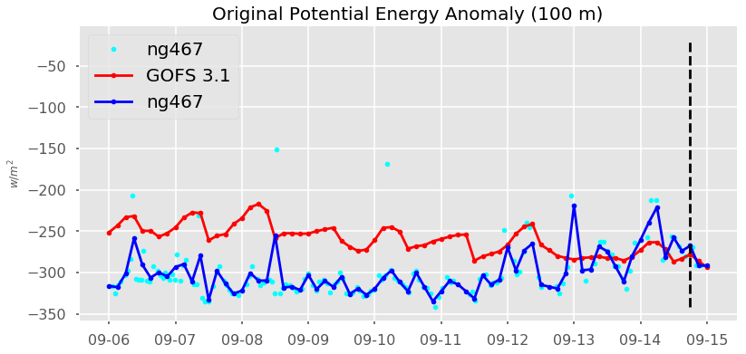
j/m^3

Slide 42
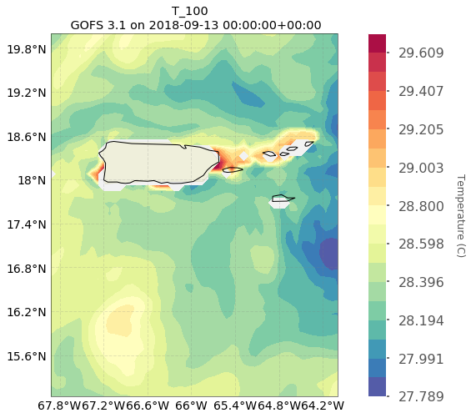
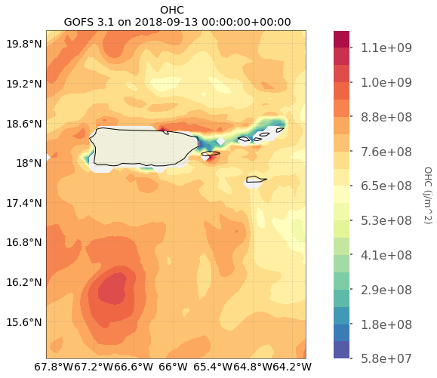
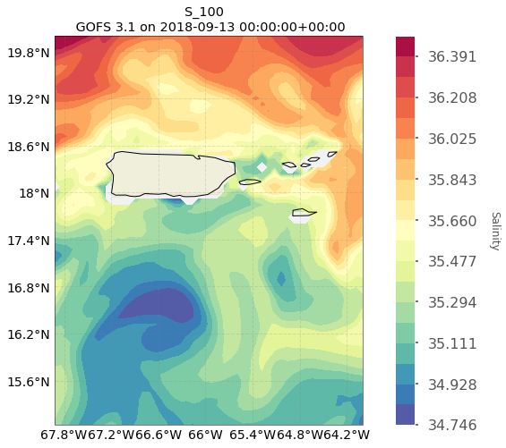
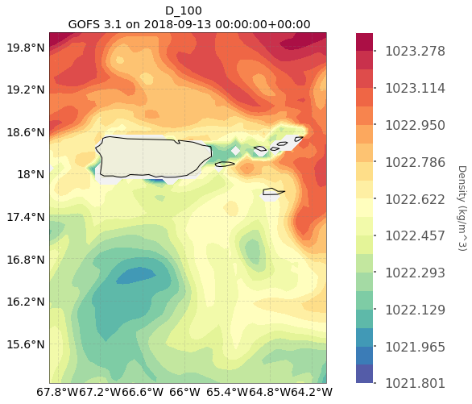

Slide 43
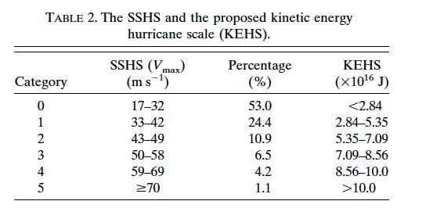
Putting PEA values into the context of the energy delivered by a hurricane
Maclay et al. 2007
Cat 4 hurricane KE surface
200 km radius storm

Slide 44
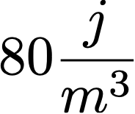
j/m^3
Due to momentum transfer:

Slide 45
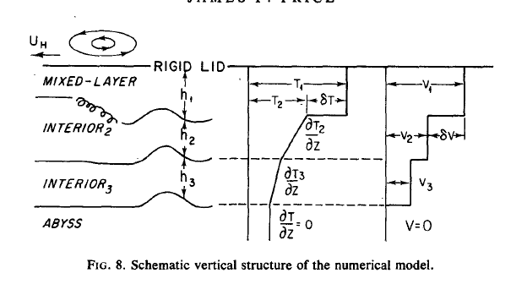
How much energy a hurricane can actually deliver to the water column?
How much mixing does it cause?
What is the SST after mixing?
Are there other processes, like horizontal advection, driving SST?
Price 1980
SST response is a mixed layer dynamic problem
Mixed layer deepens due to entrainment
Mixed layer absorbs the air-sea exchanges

Slide 46
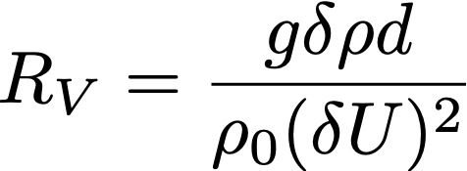
Temperature Balance within Mixed Layer
Heat fluxes
Horizontal
Advection
Vertical
Advection
Entrainment?
Entrainment
Bulk Richardson
Number

Slide 47
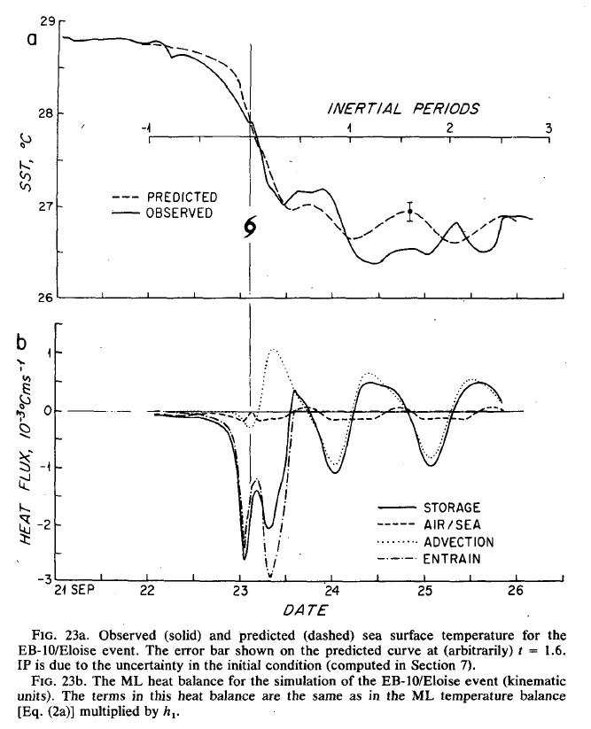

Slide 48
Michael

Slide 50
The most important component of the heat budget right after the passage of the storm is the ML entrainment. This determines the magnitude of SST change after the storm and therefore it also determines the heat fluxes.
Is the coupled atmopheric-ocean hurricane model capturing these processes?
Even if GOFS 3.1 provides good initial condition through assimilation, the forecast of the hurricane intensity will depend on how the coupled atmospheric-ocean model captures processes such as entrainment.

Slide 52
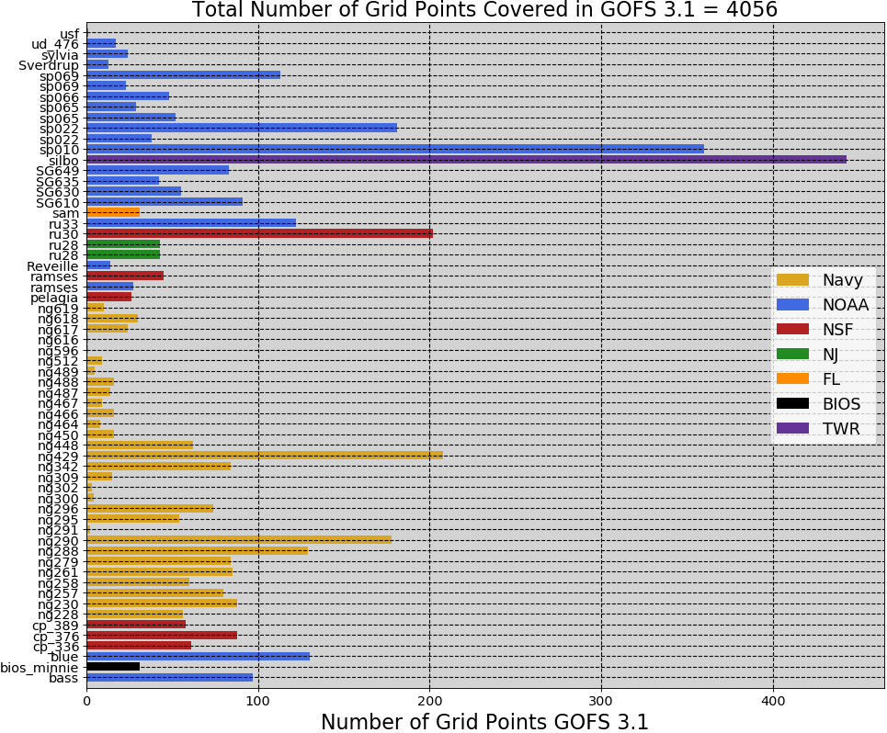

Slide 53
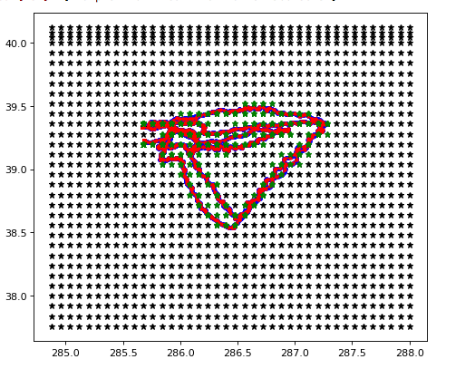

Slide 54
