Slide 1
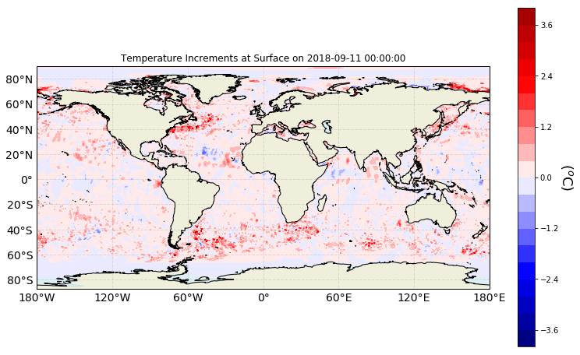

Slide 2
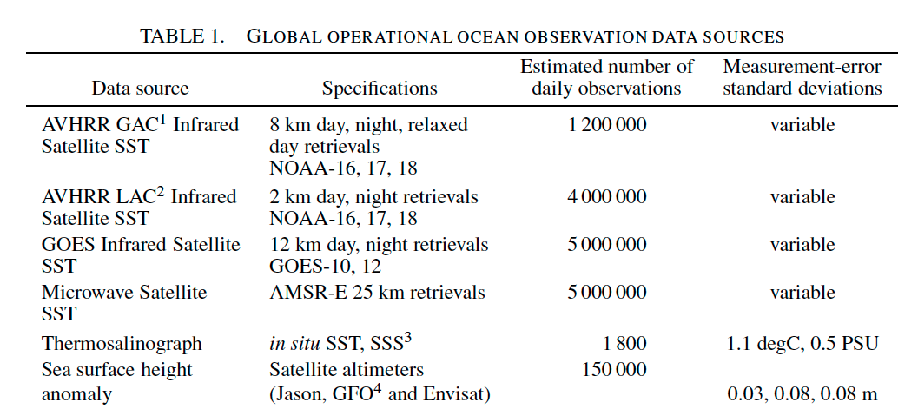
Cummings 2005
NOAA-19 is up to 2015

Slide 3
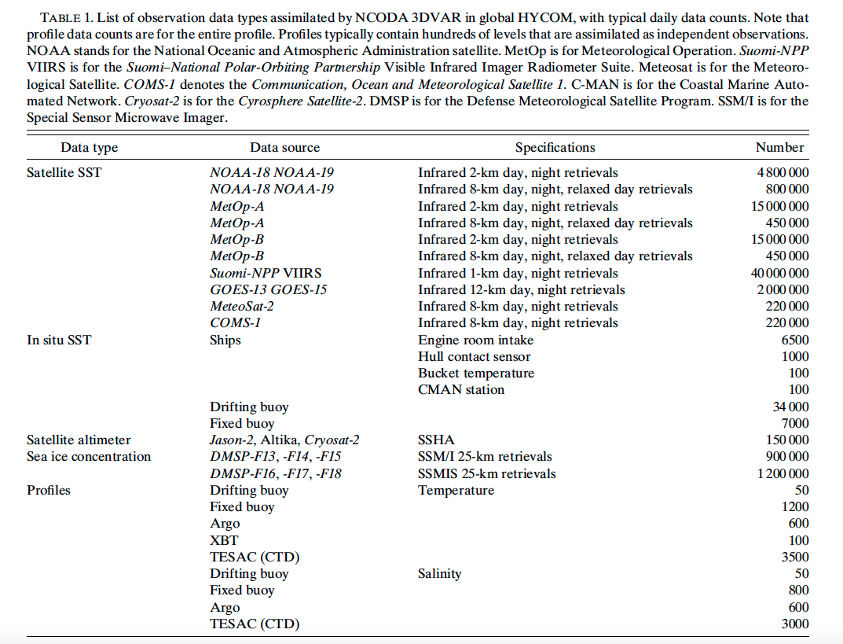
Cummings and Smedstad 2014

Slide 4
Julia uses:
AVHRR from Maracoos
GHRSST Level 3U Global Subskin Sea Surface Temperature version7.0.1a from the WindSat Polarimetric Radiometer on the Coriolis satellite
GHRSST GDS2 Level 3U Global Skin Sea Surface Temperature version 2.60 from the Visible Infrared Imaging Radiometer Suite (VIIRS) on the Suomi NPP satellite created by the NOAA Advanced Clear-Sky Processor for Ocean (ACSPO)
GHRSST Level 2P Global Subskin Sea Surface Temperature version 8a from the Advanced Microwave Scanning Radiometer 2 on the GCOM-W satellite

Slide 5
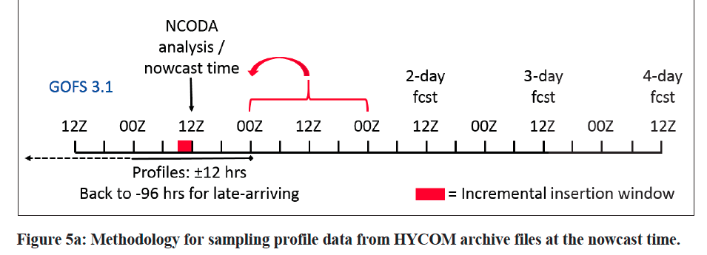

Slide 6
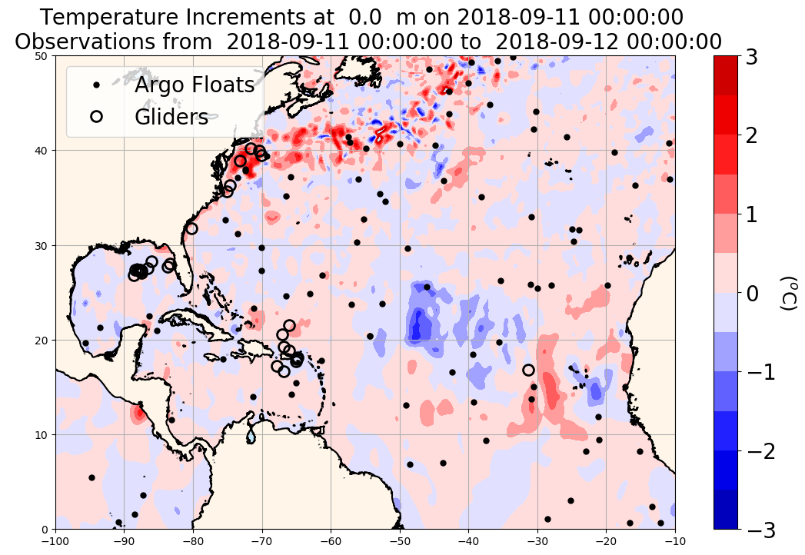
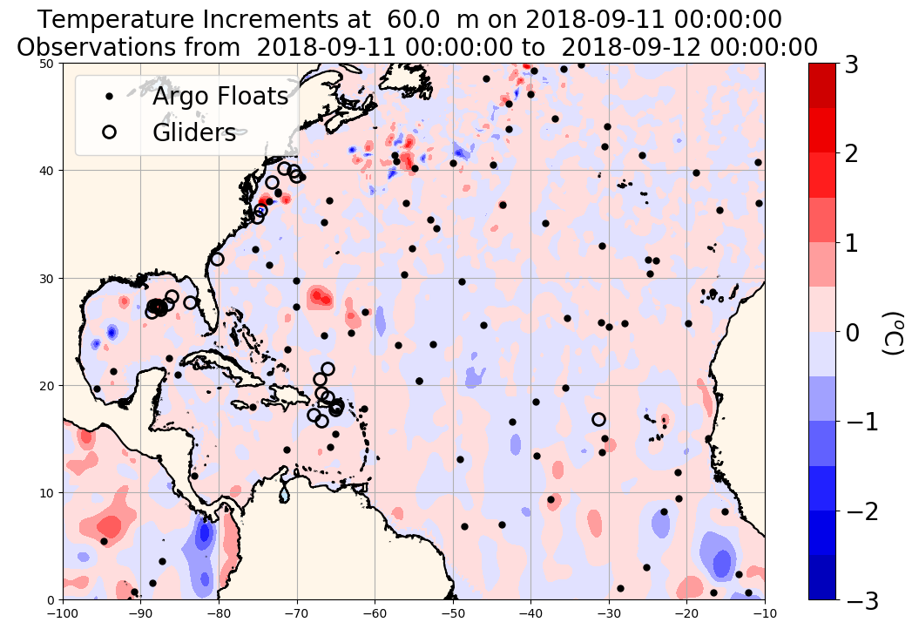
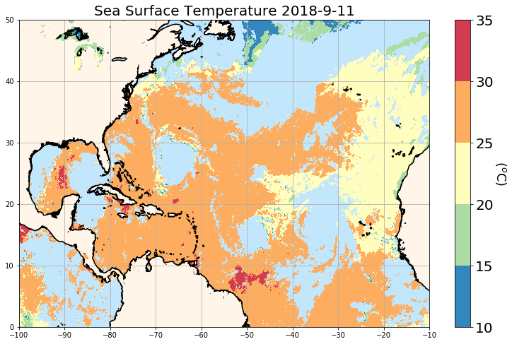
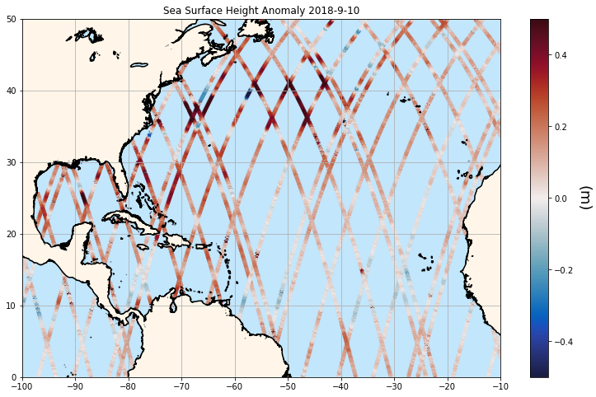
Overlap altimeter passes
AVHRR by OSI SAF
(Ocean and Sea Ice Satellite Application Facility)
https://podaac.jpl.nasa.gov/dataset/OSTM_L2_OST_OGDR_GPS
Ocean Surface Topography Mission/Jason-2 (OSTM)

Slide 7
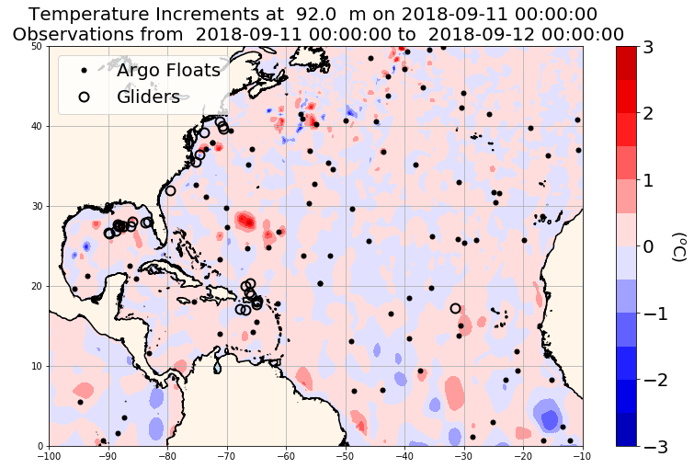
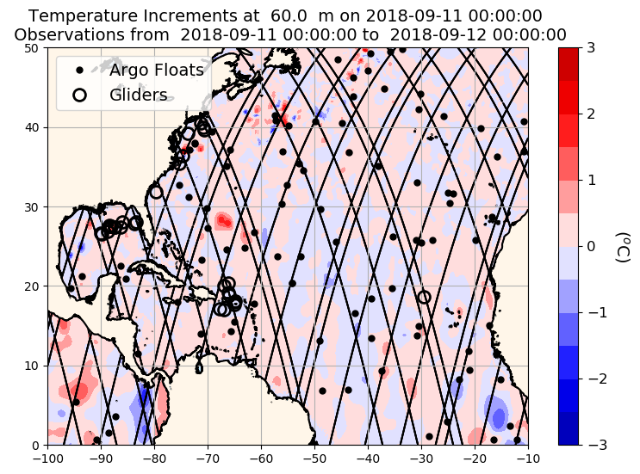

Slide 8
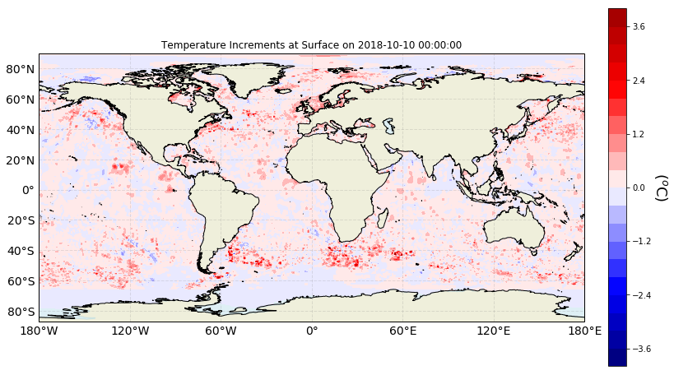

Slide 9
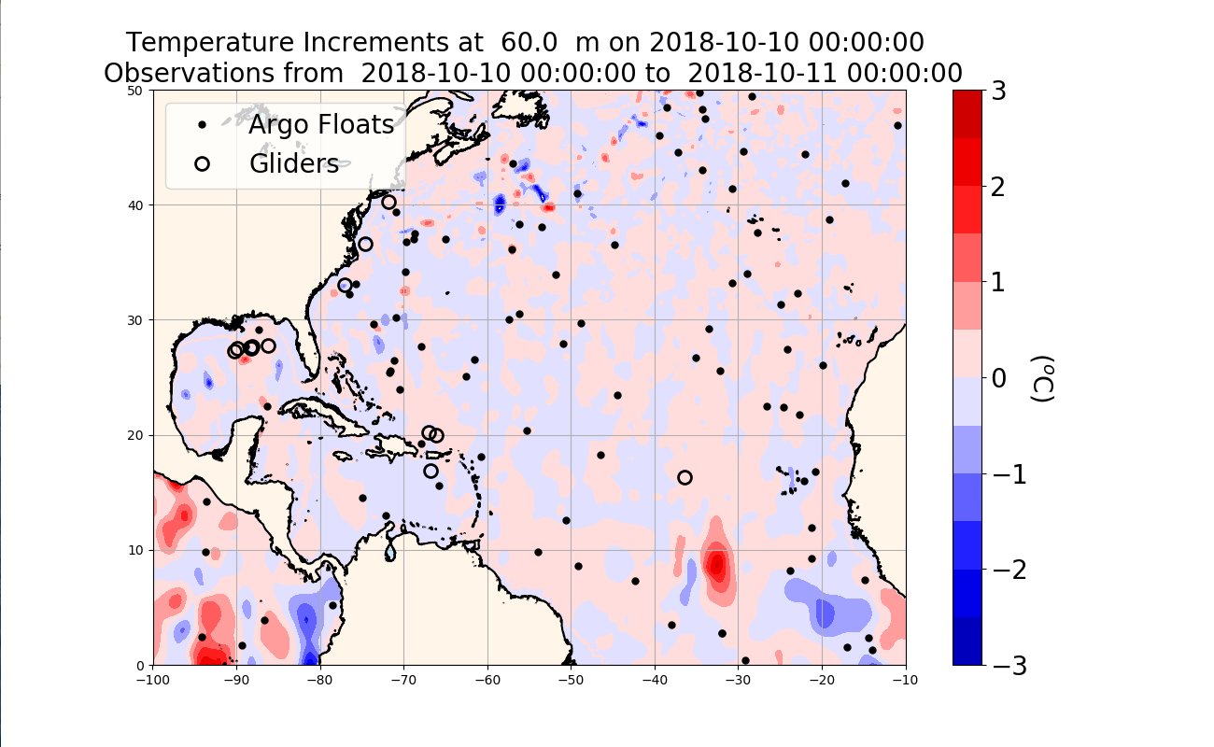
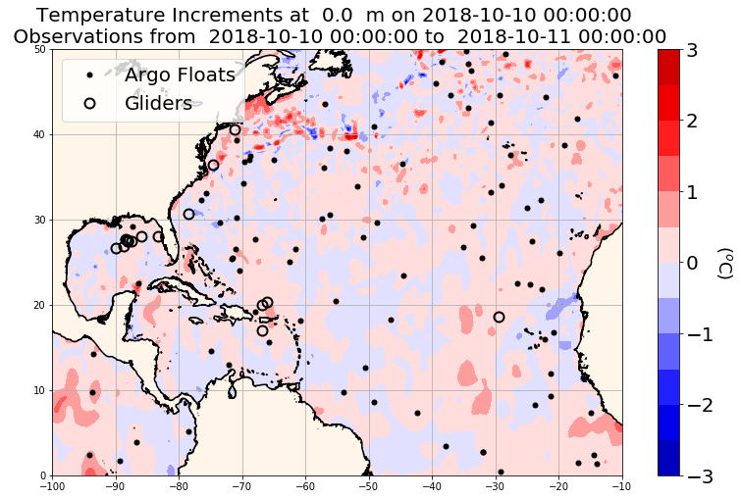
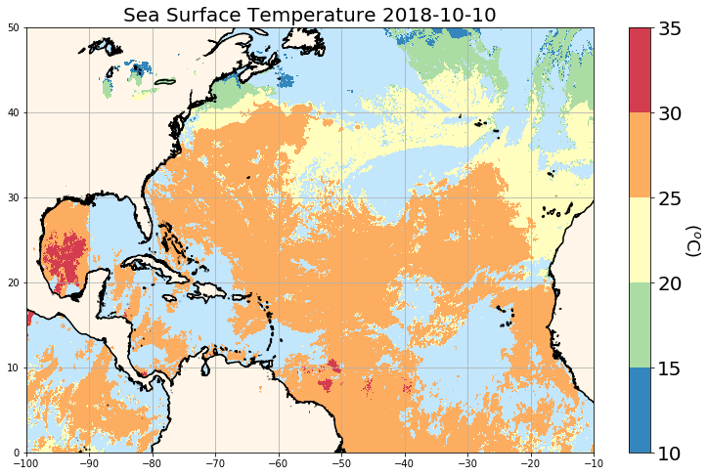
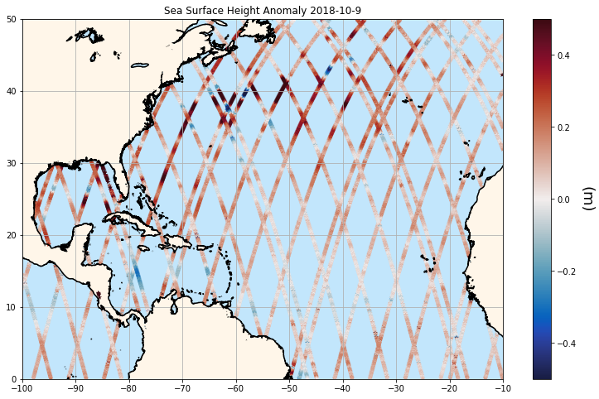
AVHRR by OSI SAF
(Ocean and Sea Ice Satellite Application Facility)
https://podaac.jpl.nasa.gov/dataset/OSTM_L2_OST_OGDR_GPS
Ocean Surface Topography Mission/Jason-2 (OSTM)

Slide 10
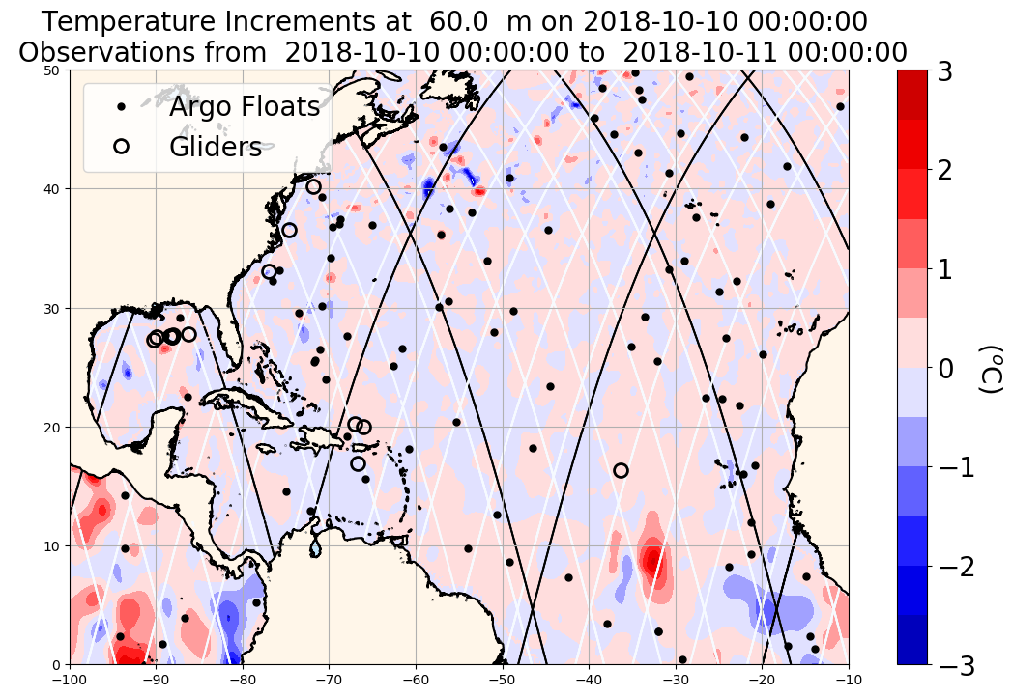

Slide 11
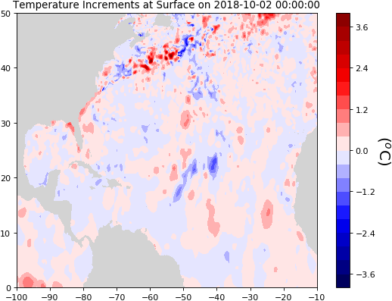
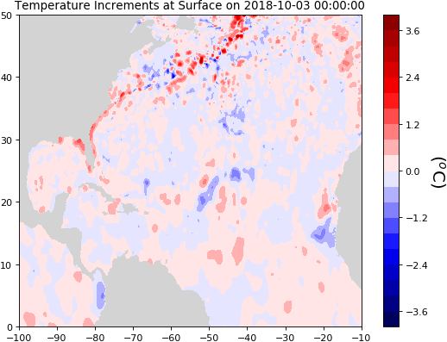
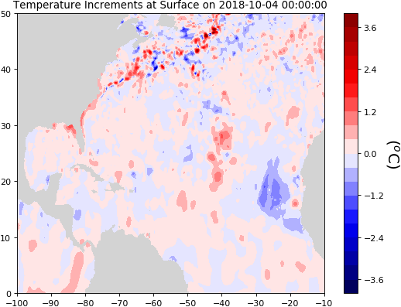
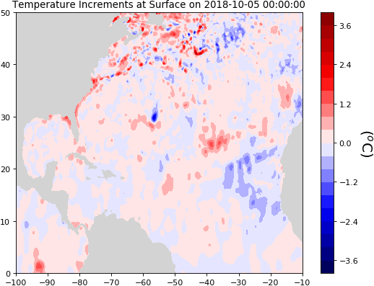
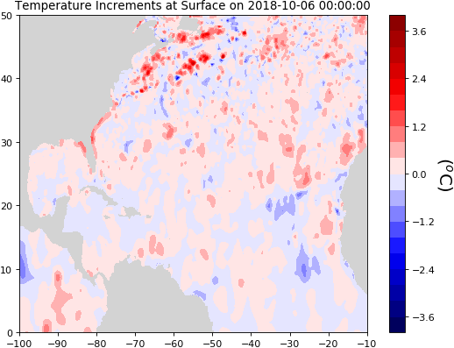
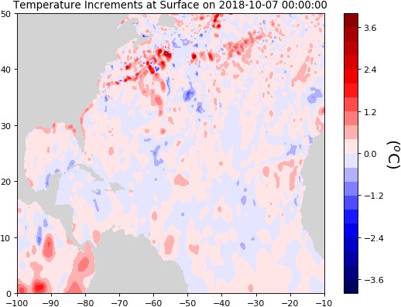
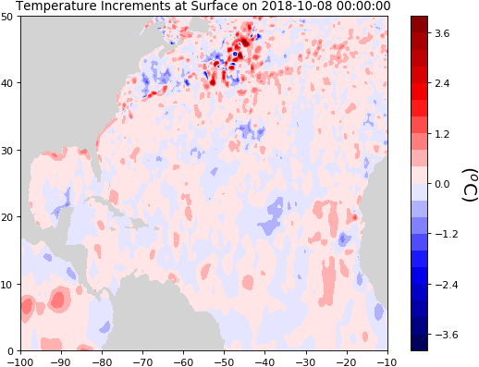
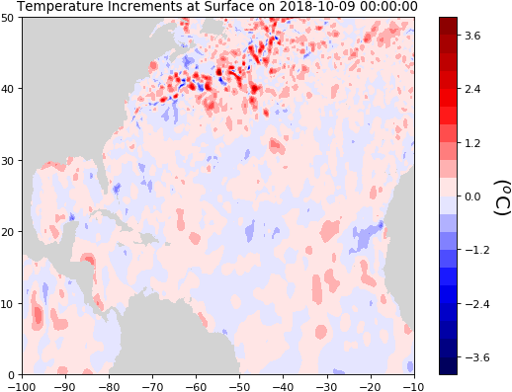
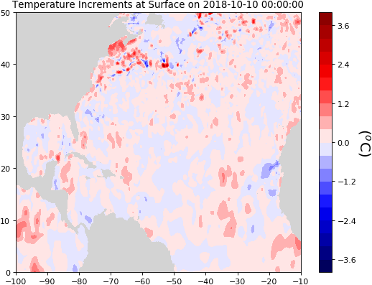
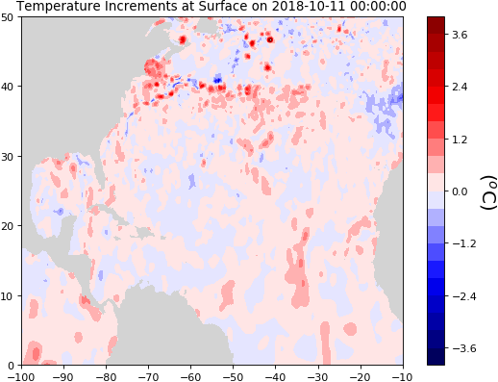
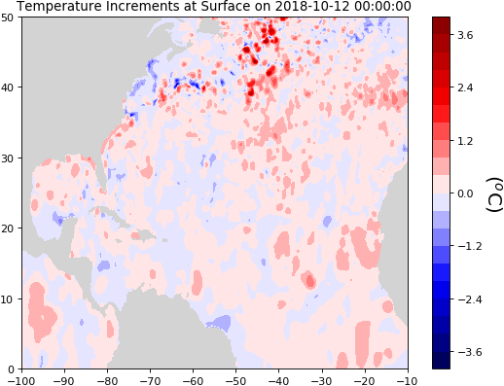
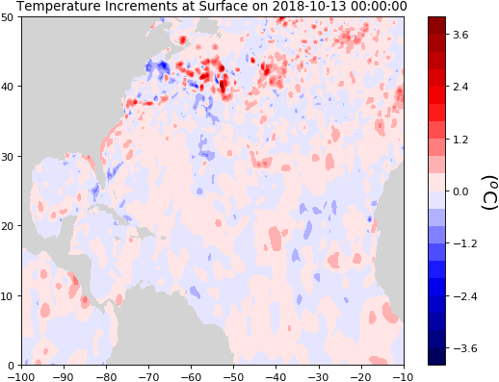

Slide 12
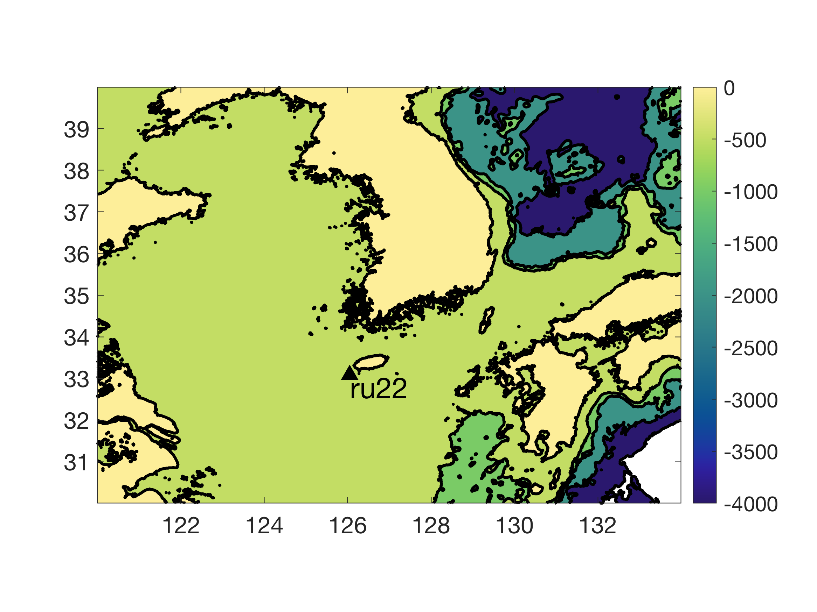
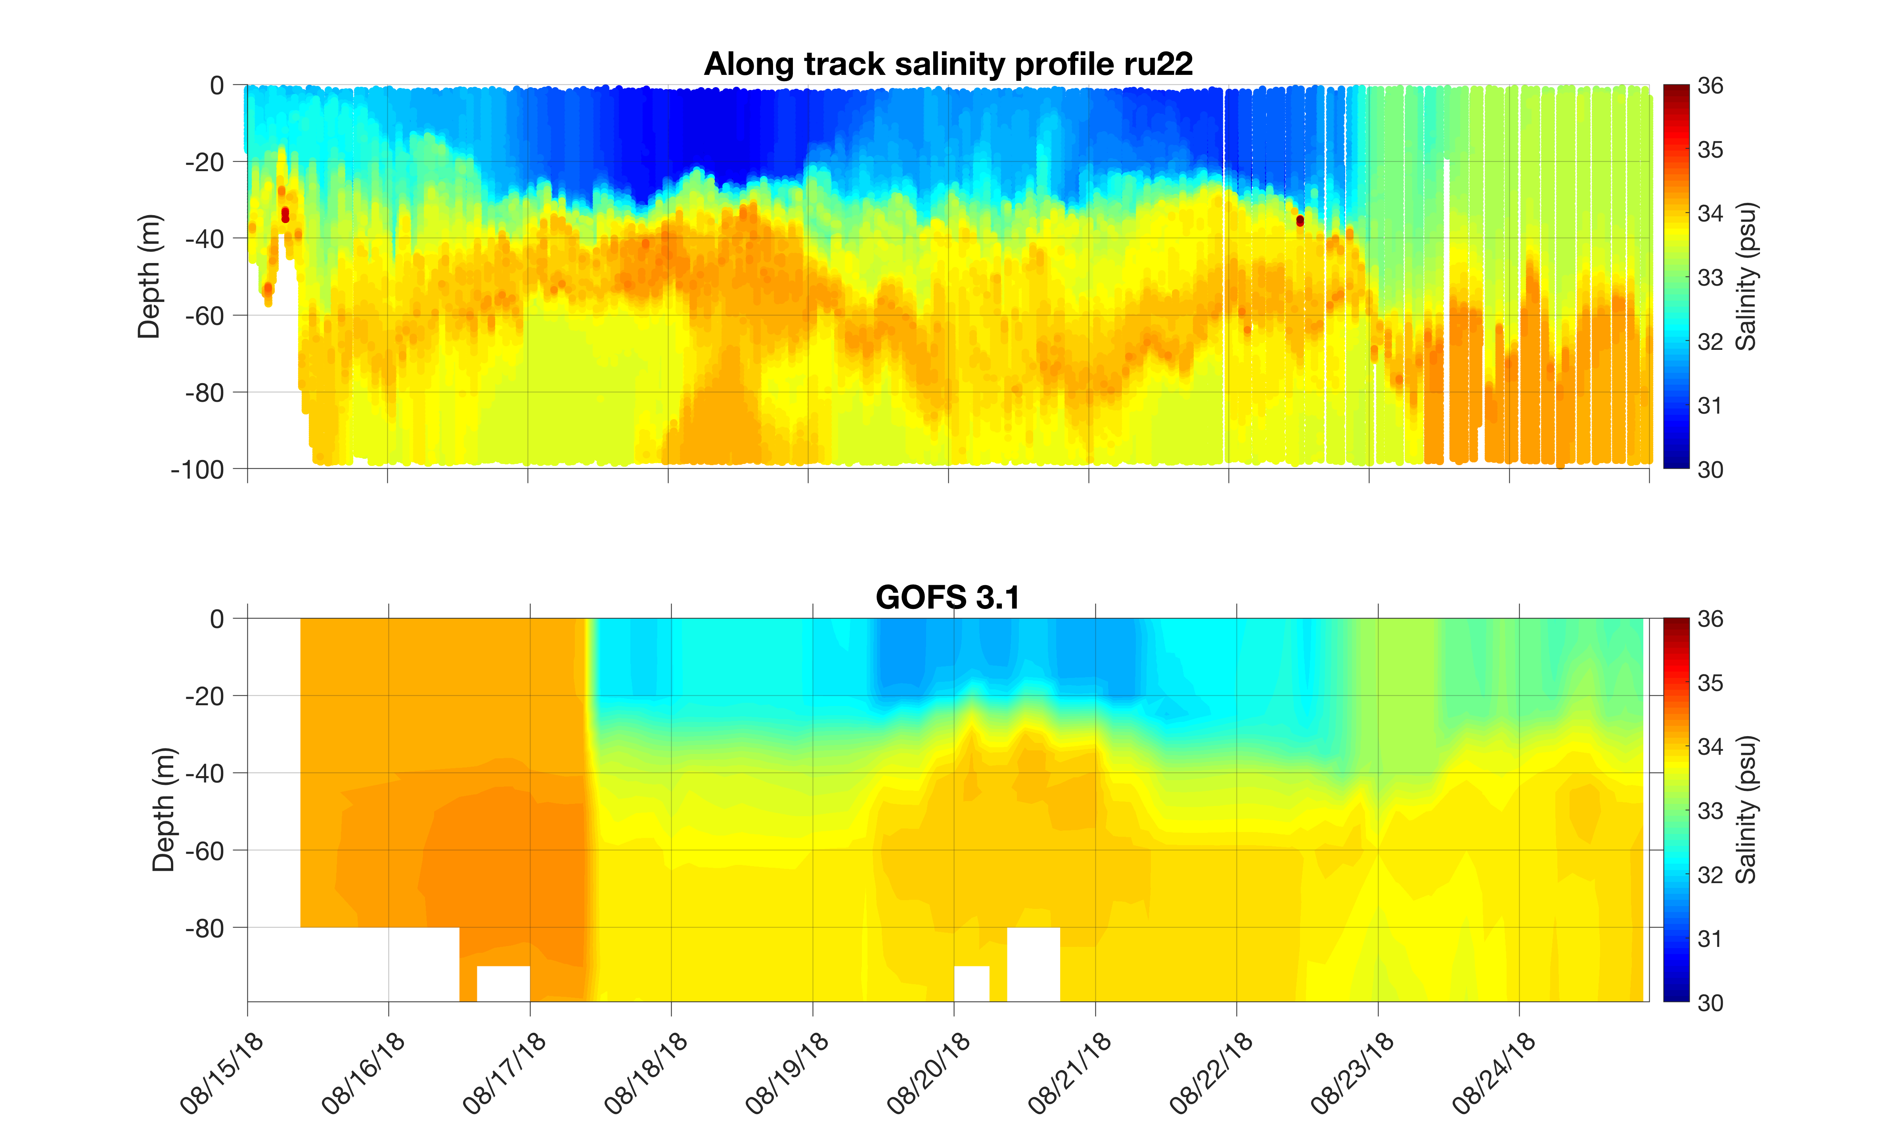
Typhoon Soulik
Time series of temperature salinity at surface and at 50 m
Typhoon Soulik

Slide 13
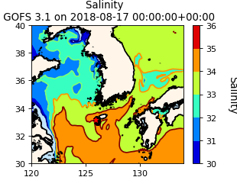
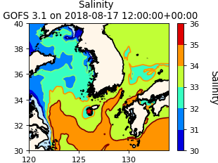
GOFS 3.1 Surface Salinity from Aug/17 to Aug/18

Slide 14
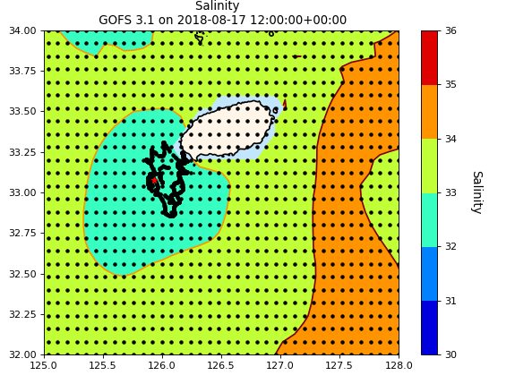
Make typhoon track
~126 km
~126 km
Grid points
1 grid point ~ 9 km

Slide 15
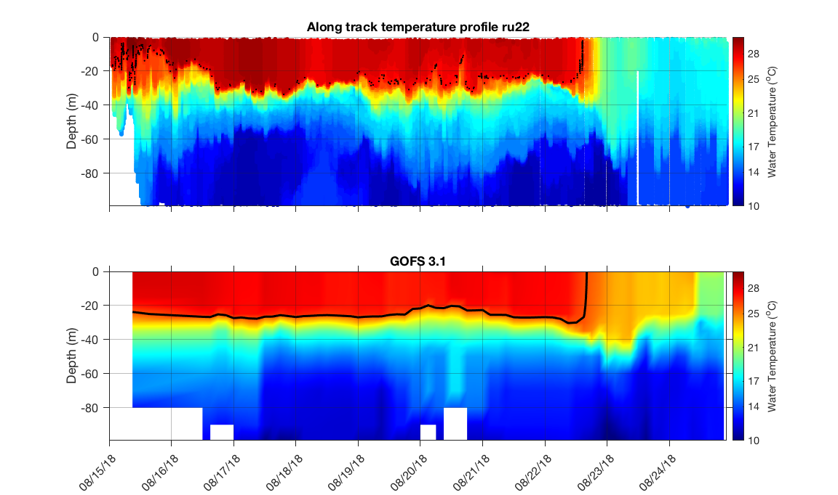
Typhoon Soulik
Typhoon Soulik

Slide 16
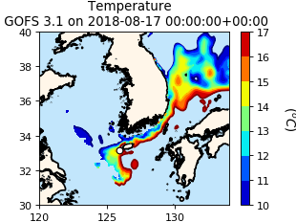
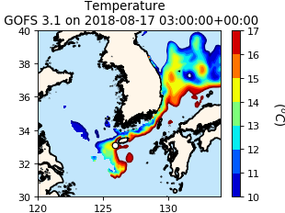
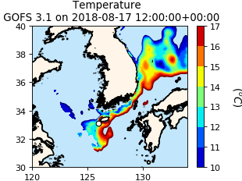
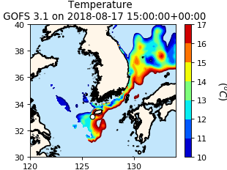
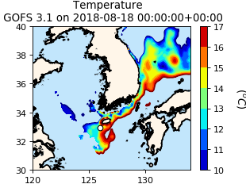
GOFS 3.1 Temperature at 60 m depth from Aug/17 to Aug/18

Slide 17
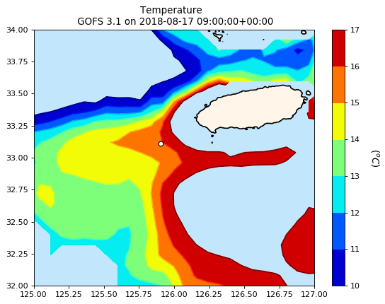
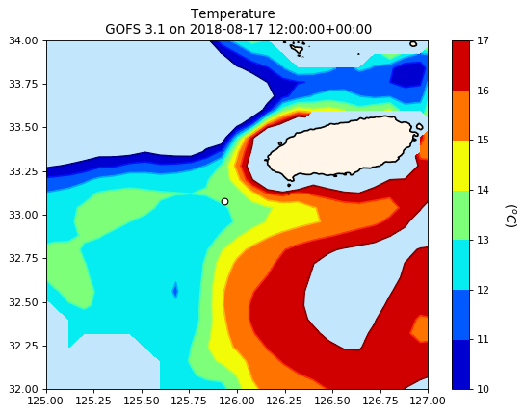
GOFS 3.1 Velocity at 60 m depth

Slide 18
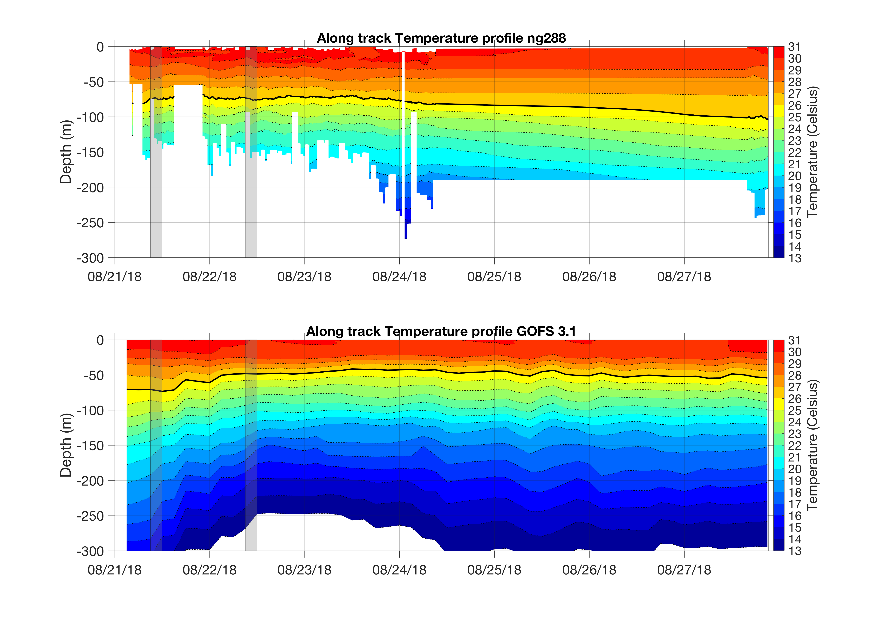
Ng288 before and after going to the GTS

Slide 19
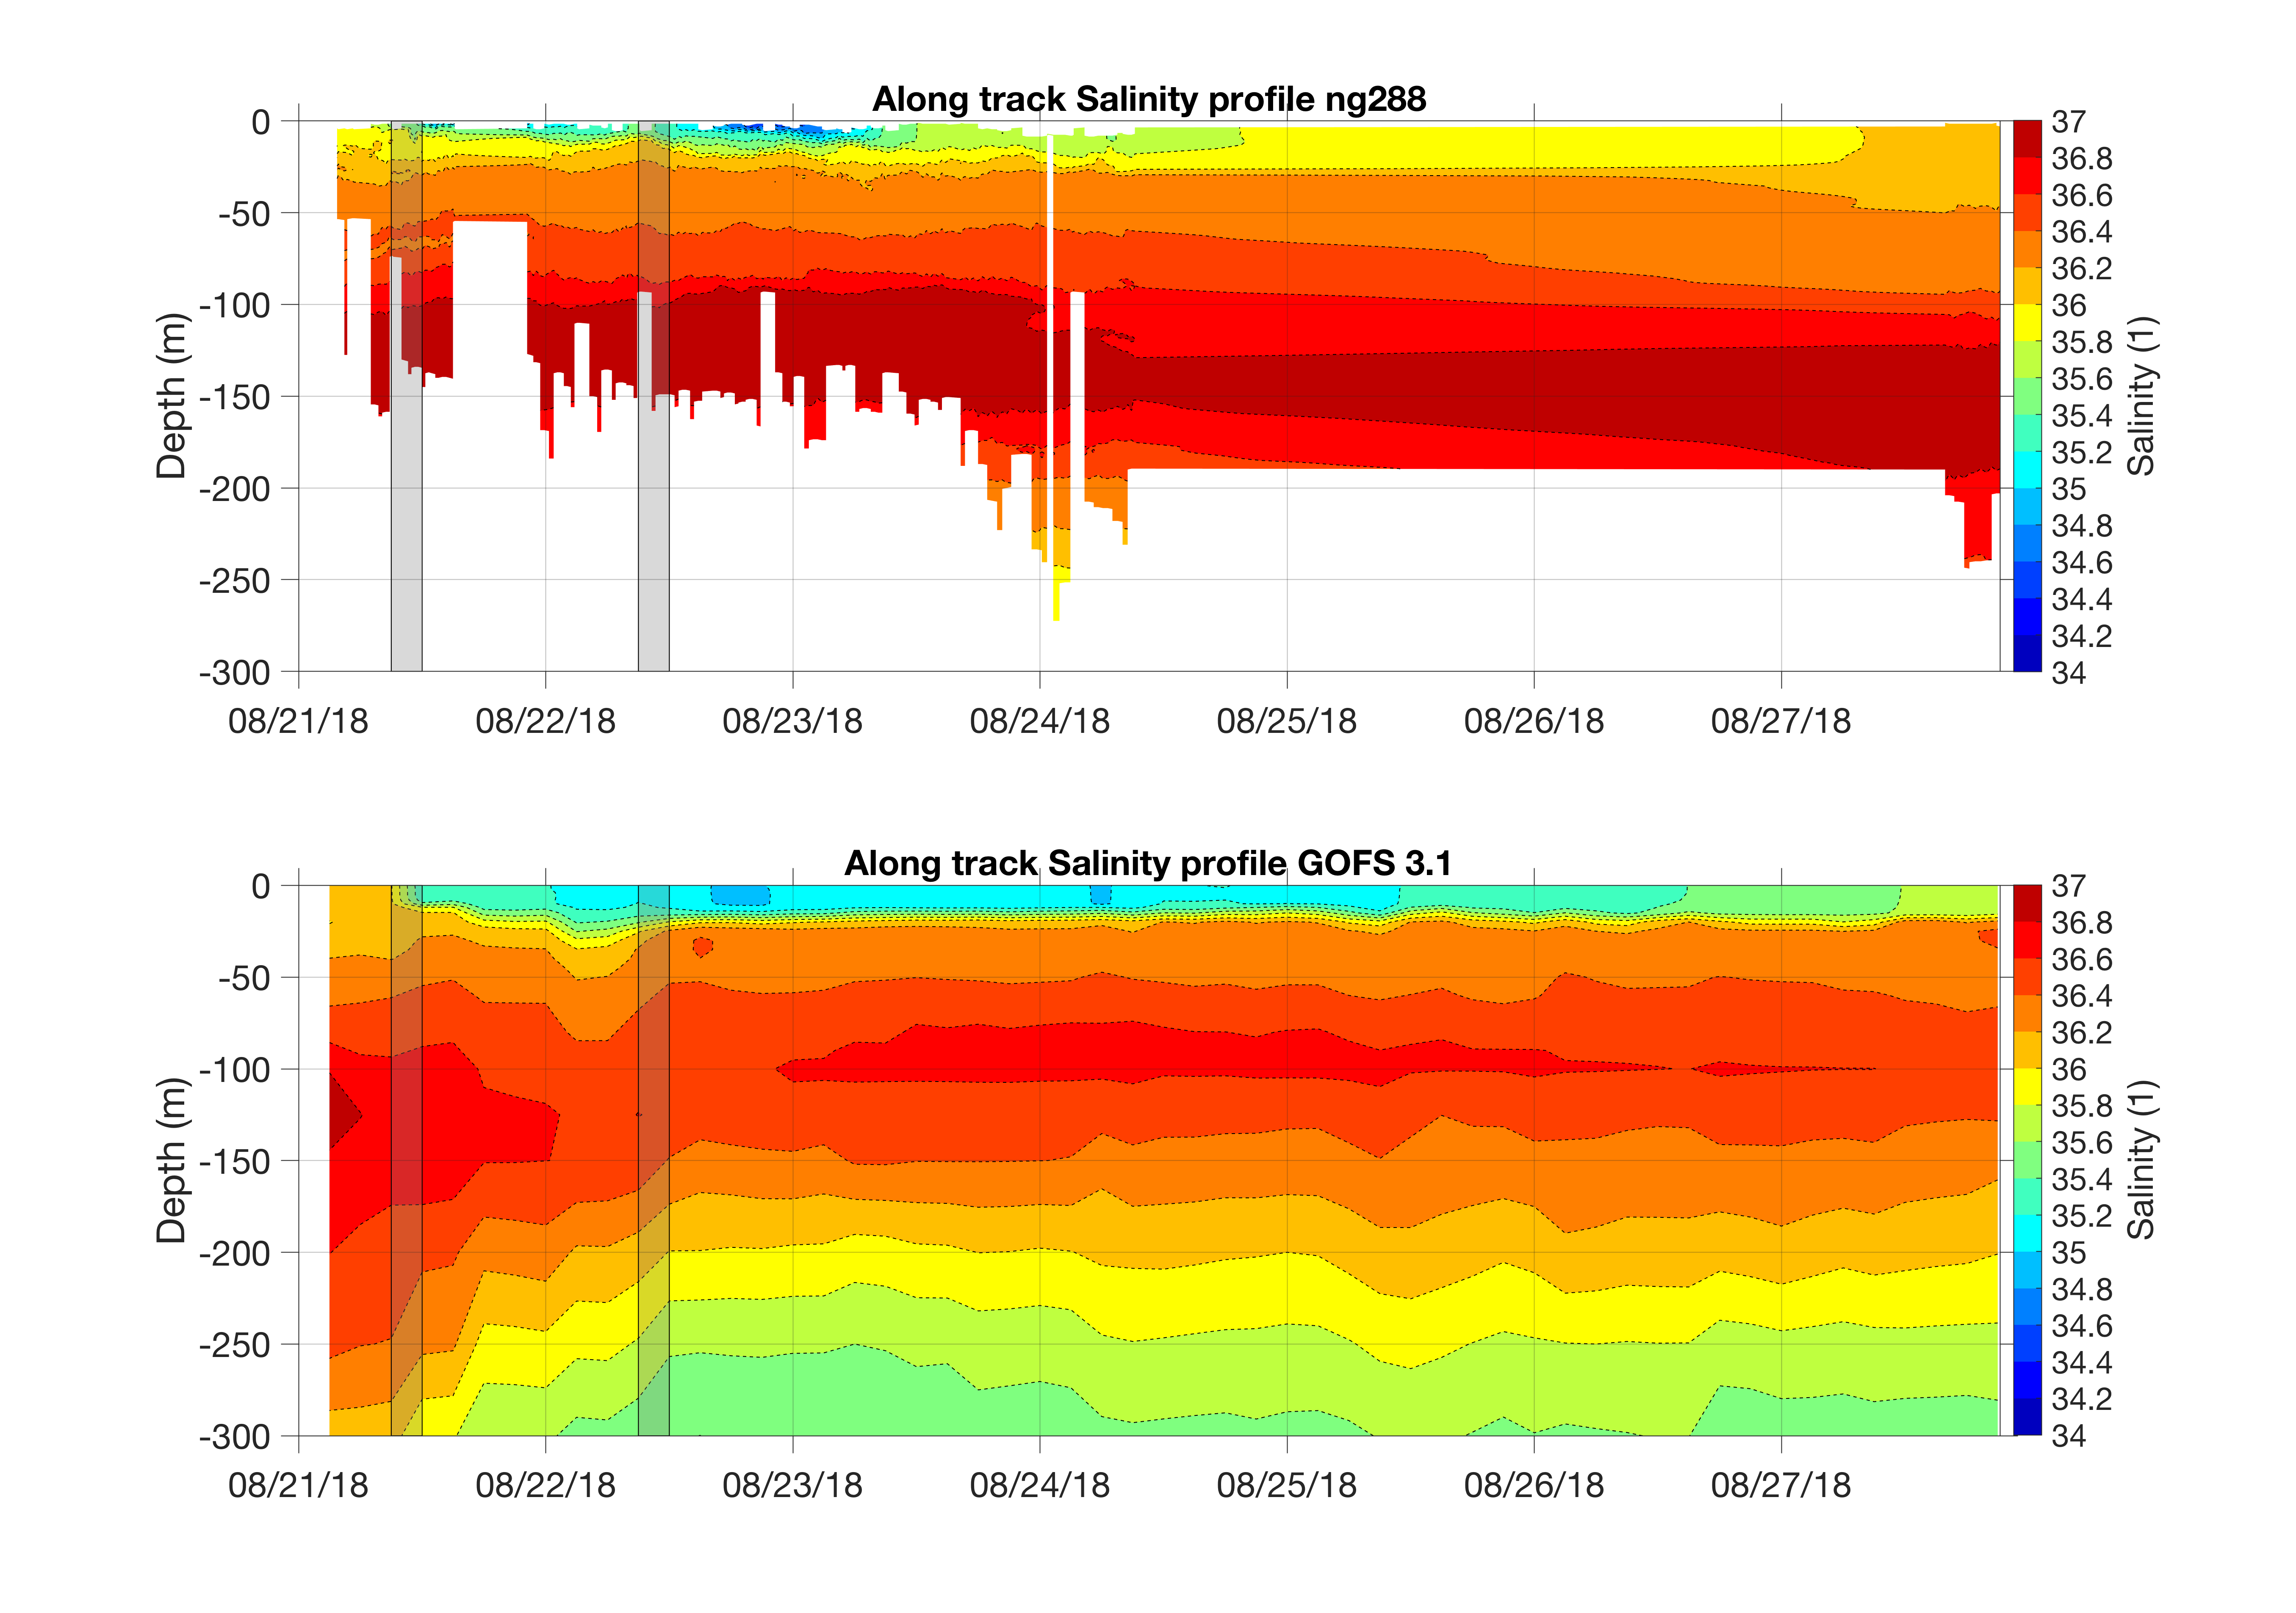
Ng288 before and after going to the GTS

Slide 20
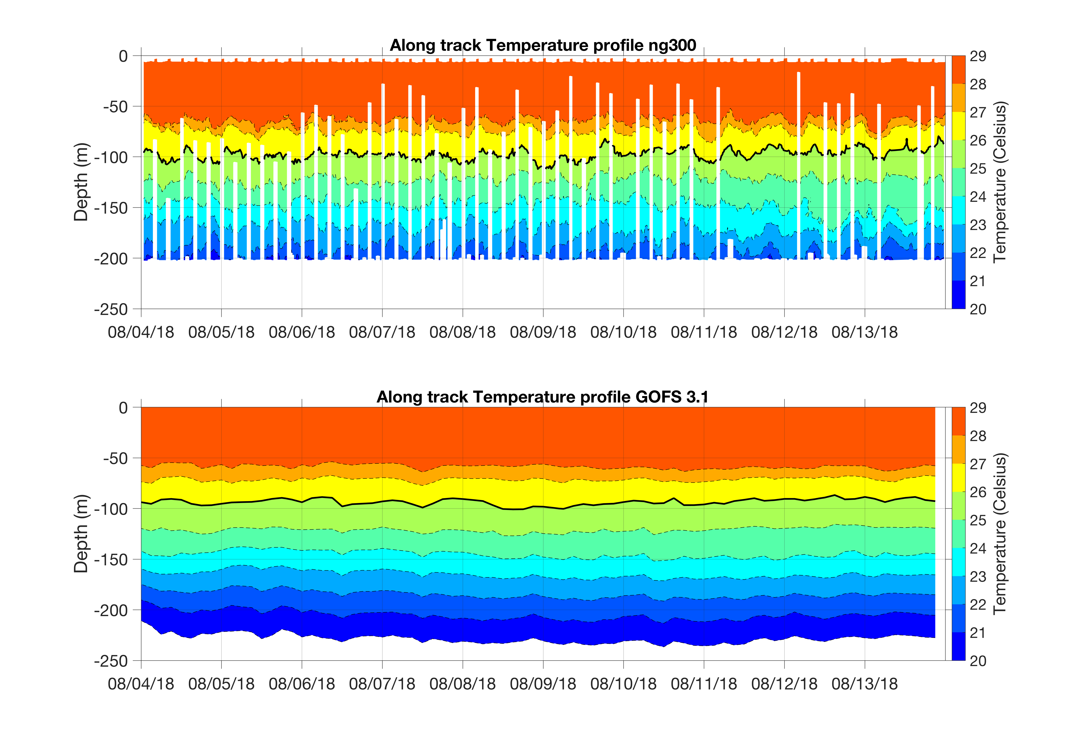
Ng300 before and after going to the GTS

Slide 21
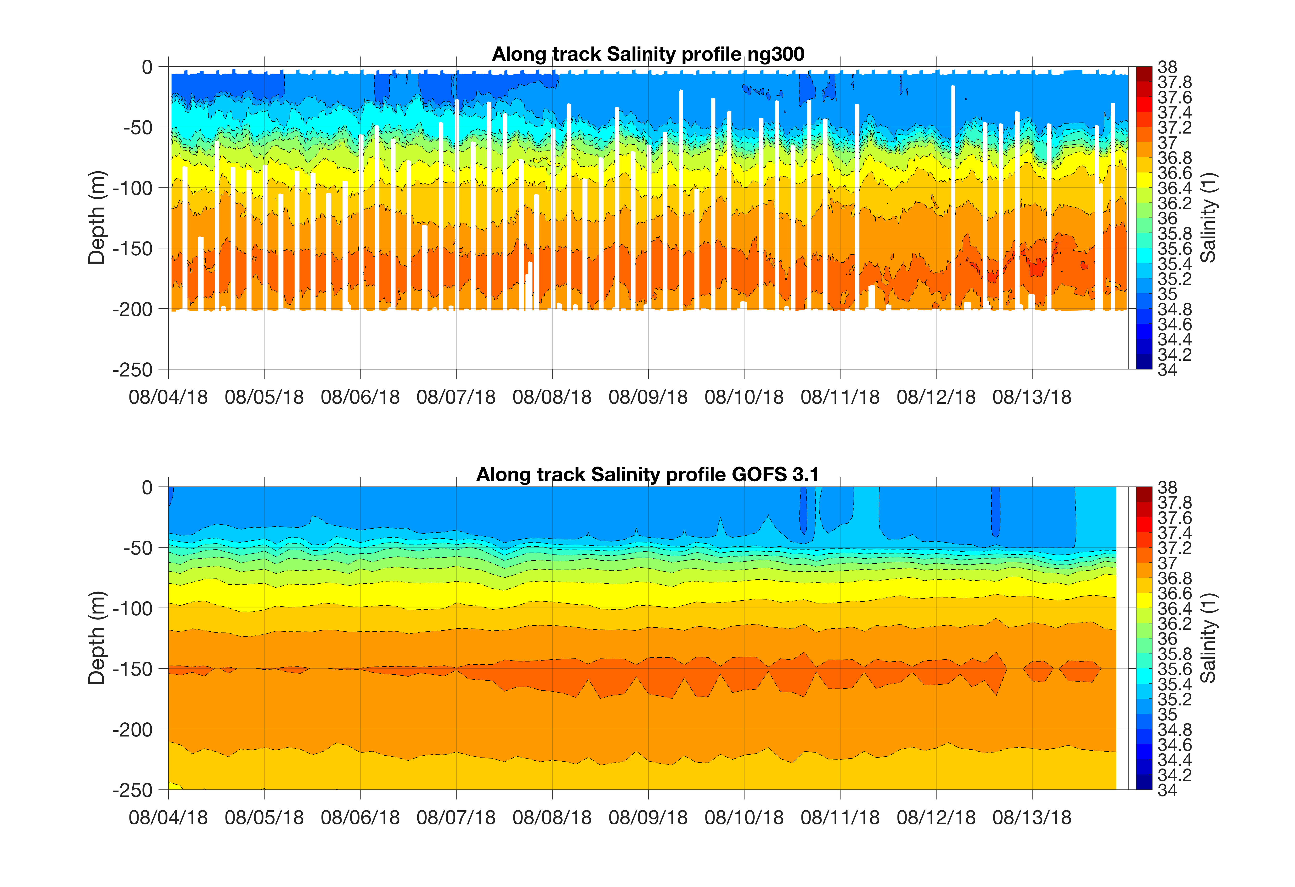
Ng300 before and after going to the GTS

Slide 22
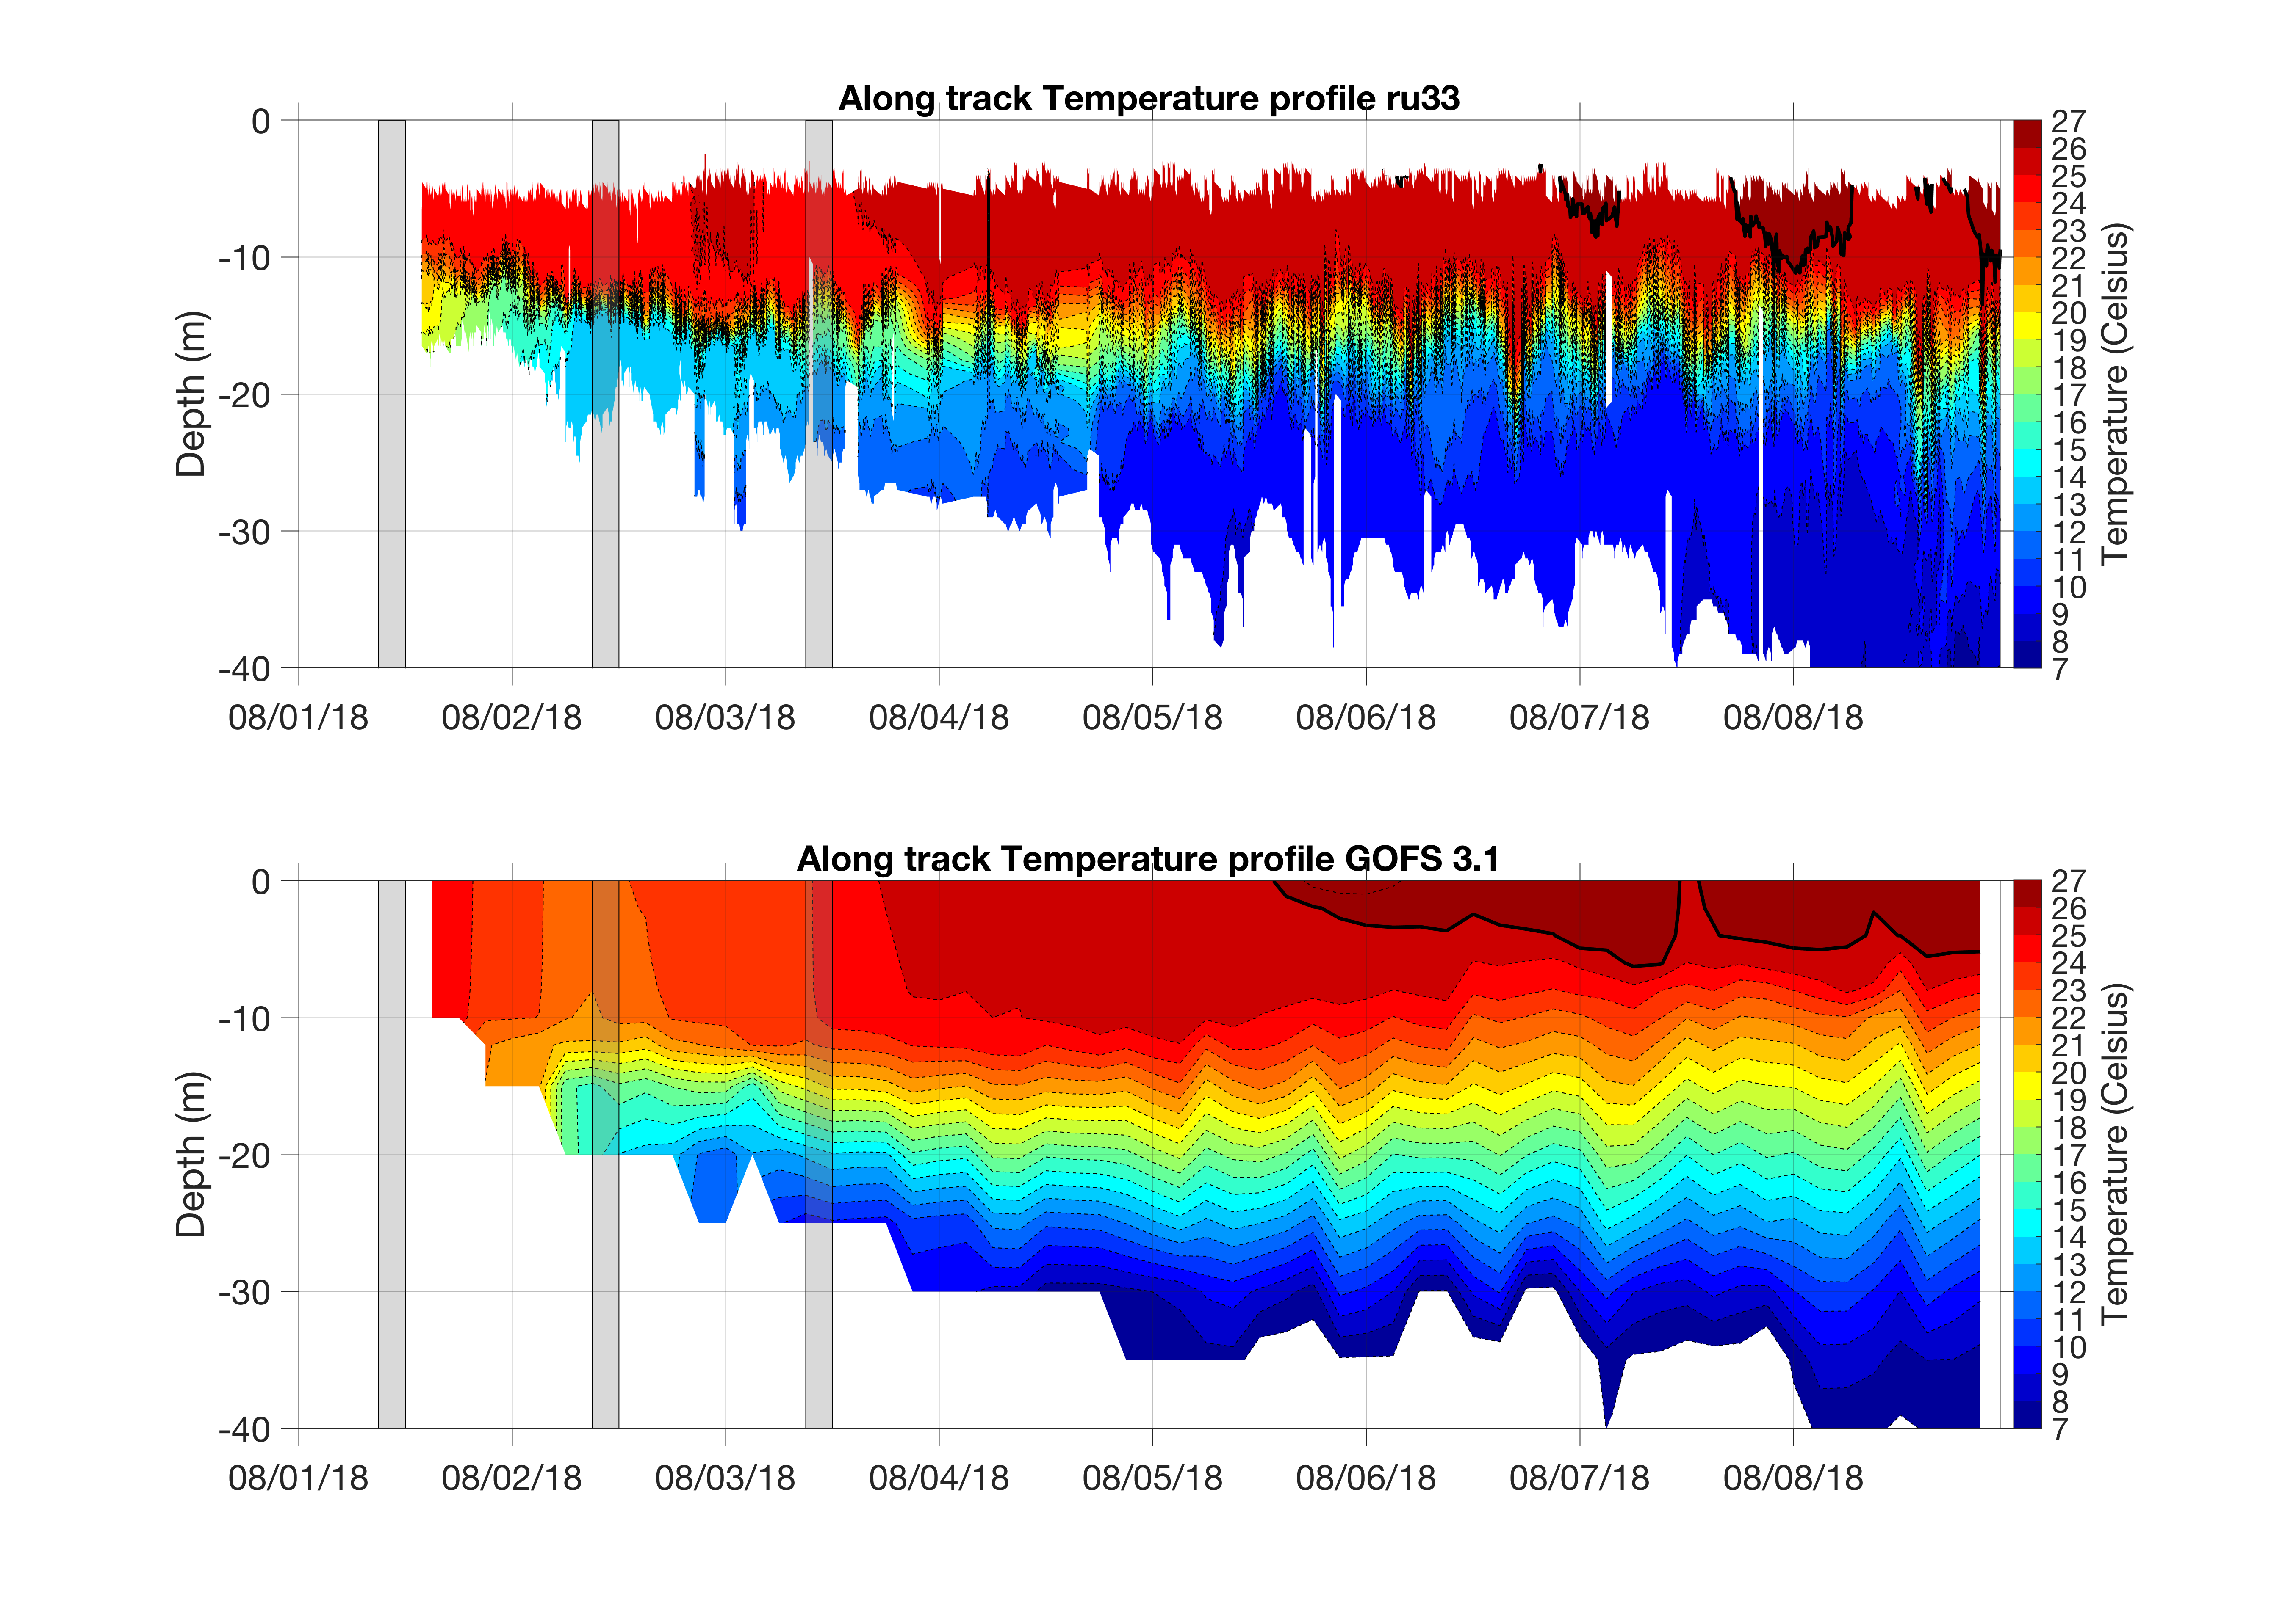
RU33 before and after going to the GTS

Slide 23
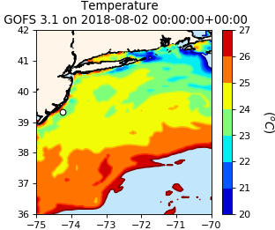
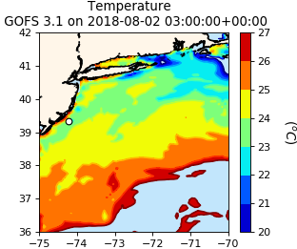
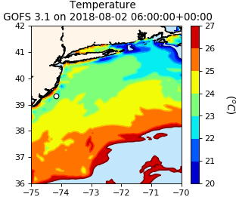
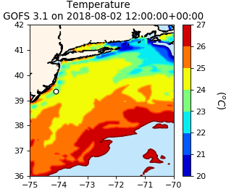

Slide 26
Cold pool?
10 degress
isotherm

Slide 28
RTOFS

Slide 30
https://podaac.jpl.nasa.gov/dataset/OSTM_L2_OST_OGDR_GPS
Ocean Surface Topography Mission/Jason-2 (OSTM)

Slide 31
GOES-16
(Geostationary Operational Enviromental Satellite)

Slide 32
NOAA AVHRR (From MARACOOS page)

Slide 33
AVHRR by OSI SAF
(Ocean and Sea Ice Satellite Application Facility)

