Slide 1
Initial Assessment of the Impact of Glider Data Assimilation on GOFS 3.1
Photos from USVI

Slide 2
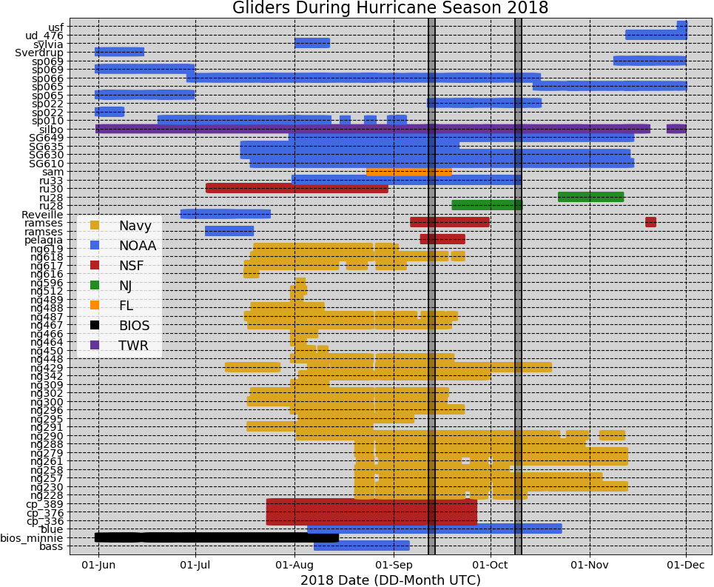
Gliders in IOOS Glider DAC during Hurricane Season 2018

Slide 3
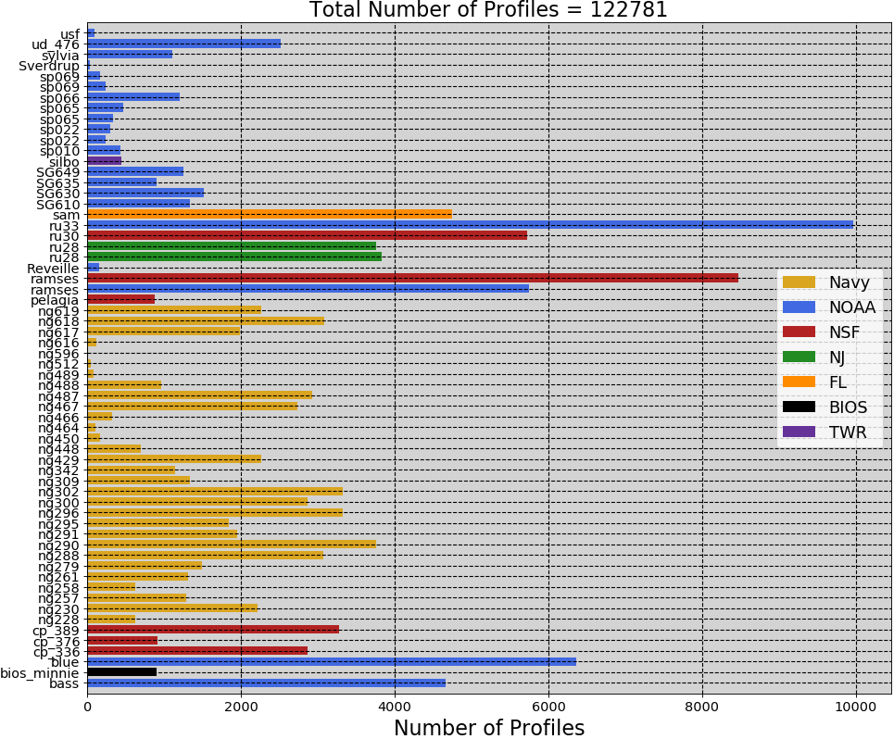

Slide 4
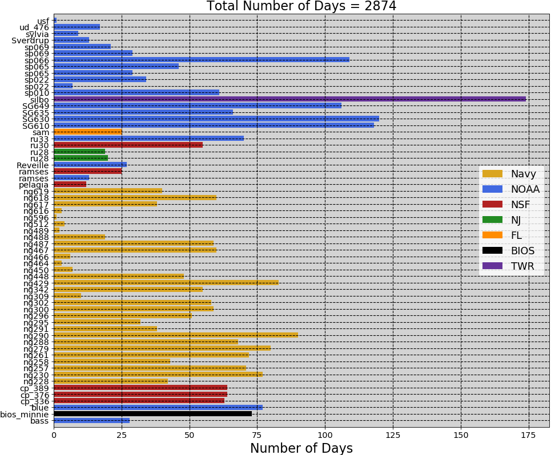

Slide 5
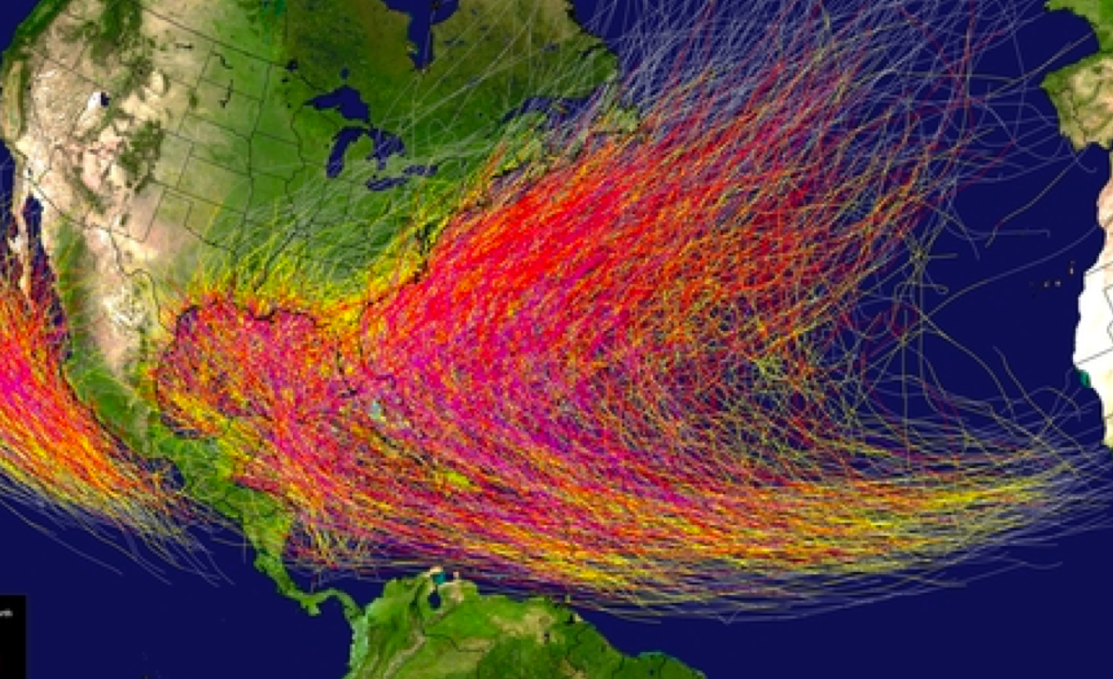
Regions of interest:
MAB,SAB,Gulf of Mexico,Caribbean,
And Yellow Sea

Slide 6
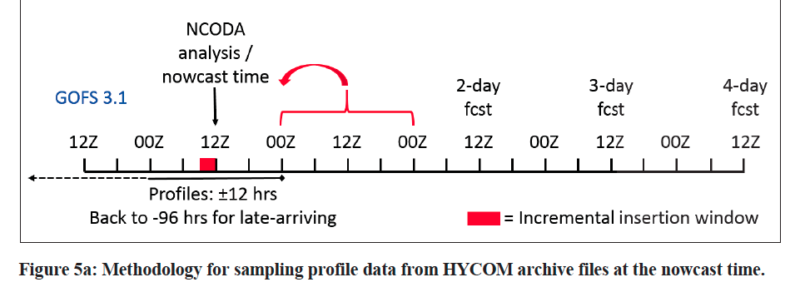
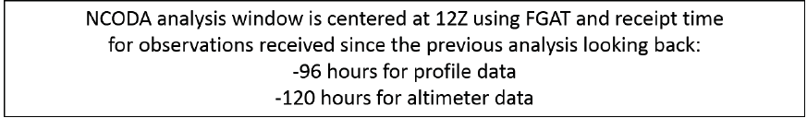
Time of NCODA increments ?
FGAT: First Guess at Appropriate Time

Slide 7
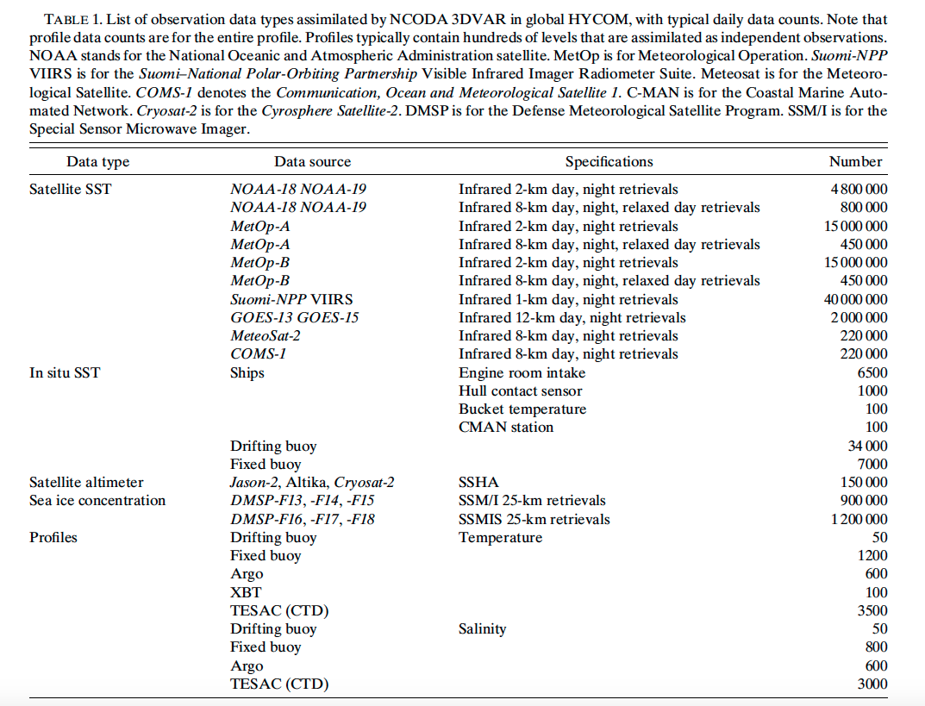
Cummings and Smedstad 2014

Slide 8
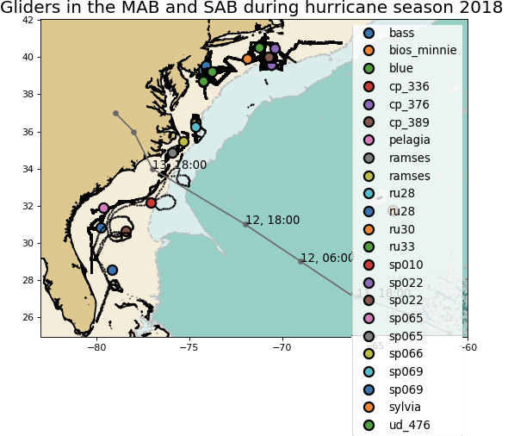
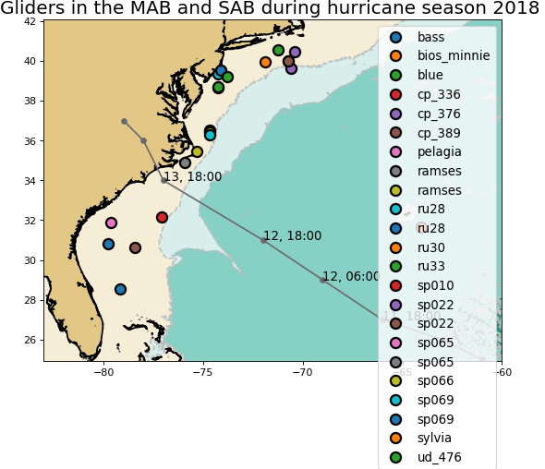
Middle Atlantic Bight

Slide 9
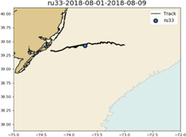
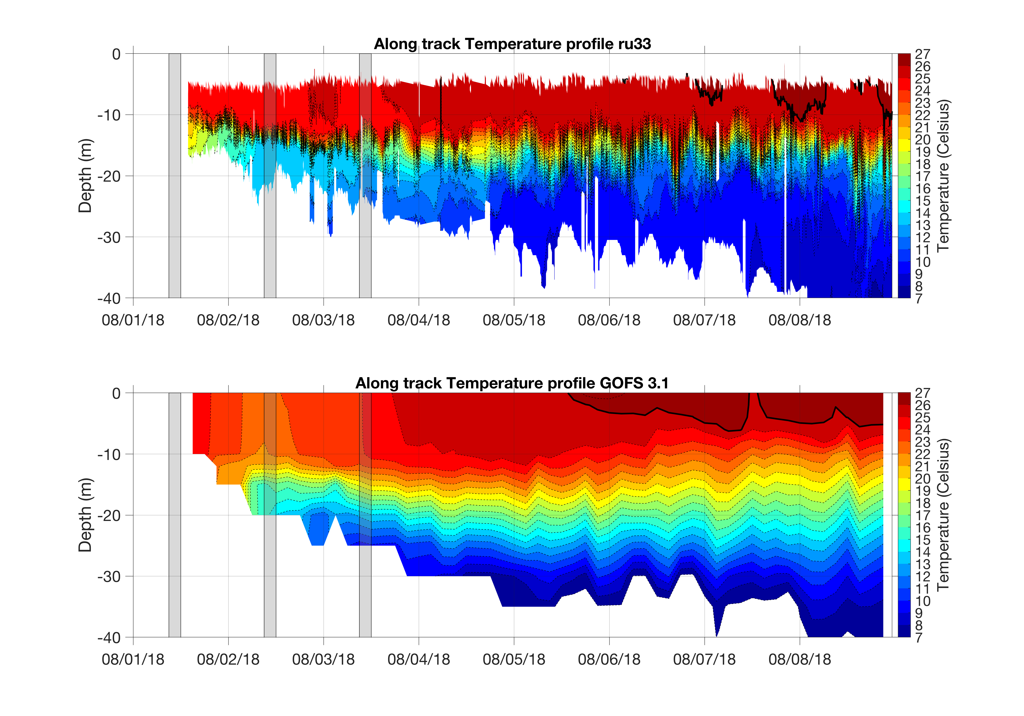
RU33 before and after going to the GTS
Weaker vertical stratification

Slide 10
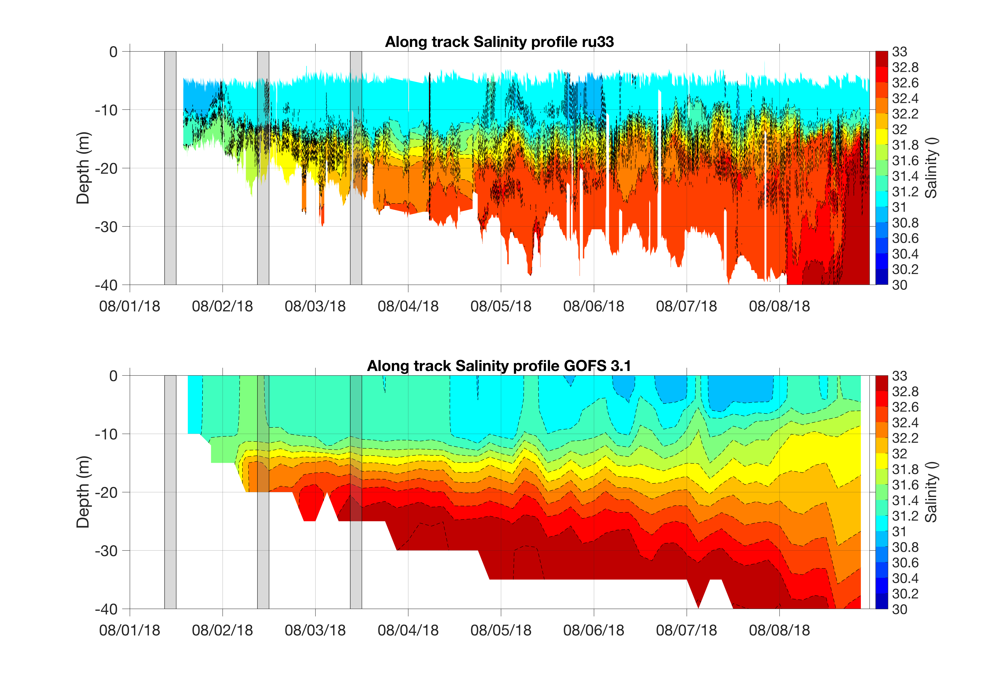

Slide 11
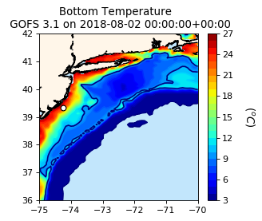







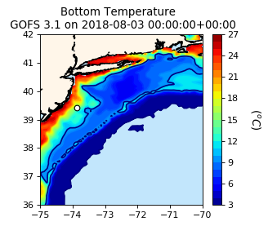
Cold pool?
10 degrees
isotherm

Slide 12
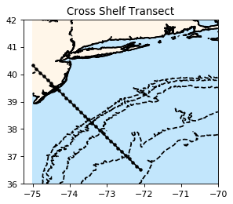
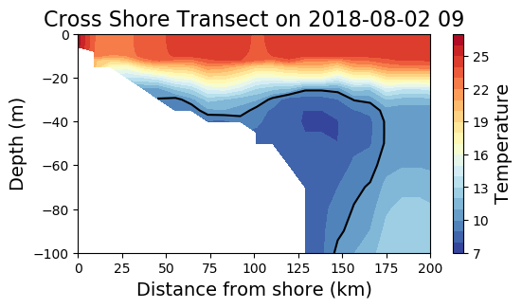
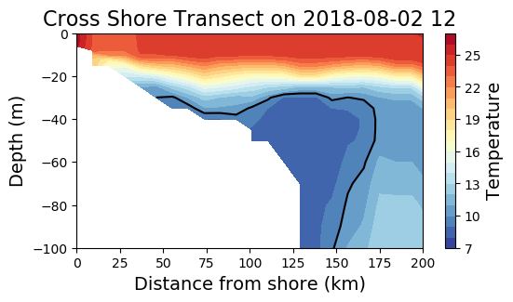

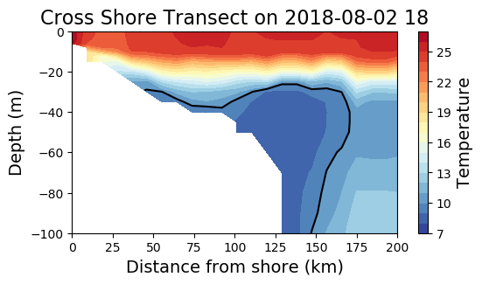
Cross Shore Transects from
GOFS 3.1

Slide 13
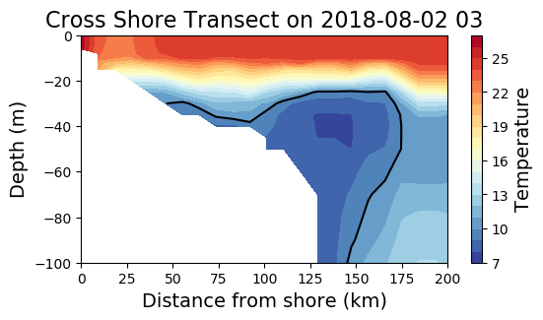


Slide 14
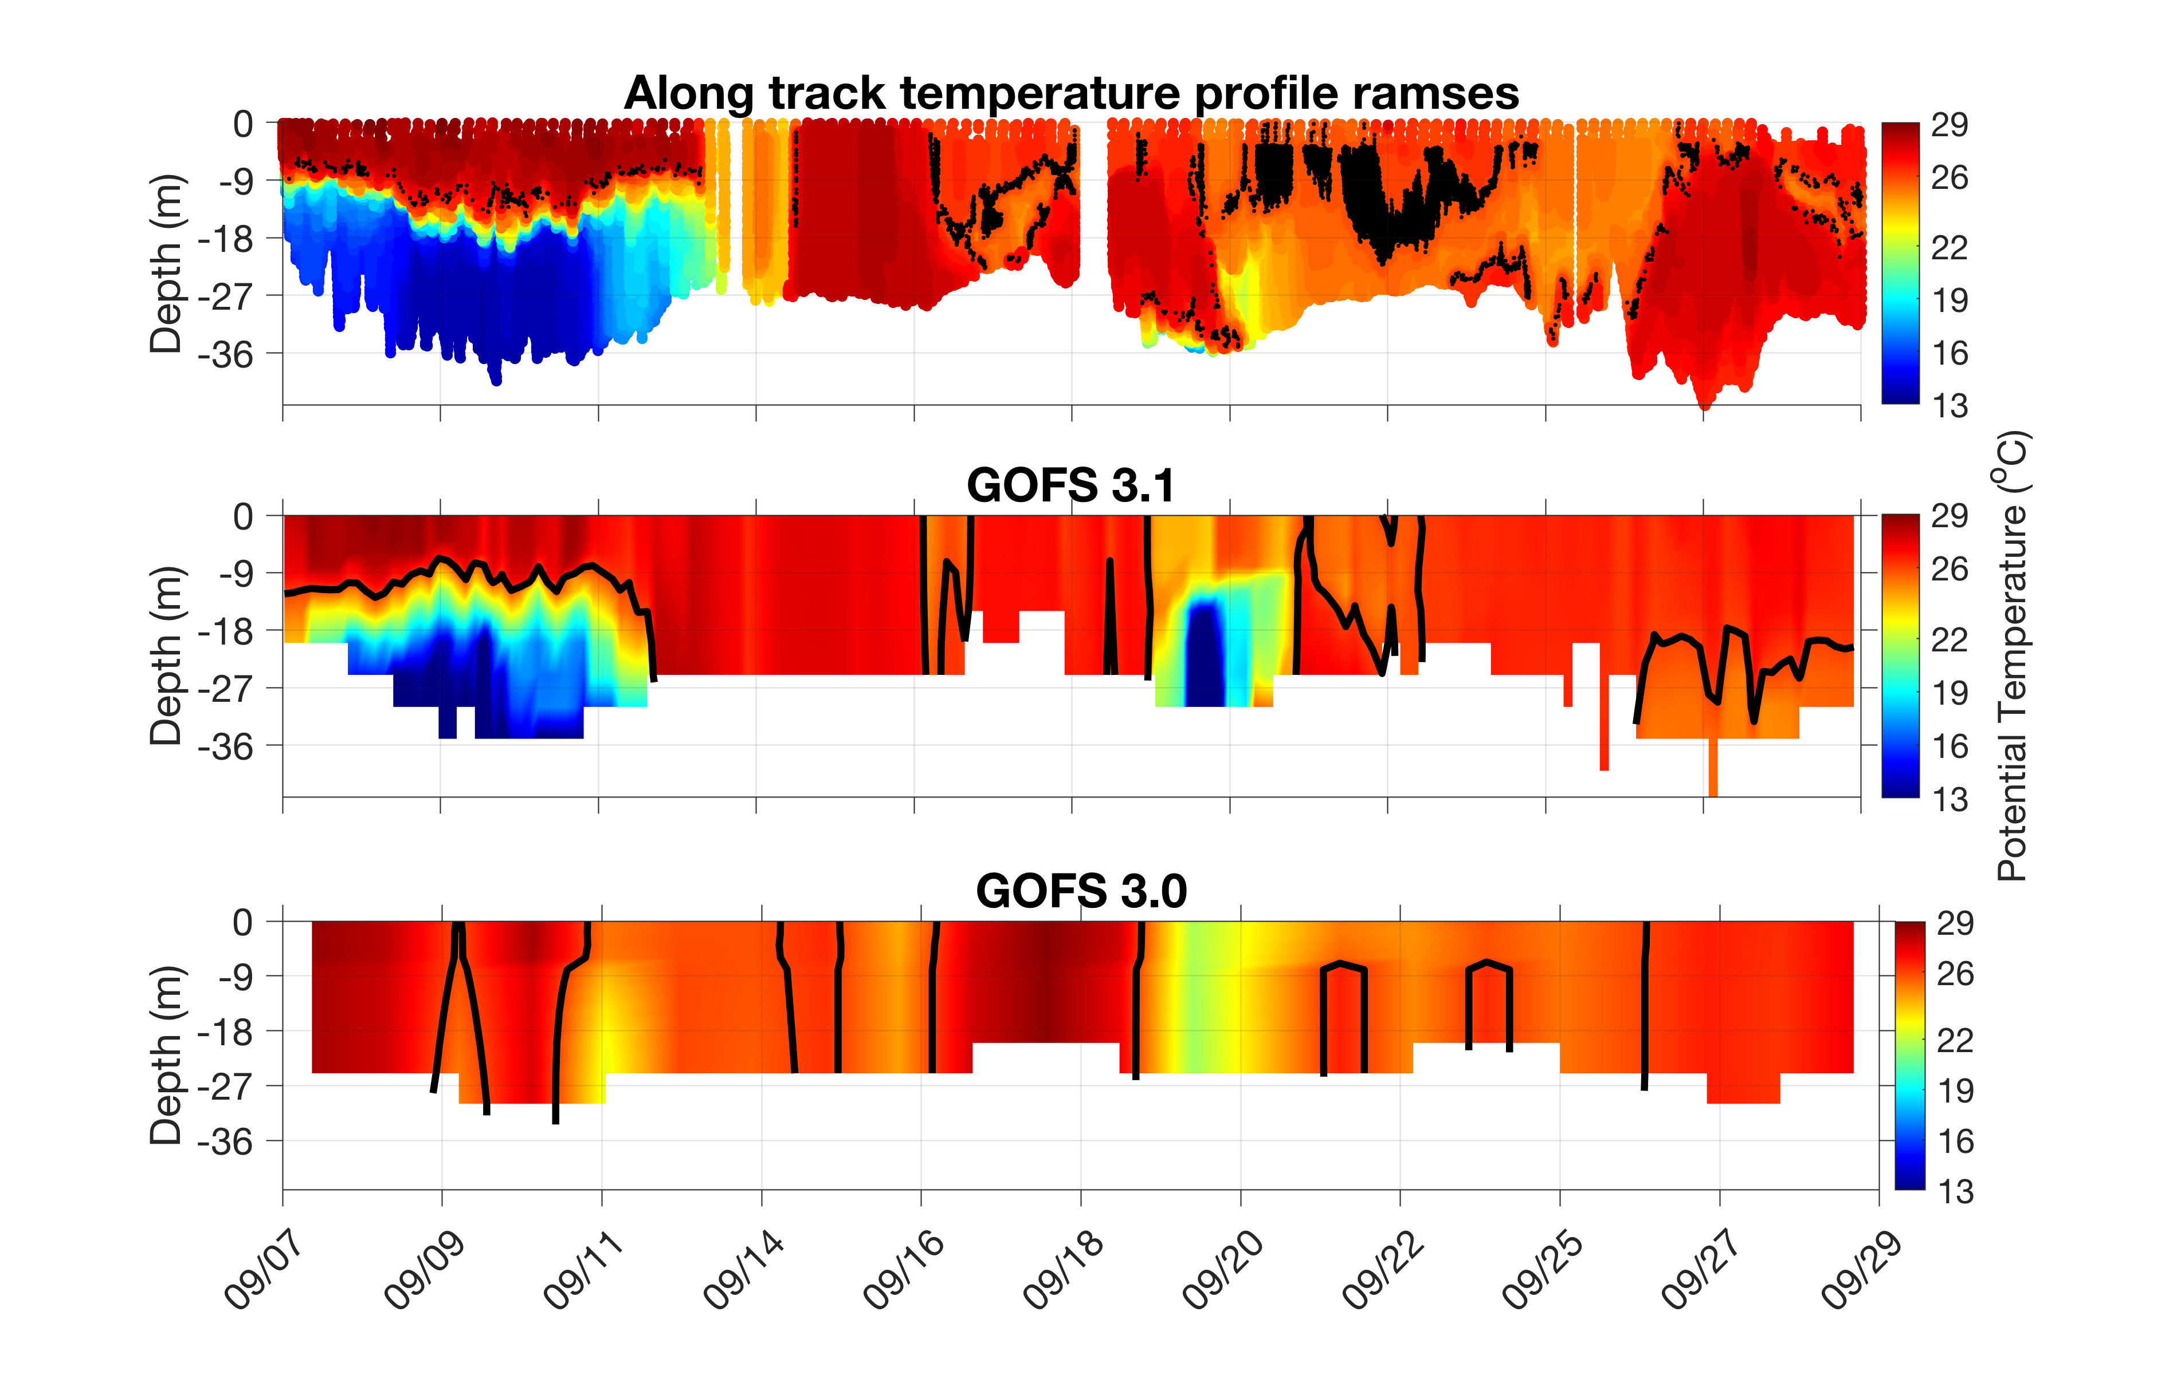
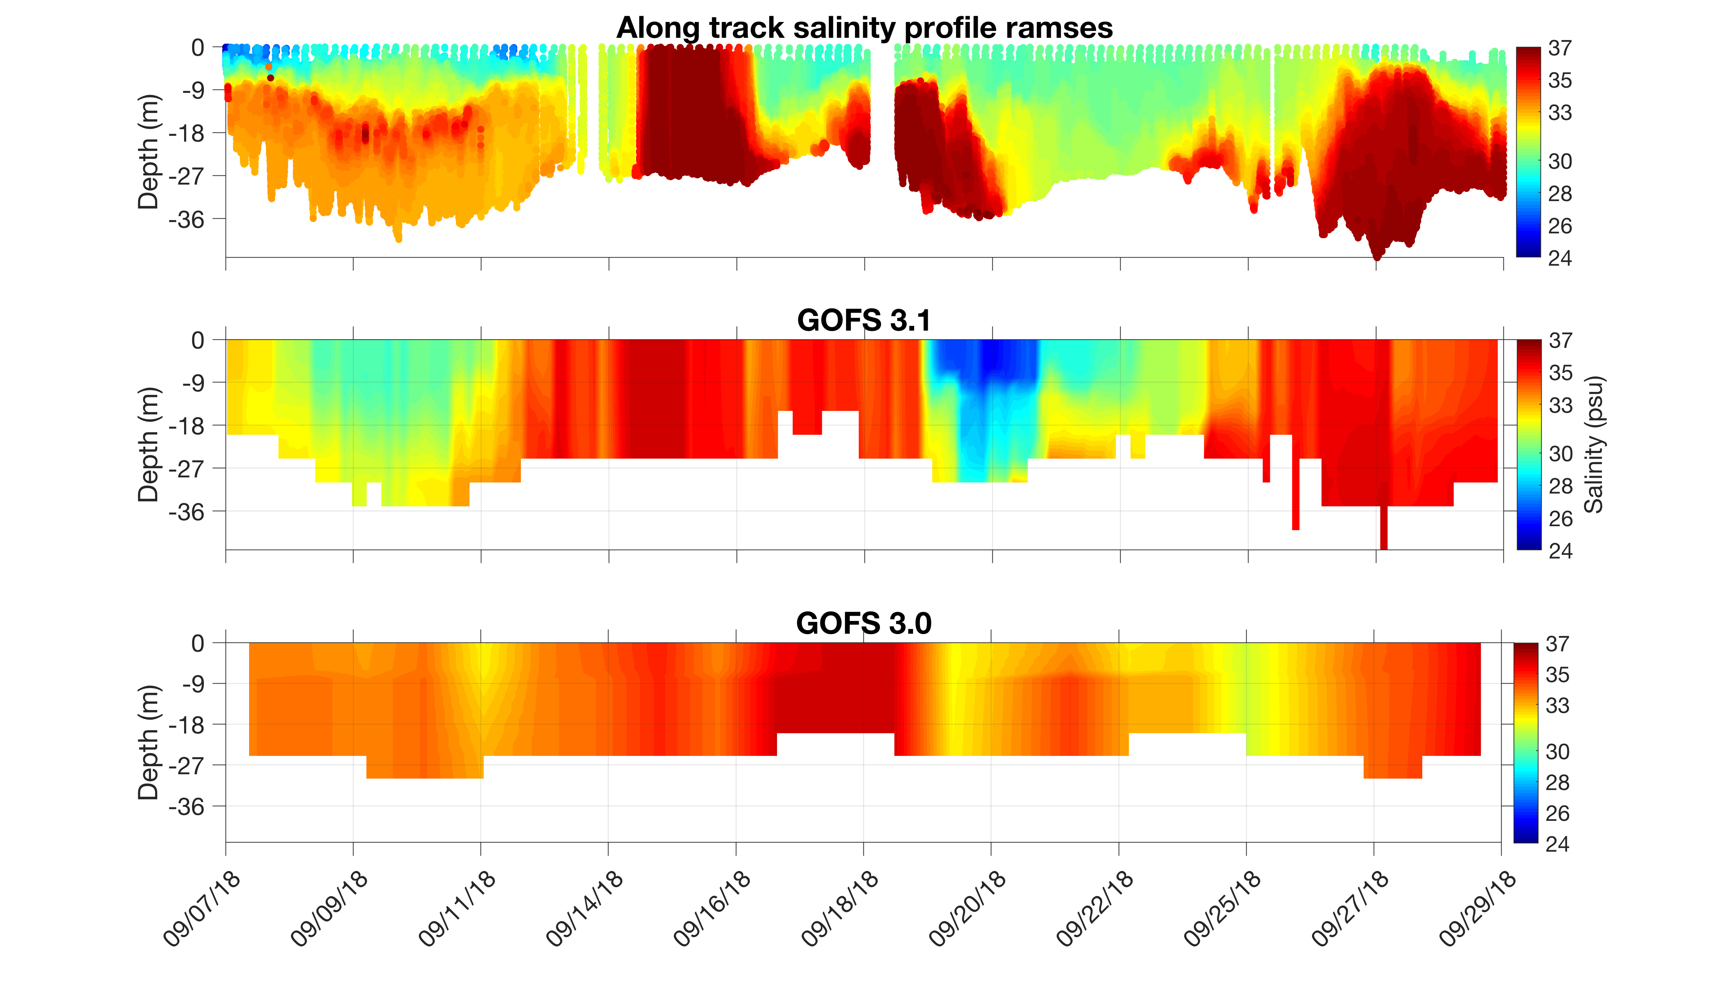
South-Middle Atlantic Bight Transition Zone
Add map?
Florence

Slide 15
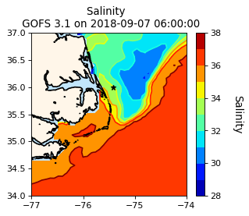
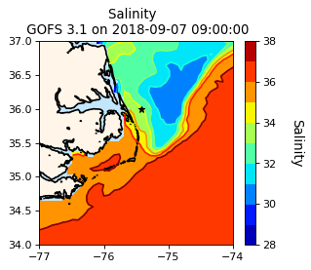
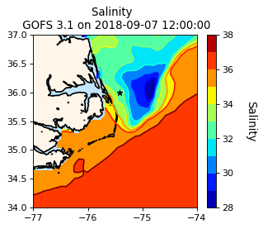
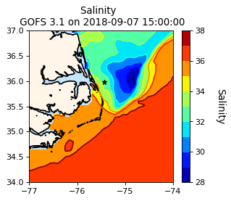
GOFS 3.1 Surface Salinity

Slide 16
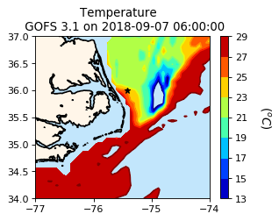
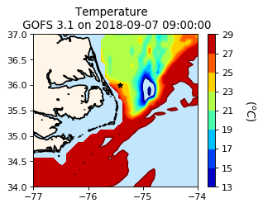
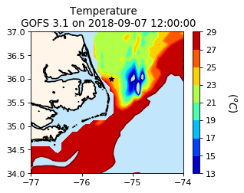
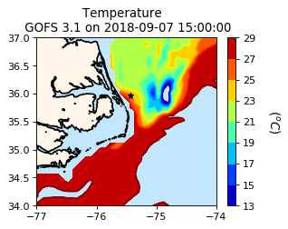
GOFS 3.1 Temperature at 15 m

Slide 17
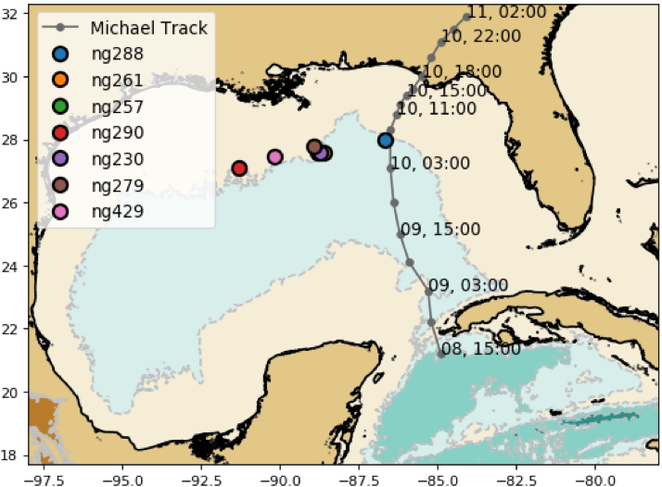
Gulf of Mexico: Hurricane Michael

Slide 18
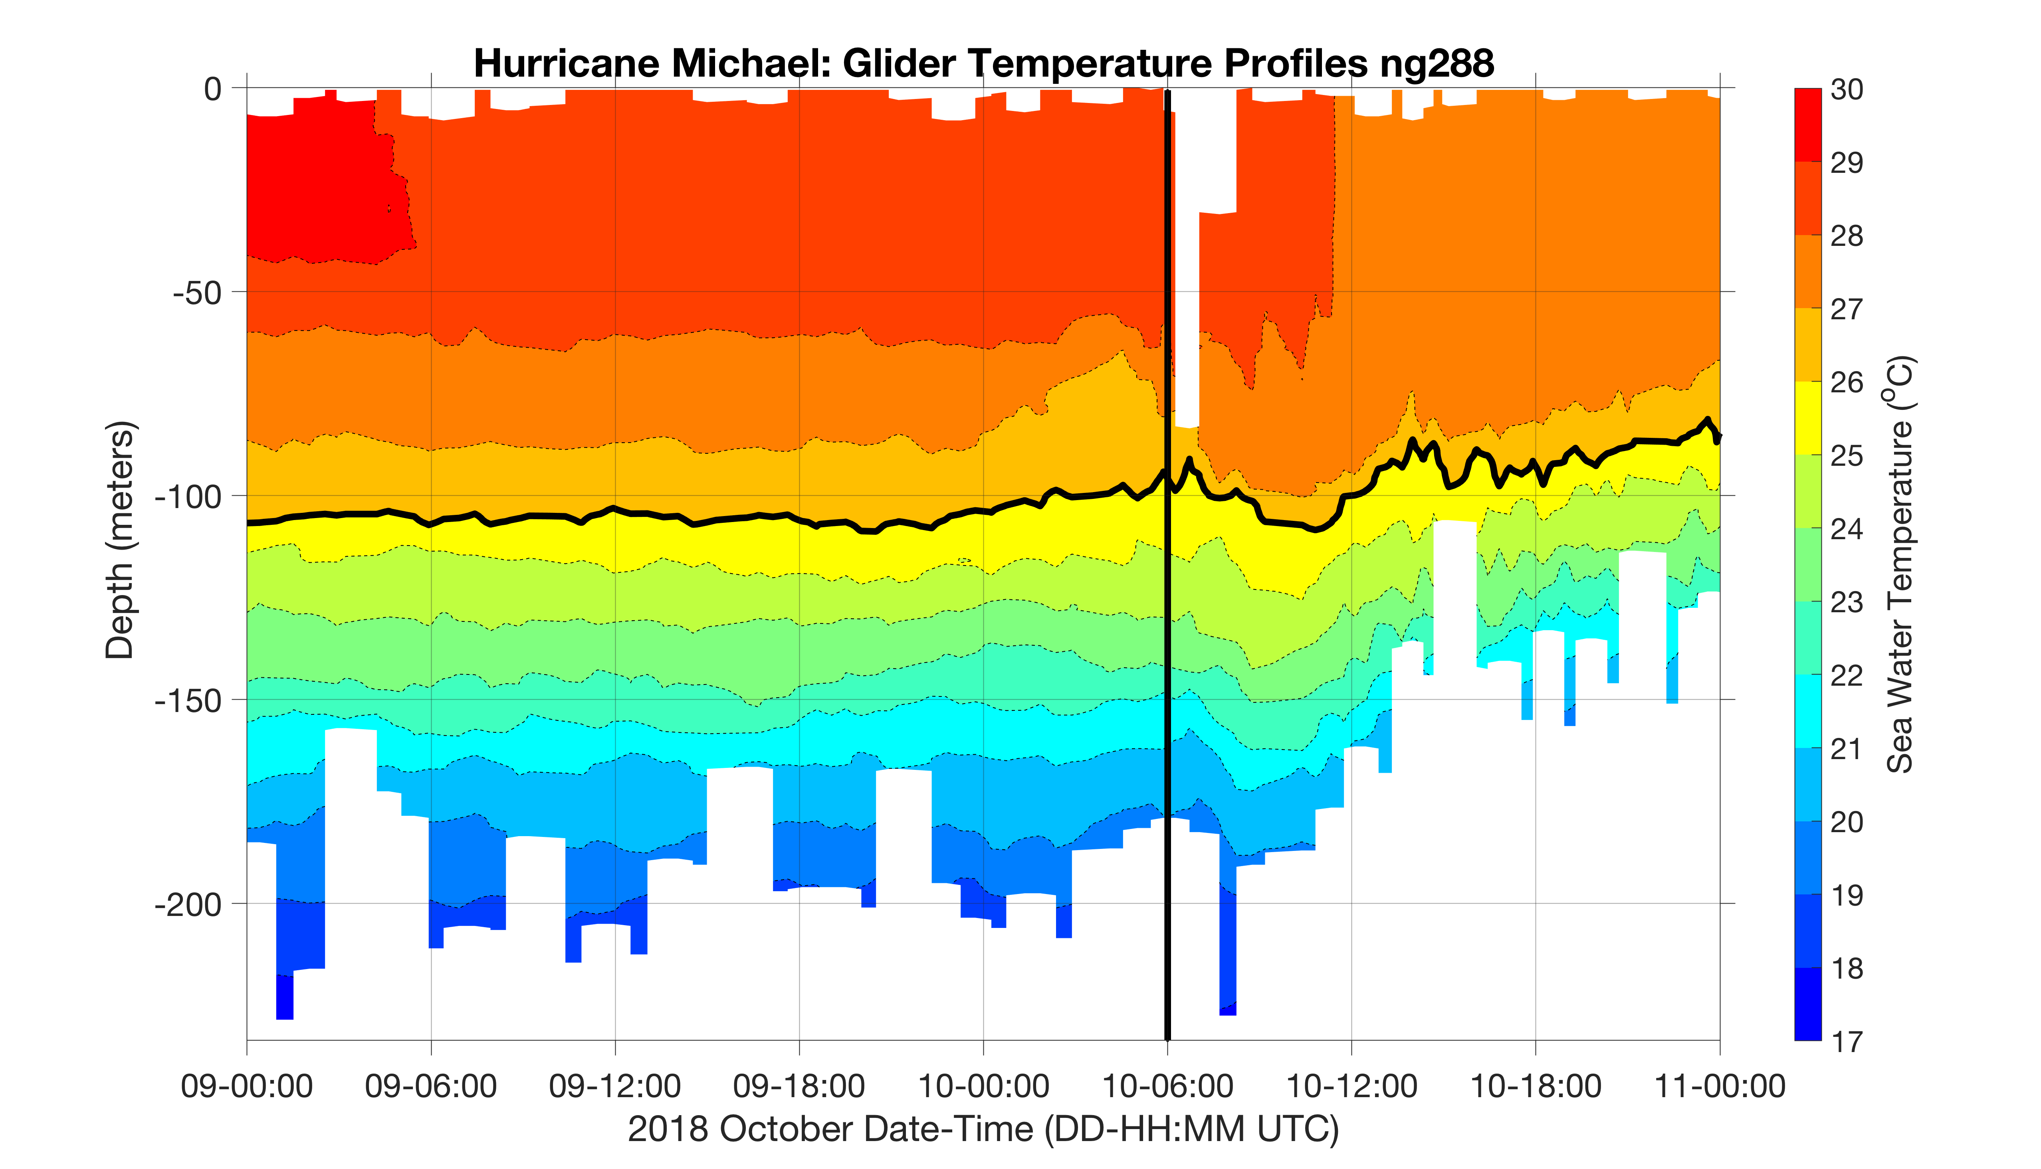
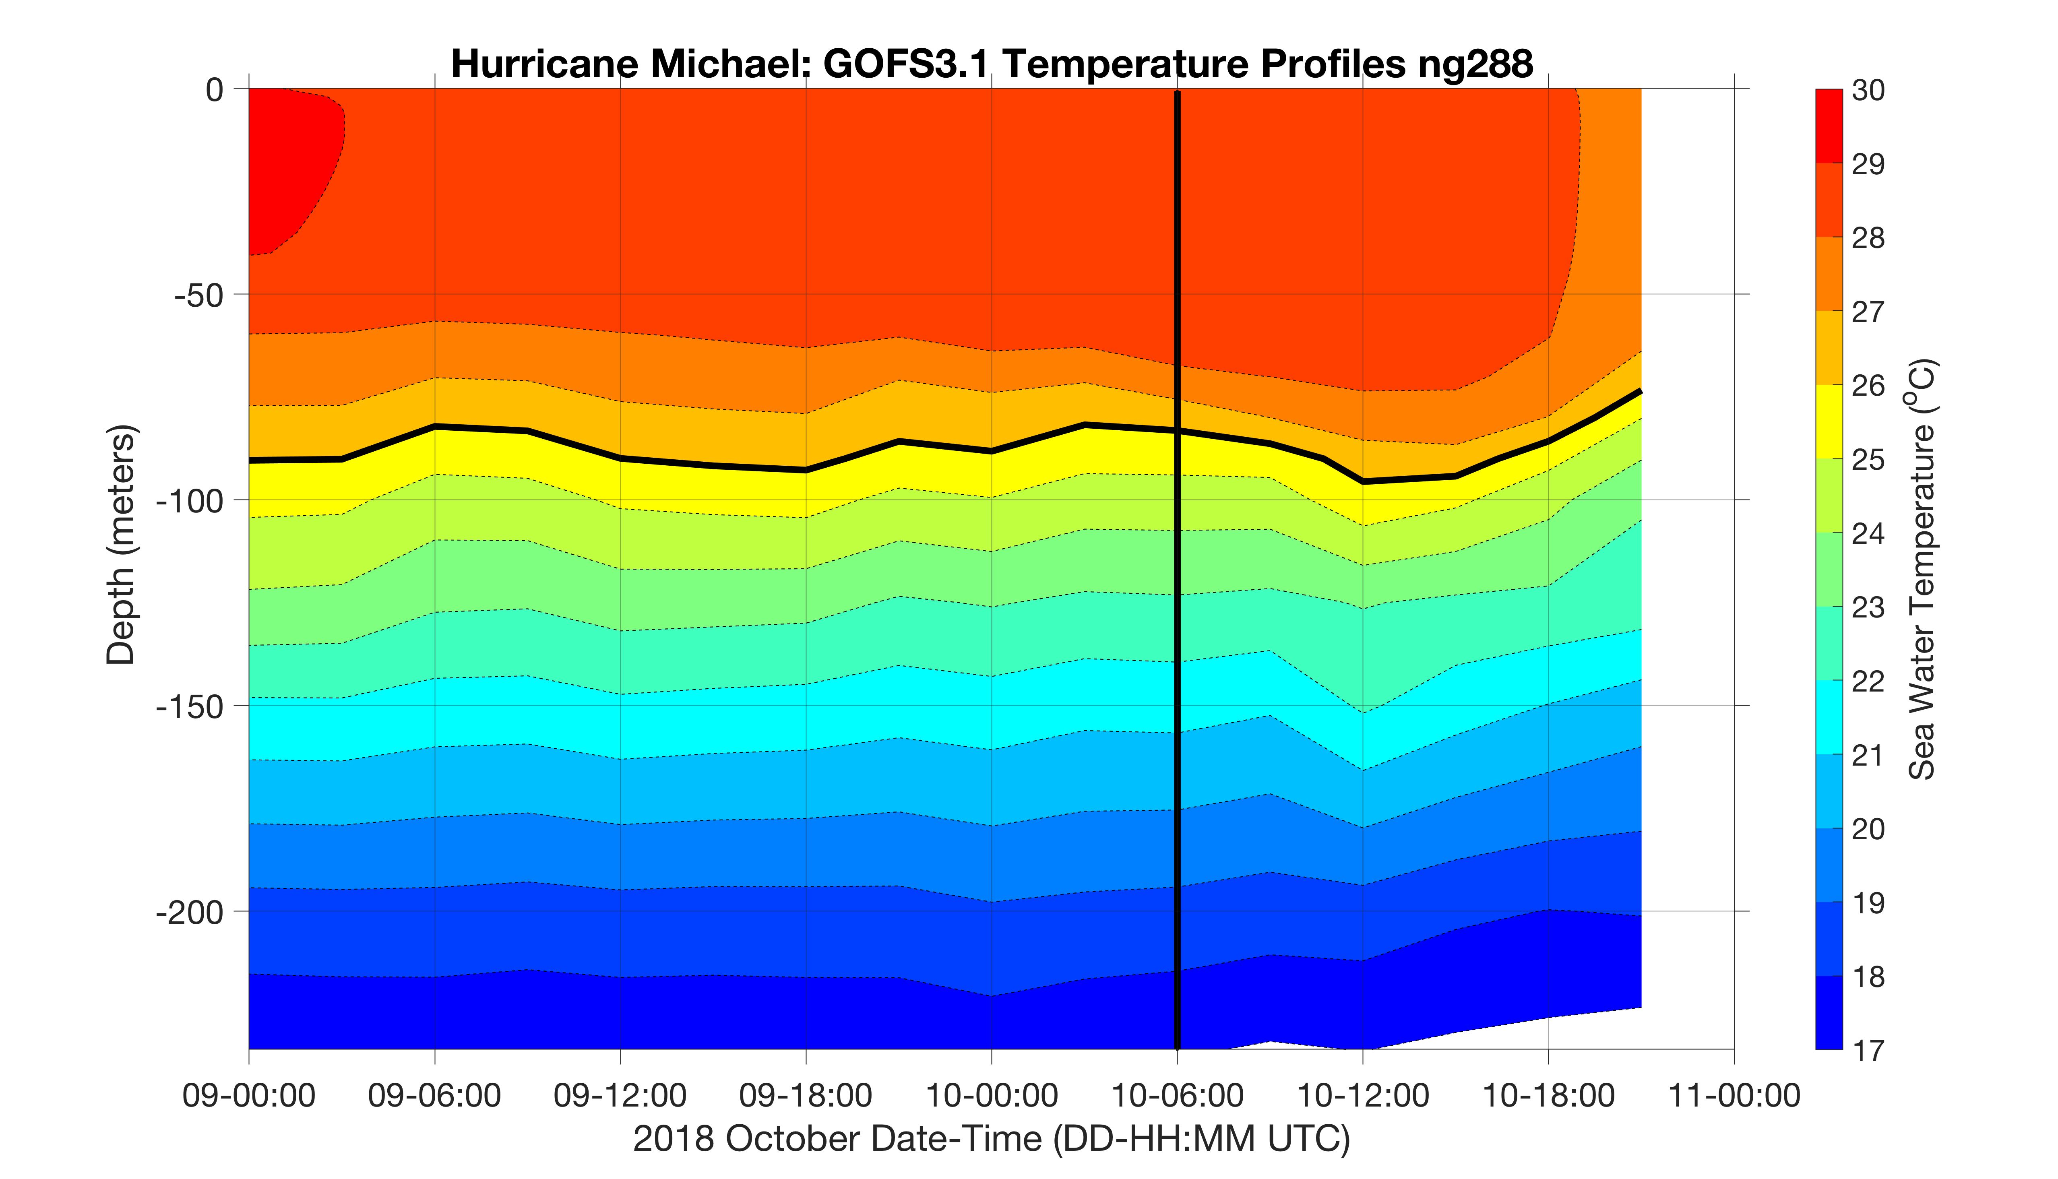
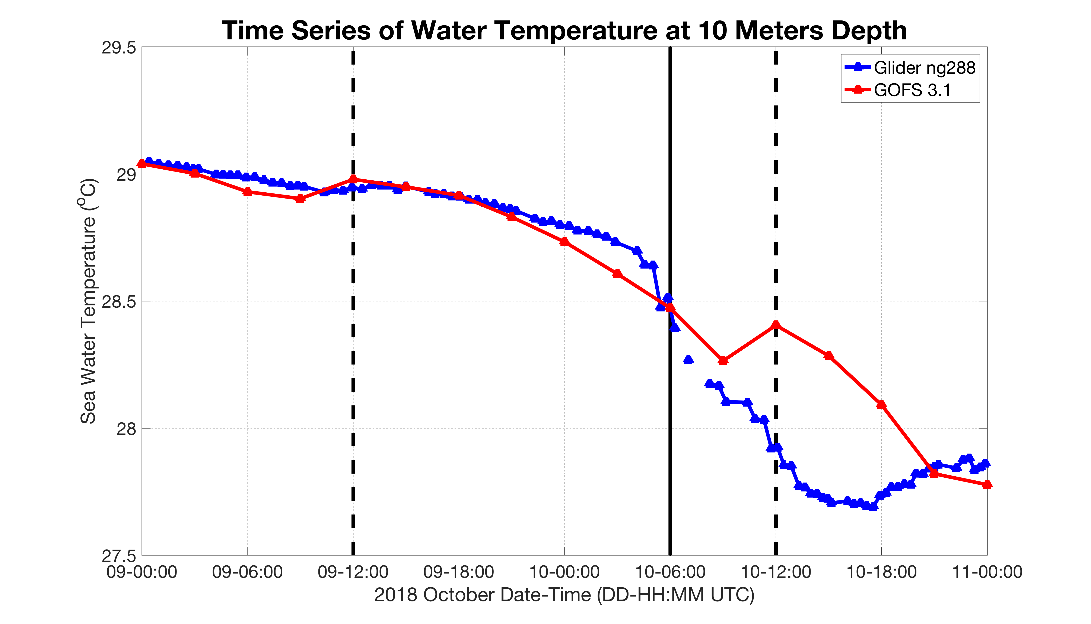
Michael

Slide 19
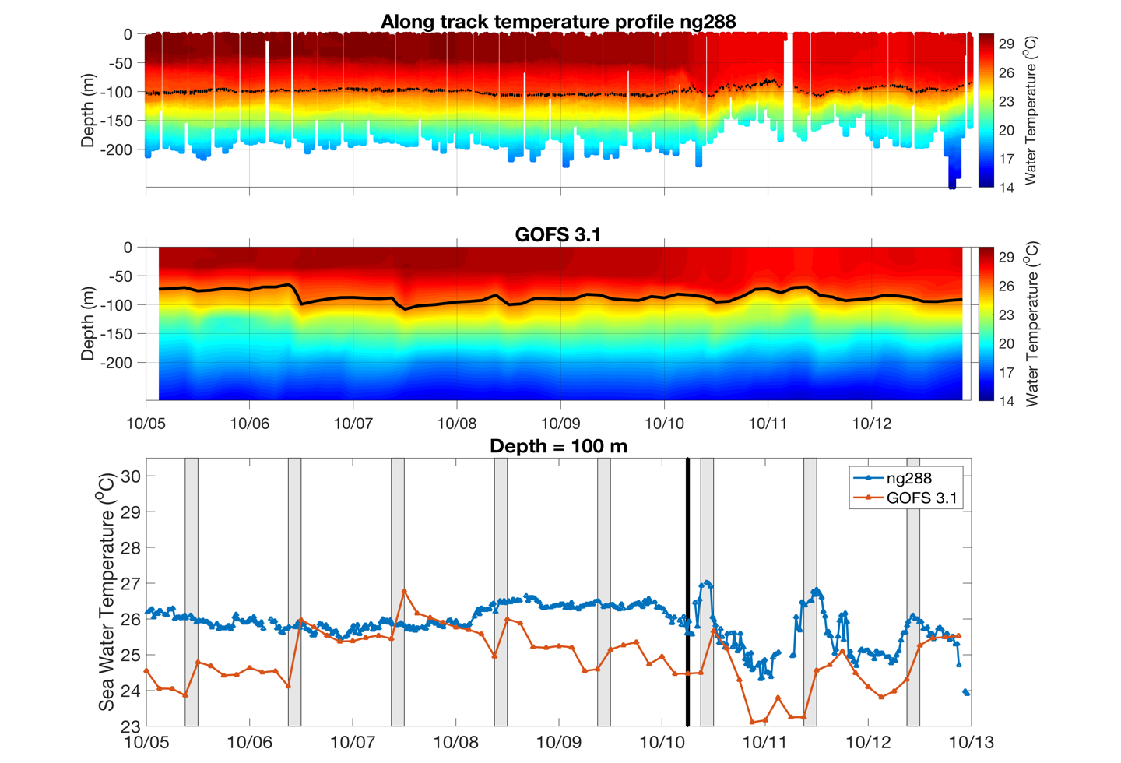

Slide 20
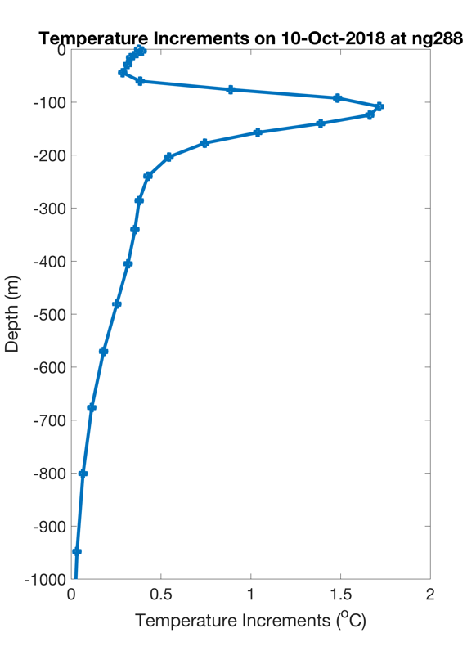
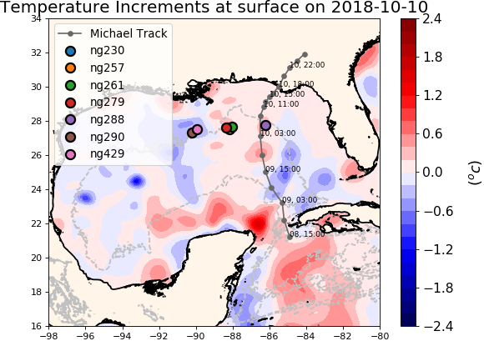
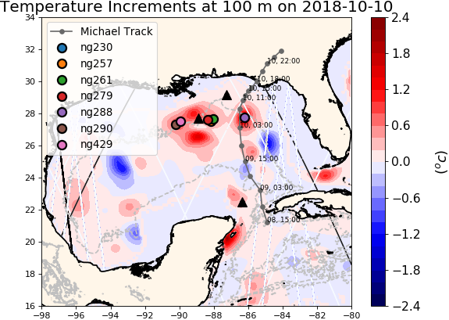
NCODA Temperature Increments
Repeat figure
Argo
Jason 2
CryoSat

Slide 21
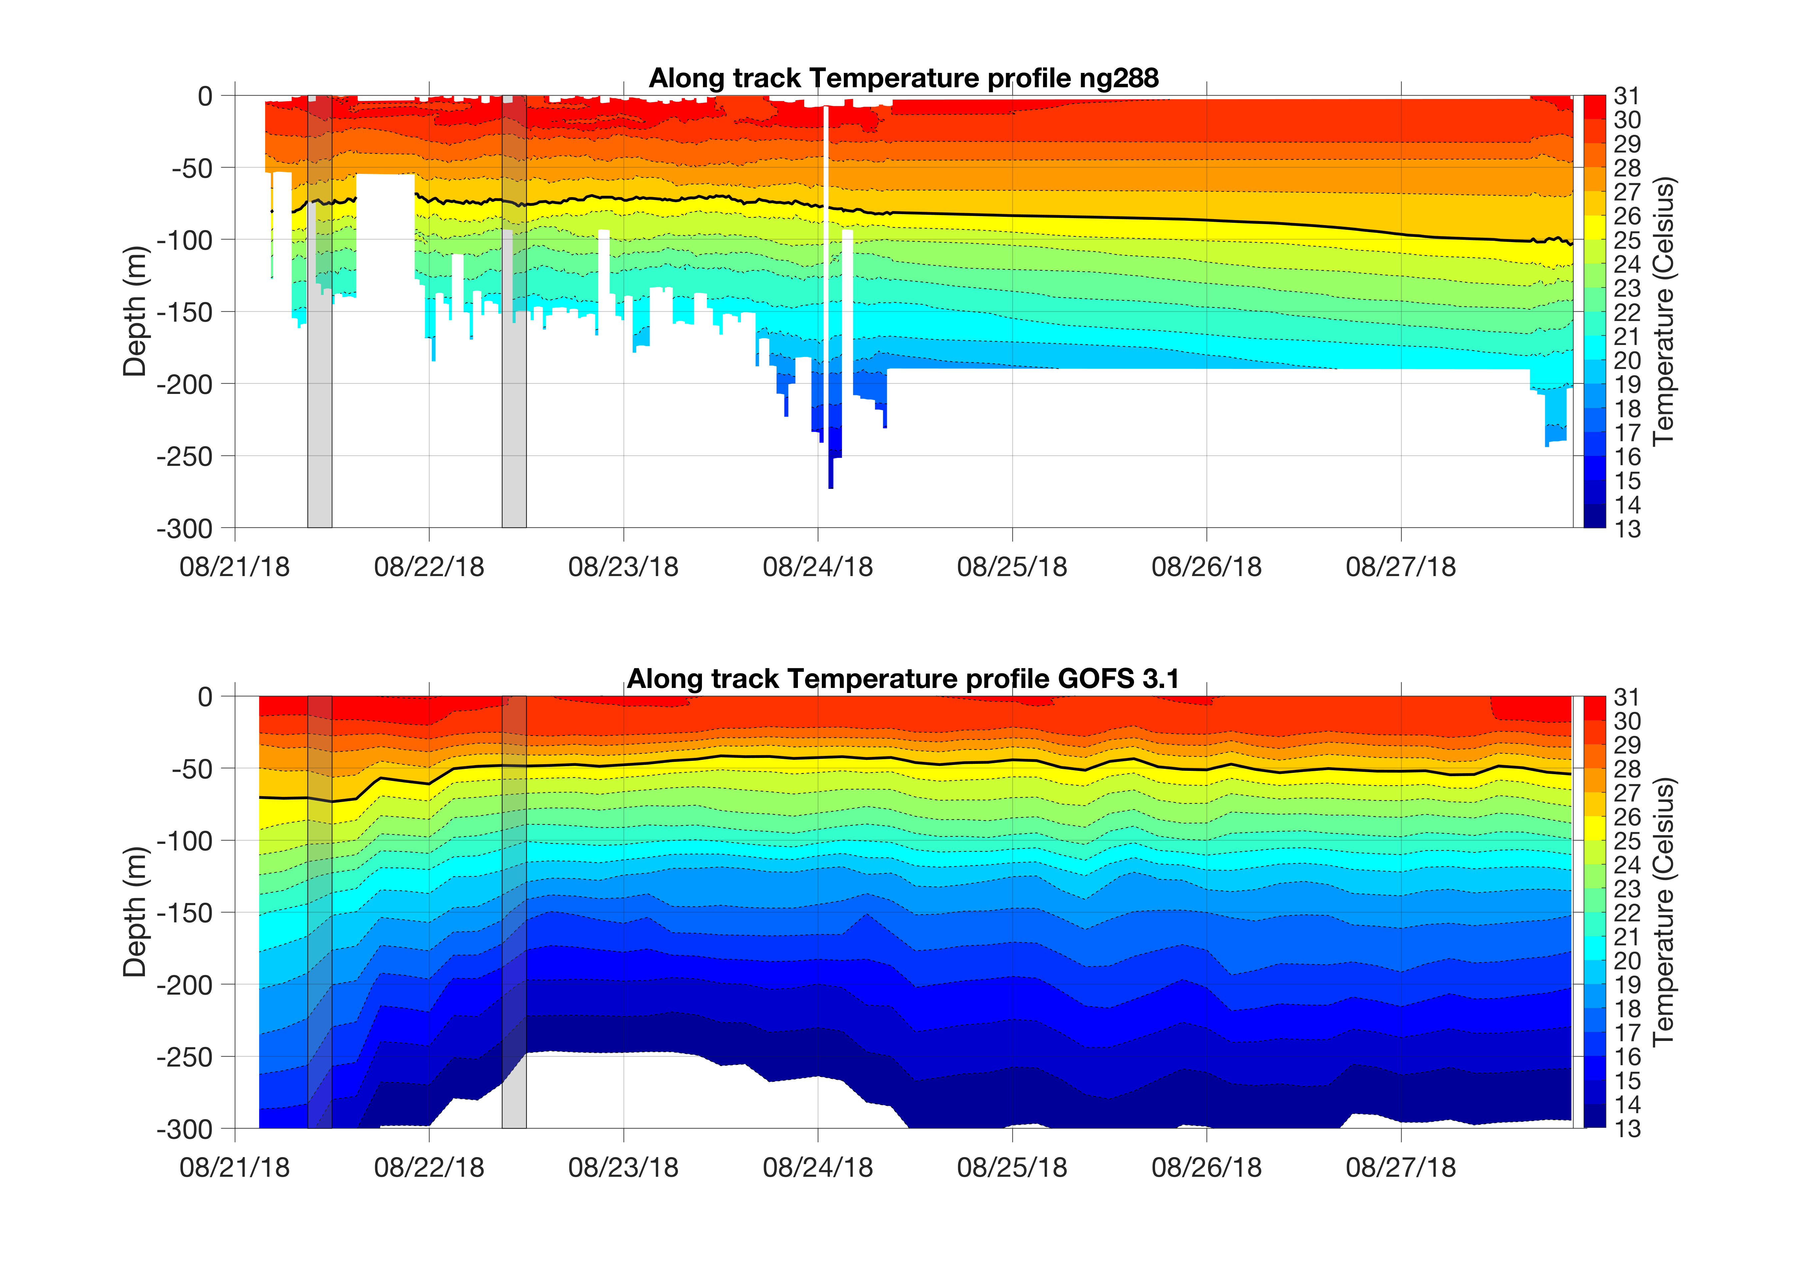
Ng288 before and after going to the GTS

Slide 22
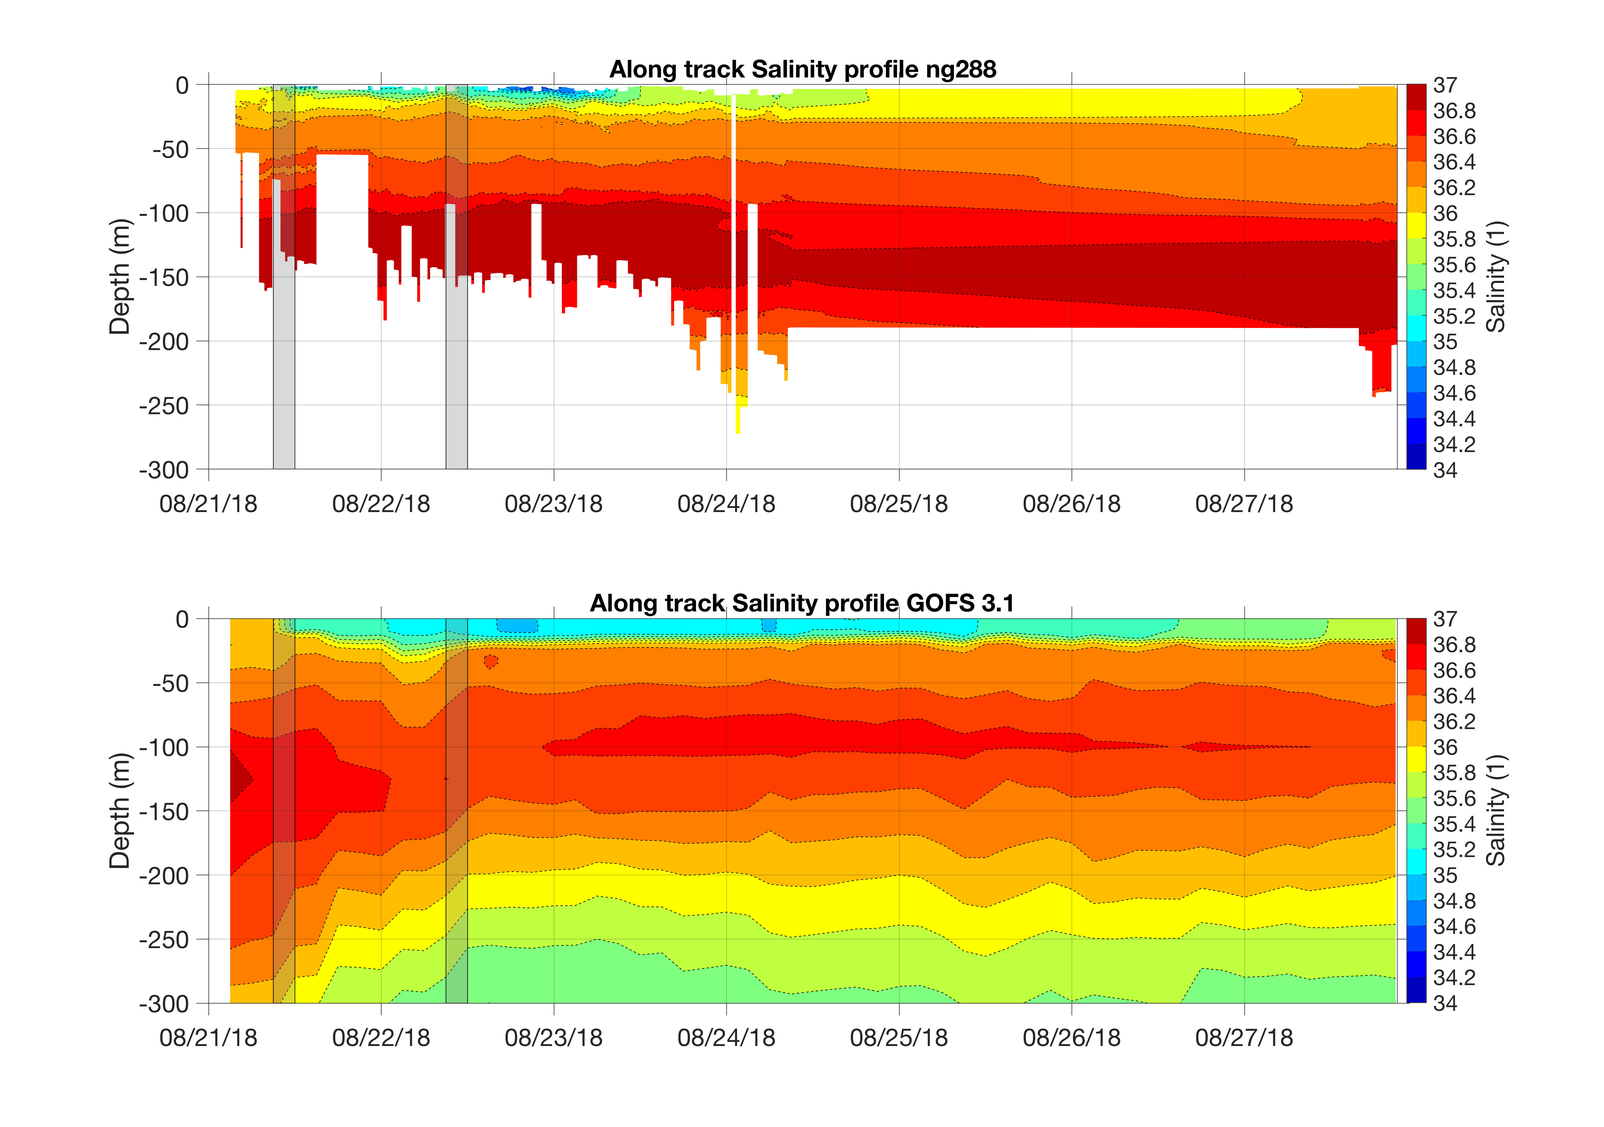
Ng288 before and after going to the GTS

Slide 23
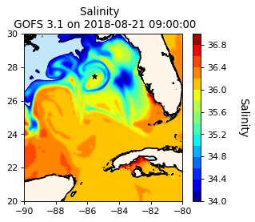
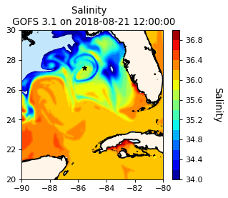


I like the maps
GOFS 3.1 Surface Salinity

Slide 24
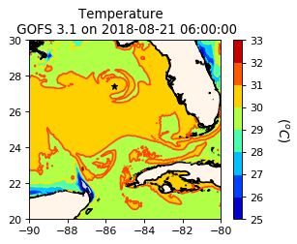
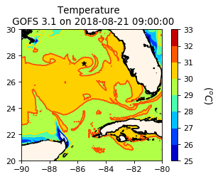
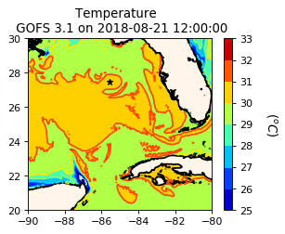
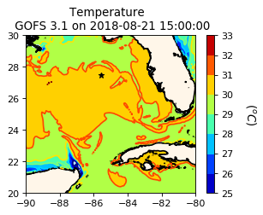
GOFS 3.1 Surface Temperature

Slide 25
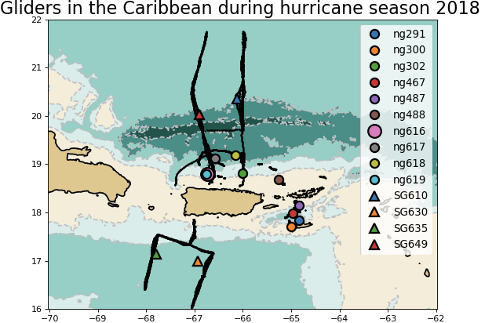
Caribbean

Slide 26
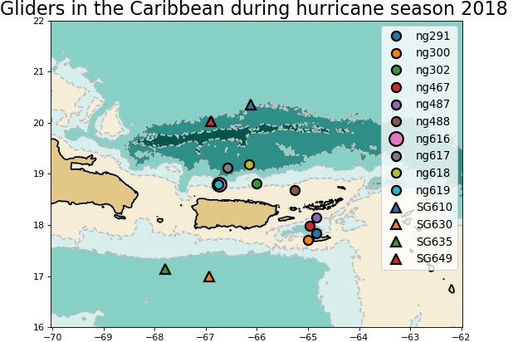
Caribbean
Maybe this size for the first copy of each map, then the shrunken maps when used with other figures. We will be presenting these images on a screen in a room of people.

Slide 27
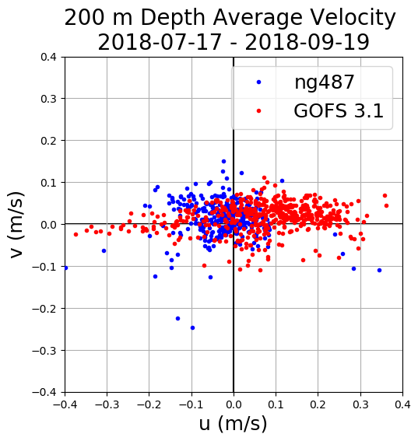
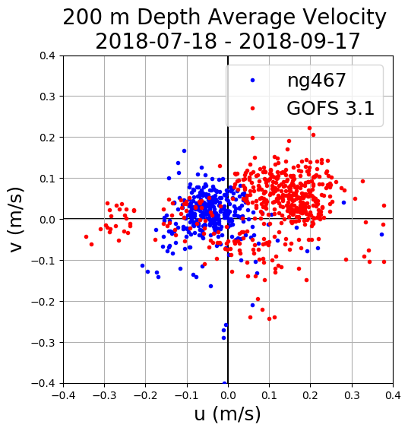
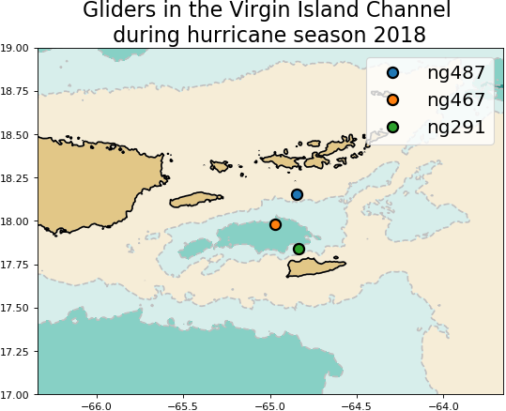

Caribbean: 200 M Depth Average Velocity 18 July -17 Sep
-0.03 m/s
0.07 m/s
-0.04 m/s
0.1 m/s
0.02 m/s
0.04 m/s

Slide 28



N
W
E
S

Slide 29



E
S
N
W

Slide 30




Depth Average Velocities Rotated Along the Channel Axis

Slide 31


Heat Transport Through the Channel
Very cool image – Units? “J” merges with “(“ - make all italics and then ok?
What do we want to do – east-west and north south, or along and cross.
Now my question is what does this mean?
I guess I am wondering – does the transport tend to heat up or cool down the Caribbean?
But to answer that question we need u*(dT/dx).

Slide 33


Heat Transport Through the Channel

Slide 34



Slide 35




Cross-channel Temperature Gradients

Slide 36



Cross-channel Salinity Gradients

Slide 37


Barrier layer
Repeat map

Slide 38



Slide 39


Yellow Sea: Typhoon Soulik
Typhoon Soulik

Slide 40




GOFS 3.1 Surface Salinity

Slide 41

~126 km
~126 km
Distance between grid points ~ 9 km

Slide 42



Slide 43

Typhoon Soulik
Typhoon Soulik

Slide 44




GOFS 3.1 Temperature at 60 m
Repeat figures

Slide 45



