Slide 1
Initial Assessment of the Impact of Glider Data Assimilation on GOFS 3.1

Slide 2
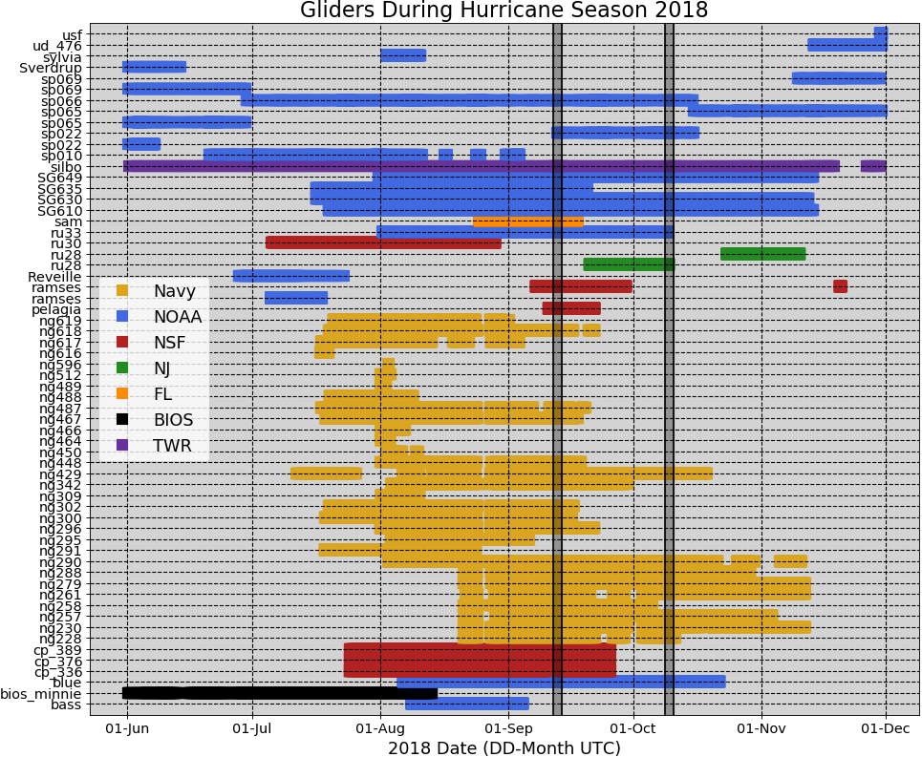
Gliders in IOOS Glider DAC during Hurricane Season 2018

Slide 3
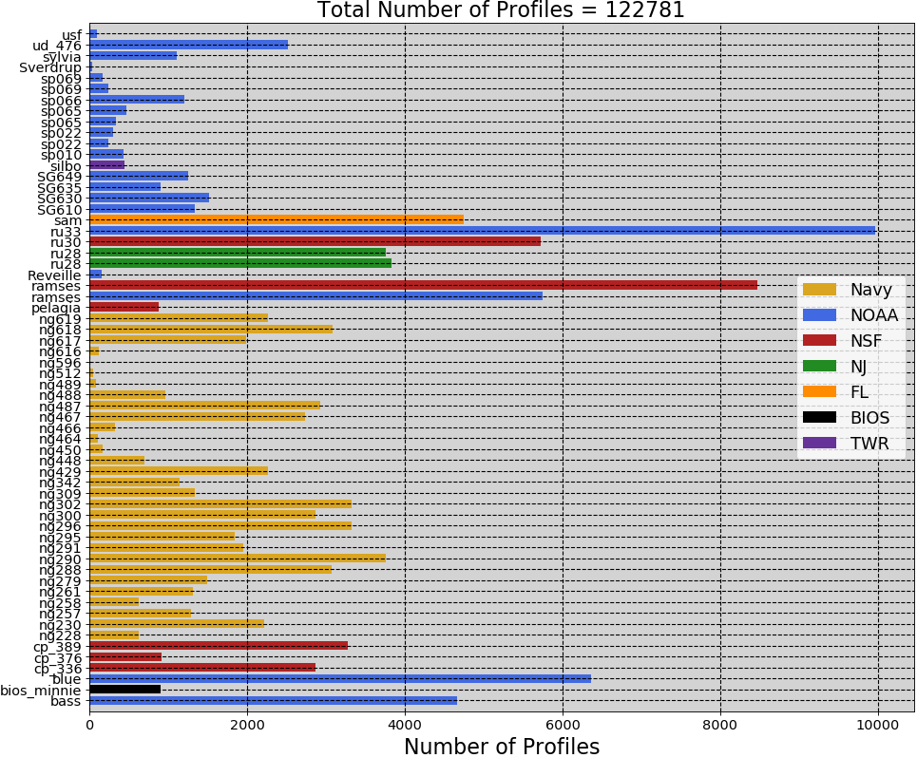

Slide 4
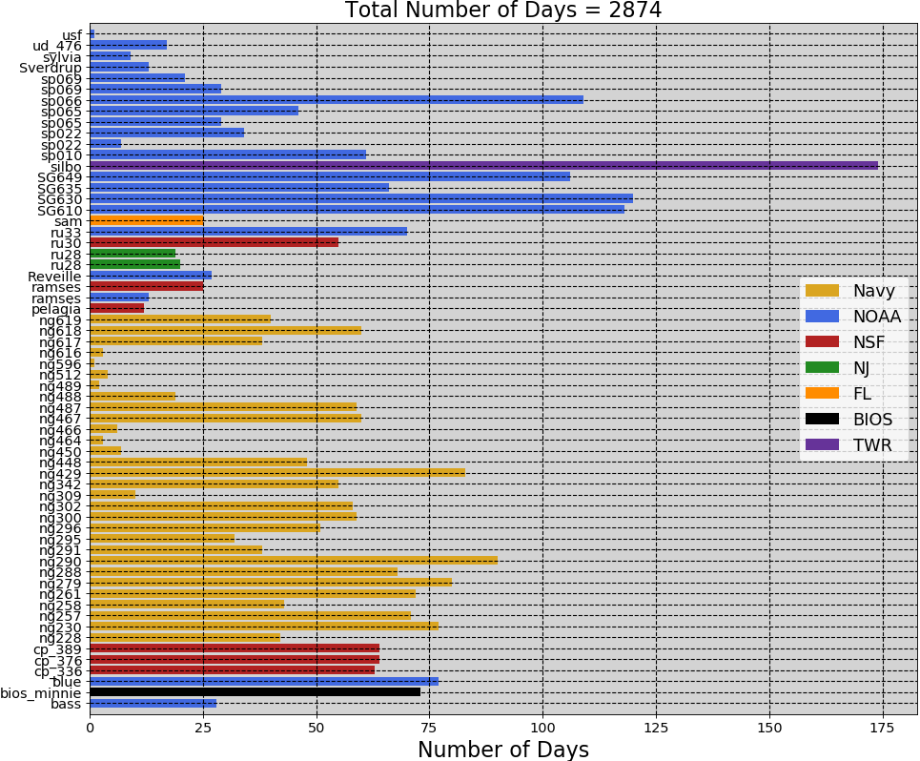

Slide 5
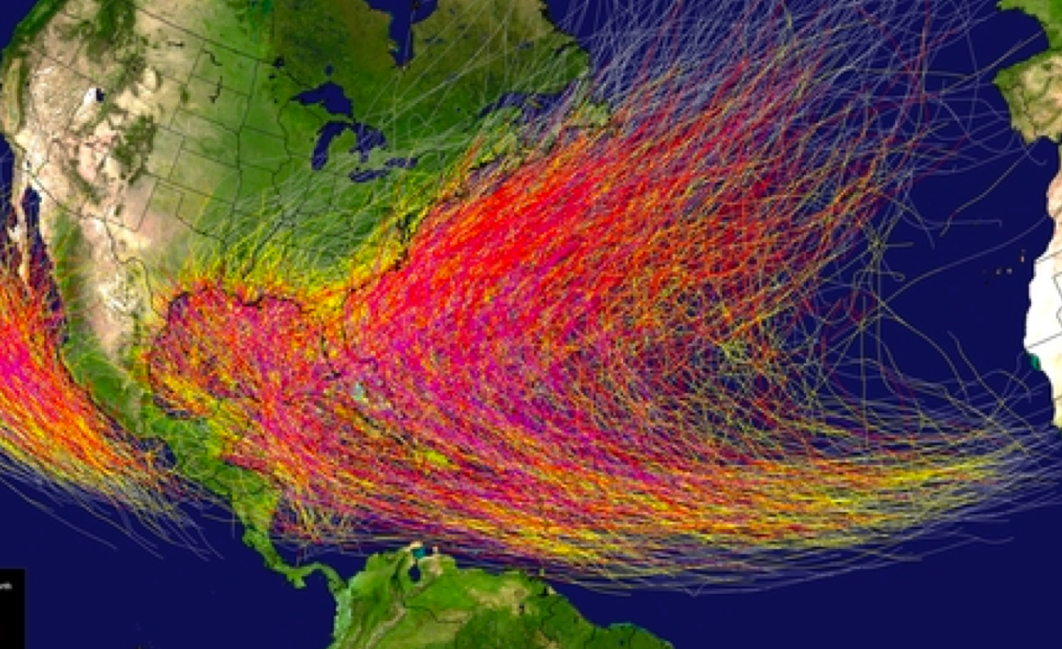
Regions of interest:
MAB,SAB,Gulf of Mexico,Caribbean,
And Yellow Sea
Yellow Sea map?

Slide 6
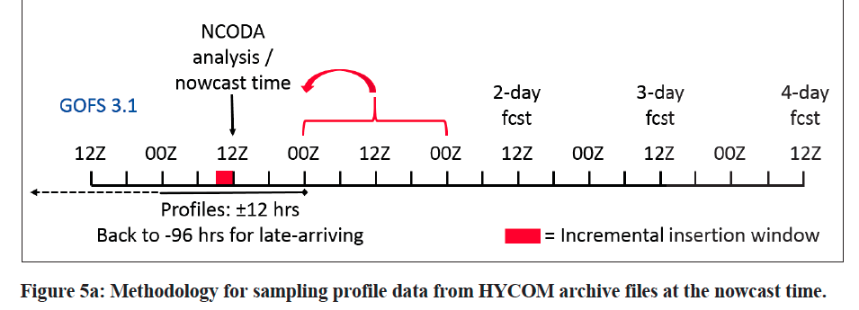
Time of NCODA increments ?

Slide 7
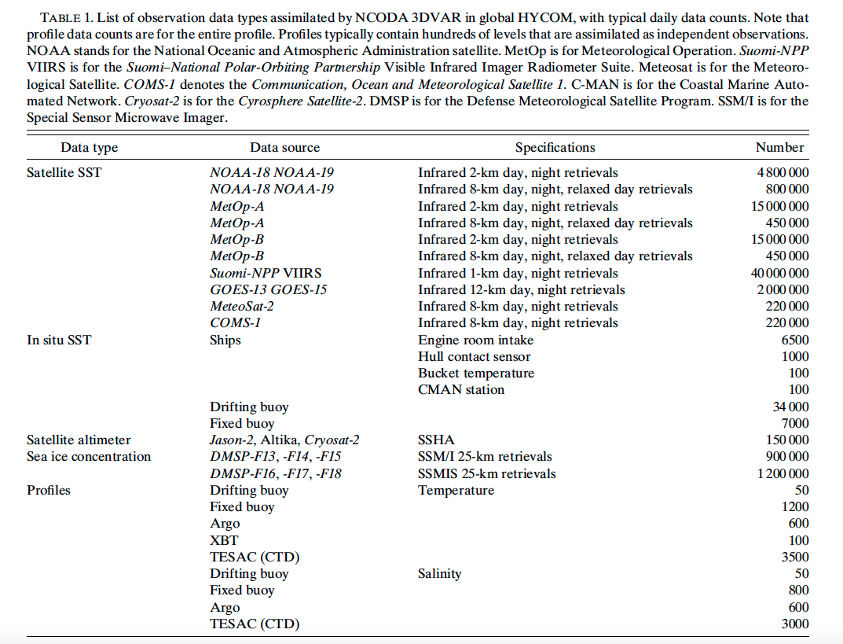
Cummings and Smedstad 2014

Slide 8
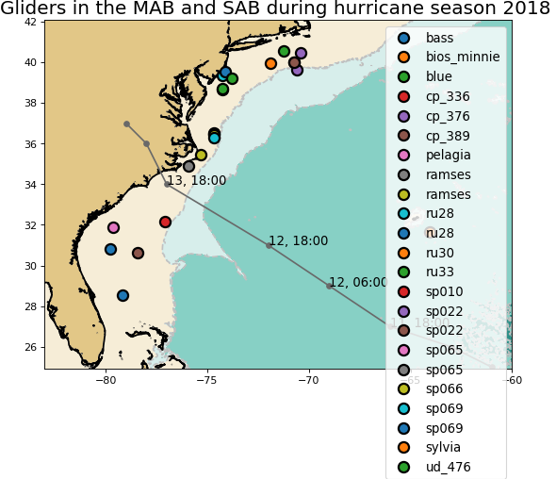
Middle Atlantic Bight

Slide 9
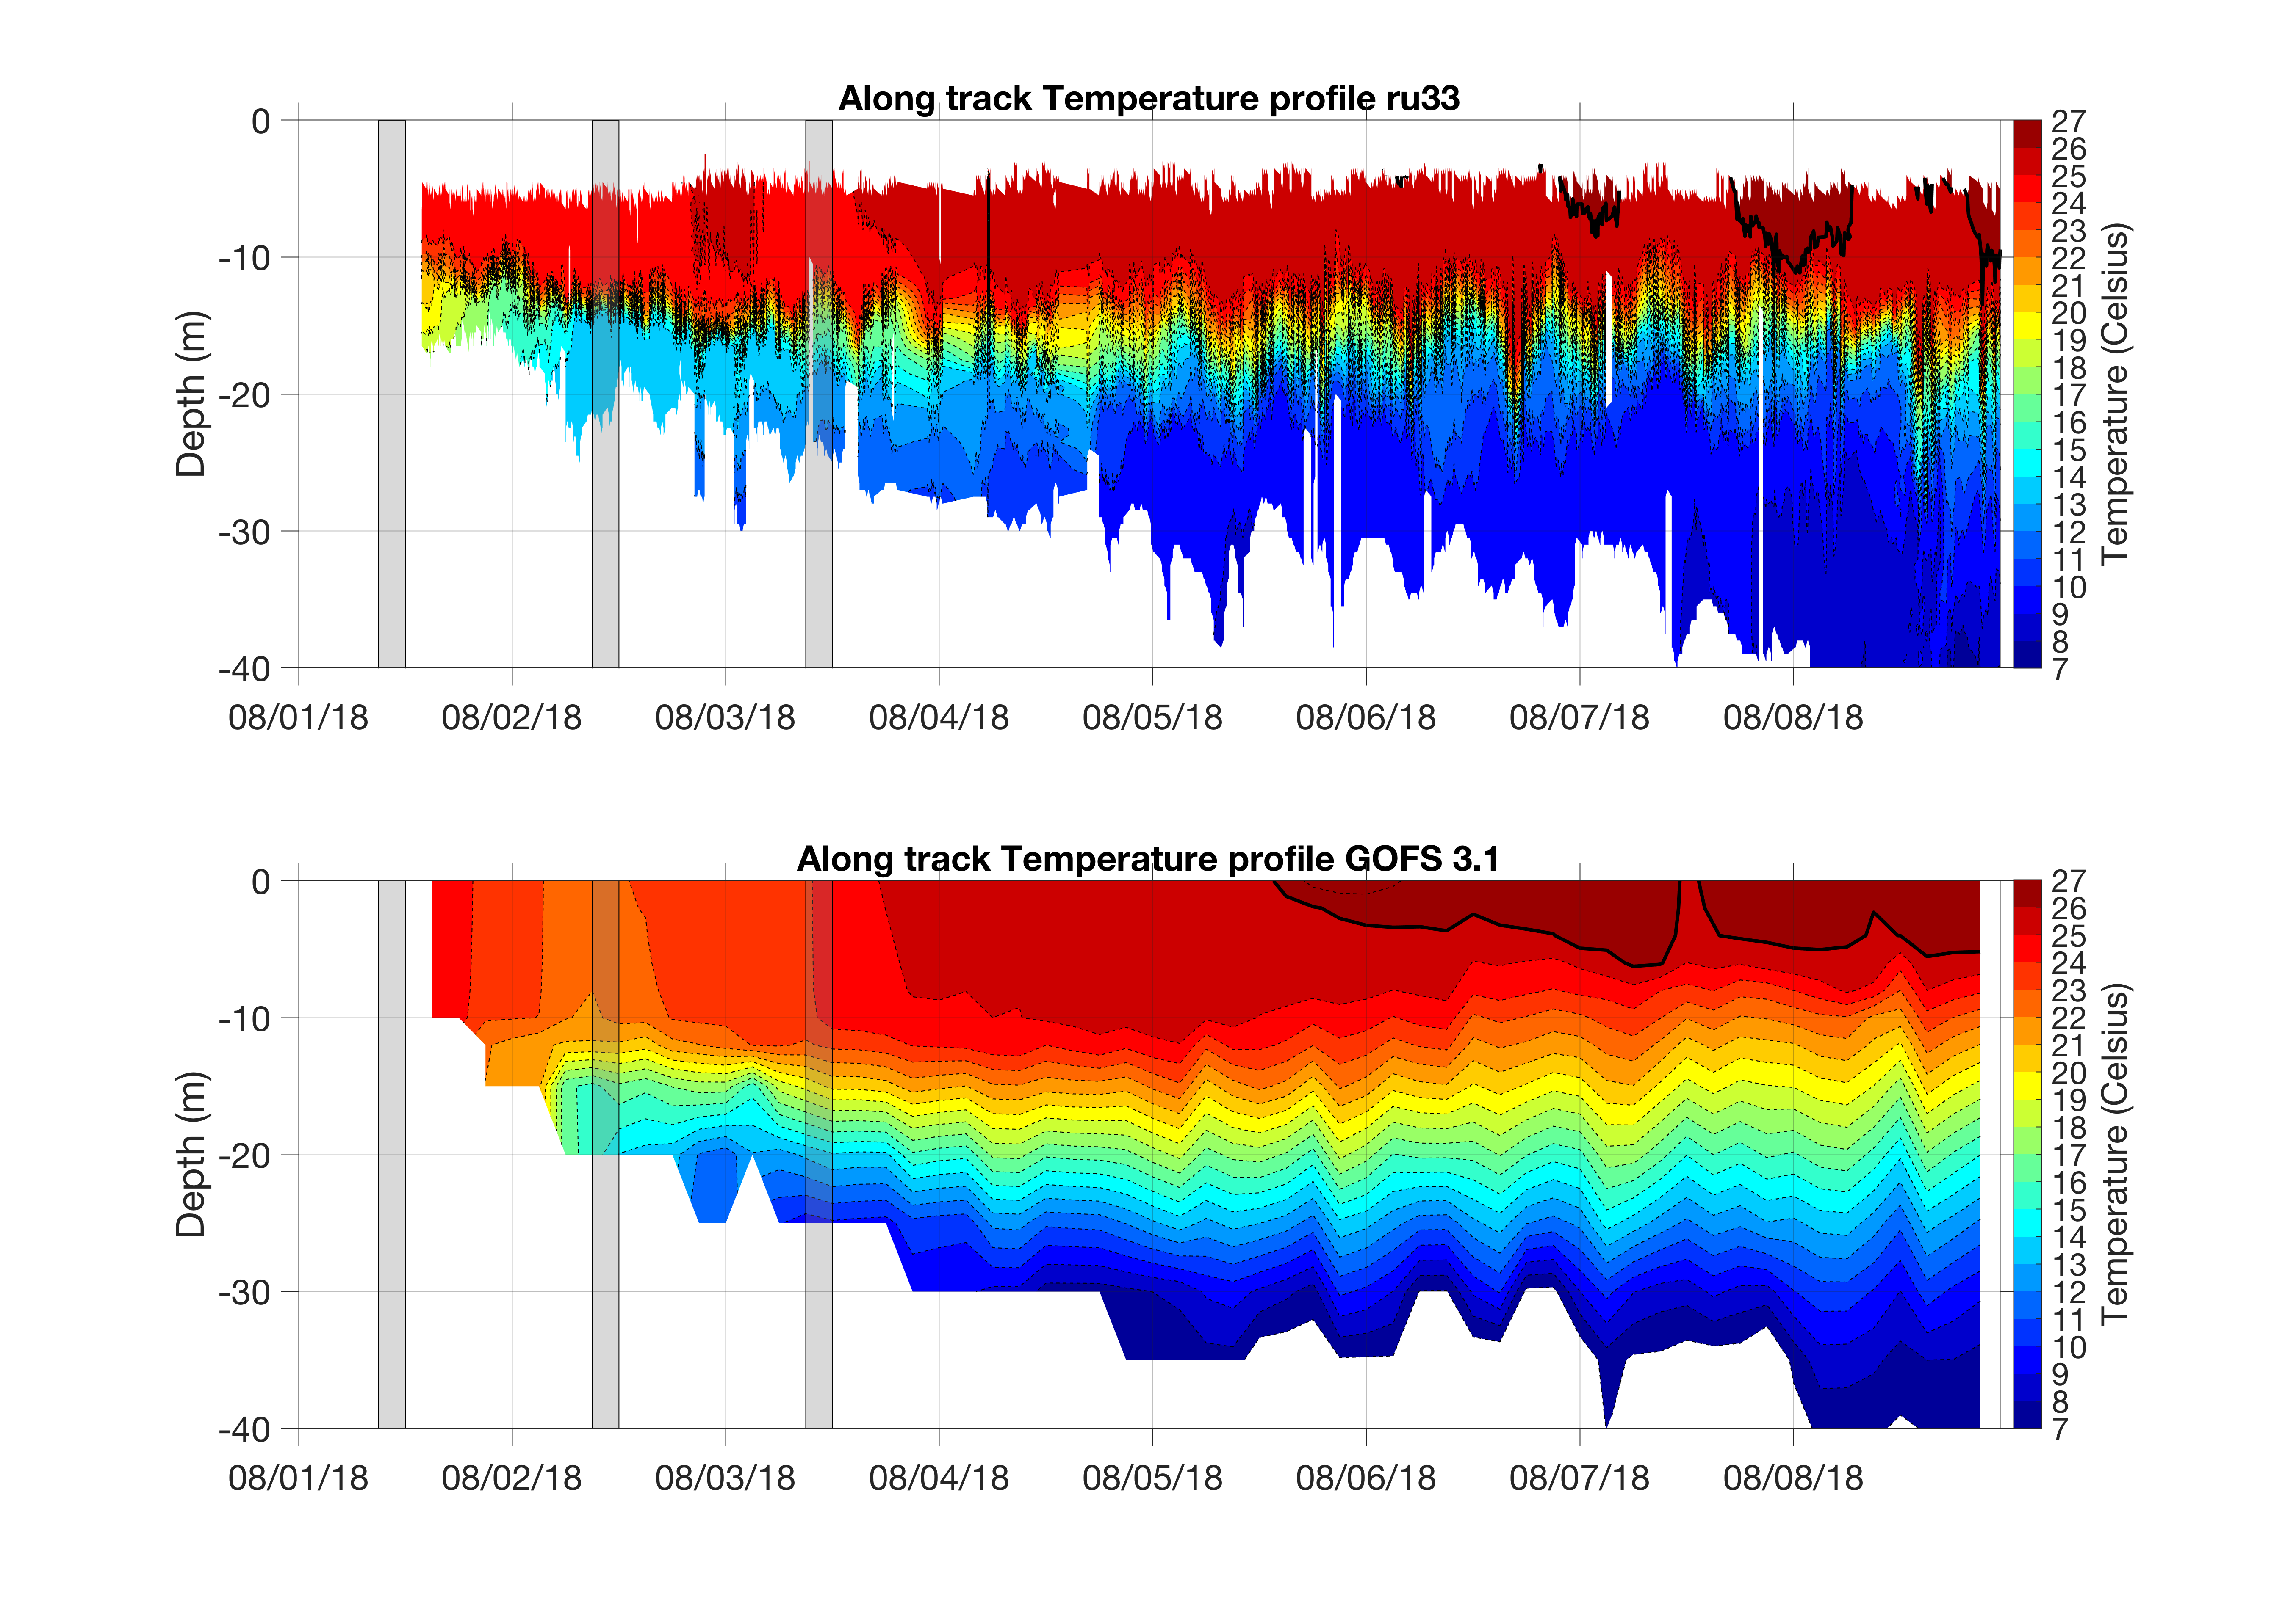
RU33 before and after going to the GTS
Weaker vertical stratification

Slide 10
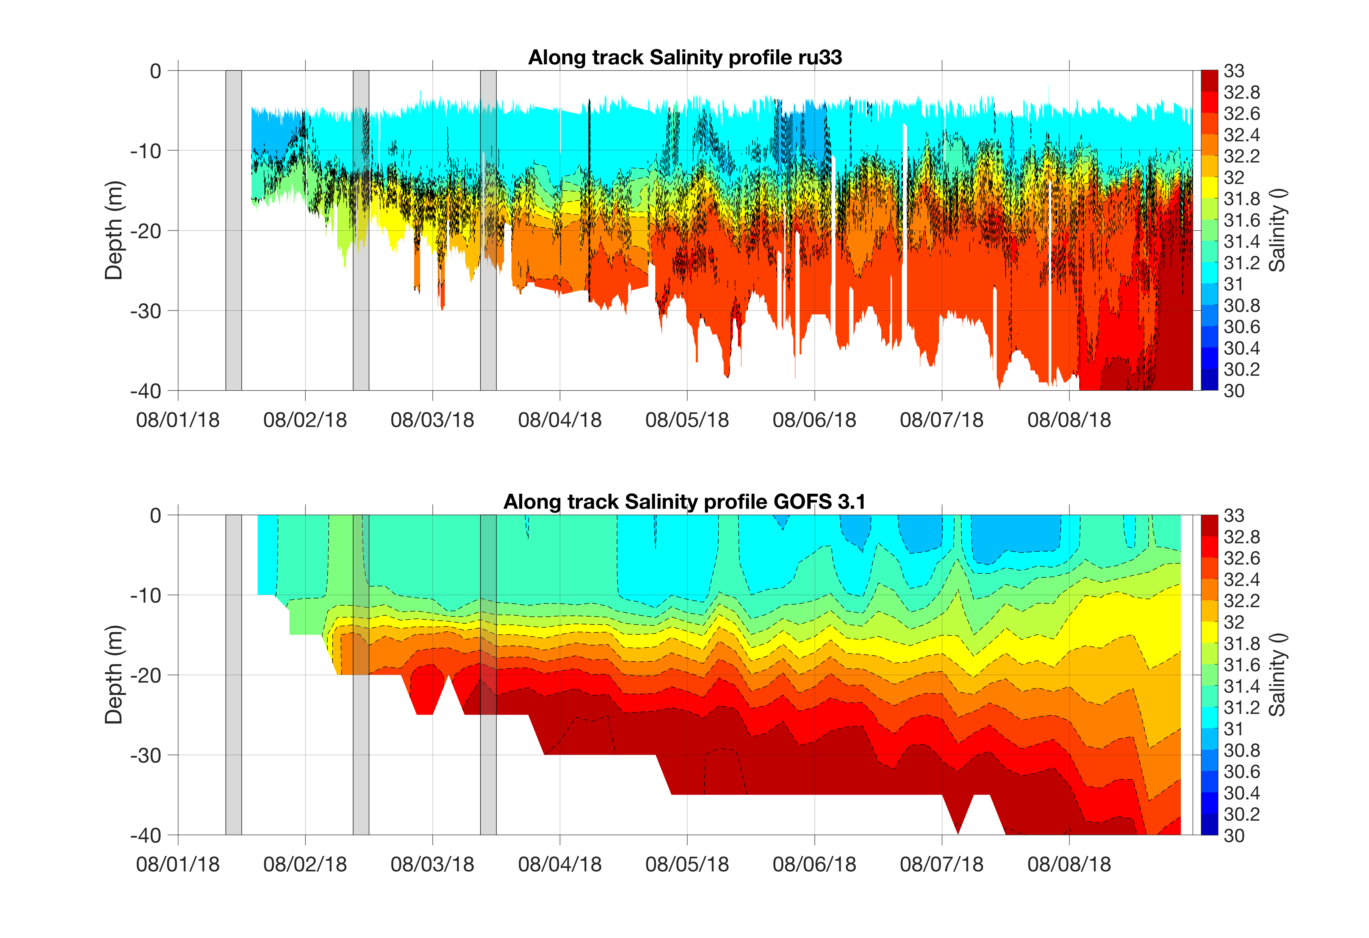

Slide 11
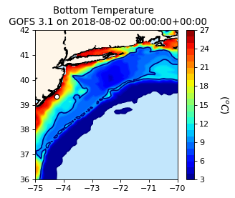
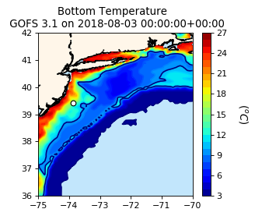
Cold pool?
10 degress
isotherm

Slide 12
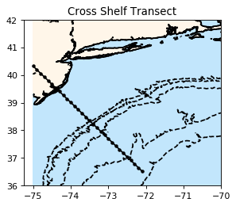
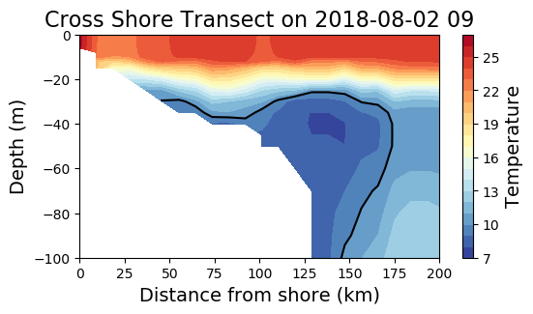
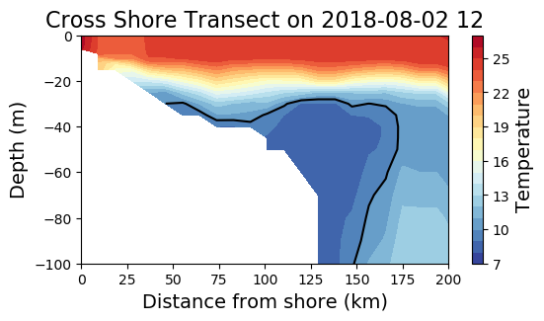
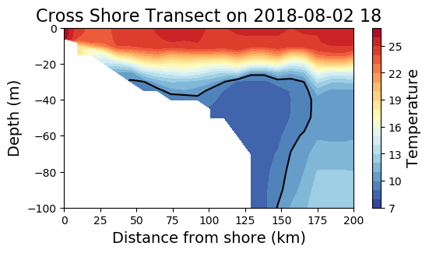

Slide 13
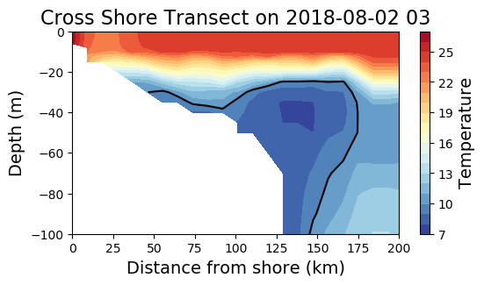

Slide 14
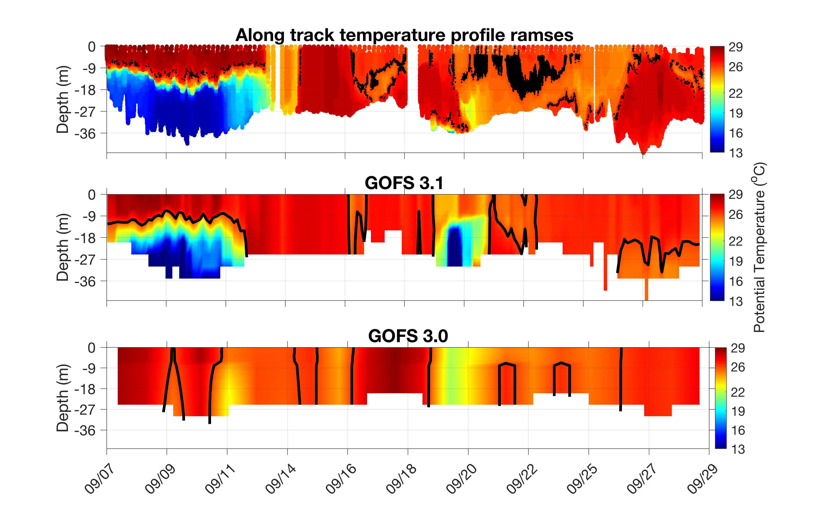
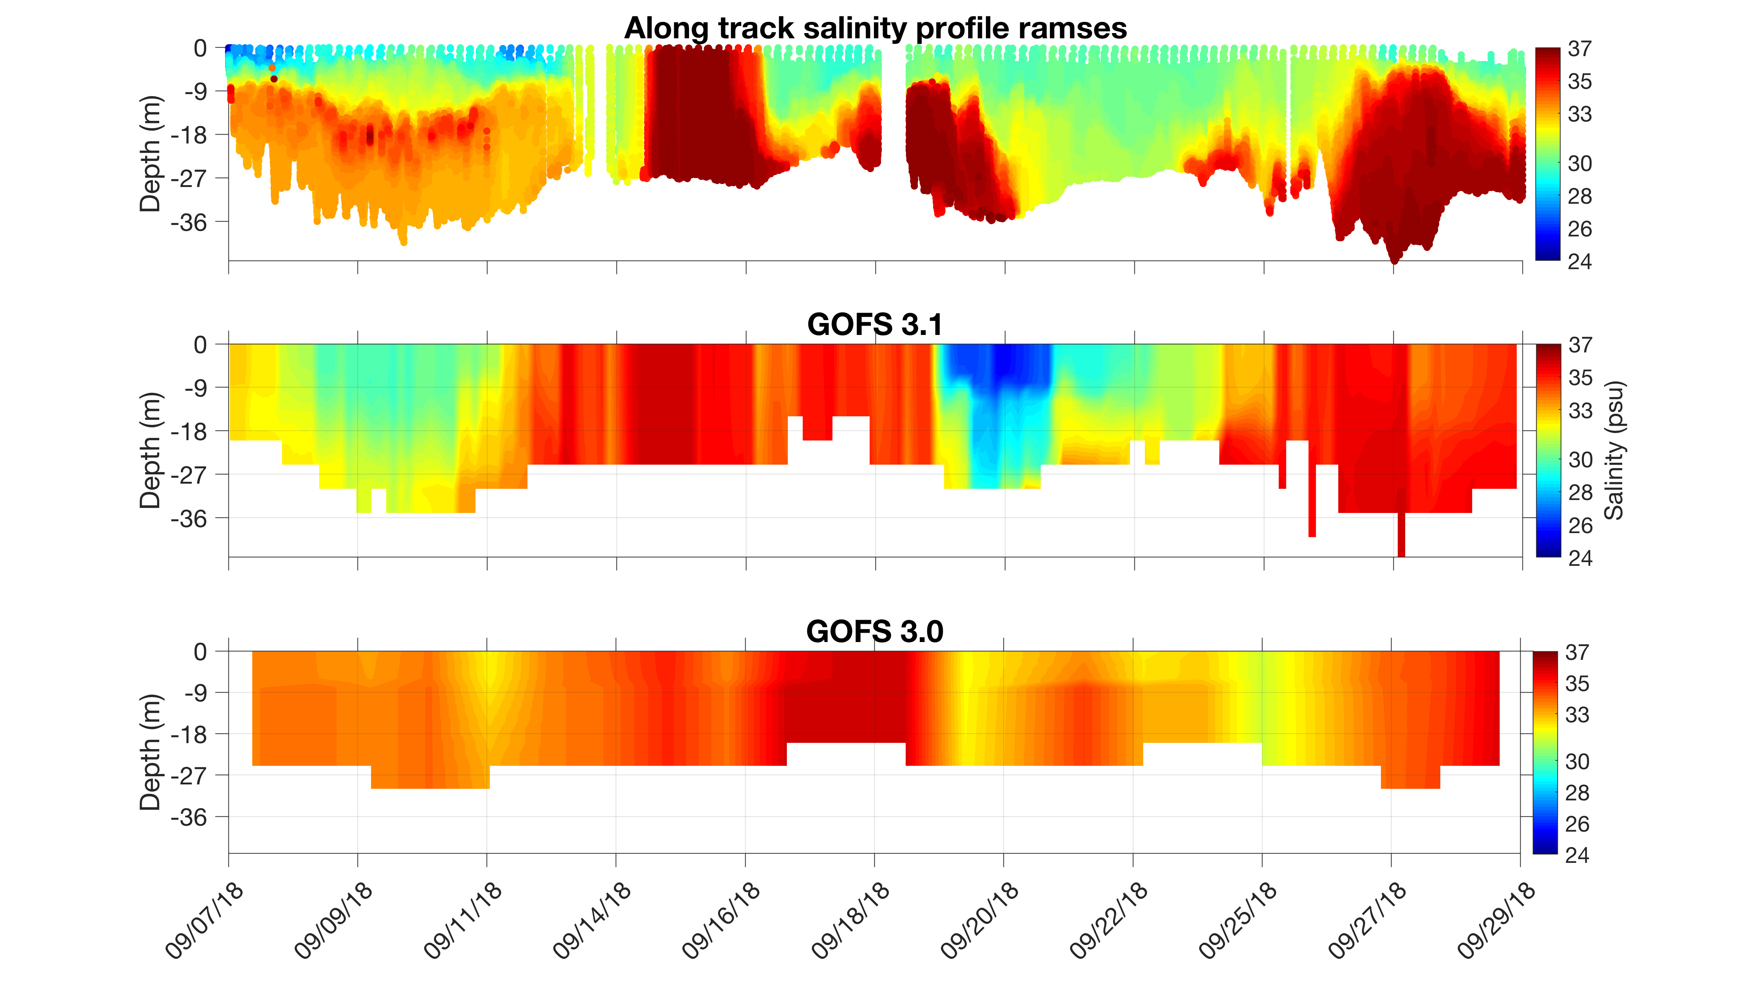
South-Middle Atlantic Bight Transition Zone
Add map?
Florence

Slide 15
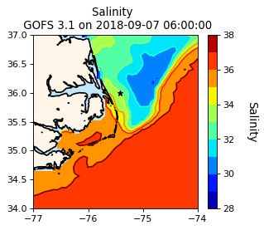
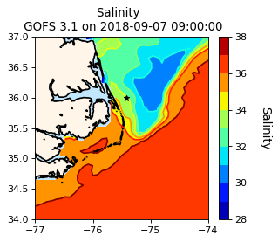
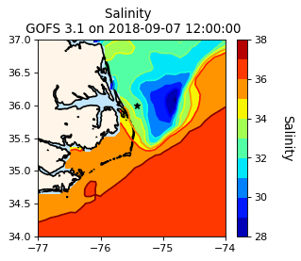
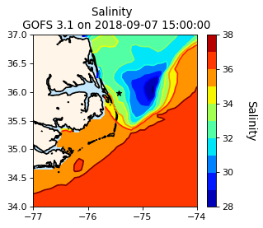
GOFS 3.1 Surface Salinity

Slide 16
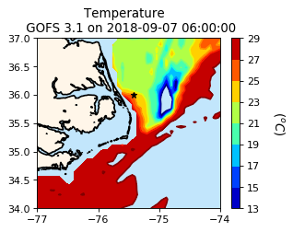
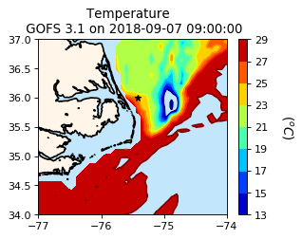
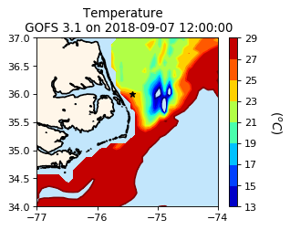
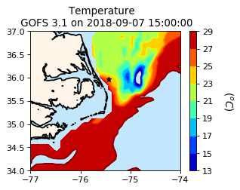
GOFS 3.1 Temperature at 15 m

Slide 17
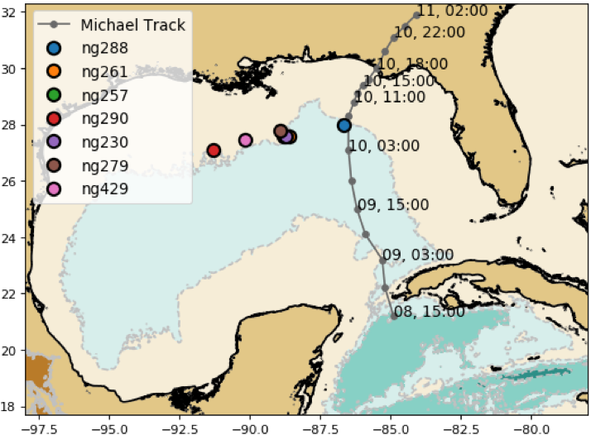
Gulf of Mexico: Hurricane Michael

Slide 18
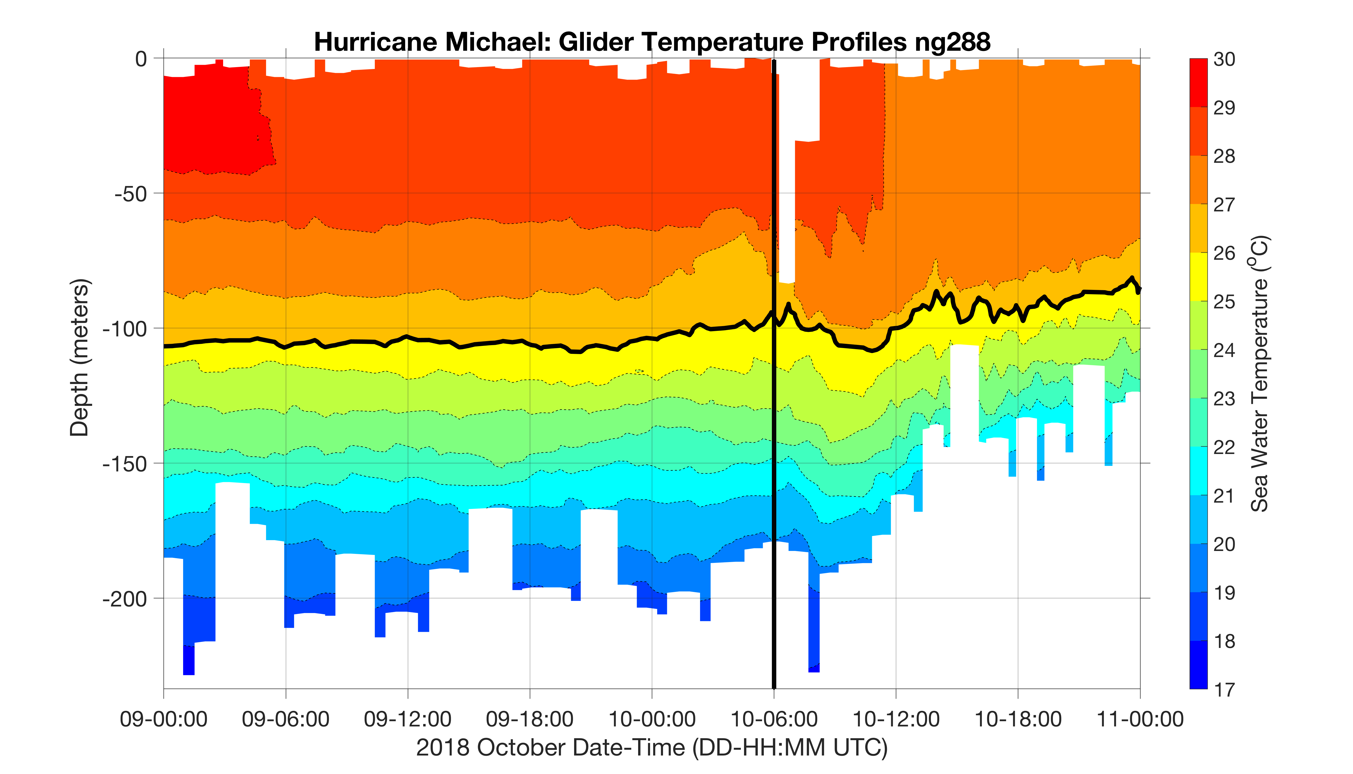
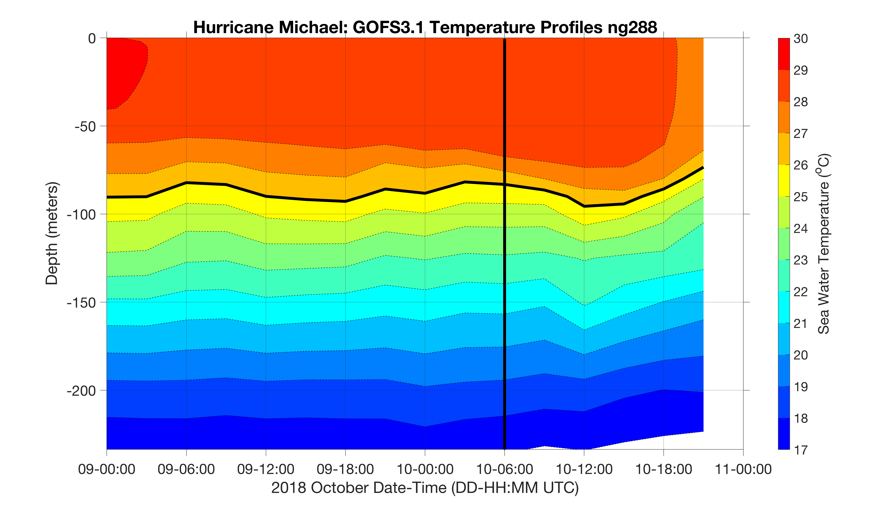
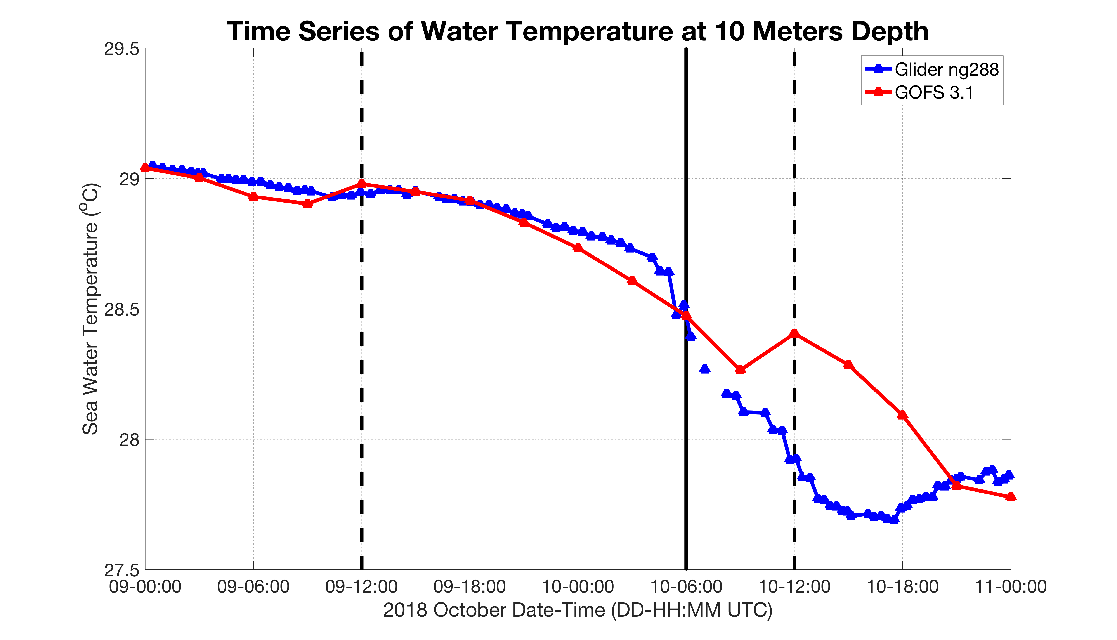
Michael

Slide 19
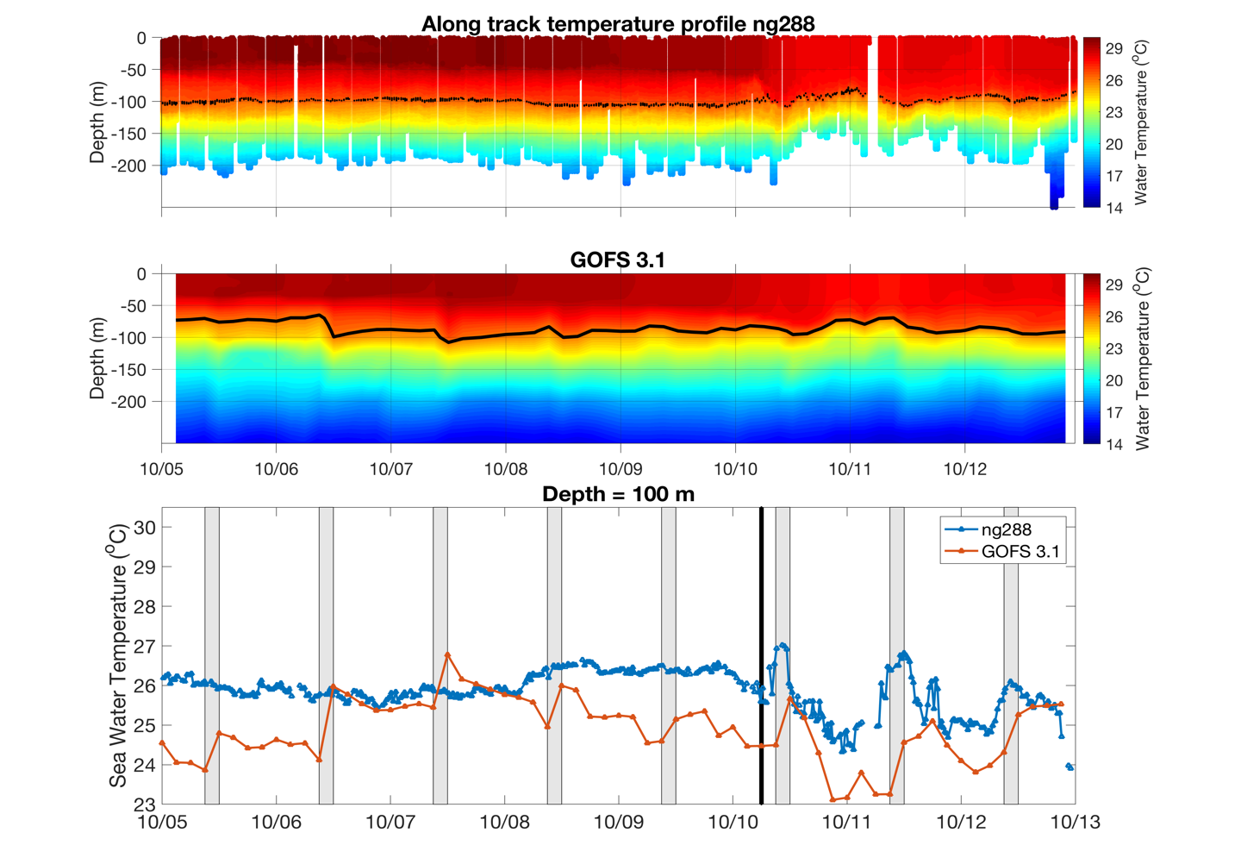

Slide 20
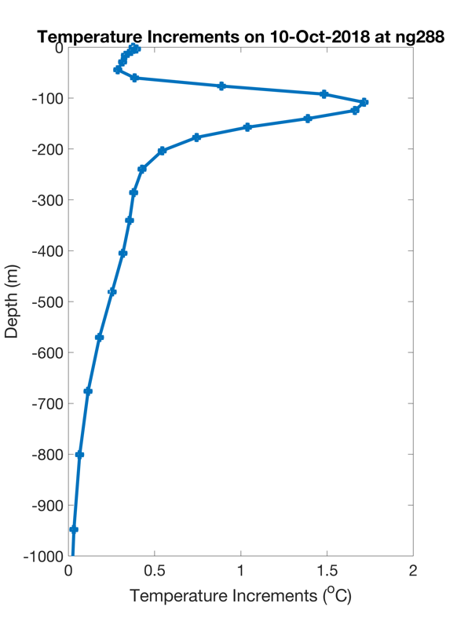
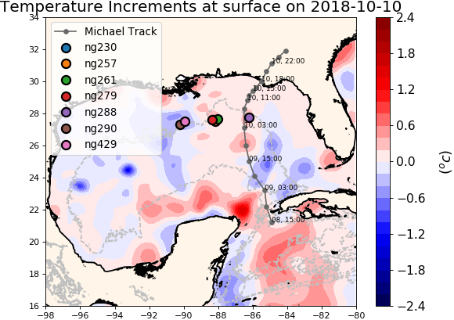
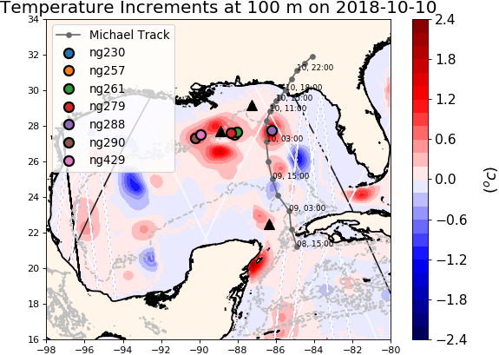
NCODA Temperature Increments
Repeat figure
Argo
Jason 2
CryoSat

Slide 21
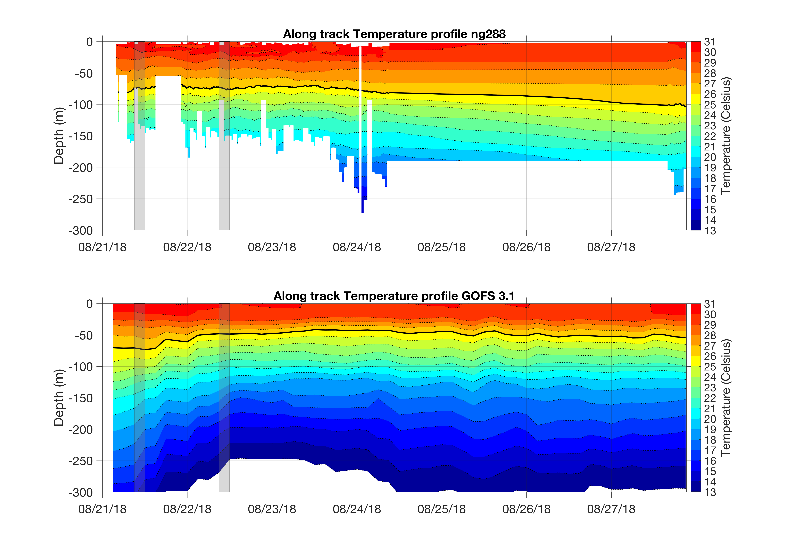
Ng288 before and after going to the GTS

Slide 22
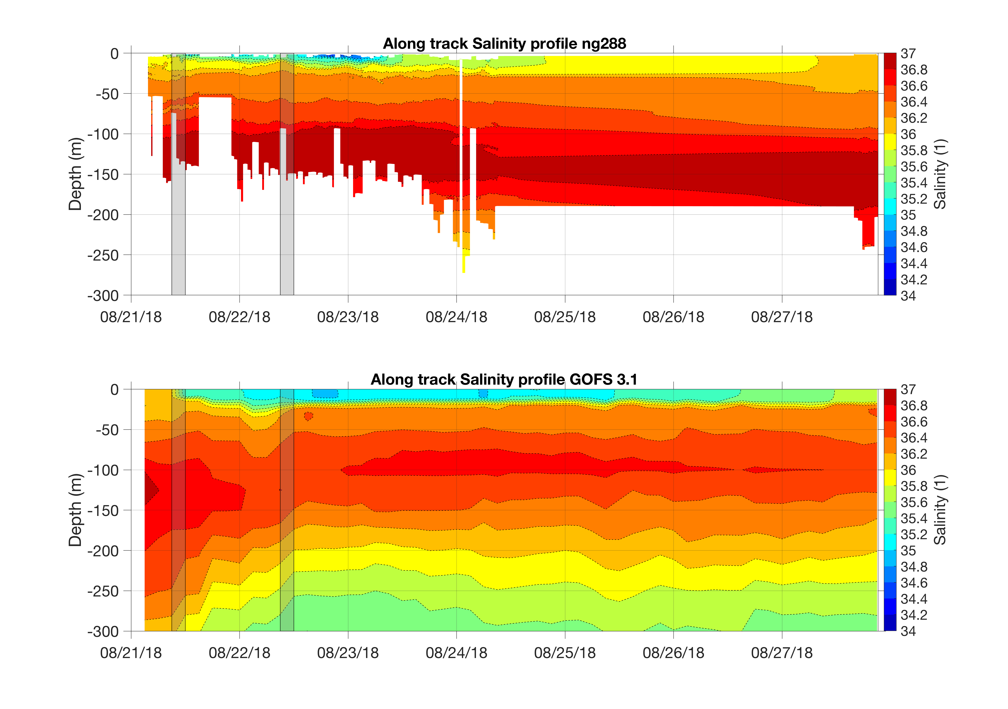
Ng288 before and after going to the GTS

Slide 23
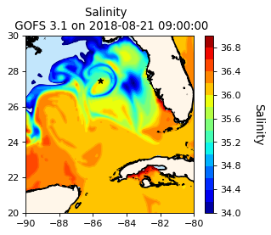
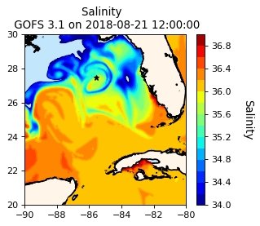
GOFS 3.1 Surface Salinity

Slide 24
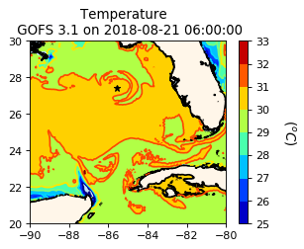
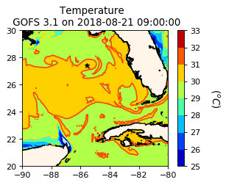
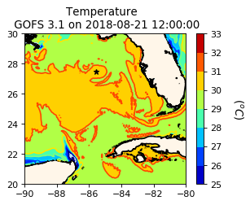
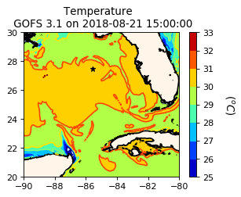
GOFS 3.1 Surface Temperature

Slide 25
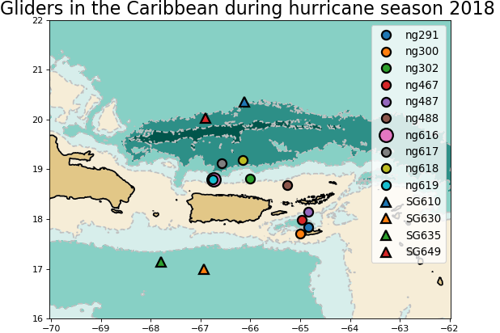
Caribbean

Slide 26
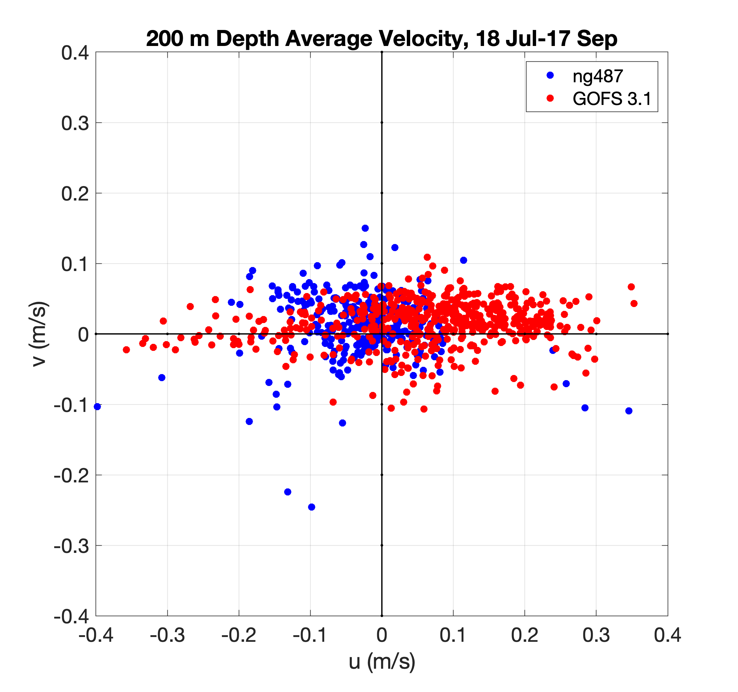
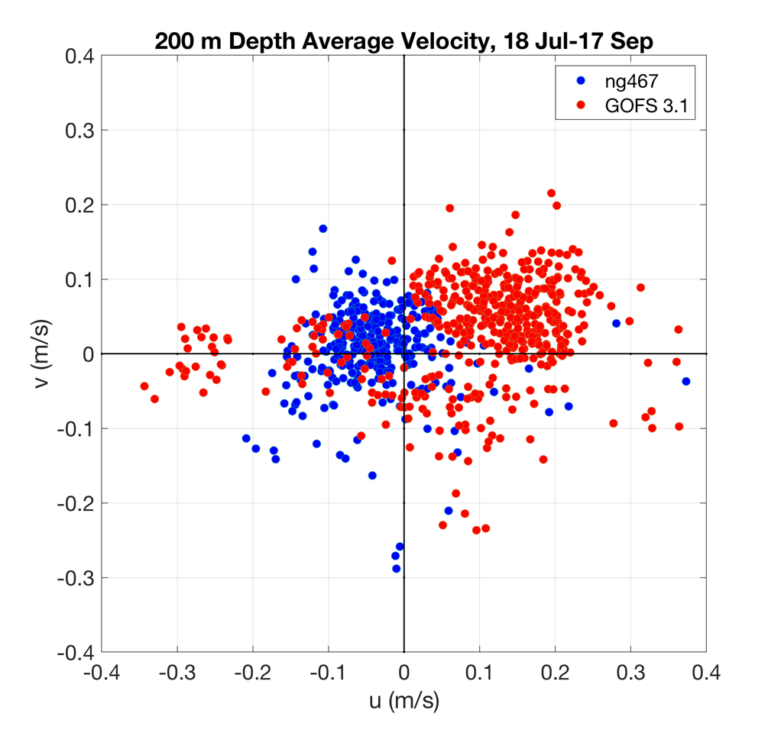
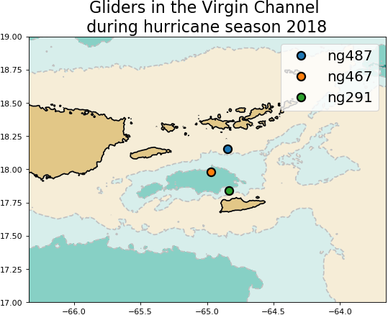
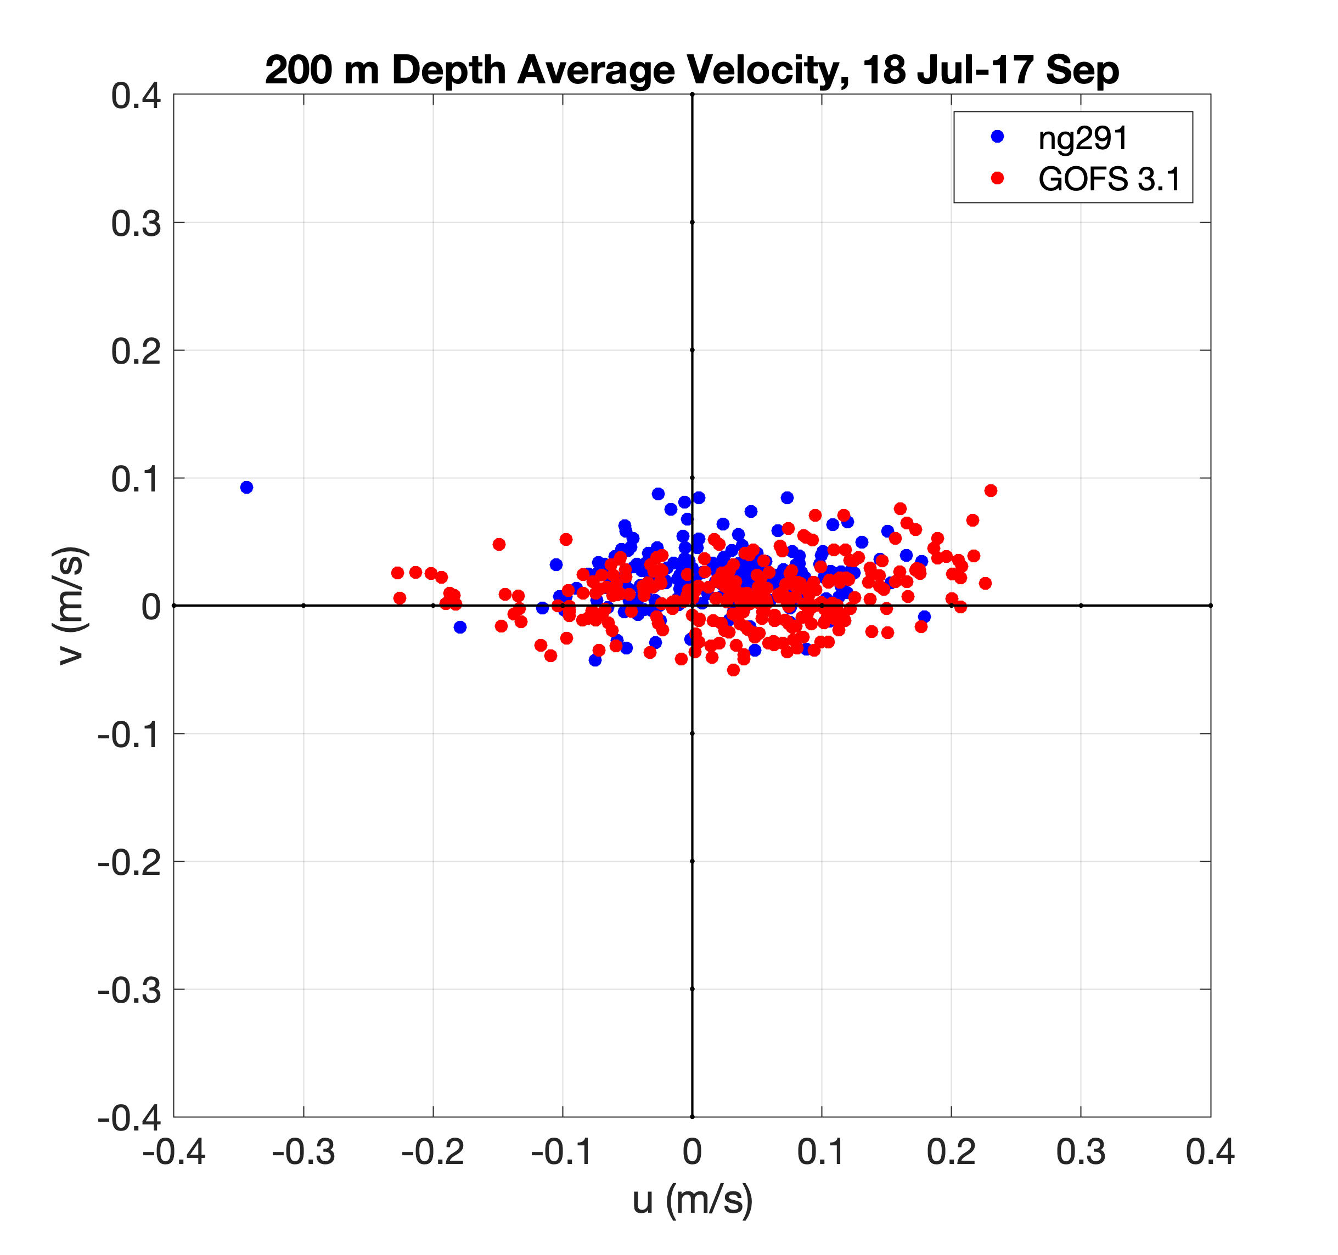
Caribbean

Slide 27
N
W
E
S

Slide 28
E
S
N
W

Slide 29
Depth Average Velocities Rotated Along the Channel Axis

Slide 30
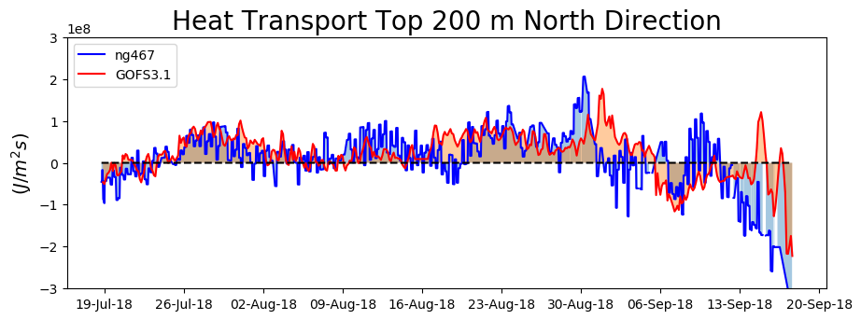
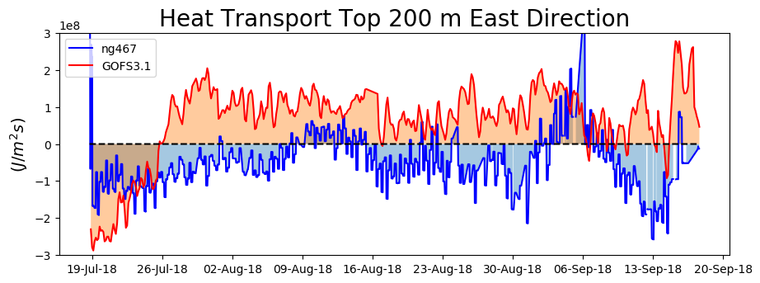
Heat Transport Through the Channel

Slide 31
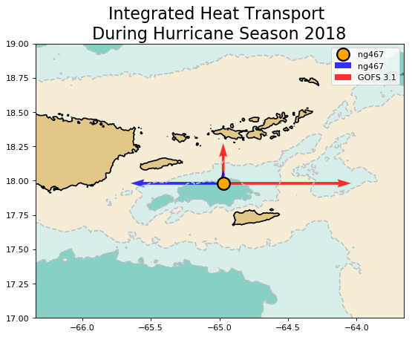

Slide 32
Cross-channel Temperature Gradients

Slide 33
Cross-channel Salinity Gradients

Slide 34
Barrier layer
Repeat map

Slide 36
Yellow Sea: Typhoon Soulik
Typhoon Soulik

Slide 37
GOFS 3.1 Surface Salinity

Slide 38
~126 km
~126 km
Distance between grid points ~ 9 km

Slide 40
Typhoon Soulik
Typhoon Soulik

Slide 41
GOFS 3.1 Temperature at 60 m
Repeat figures

