Slide 1
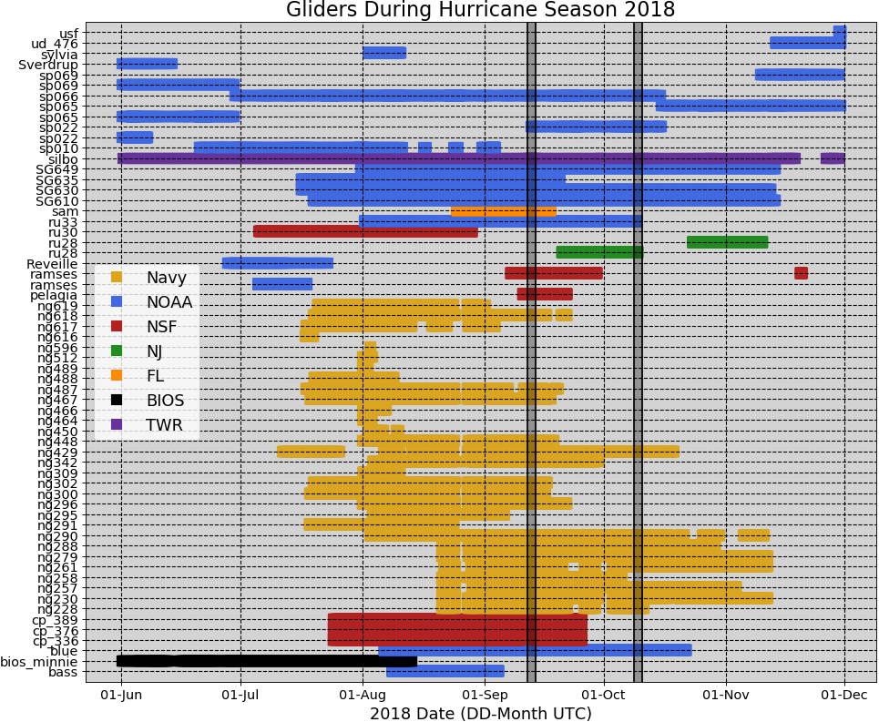
62 Gliders in the IOOS Glider Data Assembly Center (DAC)
During Hurricane Season 2018
Notes:
There were 61 gliders that reported data to the IOSS glider DAC during the 2018 hurricane season. All these data was pushed into the GTS (Global Telecommunication System) once a day. Once in the GTS, the data was accessed by a number of operational ocean models that use data assimilation: GOFS, European model ……

Slide 2
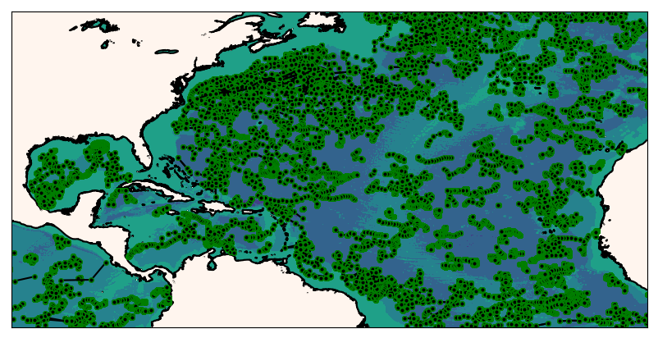
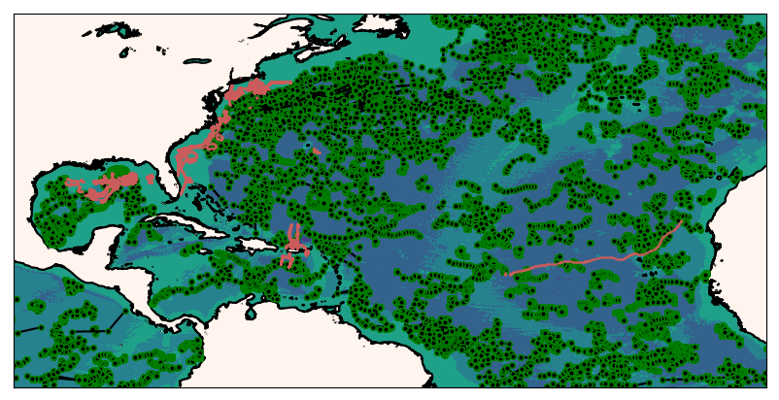
ARGO Floats and Gliders
During the 2018 Hurricane Season
Glider observations are mostly in the shelf and complement the ARGO observations

Slide 3
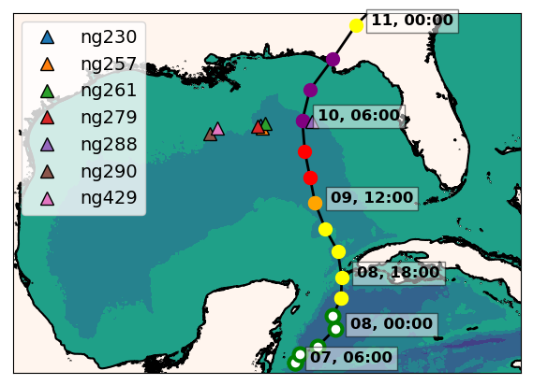
Hurricane Michael
ng288
Seven Navy gliders reporting to the glider DAC
in the GoM during hurricane Michael
Ng288 was at 36 km from the eye of hurricane Michael

Slide 4
Hurricane Michael
Increments
Insertion Window
Increments
Insertion Window
The assimilation of glider data is correcting the position
of the thermocline in GOFS 3.1

