Slide 1
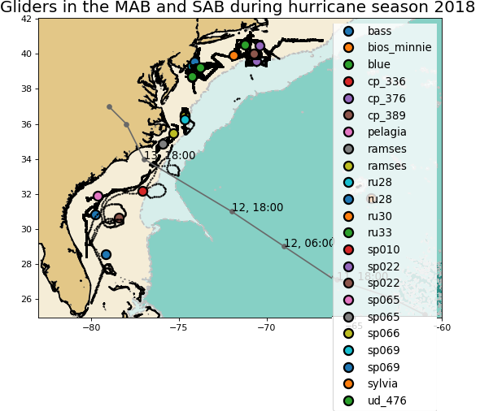
Middle/South Atlantic Bight, Hurricane Florence

Slide 2
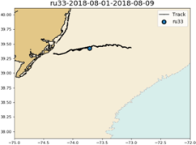
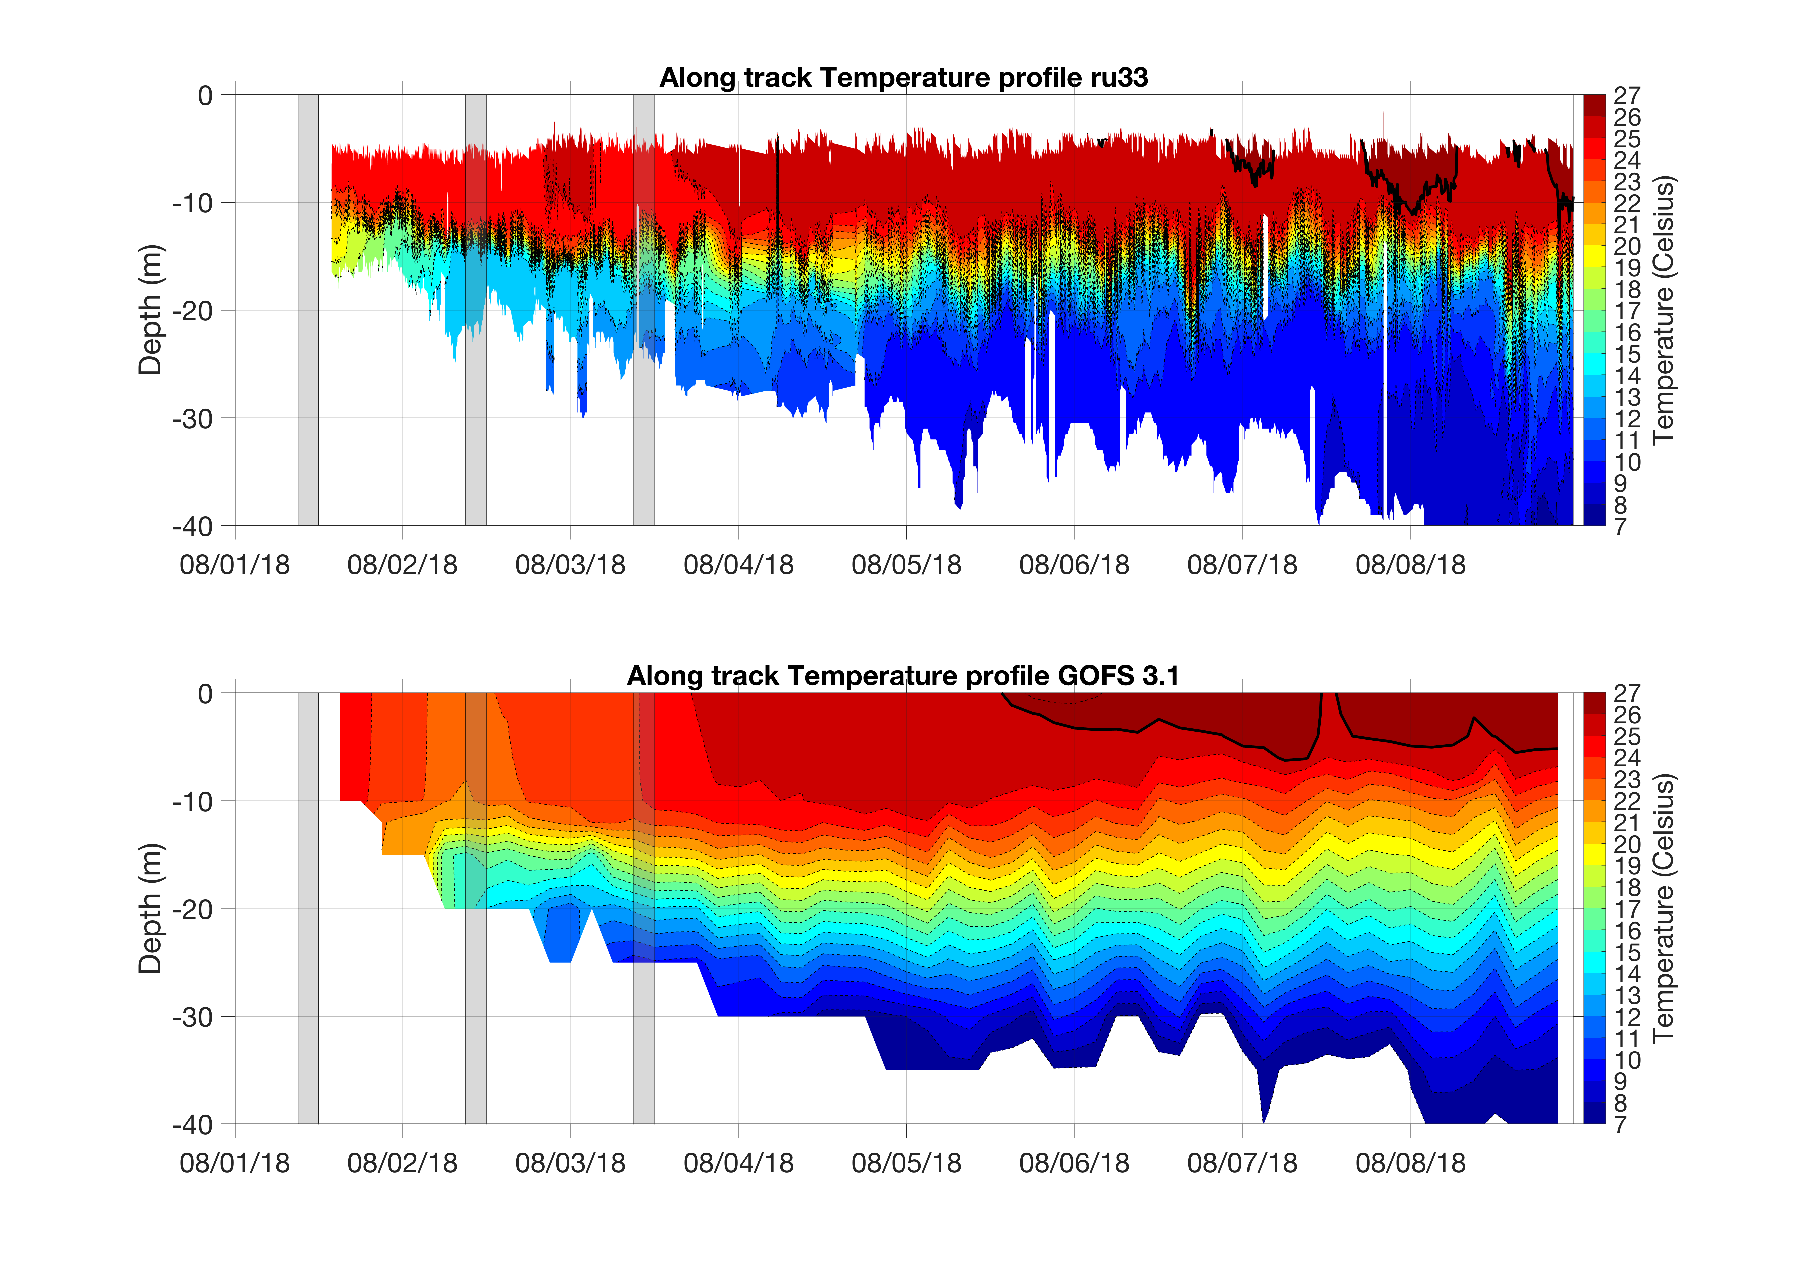
RU33 temperature
Vertical stratification in GOFS 3.1 is weaker than in observations
It can affect the strength of vertical mixing and ultimately the SST before and after passage of a hurricane

Slide 3
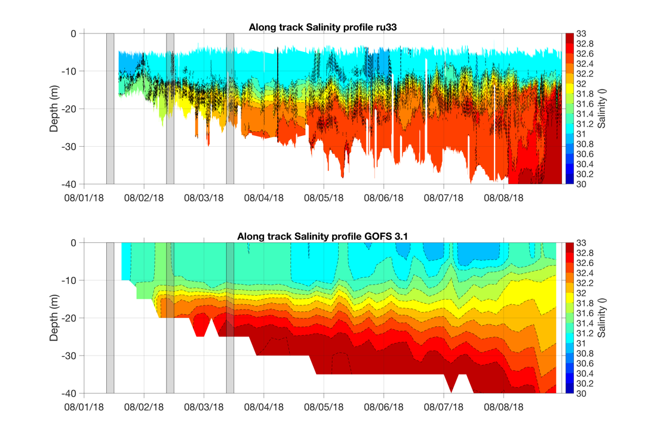
Salinity transects also show weaker vertical stratification in GOFS 3.1 compared to observations

Slide 4
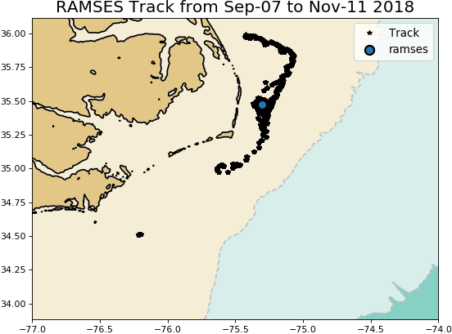
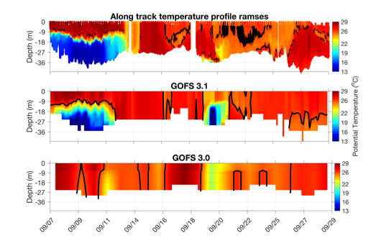
Middle/South Atlantic Bight Transition Zone
SAB has no cold pool
During Florence, water column mixes completely decreasing the SST GOFS 3.1 has transitioned already to a fully mixed water column, therefore SST remains the same before and after the storm
Extent of cold pool in GOFS 3.1 ?
Florence

Slide 5
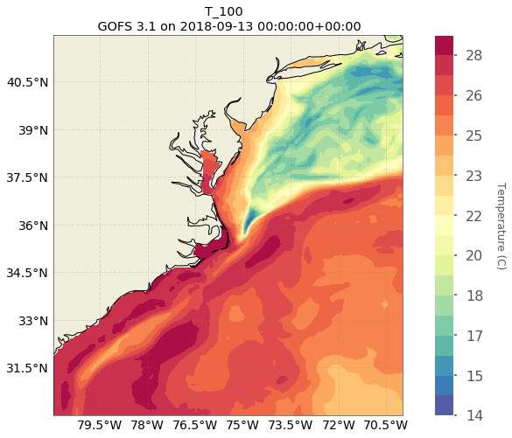
Depth Average Temperature down to 100 m or bottom

Slide 6
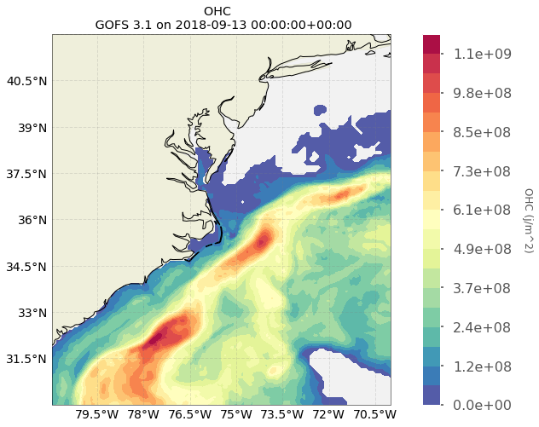
Ocean Heat Content

Slide 7
Yellow Sea

Slide 8
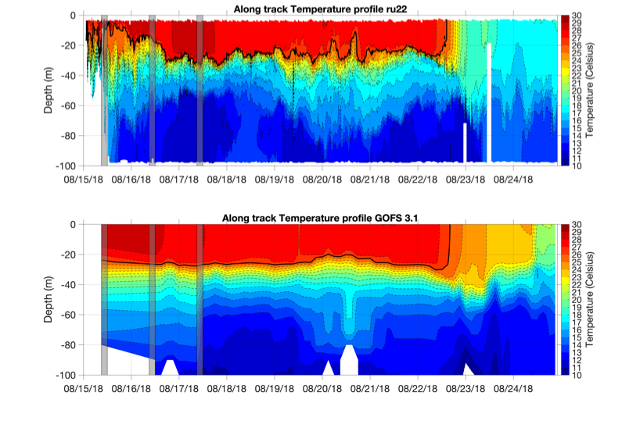
Typhoon Soulik
There is cooling ahead of eye during Typhoon Soulik
GOFS 3.1 fails to reproduce the SST cooling by 6 degrees
First Incremental Insertion Window
Typhoon Soulik

Slide 9
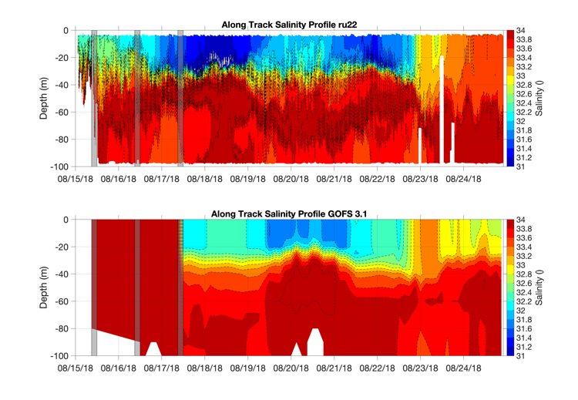
Typhoon Soulik
The correction of the salinity field in GOFS 3.1 after the glider data is assimilated for the first time is remarkable
First Incremental
Insertion Window
Typhoon Soulik

Slide 10
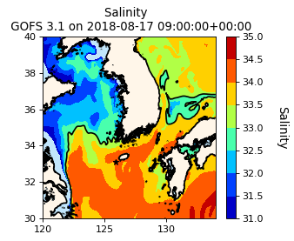
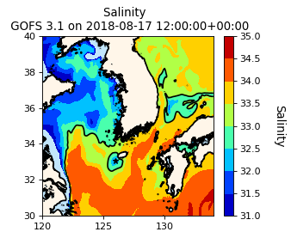
First Incremental Insertion Window

Slide 11
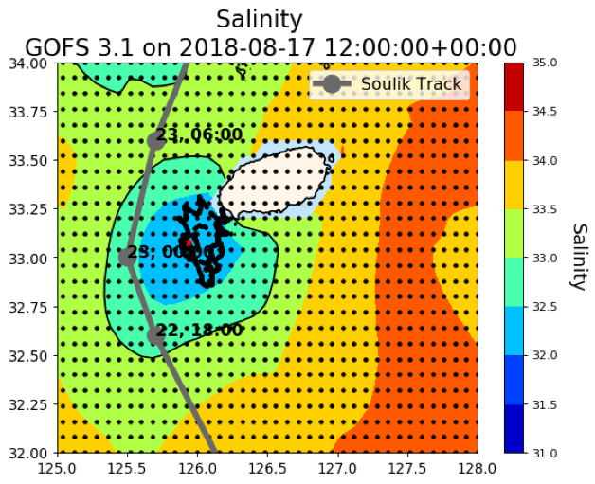
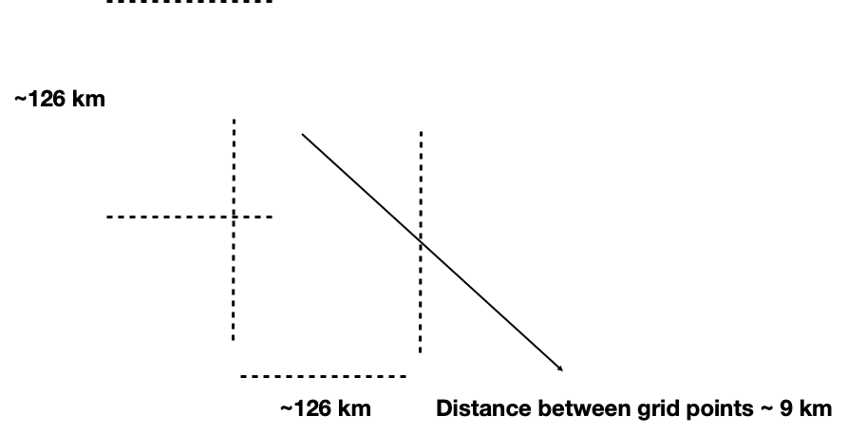
The salinity correction has an spatial extend of about 120 km

Slide 12
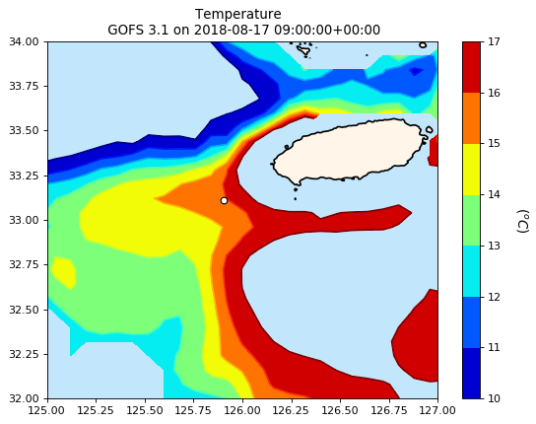
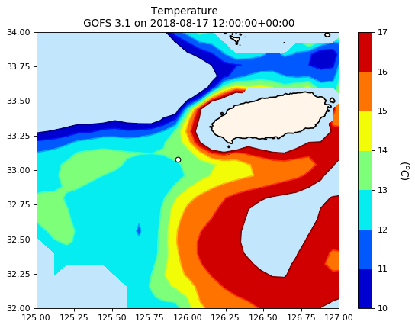
GOFS 3.1 temperature responds swiftly after glider data is assimilated for the first time
First Incremental Insertion Window

Slide 13
Typhoon Soulik
There is cooling ahead of eye during Typhoon Soulik
GOFS 3.1 fails to reproduce the SST cooling by 6 degrees
First Incremental Insertion Window
Typhoon Soulik

Slide 14
GOFS 3.1 fails to reproduce the SST cooling by 6 degrees
Is this being caused by the vertical mixing parameterization?
6º

Slide 15
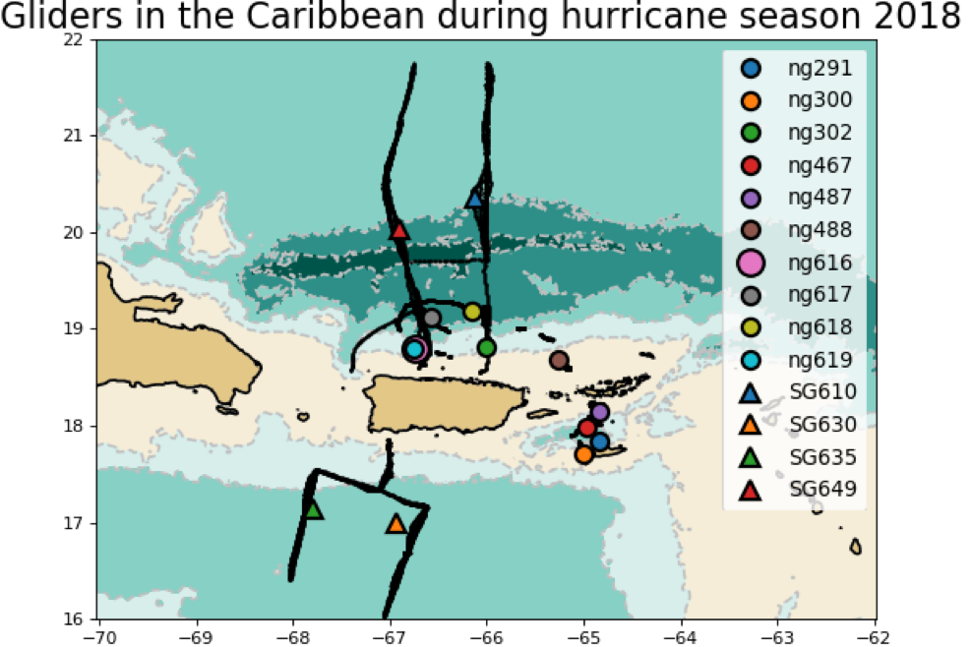
U.S Virgin Islands

Slide 16
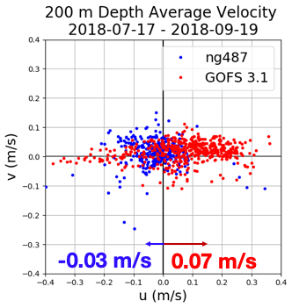
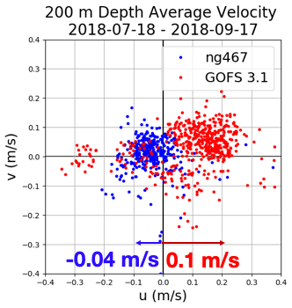
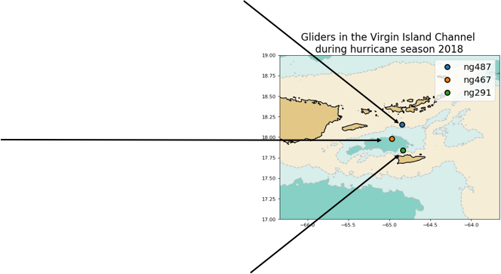
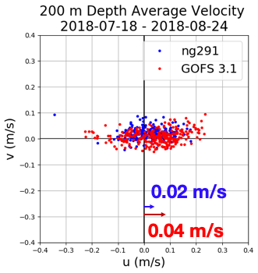
200 M Depth Average Velocity 18 July -17 Sep
The depth average velocities from observations and GOFS 3.1 are not in good agreement

Slide 17
Depth Average Velocities Rotated Along the Channel Axis

Slide 18
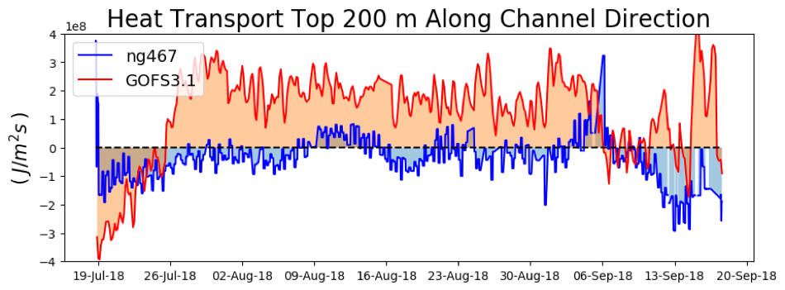
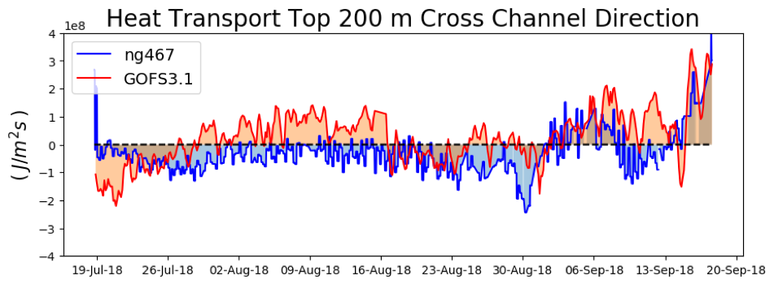
Heat Transport Through the Channel

Slide 19
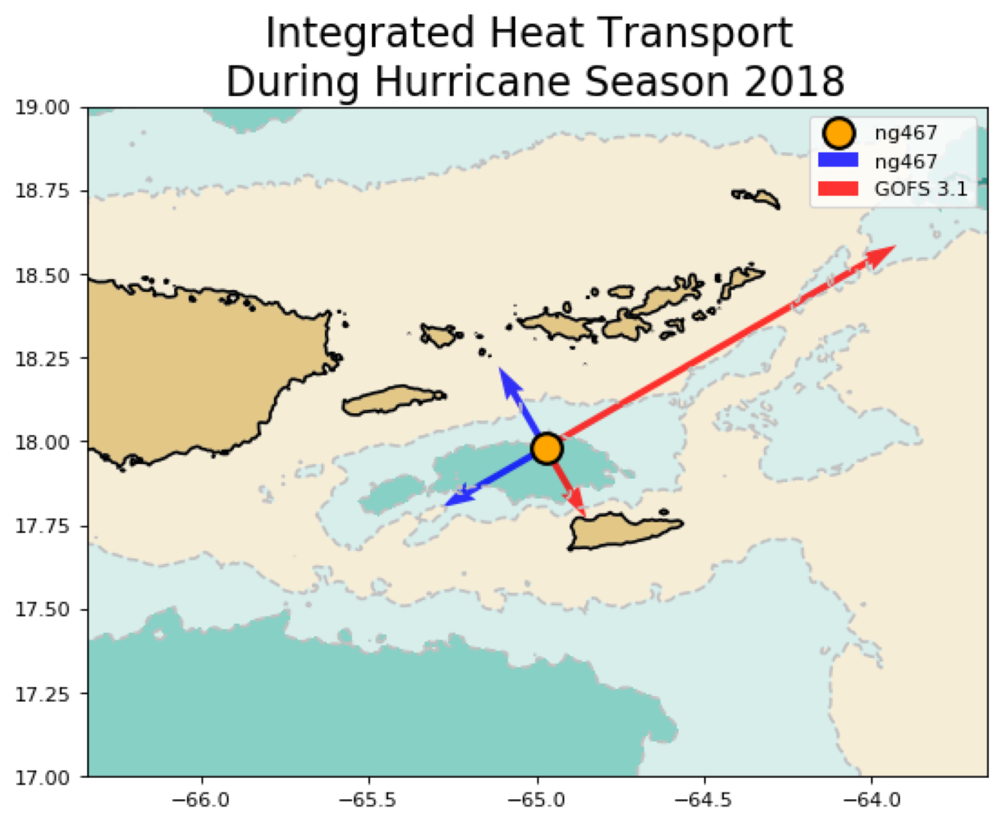
Ω

Slide 20
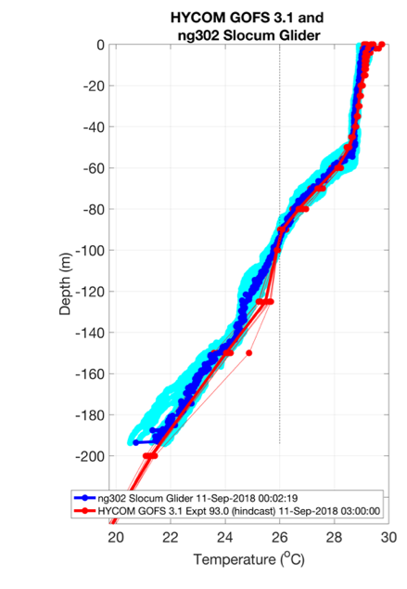
The temperature from observations and GOFS 3.1 are in good agreement
Add map

Slide 21
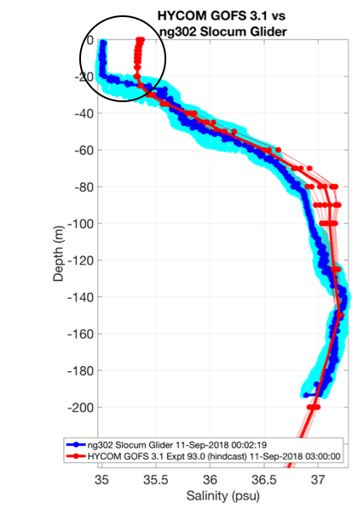
The salinity from glider data shows a relatively fresh surface layer: the barrier layer
GOFS 3.1 overestimates salinity at the surface
Add map

Slide 22
The barrier layer is a distinctive feature of the Caribbean that affects vertical water stability and therefore the vertical mixing necessary to cool down ……
Map of Amazon and Orinoco Plumes

Slide 24
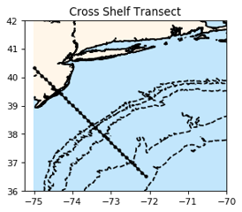
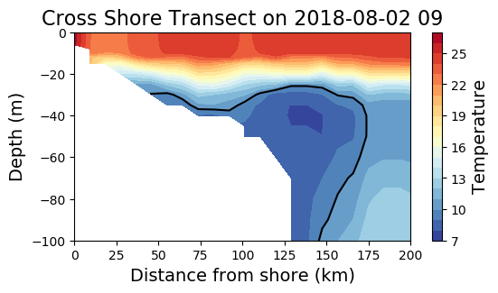
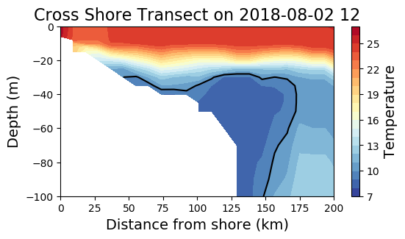
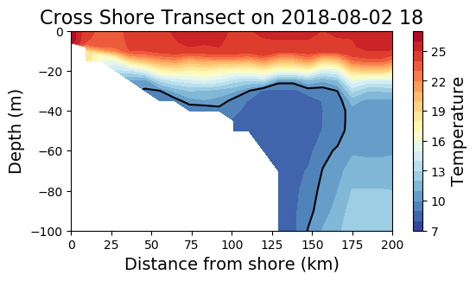
Cold Pool
What do we want to say about the cold pool?

Slide 25
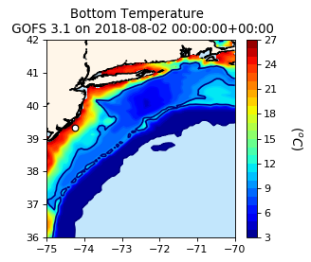
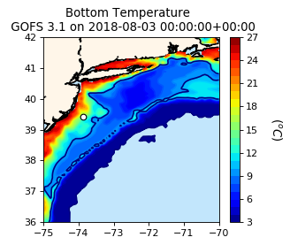
10 degrees
isotherm

