Slide 1
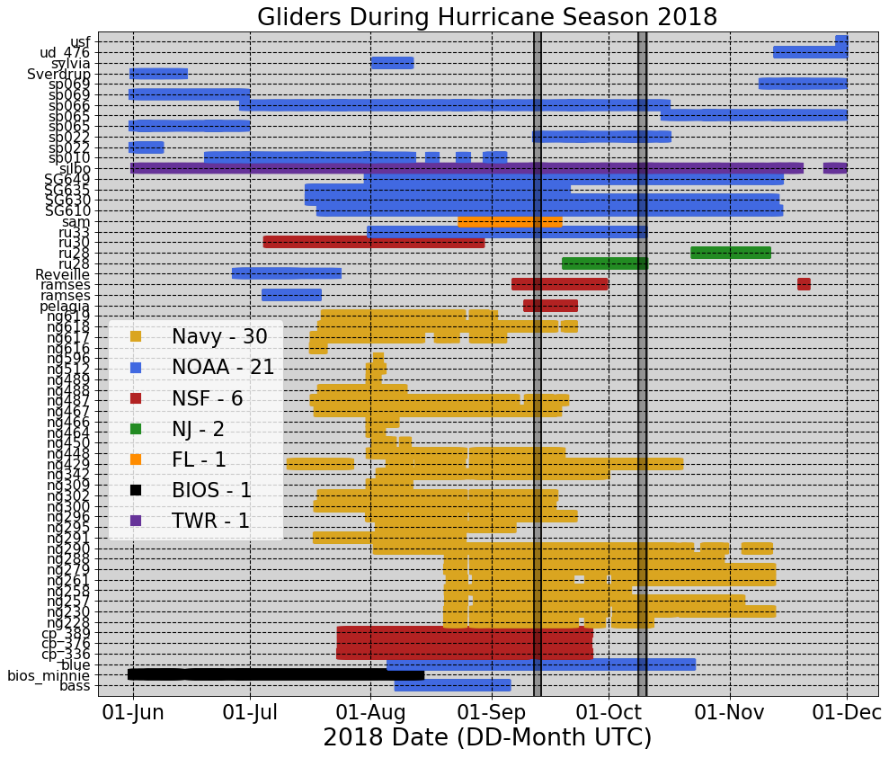
62 Gliders in the IOOS Glider Data Assembly Center (DAC)
During Hurricane Season 2018
Notes:
There were 61 gliders that reported data to the IOSS glider DAC during the 2018 hurricane season. All these data was pushed into the GTS (Global Telecommunication System) once a day. Once in the GTS, the data was accessed by a number of operational ocean models that use data assimilation: GOFS, European model ……

Slide 2
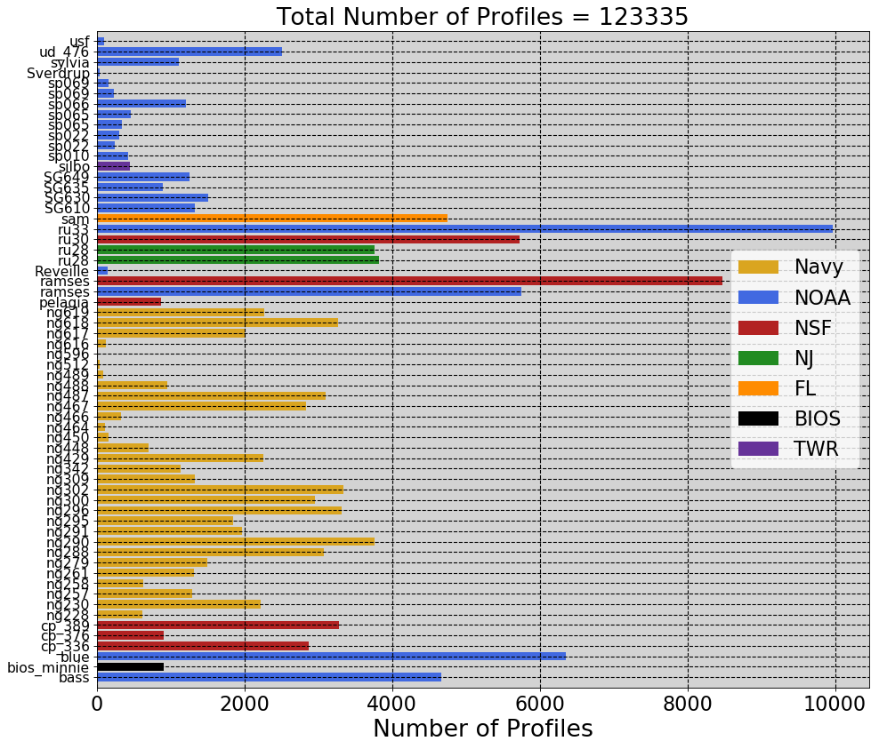
123335 Total Number of Profiles
During Hurricane Season 2018

Slide 3
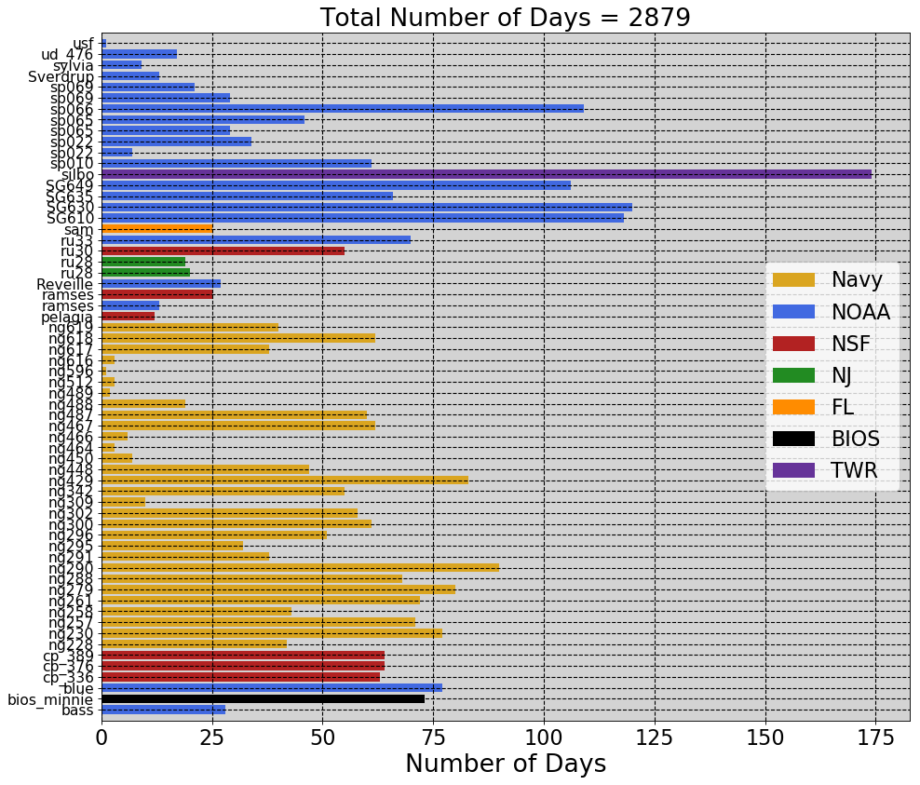
2879 Total Number of Days
During Hurricane Season 2018

Slide 4
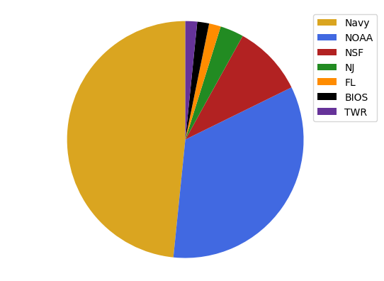
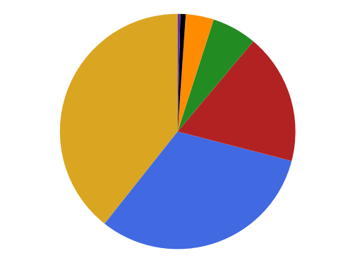
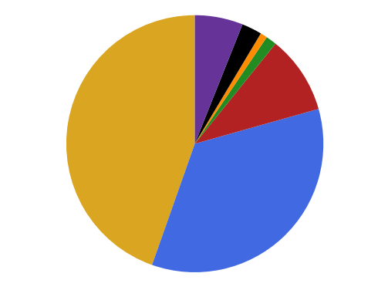
Number of Gliders
1
1
1
2
6
30
21
Number of Profiles
Number of days
446
907
73
25
174
39
4750
7587
22124
283
48522
1284
1001
38999

Slide 5
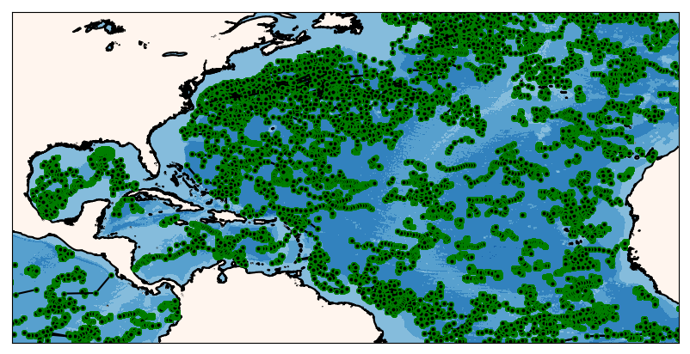
ARGO Floats
During the 2018 Hurricane Season

Slide 6
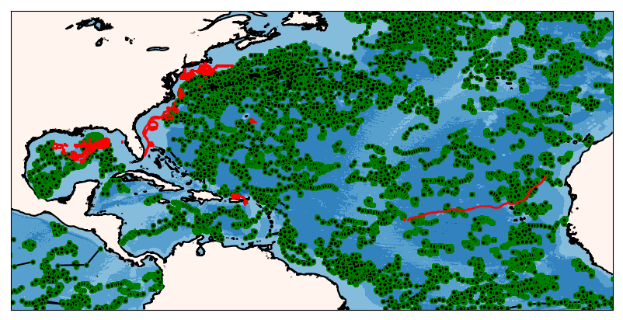
ARGO Floats
During the 2018 Hurricane Season

Slide 7
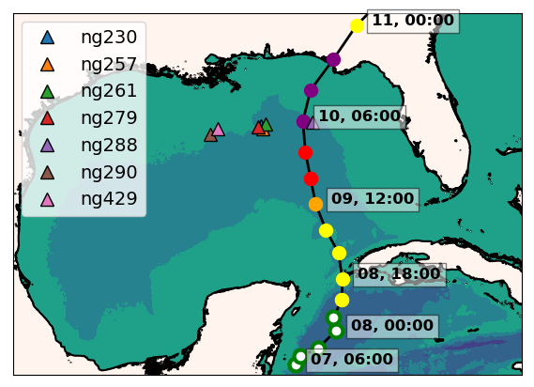
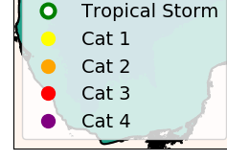
Gulf of Mexico: Hurricane Michael
ng288
Seven Navy gliders reporting to the glider DAC
in the GoM during hurricane Michael
Ng288 was at 36 km from the eye of Michael

Slide 8
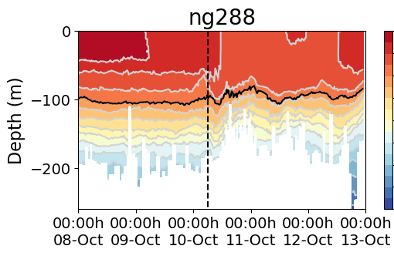
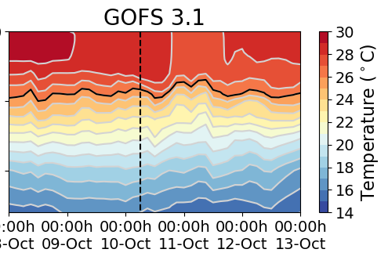
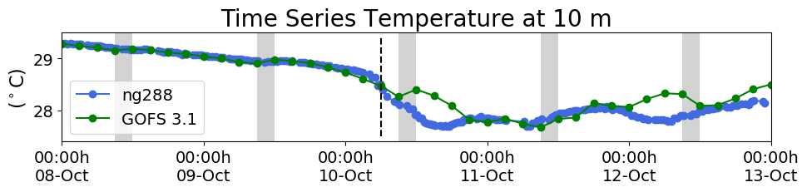
Hurricane Michael
Increments
Insertion Window
Increments
Insertion Window

Slide 9
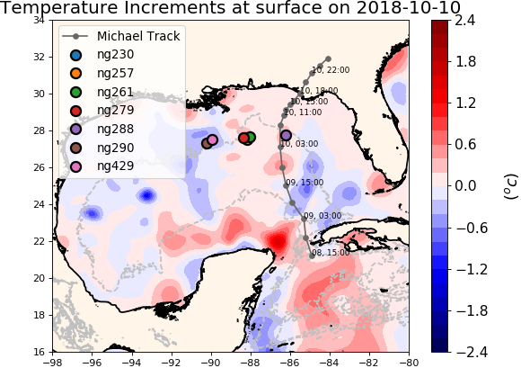
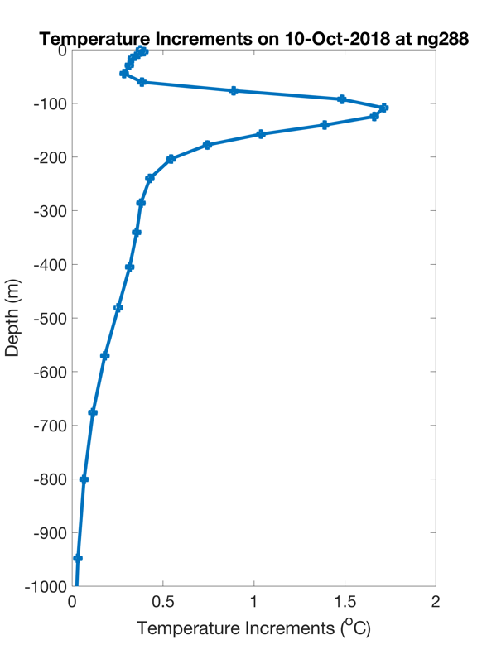
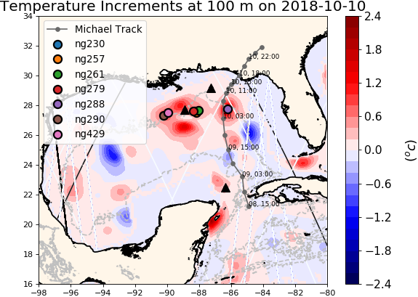
NCODA Temperature Increments
Repeat figure
Argo
Jason 2
CryoSat
Notes:
The increment is the change made to the model state at the end of the previous assimilation cycle.

Slide 10
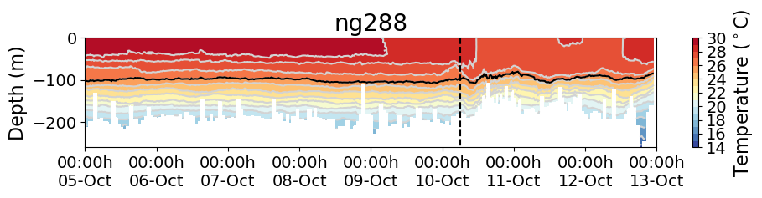
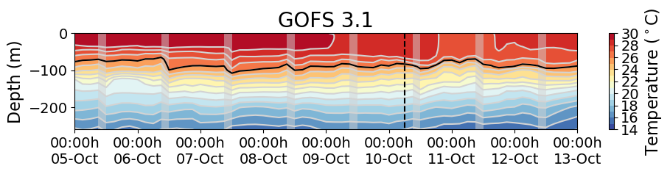
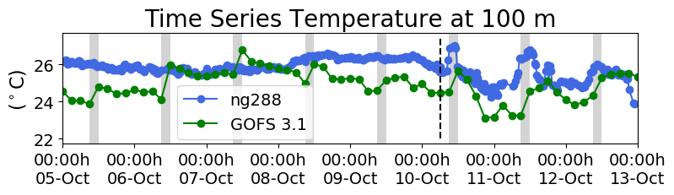
Hurricane Michael
Increments
Insertion Window
Increments
Insertion Window

Slide 11
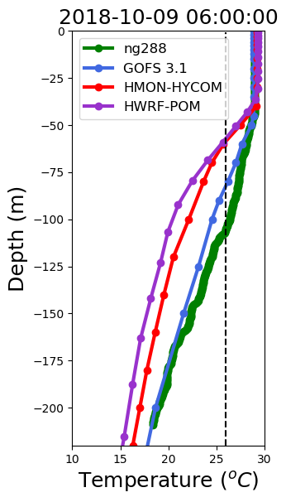
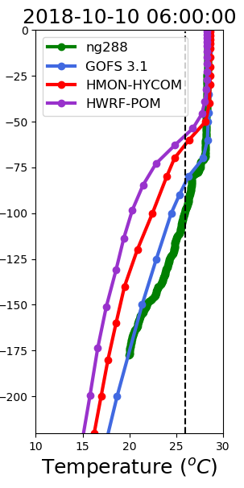
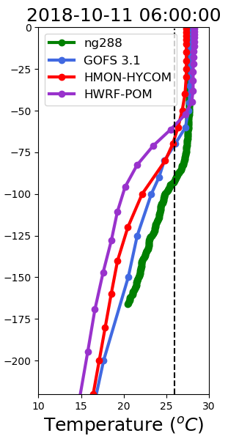
Vertical Profiles of Temperature
1 day before
During Michael
1 day after
Deepening
of mixed layer
Mixed layer
remains deep

Slide 12
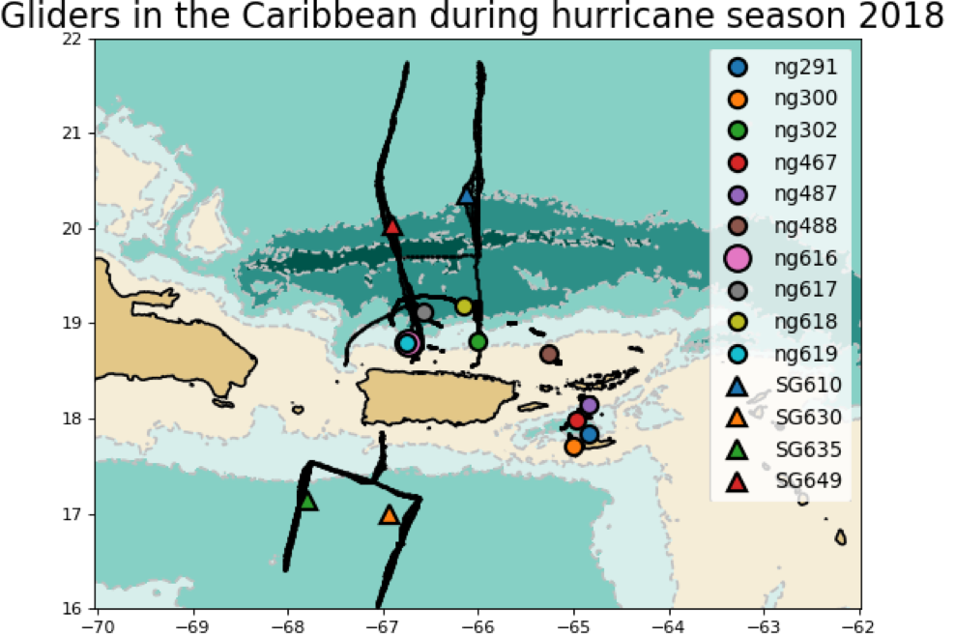
Heat Transport through the Anegada Passage

Slide 13

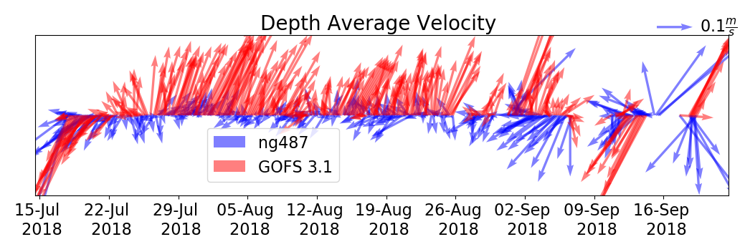
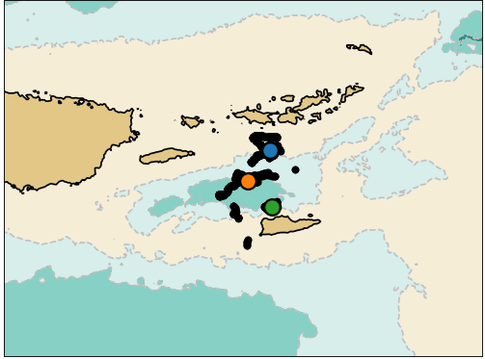
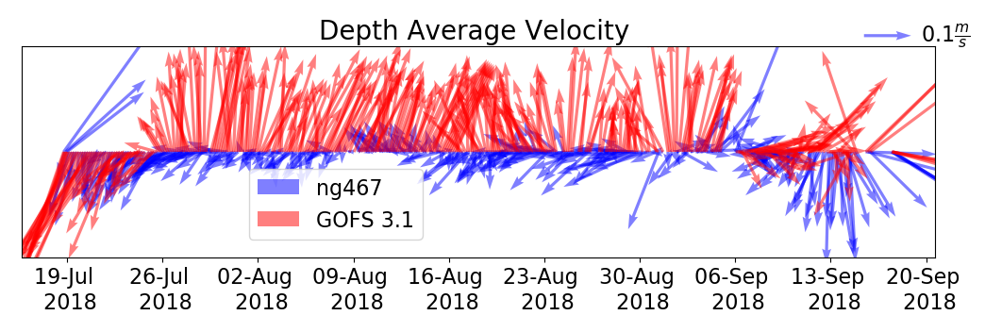
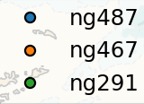
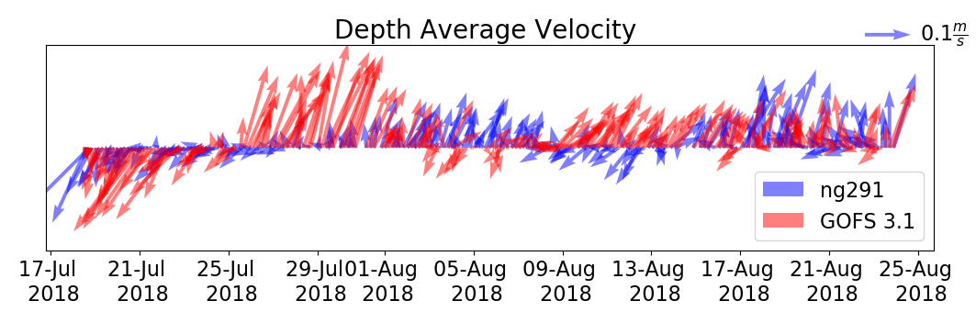
Caribbean: 200 M Depth Average Velocity 18 July -17 Sep

Slide 14
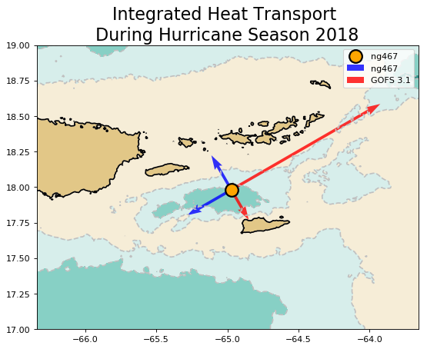


Slide 15
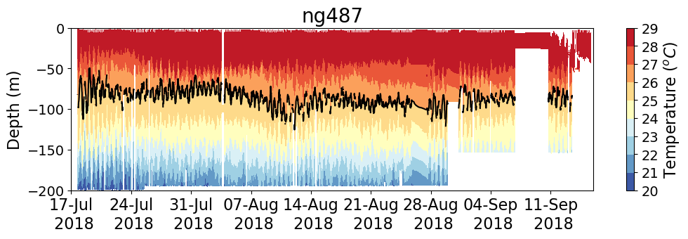
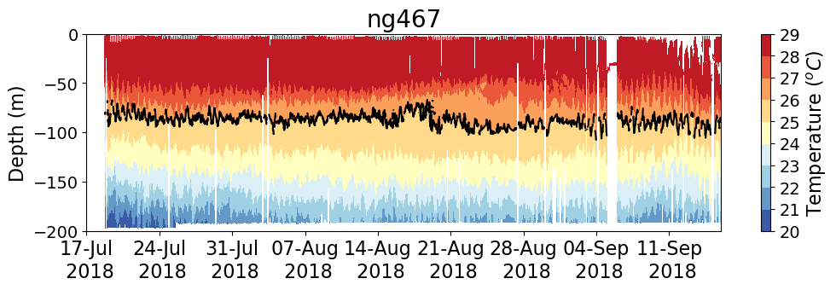
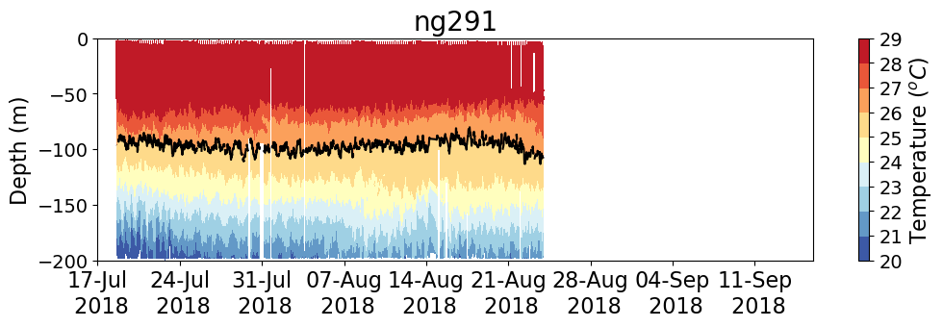
Cross-channel Temperature Gradients

Slide 16
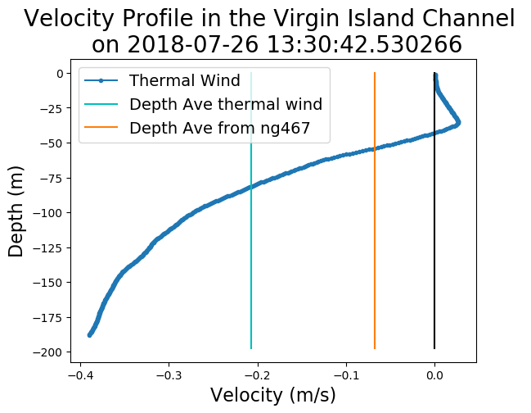
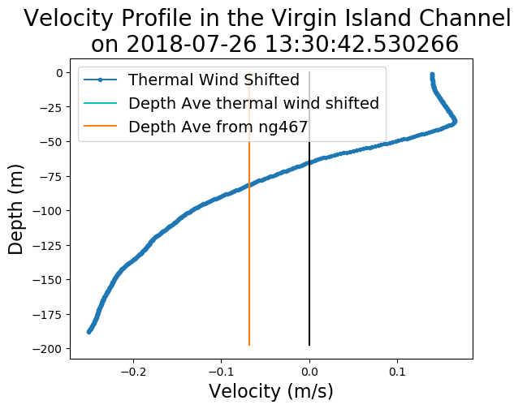
Thermal-Wind Balance Using ng487 and ng291
Shift
Shifted

Slide 17
After taking into account the vertical profile of velocity,
the model heat transport through the channel has
the opposite direction than the observed heat transport

Slide 18
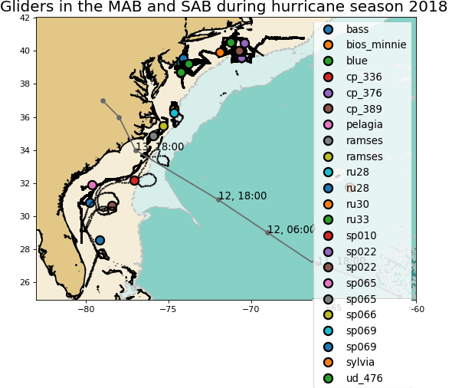
Middle/South Atlantic Bight, Hurricane Florence

Slide 19
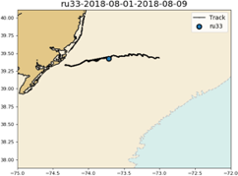
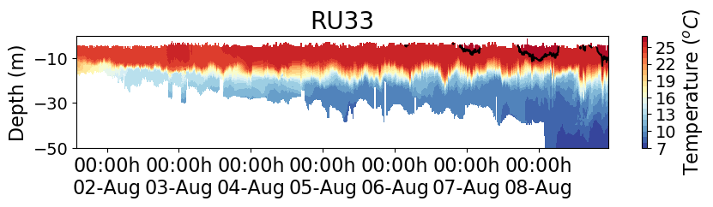
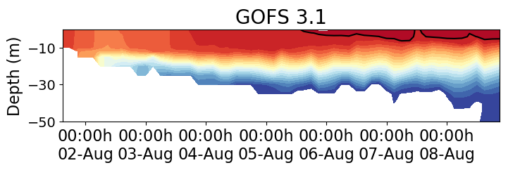
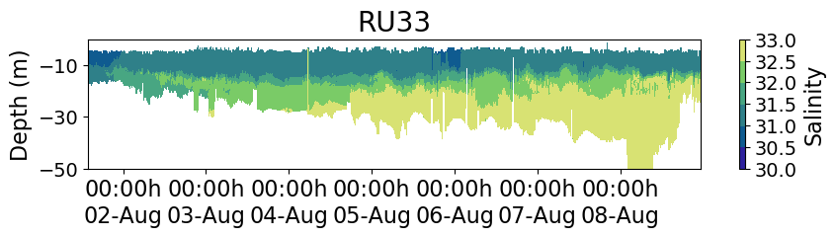
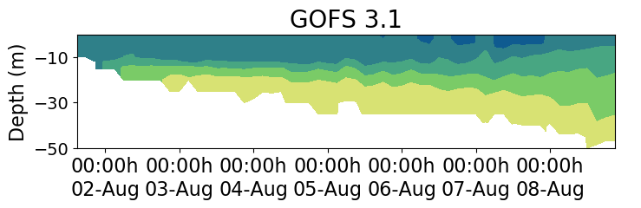
Middle Atlantic Bight

Slide 20
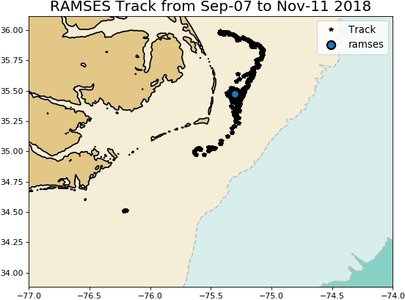
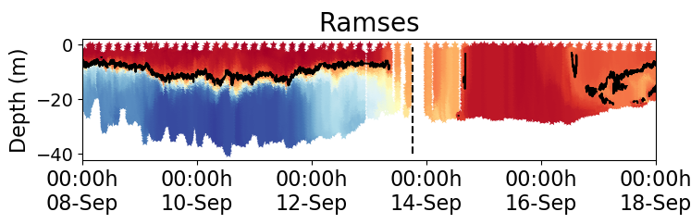
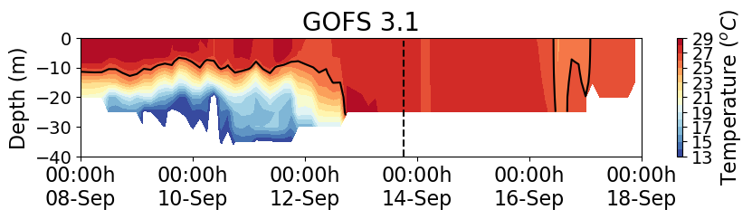

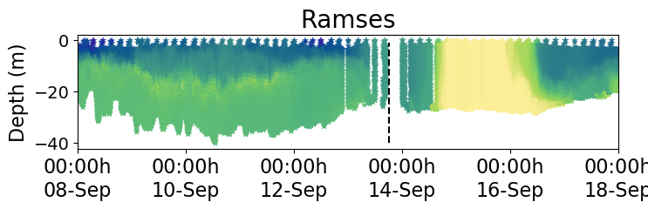
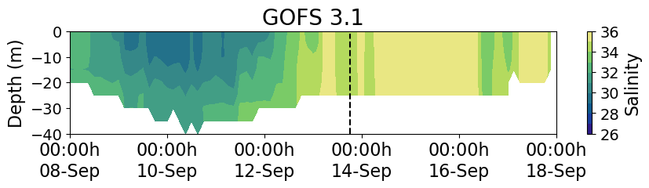
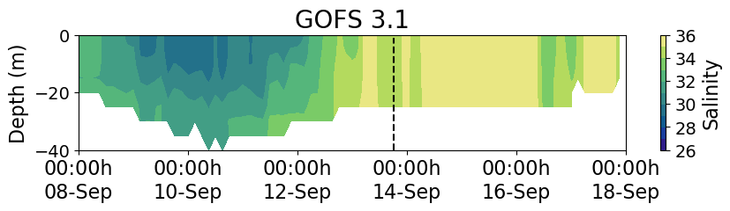
Middle/South Atlantic Bight Transition Zone
Florence

Slide 21
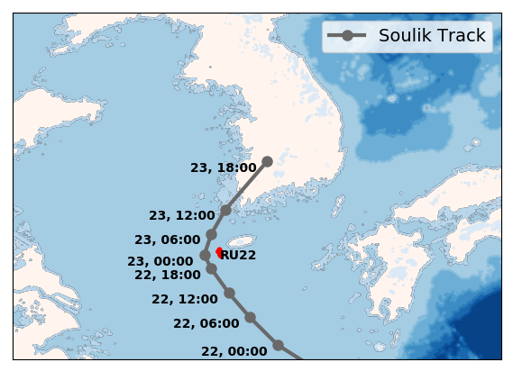
Typhoon Soulik

Slide 22
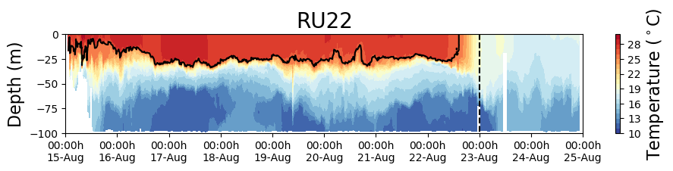
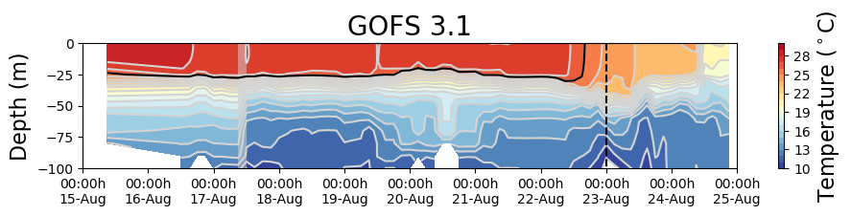
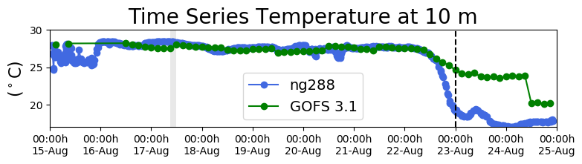
Typhoon Soulik

Slide 23



Typhoon Soulik
The correction of the salinity field in GOFS 3.1 after the glider data is assimilated for the first time is remarkable
First Incremental
Insertion Window
Typhoon Soulik

Slide 24


First Incremental Insertion Window

Slide 25



