Slide 1
Carl Gouldman, IOOS Program Update
May 14, 2019

Slide 2
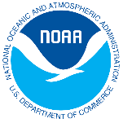
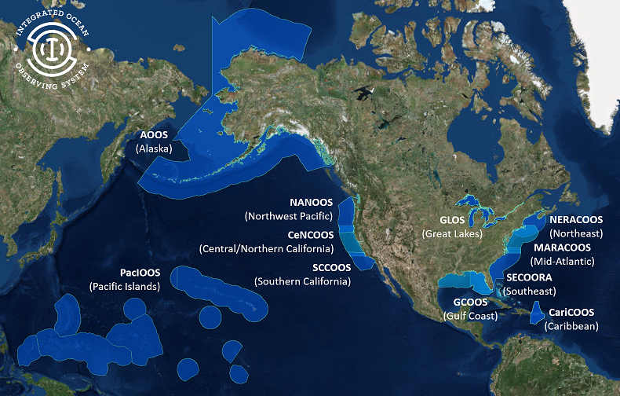
U.S. IOOS: Program Overview
Partnership effort that leverages dispersed national investments to deliver ocean, coastal and Great Lakes data relevant to decision-makers.
Global Component
US contribution to Global Ocean Observing System (GOOS)
1 of 15 Regional Alliances of GOOS
National Component
17 Federal agencies
Regional Component
11 Regional Associations
Stakeholder driven
Academia, state/local/tribal government, private industry

Slide 3
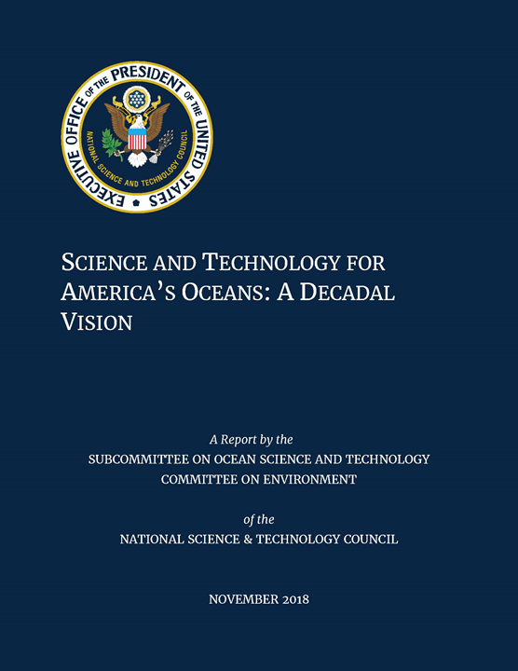
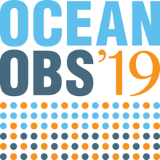
Looking forward - importance of the ocean
OceanObs’19 - Regional - Coastal - Global
Essential Ocean Variables and Communities of Practice
White House (OSTP) Science and Tech for America’s Oceans: A Decadal Vision
UN Decade of Ocean Science for Sustainable Development

Slide 4
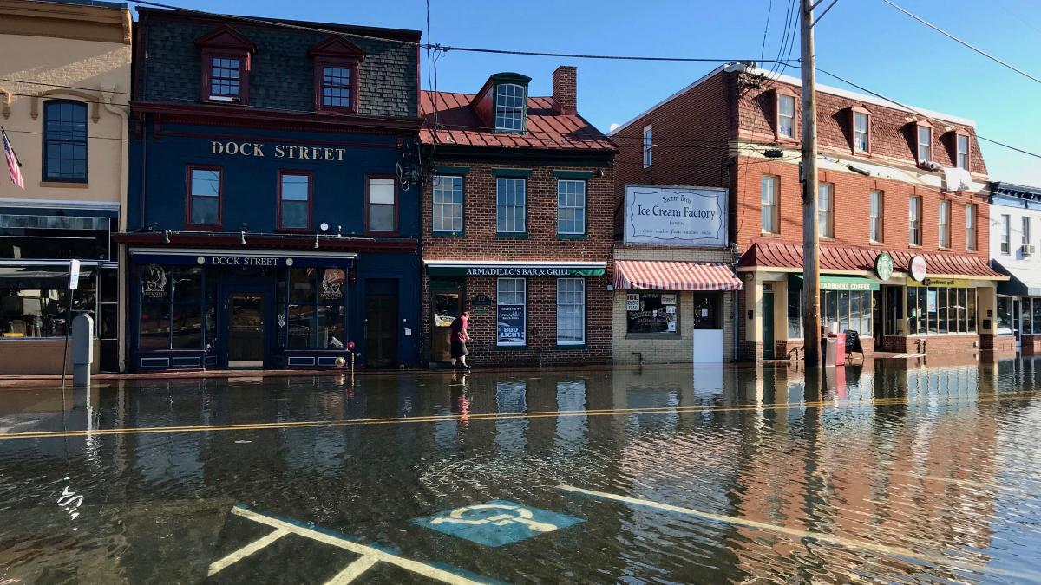
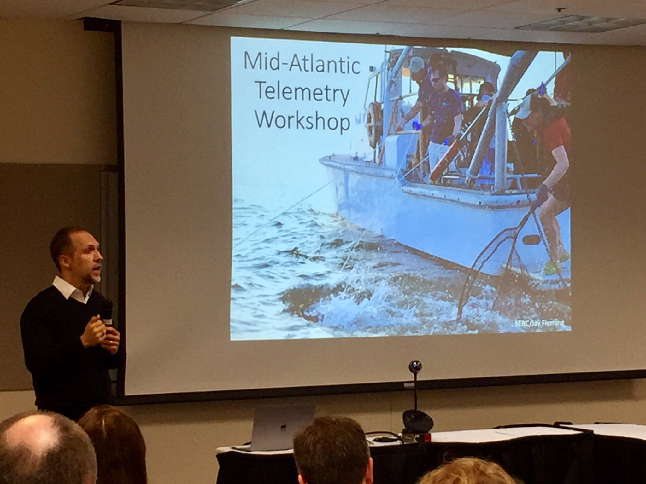
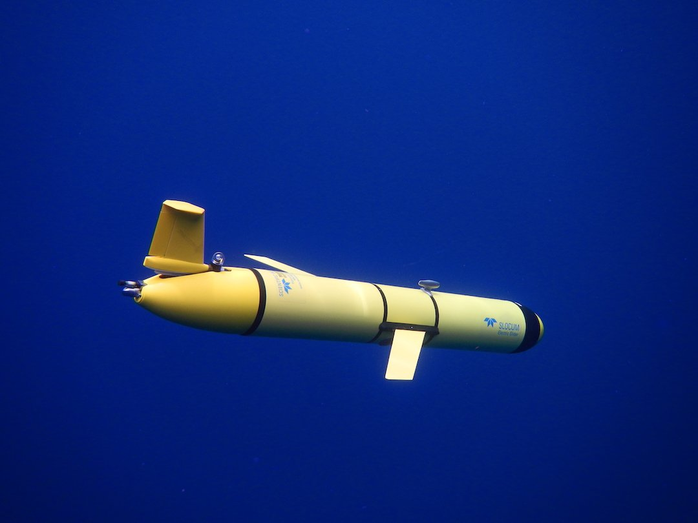
MARACOOS
Supporting decisions everyday with sustained expertise observing, modeling, & DMAC
MARACOOS Provides Data for Annapolis Flood Mitigation
Co-hosted Mid-Atlantic Acoustic Telemetry Workshop - strengthening the organization and value of telemetry in the region
Partnered with NOAA & IOOS regions to deploy 17 gliders to collect real-time data on Hurricanes Florence and Isaac
IOOS Association Board - strategic teamwork
Notes:
City of Annapolis and the United States Naval Academy are using MARACOOS data to address long-term flood mitigation needs: https://maracoos.org/node/525
Mid-Atlantic Acoustic Telemetry Workshop signals a major step towards strengthening the organization and value of telemetry in the Mid-Atlantic Region. The ATN partnered with the NMFS/Chesapeake Bay Office, MARACOOS and the Smithsonian Environmental Research Center (SERC) to co-host the Mid-Atlantic Telemetry Workshop at the University of Delaware, April 18-19, 2019. Led by Dr. Matt Ogburn from SERC, the Workshop brought together 40 of the leading acoustic telemetry researchers in the Mid-Atlantic region to present their science activities and to learn about MATOS, the Mid-Atlantic Telemetry Observation System web-based data management tool developed by RPS Group now being implemented cooperatively among SERC, ATN, CBO and MARACOOS.
Harnessing Unmanned Systems to Meet the Mission - Seventeen hurricane “picket line” gliders were deployed and operating in the Caribbean and Atlantic to collect real-time observations of Hurricanes Florence and Isaac in 2018. The NOAA, U.S. Integrated Ocean Observing System (IOOS), and Atlantic Oceanographic and Meteorological Laboratory worked with the Navy and IOOS Regional Association partners to place the gliders in front of the storms to help forecasters and researchers better understand the ocean conditions ahead of a hurricane.

Slide 5
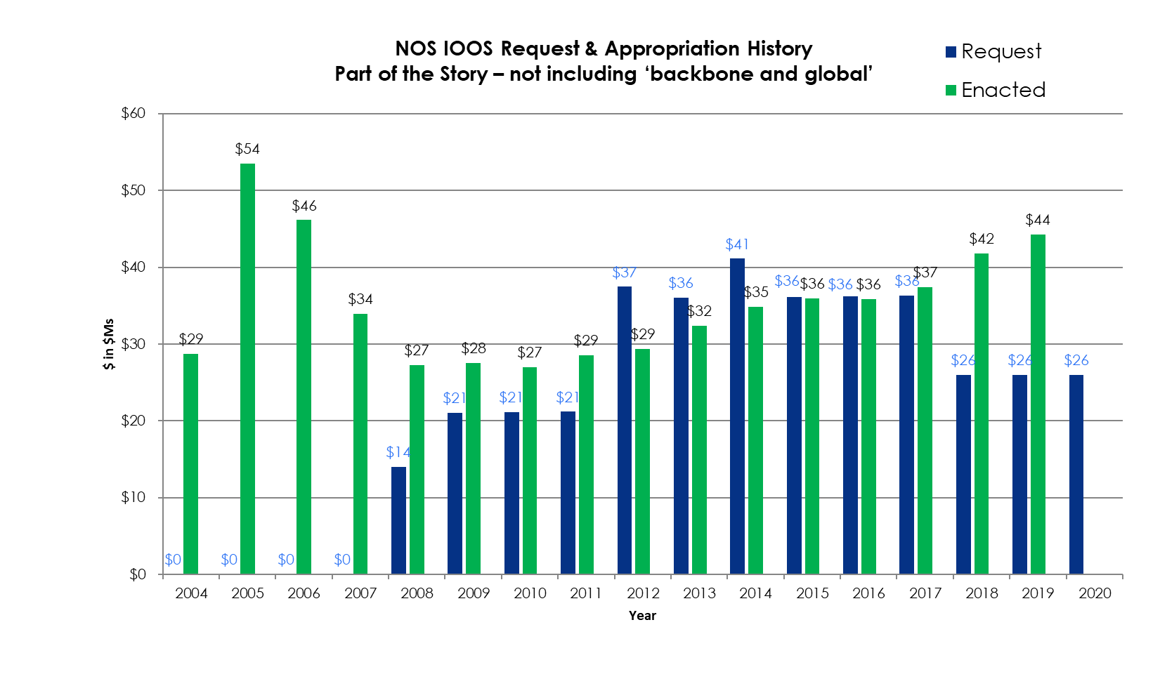
U.S. IOOS Enacted and President’s Budgets FY04-20
NOAA National Ocean Service
Navigation, Observations, and Positioning: ‘National IOOS’ component FY18 Omnibus $6.8M & ‘Regional IOOS Observations’ $35M
Estimated Enacted levels are ‘post rescission’ totals for each year
‘Request’ = the President’s Budget Request
FY19 House Mark is first, next is Senate Mark, then Conference…
5

Slide 6
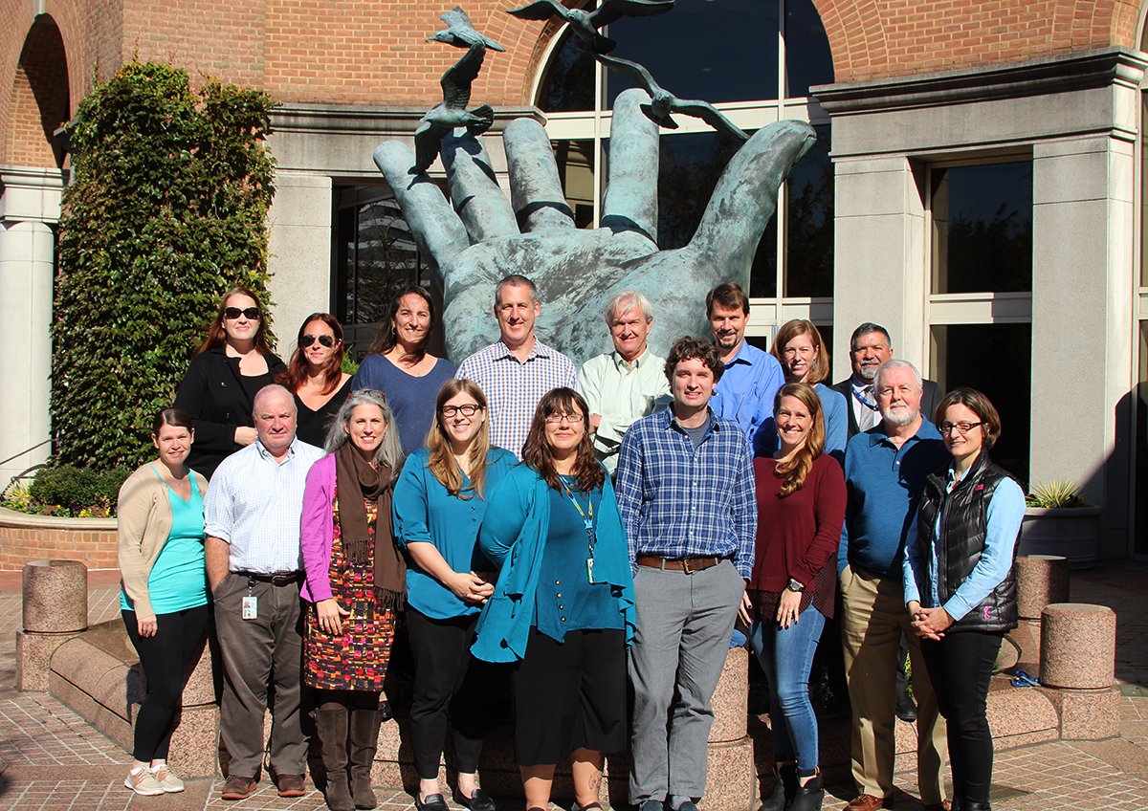
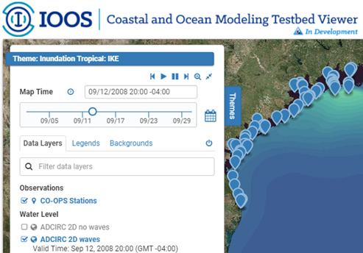
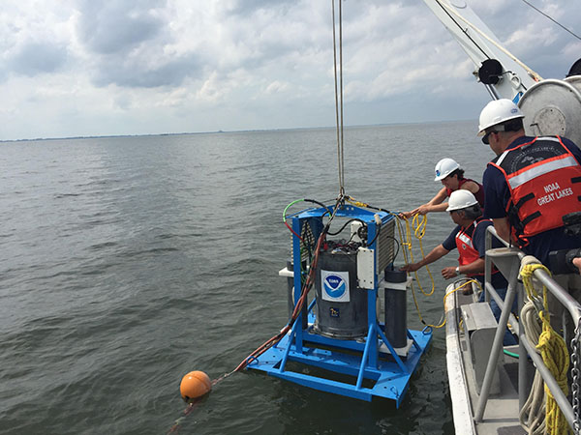
FY2019 IOOS Highlights
Blue Economy
Customer focus and stakeholder outreach
ICOOS Act reauthorization
NOAA Weather Act & NOAA Water Initiative
CENOTE Act 2018 (Commercial Engagement Through Ocean Technology Act of 2018)
IOOS Advisory Committee
Filling gaps $7.5M: Surface Currents, Gliders, Streamlined Access to observation information
Biology and Harmful Algal Bloom Observing
Research and Development
Ocean Technology Transition – new FFO for award in FY2020
Coastal and Ocean Modeling Testbed COMT - Coastal / Ocean /Water Modeling, Forecasting, and Prediction
ACT workshops for IOOS RAs and OAR Labs and Cooperative Institutes
6

Slide 7
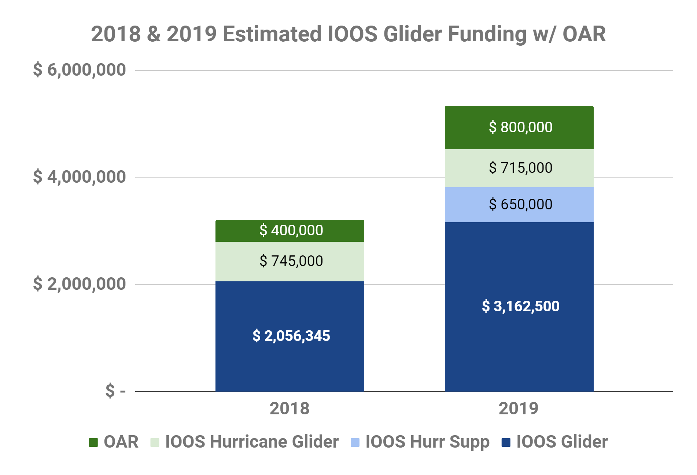
IOOS & co. gliders 2018 - 2019

Slide 8
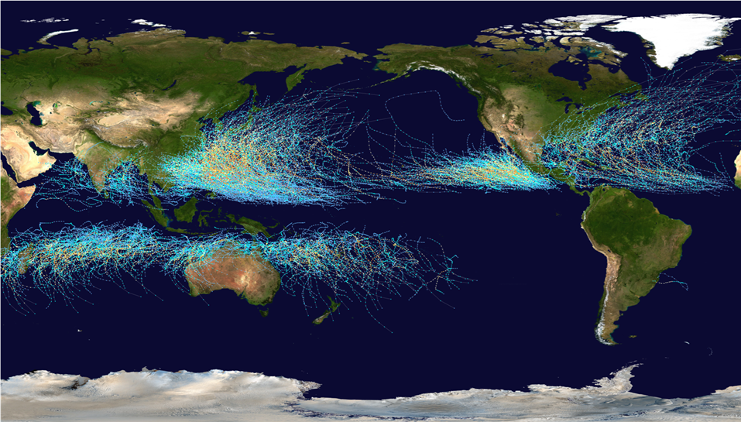
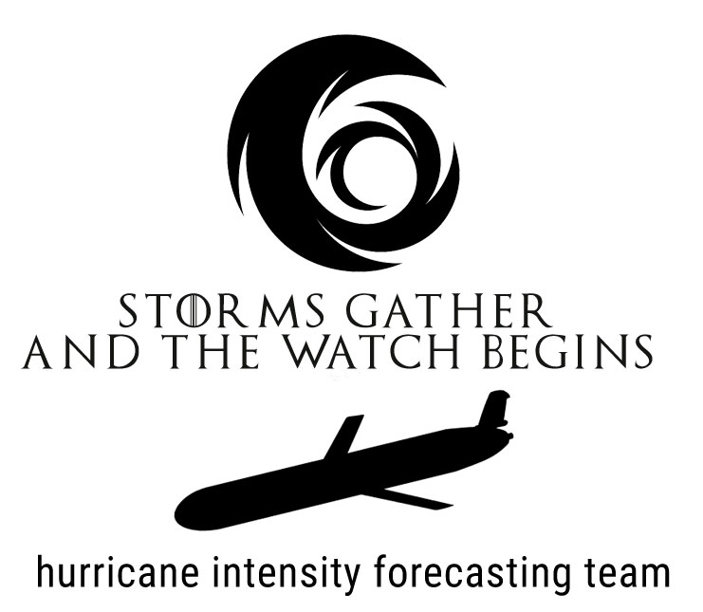
Hurricanes are coming

Slide 9
Storms are coming
Storms gather and now our watch begins …
Hear my words and bear witness to my vow
It shall not end until batteries fail
I bring ocean data through darkness
I am a watcher under waves
I am a drone that guards the realm
I bring our ocean to models for this season and seasons to come.
Adapted from adaptation by HBO Game of Thrones (Song of Fire and Ice: George R. R. Martin)

