Slide 1
MAB 2019 Hurricane Season
﻿The gliders found are:
'blue-20190815T1711’
'blue-20191014T1359’
'ng618-20190901T0000’
'ng619-20190901T0000’
'ru22-20190820T1327’
'ru22-20191014T1645’
'ru28-20190717T1522’
'ru28-20190926T1413'
'ru30-20190717T1812’
'ru30-20191015T1824’
'ru33-20191014T1643’
'sbu01-20190716T1733’
'sbu01-20191014T1634'
'sp062-20190201T1350’
'sp062-20190925T1538’
'sp065-20190517T1530'
'sp066-20190301T1640'

Slide 2
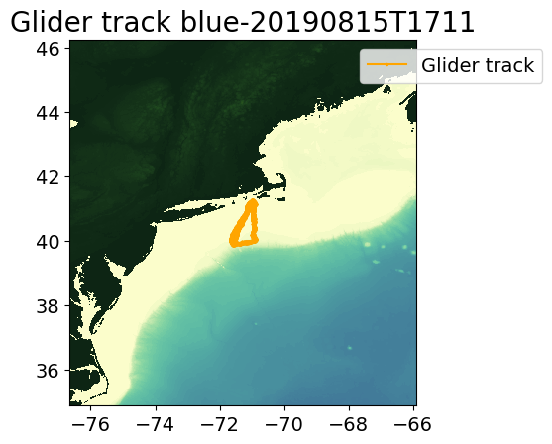
blue-20190815T1711

Slide 3
blue-20190815T1711

Slide 4
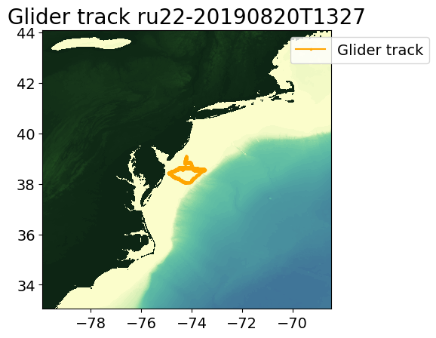
ru22-20190820T1327

Slide 5
ru22-20190820T1327

Slide 6
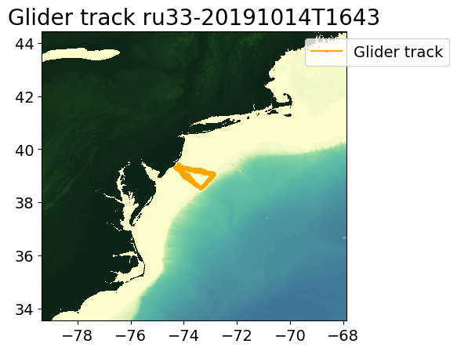
ru33-20191014T1643

Slide 7
ru33-20191014T1643

Slide 8
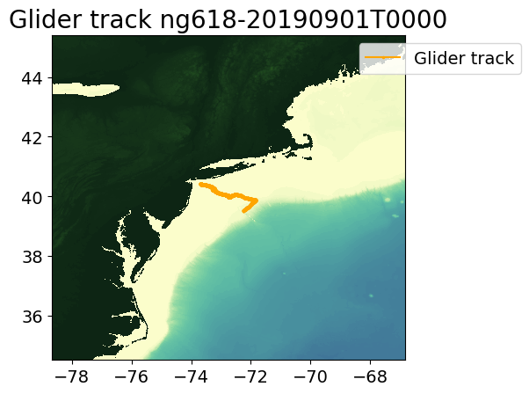
ng618

Slide 9
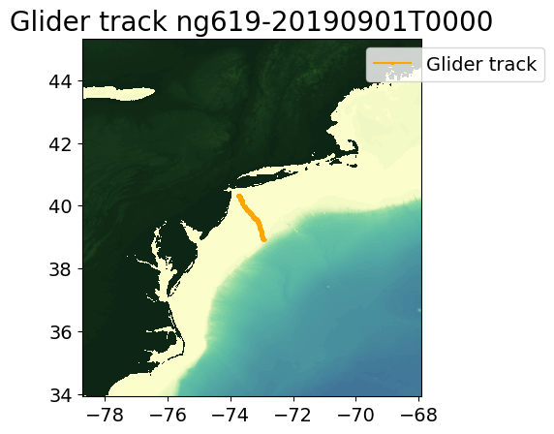
ng619

Slide 10
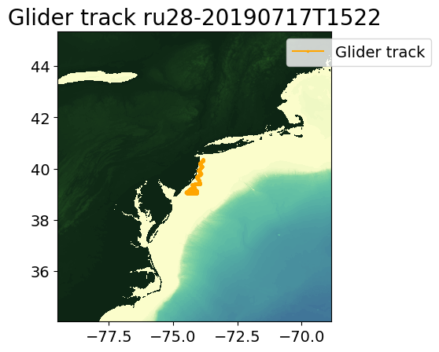
RU28

Slide 11
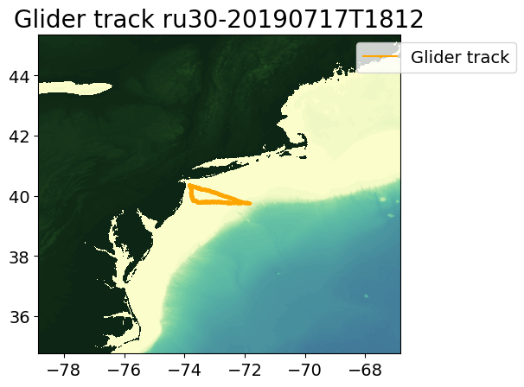
RU30

Slide 12
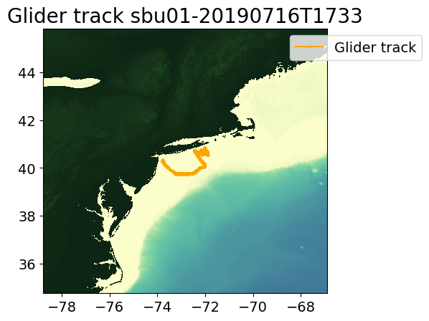
sbu01

Slide 13
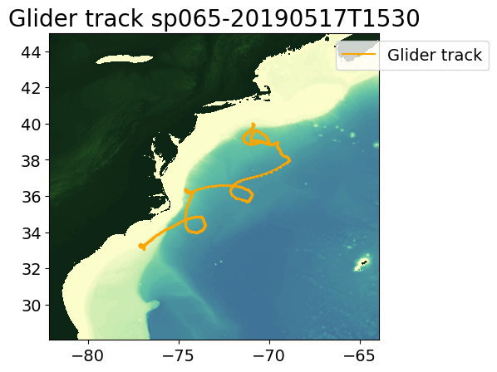
sp065

Slide 14
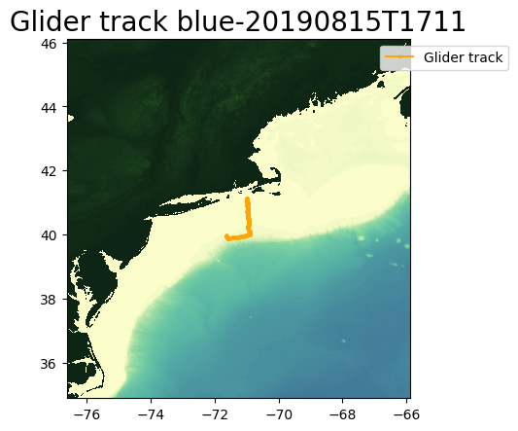
blue-20190815T1711

Slide 15
blue-20190815T1711

Slide 16
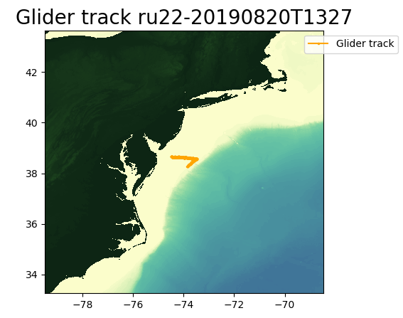
ru22-20190820T1327

Slide 17
ru22-20190820T1327

