Slide 1
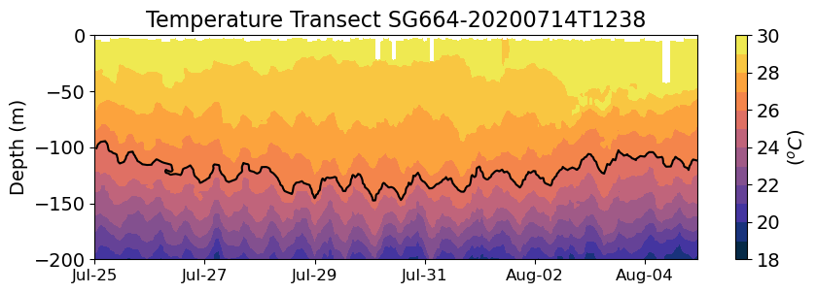
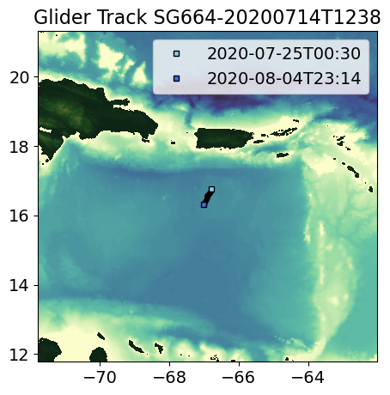
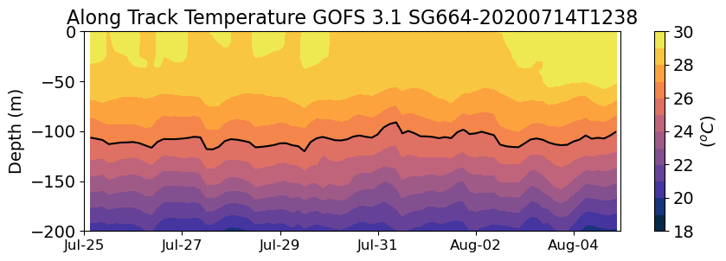
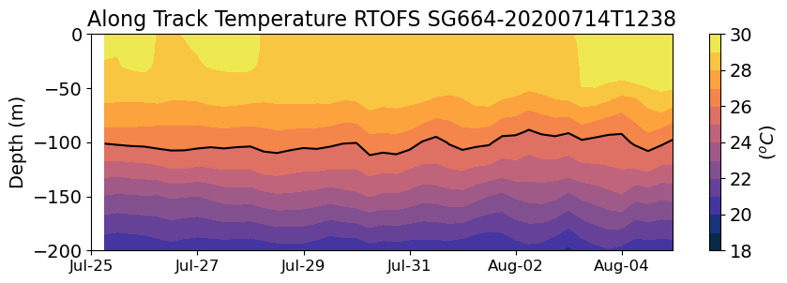
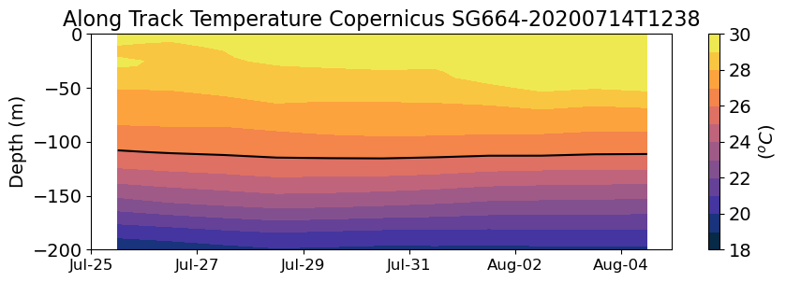
Caribbean
Isaias
Observations
Analysis
Glider SG664 showed no evident change in the temperature of the mixed layer after Isaias.
Forecast
Forecast

Slide 2
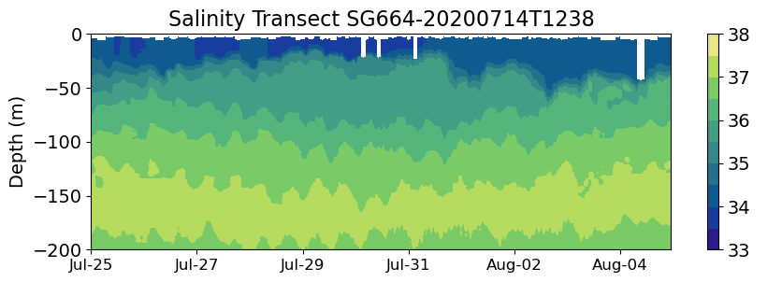
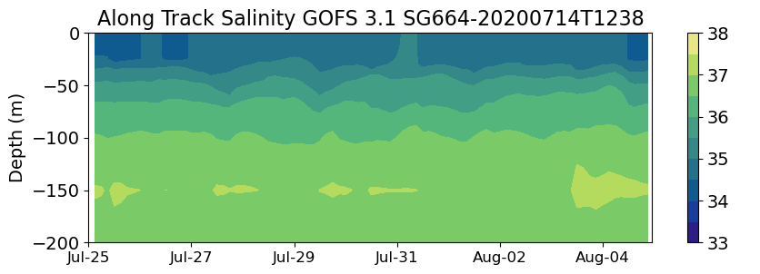
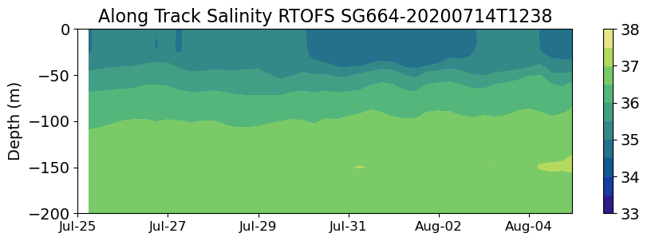
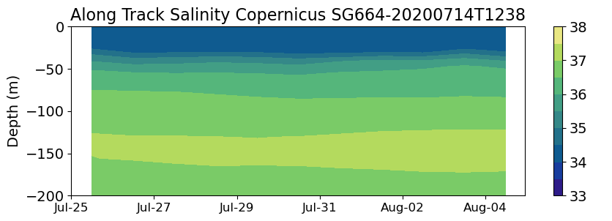
Caribbean
Isaias
Observations
Analysis
Glider SG664 was within the region of fresh water influence and showed a barrier layer. We will investigate if the barrier layer prevented the vertical mixing within the mixed layer.
Forecast
Forecast

