Slide 1
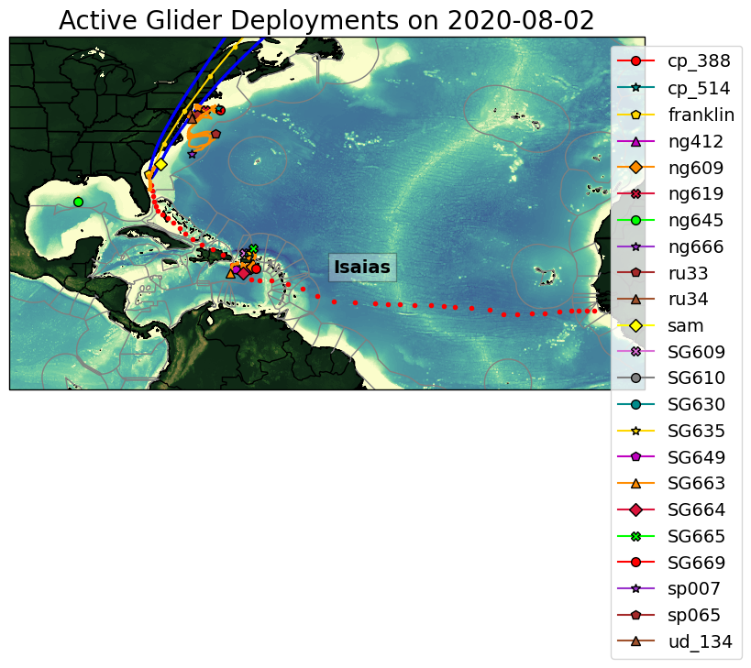
Figure 1
Autonomous underwater gliders have been deployed during hurricane season in the North Atlantic in support of hurricane research and operations since 2017. This effort is supported by the NOAA Integrated Ocean Observing System (IOOS), its regional associations and the
University community. During Storm Isaias, there were a total of 23 underwater gliders deployed in the Caribbean, Gulf of Mexico, South and Mid-Atlantic Bight. Many of the gliders were on the path of the storm (see Figure 1).

Slide 2
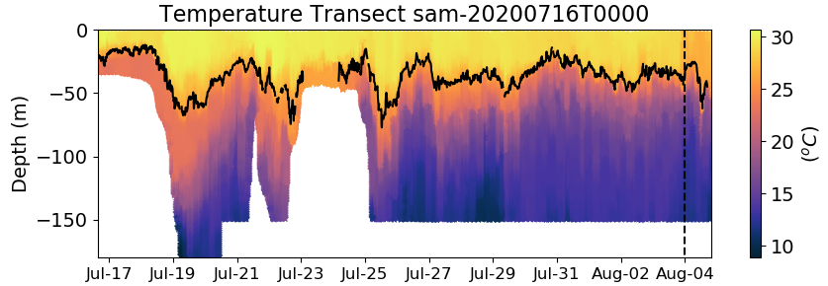
Glider Sam

Slide 3
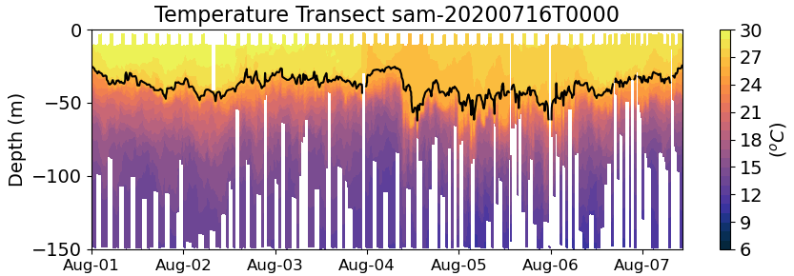
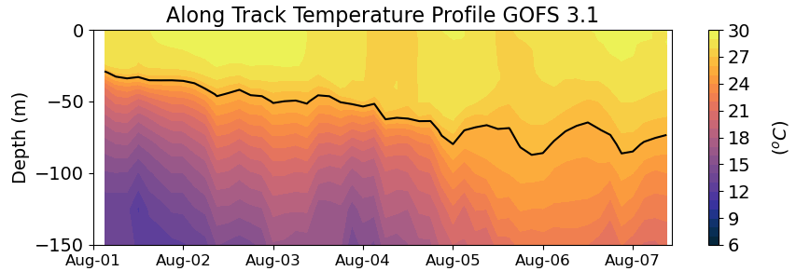
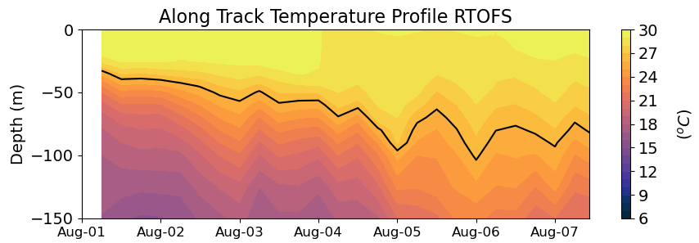

Slide 4
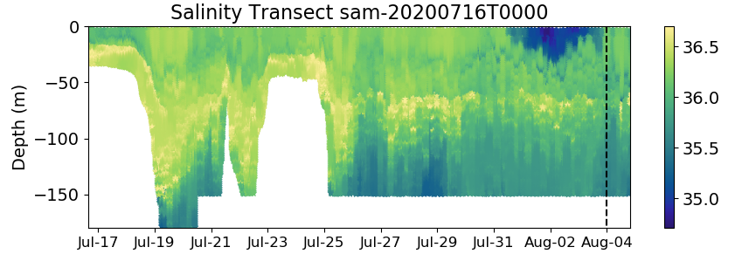
Glider Sam

Slide 5
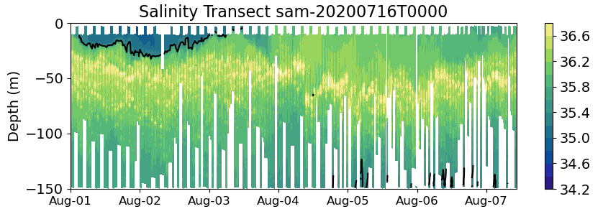
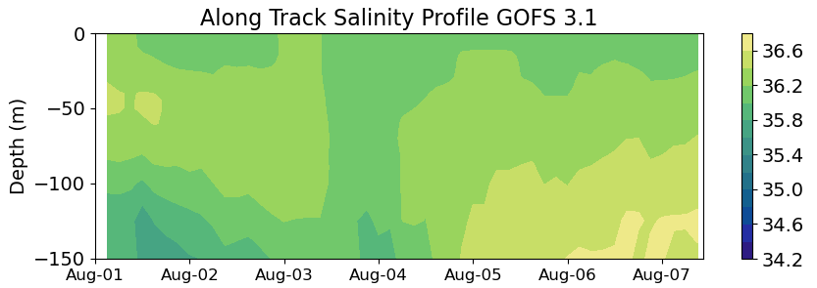
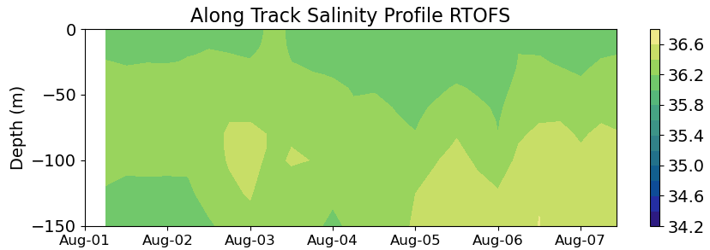

Slide 6
