Slide 1
Hurricane Gliders Operations
During the 2019 Hurricane Season
Lessons Learned from Hurricane Dorian and
Tropical Storm Karen
Maria Aristizabal
Travis Miles
Scott Glenn
Ben LaCour
…..
Gustavo Goni
…..

Slide 2
Objectives
Assess the impact of glider data assimilation on the operational ocean models during the current hurricane season
Identify relevant ocean processes for hurricane intensity that need to be captured by the operational ocean models

Slide 3
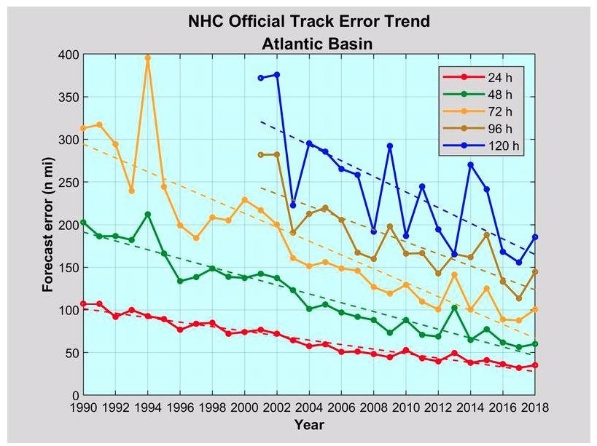
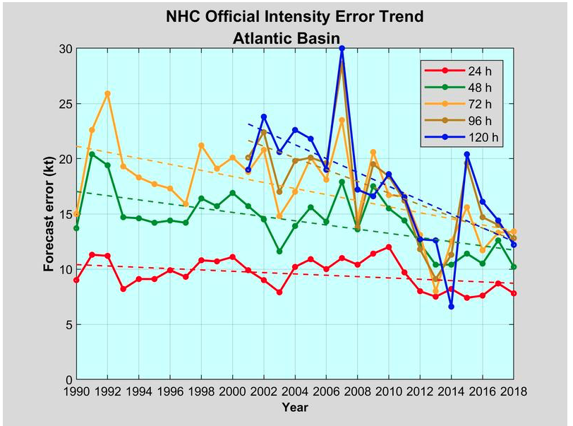
Motivation
76 %
47 %
33 %
45 %
43 %
52 %
50 %
29 %
50 %
10 %
Hurricane Forecast Improvement Program (HFIP) established 2009
20% error reduction in track and intensity in first 5 years
Improvements leveled off after 2015
To reach original 10 year goals, suggest a focus on
  Forecast outliers
  Rapid intensification events
Goals for next generation HFIP include:
  Reduction in forecast errors by 50 percent from 2017 level
Notes:
For more than a decade there has been a concerted effort by NOAA and other federal agencies to improve the hurricane forecast (Hurricane Forecast Improvement Project). There has been a fair progress reducing track errors for the different lead times: the track error has been reduced by about 50% for all the lead times. However, the error reduction in the intensity has been marginal: about only 15%. There are several reasons for the lack of progress in the intensity forecast. One limitations in the horizontal and vertical resolutions of the couple atmospheric-ocean models which is limited by the computing resources. There is still gaps in our understanding of the atmospheric-ocean boundary layer. And the aspect that concern us is the difficulty of modeling the upper ocean response under a hurricane.

Slide 4
Motivation
76 %
47 %
33 %
45 %
43 %
52 %
50 %
29 %
50 %
10 %
Limitations on Hurricane Intensity Improvement
Computing resources and model resolution (Rotunno et al., 2009)
Poor understanding of the atmospheric boundary layer (Nolan et al., 2009; Andreas et al., 2015)
Difficulty in modeling the upper ocean response to storm forcing (Yablonsky and Ginis, 2009).
Notes:
For more than a decade there has been a concerted effort by NOAA and other federal agencies to improve the hurricane forecast (Hurricane Forecast Improvement Project). There has been a fair progress reducing track errors for the different lead times: the track error has been reduced by about 50% for all the lead times. However, the error reduction in the intensity has been marginal: about only 15%. There are several reasons for the lack of progress in the intensity forecast. One limitations in the horizontal and vertical resolutions of the couple atmospheric-ocean models which is limited by the computing resources. There is still gaps in our understanding of the atmospheric-ocean boundary layer. And the aspect that concern us is the difficulty of modeling the upper ocean response under a hurricane.

Slide 5
Hurricane Dorian
NOAA Environmental Visualization Laboratory
Notes:
Range of dates for Dorian. Date it was on Bahamas as cat 5

Slide 6
Hurricane Dorian
“Historic tragedy in parts of Northern Bahamas”
Prime Minister of Bahamas
Notes:
Prime minister of Bahamas: “historical destruction”

Slide 7
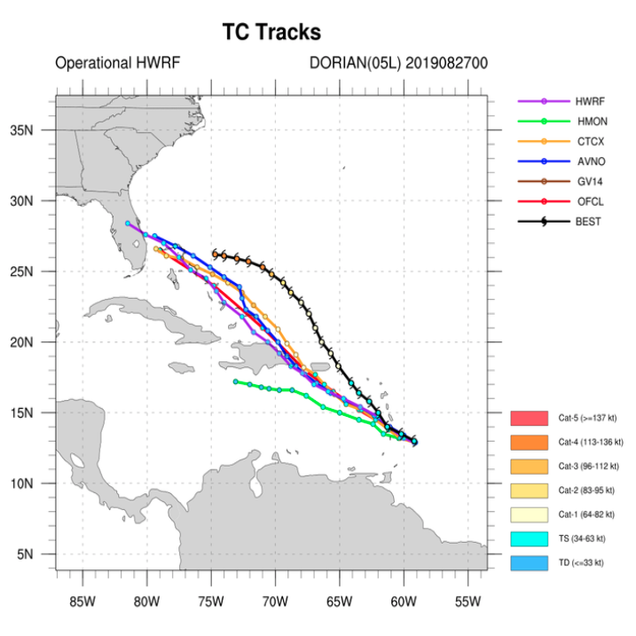
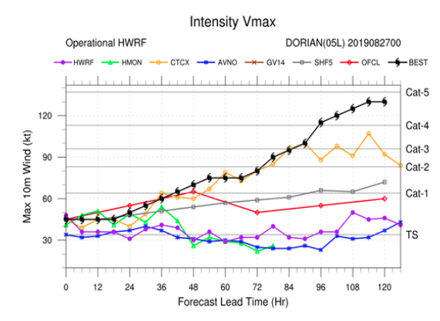
Dorian Forecast
Cycle 2019/08/27/00

Slide 8
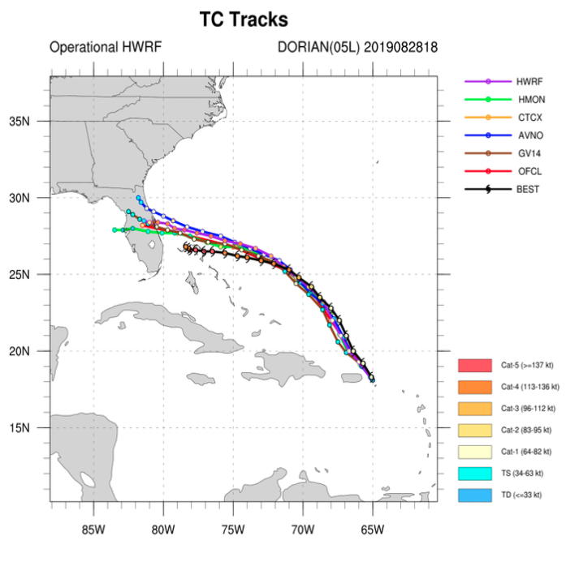
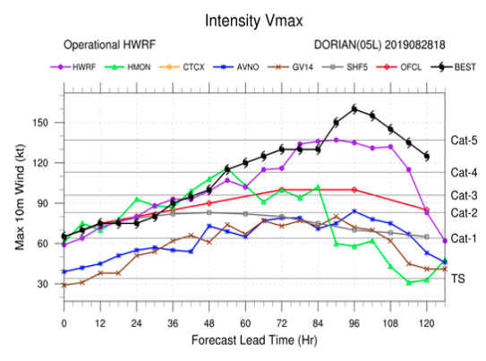
Dorian Forecast
Cycle 2019/08/28/18

Slide 9
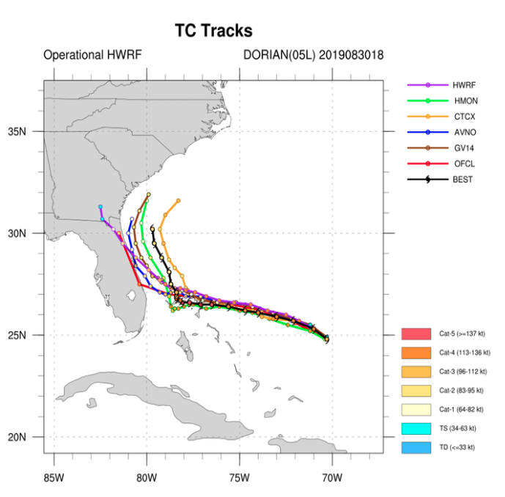
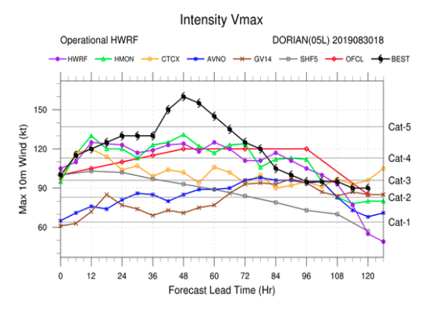
Dorian Forecast
Cycle 2019/08/30/18
Increase of 30 knots is 12 hours
Rapid Intensification:
Increase in the maximum sustained winds of at least 30 knots in 24 hours

Slide 10
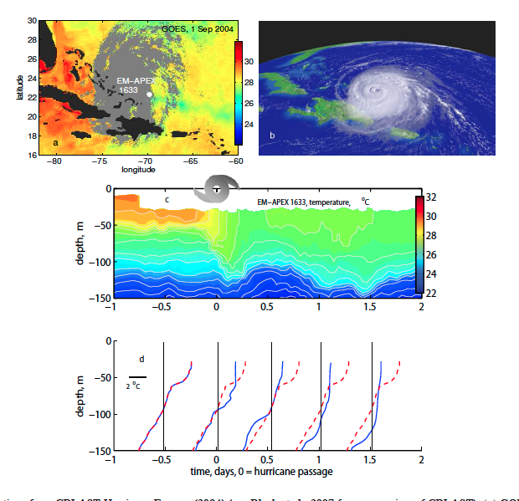
Upper Ocean Response
Temperature and humidity differences at the air-sea interface control the heat fluxes. SST is a relevant ocean quantity
During a storm, SST is mainly controlled by the storm-induced vertical mixing and the strength of the vertical stratification
Delta Q = C delta T
Hurricane Francis
2004
Price 2009
3 cat hurricane produced a
2 ºC drop in temp
Notes:
During the passage of a hurricane there is a heat flux between the atmosphere and the ocean that is mostly driven by the temperature difference between the two. So SST plays a very important role in this flux. The SST will evolve and in most cases in the open ocean the sea surface temperature will decrease because of the vigorous vertical mixing between the surface layer and the cooler subsurface layer. The vertical mixing is induced by the high hurricane winds. Because of this, the strength of the vertical stratification is also key to determine the evolution of SST during the passage of the hurricane. We see the evolution of the SST during hurricane Francis 2004 in this vertical temperature section and we can also see clearly the vertical mixing that is causing the drop on the SST.

Slide 11
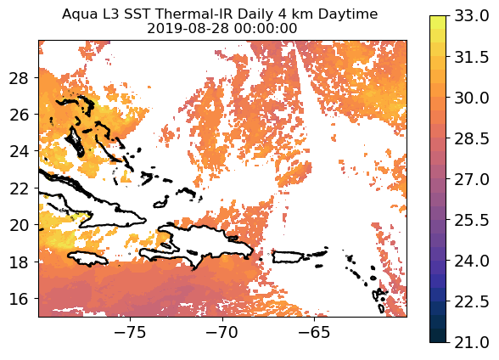
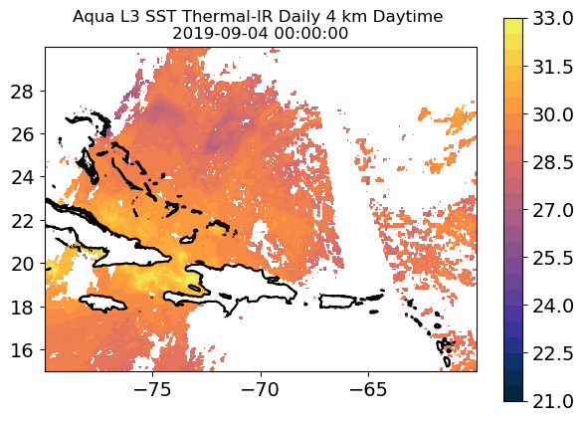


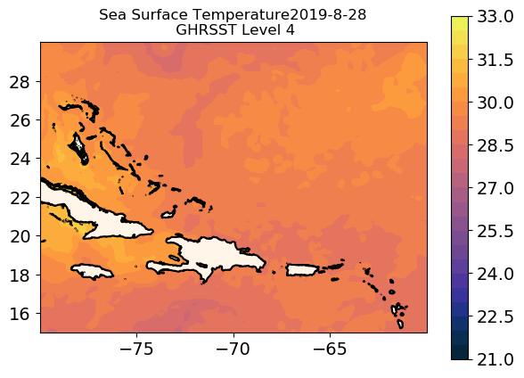
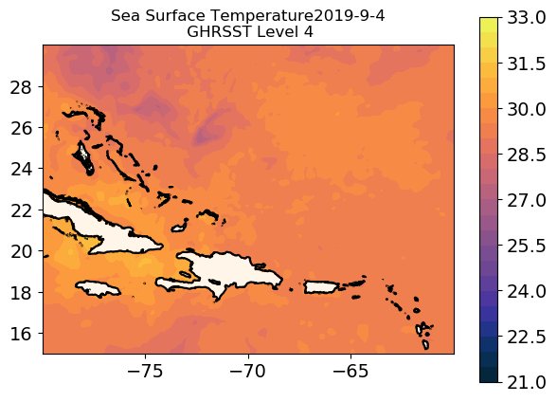
SST Before and During Dorian

Slide 12

SST Before and During Dorian
Aug 28 MODIST
15:15 GMT
Aug 28 MODISA
18:25 GMT
Sep 4 MODISA
18:30 GMT
Sep 5 MODISA
06:35 GMT
Sep 5 MODIST
16:00 GMT
Sep 6 MODIST
03:00 GMT

Slide 13
How to Improve the Modeling of the Upper Ocean Response During a Hurricane?
Improve the subsurface initial conditions in the operational ocean models: right initial vertical stratification, better evolution of the SST during storms , better heat fluxes estimates
(Halliwell et al. 2008)
Notes:
how can we improve the modeling of the upper ocean response in the continental shelf during a hurricane? The very first thing that can be do is to improve the initial conditions of the ocean models that are coupled to the hurricane forecasting models. If the IC are improved we will have the right initial vertical stratification and initial SST, then we will have a better evolution of the SST and therefore we will have a better estimate of the heat fluxes. One way to improve the IC is using data assimilation in the ocean models.

Slide 14
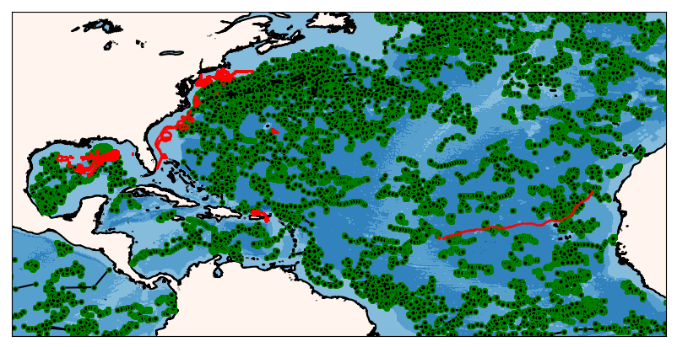
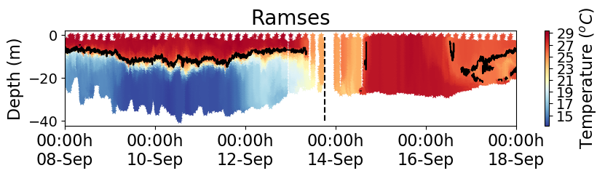
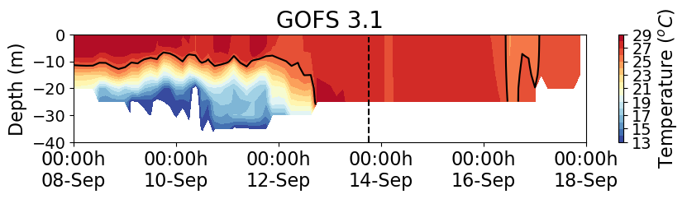

How to Improve the Modeling of the Upper Ocean Response During a Hurricane on the continental shelf?
Improve the subsurface initial conditions in the operational ocean models: right initial vertical stratification, better evolution of the SST during storms , better heat fluxes estimates
(Halliwell et al. 2008)
Ocean Data Assimilation

Slide 15
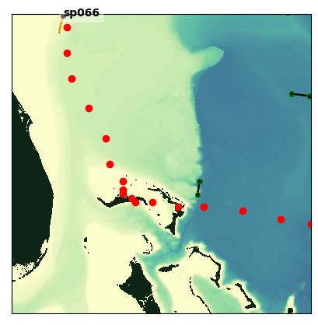
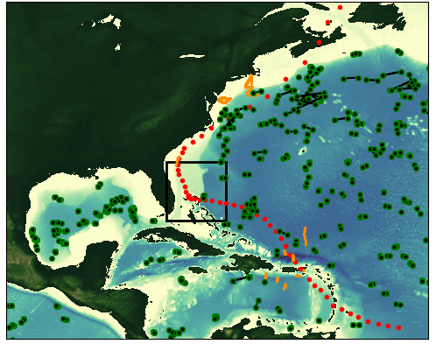
Argo Plus Glider data During Dorian
Dorian
Aug 20 – Sep 07

Slide 16
Global Ocean Forecasting System (GOFS)
Navy Coupled Ocean Data Assimilation System (NCODA)
Surface Data
Subsurface Temperature and Salinity
Satellite SST
Drifting buoys
Fixed buoys
Argo Floats
In Situ SST
GOFS/NCODA
Gliders
TESAC
Satellite Altimeter
XBTs (only temp.)
Notes:
The GOFS/NCODA system assimilates a wide variety of observations. At the surface the system assimilates satellite SST, in situ SST and satellite altimeter. It also assimilates subsurface temperature and salinity from different sources: …… temperature, salinity and current report from a sea station…..

Slide 17
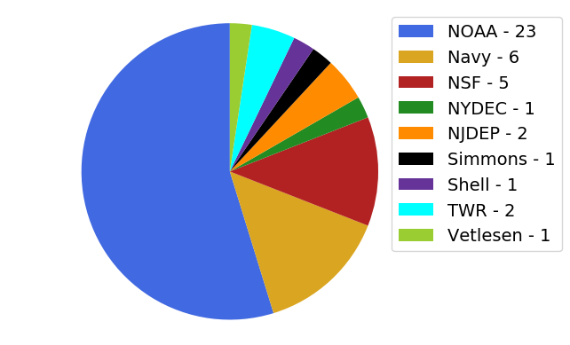
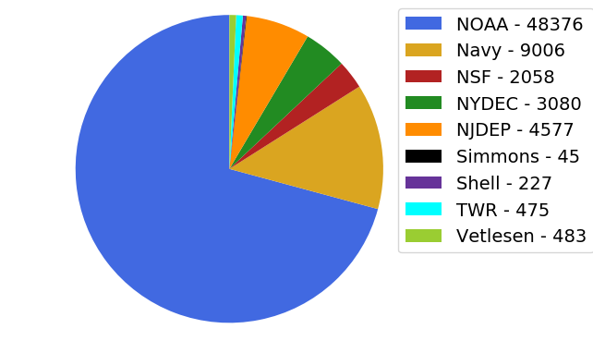
Hurricane Gliders Statistics 2019
June 1 to Oct 3
Total number of Gliders = 42
Total number of Profiles = 68327
Notes:
Hurricane gliders statistics from Jun 1 to Oct 1 2019 in the North Atlantic:
There were a total of 41 gliders from Jun 1 to Oct 1 2019 in the North Atlantic that were reporting to the IOOS glider Data Assembly Center (DAC) (link). The glider deployment and operations are funded through several projects with NOAA, the US Navy, the states of New York and New Jersey, Simmons Foundation International, Shell and Teledyne Web Research. In total the gliders have collected 64640 profiles of temperature and salinity. Some of the gliders were also equipped with oxygen, ph sensors??...
The glider data in the IOOS glider DAC is sent to the Global Telecommunication System (GTS) where numerous operational ocean models access the data for data assimilation purposes.

Slide 18
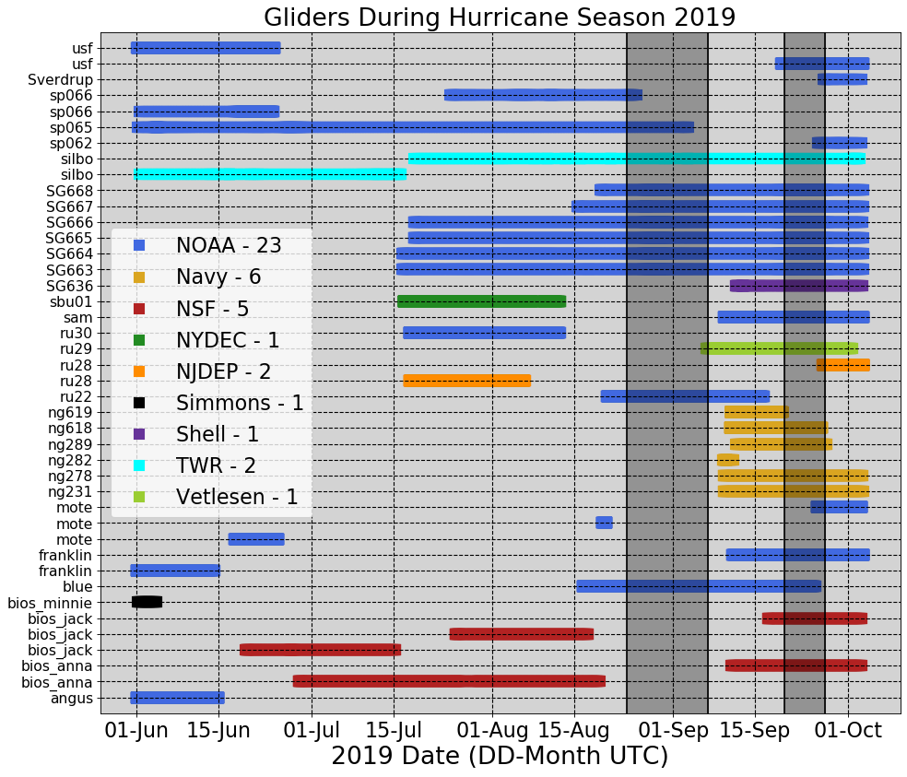
Hurricane Gliders Statistics 2019
Dorian
Karen

Slide 19
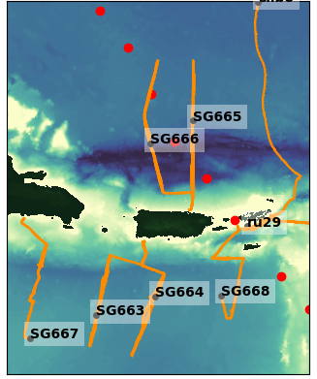
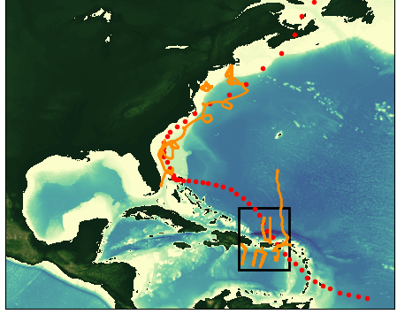
Hurricane Dorian
Gliders Deployed Aug 20th to Sep 7th 2019
Dorian
Aug 20 – Sep 07
Notes:
On August 29, Tropical Storm Dorian passed over three gliders: SG665, SG666 and SG668 in the Caribbean glider array, before moving on to catastrophically impact the Bahamas and portions of the southeastern US.

Slide 20
Did the glider data in the Caribbean help
improve the ocean initial conditions?

Slide 21
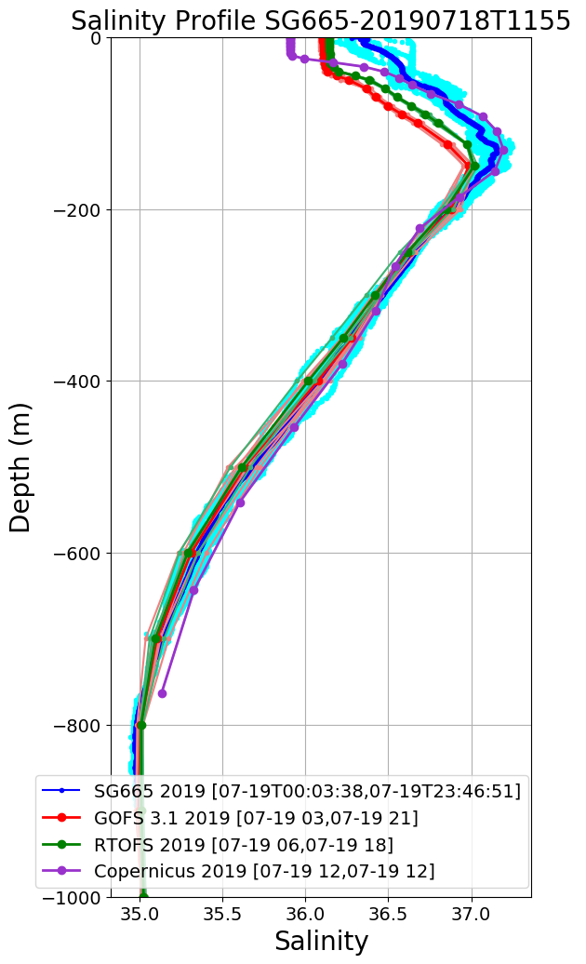
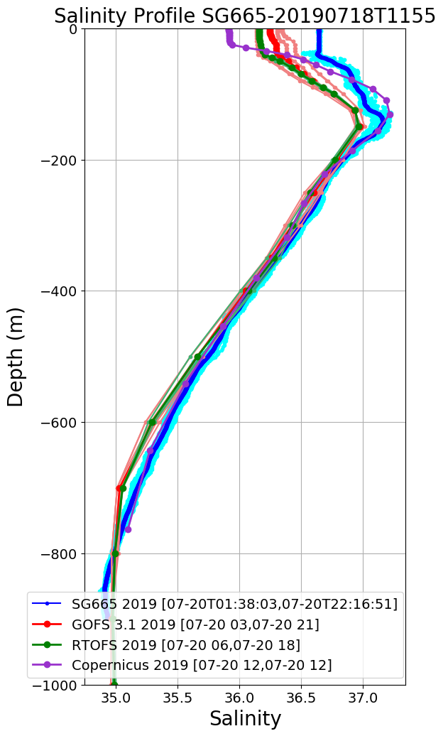
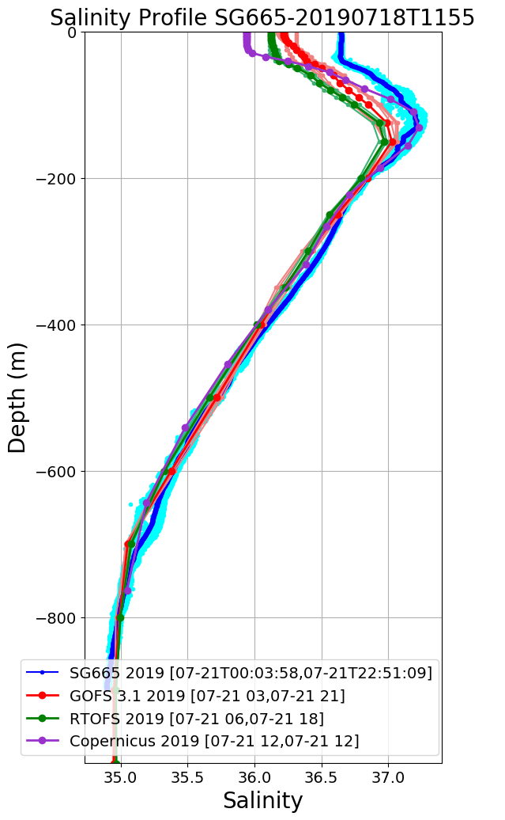
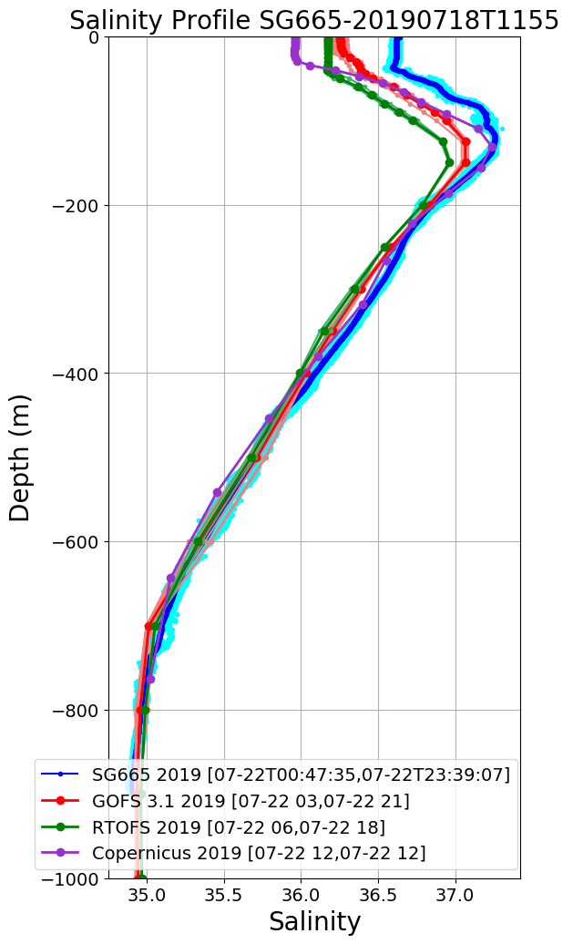
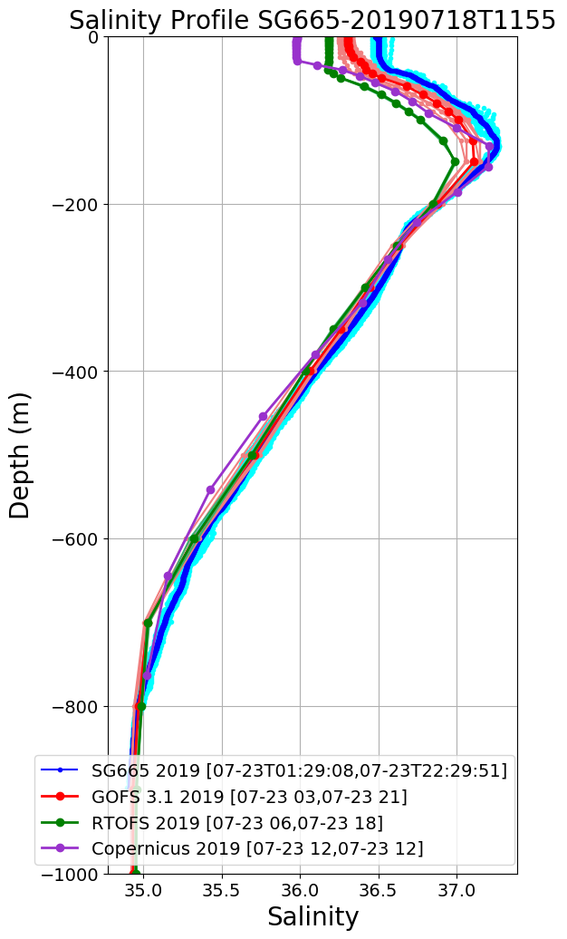
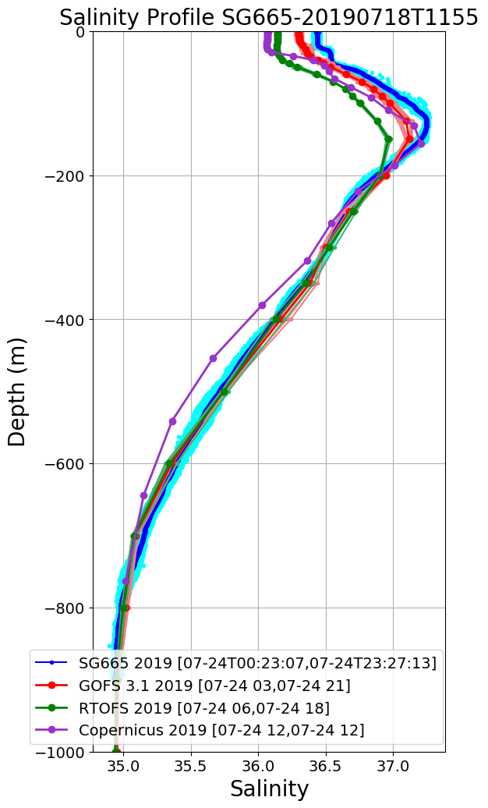
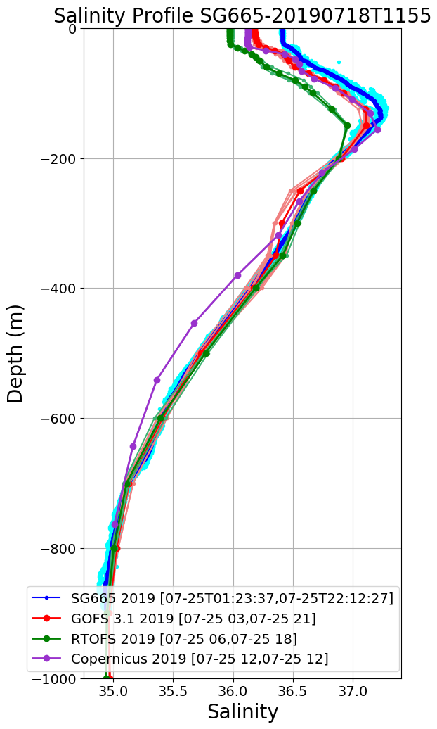
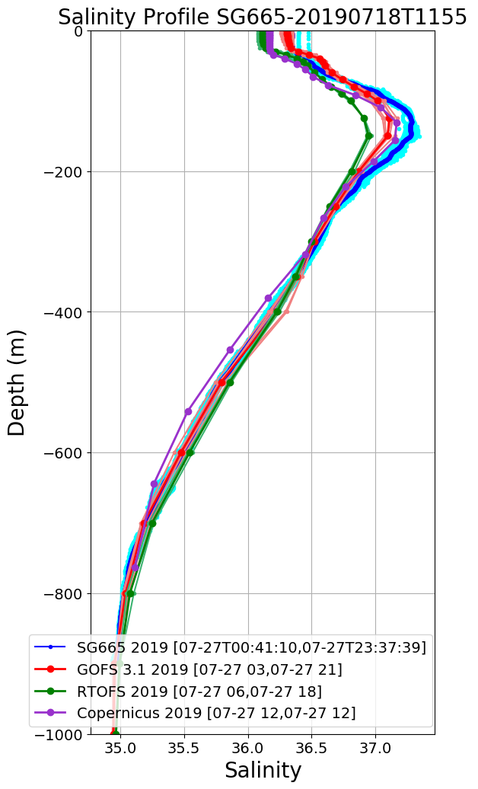
SG665 Salinity at Deployment
Large Salinity offset surface to 160 m
Jul 19
Jul 20
Jul 21
Jul 22
Salinity Progressively Improves over 1 week period
Jul 23
Jul 24
Jul 25
Jul 27

Slide 22
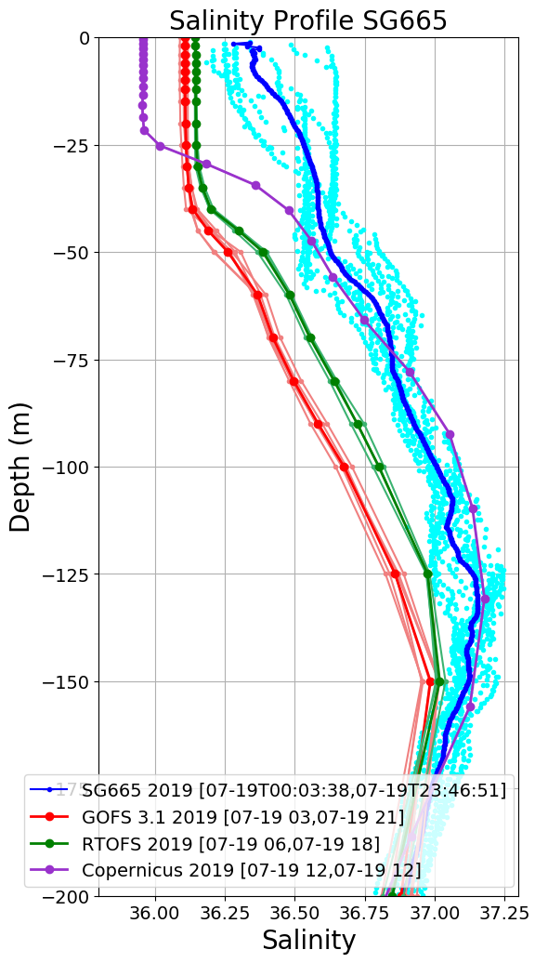
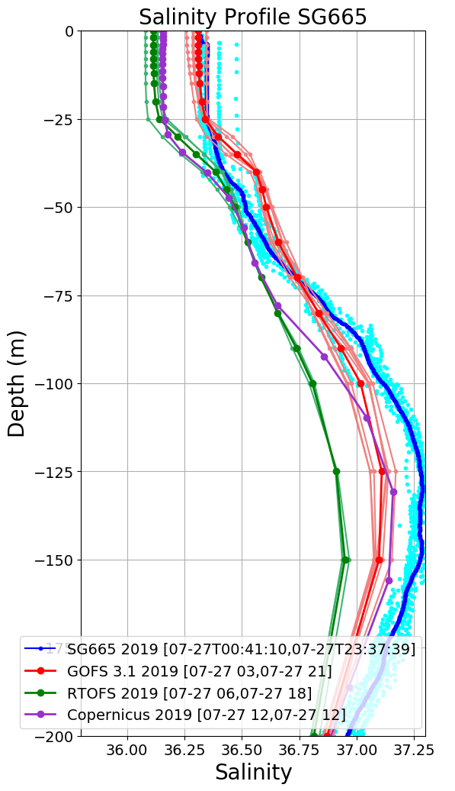
SG665 Salinity at Deployment
Jul 19
Jul 27

Slide 23
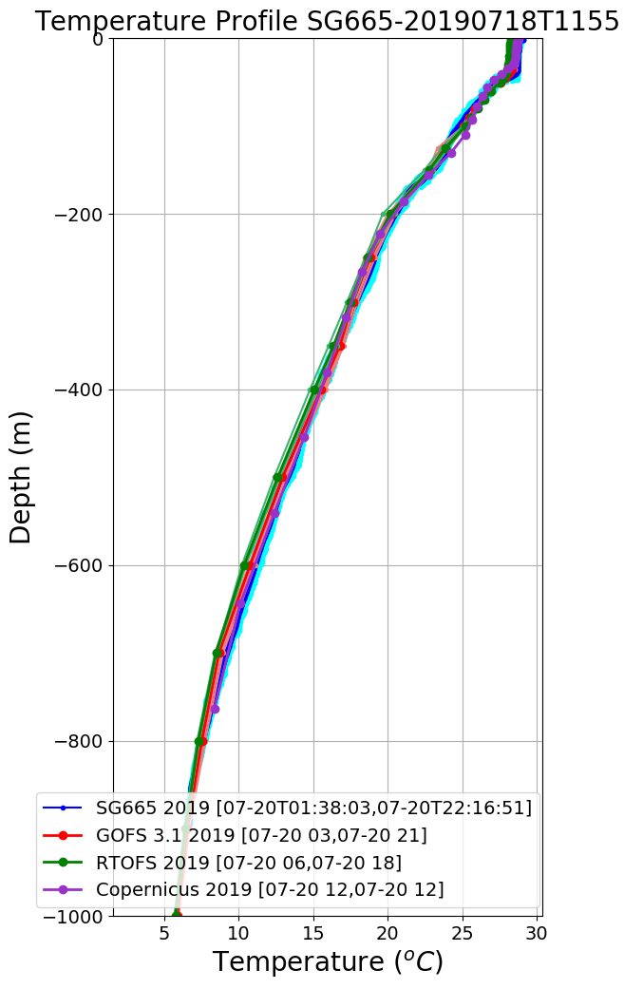

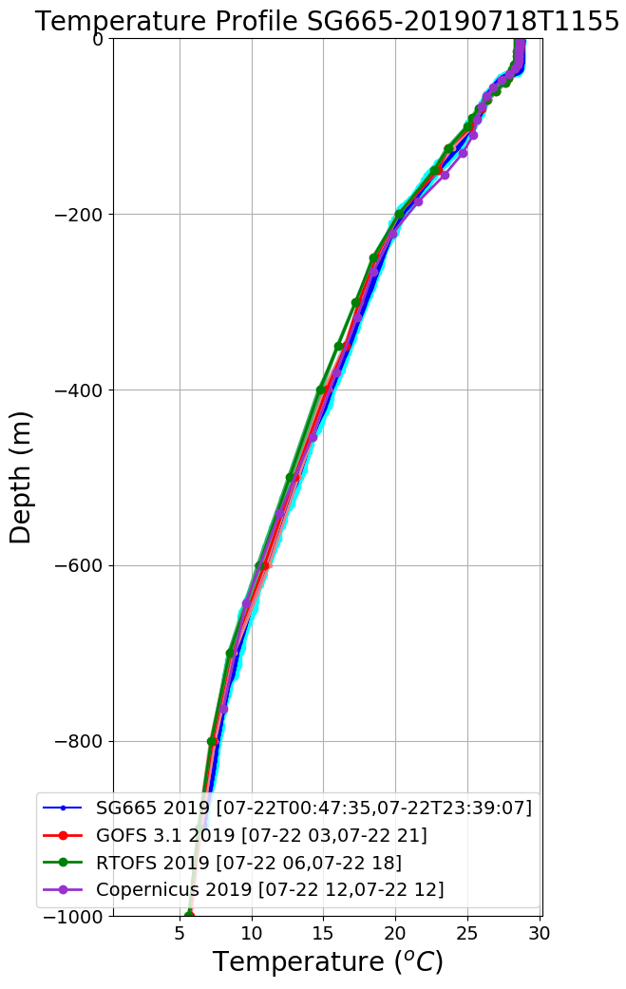
SG665 Temperature at Deployment
Jul 19
Jul 20
Jul 21

Slide 24
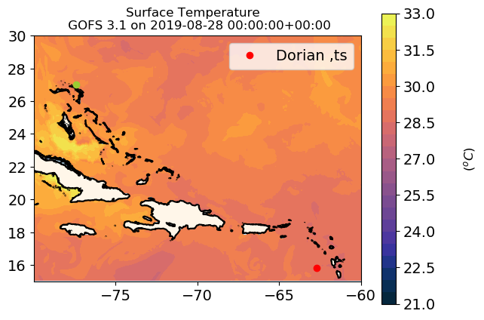
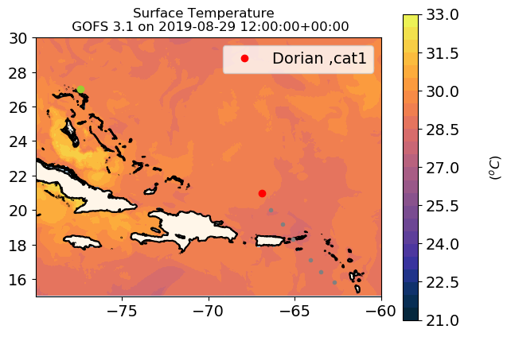
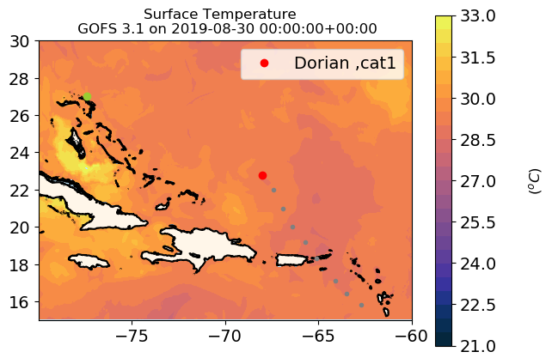

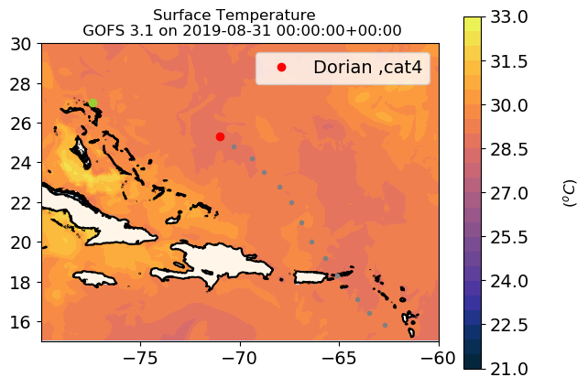
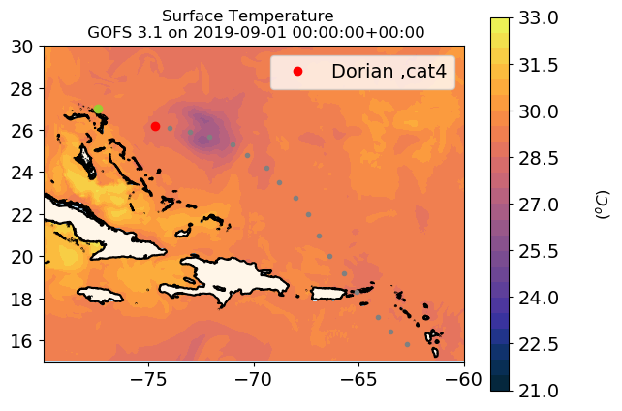
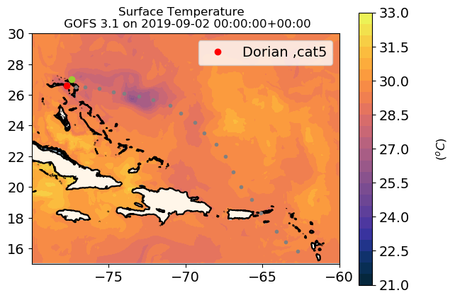


GOFS 3.1 Response to Hurricane Dorian

Slide 25
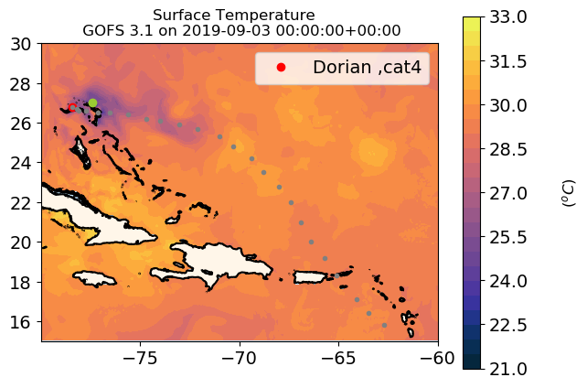
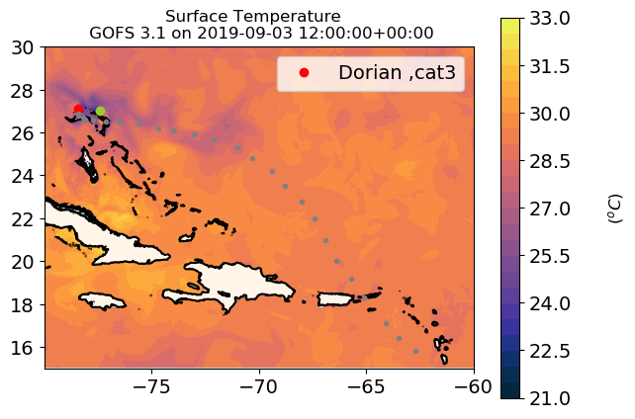

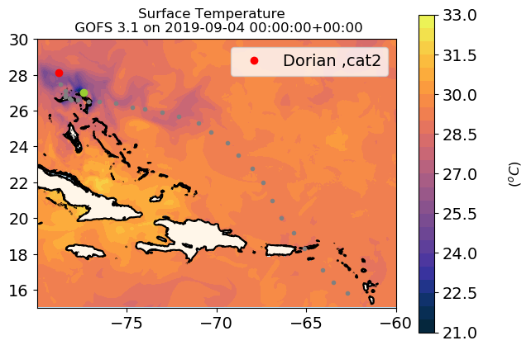
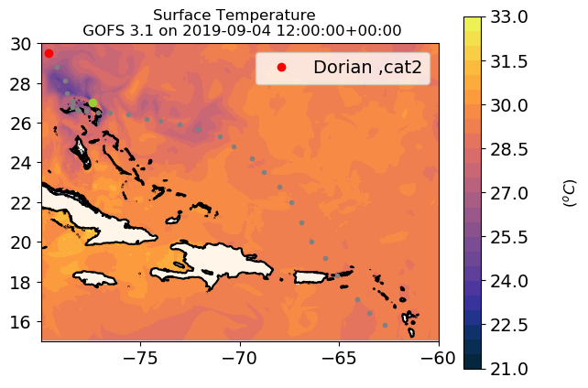
GOFS 3.1 Response to Hurricane Dorian

Slide 26
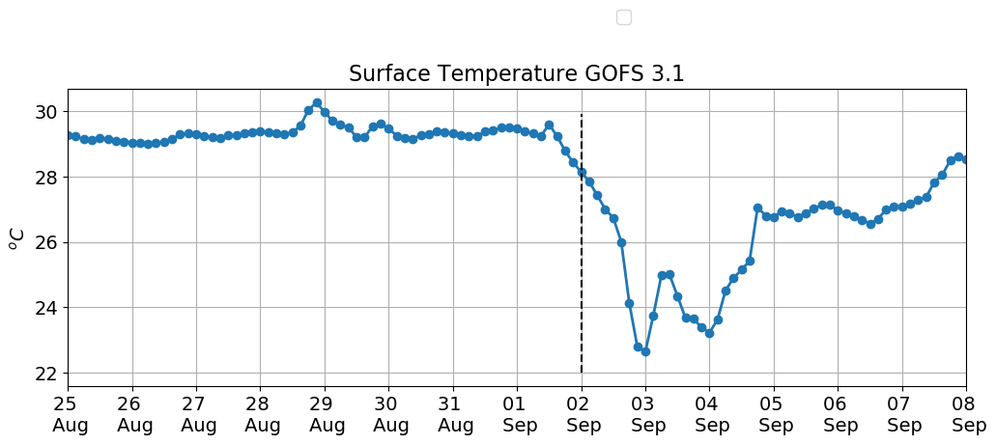
GOFS 3.1 Response to Hurricane Dorian
7 ºC

Slide 27
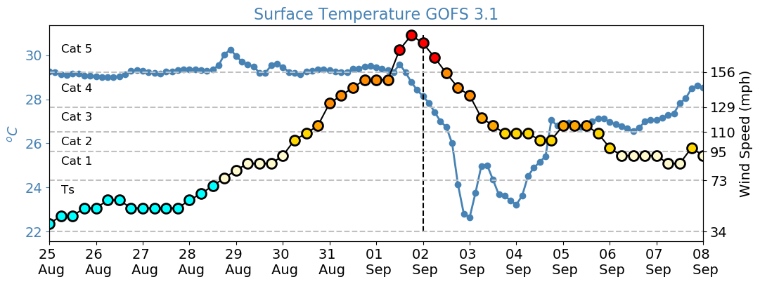
GOFS 3.1 Response to Hurricane Dorian
7 ºC

Slide 28
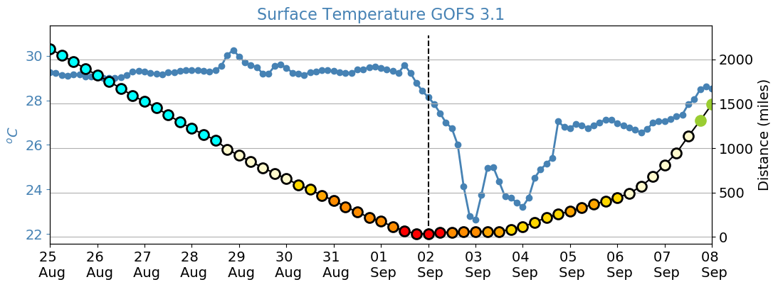
GOFS 3.1 Response to Hurricane Dorian
7 ºC

Slide 29
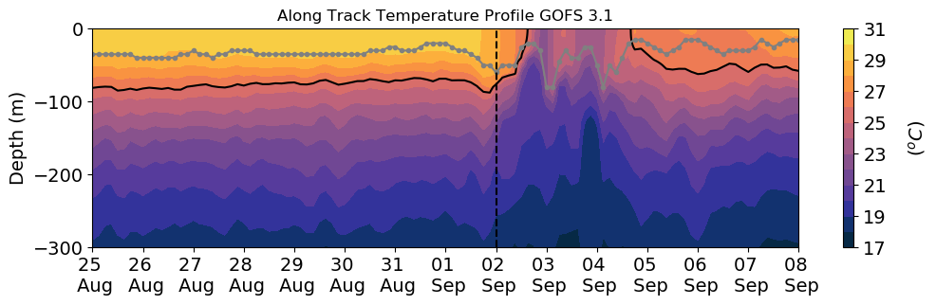
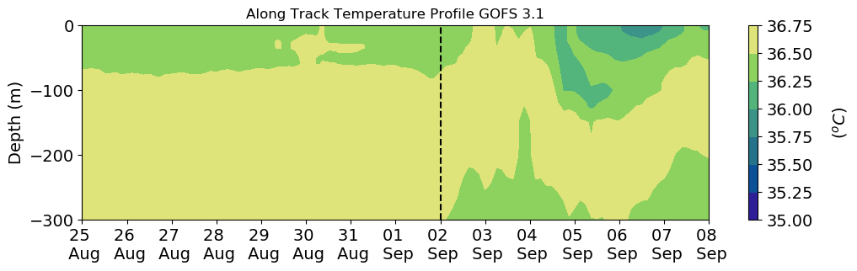
GOFS 3.1 Response to Hurricane Dorian
Mixed layer depth
26 ºC

Slide 30

GHRSST During Hurricane Dorian
1.6 ºC

Slide 31


Argo Floats During Hurricane Dorian
Red before Dorian
Blue after Dorian
3.5 ºC
2.0 ºC
0.1

Slide 32

SG665 Mixed layer depth
Dorian
26º
Notes:
Temperature profiles comparisons between these gliders and GOFS 3.1 model output show good agreement during storm passage However, modeled salinity profiles remained below glider measured salinity, and could be source of uncertainty in the rate of transfer of heat out of the ocean and into the atmosphere.

Slide 33

SG665 Mixed layer depth
Dorian

Slide 34

SG665 Mixed layer depth
Dorian

Slide 35


SG665 Mean temperature and Salinity
within the mixed layer
Dorian
0.3 ºC
Cold bias in GOFS 3.1 during Dorian
0.5

Slide 36


SG665 Correlation with wind
and Precipitation
Dorian

Slide 37

Tropical Storm Karen
National Hurricane Center

Slide 38


Tropical Storm Karen
Gliders Deployed Sep 20th to Sep 27th 2019
Dorian
8/24 – 7/07
Karen
Sep 20 – Sep 27
Notes:
During tropical storm Karen there were 10 gliders deployed in the Caribbean

Slide 39



ng278 Salinity at Deployment
Sep 11
Sep 13
Sep 14
Notes:
At the time of the deployment of ng278, the salinity match between GOFS 3.1 and glider data is already pretty good. Yet there is still an improvement in salinity at the surface by the third day of deployment.

Slide 40



ng278 Temperature at Deployment
Sep 11
Sep 13
Sep 14
Notes:
At the time of the deployment of ng278, the salinity match between GOFS 3.1 and glider data is already pretty good. Yet there is still an improvement in salinity at the surface by the third day of deployment.

Slide 41

ng278 Mixed layer depth
Karen
26º
26º
Notes:
On Sep 24, Karen passed over the Navy glider ng278. There is a good agreement in the vertical structure of temperature between GOFS 3.1 and the glider temperature.

Slide 42

ng278 Mixed layer depth
Karen
Very fresh layer.
Precipitation?
Notes:
However GOFS 3.1 has a surface fresh layer (barrier layer) that is not as sharp as the observations show. This barrier layer gets even fresher and shallower during Karen. At the moment we are investigating if this freshening can be attributed to increased precipitation during the storm. If this is the case, this can be a mechanism that reinforces stratification during a storm and inhibits vertical mixing. We would like to investigate how important this possible mechanism is in controlling the storm intensity

Slide 43


ng278 Mean temperature and Salinity
within the mixed layer
Karen
0.4 ºC
Cold bias in GOFS 3.1 during Karen
0.6

Slide 44


ng278 Correlation with Wind
and Precipitation
Karen

Slide 45






ng278 Salinity during Karen
Freshening of surface
layer during Karen
Sep 22
Sep 23
Sep 24
Sep 25
Sep 26
Sep 27
Notes:
The freshening that happened during Karen (Sep 23 – Sep 24) is not initially captured by any of the models. By Sep 26, the surface salinity in GOFS and Copernicus are much closer to the observations (both models assimilate data) but RTOFS still lags behind.

Slide 46






ng278 Salinity during Karen
Freshening of surface
layer during Karen
Sep 22
Sep 23
Sep 24
Sep 25
Sep 26
Sep 27
Notes:
The same as previous slide but showing only the top 200 meters

Slide 47
Conclusions
Hurricane Dorian went through rapid intensification. None of the models predicted the rapid intensification event
There was a lack of insitu data in the shelf during the passage of Dorian through the Bahamas when the storm underwent rapid intensification
However there were 7 gliders around the Virgin Islands and Puerto Rico when Dorian became a hurricane. There were 10 gliders in the same area during tropical storm Karen
The assimilation of these glider data at the time of deployment contributed to the rectification of the surface salinity in GOFS3.1. The surface salinity in the Caribbean plays an important role in setting vertical stratification and therefore controls the potential for the colder subsurface water to weaken the storm
There is a cold bias in GOFS 3.1 in the mixed layer temperature during both storms. We also observed a freshening of the mixed layer that is not captured by the model. It appears that the freshening is caused by increased precipitation during the passage of the storms. This is potentially a mechanism that temporarily reinforces stratification during a storm and inhibits vertical mixing

Slide 48
Proposed Work
GOFS 3.1 has a barrier layer that is less sharp than the observations in the Caribbean, contributing to a mixed layer that is less stable. We would like to investigate how the barrier layer affects the processes that control the evolution of the SST during storms, such as vertical mixing and Ekman pumping, in the coupled atmosphere-ocean hurricane model HWRF and HMON
Investigate if the cold temperature bias exits in HWRF and HMON and how much it affects the surface heat fluxes. If the effect on the heat fluxes is substantial, the models can be over predicting the cooling potential of the ocean and underestimating hurricane intensity

