Slide 1
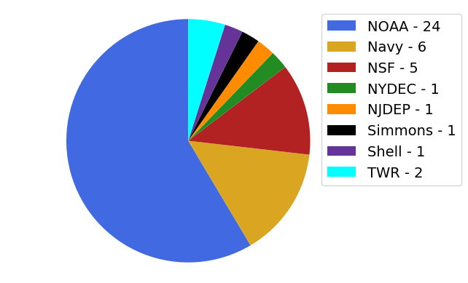
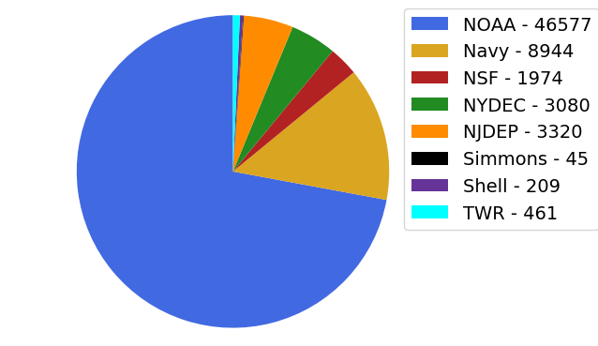
Hurricane Gliders Statistics 2019
June 1 to October 1
Total number of glider deployments = 41
Total number of Profiles = 64640
Notes:
22 NOAA funded gliders were deployed throughout the Atlantic, Caribbean, and Gulf of Mexico regions, with an additional 17 submitting data to the DAC

Slide 2
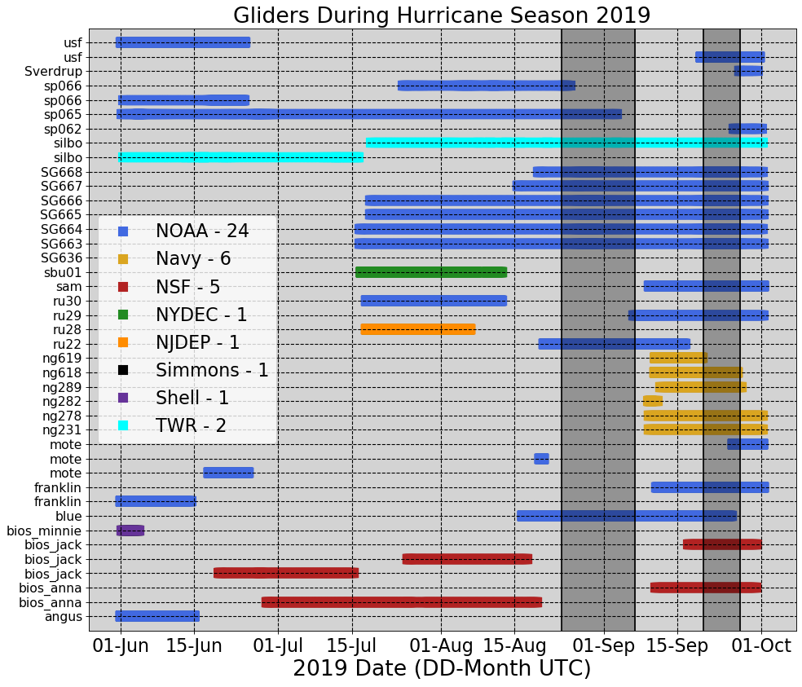
Hurricane Gliders Statistics
Dorian
Karen

Slide 3
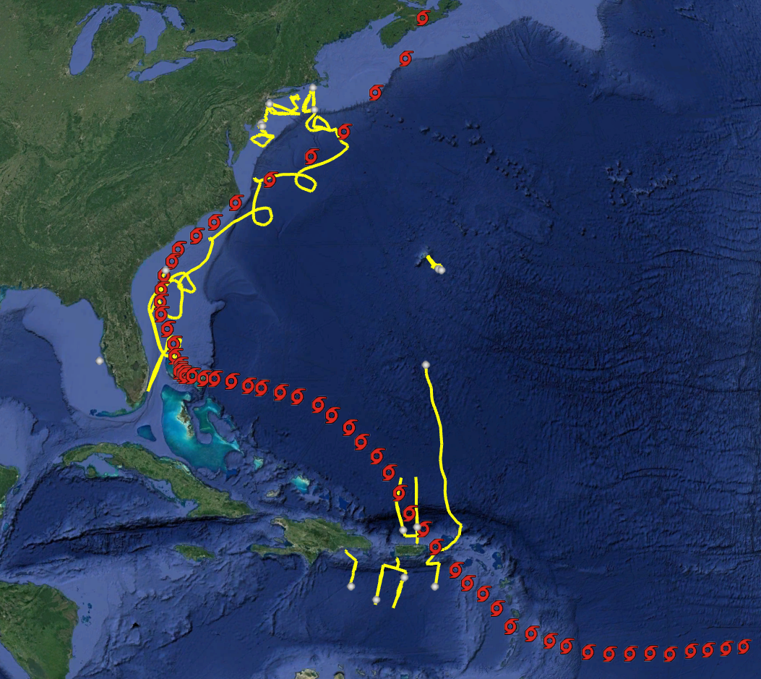
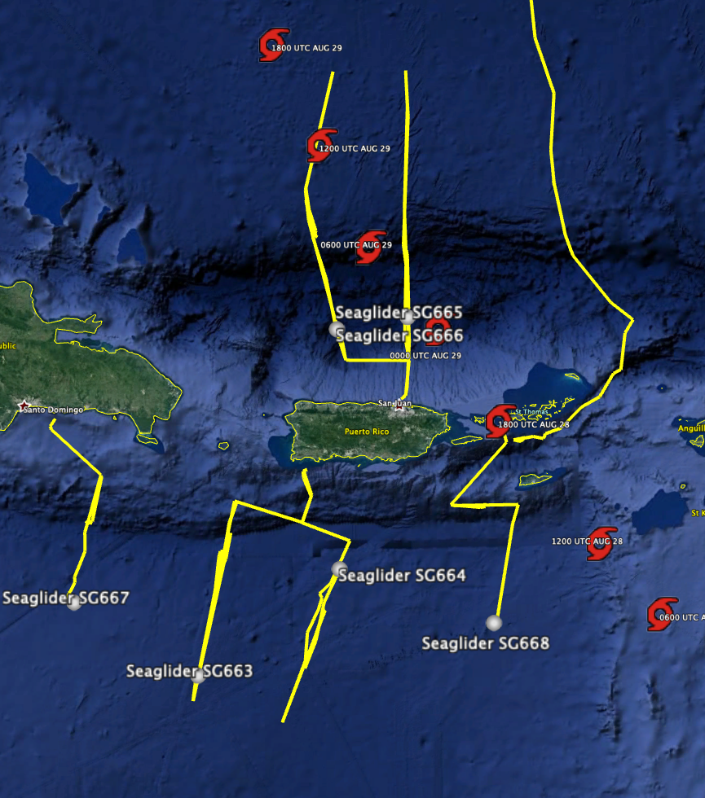
Hurricane Dorian
Gliders Deployed July 15th to September 15th 2019
Dorian
8/24 – 7/07
Notes:
On August 29, Tropical Storm Dorian passed over three gliders: SG665, SG666 and SG668 in the Caribbean glider array, before moving on to catastrophically impact the Bahamas and portions of the southeastern US.

Slide 4
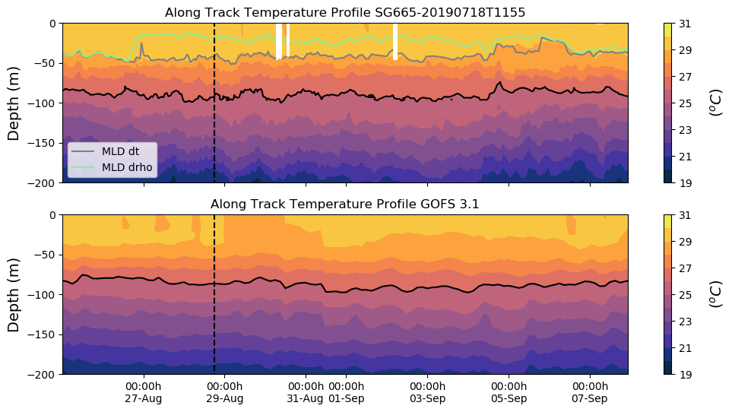
Hurricane Dorian
Dorian
26º
Notes:
Temperature profiles comparisons between these gliders and GOFS 3.1 model output show good agreement during storm passage However, modeled salinity profiles remained below glider measured salinity, and could be source of uncertainty in the rate of transfer of heat out of the ocean and into the atmosphere.

Slide 5
Hurricane Dorian
Dorian

Slide 6
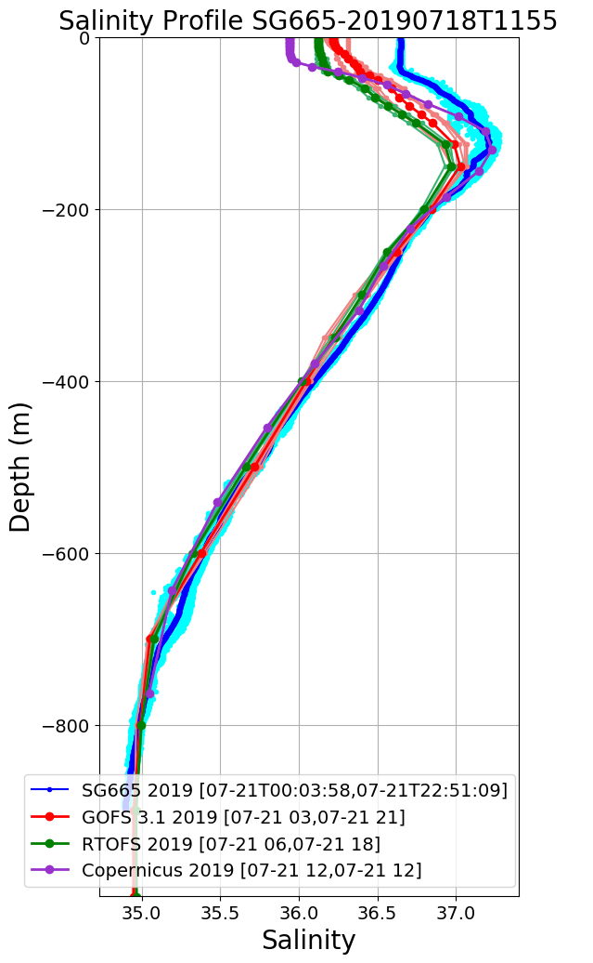
SG665 Salinity at Deployment
Large Salinity offset surface to 160 m
Jul 19
Jul 20
Jul 21
Jul 22
Salinity Progressively Improves over 1 week period
Jul 23
Jul 24
Jul 25
Jul 27

Slide 7
SG665 Salinity at Deployment
Jul 19
Jul 27

Slide 8
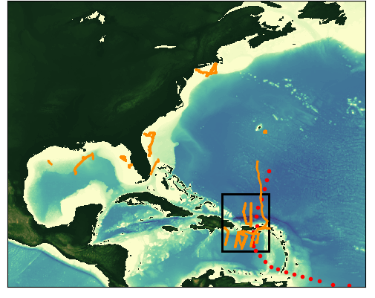
Tropical Storm Karen
Gliders Deployed Sep20th to Sep 27th 2019
Dorian
8/24 – 7/07
Karen
Sep 20 – Sep 27
Notes:
During tropical storm Karen there were 10 gliders deployed in the Caribbean

Slide 9
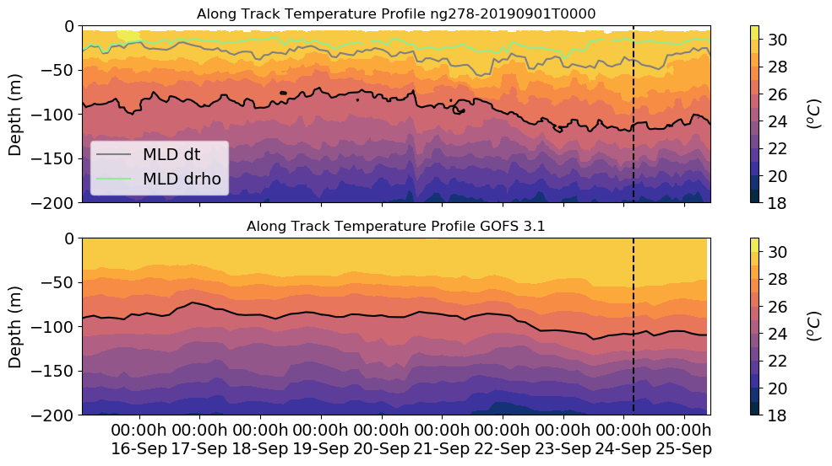
Tropical Storm Karen
Karen
26º
Notes:
On Sep 24, Karen passed over the Navy glider ng278. There is a good agreement in the vertical structure of temperature between GOFS 3.1 and the glider temperature.

Slide 10
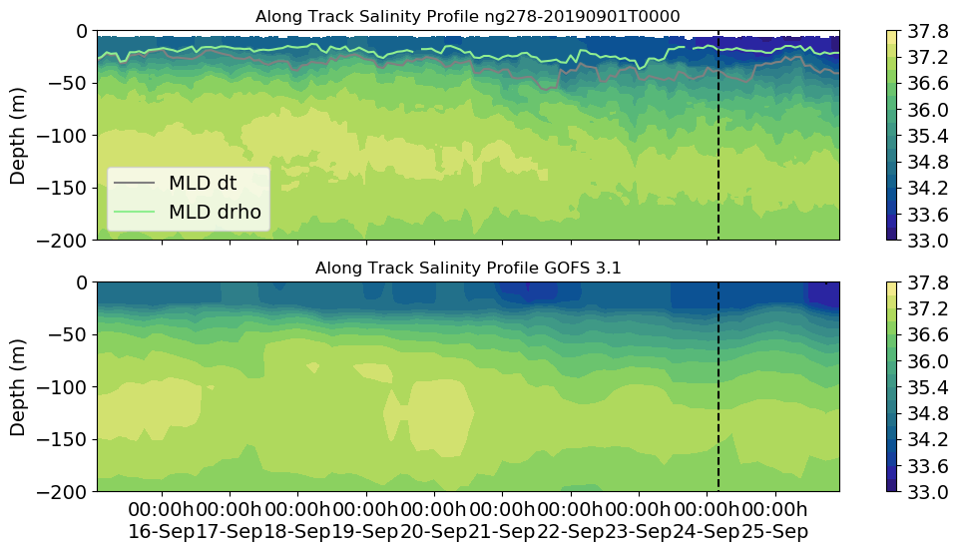
Tropical Storm Karen
Karen
Freshening of surface
layer during Karen
Notes:
However GOFS 3.1 has a surface fresh layer (barrier layer) that is not as sharp as the observations show. This barrier layer gets even fresher and shallower during Karen. At the moment we are investigating if this freshening can be attributed to increased precipitation during the storm. If this is the case, this can be a mechanism that reinforces stratification during a storm and inhibits vertical mixing. We would like to investigate how important this possible mechanism is in controlling the storm intensity

Slide 11
ng278 Salinity at Deployment
Sep 11
Sep 13
Sep 14
Notes:
At the time of the deployment of ng278, the salinity match between GOFS 3.1 and glider data is already pretty good. Yet there is still an improvement in salinity at the surface by the third day of deployment.

Slide 12
ng278 Salinity during Karen
Freshening of surface
layer during Karen
Sep 22
Sep 23
Sep 24
Sep 25
Sep 26
Sep 27
Notes:
The freshening that happened during Karen (Sep 23 – Sep 24) is not initially captured by any of the models. By Sep 26, the surface salinity in GOFS and Copernicus are much closer to the observations (both models assimilate data) but RTOFS still lags behind.

Slide 13
ng278 Salinity during Karen
Freshening of surface
layer during Karen
Sep 22
Sep 23
Sep 24
Sep 25
Sep 26
Sep 27
Notes:
The same as previous slide but showing only the top 200 meters

Slide 14
Next Steps
Compare MAB and GoM gliders to the models
We will look at the HWRF/POM and HMON/HYCOM runs during the named storms

