Slide 1
storms = ['01l','02l','03l','04l','05l','06l','07l','08l','09l','10l','11l','12l','13l','14l','15l','16l','17l','18l','19l','20l','21l’ ‘22l’ ‘23l’ ‘24l’ ‘25l’ ‘26l’ ‘27l’ ‘28l’ ‘29l’ ‘30l’ ‘31l’
numnames_2020 = ['arthur','bertha','cristobal','dolly','edouard','fay','gonzalo','hanna','isaias','josephine','kyle','laura','marco','nana','omar','paulette','rene','sally','teddy','vicky','Wilfred,’alpha’,’beta’,’gamma’,’delta’,’epsilon’,’zeta’,’eta’,’theta’,
‘iota’]
Best track link
https://www.nhc.noaa.gov/gis/best_track/?C=N;O=D

Slide 2
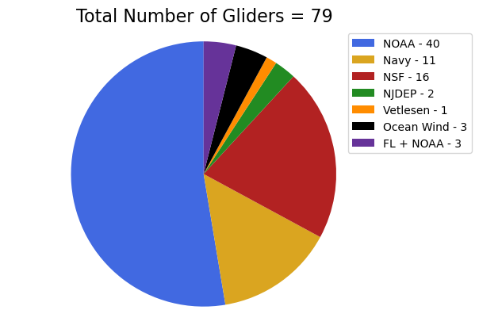
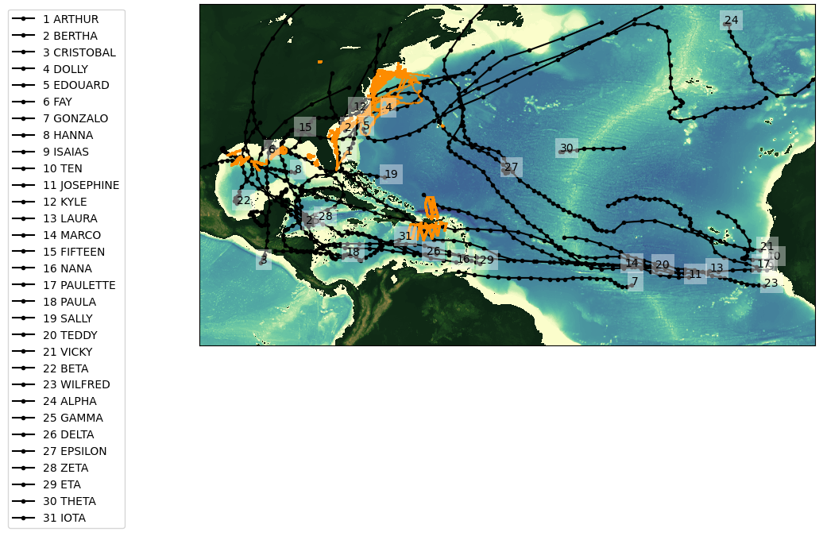
2020 Glider Picket line and Hurricane Tracks
Total number of gliders = 79
Total number of glider profiles = 183377

Slide 3
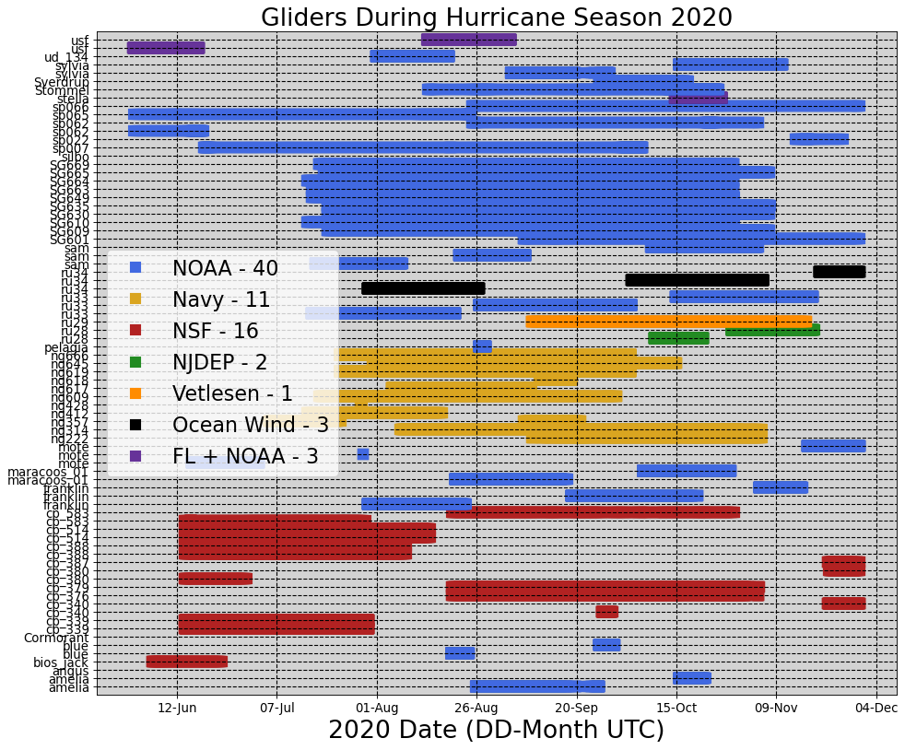

Slide 4
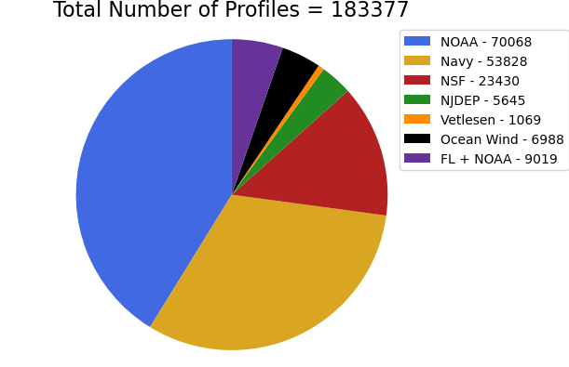
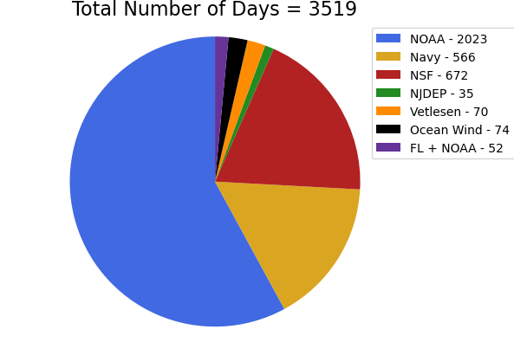
Total number of deployments = 79

Slide 5
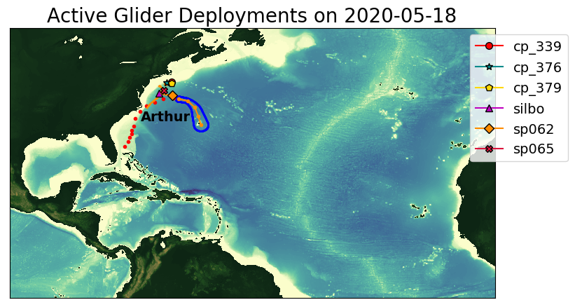
Arthur

Slide 6
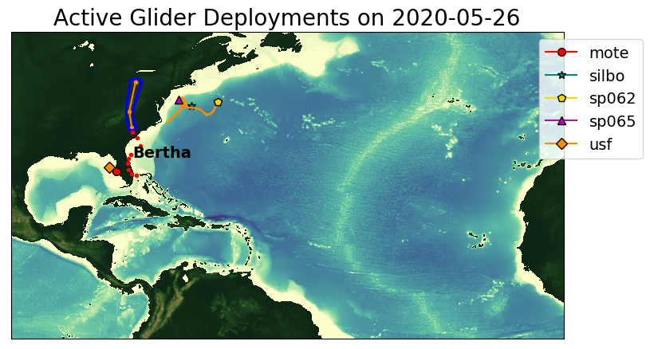
Bertha

Slide 7
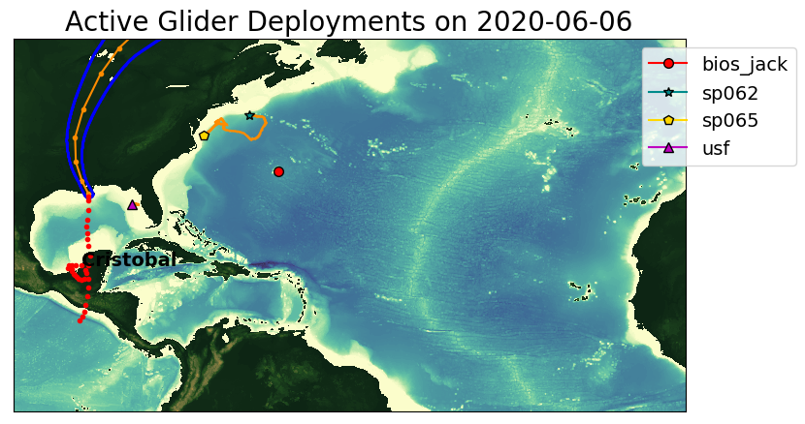
Cristobal

Slide 8
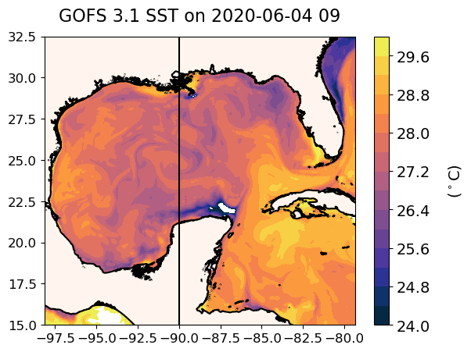
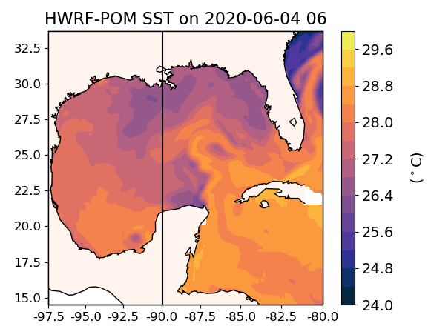
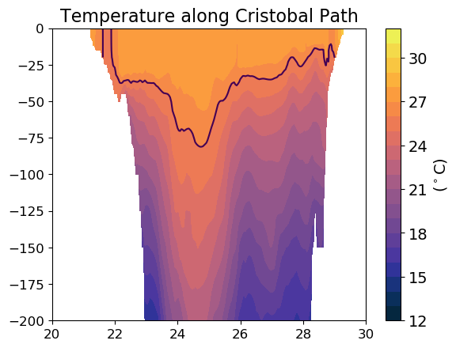
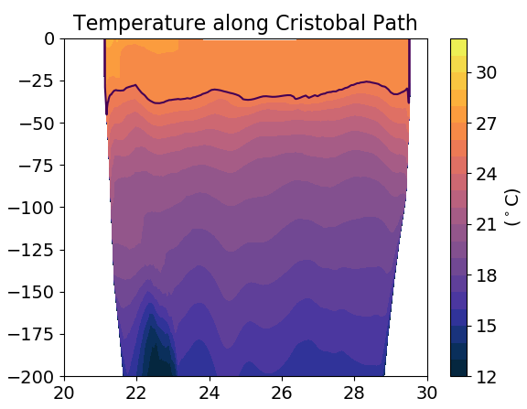
Cristobal

Slide 9
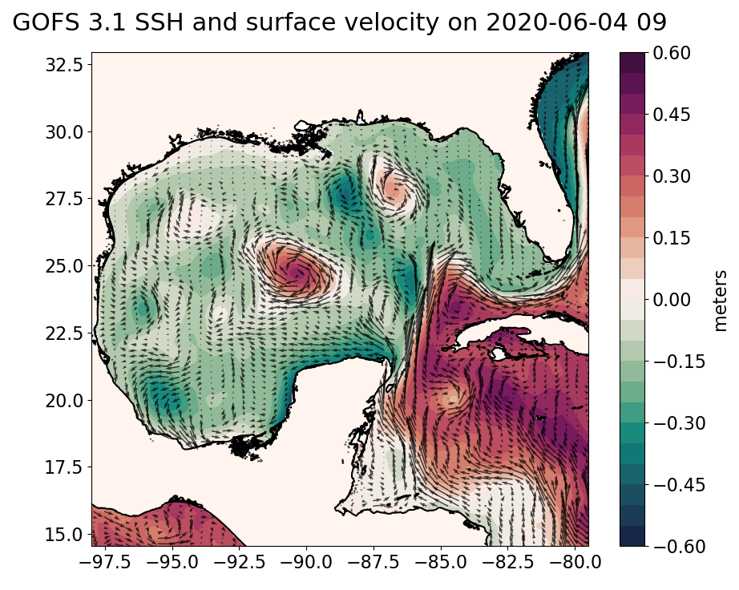
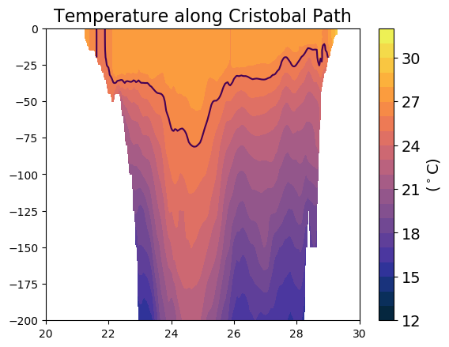

Slide 10
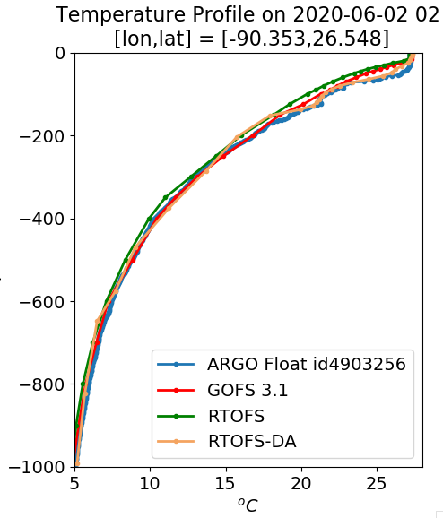
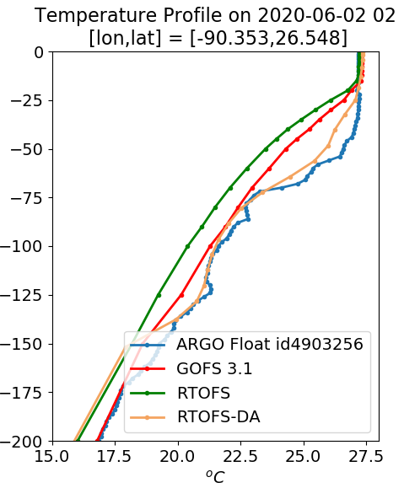
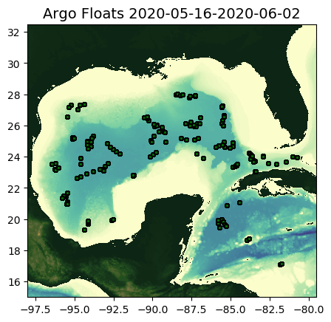
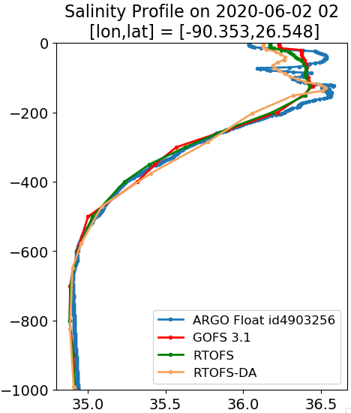
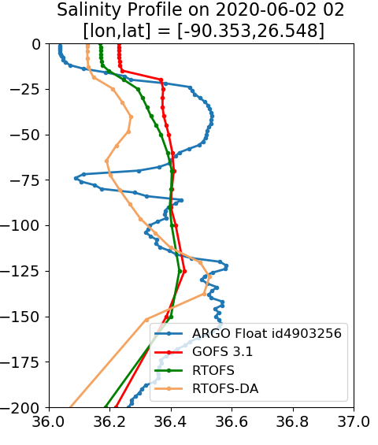
2020/06/01 – 2020/06/04

Slide 11
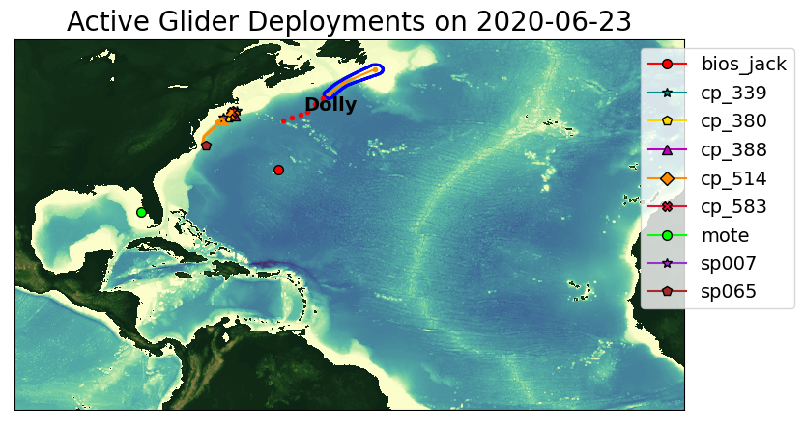
Dolly

Slide 12
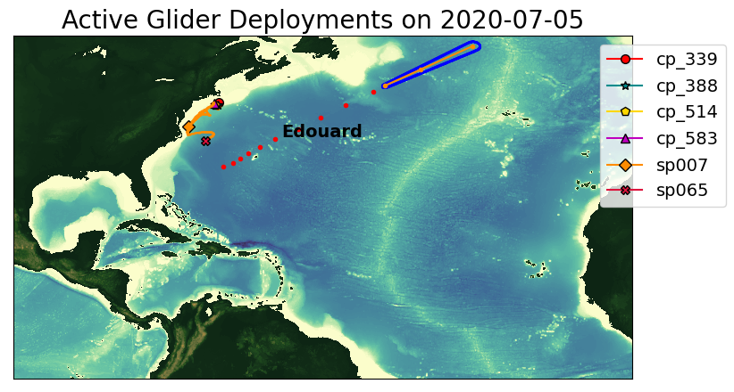
Edouard

Slide 13
Fey

Slide 14
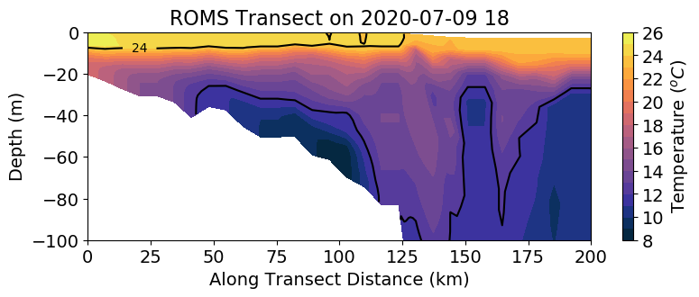
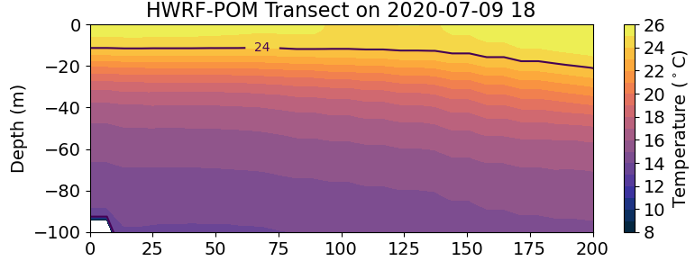
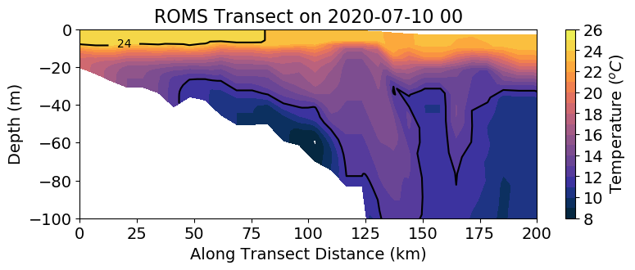
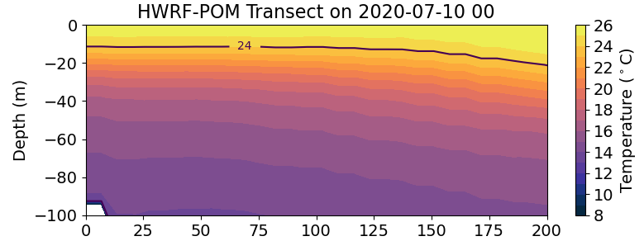
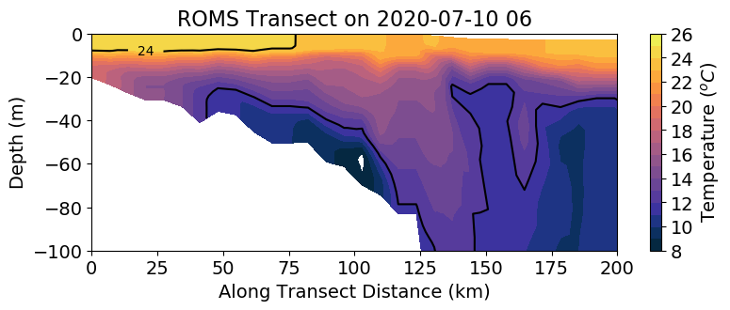
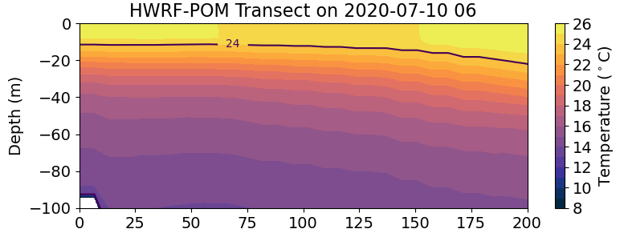
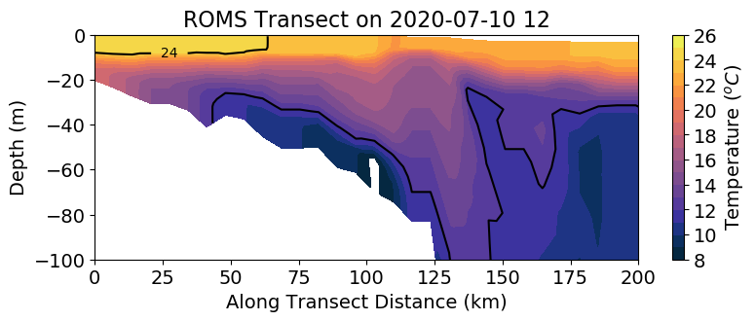
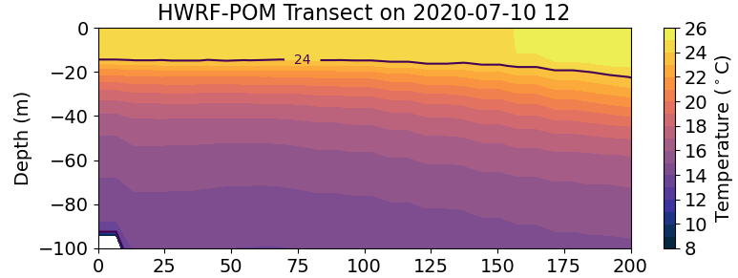
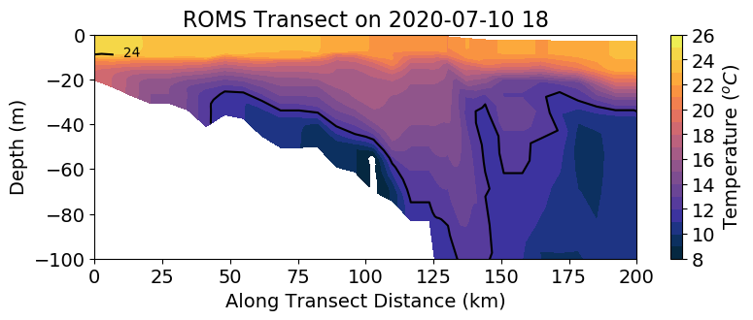
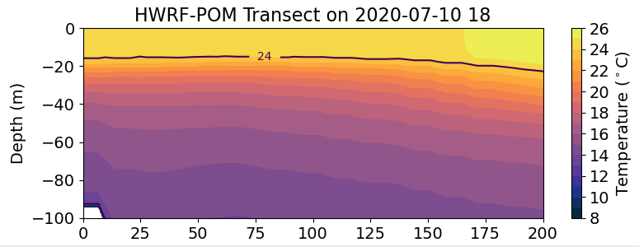
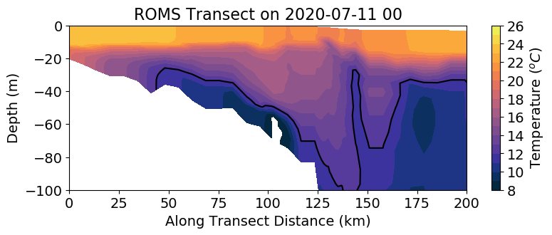
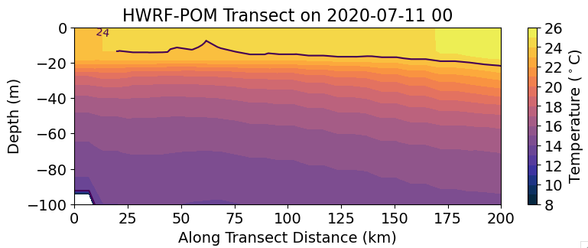
Fey
Run
July 12

Slide 15
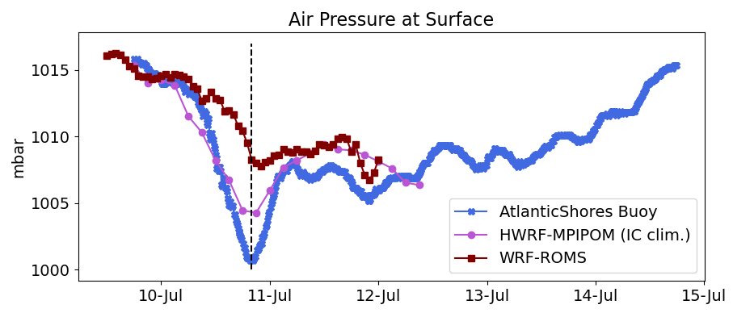
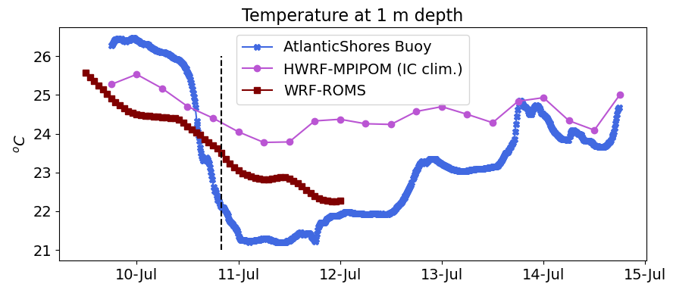

Slide 16
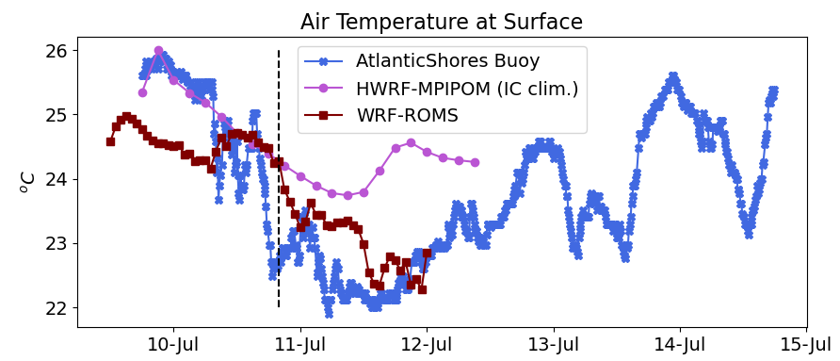
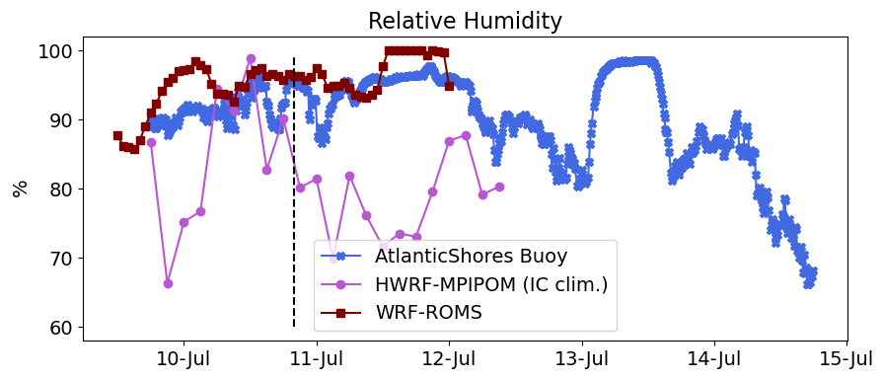

Slide 17
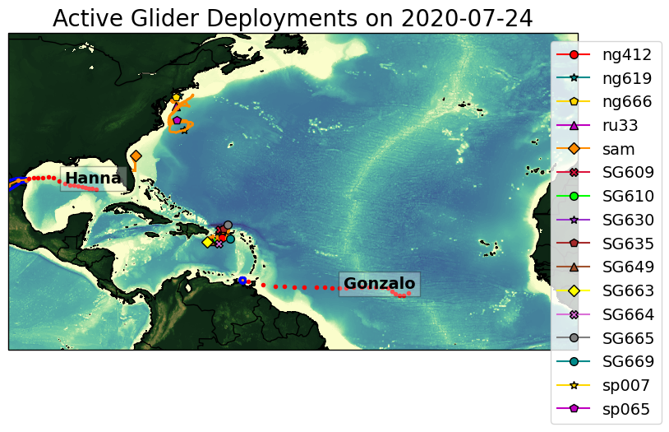
Gonzalo

Slide 18
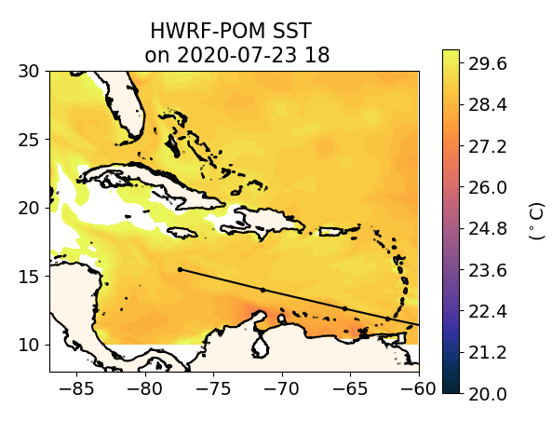
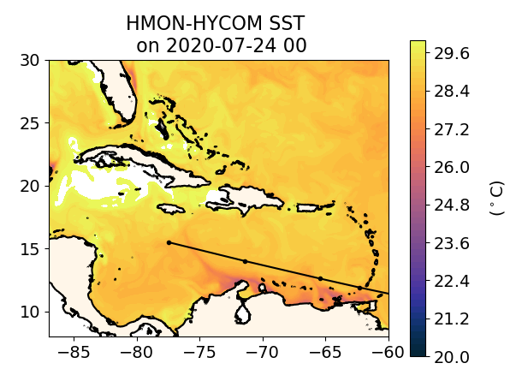
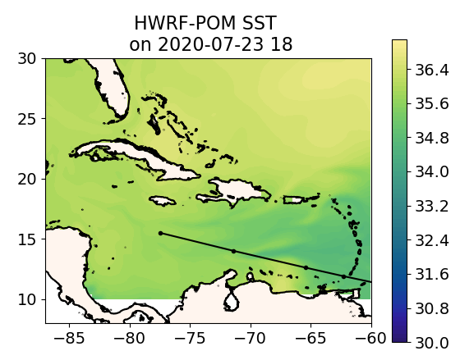
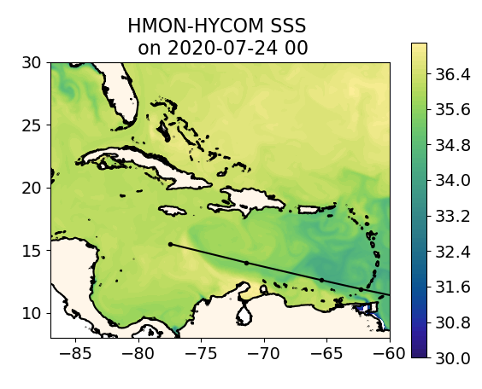
Gonzalo

Slide 19
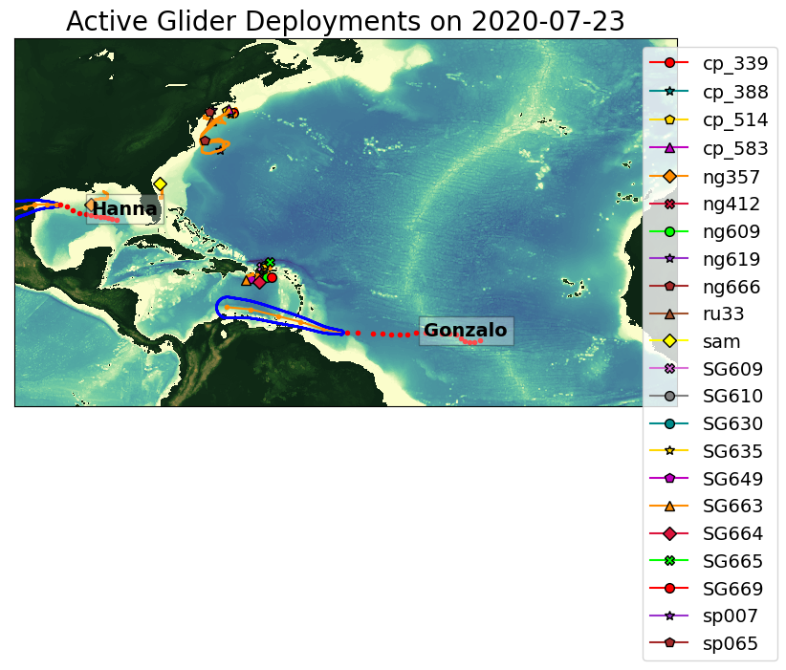
Hanna

Slide 20
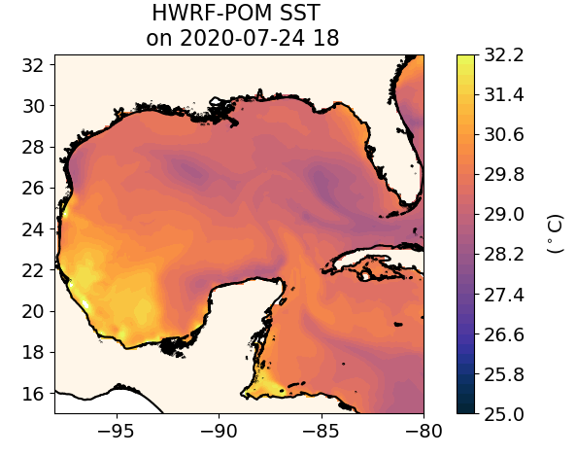
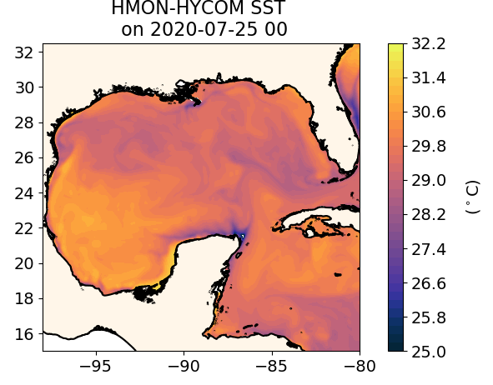
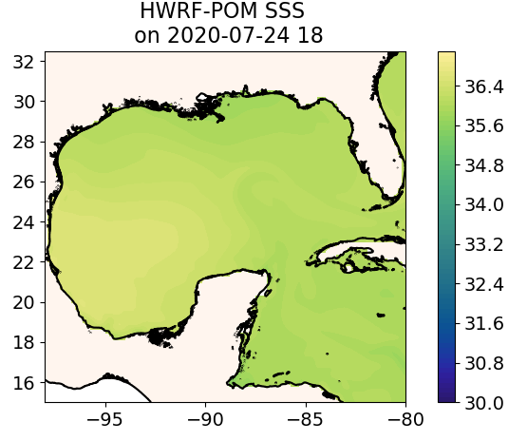
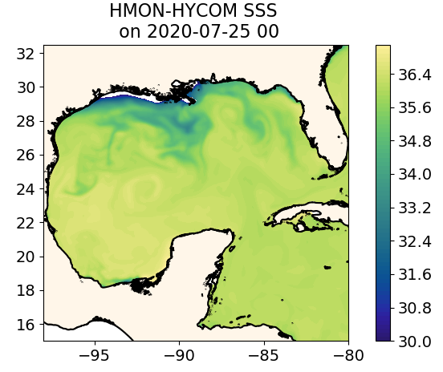
Hanna

Slide 21
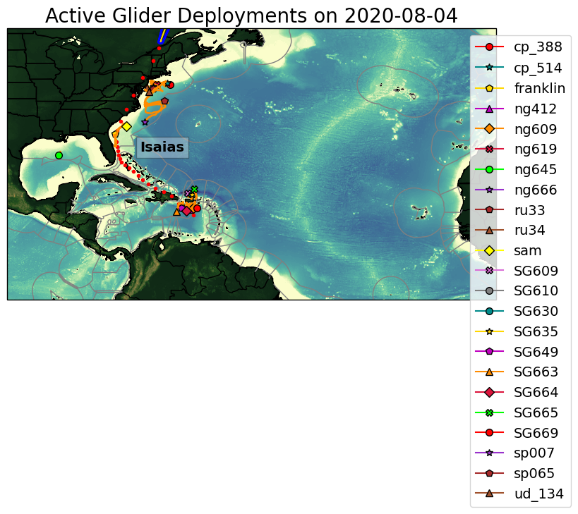
Isaias

Slide 22
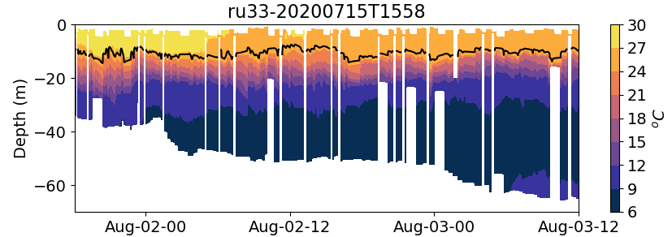
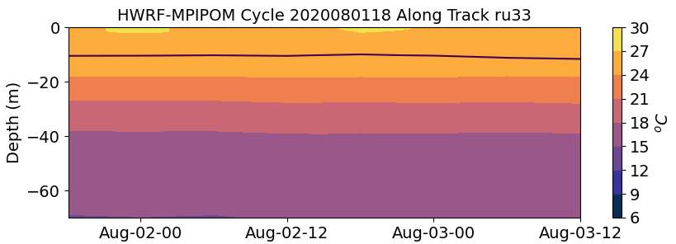

Slide 23
Glider Sam

Slide 25
MAB

Slide 26
26º
26º

Slide 27
35
35

Slide 28
Josephine

Slide 29
Kyle

Slide 30
Laura

Slide 32
Laura cycle 2020082500

Slide 35
HWRF-POM vs GOFS

Slide 36
2020-08-31

Slide 37
2020-08-31

Slide 38
Marco

Slide 39
Nana

Slide 40
Omar

Slide 41
Paulette

Slide 42
Rene

Slide 43
Sally

Slide 44
Sally Sep 2020

Slide 45
0
Pom presents an isothermal
Structure that seems unrealistic and it is not present in any of the other ocean models.
540 km

Slide 46
0
540 km

Slide 47
0
540 km

Slide 48
SG601

Slide 49
SG601

Slide 50
Teddy

Slide 51
Vicky

Slide 52
Wilfred

Slide 53
Alpha

Slide 54
Beta

Slide 55
Gamma

Slide 56
Delta

Slide 57
26º
26º
26º
26º

Slide 58
Glider Observations on the path of Delta
26º
26º
26º
26º

Slide 59
Glider Observations on the path of Delta
35.4
35.4

Slide 60
Epsilon

Slide 61
Zeta

Slide 62
Eta

Slide 63
Theta

Slide 64
Iota

