Slide 1
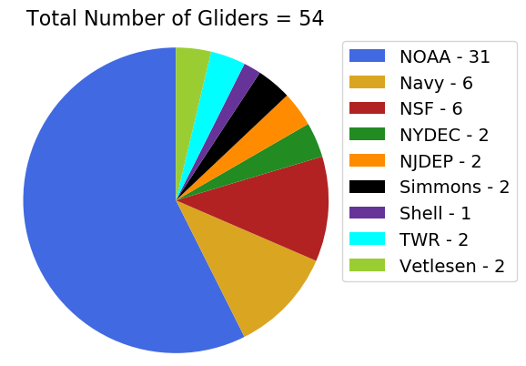
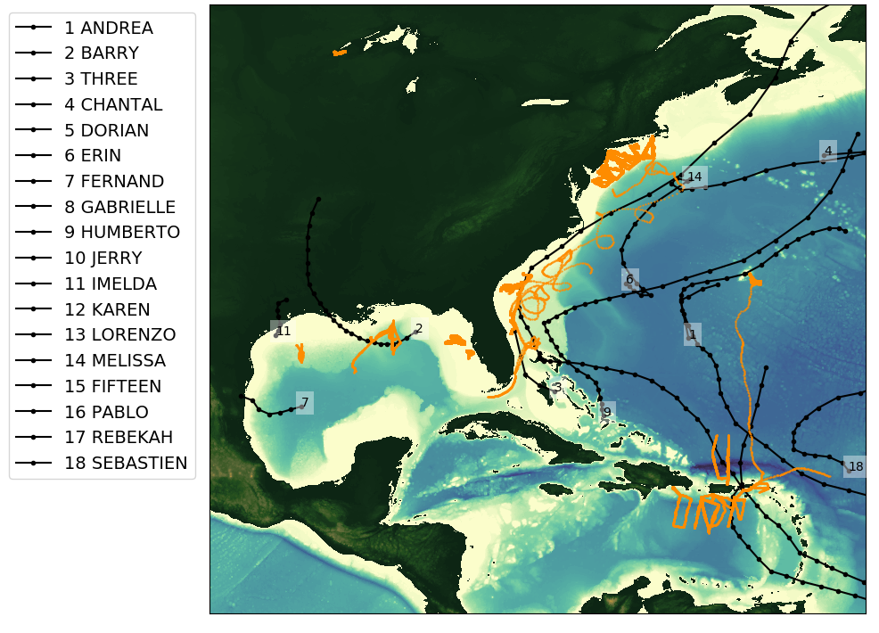
2019 Glider Picket line and Hurricane Tracks
Total number of gliders = 54 (~half volunteer)
Total number of glider profiles = 103511

Slide 2
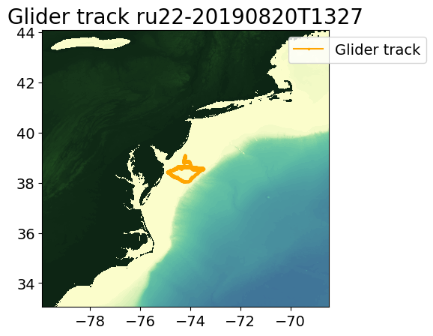
ru22-20190820T1327

Slide 3
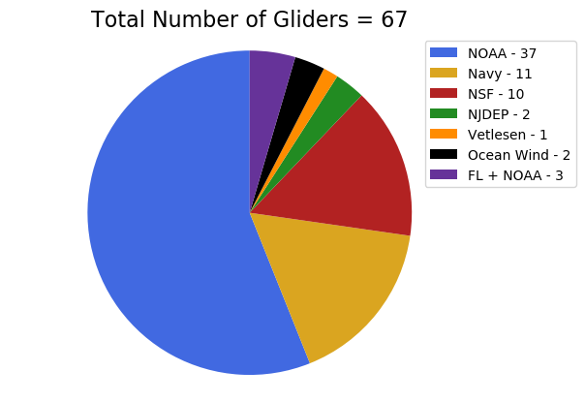
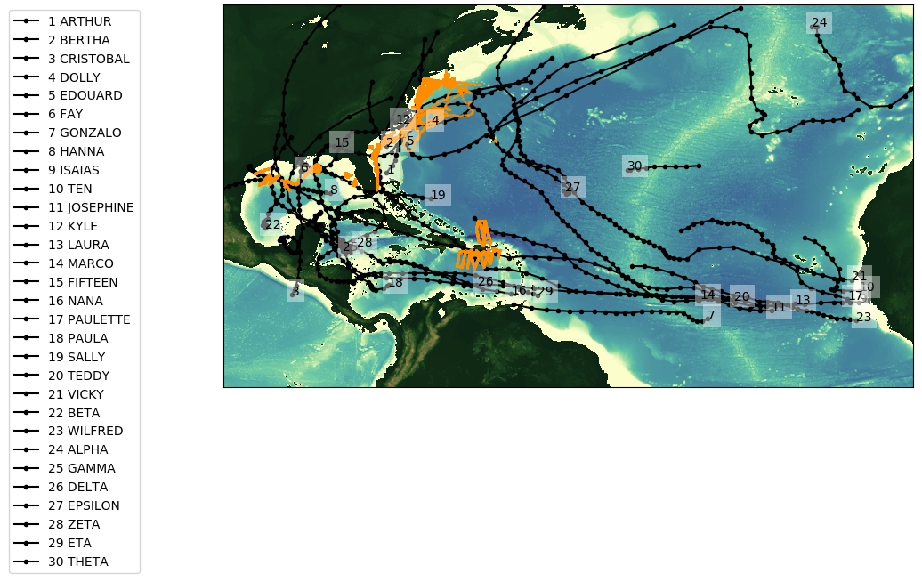
2020 Glider Picket line and Hurricane Tracks (up to Nov 10)
Total number of gliders = 67
Total number of glider profiles = 155373

Slide 4
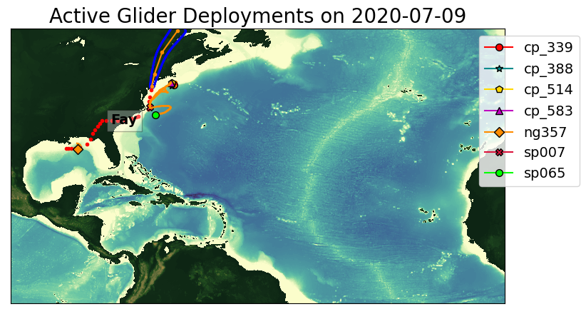
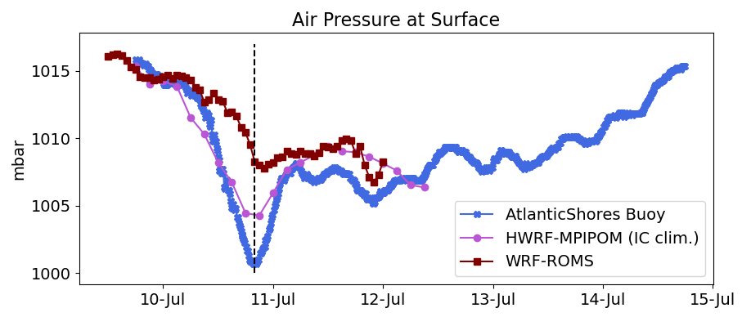
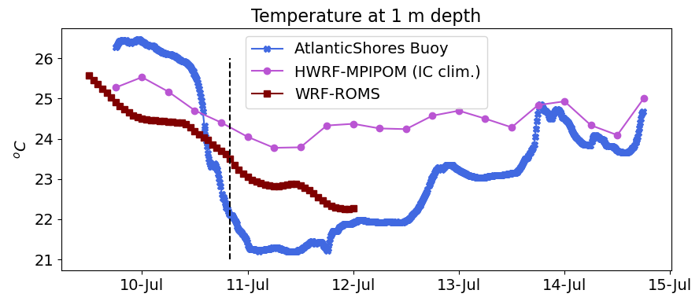
Tropical Storm Fay

