Slide 1
Impact of the Anomalously Warm Gulf of Mexico on Hurricane Michael (2018) Intensity
George Halliwell (NOAA/AOML/PhOD)
Matthieu Le Hénaff (CIMAS/UM and NOAA/AOML/PhOD)
The abnormally warm conditions in the Gulf of Mexico likely contributed to the intensification of Michael
How big was this contribution?

Slide 2
Approach
Perform idealized twin experiments:
Use HYCOM ocean model to generate a balanced ocean climatological analysis to initialize the coupled prediction system
Run HYCOM simulation over the North Atlantic hurricane domain with strong relaxation of 3-D model fields to Navy GDEM4 climatology
Compare coupled forecasts initialized by climatology to the same forecasts produced by NOAA/EMC that were initialized by the realistic RTOFS (Real-Time Ocean Forecast System) ocean analysis product produced by EMC.
Used the HWRF-HYCOM coupled prediction system (M. Le Hénaff)
Outline:
Compare the RTOFS analysis to climatology
Present two forecast cycles for Michael, RTOFS versus climatology IC
Look at time series of ocean coupling parameters along the storm track

Slide 3
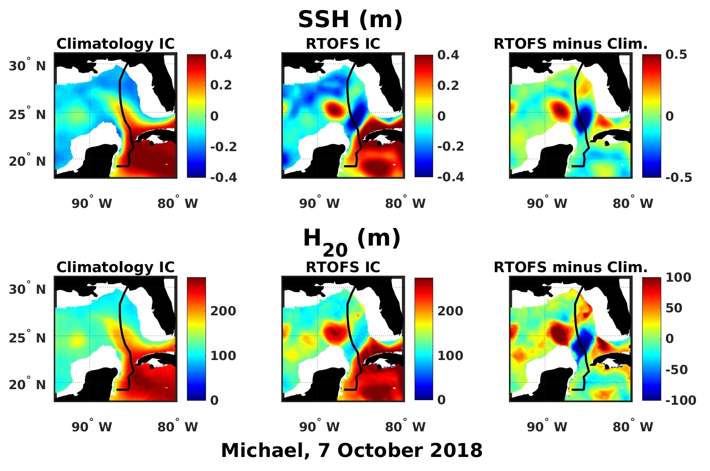
Climatology vs. RTOFS IC: Dynamics

Slide 4
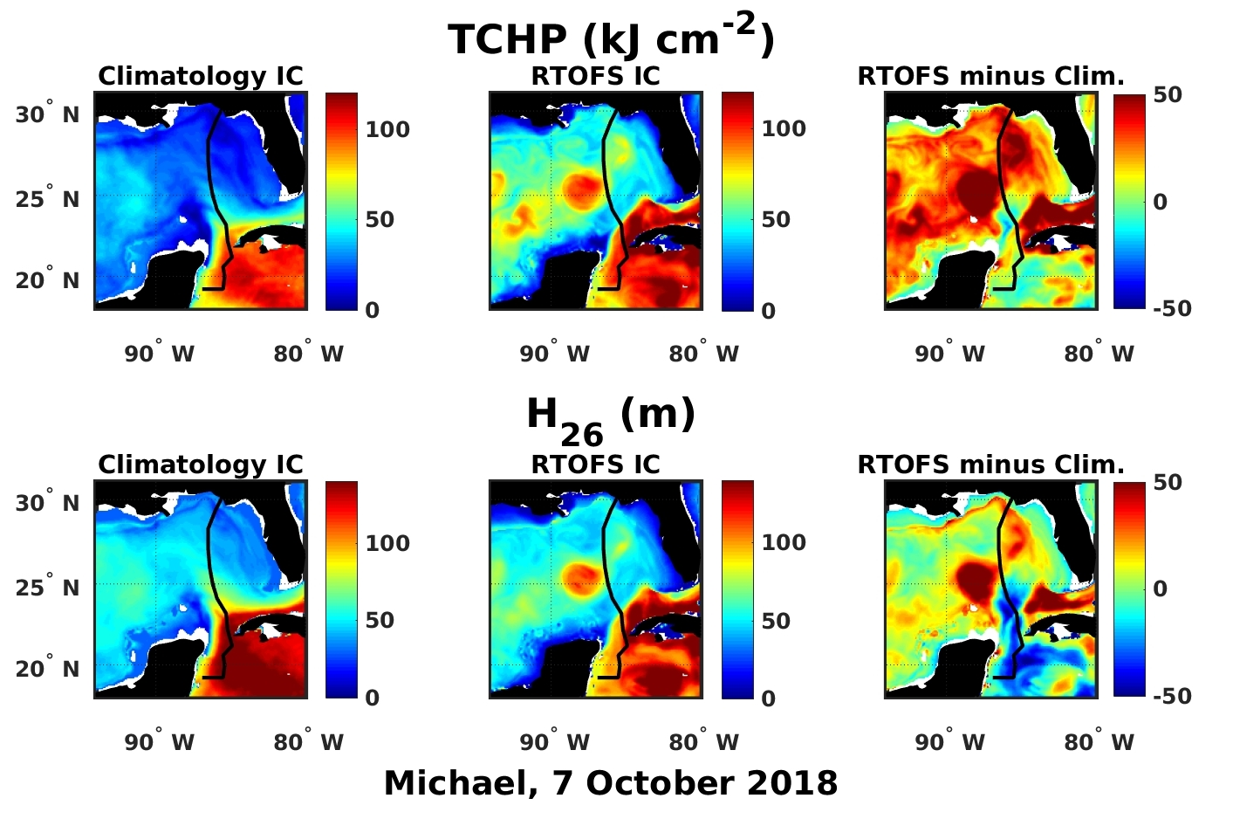
Climatology vs. RTOFS IC: Heat Potential

Slide 5
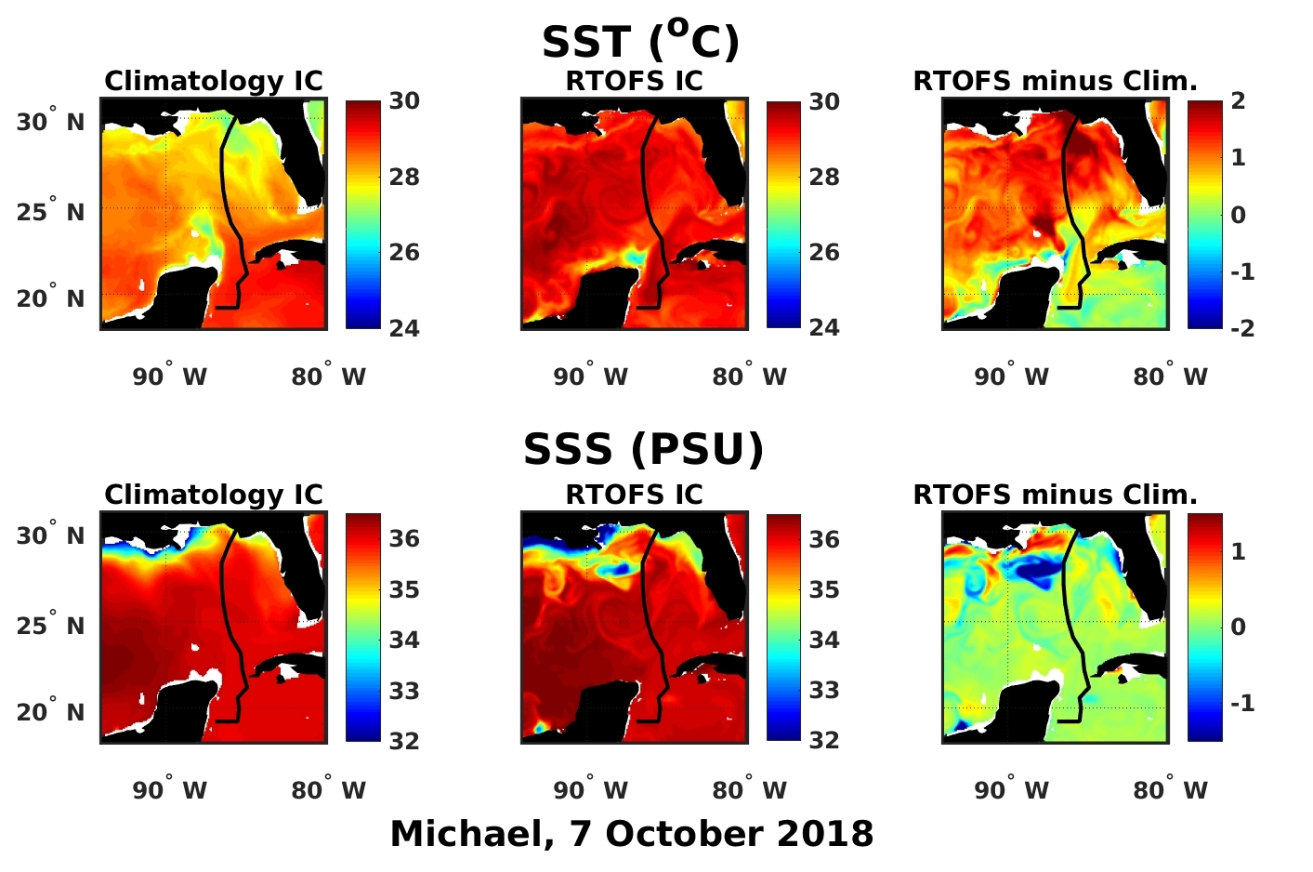
Climatology vs. RTOFS IC: Surface Fields

Slide 6
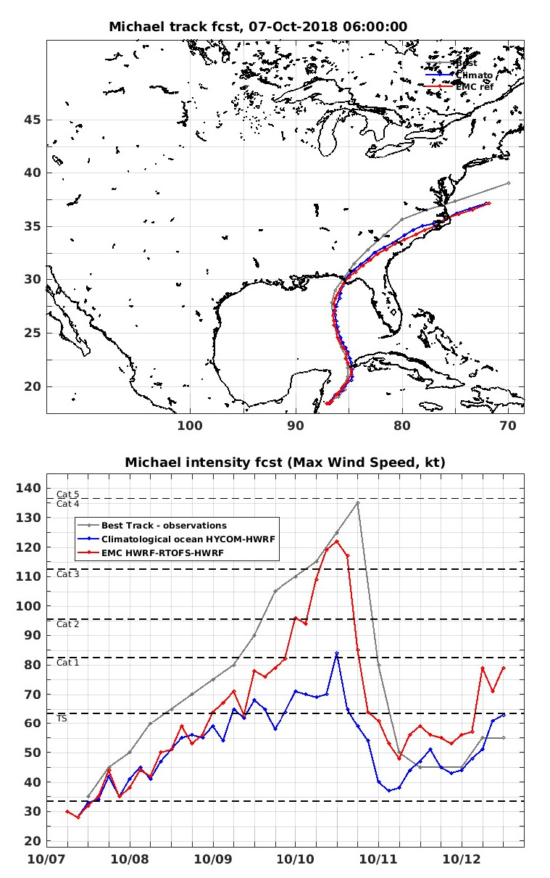
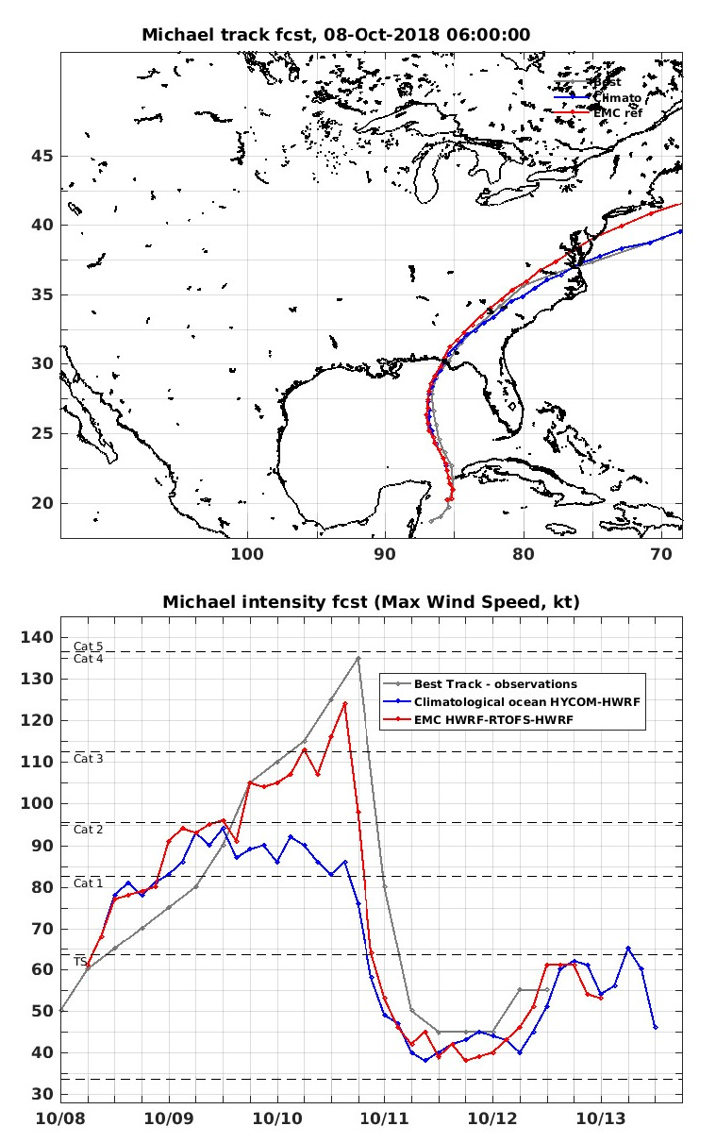

Slide 7
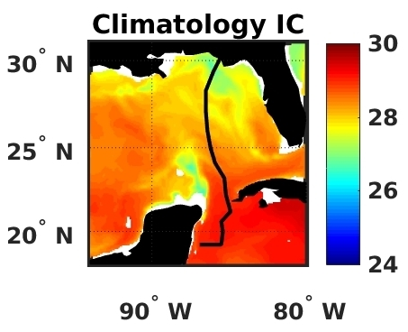
Ocean Coupling along the Track
Calculate time series of mean air-sea flux
parameters over the inner-core region as
the storm moves northward.
Averaging is performed over a circle with
an approximate radius of 2.5R_{MAX} (see
Figure) that follows the storm.

Slide 8
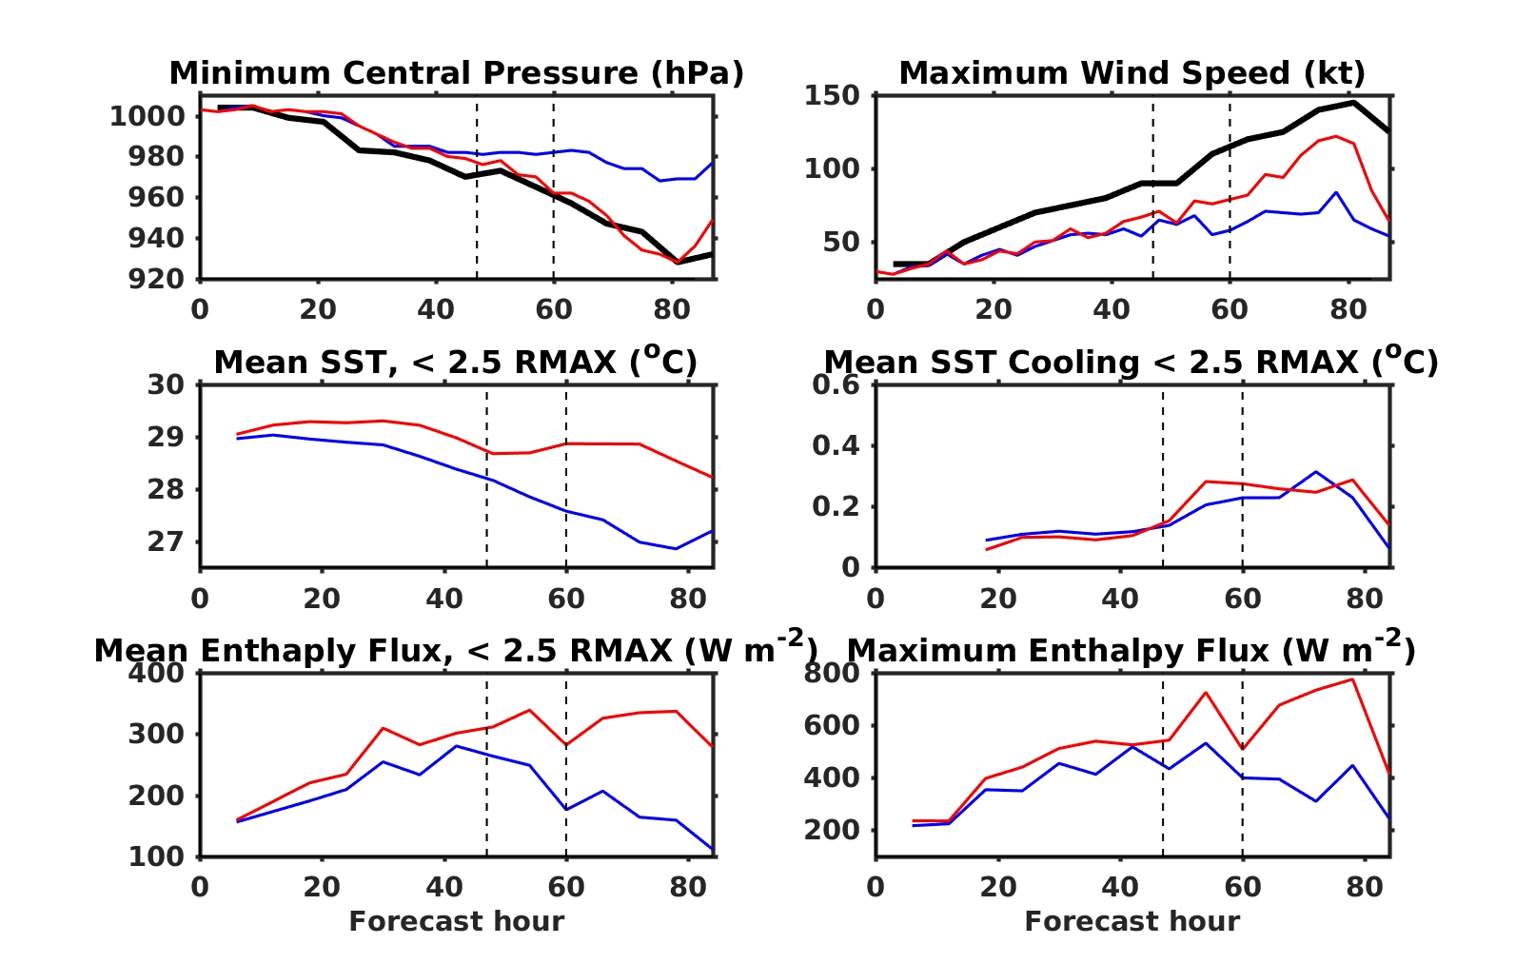
Ocean Coupling time series along the Track
0600 UTC, 7 October 2018 forecast cycle

Slide 9
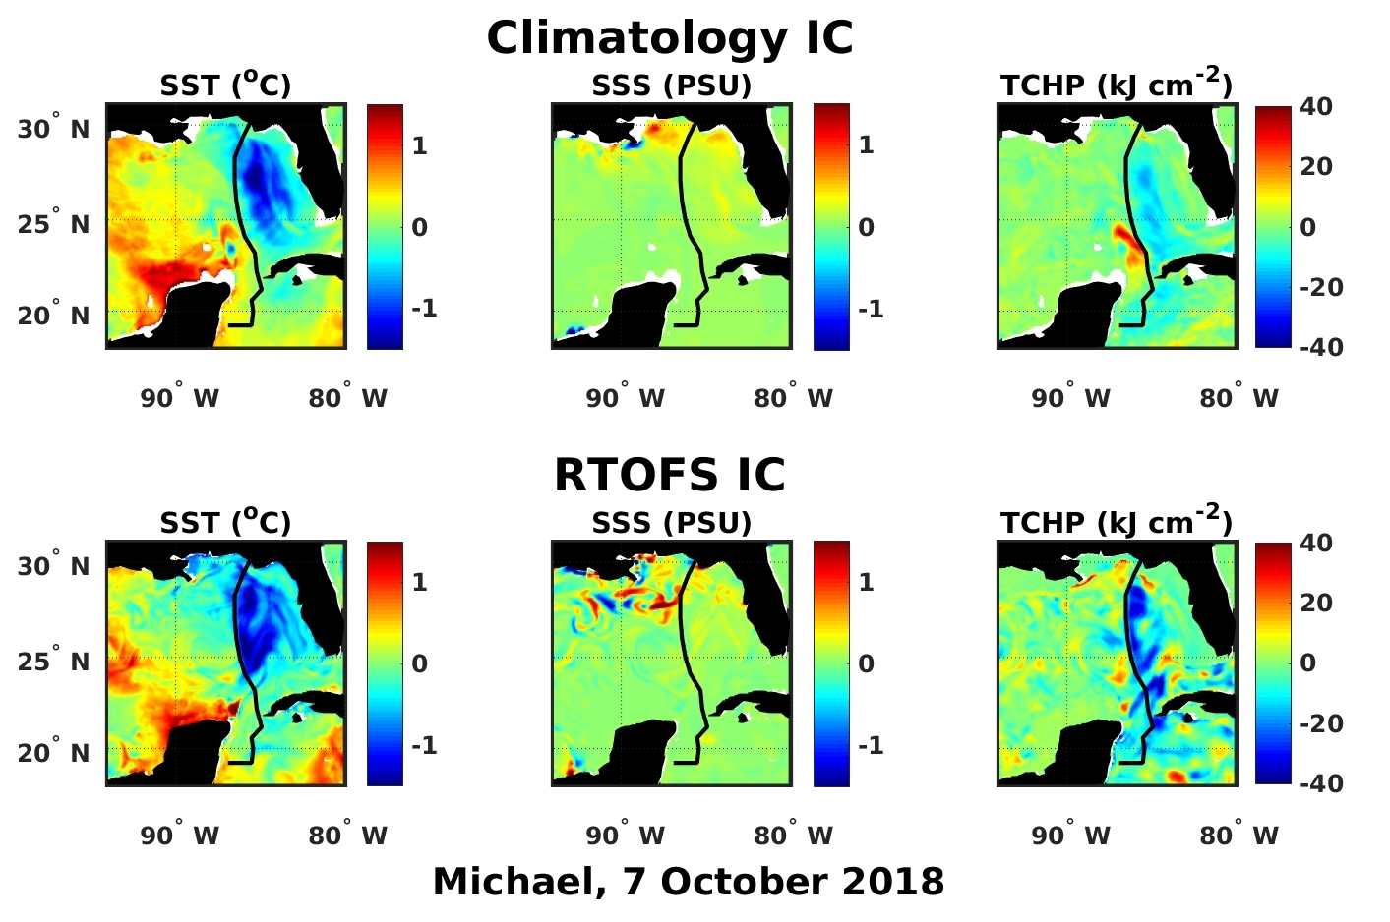
Ocean Fields after Landfall

Slide 10
Summary of Michael Results
The anomalously warm water encountered by the storm in the northeastern Gulf of Mexico enabled a major hurricane to form prior to landfall.
Realistic IC => model storm reaches cat 4
Climatological IC => model storm reaches cat 1-2
SST cooling rate did not differ significantly between the two cases. The differences in pre-storm SST and upper ocean heat content were primarily responsible for the intensity difference
Additional experiments are planned to quantitatively assess the impact of different ocean observing systems for improving ocean model initial conditions and subsequent intensity forecasts

