Slide 1
EMC Hurricane-Ocean Forecast Modeling and Data Assimilation
Hyun-Sook Kim
and
Hurricane and RTOFS-DA project teams
Dynamics and Coupled Modeling Group
Modeling and Data Assimilation Branch
EMC/NCEP/NWS/NOAA, College Park, MD 20740
Bi-Weekly Hurricane Glider Working Group Call
May 26, 2020

Slide 2
Outline
Operational Ocean Coupled Hurricane Models
2020 Upgrades
Experimental Models and Configurations
RTOFS-DA
Timeline for implementation
Metrics
Examples of validation
Introduction of Marine JEDI
5) Remark

Slide 3
1) 2020 Upgrade Operational Models
Note: Items in Red are different from the previous version
 | HWRF | HMON
Dynamic core | Non-hydrostatic, NMM-E | Non-hydrostatic, NMM-B
Nesting | 13.5/4.5/1.5 km; 77°/18°/6°; 75 vertical levels; Full two-way moving | 18/6/2 km; 75°/12°/8°; 71 vertical levels; Full two-way moving
Data Assimilation and Initialization | Vortex relocation & adjustment, Self-cycled hybrid EnKF-GSI with inner core DA (TDR) | Modified vortex relocation & adjustment, no DA
Physics | Updated surface (GFDL), GFS-EDMF PBL, Updated Scale-aware SAS, NOAH LSM, Modified RRTM, Ferrier | Surface (GFDL), GFS-EDMF PBL, Scale-aware SAS, NOAH LSM, RRTM, Ferrier
Coupling | MPIPOM/HYCOM (IC/BC from RTOFS), WaveWatch-III | HYCOM, RTOFS, No waves
Post-processing | NHC interpolation method, Updated GFDL tracker | NHC interpolation method, GFDL tracker
NEMS/NUOPC | No | Yes with moving nests
Computation cost for forecast job | 81 nodes in 98 mins | 43 nodes in 100 mins*

Slide 4
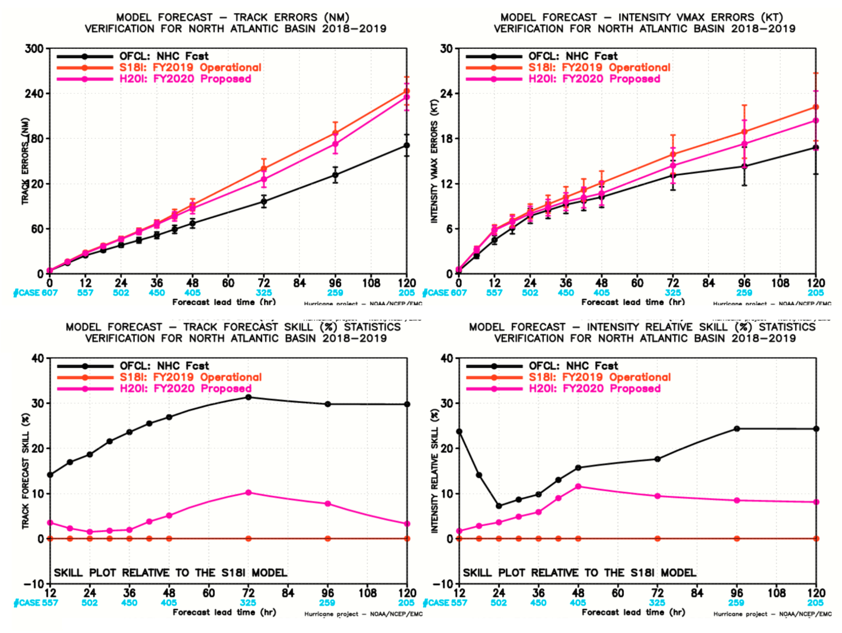
Upgrade Performance
1a. HWRF: North Atlantic
Mean Absolute Error (MAE):
Both track and intensity errors are reduced at all lead times, with more improvement at late lead times, as compared to the 2019 HWRF.
Skill Improvement:
Track <10%
Vmax intensity < 10%

Slide 5
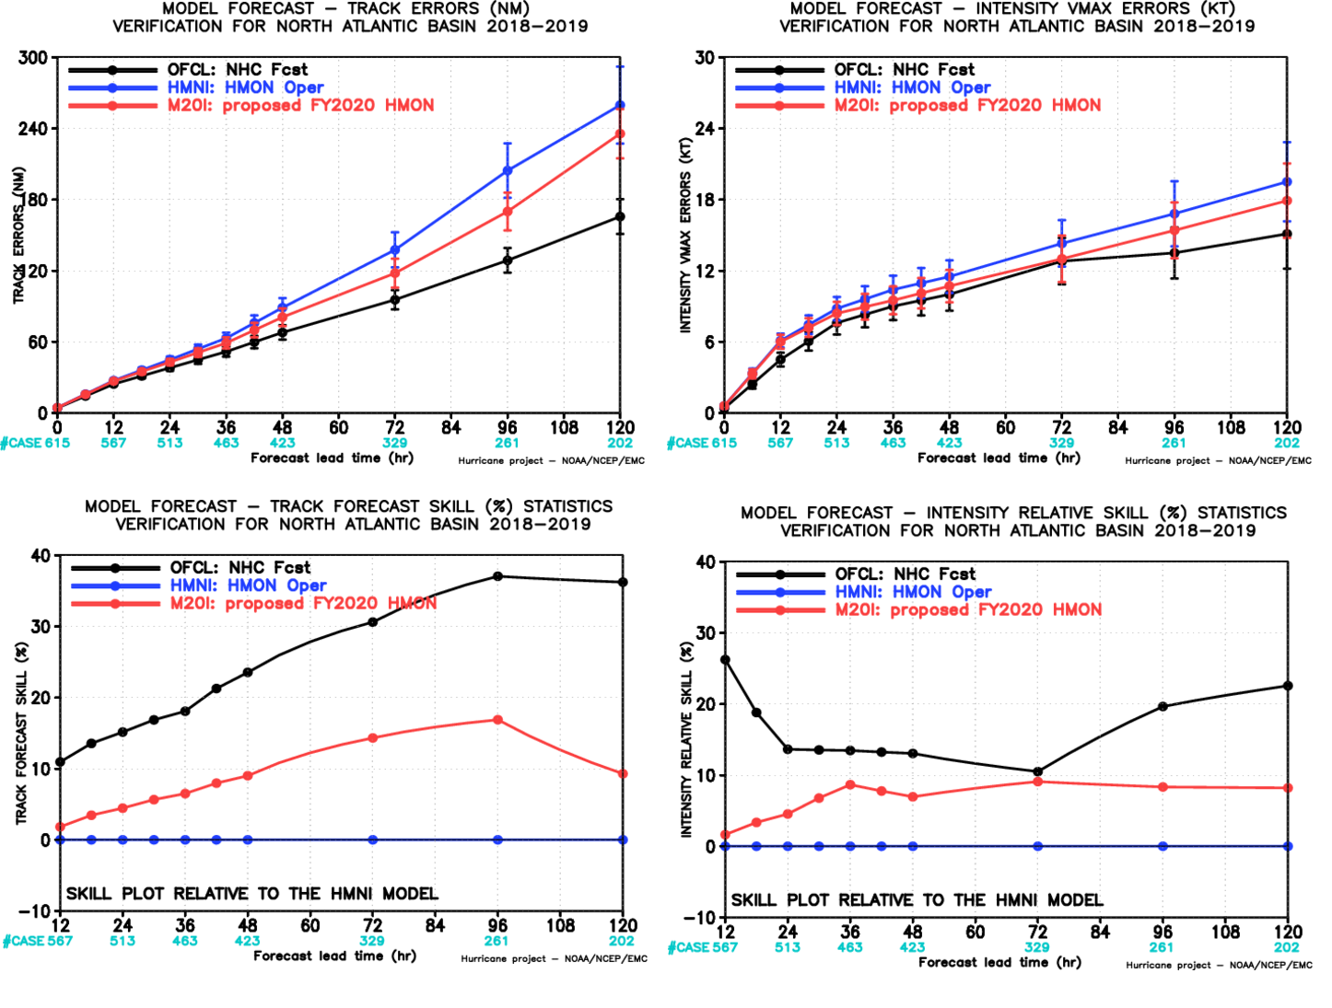
1c. HMON: North Atlantic
Upgrade Performance
Mean Absolute Error: significant improvements in track (by <50 nm), and intensity over the 2019 HMON (by 2 kt).
Skill Improvement:
Track <17%
Vmax intensity < 10%

Slide 6
2) Experimental Models and Configurations for 2020
 | configuration | basin | comments
2-way HWRF | HYCOM coupling with IC from RTOFS-DA | North Atlantic, Eastern Pacific | Case by case, near real-time (NRT)
HMON | HYCOM coupling with IC from RTOFS-DA | North Atlantic, Eastern Pacific | Case by case, NRT
3-way HWRF | HYCOM+WW3 coupling | North Atlantic, North Pacific | Case by case, NRT
HAFS | ATM alone | North Atlantic | HFIP Stream 2, RT
HAFS | HYCOM coupling | North Atlantic, Eastern Pacific | HFIP Stream 2, RT
Note: Items in Red are contingency

Slide 7
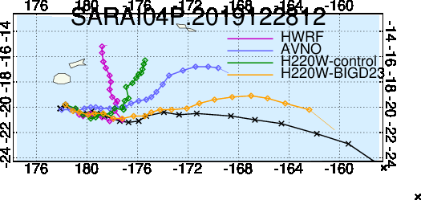
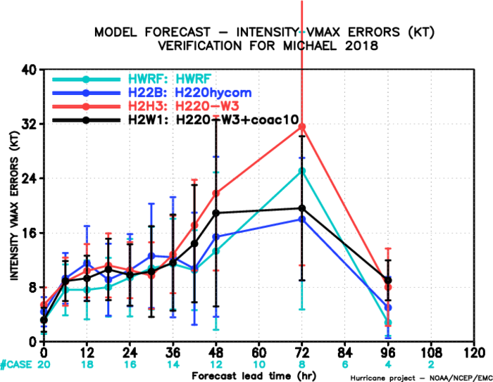
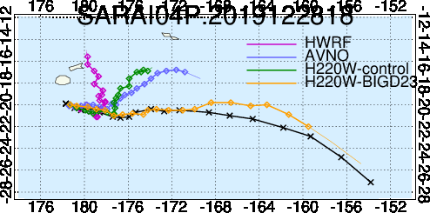
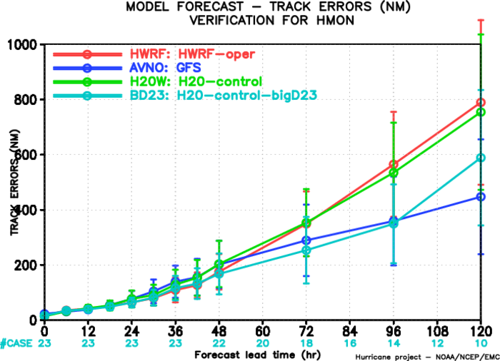
2a. 3-way coupling, HWRF-HYCOM-WW3
Track and Intensity forecast improvement by including sea-state dependent flux exchange
Cyclone Sarai (2019)
Hurricane Michael (2018)

Slide 8
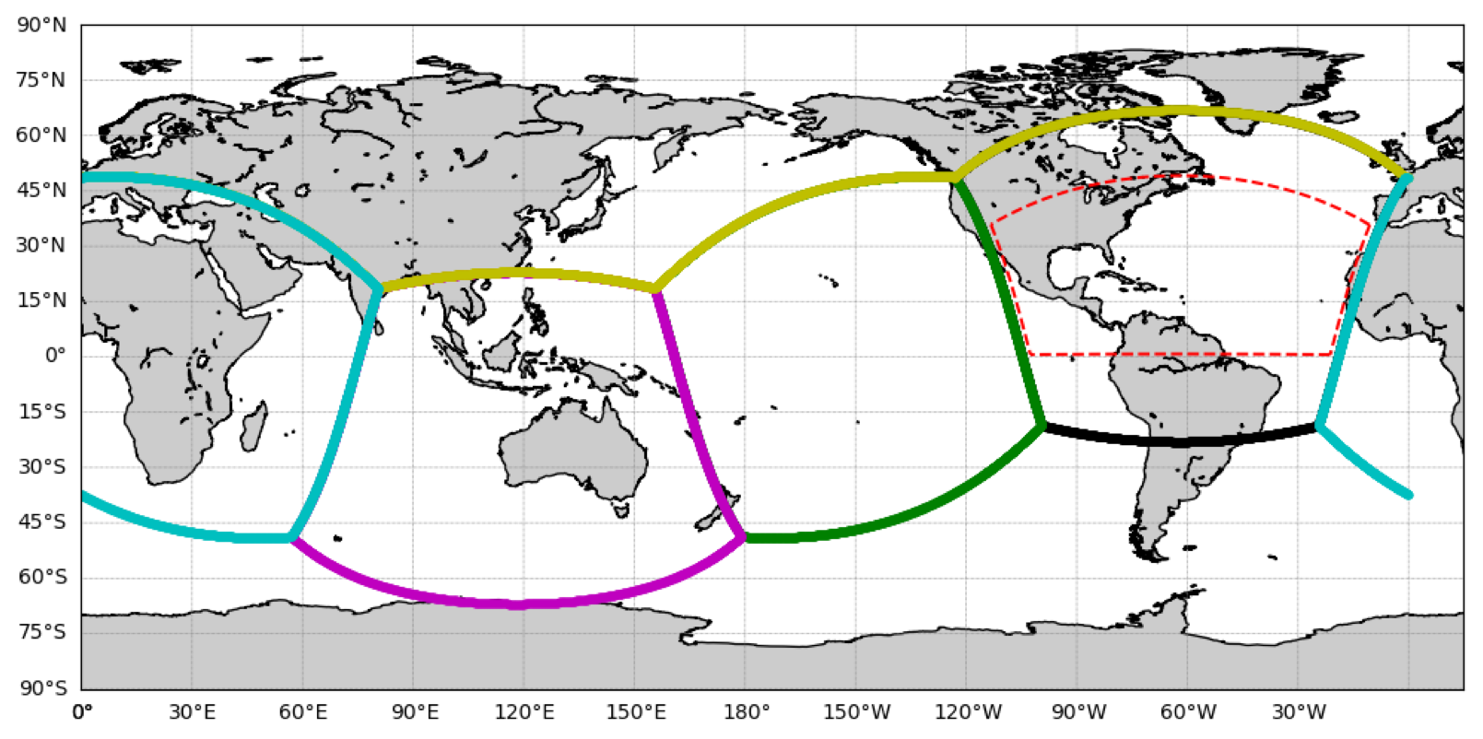
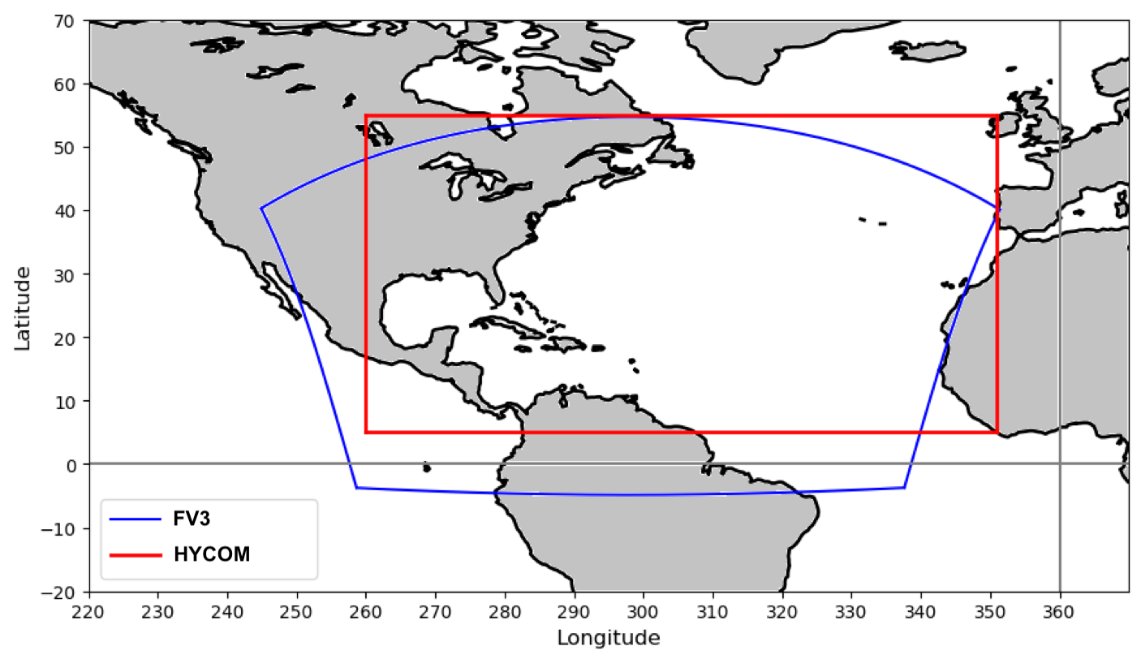
2b. Next-generational coupled TC forecast System(s)
HAFS (Hurricane Analysis and Forecast System) based on FV3
1. ocean model: HYCOM initially and MOM6 later
2. DA: weakly coupled DA to strongly coupled DA; will be transitioned to the JEDI (Joint Effort for Data Assimilation Integration) framework
3. Will be transitioned to the UFS (Unified Forecast System) framework – community base, coupled comprehensive earth modeling system
Global-Nested Configuration
Stand Alone Regional (SAR) Configuration
(courtesy of Hazelton)

Slide 9
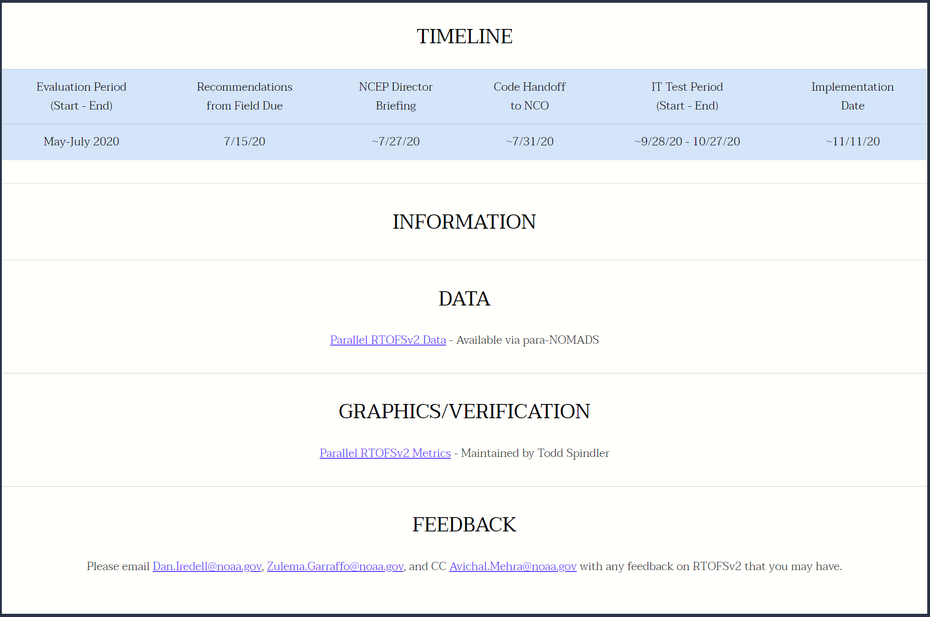
3) RTOFS-DA
Visit the RTOFSv2 Official Evaluation website
https://www.emc.ncep.noaa.gov/users/meg/rtofsv2/
Can be delayed due to implementation of upstream or other models.

Slide 10
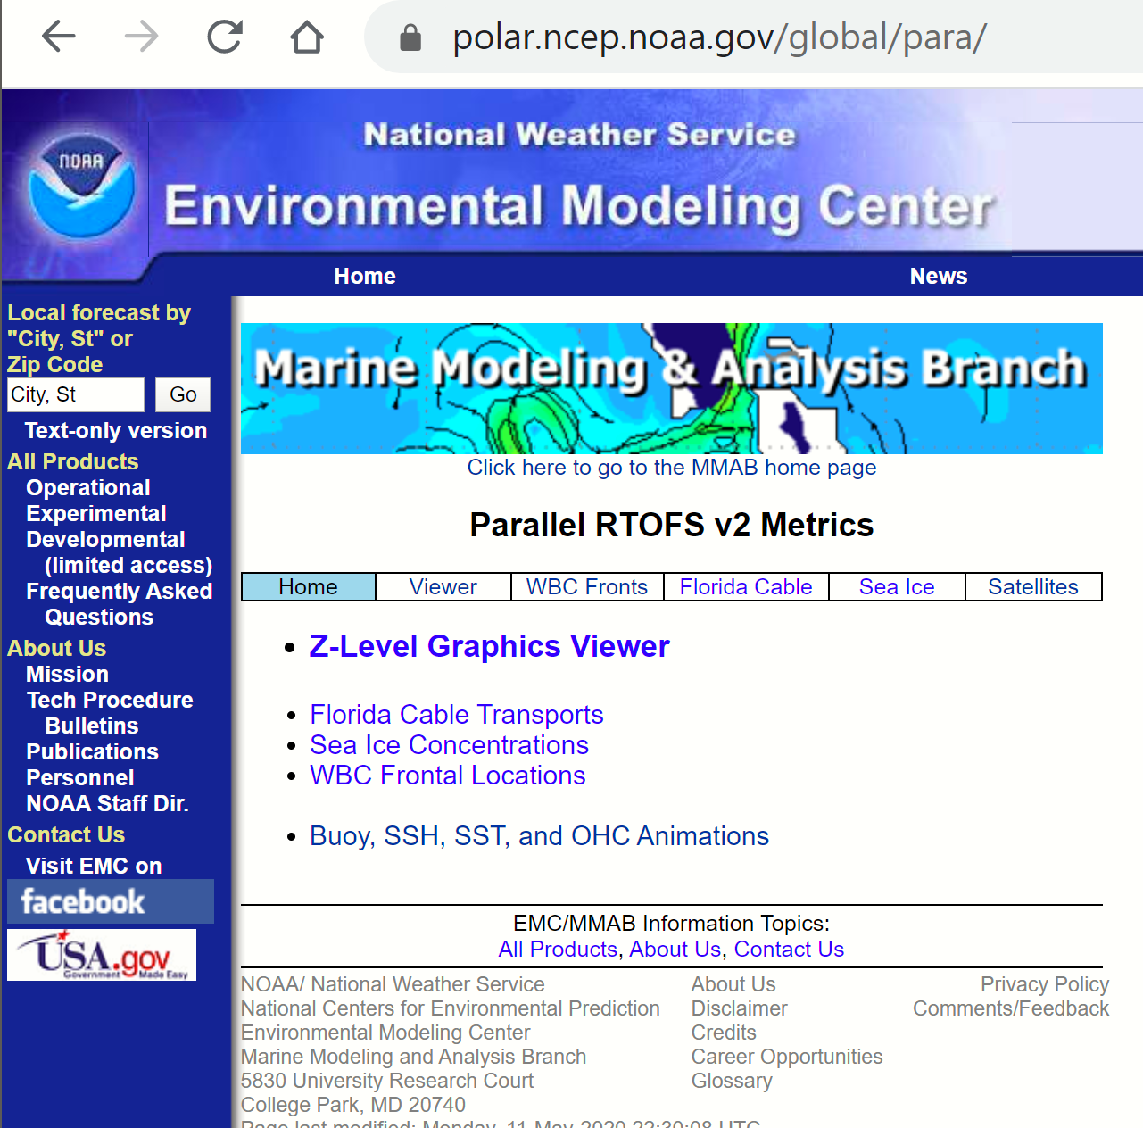
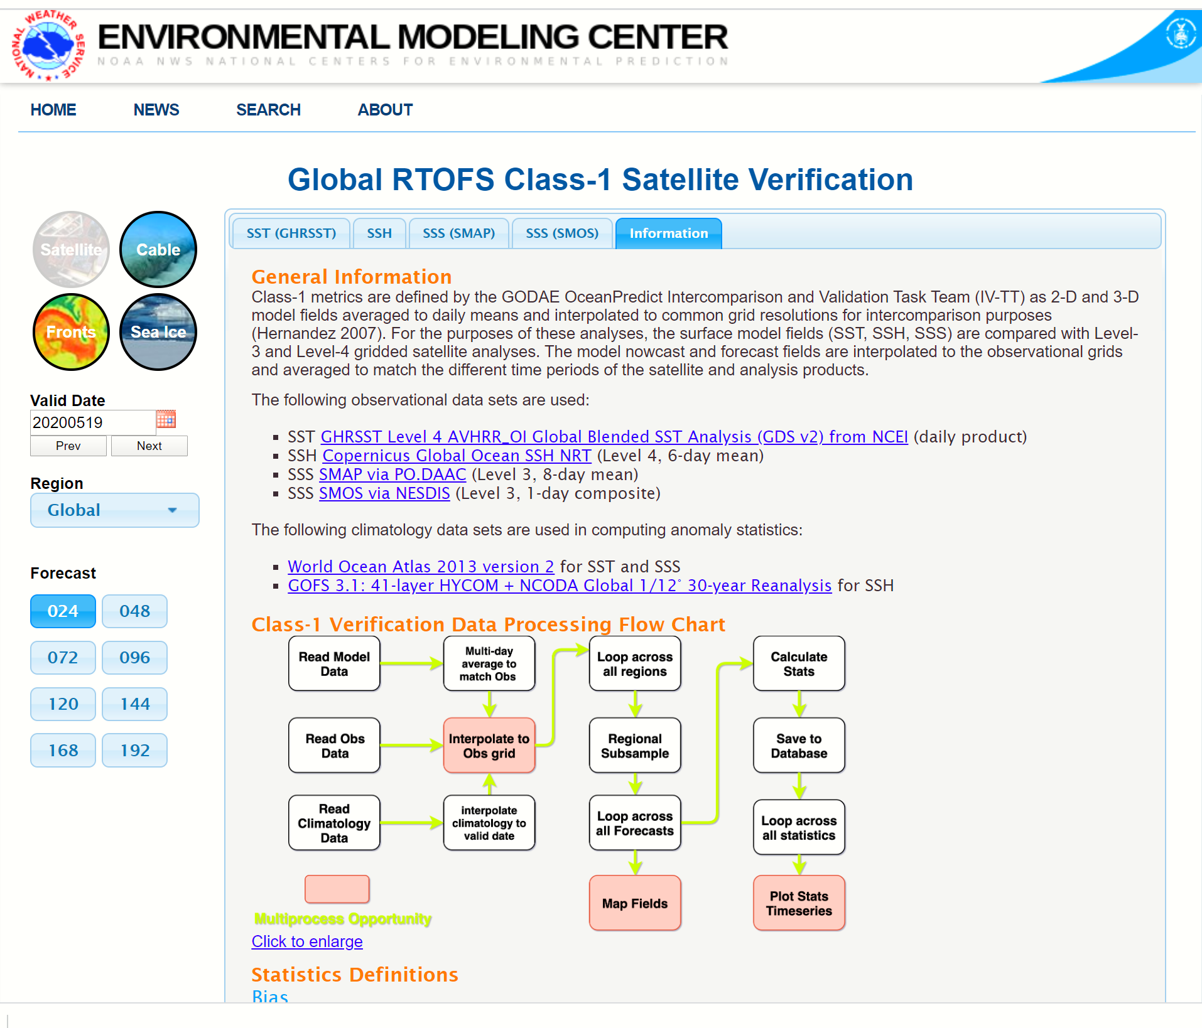
3a. RTOFS-DA: Metrics

Slide 11
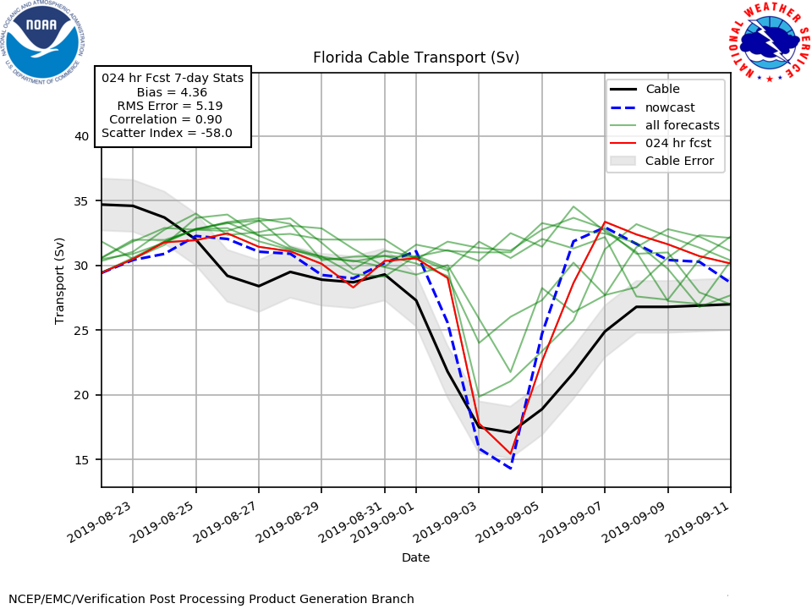
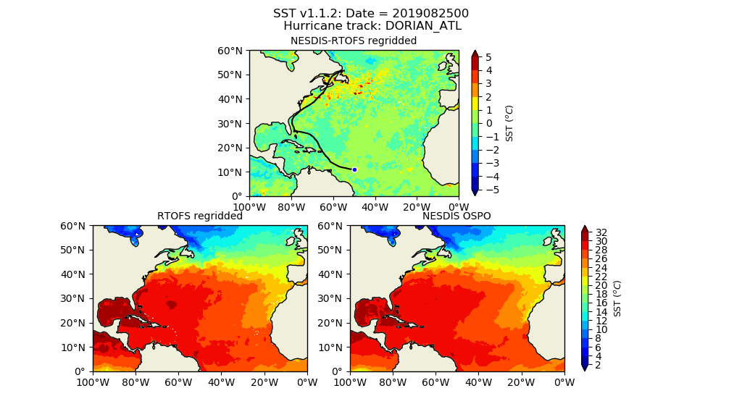
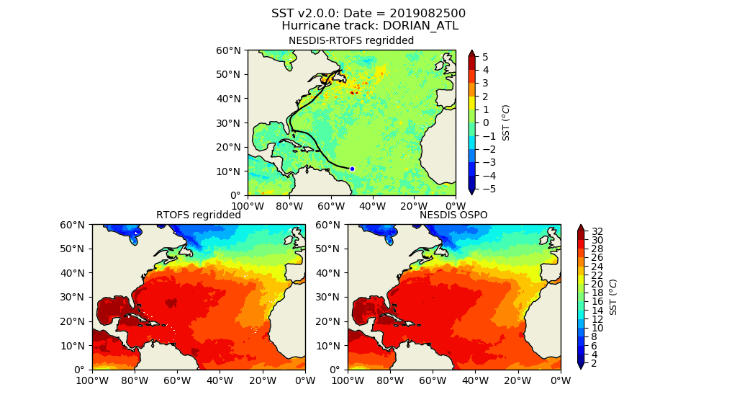
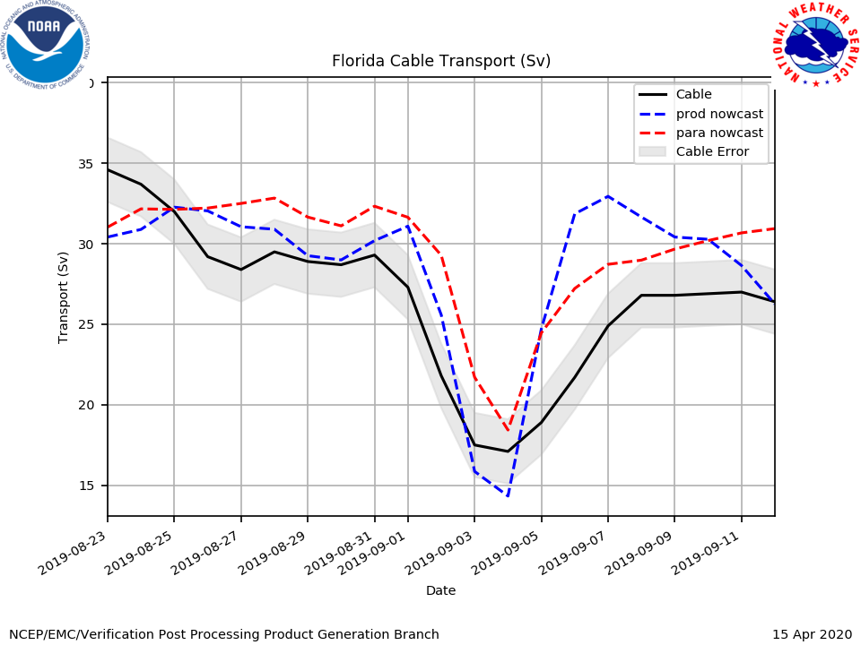
3b. RTOFS-DA: Verification examples
Florida Current Transports
SST comparison for Hurricane Dorian (2019)
RTOFS V1
RTOFS V1
RTOFS V2
RTOFS V2

Slide 12
4) Unified DA effort – JEDI: Future
JEDI (Joint Efforts for Data assimilation Integration) is a collaborative development spearheaded by the JCSDA.
Collaborative teams – NOAA, NASA, US NAVY
Next generation unified data assimilation system
For research and operations (including R2O/O2R)
For various components of the earth system, including coupled DA
Mutualize as much as possible without imposing single approach
Open-development software –model: in addition to supported releases, community, developers can obtain and collaborate on latest development branches (via github)
The Marine JEDI DA system for NOAA/NCEP is through SOCA (Sea-ice Ocean Coupled Assimilation)
Courtesy of JCSDA

Slide 13
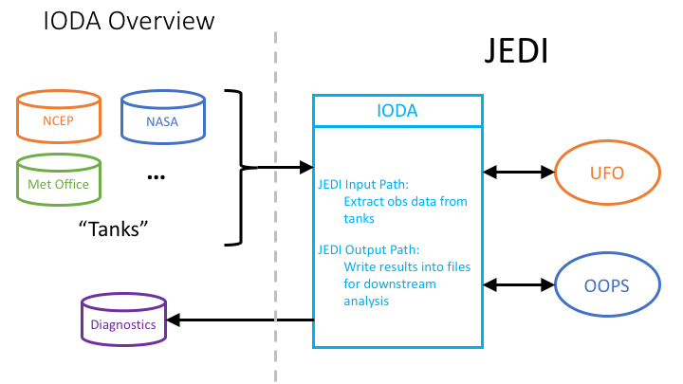
4a. IODA component
With a goal of unification of DA, this framework will include existing operational DA algorithms and facilitate exploration of new DA science across domains and applications.
Modernization/Unification of common utilities (Pre- & Post-processing, obs, workflow, etc.), integrated into UFS as a component.
IODA component
JEDI=Joint Efforts for Data assimilation Integration
UFS=Unified Forecast System
IODA=Interface for Observation data Access
UFO=Unified Forward Operator
OOPS=Object Oriented Prediction System

Slide 14
4b. OOPS component
OOPS (Objected Oriented Prediction System) component
Abstract Layer - OOPS
Generic
Applications
Forecast
3DVar
LETKF
4D-Var
…
Abstract building blocks
State
Model
Covariance
Observations
Courtesy of JCSDA
Model Systems
Lorenz
MOM6
WW3
CICE6
FV3
…

Slide 15
5) Remark
Experimental runs
Limited resources ➔ selected storms
Validation and Metrics:
welcome community involvement

Slide 16
Thank you!

