Slide 1
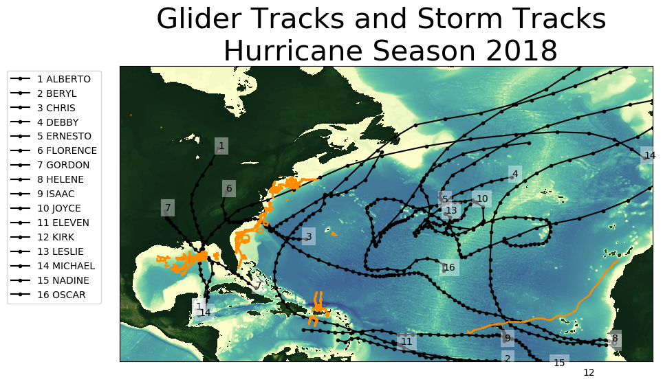

Slide 2
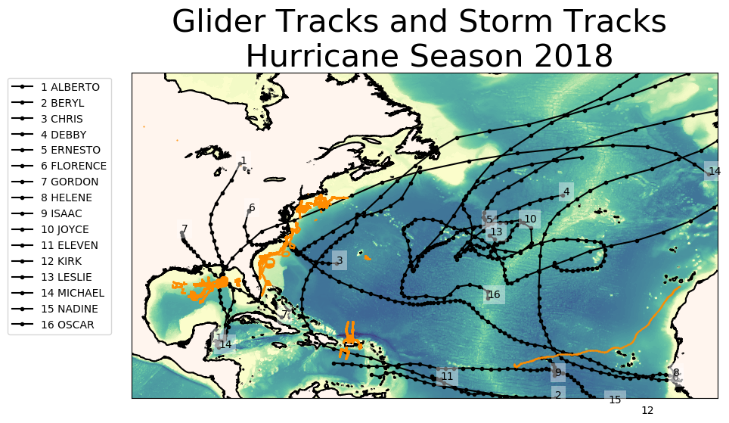

Slide 3
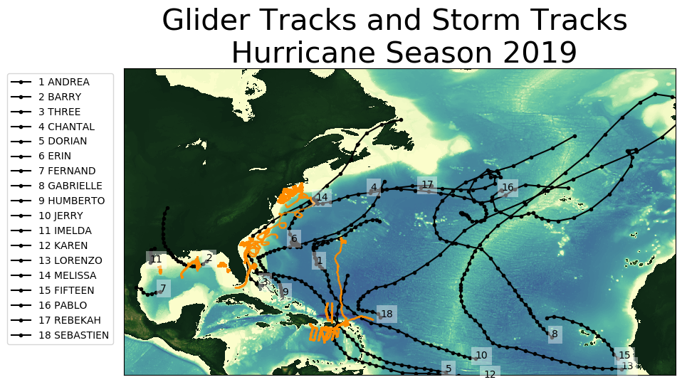

Slide 4
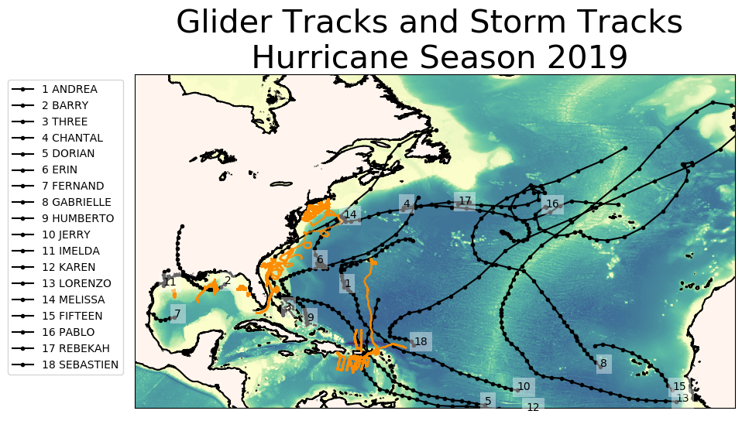

Slide 5
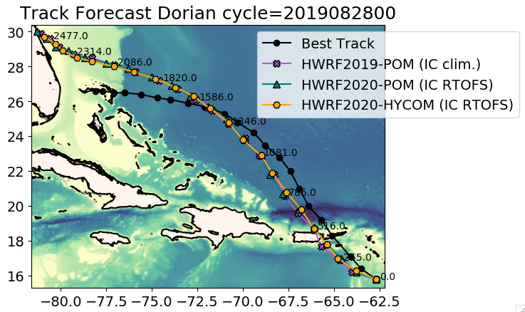
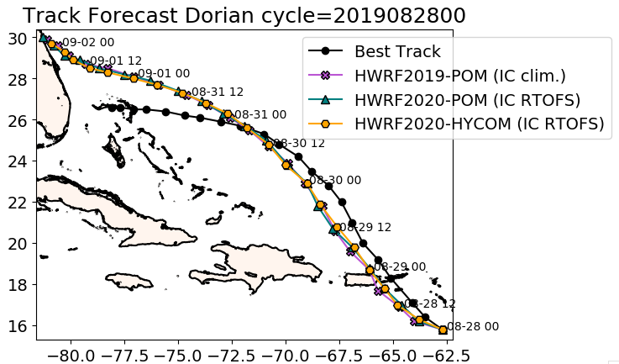
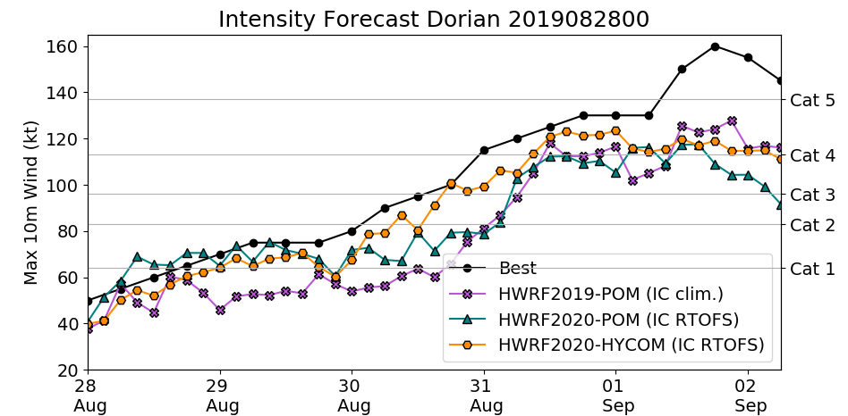
Hurricane Dorian
Cycle 2019082800

Slide 6
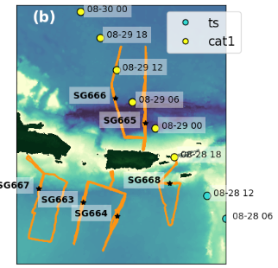
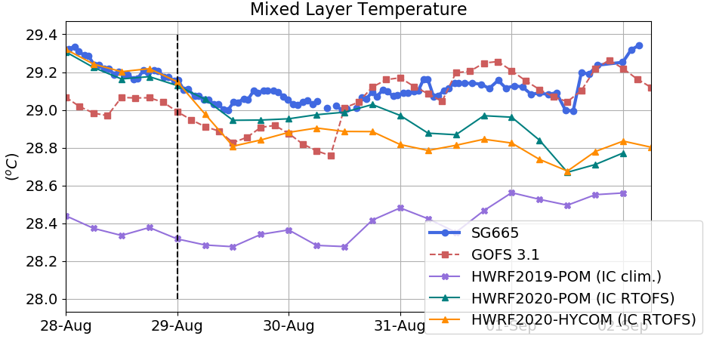
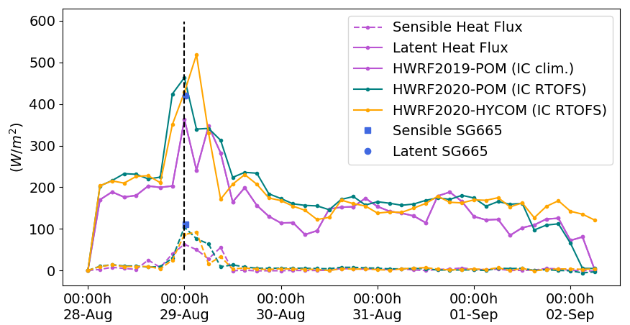
SG665
Time series at this
location

Slide 7
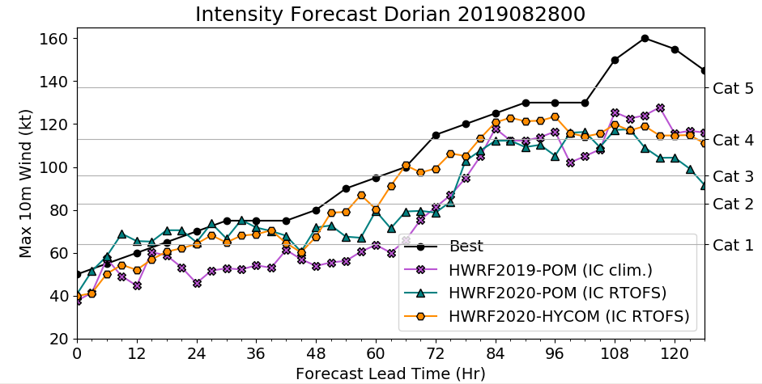
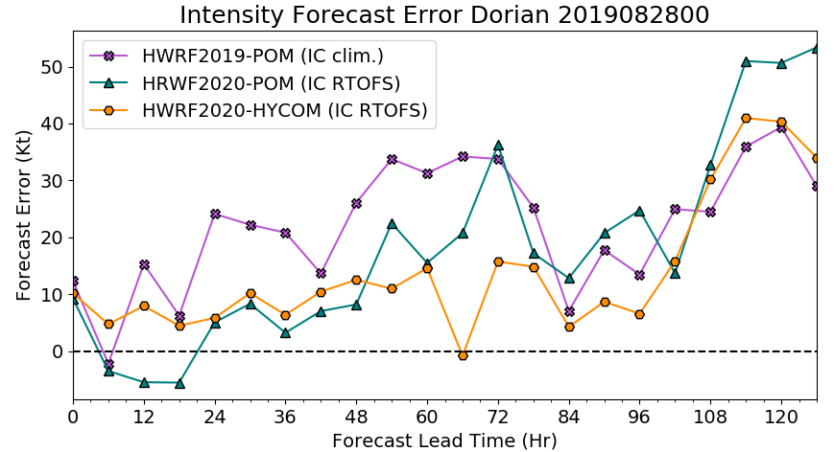

Slide 8
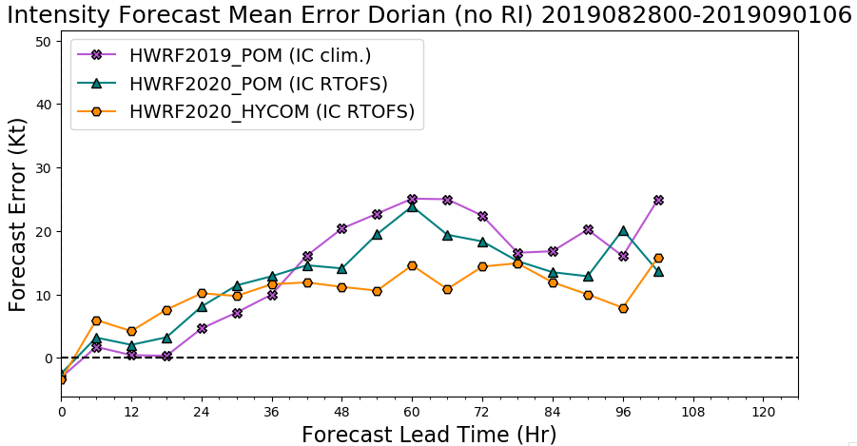
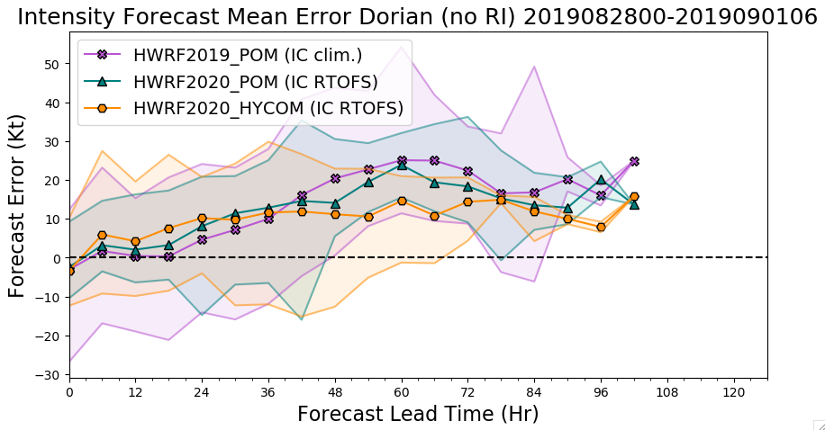
It does not include lead times
of the cycles after rapid intensification (RI)

Slide 9
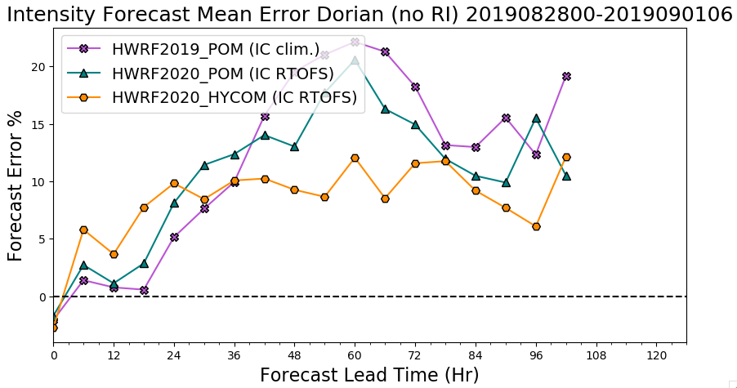

Slide 10
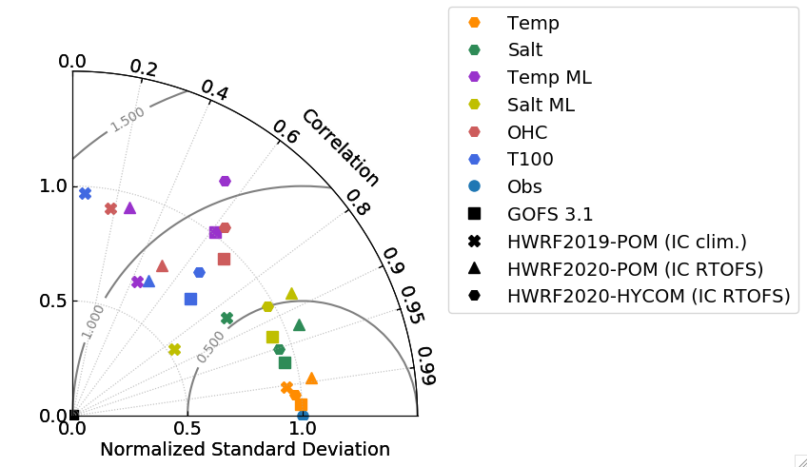
Temp ML
HWRF2020-POM
OHC
HWRF2019-
POM
HWRF2020-HYCOM
Salt ML
T100
GOFS 3.1
Salt
Temp

Slide 12
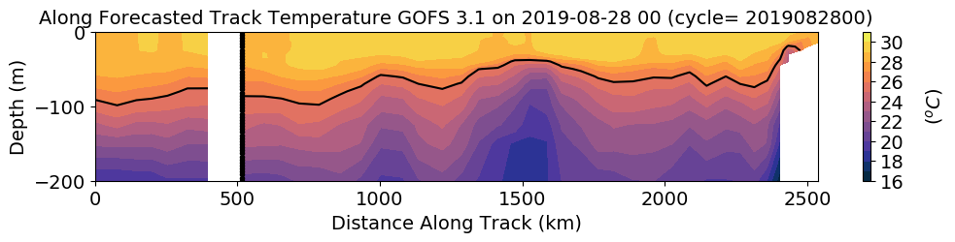
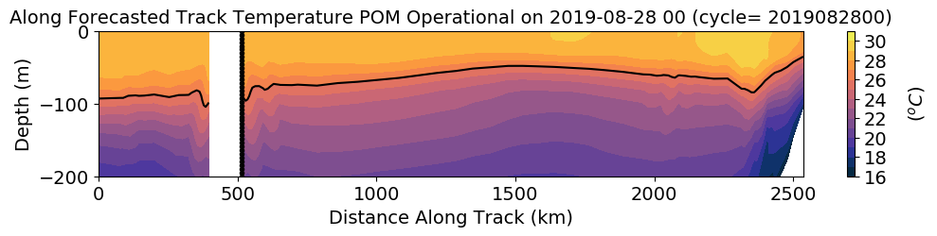
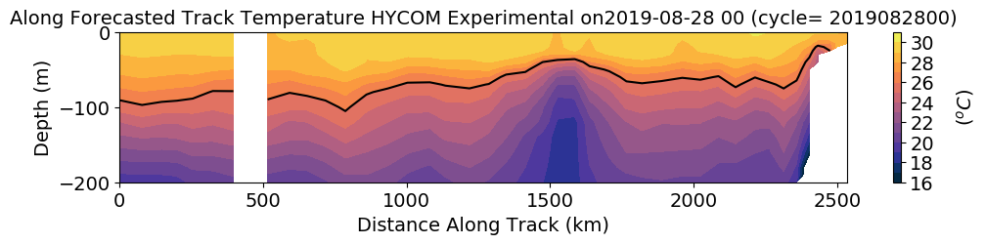
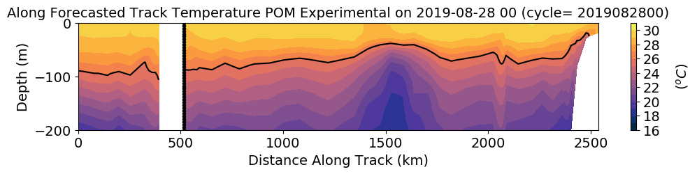
IC along forecasted Hurricane Dorian Track
Why the lost in Correlation of Surface Quantities ?

Slide 13
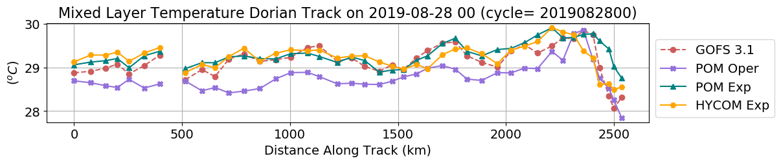
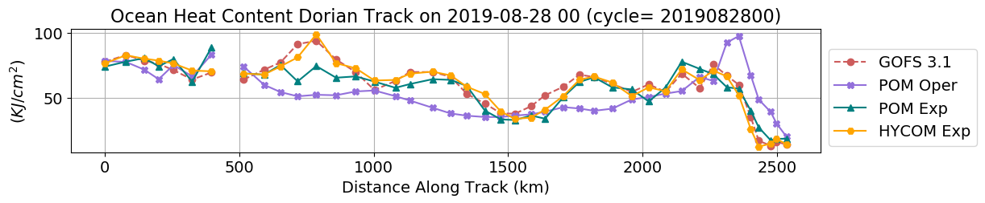
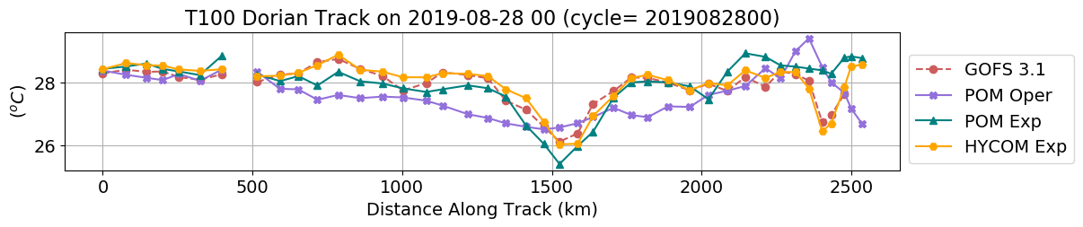
IC along forecasted Hurricane Dorian Track

Slide 14
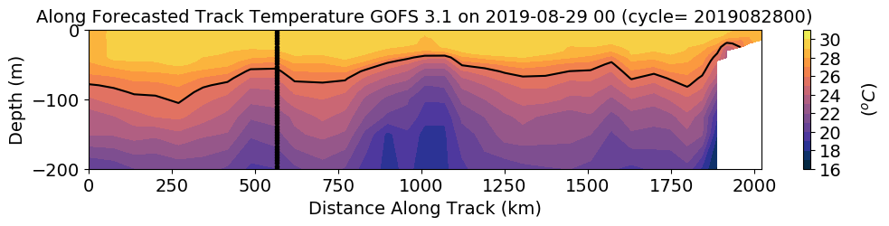
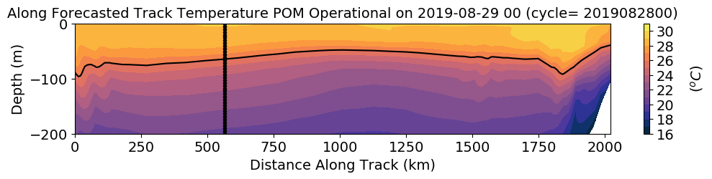
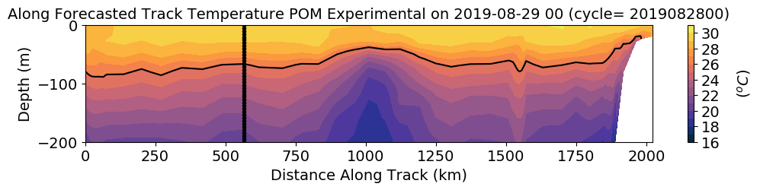
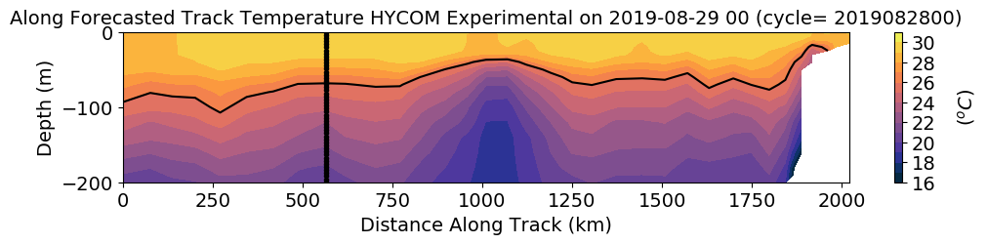
IC along forecasted Hurricane Dorian Track

Slide 15
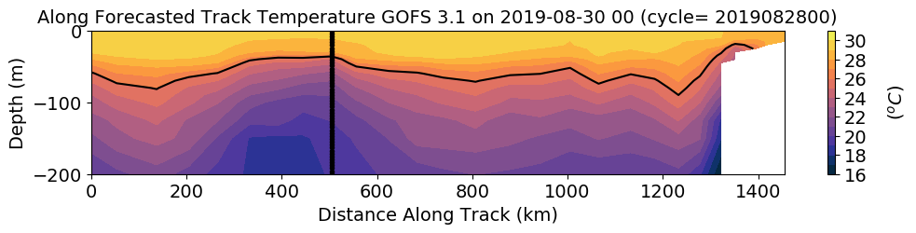
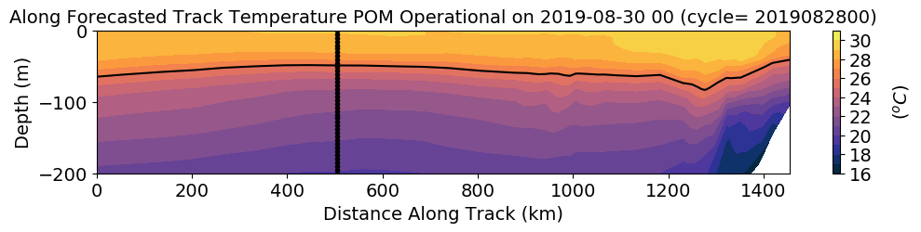
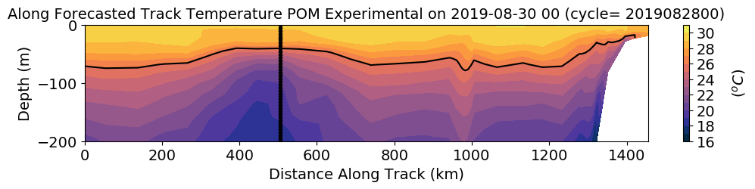
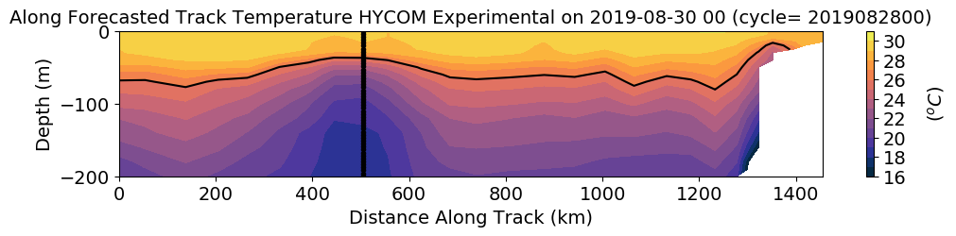
IC along forecasted Hurricane Dorian Track

Slide 16
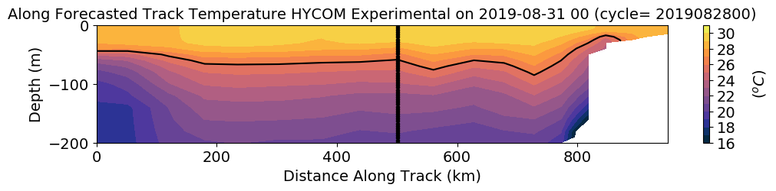
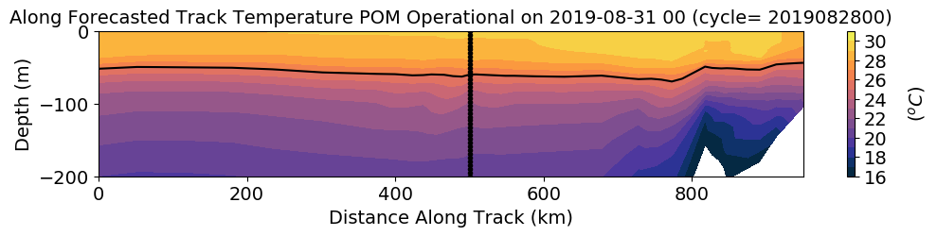
IC along forecasted Hurricane Dorian Track

Slide 17
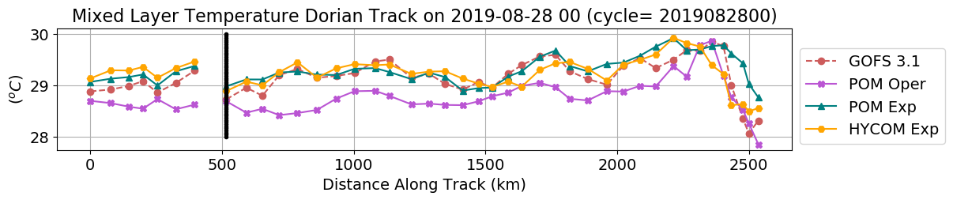
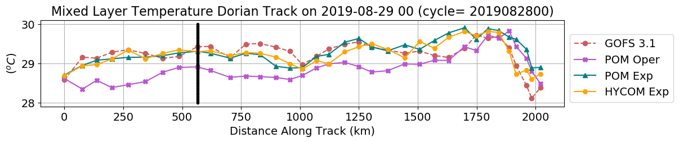
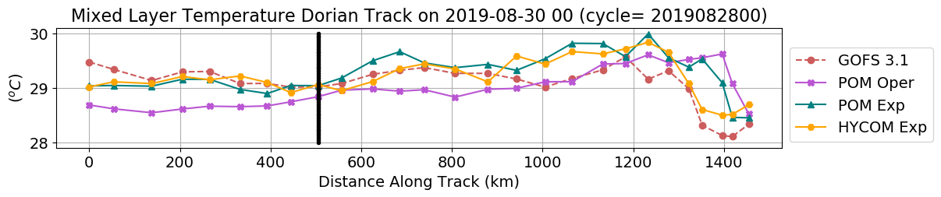
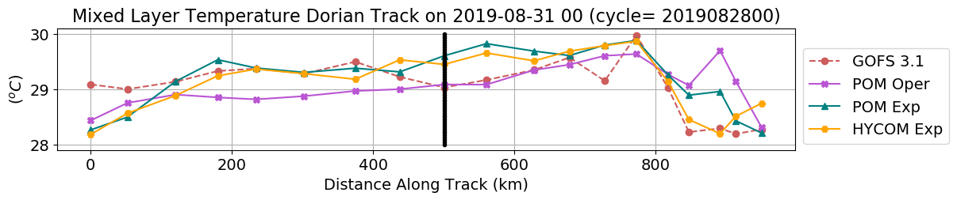

Slide 18
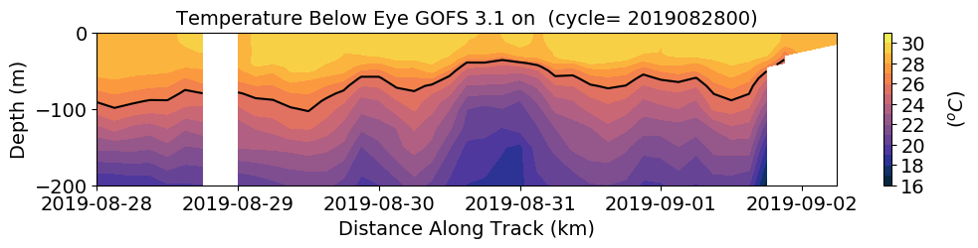
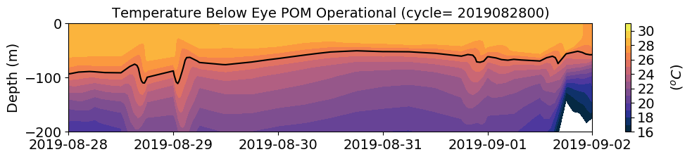
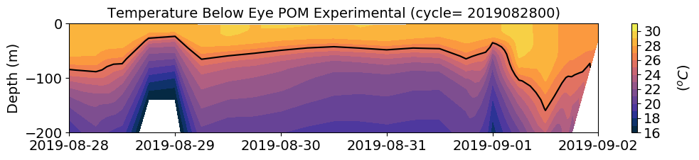
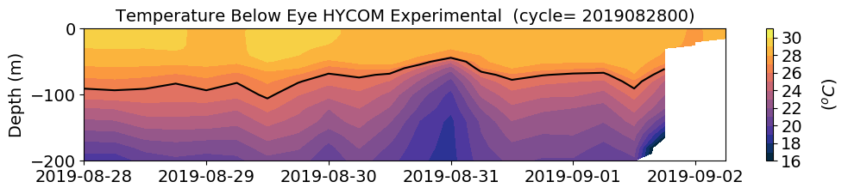
Temperature response following Dorian’s eye

Slide 19
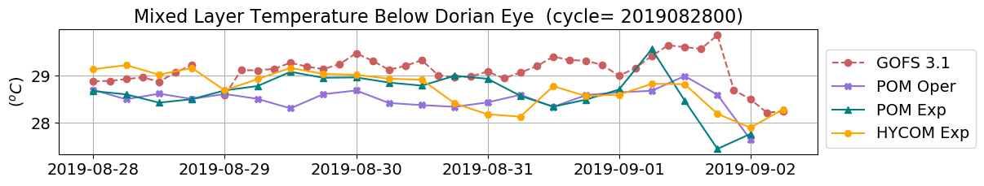
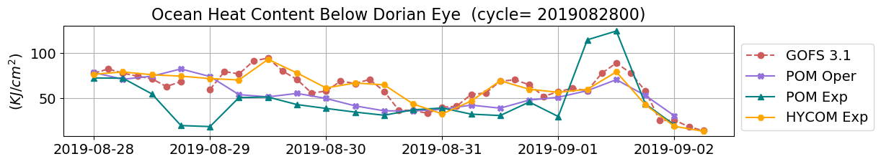
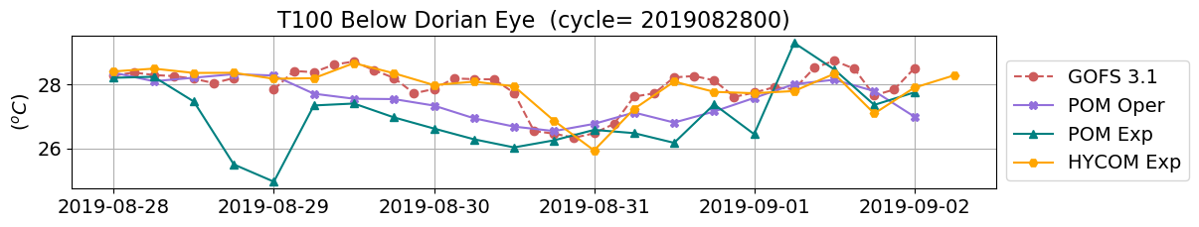
Temperature respond following Dorian’s eye

Slide 20
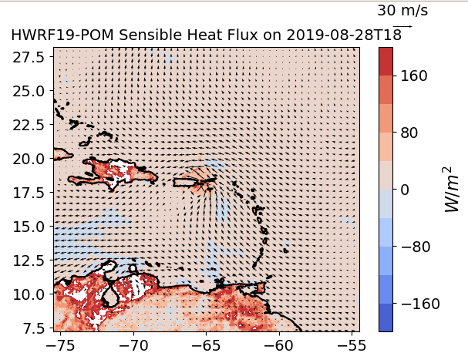
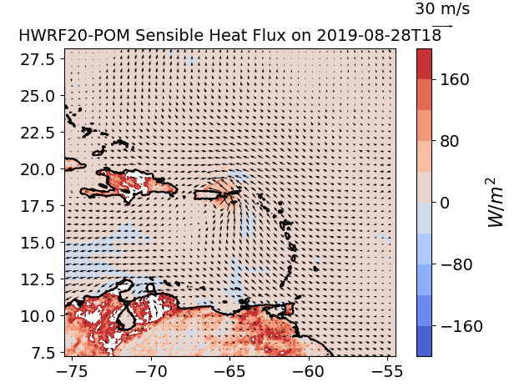
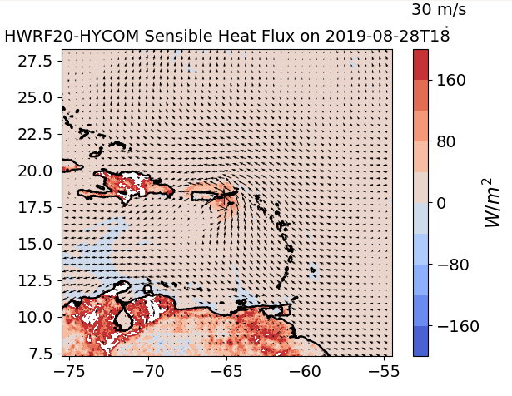
Sensible Heat Flux when Dorian
Was passing through the Glider Array

Slide 21
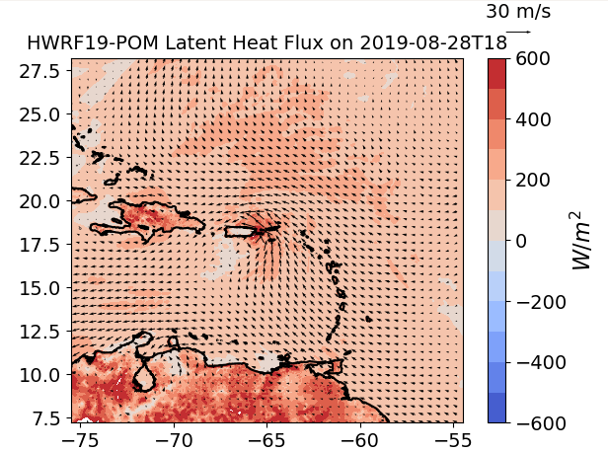
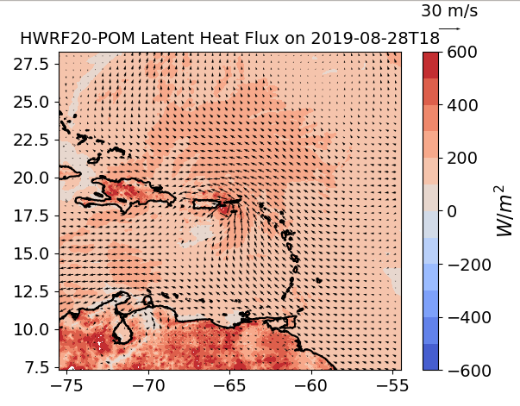
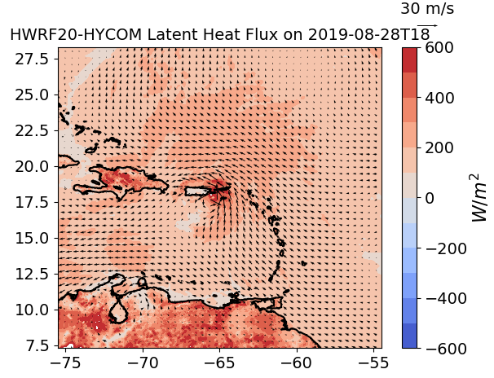
Latent Heat Flux when Dorian
Was passing through the Glider Array

Slide 22


SG665
Time series at this
location

Slide 23





SG666
Time series at this
location

Slide 24



SG668
Time series at this
location

Slide 25






RI
RI
RI
RI
RI
RI

Slide 26






RI
RI
RI
RI
RI
RI

Slide 27






RI
RI
RI
RI
RI

Slide 28


It does not include lead times of the
cycles after rapid intensification (RI)

Slide 29


It includes all part of the
Cycles after rapid intensification (RI)

Slide 31



Hurricane Dorian
Cycle 2019083018
Eddy

Slide 32




IC along forecasted Hurricane Dorian Track

Slide 33



IC along forecasted Hurricane Dorian Track

Slide 34




Temperature respond following Dorian’s eye

Slide 35



Temperature respond following Dorian’s eye

Slide 36

Heat Fluxes before and after Dorian
Passed at SG665 location

Slide 37


Heat Fluxes Bulk Formulas
Sensible
Latent

Slide 38
Sensible Heat Fluxes
D’Asaro 2002
When Dorian was passing the
Closest to ng665
Using heat flux calculations from bulk.m:
﻿ur = 36 m/s; zr = 10 m; Ta = 26.5 C; zt = 3 m; rh = 97%; zq = 3 m; Pa = 990 mb; Ts = 29 C;

Slide 39



NDBC 41043
NDBC 41043
﻿Uz2 = Uz1 (z2/z1)^(0.11)

Slide 40

Sensible Heat Fluxes
When Dorian was passing the
Closest to ng665
Using heat flux calculations from bulk.m:
﻿ur = 36 m/s; zr = 10 m; Ta = 26.22 C; zt = 3 m; rh = 97%; zq = 3 m; Pa = 990 mb; Ts = 29.15 C;

Slide 41




Cione at al. 2000
204 km ~ 1.83 º

Slide 42
Latent Heat Flux
D’Asaro 2002
Near the storm
center
When Dorian was passing the
Closest to ng665
Using heat flux calculations from bulk.m:
﻿ur = 36 m/s; zr = 10 m; Ta = 26.22 C; zt = 3 m; rh = 97%; zq = 3 m; Pa = 990 mb; Ts = 29.15 C;

Slide 43

Cycle 2019082800

Slide 45



Cycle 20190918

Slide 46



SG666
Using heat flux calculations from bulk.m:
﻿ur = 36.2 m/s; zr = 10 m; Ta = 28.08 C; zt = 3 m; rh = 97%; zq = 3 m; Pa = 990 mb; Ts = 29.21 C;

Slide 47


GOFS respond following Dorian’s eye (best track)

Slide 48

Cione at al. 2000

Slide 49


Potential Energy Anomaly

Slide 50


Potential Energy Anomaly

Slide 51




GOFS 3.1
Draw forecasted track
POM oper
HYCOM exp

Slide 52



POM Oper
POM Exp

Slide 53




GOFS

Slide 54




POM Operational

Slide 55




POM Experimental
140

Slide 56




HWRF-HYCOM

Slide 57




POM Experimental

