Slide 1
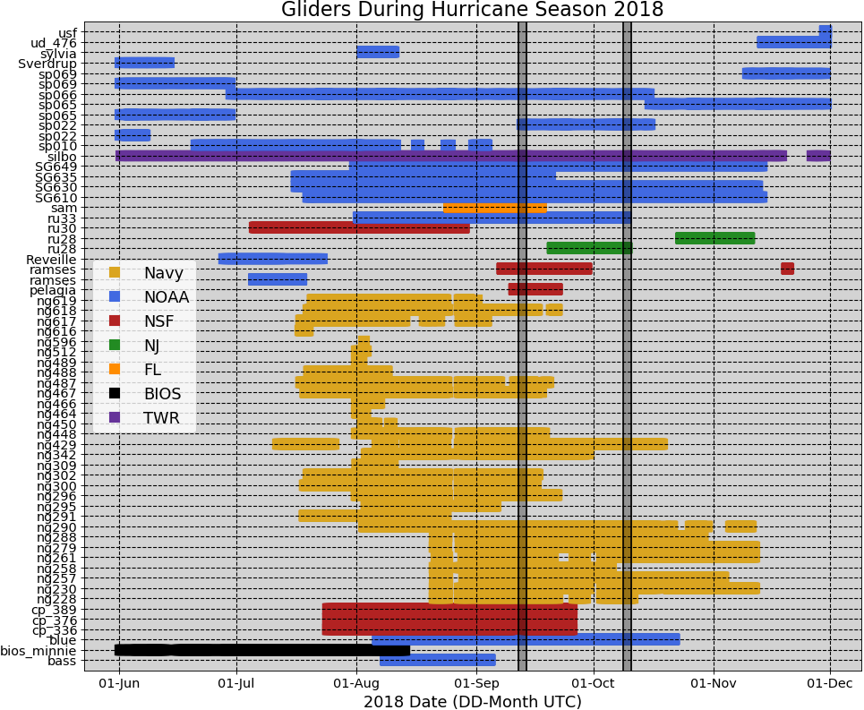
Gliders in IOOS Glider DAC during Hurricane Season 2018

Slide 2
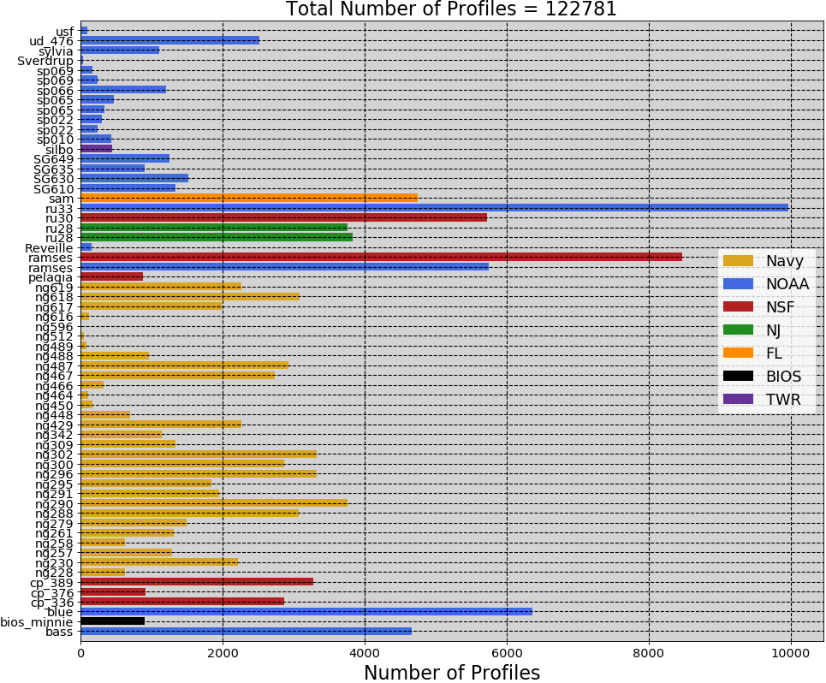

Slide 3
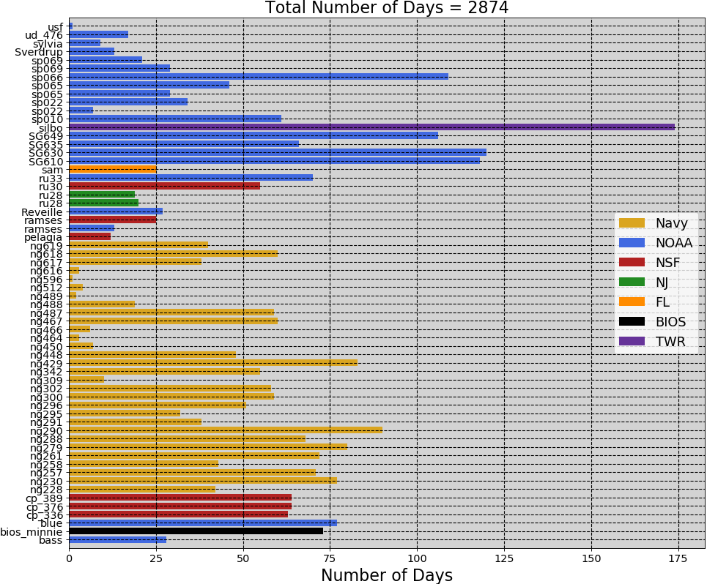

Slide 4
