Slide 1
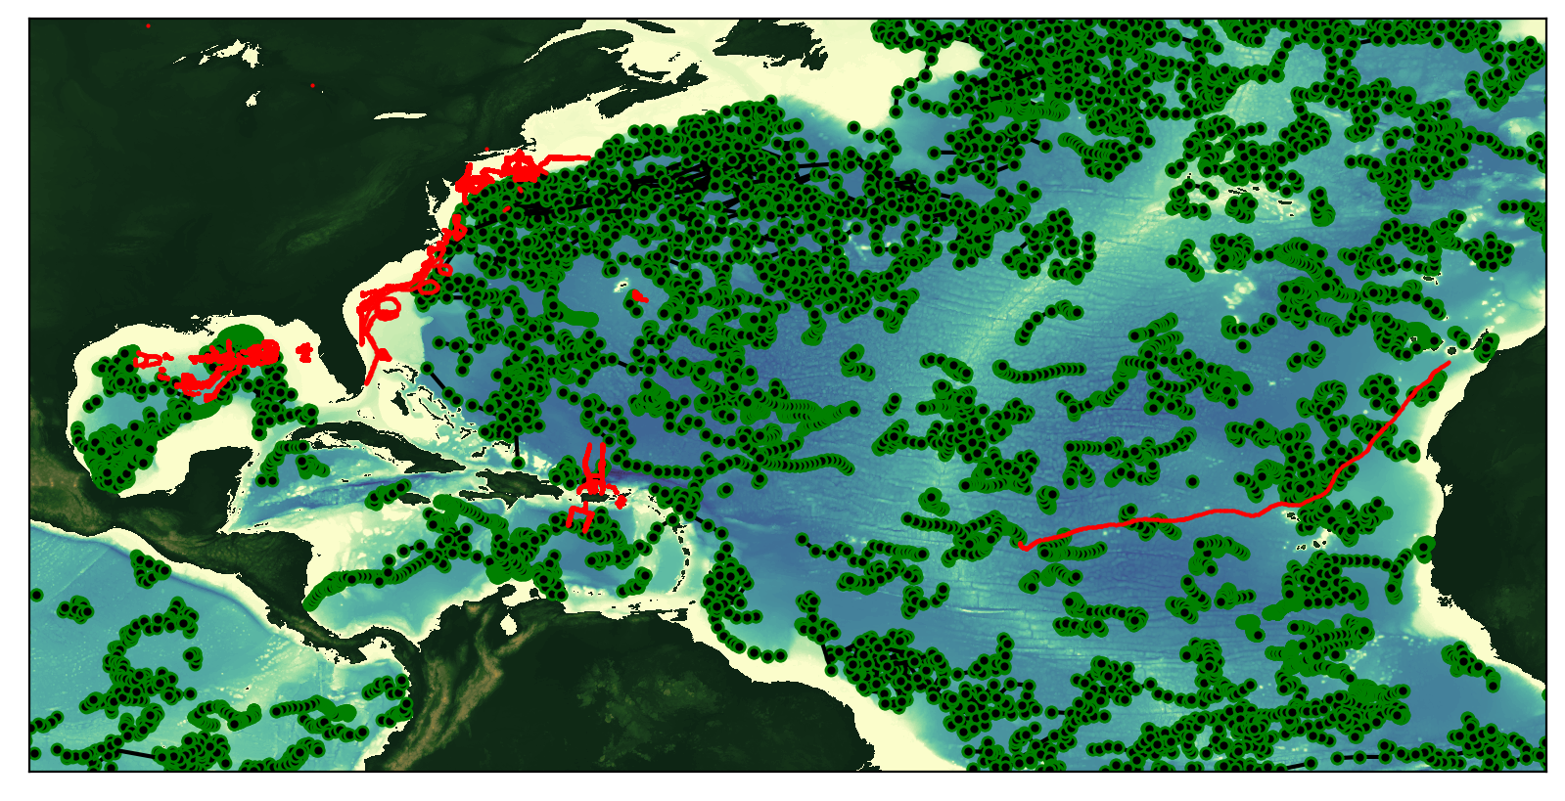
Glider Tracks and ARGO Floats
During the 2018 Hurricane Season
Total number of glider profiles = 123335
Total number of Argo profiles = 17264

Slide 2
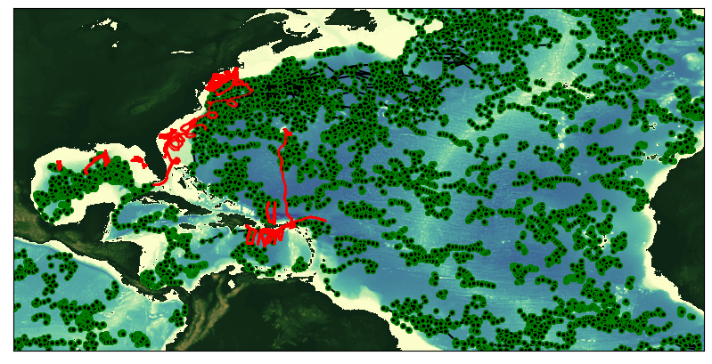
Glider Tracks and ARGO Floats
During the 2019 Hurricane Season
Total number of glider profiles = 103511
Total number of Argo profiles = 13164

Slide 3
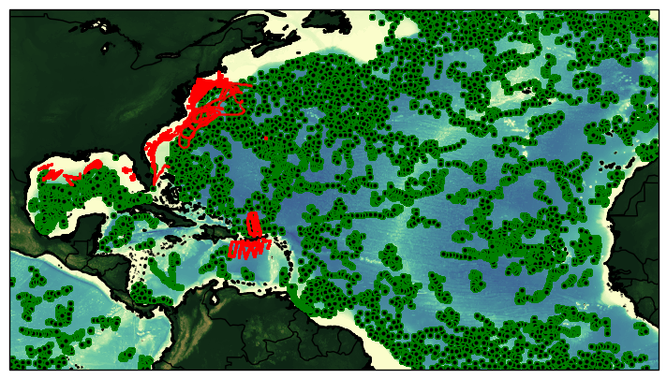
Glider Tracks and ARGO Floats
During the 2020 Hurricane Season
Total number of glider profiles = 183377
Total number of Argo profiles = 9025

Slide 4
