Slide 1
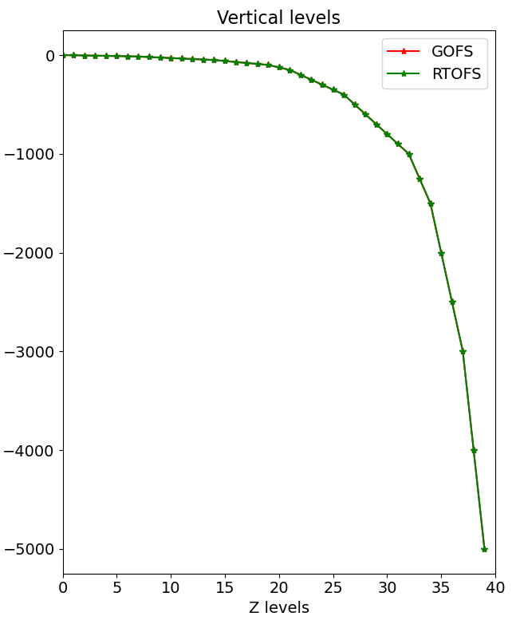
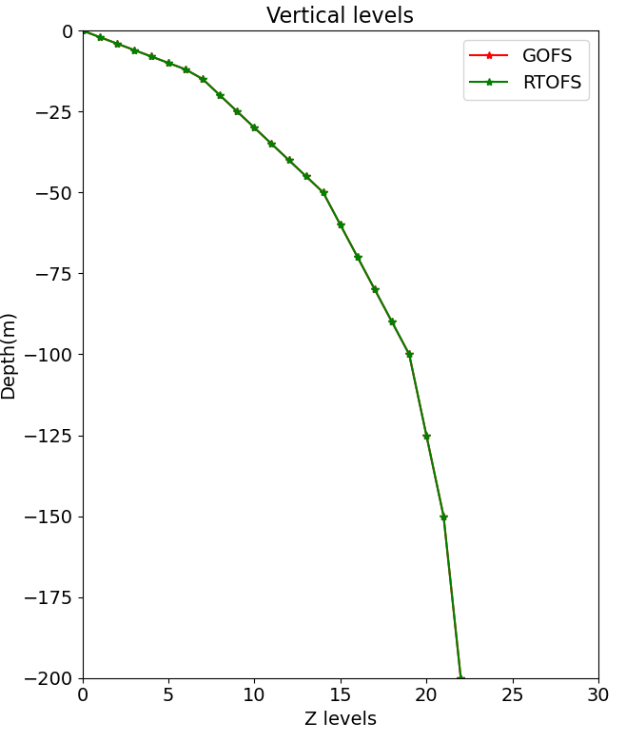
Fixed Z-leves (no native vertical grid!)

Slide 2
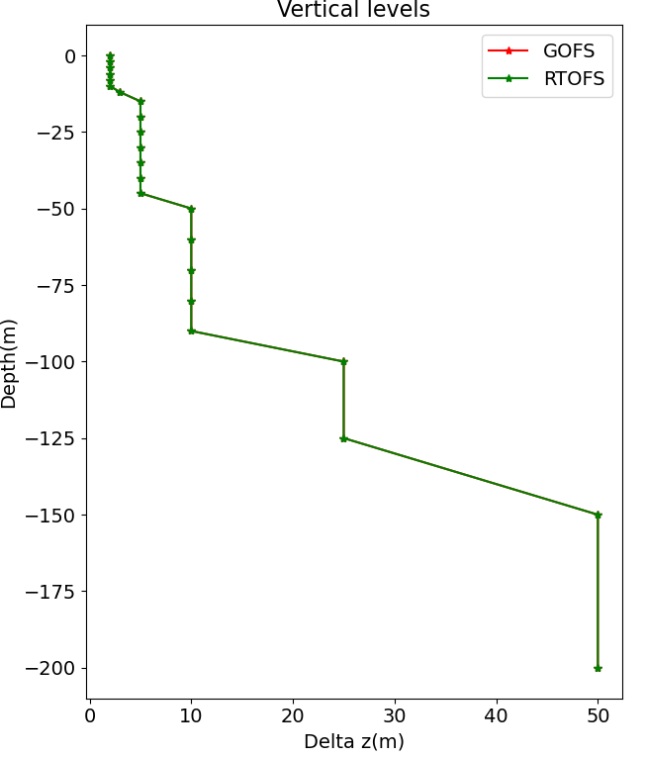

Slide 3
GOFS 3.1
GOFS 3.1 has 41 layers in the vertical. Most of the original 32 layers are retained, with the additional 9 layers all located near the surface such that at least the top 14 layers are always sigma-z levels so that water shallower than 84 m is always in fixed depth coordinates
The “sigma-z” setup has also been modified such that the top layer is 1 m thick everywhere as this simplifies layer 1 temperature's association with SST
NRL runs archv2ncdf3z on the resulting file using the “NAVO” (NetCDF) output type (interpolated to 40 standard levels). Only five fields are provided: SSH, zonal velocity, meridional velocity, temperature, and salinity
Note: I realized today that they do provide the native ab HYCOM files.

Slide 4
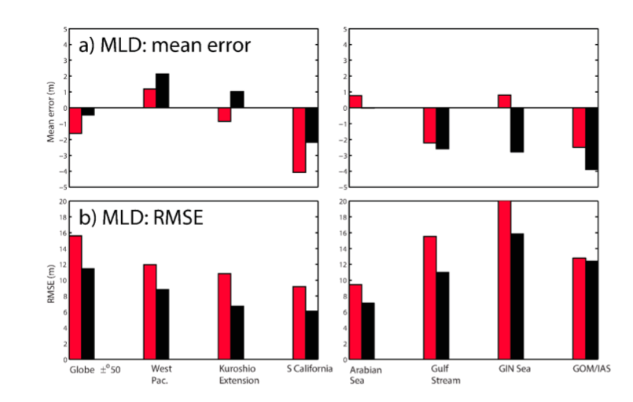
GOFS 3.1 under estimates MLD
Model - obs ?

Slide 5
