Slide 1
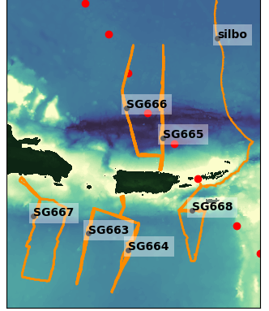
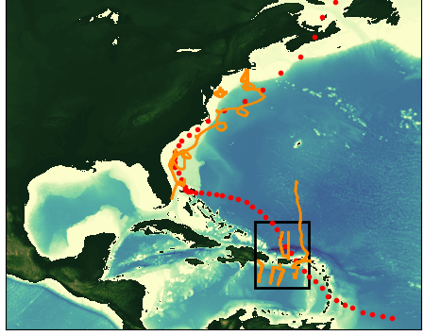
Hurricane Dorian
Gliders Deployed Aug 20th to Sep 7th 2019
Dorian
Aug 20 – Sep 07
Notes:
On August 29, Tropical Storm Dorian passed over three gliders: SG665, SG666 and SG668 in the Caribbean glider array, before moving on to catastrophically impact the Bahamas and portions of the southeastern US.

Slide 2
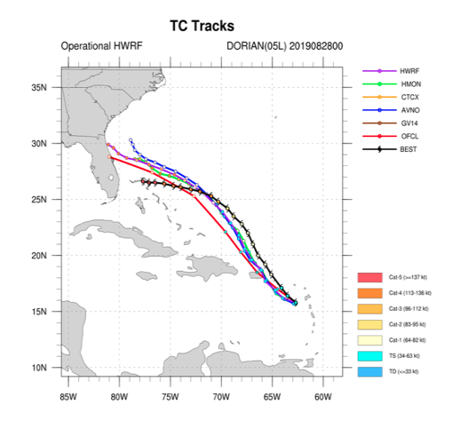
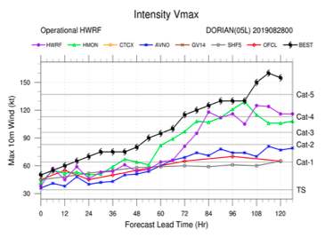
Dorian Forecast
Cycle 2019/08/28/00
Dorian transitions from tropical storm to cat 1 hurricane
Dorian passes over the glider array

Slide 3
Dorian Forecast
Cycle 2019/08/28/00
Dorian transitions from tropical storm to cat 1 hurricane
Dorian passes over the glider array

Slide 4
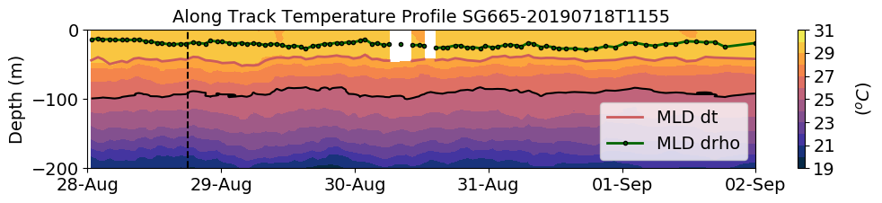
SG665 Temperature
Dorian

Slide 5
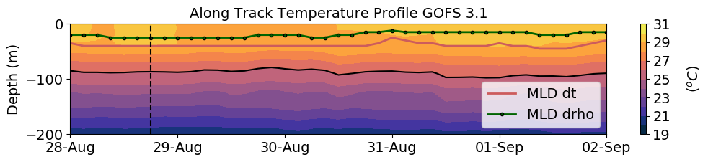
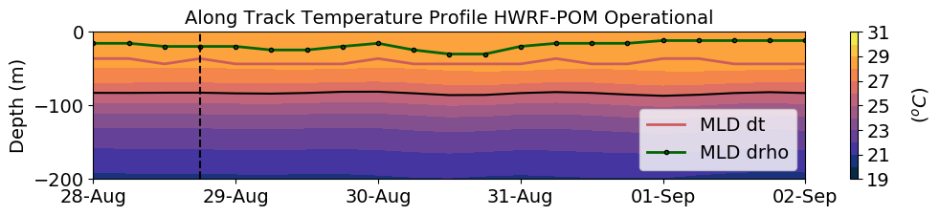
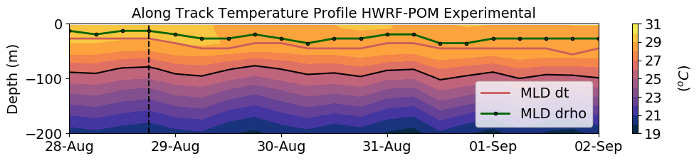
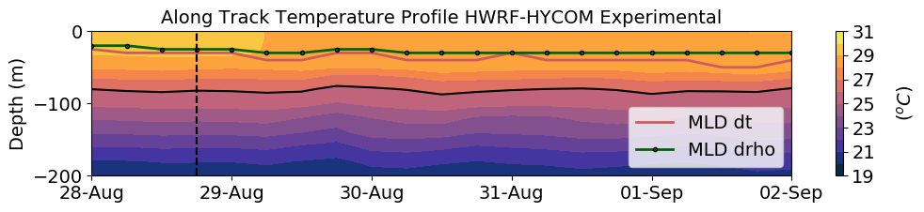
SG665 Temperature
Dorian

Slide 6
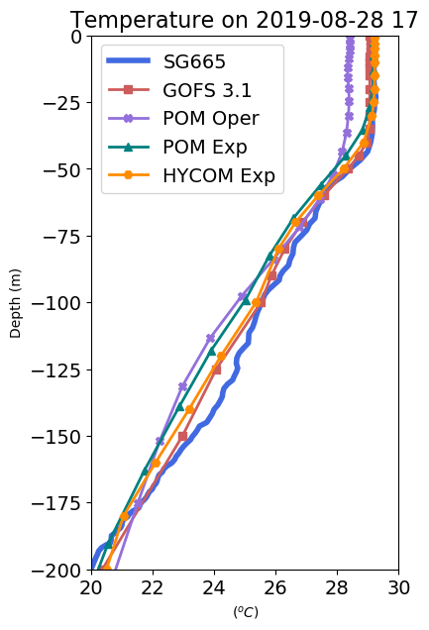
SG665 Temperature
Dorian

Slide 7
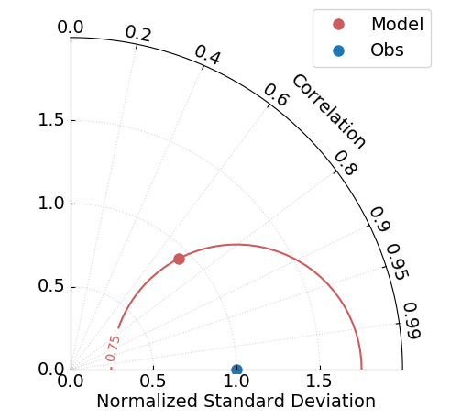
Normalized Taylor Diagram
Accurate model

Slide 8
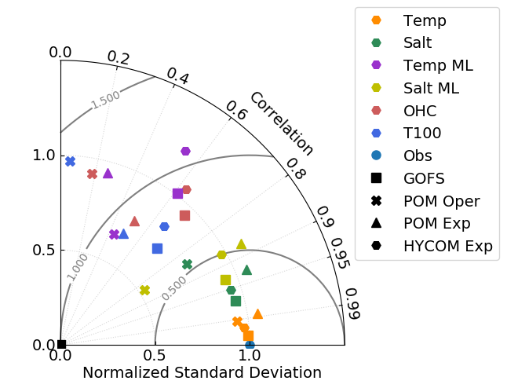
How are the models performing?
Normalized Taylor Diagrams all SG
OHC
Temp ML
Salt ML
T100
Salt
Temp
Number of data points used in the statistics
 | Temp and salt | Temp ML, Salt ML, OHC, T100, T100_to_ml
NGOFS | 6824 | 246
NPOM | 2820 | 118
NHYCOM | 3141 | 122

Slide 9
Bias = mean obs – mean models
 | GOFS | POM Oper | POM Exp | HYCOM Exp
Temp | 0.084 | 0.41 | 0.44 | 0.053
Salt | 0.0086 | -0.0015 | -0.070 | 0.0045
T ML | 0.11 | 0.88 | 0.28 | 0.19
S ML | -0.051 | -0.41 | -0.066 | -0.20
OHC | 3.06 x 10⁷ | 1.86 x 10⁸ | 1.46 x 10⁸ | 7.38 x 10⁷
T100 | -0.40 | 0.13 | 0.14 | -0.35

Slide 10
How are the models performing?
-Bias *100% / mean obs
 | GOFS | POM Oper | POM Exp | HYCOM Exp
T ML | -0.40% | -3.0% | -0.94% | -0.62%
OHC | -3.6% | -22% | -17% | -8.7%
T100 | 1.4% | -0.46% | 0.49% | 1.2%
Models are colder in the mixed layer
Models have a deficit of in OHC
POM Oper:
warmer SST due to vertical mixing
GOFS, POM Exp and HYCOM:
colder SST due to vertical mixing

Slide 11
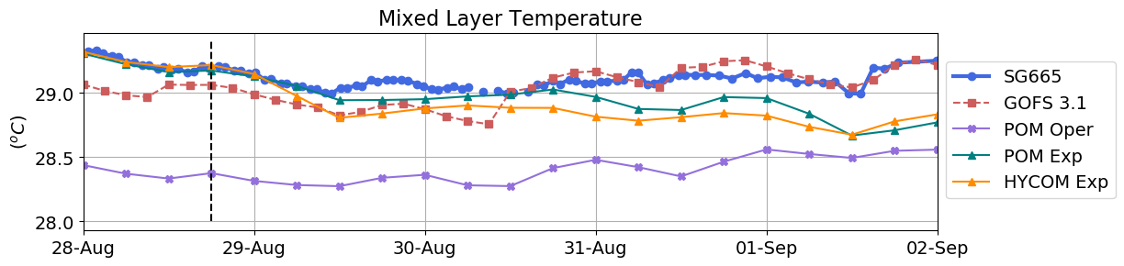
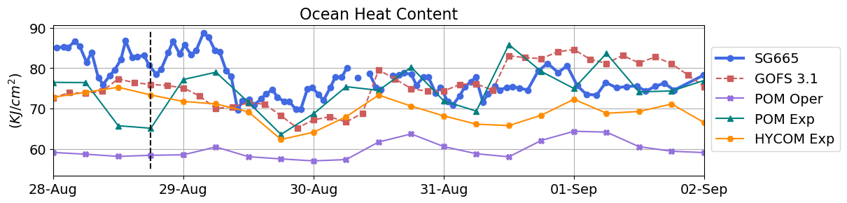
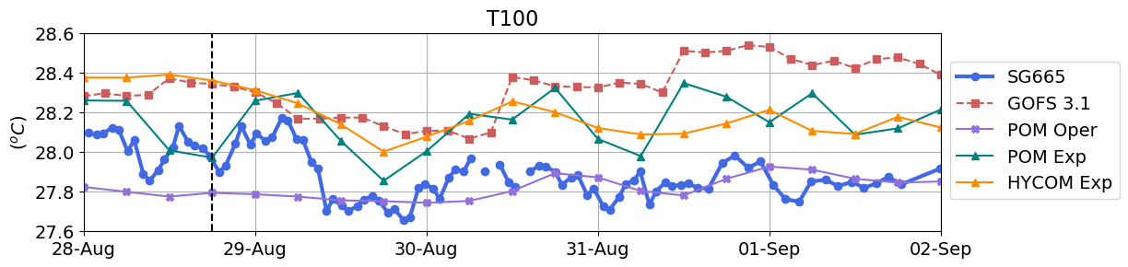
Ocean Heat Content

Slide 12
How are the models performing?
Normalized Taylor Diagrams all SG
POM
Oper
POM
Exp
HYCOM
Exp
GOFS

