Slide 1
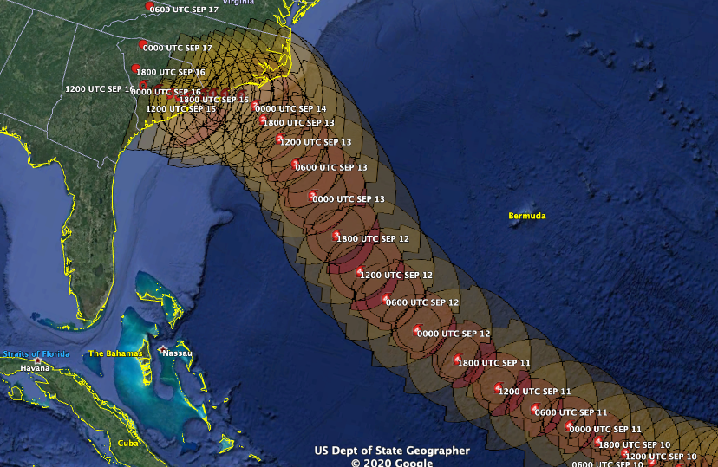
Hurricane Florence Best Track

Slide 2
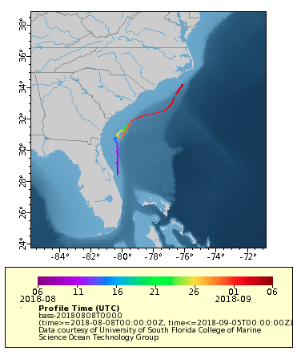
Bass-20180808

Slide 3
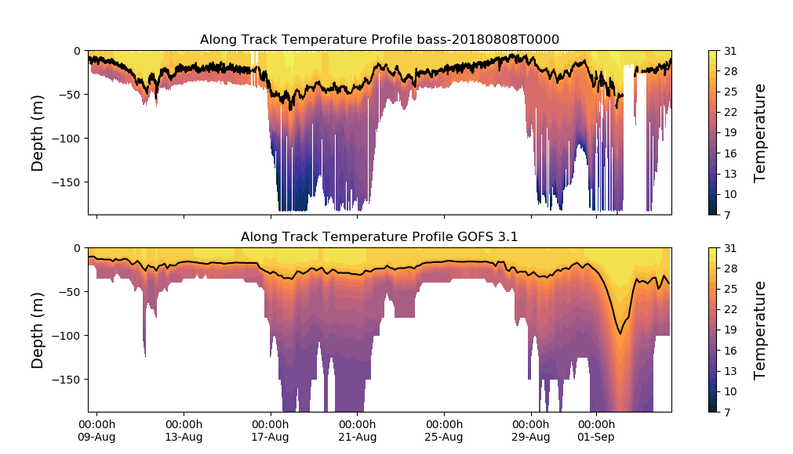
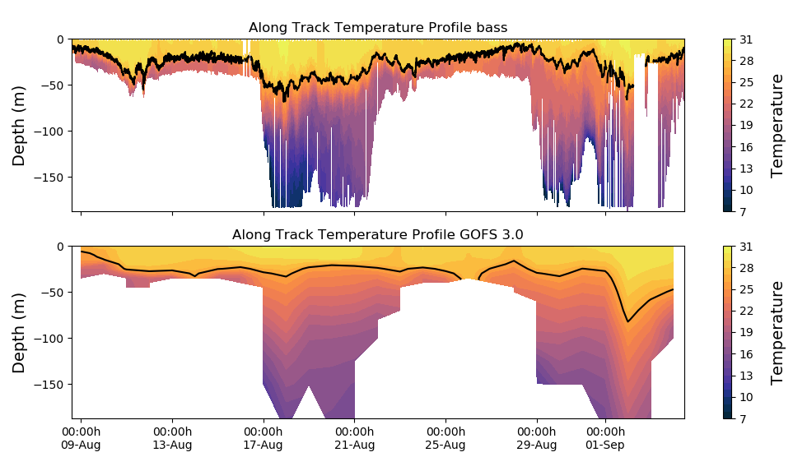

Slide 4
Temperature Increments from GOFS 3.1/NCODA
on Sep. 11/2018

Slide 5
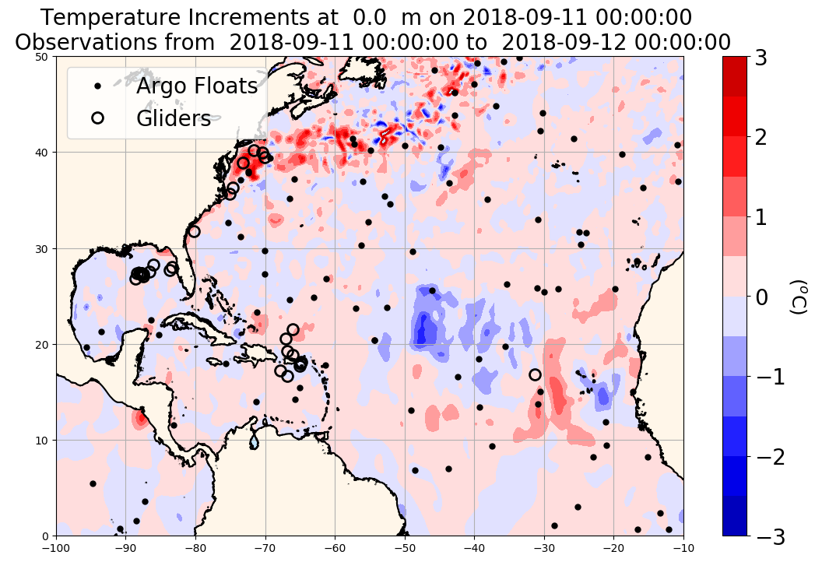
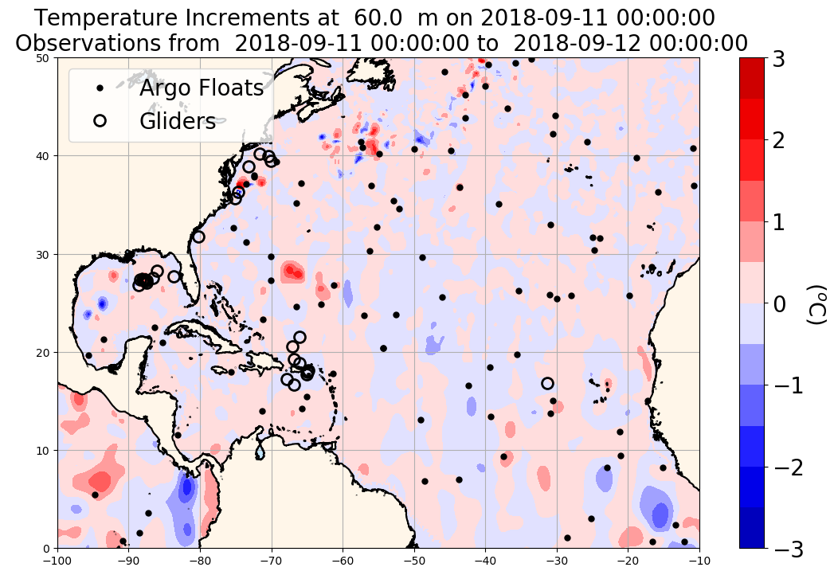
Temperature increments from NCODA (provided by Pat Hogan) on 2018-09-11 at 0 m (top left figure) and at 60 m (top right figure)
Black dots: position of Argo floats profiles on 2018-09-11
Open black circles: mean position of glider tracks on 2018-09-11

Slide 6
