Slide 1
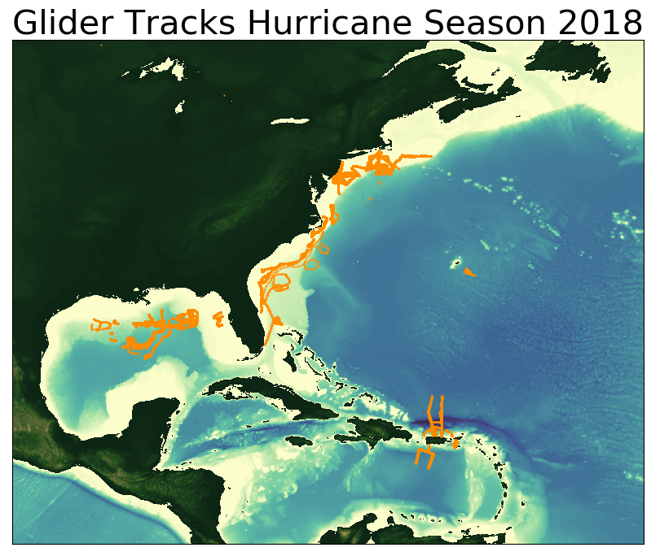
Glider Data assimilation in operational ocean models
Glider Data
IOOS Glider DAC
GTS
Operational Ocean Models
GOFS
RTOFS-DA
Copernicus
DOPPIO
AmSeas

Slide 2
Global Ocean Forecasting System (GOFS)
Navy Coupled Ocean Data Assimilation System (NCODA)
Surface Data
Subsurface Temperature and Salinity
Satellite SST
Drifting buoys
Fixed buoys
Argo Floats
In Situ SST
GOFS/NCODA
Gliders
TESAC
Satellite Altimeter
XBTs (only temp.)
Notes:
The GOFS/NCODA system assimilates a wide variety of observations. At the surface the system assimilates satellite SST, in situ SST and satellite altimeter. It also assimilates subsurface temperature and salinity from different sources: …… temperature, salinity and current report from a sea station…..

Slide 3
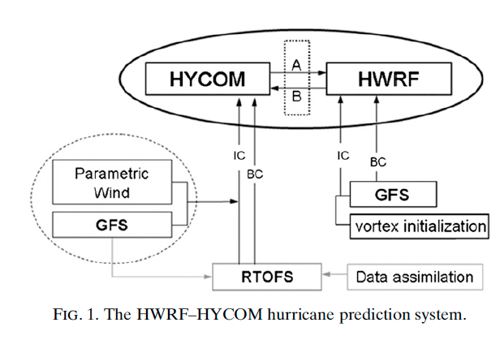
Hurricane Coupled Ocean-Atmosphere
Forecasting Model: HWRF-HYCOM System
IC
IC
Kim et al. 2014
GOFS/NCODA
RTOFS – Real Time Ocean Forecasting System
GFS – Global Forecasting System
Notes:
This is a schematic of the workflow for the HWRF/HYCOM system. The right side shows the atmospheric component and the left side is the oceanic component. The IC and BC for the regional HYCOM come from the global RTOFS, that is the NOAA operational ocean model. At the same time, the IC for the global RTOFS comes from Global Ocean Forecasting System GOFS that is the Navy operational ocean model and implements data assimilation though NCODA that is the Navy coupled ocean data assimilations system. So in its current state, the NOAA hurricane forecasting models incorporates ocean data assimilation through the IC to their own global ocean model. NCEP is currently working to implement data assimilation directly into RTOFS.

Slide 4
Hurricane Coupled Ocean-Atmosphere
Forecasting Model: HWRF-HYCOM System
IC
RTOFS/DA
IC
Kim et al. 2014
GOFS/NCODA
RTOFS – Real Time Ocean Forecasting System
GFS – Global Forecasting System
Notes:
This is a schematic of the workflow for the HWRF/HYCOM system. The right side shows the atmospheric component and the left side is the oceanic component. The IC and BC for the regional HYCOM come from the global RTOFS, that is the NOAA operational ocean model. At the same time, the IC for the global RTOFS comes from Global Ocean Forecasting System GOFS that is the Navy operational ocean model and implements data assimilation though NCODA that is the Navy coupled ocean data assimilations system. So in its current state, the NOAA hurricane forecasting models incorporates ocean data assimilation through the IC to their own global ocean model. NCEP is currently working to implement data assimilation directly into RTOFS.

Slide 5
Hurricane Coupled Ocean-Atmosphere
Forecasting Model: HWRF-HYCOM System
IC
IC
Kim et al. 2014
GOFS/NCODA
RTOFS – Real Time Ocean Forecasting System
GFS – Global Forecasting System
Notes:
This is a schematic of the workflow for the HWRF/HYCOM system. The right side shows the atmospheric component and the left side is the oceanic component. The IC and BC for the regional HYCOM come from the global RTOFS, that is the NOAA operational ocean model. At the same time, the IC for the global RTOFS comes from Global Ocean Forecasting System GOFS that is the Navy operational ocean model and implements data assimilation though NCODA that is the Navy coupled ocean data assimilations system. So in its current state, the NOAA hurricane forecasting models incorporates ocean data assimilation through the IC to their own global ocean model. NCEP is currently working to implement data assimilation directly into RTOFS.

Slide 6
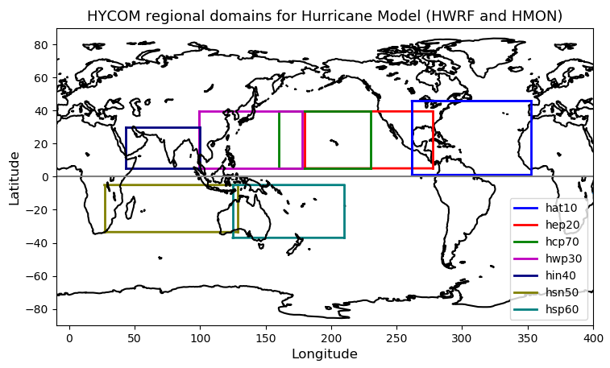
NOAA Hurricane Forecasting Models
HWRF/HYCOM
HMON/HYCOM
HWRF/POM
West
Pacific
Central
Pacific
East
Pacific
North
Atlantic
North
Indian
South
Indian
South
Pacific
HWRF – Hurricane Weather Research Forecasting Model
HYCOM – Hybrid Coordinate Ocean Model
HMON - Hurricanes in a Multi-scale Ocean-coupled Non- hydrostatic model
POM – Princeton Ocean Model
Notes:
Currently NOAA has there different coupled ocean-atmosphere hurricane models that operate in different regions. In the North Atlantic there are two model: the HMON/HYCOM and the HWRF/POM.

Slide 7
NOAA Hurricane Forecasting Models
HWRF/HYCOM
HMON/HYCOM
HWRF/POM
West/South Pacific, South/North Indian Ocean
North Atlantic,
East/Central Pacific
North
Atlantic
East/Central
Pacific
IC come from climatology and the POM (w/ feature model only in the GoM)
IC and BC from
Global RTOFS spun up from the global
GOFS 3.1/NCODA
IC from Global RTOFS nowcast

Slide 8
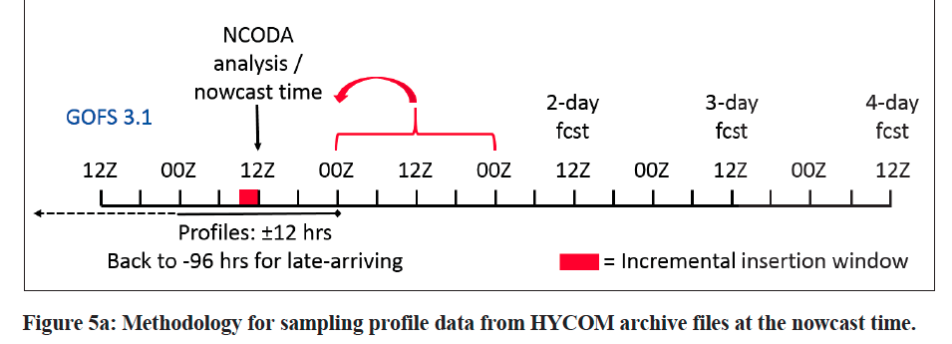
Time of NCODA increments ?
FGAT: First Guess at Appropriate Time

Slide 9
Work Flow HMON/HYCOM and HWRF/HYCOM
Global GOFS 3.1/NCODA System
Nowcast
7-day frcst
0Z
12Z
0Z
Nowcast
1-day frcst
7-day frcst
0Z
12Z
0Z
0Z
0Z
12Z
0Z
0Z
0Z
Nowcast
1-day frcst
2-day frcst
7-day frcst
0Z
12Z
0Z
0Z
0Z
Global
RTOFS
NCODA Incremental Insertion Window

Slide 10
Hurricane Michael
Increments
Insertion Window
Increments
Insertion Window
Increments
Insertion Window
The assimilation of glider data days ahead of Michael corrected
the position of the thermocline
Notes:
This is the temperature transect from ng288 and we also have the temperature transect form the GOFS 3.1 following ng288 glider track. When we look back 5 days before the passage of Michael, we observe that in GOFS 3.1 after every increment insertion window, the thermocline is pulled down to match the depth of the thermocline from the glider data until it settles down at the right depth. This highlights the importance of having a continuous glider presence so when a storm strikes, the model ocean has a most realistic vertical stratification.

Slide 11
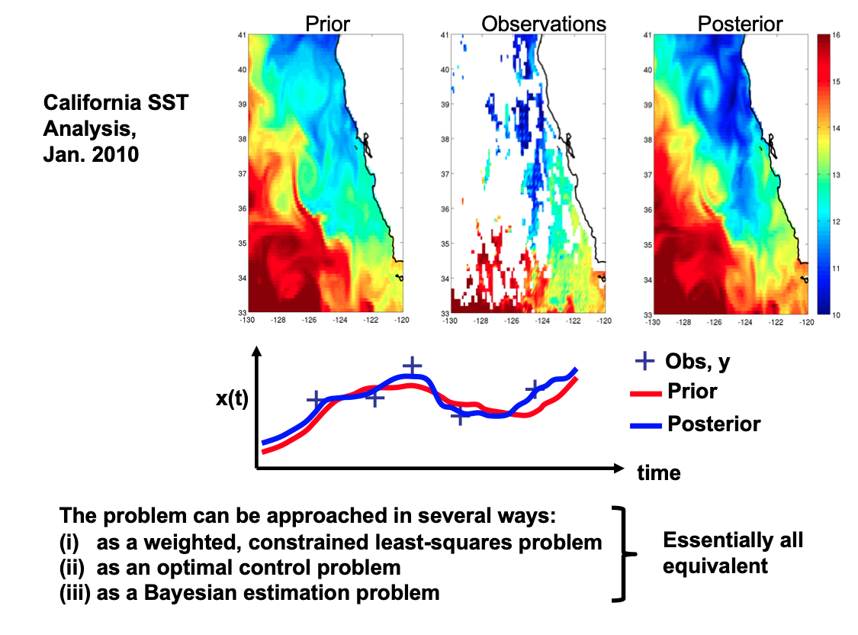
From 4D-Var workshop Aug. 2019, Andy Moore

Slide 12
From John Wilkin
Basic 4D-Var procedure
x_{b} = model state (background) at end of previous cycle, and 1st guess for the next forecast
In 4D-Var assimilation the adjoint gives the sensitivity of the initial conditions to mis-match between model and data
A descent algorithm uses this sensitivity to iteratively update the initial conditions, x_{a}=x_{b}(0)+dx (analysis), to minimize J = J_{o+} J_{b}
◆
new solution with modified initial conditions
model-data misfit
◆
◆
x_{b}
previous forecast
x_{b}(0)+δx
◆
observations
0 1 2 3 4 time
Observations minus previous forecast (weighted)
Adjoint model integration is forced by the model-data error

Slide 13
The best fit becomes the analysis
assimilation window
◆
◆
◆
◆
t_{i} = analysis initial time
t_{f} = analysis final time
The strong constraint requires the trajectory satisfies the physics in ROMS. The Adjoint enforces the consistency among state variables.

Slide 14
The best fit becomes the analysis
The final analysis becomes initial conditions for the forecast
assimilation window
forecast
◆
◆
◆
◆
t_{i} = analysis initial time
t_{f} = analysis final time
The strong constraint requires the trajectory satisfies the physics in ROMS. The Adjoint enforces the consistency among state variables.

Slide 15
The best fit becomes the analysis
The final analysis becomes initial conditions for the forecast
Forecast verification can be w.r.t. data not yet assimilated
assimilation window
forecast
verification
◆
◆
◆
◆
◆
◆
◆
◆
t_{i} = analysis initial time
t_{f} = analysis final time
The strong constraint requires the trajectory satisfies the physics in ROMS. The Adjoint enforces the consistency among state variables.

Slide 16
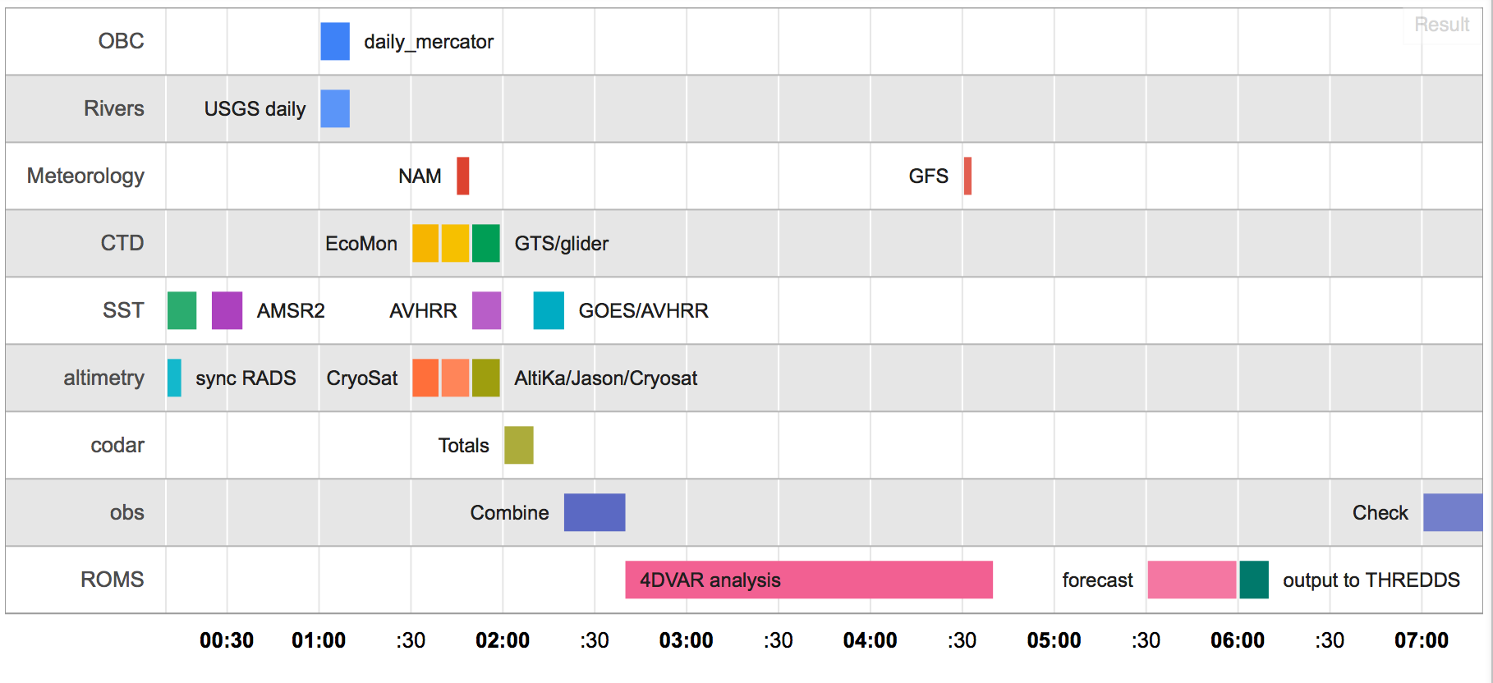
Data pre-processing flow for MARACOOS ROMS 4DVar
Scripts run daily (cron jobs) and use Matlab, Python, perl and NCO tools
All times New York local (U.S. EST)
From 4D-Var workshop Aug. 2019, John Wilkin

