Slide 1
Evaluation of Initial Conditions
Cycle 2019/08/28/00

Slide 2
SG665 vs Models
Dorian
Operational
Experimental

Slide 3
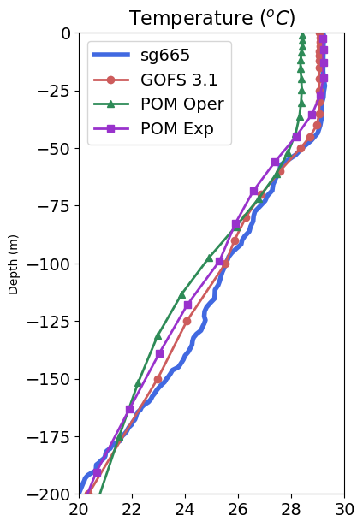
SG665 vs Models
Dorian
Operational
Experimental

Slide 4
SG665 vs Models

Slide 5
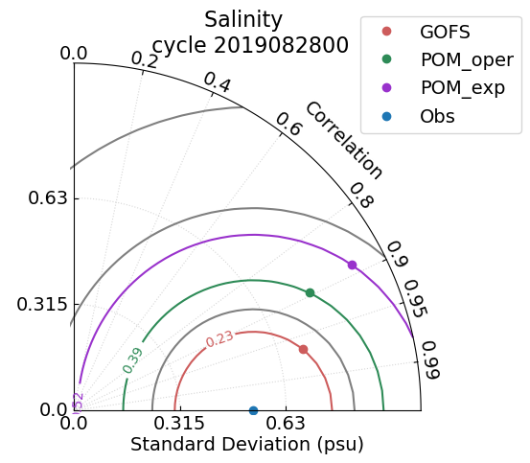
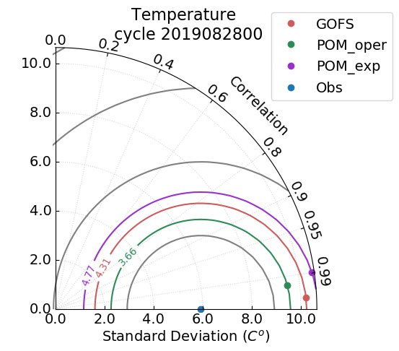
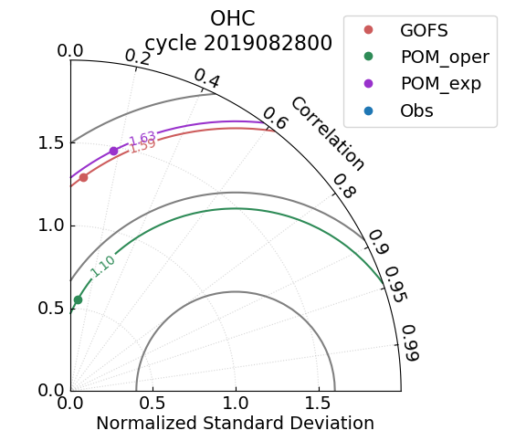
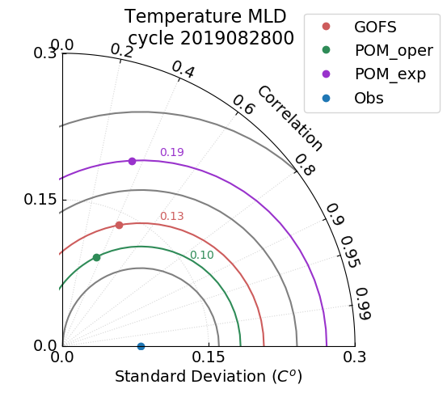
How are the models performing?
Taylor Diagrams

Slide 6
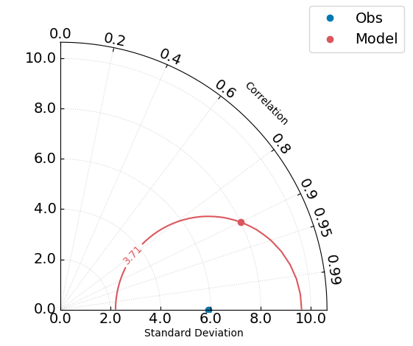
Taylor Diagram
Observations
Model

Slide 7
Taylor Diagram
r = 0.9
Model
Observations
r = 0.1
Model
Observations

Slide 8
Taylor Diagram
Model
Observations
Accurate model

Slide 9
How are the models performing?
Taylor Diagrams

Slide 10
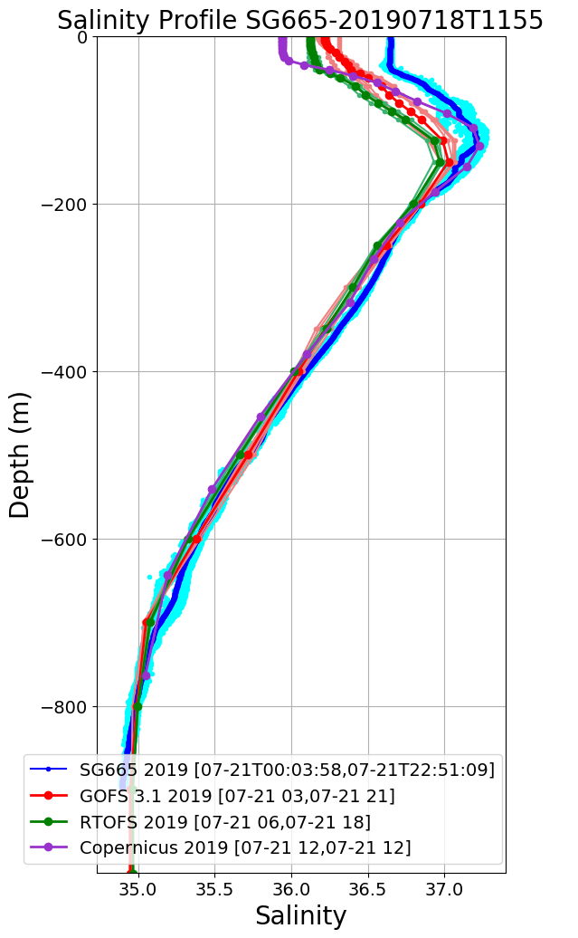
SG665 Salinity at Deployment
Large Salinity offset surface to 160 m
Jul 19
Jul 20
Jul 21
Jul 22
Salinity Progressively Improves over 1 week period
Jul 23
Jul 24
Jul 25
Jul 27

Slide 11
SG665 Salinity at Deployment
Jul 19
Jul 27

