Slide 1
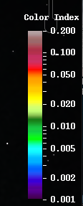
MODIS Color Index
Aug 25 /2019 17:50 GMT
MODIS Color Index
Aug 30 /2019 18:10 GMT
MODIS Color Index derived from reflectance data after correction for gaseous absorption, molecular scattering, and sun glint effects. It is basically the reflectance at 555 nm, referenced against linear baseline between 469 and 645 nm (Hu, 2011). CI has the advantage over the “standard” NASA chlor_a or other products because it is nearly immune to sun glint contamination, and therefore increases the data coverage for subtropical and tropical oceans. This is particular useful for cruise planning and for feature tracking. The MODIS standard product MOD35 (Ackerman et al., 2010) is used to discriminate clouds from water, and a cloudmask (grey color) is overlaid on the image.
However Doxaran et al. (2009) demonstrated that this product can be appropriate for monitoring reflective turbid waters,
The strongest turbidity signal is observed at 555 nm (nLw555), as previously reported for other locations (e.g. Nezlin and DiGiacomo, 2005, Nezlin et al., 2005, Thomas and Weatherbee, 2006).

Slide 2
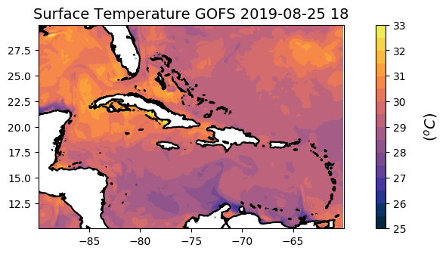
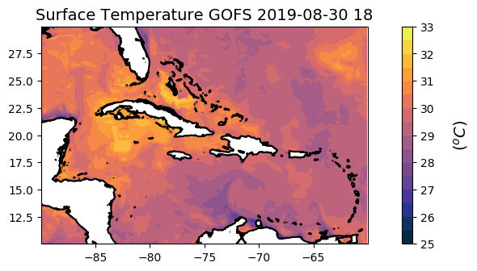
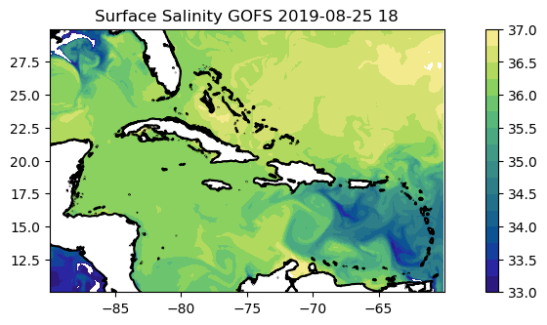
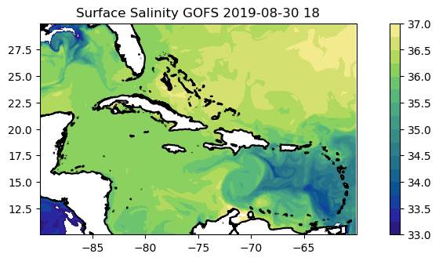

Slide 3
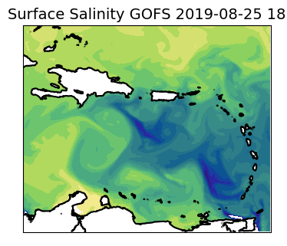
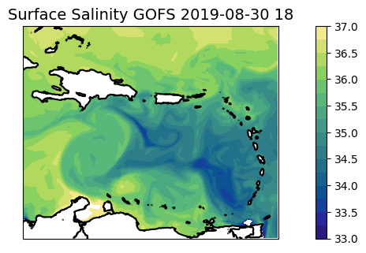
MODIS Color Index
Aug 25 /2019 17:50 GMT
MODIS Color Index
Aug 30 /2019 18:10 GMT

Slide 4
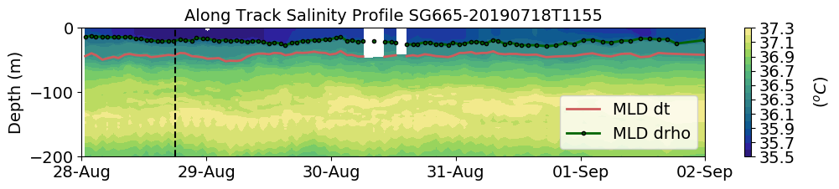
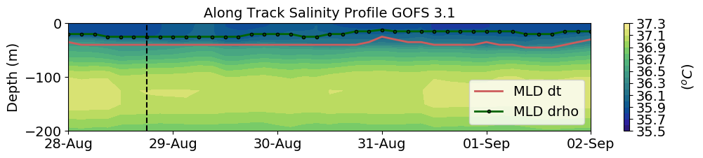
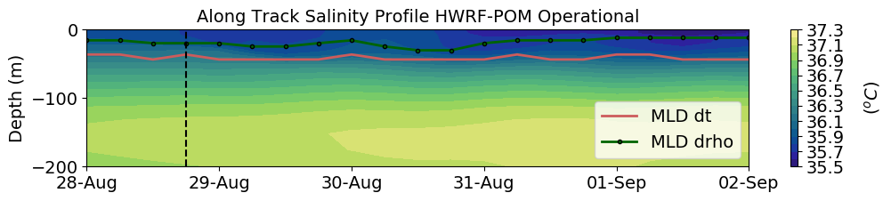
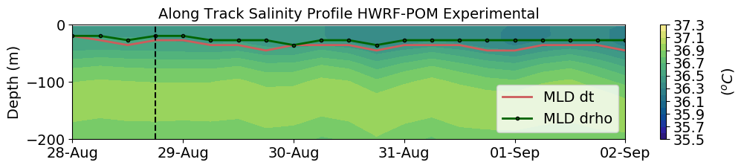
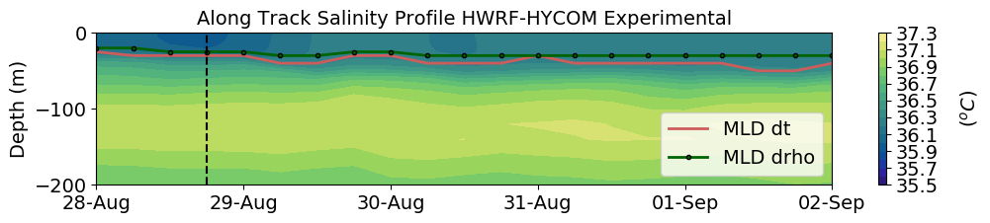
Inside Area of Fresh Water Influence
Dorian
(a)
Observations
(b)
Data Assimilative Model
(c)
Forecast
(d)
Forecast
(e)
Forecast

Slide 5
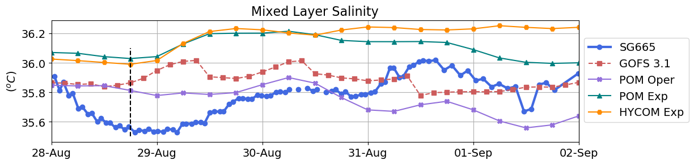
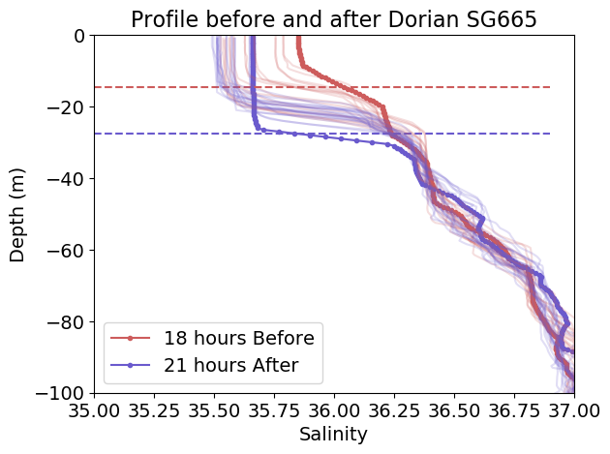
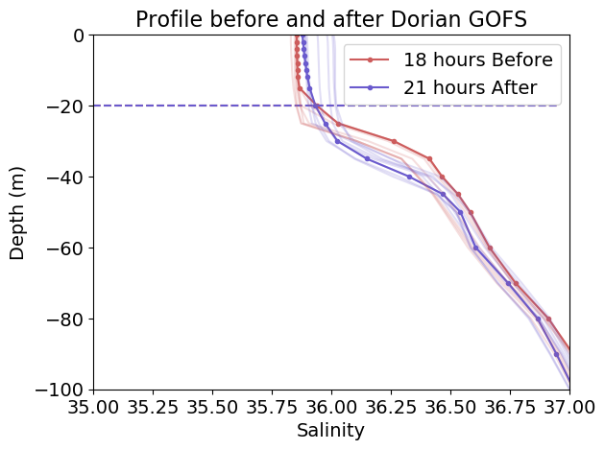
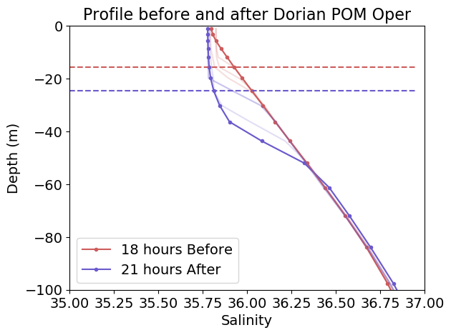
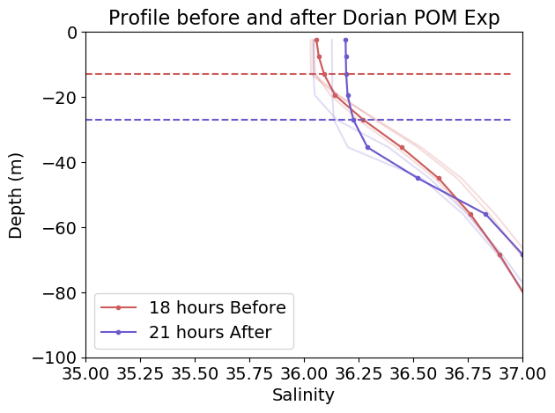
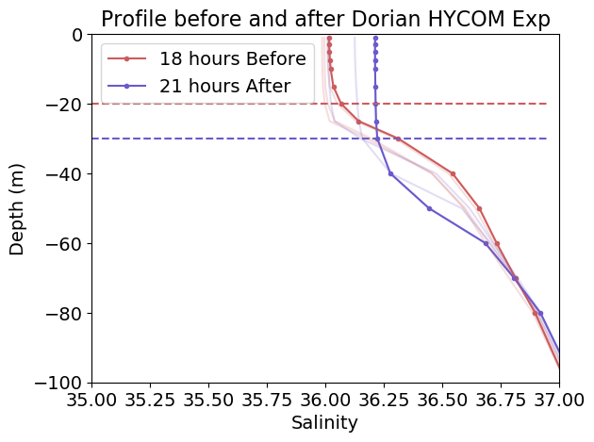
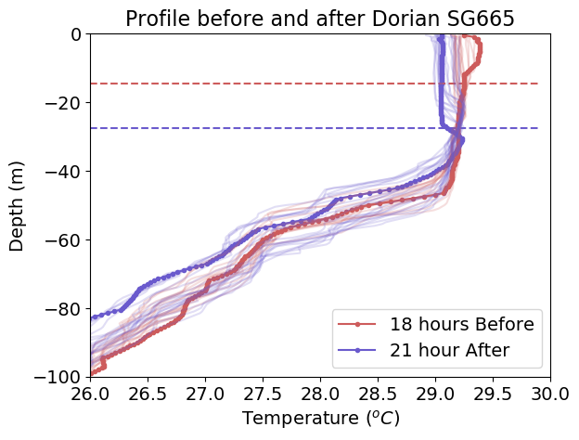
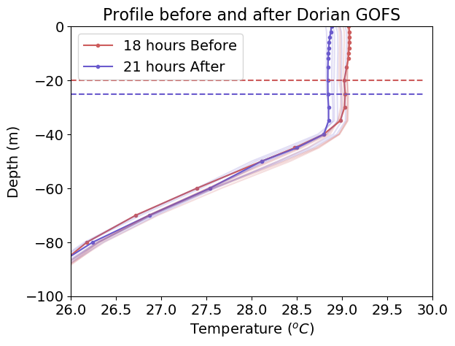
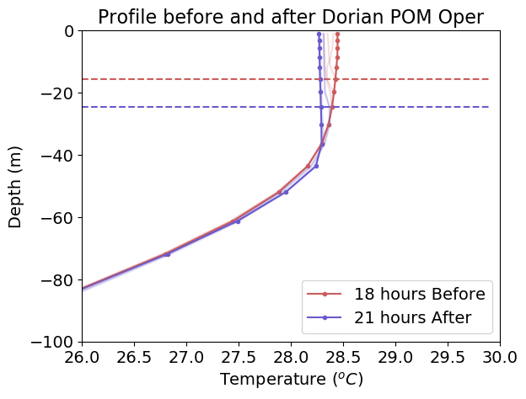
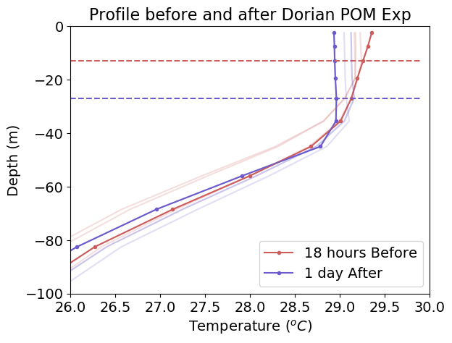
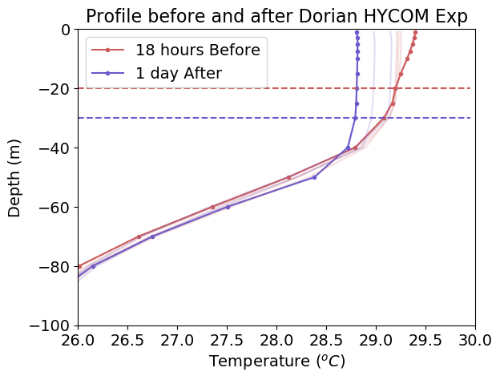
Inside Barrier layer SG665
MLD
MLD
(a)
(b)
(c)
(d)
(e)
MLD
MLD
(f)
(g)
(h)
(i)
(j)

