Slide 1
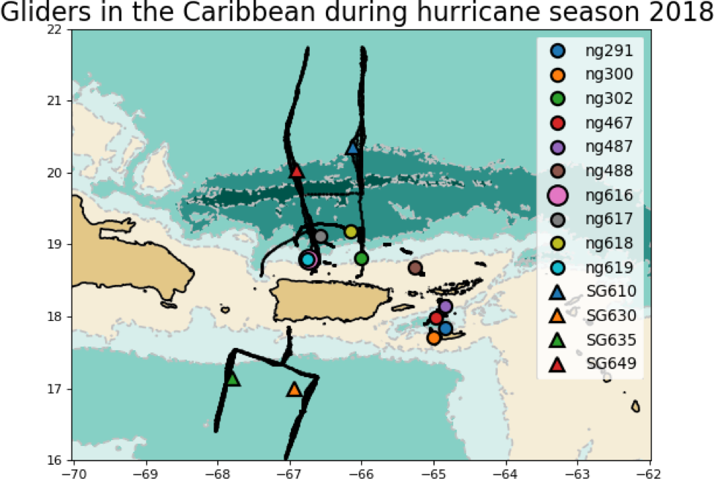
Heat Transport through the Anegada Passage

Slide 2

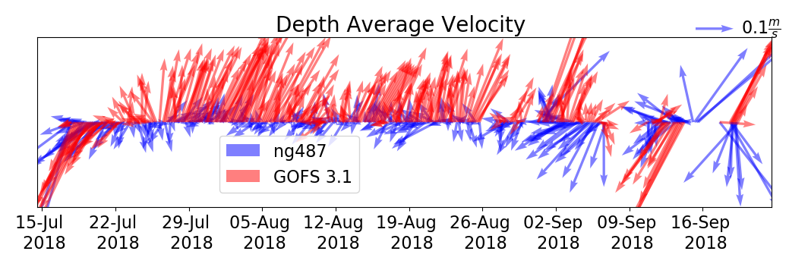
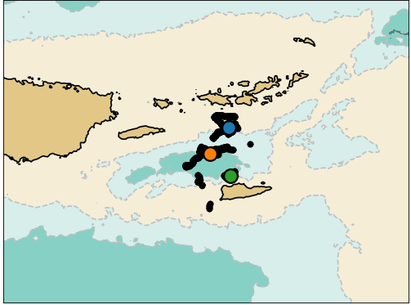
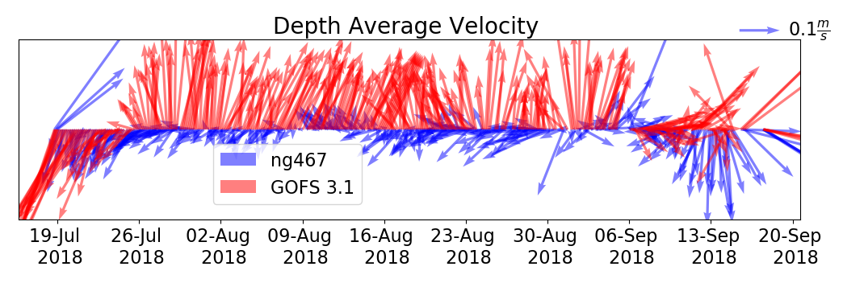
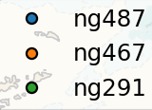

Caribbean: 200 M Depth Average Velocity 18 July -17 Sep

Slide 3
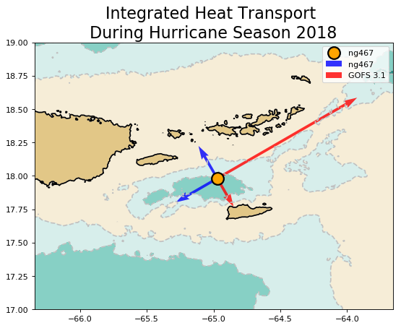


Slide 4
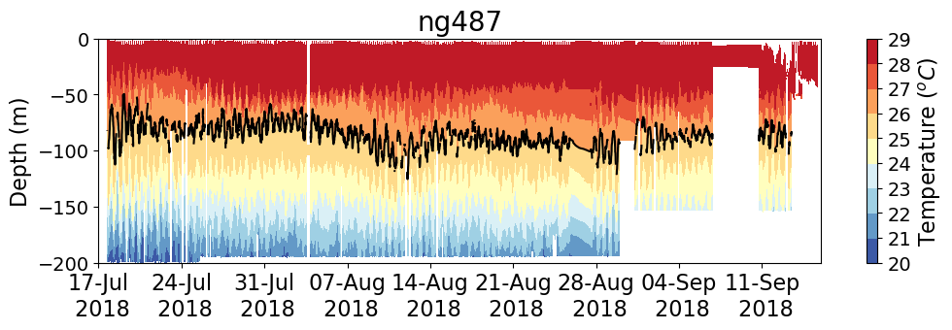
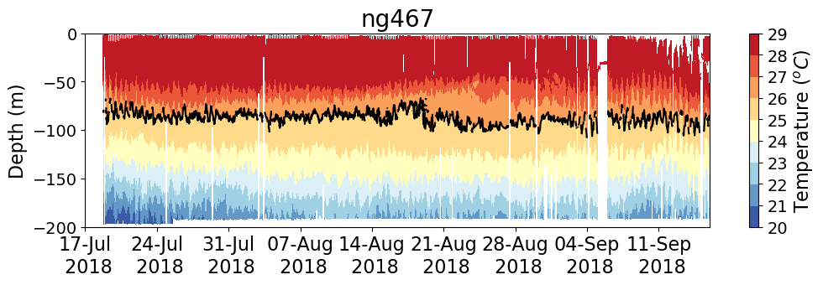
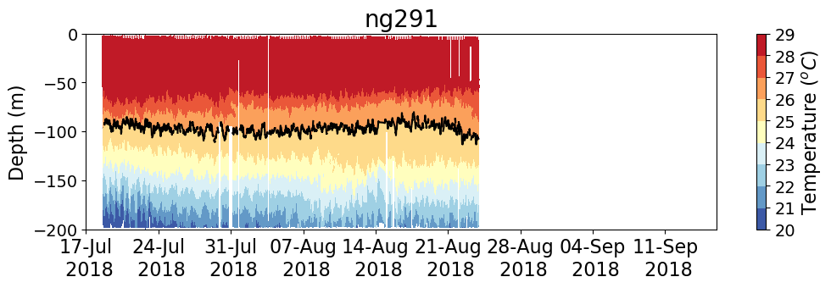
Cross-channel Temperature Gradients

Slide 5
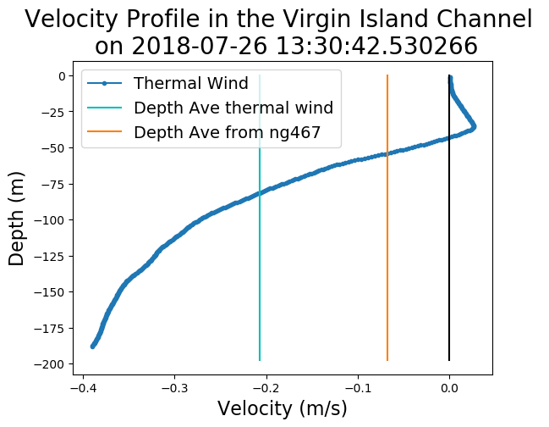
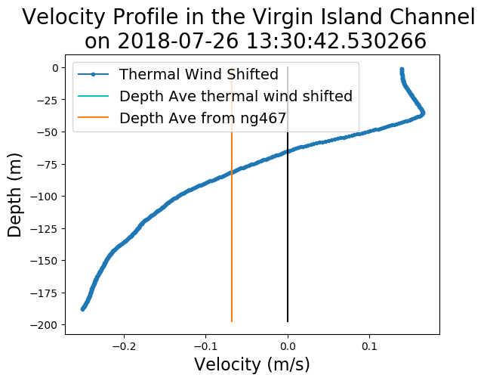
Thermal-Wind Balance Using ng487 and ng291
Shift
Shifted

Slide 6
After taking into account the vertical profile of velocity,
the model heat transport through the channel has
the opposite direction than the observed heat transport

