Slide 1

Hurricane Glider Program
2018 and 2019 Season
Maria Aristizabal
Travis Miles
Scott Glenn

Slide 2
Overview of the hurricane glider program
What is the purpose of collecting these data?
  Data assimilation in operational ocean models
  to improve hurricane forecast
  Validation of ocean models
  Research: Barrier layer in the Caribbean

Slide 3
Overview of the Hurricane Glider Program
https://www.aoml.noaa.gov/phod/goos/gliders/index.php#gliders-project
“It is a multi-institutional effort that brings together the research and operational components within NOAA and the university community to implement and carry out sustained and targeted ocean observations from underwater gliders in the Caribbean Sea and tropical North Atlantic Ocean in support of hurricane studies and forecasts”.
The goal of this work is to enhance our understanding of air-sea interaction processes during hurricane force wind events. In order to accomplish this goal, a pilot network of hurricane underwater gliders is implemented to:
Assess the impact of hurricane force winds on upper ocean density structure, and
Assess the impact of ocean profile data from underwater gliders in operational hurricane intensity forecasts

Slide 4
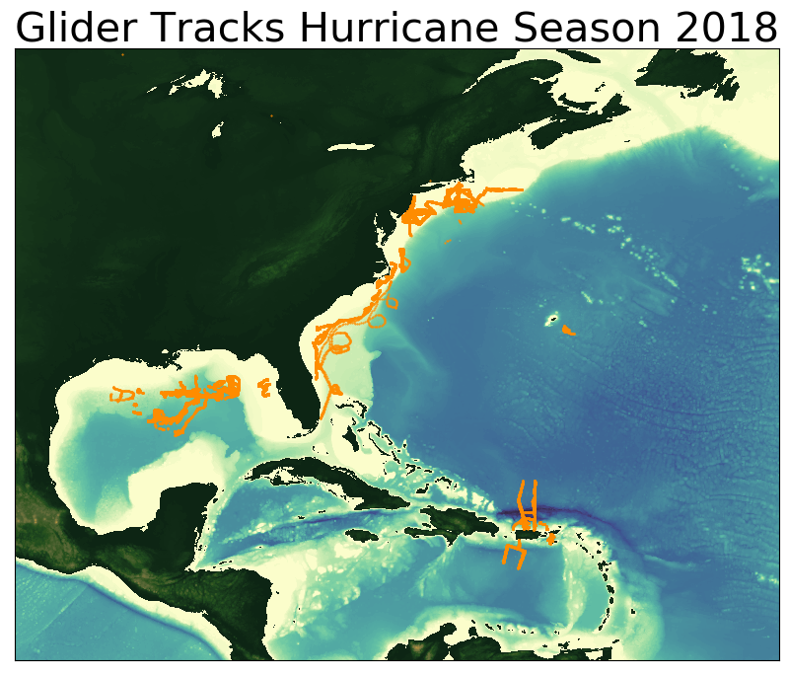
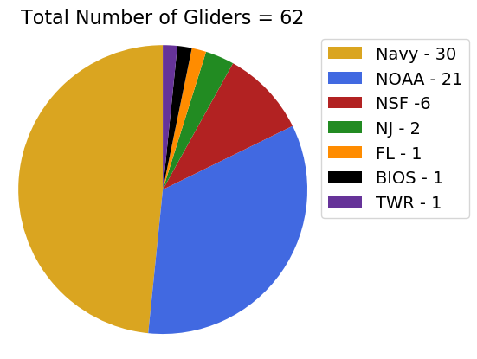
Overview of the Hurricane Glider Program

Slide 5
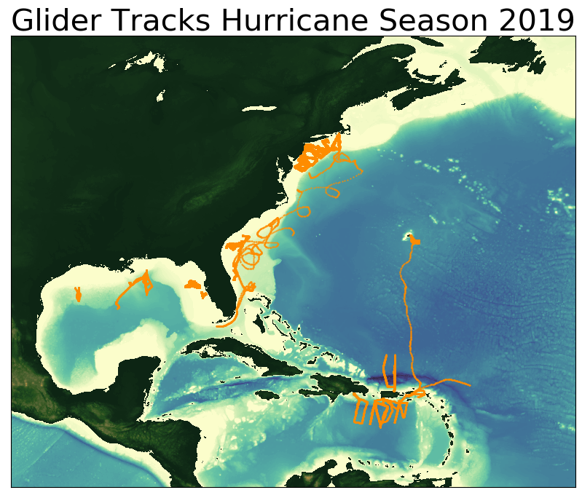
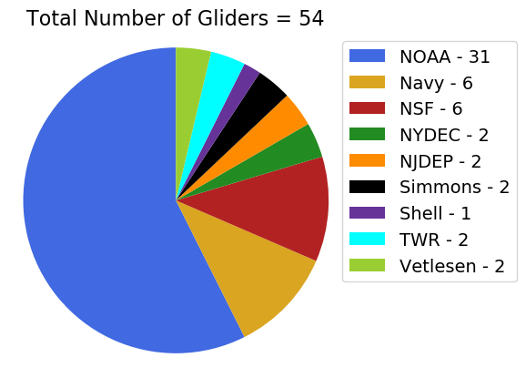
Overview of the Hurricane Glider Program

Slide 6
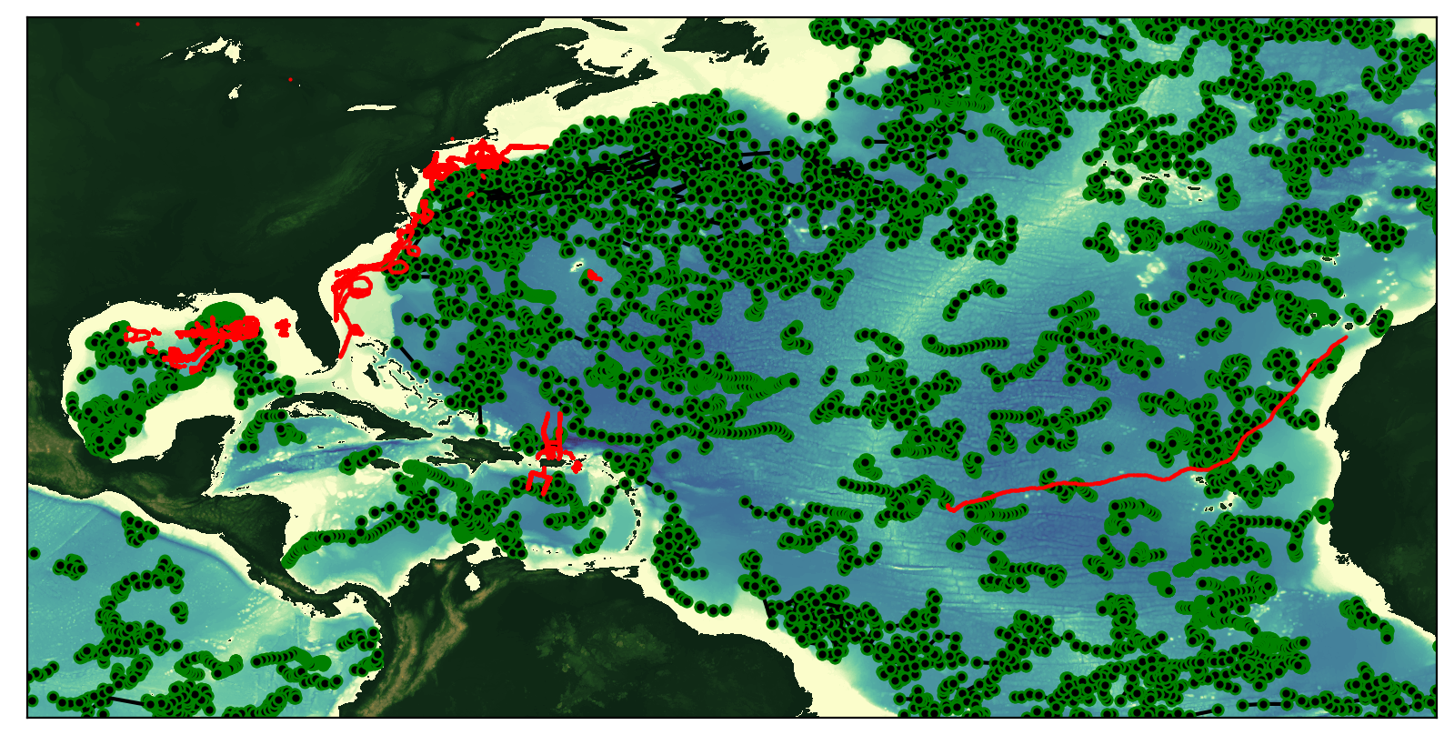
Argo Floats vs Glider
2018 Hurricane Season
Total number of glider profiles = 123335
Total number of Argo profiles = 17264

Slide 7
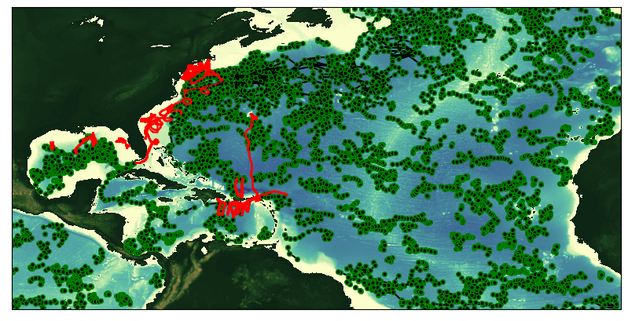
Argo Floats vs Glider
2019 Hurricane Season
Total number of glider profiles = 103511
Total number of Argo profiles = 13164

Slide 8
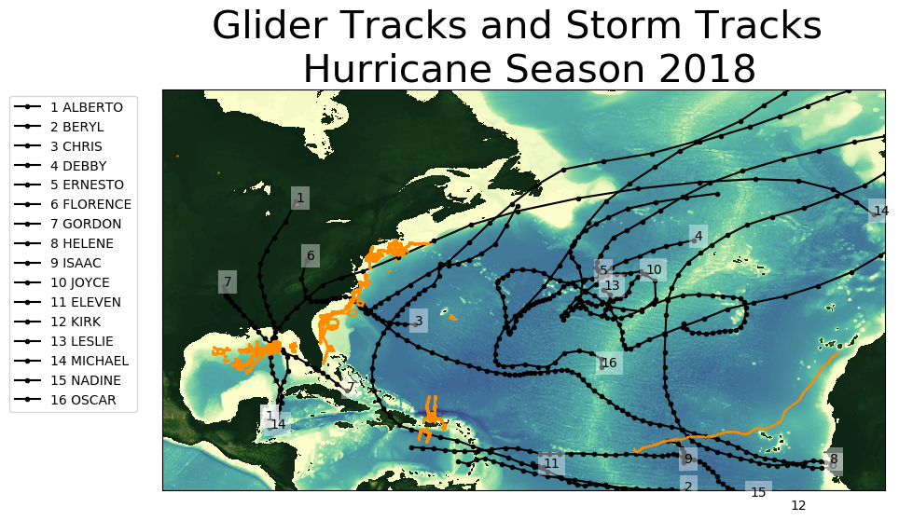

Slide 9
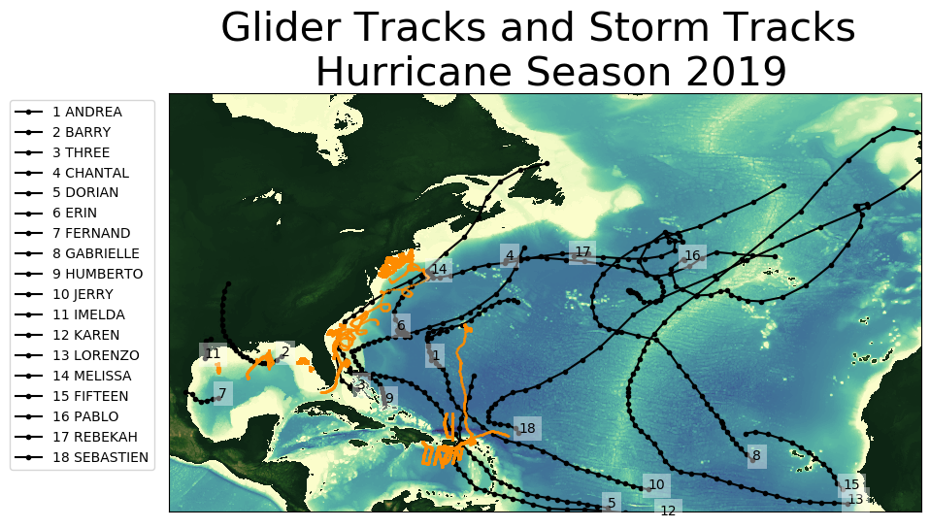

Slide 10
  Glider Data assimilation in operational ocean models
Glider Data
IOOS Glider DAC
GTS
Operational Ocean Models
GOFS
RTOFS
Copernicus
DOPPIO
AmSeas

Slide 11
Global Ocean Forecasting System (GOFS)
Navy Coupled Ocean Data Assimilation System (NCODA)
Surface Data
Subsurface Temperature and Salinity
Satellite SST
Drifting buoys
Fixed buoys
Argo Floats
In Situ SST
GOFS/NCODA
Gliders
TESAC
Satellite Altimeter
XBTs (only temp.)
Notes:
The GOFS/NCODA system assimilates a wide variety of observations. At the surface the system assimilates satellite SST, in situ SST and satellite altimeter. It also assimilates subsurface temperature and salinity from different sources: …… temperature, salinity and current report from a sea station…..

Slide 12
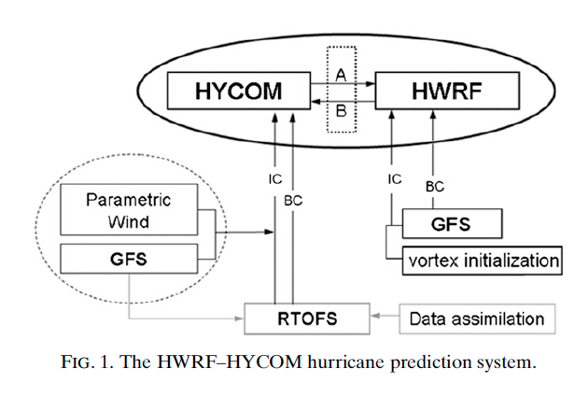
Hurricane Coupled Ocean-Atmosphere
Forecasting Model: HWRF-HYCOM System
IC
IC
Kim et al. 2014
GOFS/NCODA
RTOFS – Real Time Ocean Forecasting System
GFS – Global Forecasting System
Notes:
This is a schematic of the workflow for the HWRF/HYCOM system. The right side shows the atmospheric component and the left side is the oceanic component. The IC and BC for the regional HYCOM come from the global RTOFS, that is the NOAA operational ocean model. At the same time, the IC for the global RTOFS comes from Global Ocean Forecasting System GOFS that is the Navy operational ocean model and implements data assimilation though NCODA that is the Navy coupled ocean data assimilations system. So in its current state, the NOAA hurricane forecasting models incorporates ocean data assimilation through the IC to their own global ocean model. NCEP is currently working to implement data assimilation directly into RTOFS.

Slide 13
Hurricane Coupled Ocean-Atmosphere
Forecasting Model: HWRF-HYCOM System
IC
RTOFS/DA
IC
Kim et al. 2014
GOFS/NCODA
RTOFS – Real Time Ocean Forecasting System
GFS – Global Forecasting System
Notes:
This is a schematic of the workflow for the HWRF/HYCOM system. The right side shows the atmospheric component and the left side is the oceanic component. The IC and BC for the regional HYCOM come from the global RTOFS, that is the NOAA operational ocean model. At the same time, the IC for the global RTOFS comes from Global Ocean Forecasting System GOFS that is the Navy operational ocean model and implements data assimilation though NCODA that is the Navy coupled ocean data assimilations system. So in its current state, the NOAA hurricane forecasting models incorporates ocean data assimilation through the IC to their own global ocean model. NCEP is currently working to implement data assimilation directly into RTOFS.

Slide 14
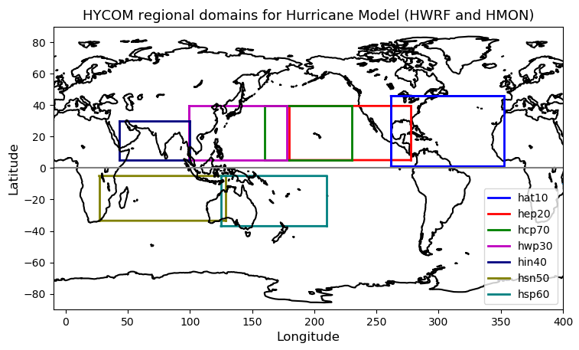
NOAA Hurricane Forecasting Models
HWRF/HYCOM
HMON/HYCOM
HWRF/POM
West
Pacific
Central
Pacific
East
Pacific
North
Atlantic
North
Indian
South
Indian
South
Pacific
HWRF – Hurricane Weather Research Forecasting Model
HYCOM – Hybrid Coordinate Ocean Model
HMON - Hurricanes in a Multi-scale Ocean-coupled Non- hydrostatic model
POM – Princeton Ocean Model
Notes:
Currently NOAA has there different coupled ocean-atmosphere hurricane models that operate in different regions. In the North Atlantic there are two model: the HMON/HYCOM and the HWRF/POM.

Slide 15
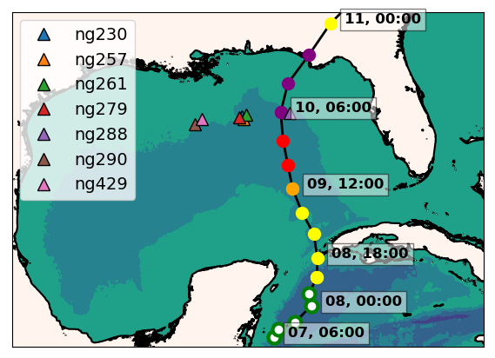
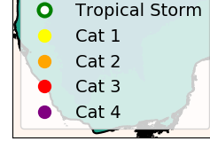
Hurricane Michael
ng288
Seven Navy gliders reporting to the glider DAC
in the GoM during hurricane Michael
Ng288 was at 36 km from the eye
of hurricane Michael
Notes:
During the passage of hurricane Michael, there were 7 Navy gliders in the Gulf of Mexico. One of them ng288 was 36 km away of the hurricane eye.

Slide 16
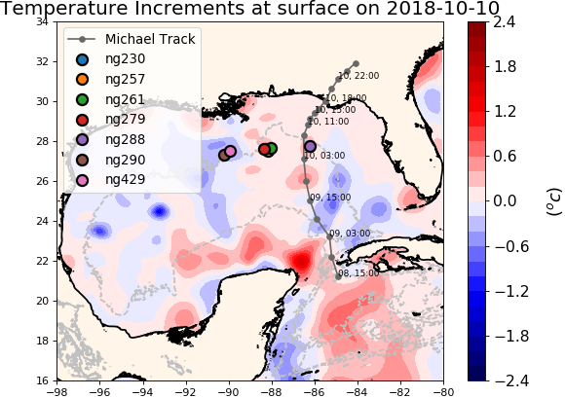
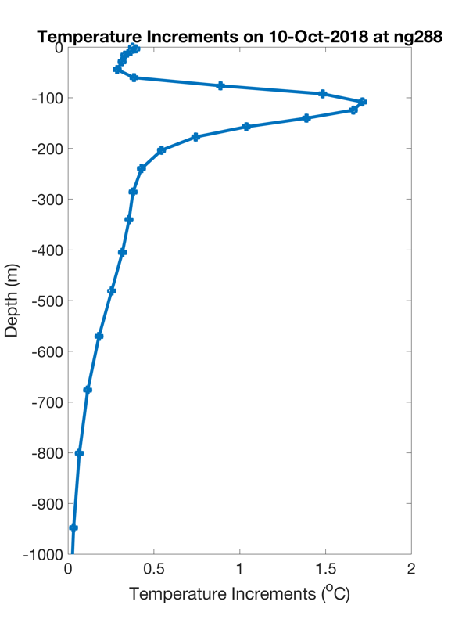
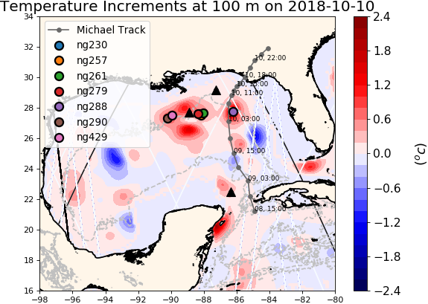
NCODA Temperature Increments
Argo
Jason 2
CryoSat
The increment is the change made to the model state at the end of the previous assimilation cycle
Notes:
The data from these gliders was assimilated by the navy operational ocean model GOFS. These figures show the temperature increments that are calculated by NCODA, the data assimilation system within GOFS. In the data assimilation jargon, the increments is the change made to the model when compared to the previous assimilation cycle. At the surface the temperature increments have a moderate value but most of the correction happens at depth around the locations of the gliders.

Slide 17
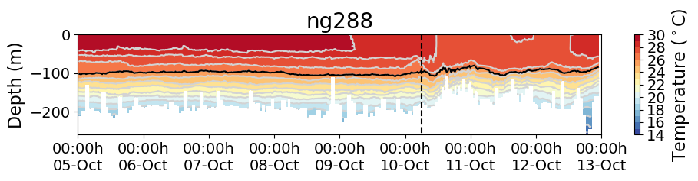
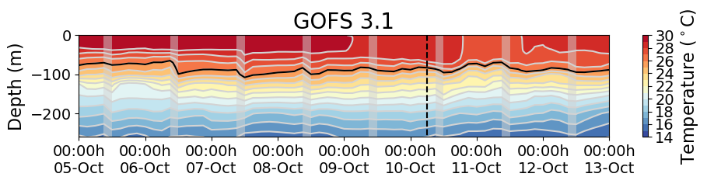
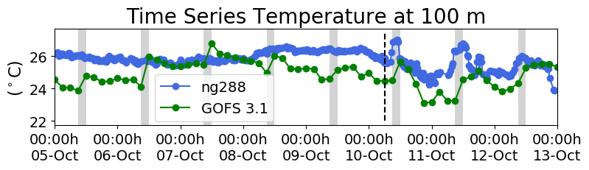
Hurricane Michael
Increments
Insertion Window
Increments
Insertion Window
Increments
Insertion Window
The assimilation of glider data days ahead of Michael corrected
the position of the thermocline
Notes:
This is the temperature transect from ng288 and we also have the temperature transect form the GOFS 3.1 following ng288 glider track. When we look back 5 days before the passage of Michael, we observe that in GOFS 3.1 after every increment insertion window, the thermocline is pulled down to match the depth of the thermocline from the glider data until it settles down at the right depth. This highlights the importance of having a continuous glider presence so when a storm strikes, the model ocean has a most realistic vertical stratification.

Slide 18

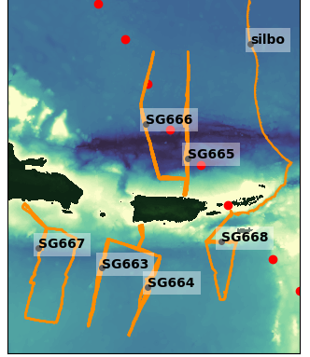
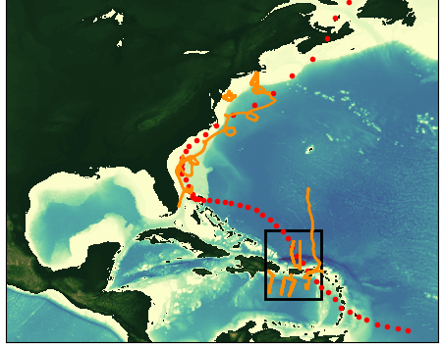

Evaluation of NOAA Hurricane Forecasting Models During Hurricane Dorian
Dorian
Aug 20 – Sep 07

Slide 19
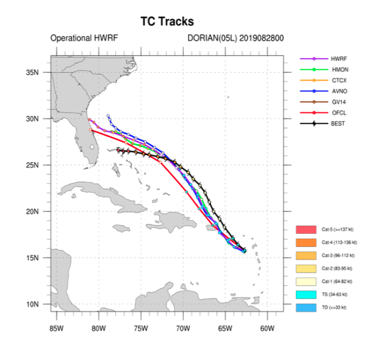
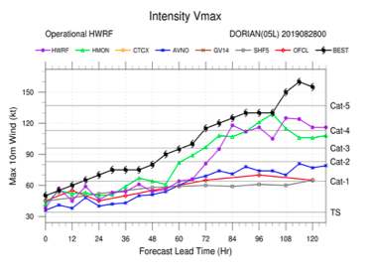
Dorian Forecast
Cycle 2019/08/28/00
Dorian transitions from tropical storm to cat 1 hurricane
Dorian passes over the glider array
5 days before hitting Abaco Island

Slide 20
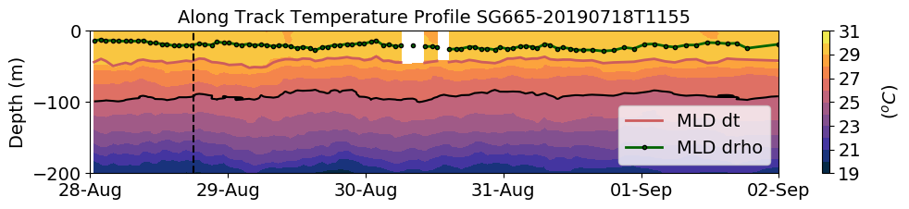
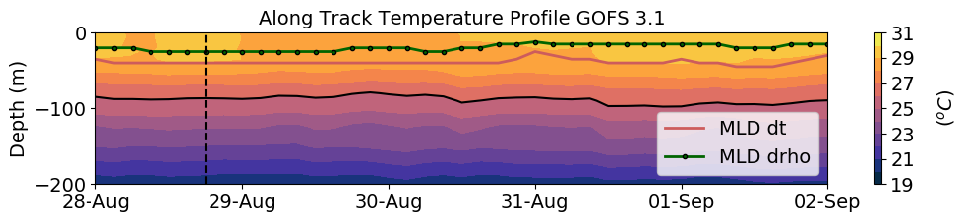
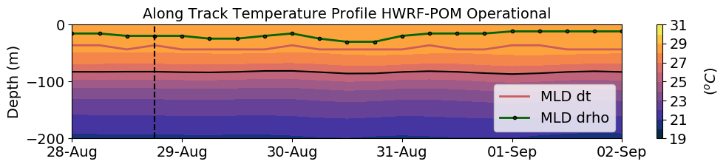
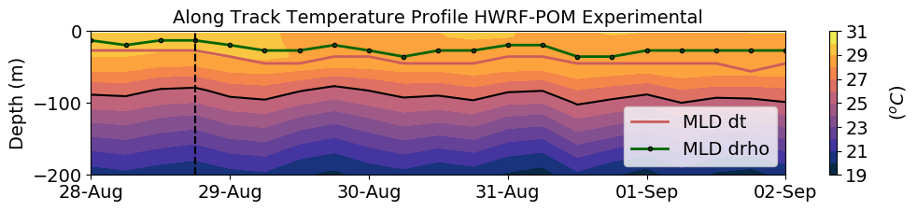
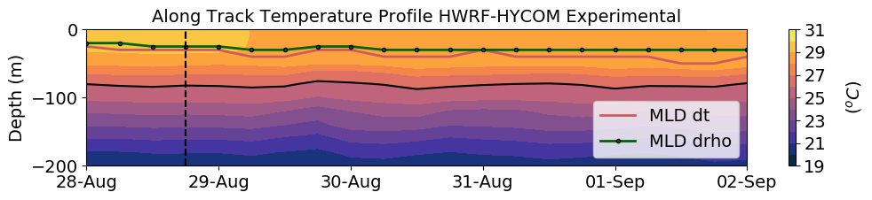
SG665 Temperature
Dorian
(a)
Observations
(b)
Data Assimilative Model
(c)
Forecast
(d)
Forecast
(e)
Forecast

Slide 21
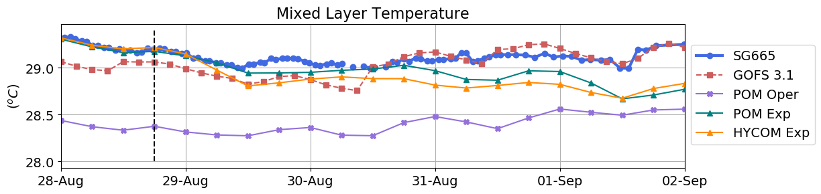
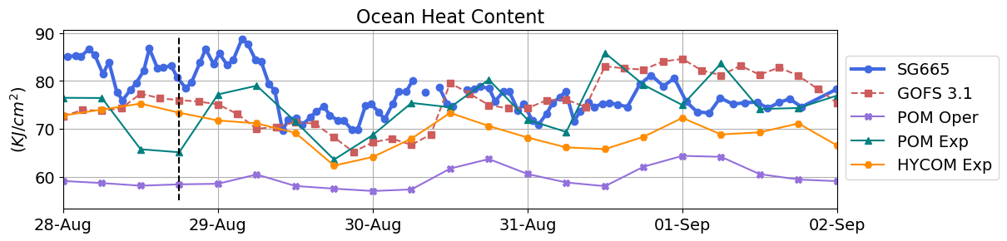
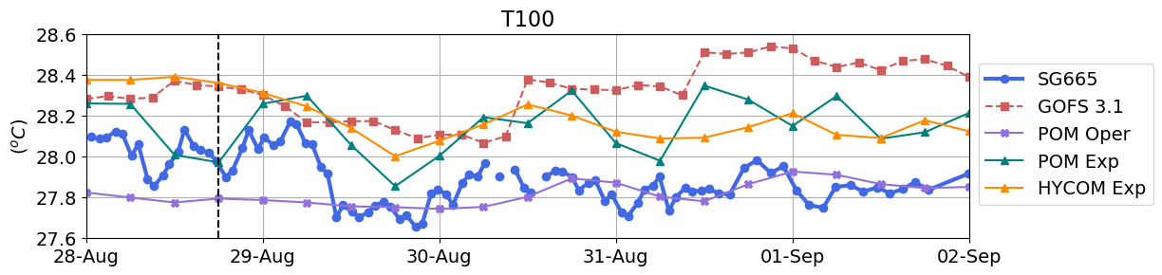
Surface Ocean Metrics
(a)
(b)
(c)

Slide 22
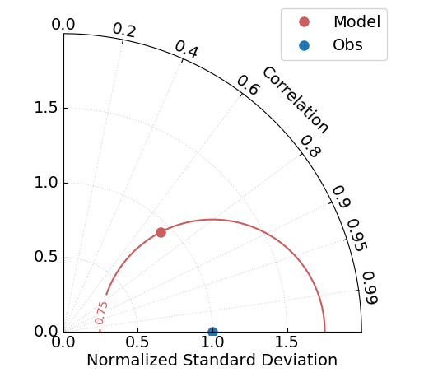
Normalized Taylor Diagram
Accurate
model

Slide 23
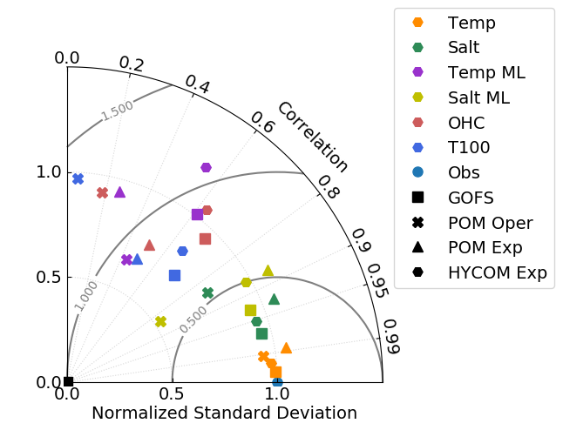
Evaluation of Surface Ocean Metrics
Relevant to Air-Sea Heat Fluxes
OHC
Temp ML
Salt ML
T100
Salt
Temp
The models' skill considerably deteriorates for the upper ocean metrics that are relevant for air/sea heat fluxes such as temperature in the mixed layer (Temp ML), ocean heat content (OHC) and depth average temperature in the top 100 meters (T100).

Slide 24
 | GOFS | POM Oper | POM Exp | HYCOM Exp
T ML | -0.40% | -3.0% | -0.94% | -0.62%
OHC | -3.6% | -22% | -17% | -8.7%
T100 | 1.4% | -0.46% | 0.49% | 1.2%
All models are colder in the mixed layer
All models have a deficit in the OHC

Slide 25
Evaluation of Surface Ocean Metrics
Relevant to Air-Sea Heat Fluxes
POM
Oper
POM
Exp
HYCOM
Exp
GOFS
GOFS 3.1 has the best skill for the upper ocean metrics, followed by HWRF-HYCOM experimental and HWRF-POM experimental, while HWRF-POM operational has a poor skill for the same metrics.

Slide 26
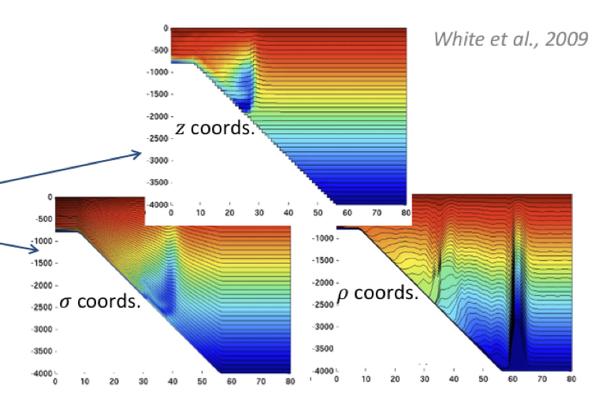
Near Future of NOAA Hurricane Forecasting Models
Finite Volume Cubed-Sphere
FV3
JEDI
The Joint Effort for Data Assimilation
Integration
MOM6
Modular Ocean Model

Slide 27
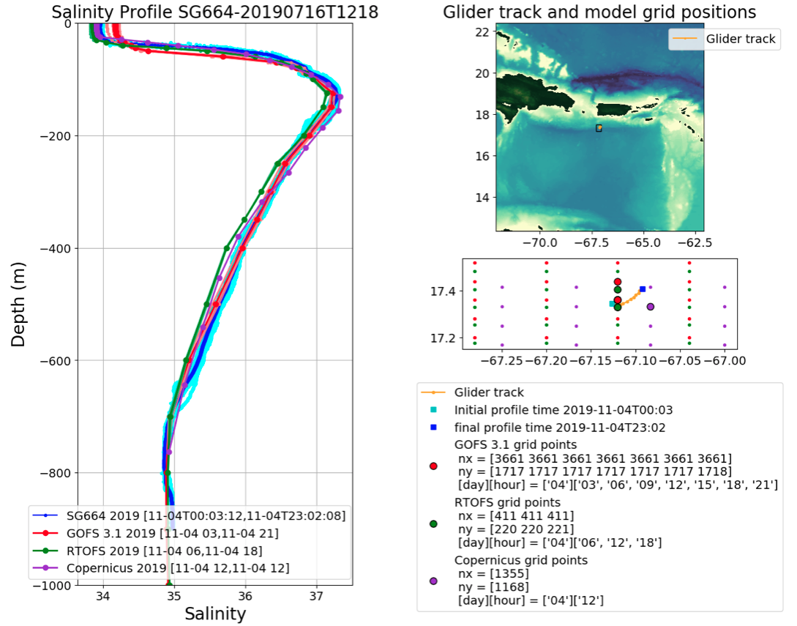
Daily Profile Comparisons between
Operational Ocean Models and Glider Data
https://rucool.marine.rutgers.edu/hurricane/Hurricane_season_2019/

Slide 28
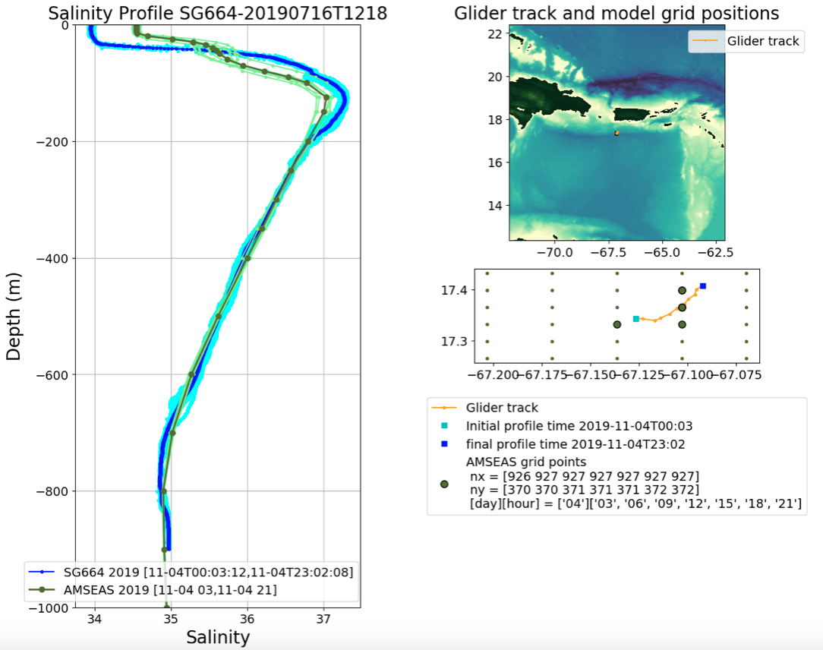
Daily Profile Comparisons between
Operational Ocean Models and Glider Data

Slide 29
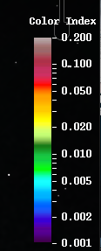
Influence of the Barrier Layer on the Mixed Layer
Response to storms
MODIS Color Index
Aug 25 /2019 17:50 GMT
MODIS Color Index
Aug 30 /2019 18:10 GMT
MODIS Color Index derived from reflectance data at 555 nm after correction for gaseous absorption, molecular scattering, and sun glint effects (Hu 2011) https://optics.marine.usf.edu/cgi-bin/optics_data. This color index is a good proxy for turbidity signals (Saldias et al. 2012).

Slide 30
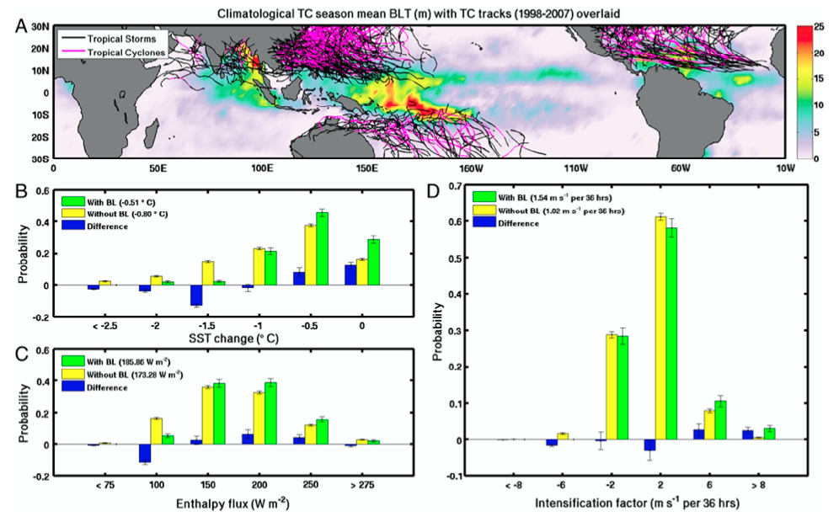
The warm and fresh surface layer promotes water stability, which can inhibit vertical mixing during storm events, making it more difficult for hurricanes to access the colder water beneath the surface mixed layer and potentially preventing the storm from weakening (Balaguru et al. 2012, Domingues et al. 2015, Rudzin et al. 2018).
Balaguru et al. 2012

Slide 31
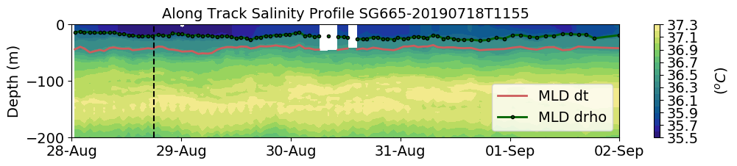
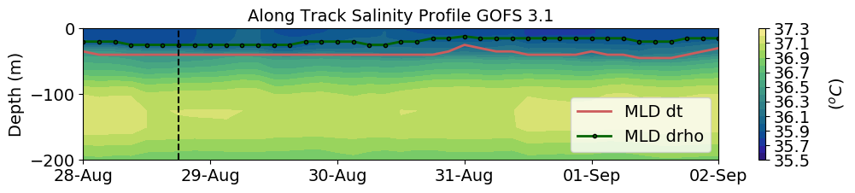
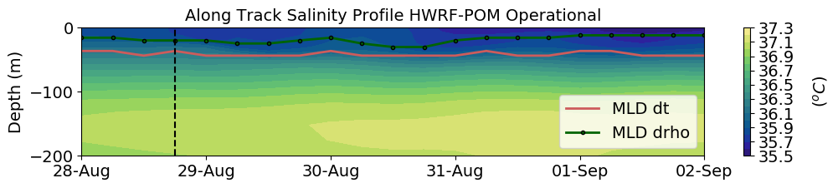
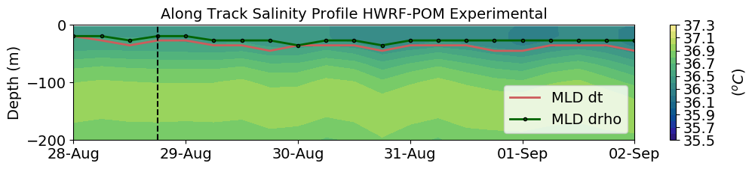
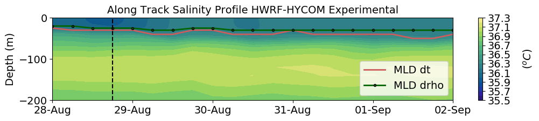
Inside Area of Fresh Water Influence
Dorian
(a)
Observations
The mixed layer depth estimated using the density criteria (green dotted line) is significantly shallower than the mixed layer depth estimated using the temperature criteria (red line).
(b)
Data Assimilative Model
(c)
Forecast
(d)
Forecast
(e)
Forecast

Slide 32
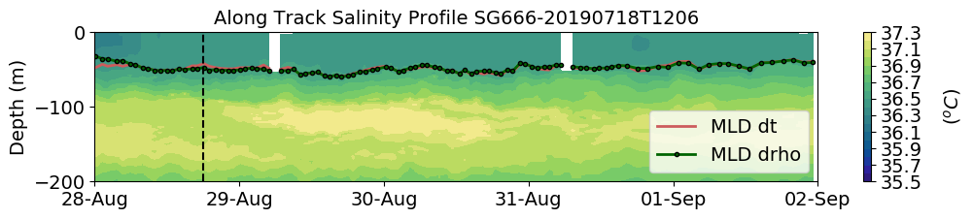
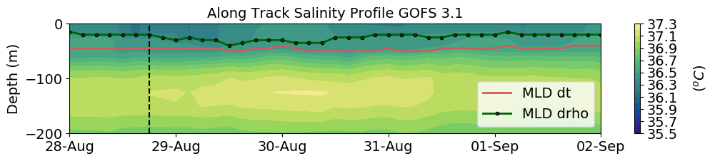
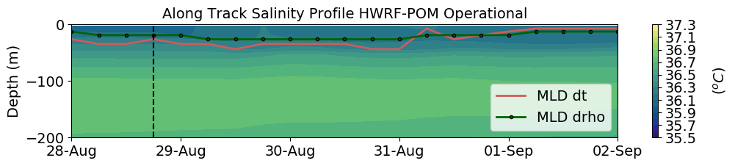
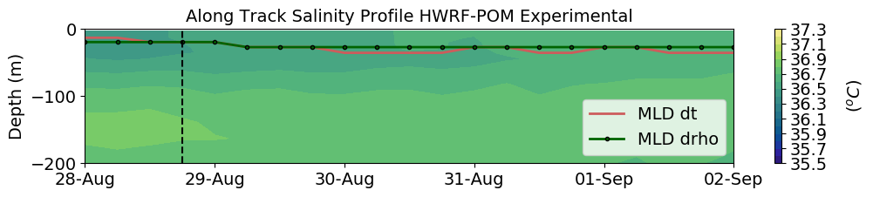
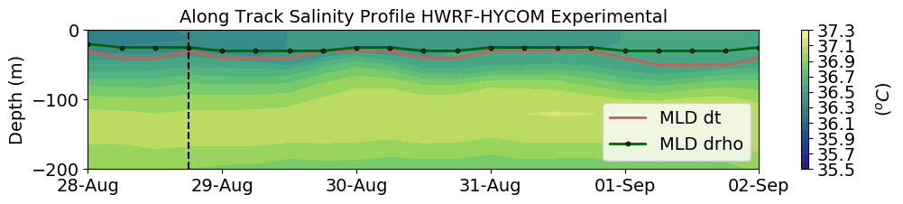
Outside Area of Fresh Water Influence
Dorian
(a)
Observations
In this area the mixed layer depth estimated using the density criteria (green dotted line) and the one estimated using the temperature criteria (red line) coincide. The mixed later depth at this location is 30 meters deeper than at the SG665 location.
(b)
Data Assimilative Model
(c)
Forecast
(d)
Forecast
(e)
Forecast

Slide 33
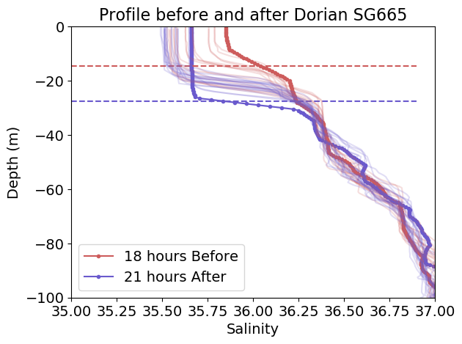
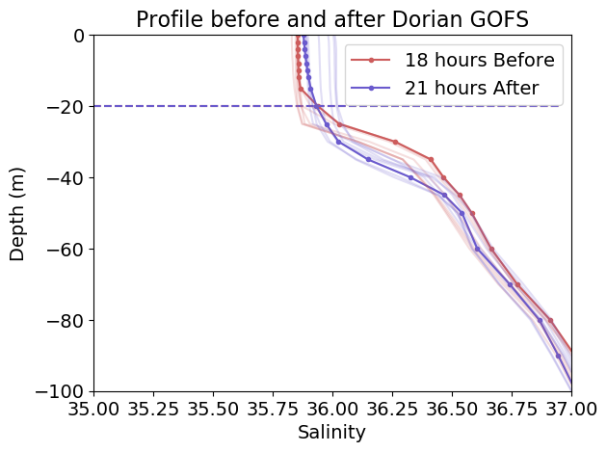
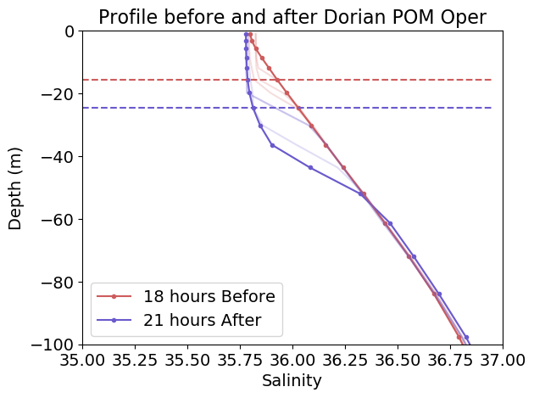







Inside Barrier layer SG665
MLD
MLD
(a)
(b)
(c)
(d)
(e)
MLD
MLD
(e)
(f)
(g)
(h)
(i)
The vertical profiles of salinity before and after the passage of Dorian at the location of glider SG665 show that that there was a freshening of 0.5 psu within the mixed layer and that a very sharp halocline developed at this time. We think that this freshening was caused by an increase in precipitation during the passage of Dorian and a preexisting barrier layer that further inhibited vertical mixing. The effects of the inhibited vertical mixing are seen in the vertical profiles of temperature.

Slide 34

Inside Barrier layer SG665
MLD
MLD
(a)
(b)
(c)
(d)
(e)
MLD
MLD
(e)
(f)
(g)
(h)
(i)

Slide 35


Precipitation
http://data.cocorahs.org/cocorahs/maps/?country=usa&amp;state=vi
VI-SC-8

Slide 36










Outside Area of Fresh Water Influence
MLD
MLD
(a)
(b)
(c)
(d)
(e)
MLD
MLD
(e)
(f)
(g)
(h)
(i)
Dorian had a modest effect in the temperature and salinity profiles at this location. However we do see evidence of vertical mixing as the salinity within the mixed layer increases slightly. All the models have a mixed layer depth that is about 20 meters shallower than the observations.

Slide 37
Conclusions
Underwater glider data is complementary to the Argo data
Navy operational ocean model (GOFS) benefits from the assimilation of insitu subsurface temperature and salinity from the hurricane glider program
The skill of the current NOAA hurricane forecasting models considerably deteriorates for the upper ocean metrics that are relevant for air/sea heat fluxes
From the four models evaluated, the ones that have better skill are the ones that are HYCOM based
There is evidence that during the passage of Dorian through the area of fresh water influence, vertical mixing was inhibited by the presence of a barrier layer. However, none of the models captured the strength of the barrier layer and its effect on vertical mixing

Slide 38
Future Collaboration
Use glider observations along with satellite color data to
estimate halocline depth
Heat budget within the mixed layer

Slide 39
Glider Data Workshop
Access glider data from the IOOS glider DAC using the Thredds server and ERDDAP server
Access GOFS 3.1 and AmSeas output and compare with glider data
Produce daily comparison between glider profiles and AmSeas model

Slide 40
Glider Data Workshop
Download Python Anaconda distribution:
https://www.anaconda.com/distribution/#download-section
2. Open Anaconda and then open Spyder
3. Download or clone (using git) a set of Python functions that read glider
data from the IOOS glider DAC and GOFS output. Go to https://github.com/MariaAristizabal/glider_model_comparisons_Python
4. Read README.md from my github account
5. From Spyder, go inside the folder “glider_model_comparisons_Python”
Thredds server:
6. Open “working_examples.py” and run cell #1: Read glider data
from the IOOS thredds server and plots a scatter plot of a glider transect
for the entire length of the deployment. In this example, we are reading
data from the SG668-20190819T1217 deployment.
You may need to install the following packages: xarray, netCDF4, erddapy,
cmocean. Continue in next slide …

Slide 41
Glider Data Workshop
If this is the case, open terminal (on a Mac) or a Command
Prompt (in Windows) and run the following commands:
conda install -c anaconda xarray
conda install -c anaconda netcdf4
conda install -c conda-forge erddapy
conda install -c conda-forge cmocean
7. In “working_examples.py” run cell #2: Read glider data from the IOOS
thredds server and plots a scatter plot of a glider transect for a specific
time window
8. Go to the IOOS thredds server:
https://gliders.ioos.us/thredds/catalog/deployments/catalog.html
to learn where to find the url addresses for other deployments
9. In “working_examples.py” run cell #3: Same as cell #2, in addition to
interpolating the variable of interest (temperature, salinity or density) to
regular depth levels (gridding variables in the vertical)

Slide 42
Glider Data Workshop
ERDDAP server:
10. Let’s go to the IOOS ERDDAPP server:
https://gliders.ioos.us/erddap/index.html and look for deployment
SG666-20190718T1206
11. In “working_examples.py” run cell #4: Search for glider data sets
given a latitude and longitude box and time window
12. In “working_examples.py” run cell #5: Search for glider data sets given a
latitude and longitude box and time window, choose one those data sets
(glider_id), plot a scatter plot of the chosen glider transect, grid
and plot a contour plot of the chosen glider transect
13. In “working_examples.py” run cell #6: Search for glider data sets given a
latitude and longitude box and time window, choose one those data sets
(dataset_id), grid in the vertical the glider transect, get the glider
transect in the GOFS 3.1 grid, and plot both the transect from the glider
deployment and GOFS 3.1 output

Slide 43
ERDDAP server:
14. In “working_examples.py” run cell #7: Search for glider data sets given a
latitude and longitude box and time window, choose one those data sets
(dataset_id), grid in the vertical the glider transect, get the glider
transect in the AmSeas grid, and plot both the transect from the glider
deployment and the AmSeas output

Slide 44
Glider Data Workshop
AmSeas model
15. Download or clone (using git) a set of Python functions that create the
daily glider-data/models comparisons that can be found at
https://rucool.marine.rutgers.edu/hurricane/Hurricane_season_2019/
Go to
https://github.com/MariaAristizabal/Daily_glider_models_comparisons
16. From Spyder, go inside the folder “Daily_glider_models_comparisons”
and open the script “Daily_glider_profiles_vs_AmSeas.py”.
This script won’t run right away. First, we need to make some small
changes:
- line 19: change the path and name of bathymetry file
(inside folder cloned from my github account).
New name: GEBCO_2014_2D_-100.0_0.0_-60.0_45.0.nc
- line 34: comment that line so figures will show on the screen
- line 383-385 and 458-460: comment so we do not save the figures

Slide 45
A Thredds server “is a web server that provides
metadata and data access to scientific data sets
using OpeNDAP and other remote data access
protocols”
Thredds: Thematic Real-Time Environment Distributed Data
Service
OpenDAP: Open-Source Project for a network data access
protocol
“ERDDAP is a data server that gives you a simple, consistent
way to download subsets of gridded and tabular scientific
datasets in common file formats and make graphs and maps”
ERDDAP returns data in the file format of your choice:
.html table, .asc, google earth lml, .mat, .nc, .txt, .json…
“NetCDF (Network Common Data Form) is a set of interfaces
for array-oriented data access and freely distributed of data
access libraries for C, Fortran, C++, Java, and other
languages”

