Slide 1
Evaluation of Ocean Surface metrics relevant to Heat Fluxes on the HWRF-POM and HWRF-HYCOM Forecasting Models during Hurricane Dorian
Maria Aristizabal
Travis Miles
Scott Glenn
Hyun-Sook Kim
Avichal Mehra
Benjamin LaCour

Slide 2
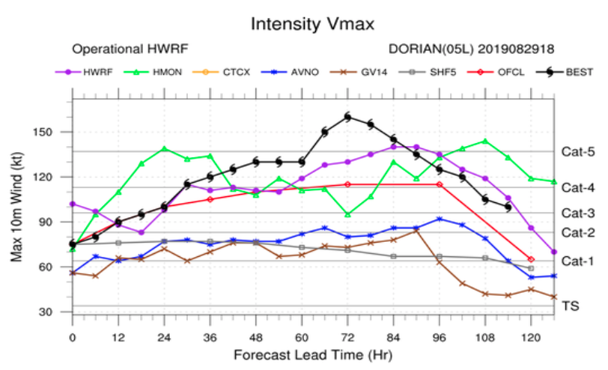
Motivation
The Caribbean is an important area for the genesis
and strengthening of tropical cyclones
Hurricane Dorian experienced
rapid intensification but none of
the operational hurricane
forecasting models predicted it
Accurate ocean initial conditions are essential for the
correct evolution of the temperature within the ocean
surface mixed layer in coupled atmosphere/ocean models
and the subsequent evolution of the storm intensity
(Halliwell et al. 2008,…..)

Slide 3

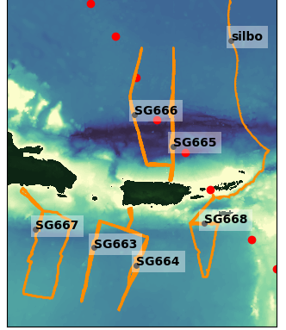
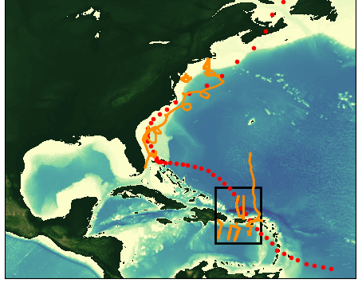

Objective
Evaluate the ocean initial conditions in the Global Ocean
Forecasting System (GOFS 3.1) and the operational and
experimental HWRF-POM forecasting systems, using
temperature and salinity from a fleet of autonomous
underwater gliders, dedicated to hurricane research and
operations
Dorian
Aug 20 – Sep 07

Slide 4
Conclusions
The oceans models evaluated here, GOFS and HWRF/POM
operational and experimental, have a good skill in the bulk temp
and salinity when hurricane Dorian was transitioning from
tropical storm to category 1 hurricane. However, their skill is
significantly reduced for surface quantities that are relevant to
the atmosphere/ocean heat fluxes such as temperature in the
mixed layer, ocean heat content and T100
The evolution of the temperature in the mixed layer in the Caribbean is highly influenced by the barrier layer. This barrier layer is poorly represented in the ocean models evaluated here……………….

Slide 5
Hurricane Dorian
Aug 20 – Sep 07

Slide 6
Evaluation of Initial Conditions

Slide 7
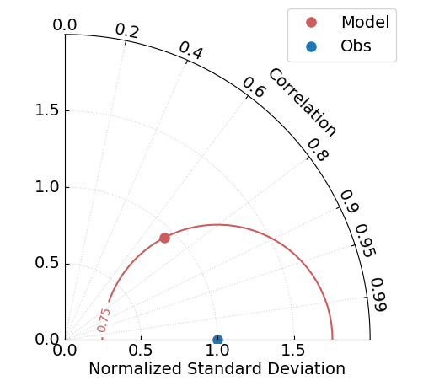
Normalized Taylor Diagram
Accurate
model

Slide 8
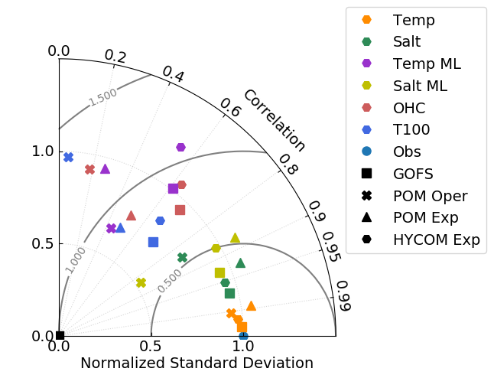
OHC
Temp ML
Salt ML
T100
Salt
Temp

Slide 9
 | GOFS | POM Oper | POM Exp | HYCOM Exp
T ML | -0.40% | -3.0% | -0.94% | -0.62%
OHC | -3.6% | -22% | -17% | -8.7%
T100 | 1.4% | -0.46% | 0.49% | 1.2%

Slide 10
POM
Oper
POM
Exp
HYCOM
Exp
GOFS

Slide 11
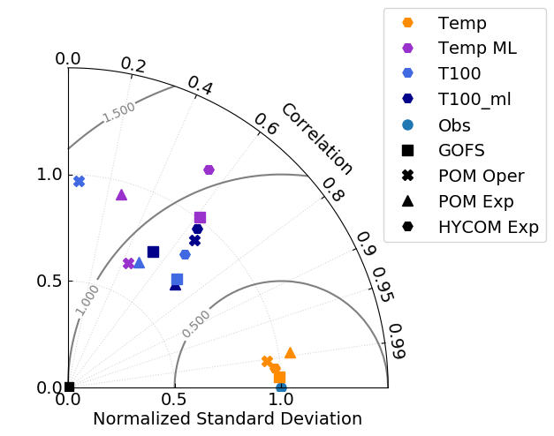
Temp. mean from 100 m to base mixed Layer
Temp ML
T100
T100 to ml
Temp

Slide 12
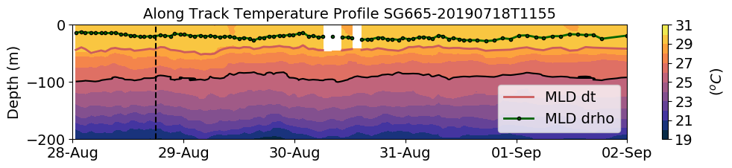
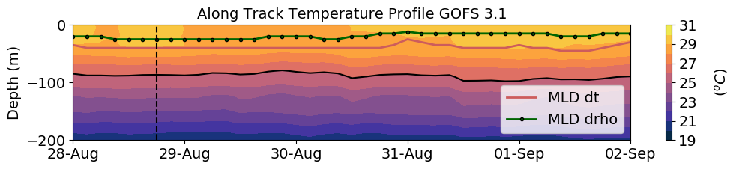
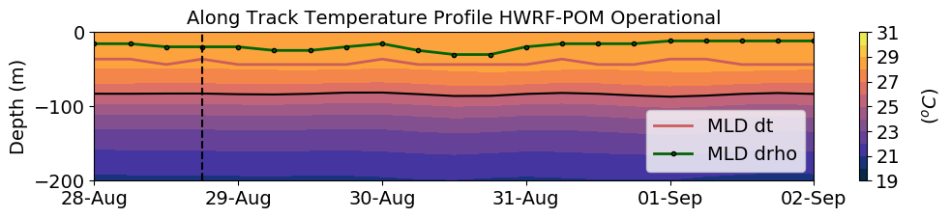
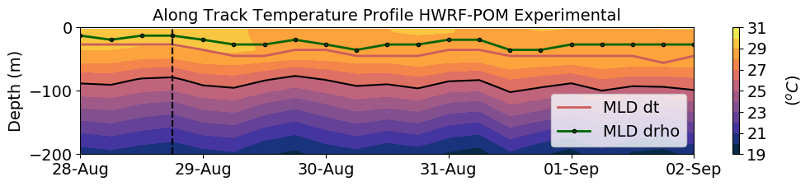
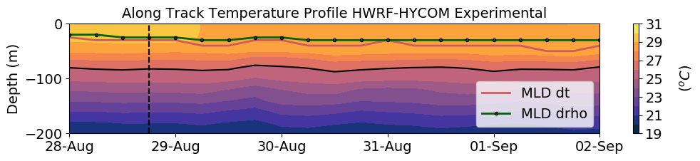
SG665 Temperature
Dorian
(a)
Observations
(b)
Data Assimilative Model
(c)
Forecast
(d)
Forecast
(e)
Forecast

Slide 13
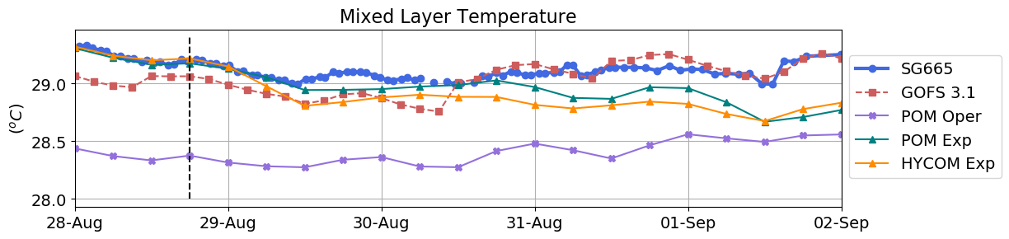
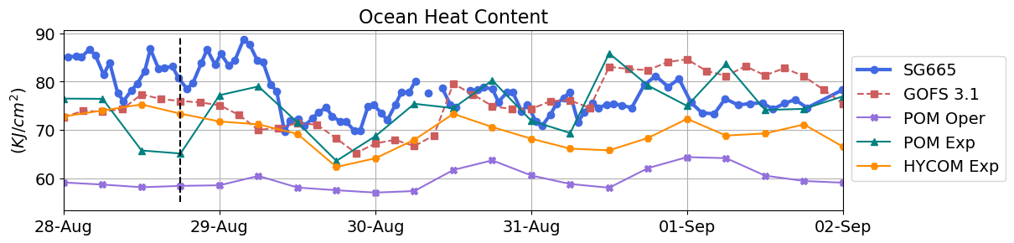
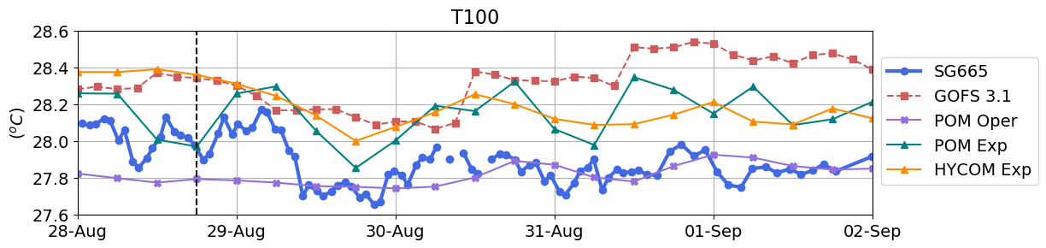
Ocean Heat Content
(a)
(b)
(c)

Slide 14
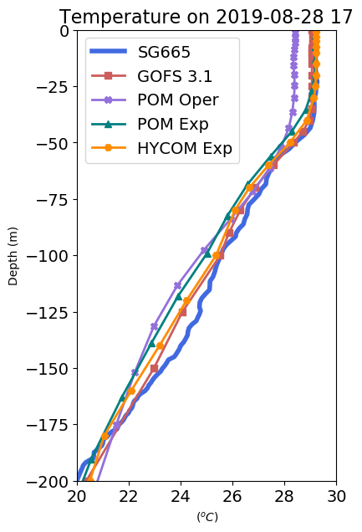
Temp ml
T100_ml

Slide 15
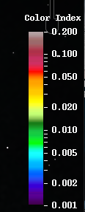
MODIS Color Index
Aug 25 /2019 17:50 GMT
MODIS Color Index
Aug 30 /2019 18:10 GMT
MODIS Color Index derived from reflectance data after correction for gaseous absorption, molecular scattering, and sun glint effects. It is basically the reflectance at 555 nm, referenced against linear baseline between 469 and 645 nm (Hu, 2011). CI has the advantage over the “standard” NASA chlor_a or other products because it is nearly immune to sun glint contamination, and therefore increases the data coverage for subtropical and tropical oceans. This is particular useful for cruise planning and for feature tracking. The MODIS standard product MOD35 (Ackerman et al., 2010) is used to discriminate clouds from water, and a cloudmask (grey color) is overlaid on the image.
However Doxaran et al. (2009) demonstrated that this product can be appropriate for monitoring reflective turbid waters,
The strongest turbidity signal is observed at 555 nm (nLw555), as previously reported for other locations (e.g. Nezlin and DiGiacomo, 2005, Nezlin et al., 2005, Thomas and Weatherbee, 2006).

Slide 16
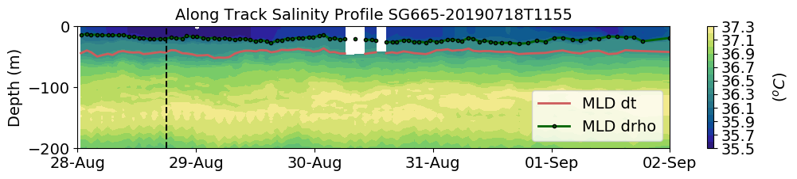
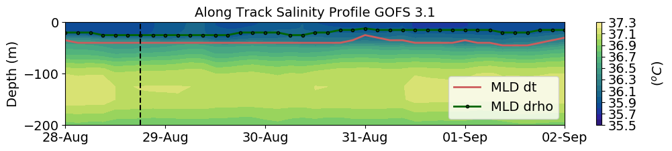
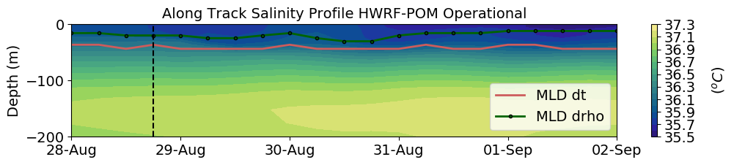
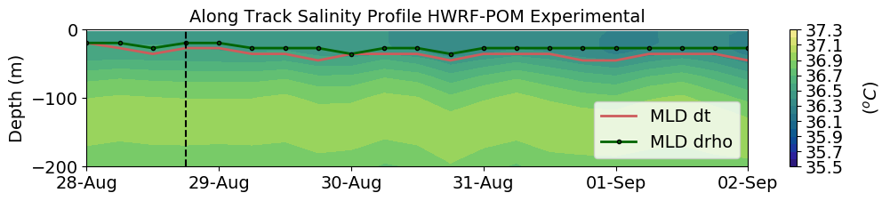
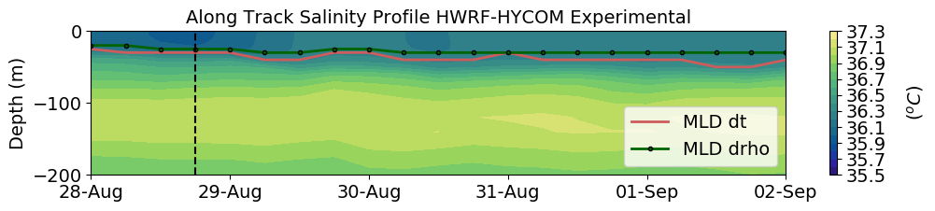
Inside Area of Fresh Water Influence
Dorian
(a)
Observations
(b)
Data Assimilative Model
(c)
Forecast
(d)
Forecast
(e)
Forecast

Slide 17
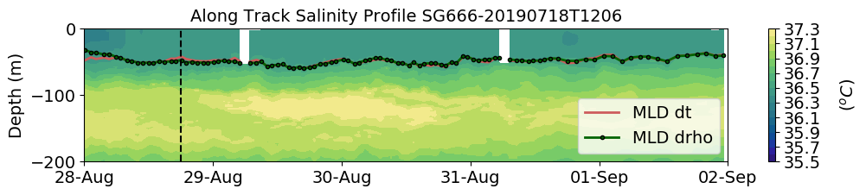
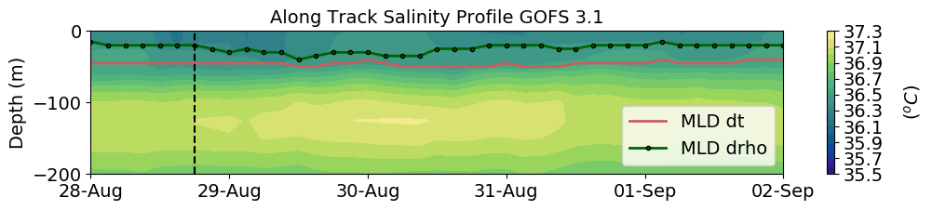
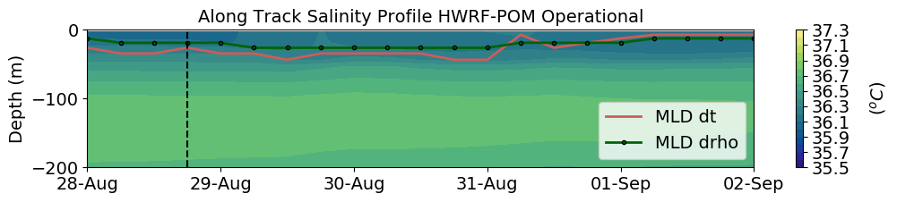
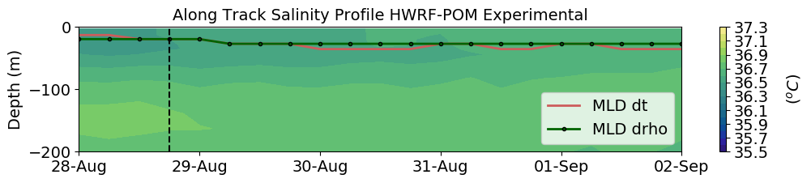
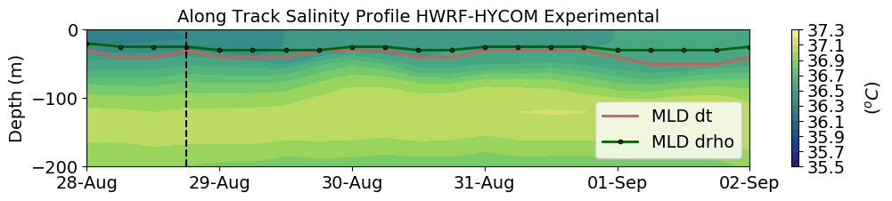
Outside Area of Fresh Water Influence
Inside Area of Fresh Water Influence
Dorian
(a)
Observations
(b)
Data Assimilative Model
(c)
Forecast
(d)
Forecast
(e)
Forecast

Slide 18
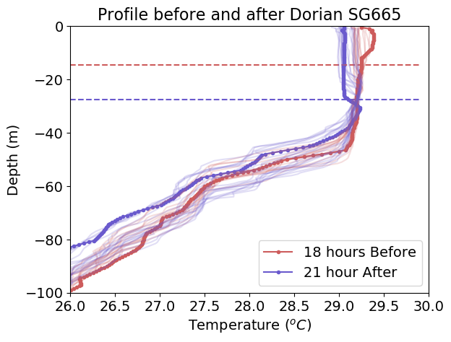
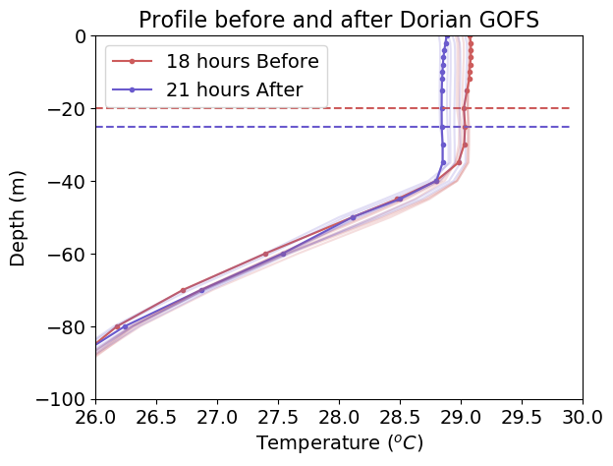
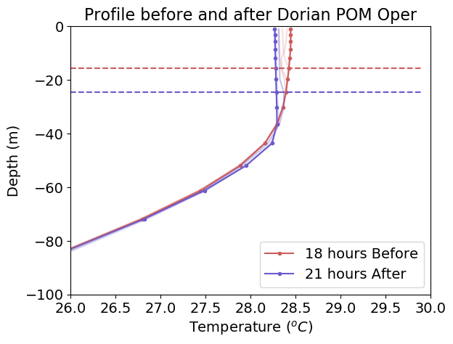
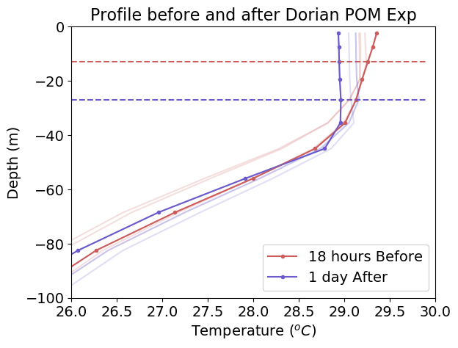
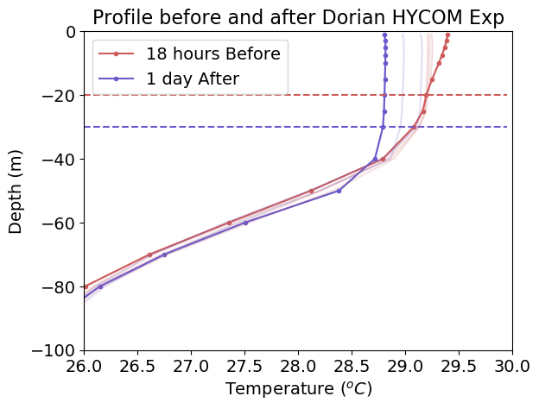
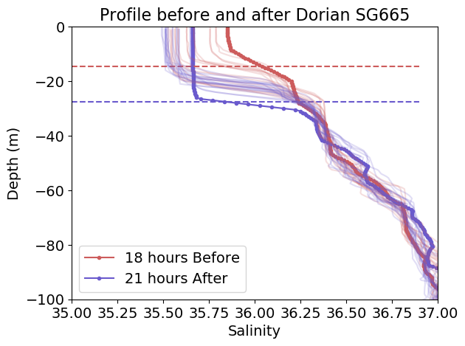
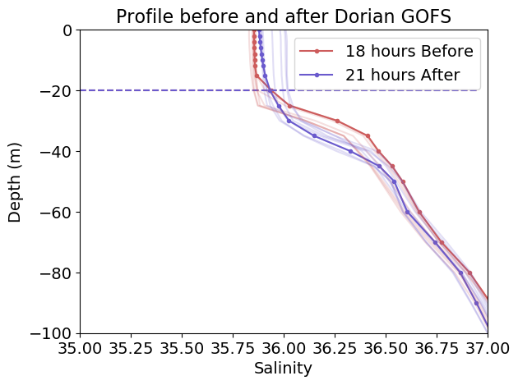
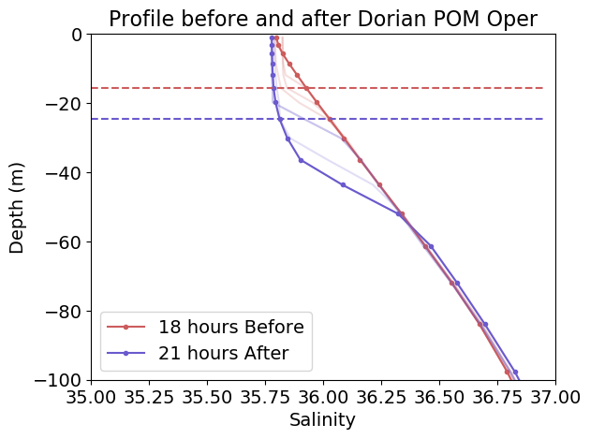
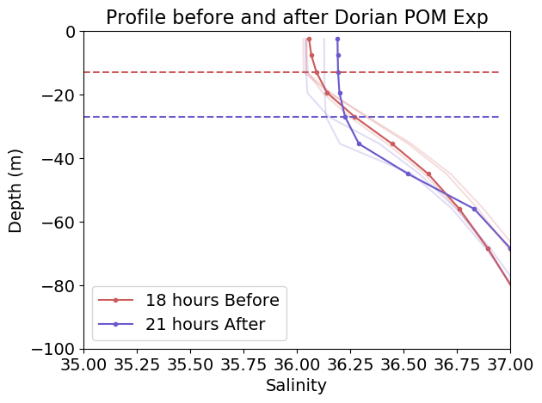
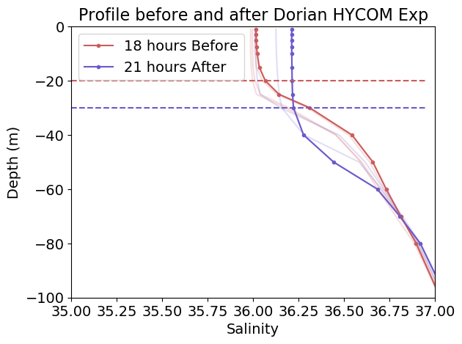
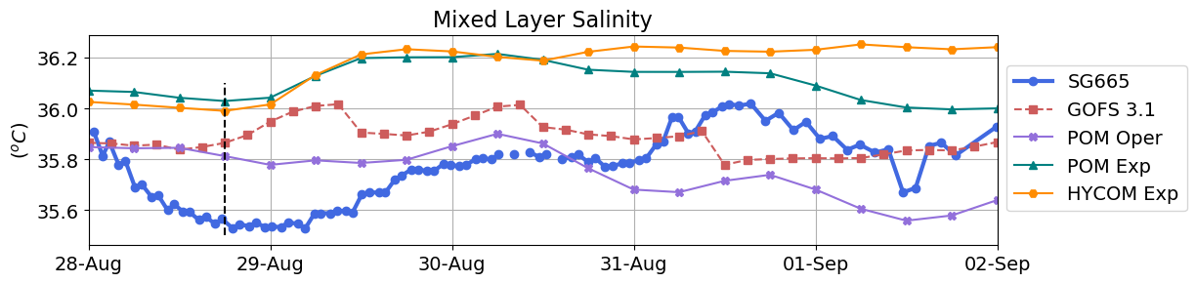
Inside Barrier layer SG665
MLD
MLD
(a)
(b)
(c)
(d)
(e)
MLD
MLD
(f)
(g)
(h)
(i)
(j)

Slide 19
Inside Barrier layer SG665
MLD
MLD
(a)
(b)
(c)
(d)
(e)
MLD
MLD
(f)
(g)
(h)
(i)
(j)

Slide 20
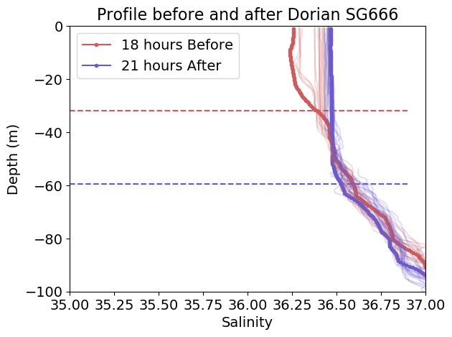
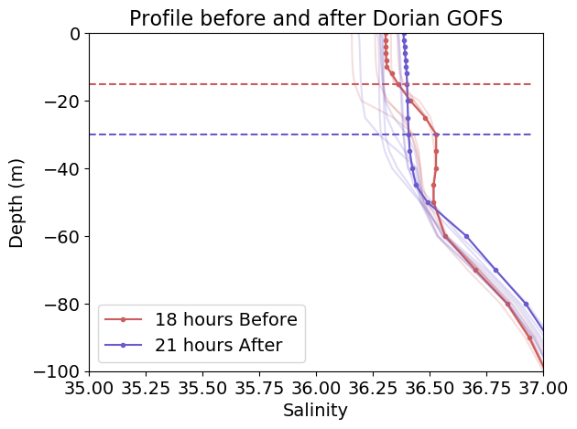
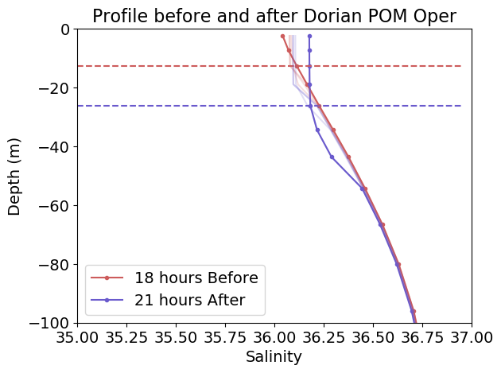
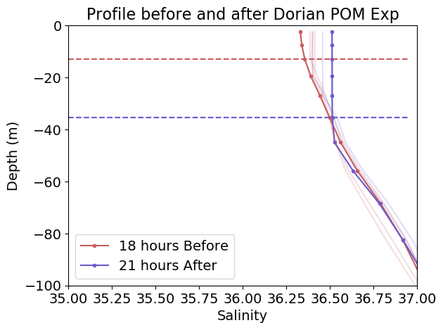
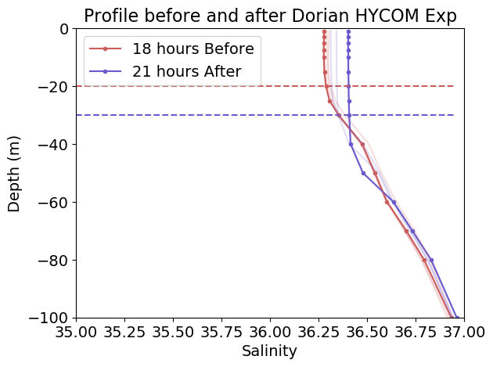
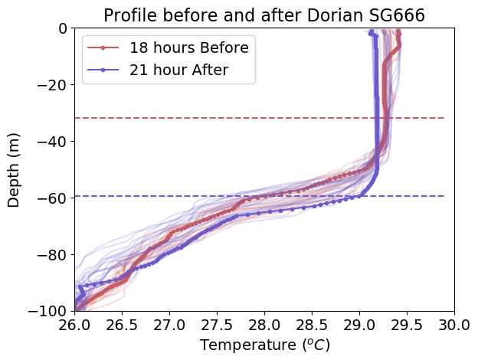
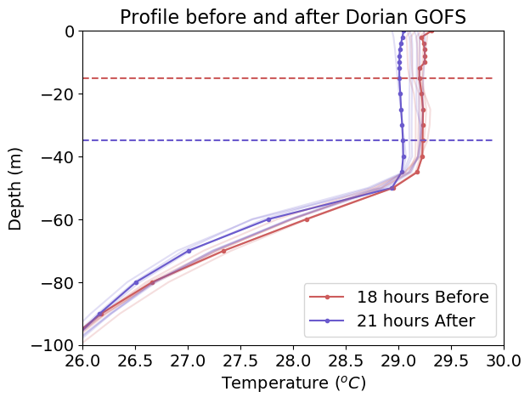
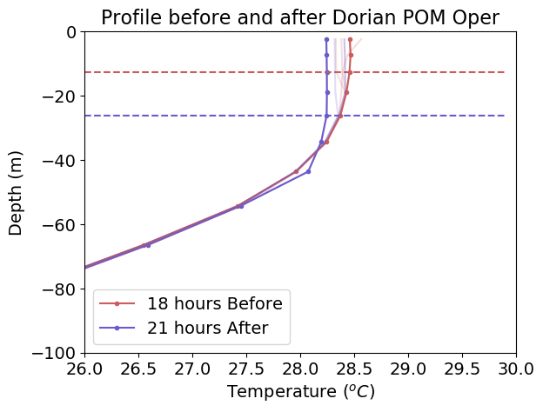
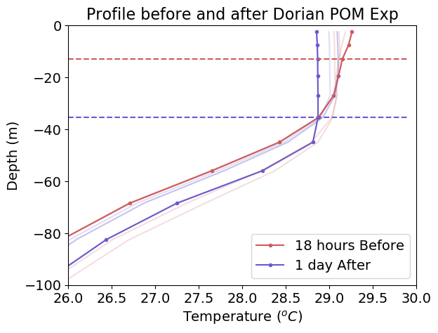
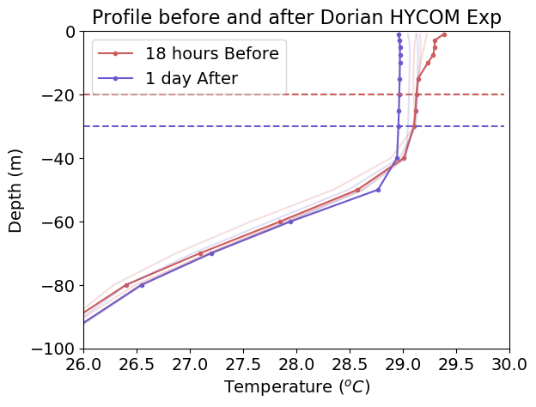
MLD
MLD
(a)
(b)
(c)
(d)
(e)
MLD
MLD
(f)
(g)
(h)
(i)
(j)

Slide 21
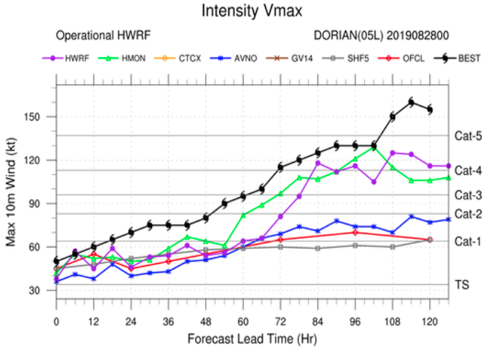

Slide 22
HWRF - Hurricane Weather Research and Forecast model
HMON - Hurricane Multi-scale Ocean-coupled Non-hydrostatic model
CTCX - NRL COAMPS-TC 5km model (experimental version)
AVNO - NWS / Global Forecast System (GFS model)
GV14 – NSF/NCAR Gulfstream V (G-V) aircraft ????
SHF5 - Statistical Hurricane Intensity Forecast (SHIFOR) intensity model 5-day
OFCL - National Hurricane Center (NHC) official forecast
(in ATCF system and not from advisory data)
ATCF – Automated Tropical Cyclone Forecast System

Slide 24
OHC
Surface Mixed Layer

Slide 25
Surface Mixed Layer
T100

Slide 26
POM
Exp
POM
Oper
Temp ML
OHC
Salt ML
T100
Salt
Temp
GOFS
HYCOM
Exp

Slide 27
MODIS Color Index
Aug 25 /2019 17:50 GMT

