Slide 1
Validation of the HWRF-POM and HWRF-HYCOM Hurricane Forecasting Systems during Hurricane Dorian using Glider Observations
Maria Aristizabal
Travis Miles
Scott Glenn
Hyun-Sook Kim
Avichal Mehra

Slide 2
Motivation
NOAA Environmental Visualization Laboratory

Slide 3
Motivation
https://www.aljazeera.com/news/2019/09/death-destruction-stalks-bahamas-wake-hurricane-dorian-190906022923964.html

Slide 4
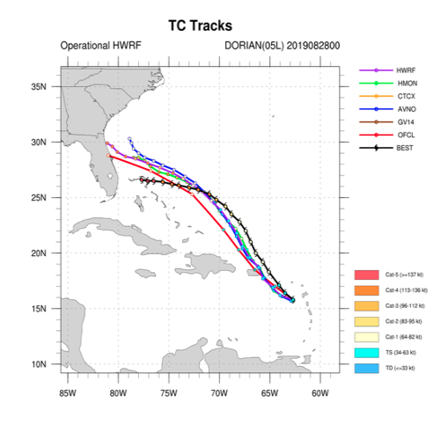
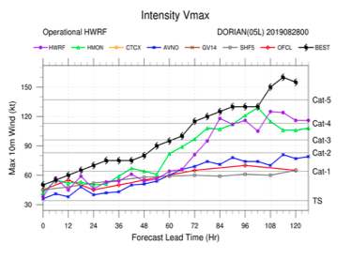
Motivation
Dorian Forecast Cycle 2019/08/28/00
None of the hurricane forecasting models captured the intensity evolution five days prior to Dorian reaching its maximum strength (Avila, L., Stewart, S., Berg, R., and AB, H, "Tropical cyclone report hurricane dorian (al052019) 24 august–7 september 2019". 2020. National Hurricane Center.)

Slide 5
Objective
Evaluate different upper ocean metrics: temperature and salinity in the mixed layer, ocean heat content and average temperature in the top 100 meters, that are relevant to air-sea heat fluxes, and therefore to hurricane intensity, in three hurricane forecasting models, using temperature and salinity data from a fleet of autonomous underwater gliders, dedicated to hurricane research and operations.

Slide 6
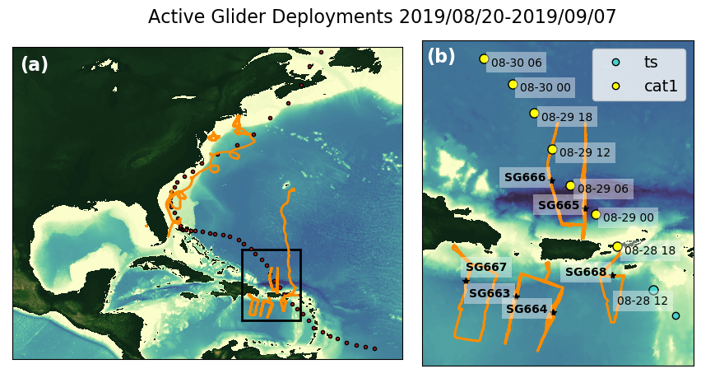
Methods
Glider data assembly center (DAC)
(https://gliders.ioos.us/erddap/index.html)

Slide 7
Methods
Numerical Models
HWRF2019-POM: One of the operational NOAA hurricane forecasting system during 2019. IC from climatology and a feature-based model
HWRF2020-POM: Experimental system. IC from RTOFS
HWRF2020-HYCOM: Experimental system. IC from RTOFS
GOFS 3.1: Navy operational ocean model. Implements data assimilation. https://tds.hycom.org/thredds/

Slide 8
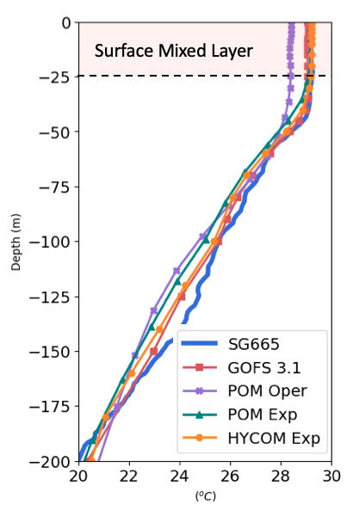
Methods
Surface Ocean Metrics
Temperature in the surface mixed layer (Temp ML)
Temperature Criteria:
Density Criteria:
Ocean Heat Content (OHC)
Depth average temperature
top 100 m. (T100)

Slide 9
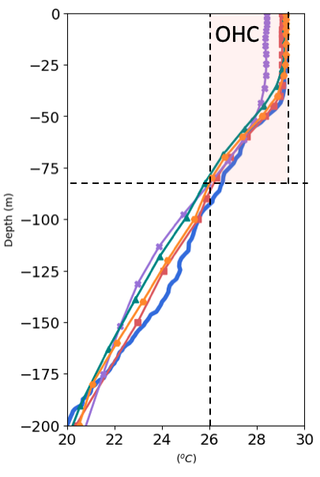
Methods
Surface Ocean Metrics
Temperature in the surface mixed layer (Temp ML)
Ocean Heat Content (OHC)
Depth average temperature
top 100 m. (T100)

Slide 10
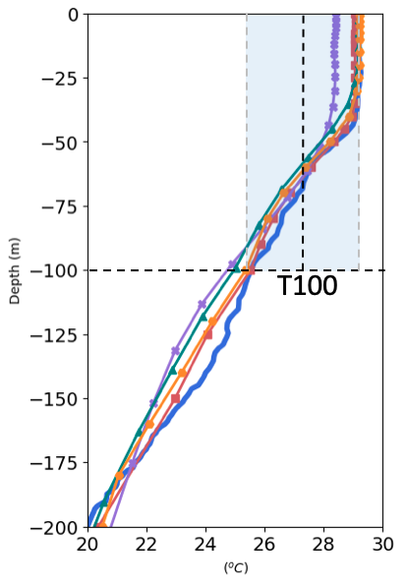
Methods
Surface Ocean Metrics
Temperature in the surface mixed layer (Temp ML)
Ocean Heat Content (OHC)
Depth average temperature
top 100 meters (T100)

Slide 11
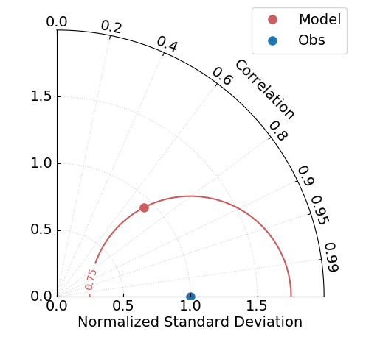
Normalized Taylor Diagram
Accurate
model

Slide 12
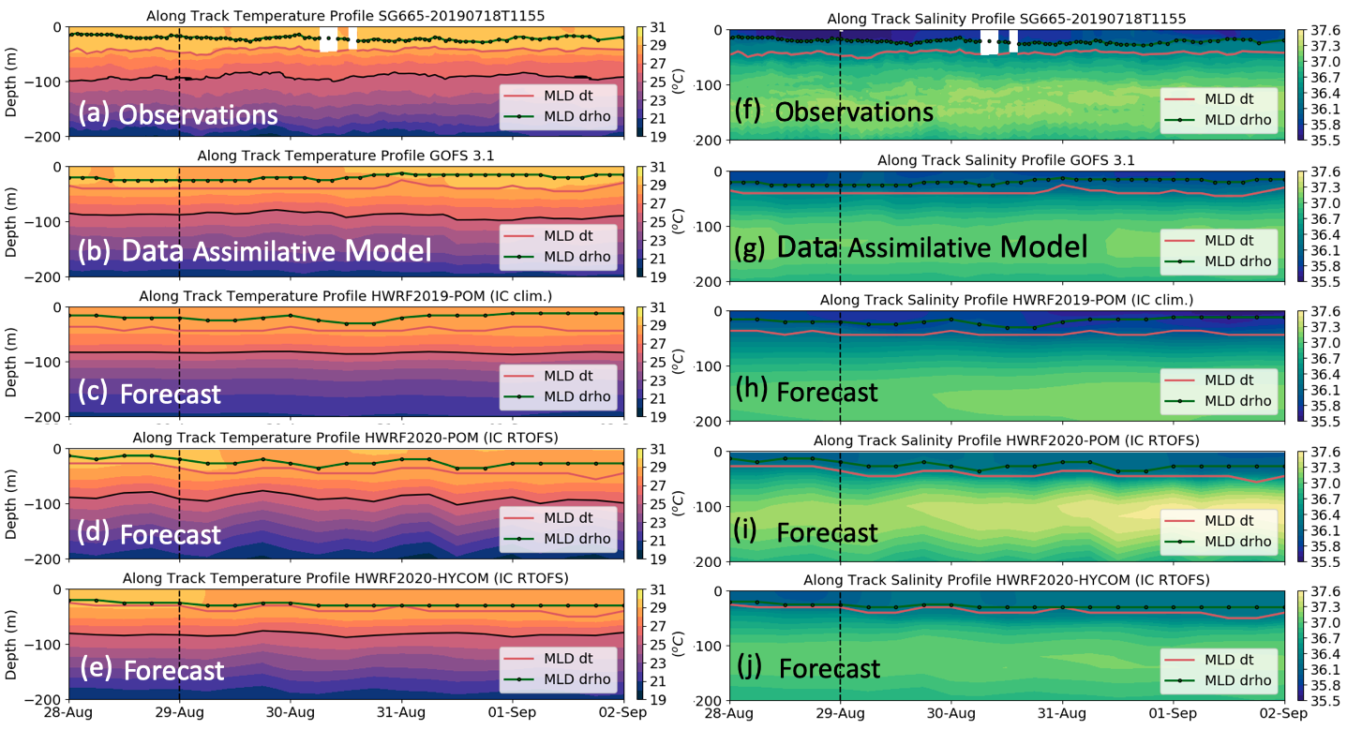
Results
Dorian
Temperature fields in the four ocean models agree well with the glider observations
Salinity controls vertical stratification in the Caribbean Sea

Slide 13
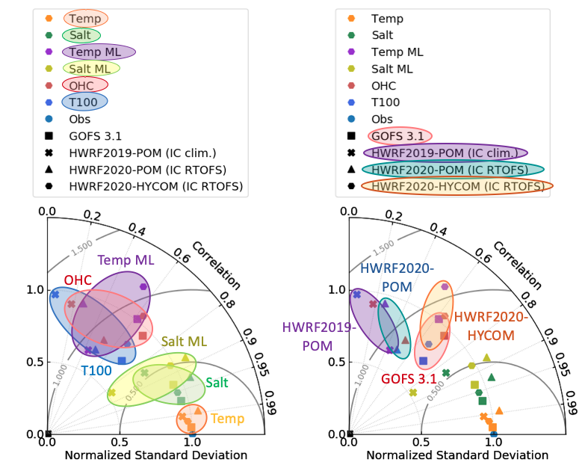
Results
All models have a good skill in the temperature and salinity of the entire water column
The models' skill considerably deteriorates for the upper ocean metrics that are relevant for air/sea heat fluxes such as temperature in the mixed layer (Temp ML), ocean heat content (OHC) and depth average temperature in the top 100 meters (T100).

Slide 14
Results
HWRF2020-HYCOM is the hurricane forecasting model with best skill for the surface ocean metrics and its skill is close to the skill of the data assimilative model GOFS 3.1
HWRF2019-POM and HWRF2020-POM have a poor skill for these metrics

Slide 15
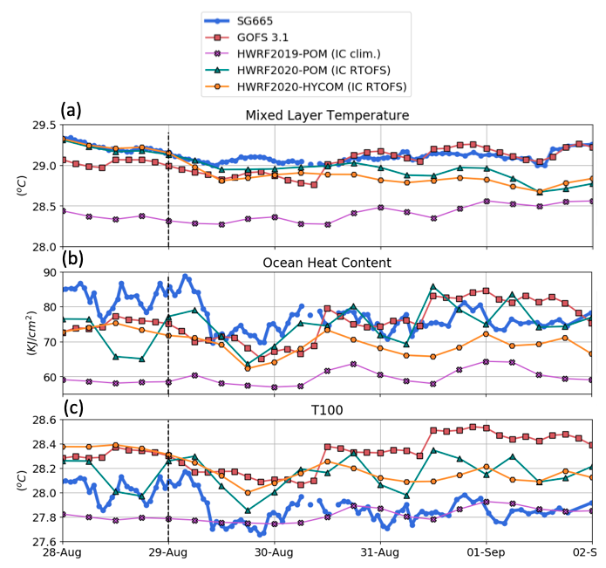
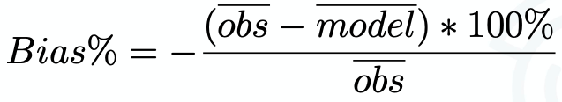
Results
 | GOFS | POM Oper | POM Exp | HYCOM Exp
T ML | -0.40% | -3.0% | -0.94% | -0.62%
OHC | -3.6% | -22% | -17% | -8.7%
T100 | 1.4% | -0.46% | 0.49% | 1.2%
All models are colder in the surface mixed layer
All models have a deficit in the OHC

Slide 16
Conclusions
All the ocean-atmosphere coupled hurricane models evaluated: HWRF2019-POM operational, HWRF2020-POM experimental and HWRF2020-HYCOM have a cold bias in the surface mixed layer and a deficit in the ocean heat content
All the models have a good skill in the temperature and salinity over the full water column, However their skill is significantly reduced for the upper ocean metrics that are relevant to the air-sea heat fluxes such as temperature in the mixed layer (Temp ML), ocean heat content (OHC) and average temperature in the top 100 meters (T100)
The skill of HRWR2020-HYCOM was the best of the three coupled models and comparable to the data assimilative model GOFS 3.1. These results demonstrate that the implementation of HYCOM as the ocean model underneath the hurricane forecasting models, will significantly improve the representation of key quantities that are important for the air-sea heat fluxes during tropical cyclones

Slide 17
Future Work
In collaboration with NOAA/NCEP, we will continue to evaluate the new generation of hurricane forecasting models HAFS (Hurricane Analysis and Forecast System)
Identify key physical quantities in the Ocean models that are critical for hurricane intensity evolution

