Slide 1
Impact of Glider Data Assimilation on Operational Ocean Models During
the 2018 Hurricane Season
Avichal Mehra
Hyun-Sook Kim
Pat Hogan
Gregg Jacobs
Sue Chen
8th EGO Meeting
May 21-23 2019
Maria Aristizabal
Scott Glen
Travis Miles
Notes:
This talk is about the impact of glider data assimilation on the operational ocean model that provides the IC for the NOAA hurricane forecasting models and the ocean models that are under the hurricane forecasting models. This work has been done in collaboration with Avichal and Hyun-Sook from NCEP and Pat, Gregg and Sue from NRL.

Slide 2
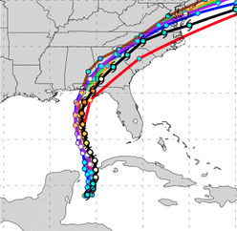
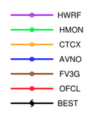
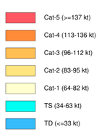
Motivation
Assess the impact of glider data assimilation on the operational hurricane models
Hurricane Michael Forecast
https://www.emc.ncep.noaa.gov/gc_wmb/vxt/HWRF/index.php
Notes:
our overarching motivation is to contribute to the ongoing efforts to improve the forecast of the operational hurricane models but more specifically we want to assess the impact of glider data assimilation in the forecast of these operational hurricane models.

Slide 3
Mexico Beach
After Hurricane Michael
Category 5 at landfall
Storm surge 7.7 feet
Total cost estimated as $25 billion
Notes:
We all know that every year hurricanes cause human and property loses and that is why is critical to improve the forecast of tropical cyclones. Just last year we had two very damaging hurricanes. hurricane Michale in the gulf of Mexico. Michale was a category 4 hurricane, almost a cat 5 at landfall and It caused damages estimated in 25 billion dollars.

Slide 4
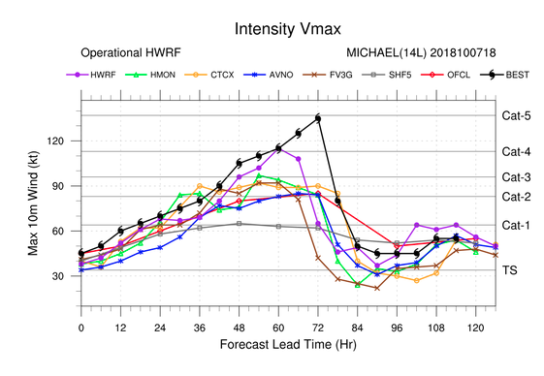
Forecast Guidance for Storm Michael
Oct 8/2018
https://www.emc.ncep.noaa.gov/
https://www.emc.ncep.noaa.gov/gc_wmb/vxt/HWRF/index.php
None of the models forecasted the rapid intensification
Official forecast predicted a cat 2 at landfall
Notes:
This plot shows the forecast for hurricane Michael two days before landfall for various forecasting models. The black line shows the actual intensity. We can see that none of the models was able to predict the rapid intensification before landfall. The red line, that is the official forecast, significantly under predicted the intensity at landfall predicting a category 2 storm. We still do not understand why all the models under predicted Michael’s intensity so significantly.

Slide 5
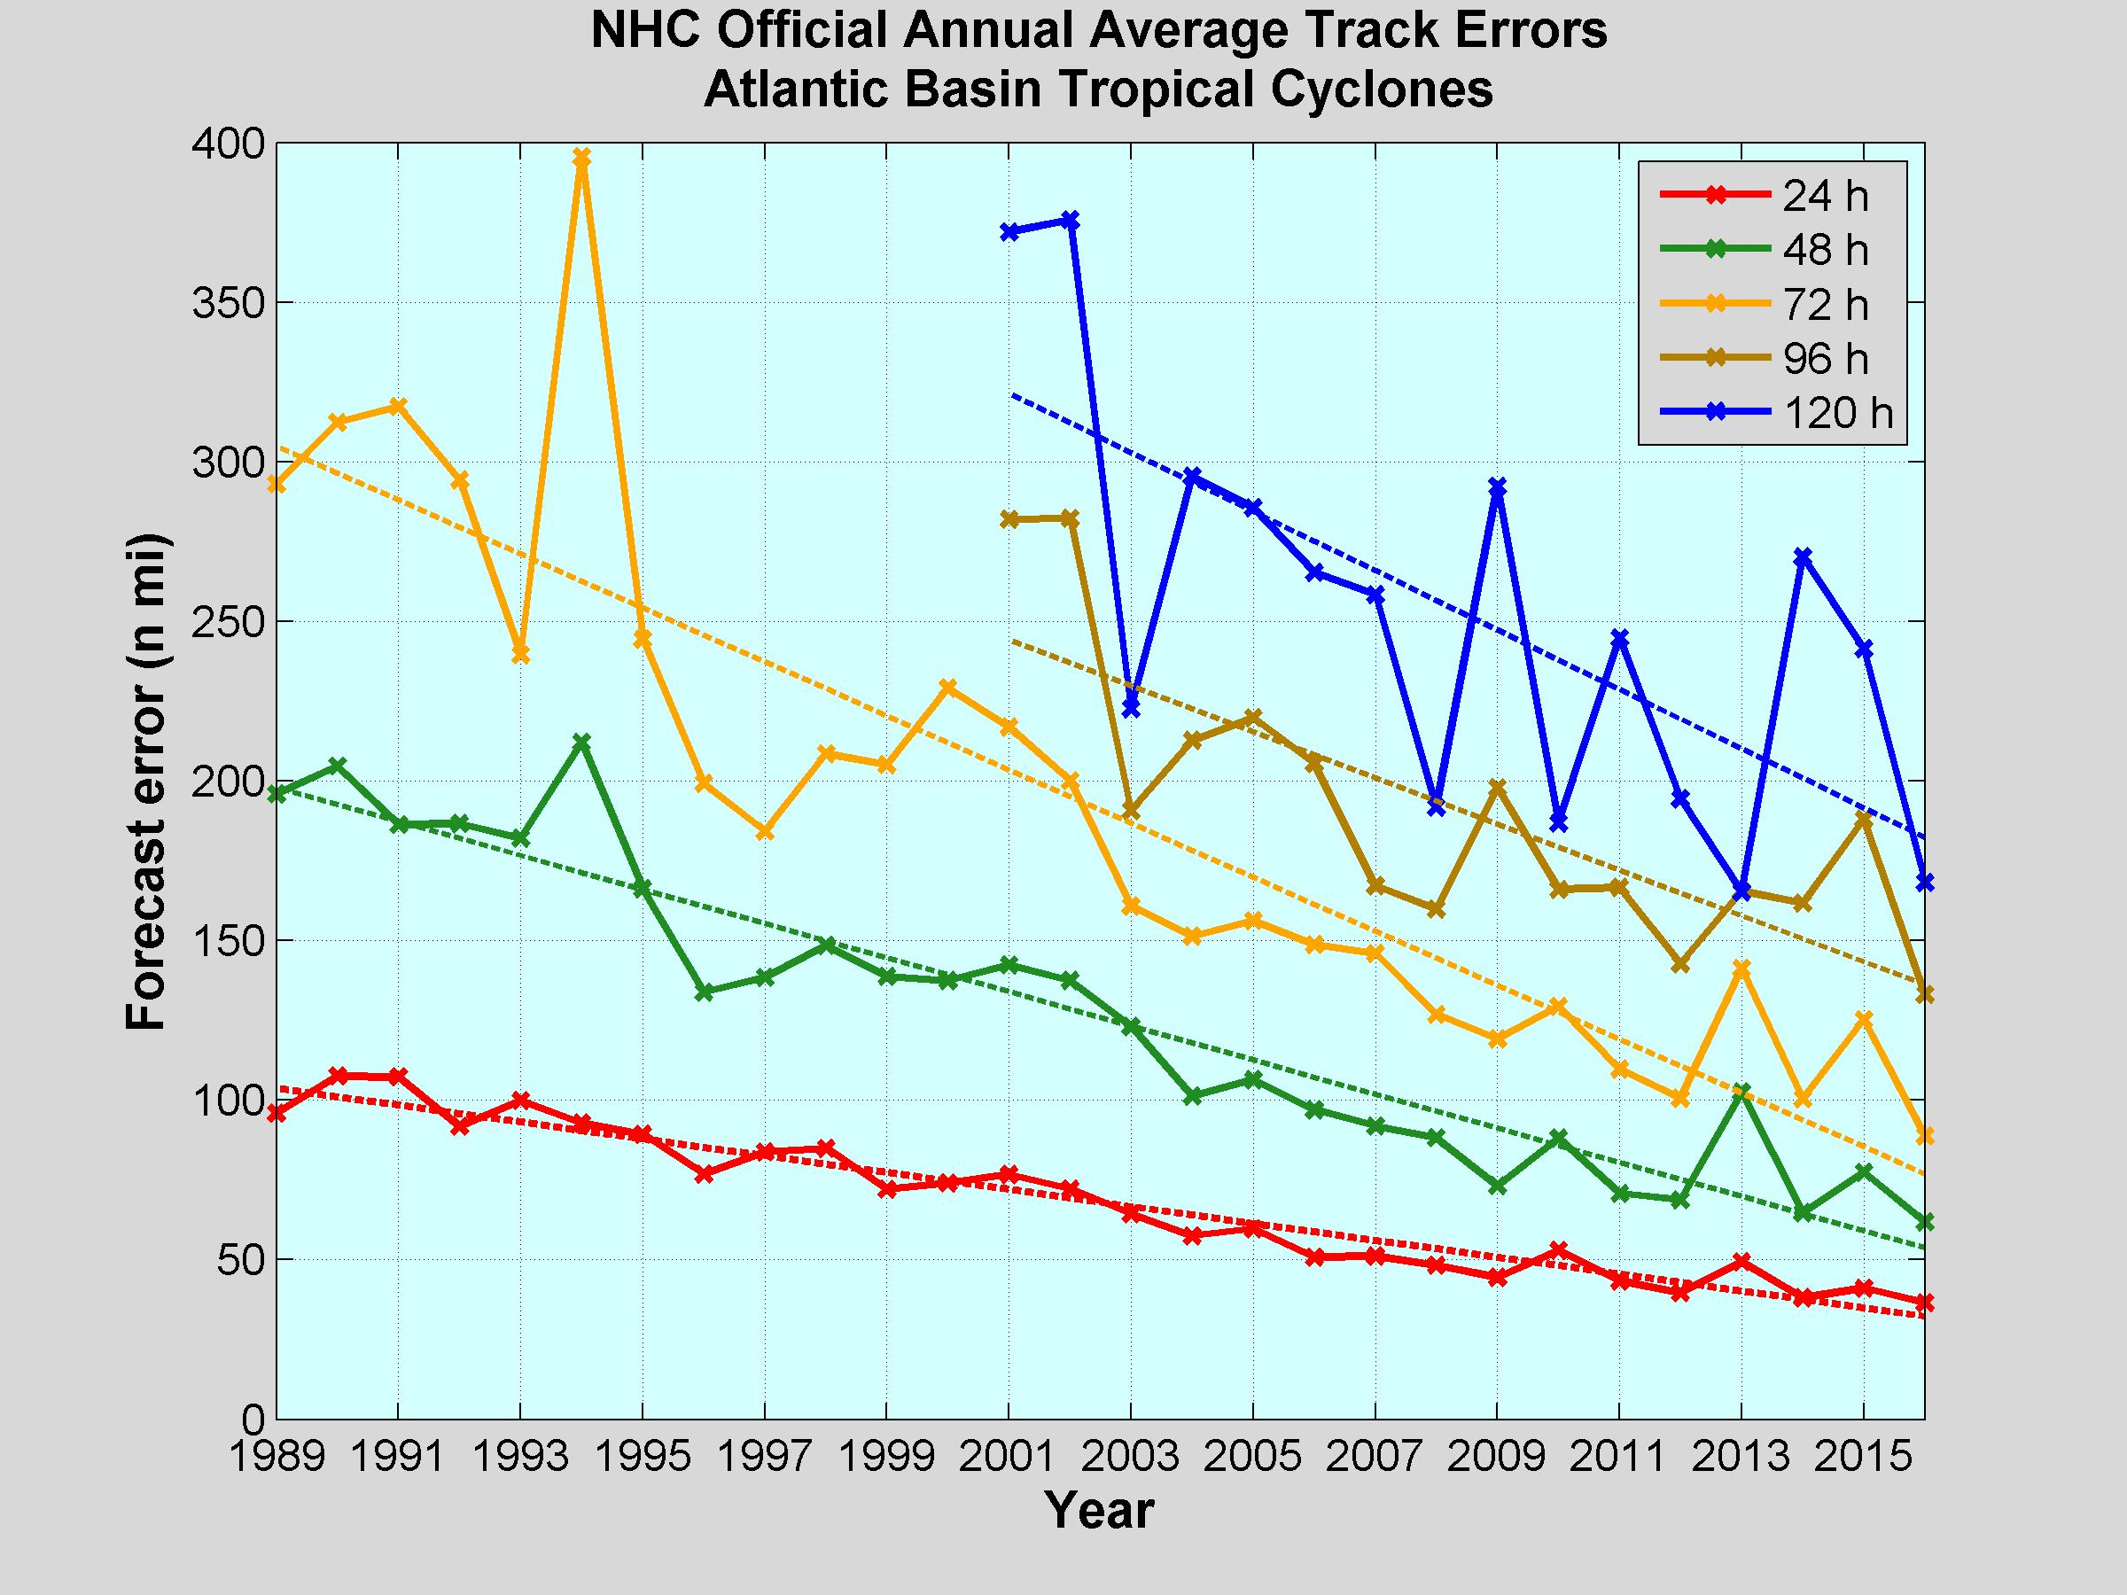
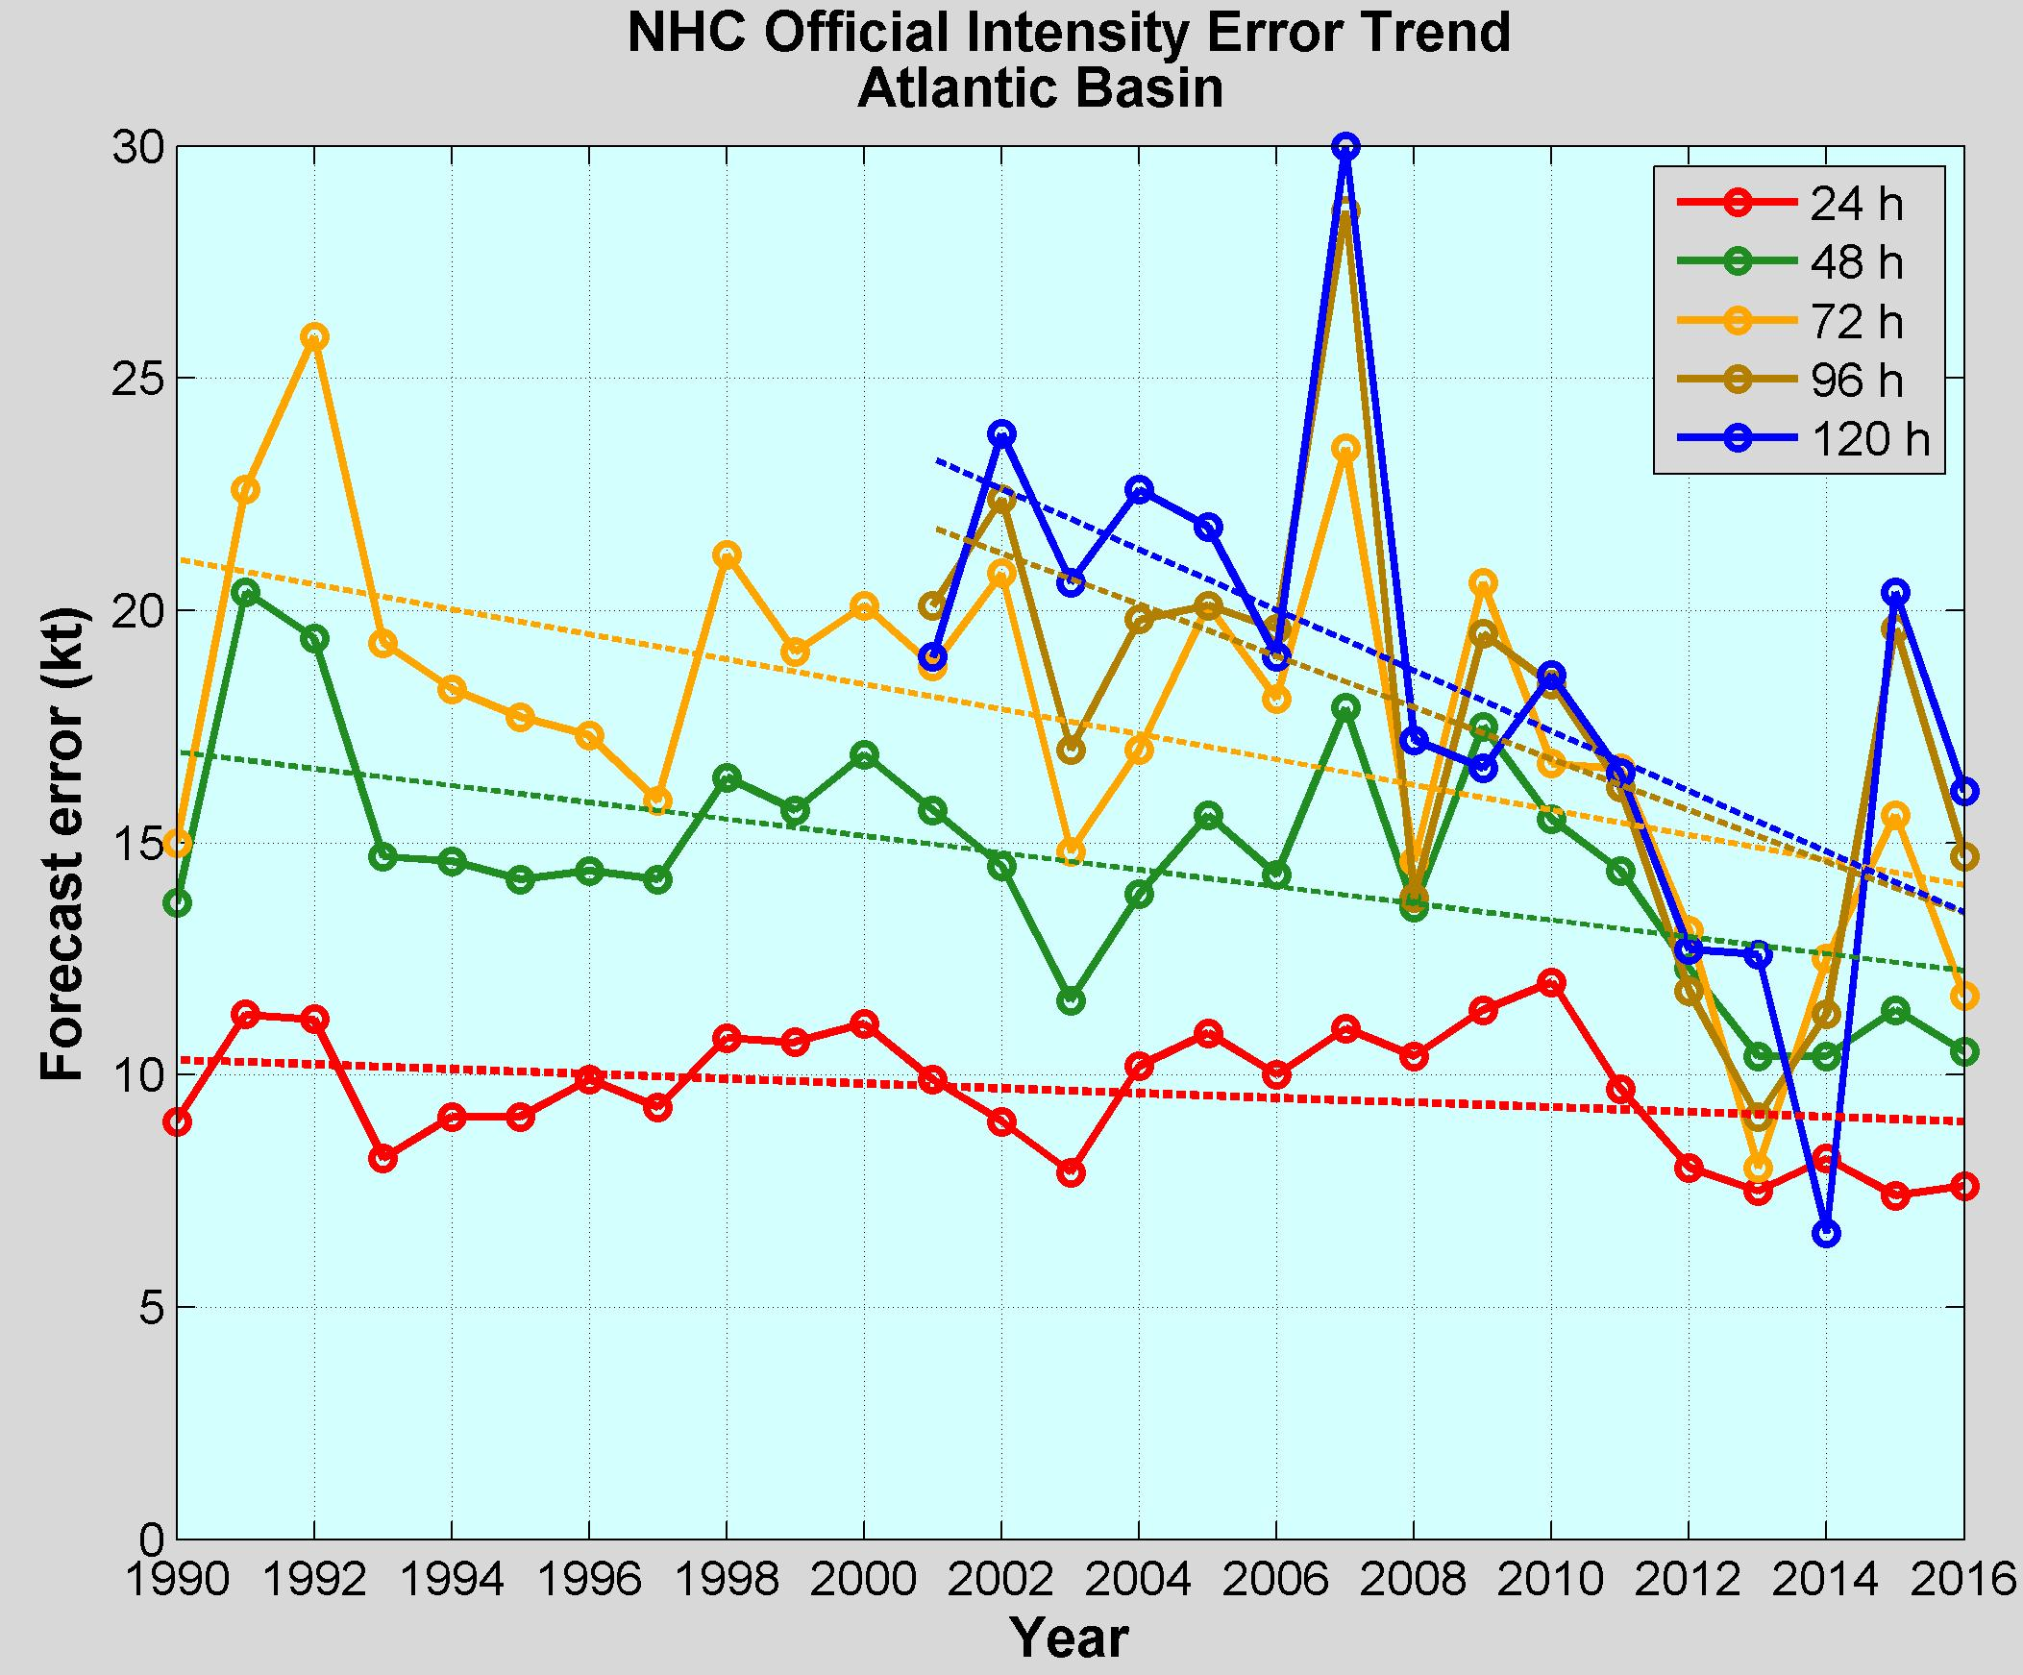
NOAA Annual Operational Suite Review
~ 50%
~ 15 %
Limitations on Hurricane Intensity Improvement
Computing resources and model resolution (Rotunno et al., 2009)
Poor understanding of the atmospheric boundary layer (Nolan et al., 2009; Andreas et al., 2015)
Difficulty in modeling the upper ocean response to storm forcing (Yablonsky and Ginis, 2009).
Notes:
For more than a decade there has been a concerted effort by NOAA and other federal agencies to improve the hurricane forecast (Hurricane Forecast Improvement Project). There has been a fair progress reducing track errors for the different lead times: the track error has been reduced by about 50% for all the lead times. However, the error reduction in the intensity has been marginal: about only 15%. There are several reasons for the lack of progress in the intensity forecast. One limitations in the horizontal and vertical resolutions of the couple atmospheric-ocean models which is limited by the computing resources. There is still gaps in our understanding of the atmospheric-ocean boundary layer. And the aspect that concern us is the difficulty of modeling the upper ocean response under a hurricane.

Slide 6
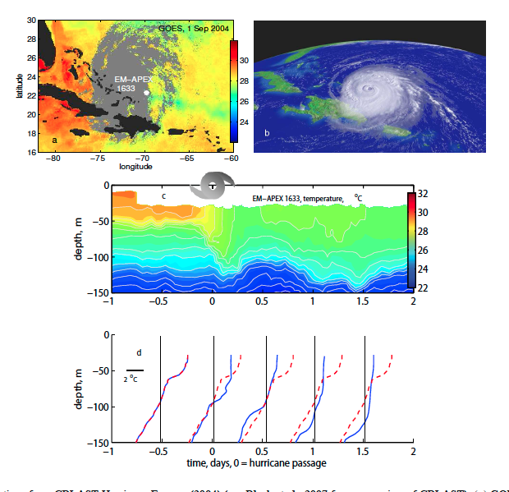
Upper Ocean Response
Temperature and humidity differences at the air-sea interface control the heat fluxes. SST is a relevant ocean quantity
During a storm, SST is manly controlled by the storm-induced vertical mixing and the strength of the vertical stratification
Hurricane Francis
2004
Price 2009
Notes:
During the passage of a hurricane there is a heat flux between the atmosphere and the ocean that is mostly driven by the temperature difference between the two. So SST plays a very important role in this flux. The SST will evolve and in most cases in the open ocean the sea surface temperature will decrease because of the vigorous vertical mixing between the surface layer and the cooler subsurface layer. The vertical mixing is induced by the high hurricane winds. Because of this, the strength of the vertical stratification is also key to determine the evolution of SST during the passage of the hurricane. We see the evolution of the SST during hurricane Francis 2004 in this vertical temperature section and we can also see clearly the vertical mixing that is causing the drop on the SST.

Slide 7
Upper Ocean Response
In the continental shelf, there are other physical processes that control SST during storms: shear-induced vertical mixing due to wind-forced two-layer circulation (Glenn et al 2016), upwelling/downwelling circulation depending on the incident angle of the storm (Miles et al 2017)
Hurricane Irene (Glenn et al 2016)
On Shore
Off Shore
To capture the upper ocean response in the shelf is critical because the SST at the shelf will determine if a hurricane will intensify or weaken before landfall
Notes:
In the shelf, aside from the wind-induced vertical mixing, there are other processes that can take place. The hurricane winds can set up a two layer cross-shore circulating way ahead of the eye. This two layer circulation will also induce vertical mixing but due to the vertical velocity shear. Another process that can happen is upwelling or downwelling at the coast depending on the incident angle of the storm. If we have upwelling, colder bottom water will be brought to the surface and this will promote a weakening of the storm. The opposite will happen if we have downwelling. So it is very important to capture the upper ocean response in the shelf because the SST at the shelf will determine if the hurricane will intensify or weaken before landfall.

Slide 8
How to Improve the Modeling of the Upper Ocean Response During a Hurricane on the continental shelf?
Improve the subsurface initial conditions in the operational ocean models: right initial vertical stratification, better evolution of the SST during storms , better heat fluxes estimates
Notes:
how can we improve the modeling of the upper ocean response in the continental shelf during a hurricane? The very first thing that can be do is to improve the initial conditions of the ocean models that are coupled to the hurricane forecasting models. If the IC are improved we will have the right initial vertical stratification and initial SST, then we will have a better evolution of the SST and therefore we will have a better estimate of the heat fluxes. One way to improve the IC is using data assimilation in the ocean models.

Slide 9
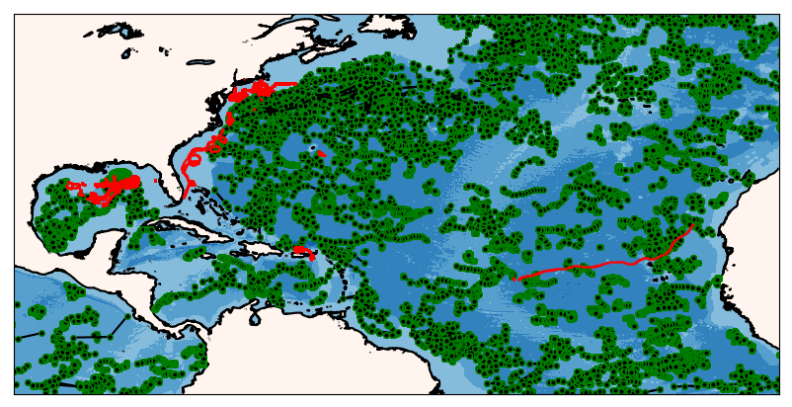
How to Improve the Modeling of the Upper Ocean Response During a Hurricane on the continental shelf?
Improve the subsurface initial conditions in the operational ocean models: right initial vertical stratification, better evolution of the SST during storms , better heat fluxes estimates
Ocean Data Assimilation

Slide 10
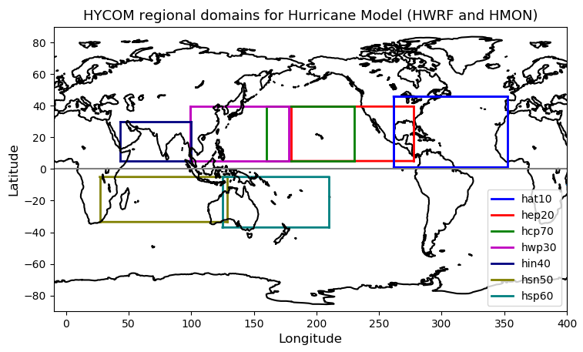
NOAA Hurricane Forecasting Models
HWRF/HYCOM
HMON/HYCOM
HWRF/POM
West
Pacific
Central
Pacific
East
Pacific
North
Atlantic
North
Indian
South
Indian
South
Pacific
HWRF – Hurricane Weather Research Forecasting Model
HYCOM – Hybrid Coordinate Ocean Model
HMON - Hurricanes in a Multi-scale Ocean-coupled Non- hydrostatic model
POM – Princeton Ocean Model
Notes:
Currently NOAA has there different coupled ocean-atmosphere hurricane models that operate in different regions. In the North Atlantic there are two model: the HMON/HYCOM and the HWRF/POM.

Slide 11
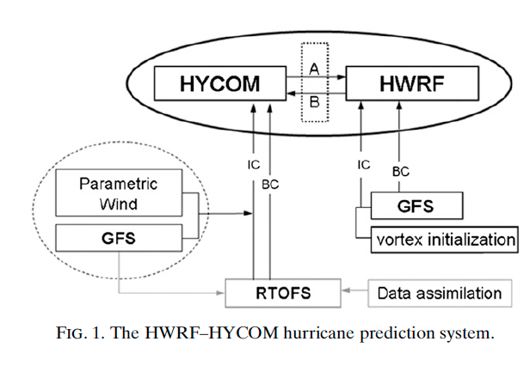
Hurricane Coupled Ocean-Atmosphere
Forecasting Model: HWRF-HYCOM System
IC
IC
Kim et al. 2014
GOFS/NCODA
RTOFS – Real Time Ocean Forecasting System
GFS – Global Forecasting System
Notes:
This is a schematic of the workflow for the HWRF/HYCOM system. The right side shows the atmospheric component and the left side is the oceanic component. The IC and BC for the regional HYCOM come from the global RTOFS, that is the NOAA operational ocean model. At the same time, the IC for the global RTOFS comes from Global Ocean Forecasting System GOFS that is the Navy operational ocean model and implements data assimilation though NCODA that is the Navy coupled ocean data assimilations system. So in its current state, the NOAA hurricane forecasting models incorporates ocean data assimilation through the IC to their own global ocean model. NCEP is currently working to implement data assimilation directly into RTOFS.

Slide 12
Global Ocean Forecasting System (GOFS)/
Navy Coupled Ocean Data Assimilation System (NCODA)
Surface Data
Subsurface Temperature and
Salinity
Satellite SST
Drifting buoys
Fixed buoys
Argo Floats
In Situ SST
GOFS/NCODA
Gliders
TESAC
Satellite Altimeter
XBTs (only temp.)
Notes:
The GOFS/NCODA system assimilates a wide variety of observations. At the surface the system assimilates satellite SST, in situ SST and satellite altimeter. It also assimilates subsurface temperature and salinity from different sources: …… temperature, salinity and current report from a sea station…..

Slide 13
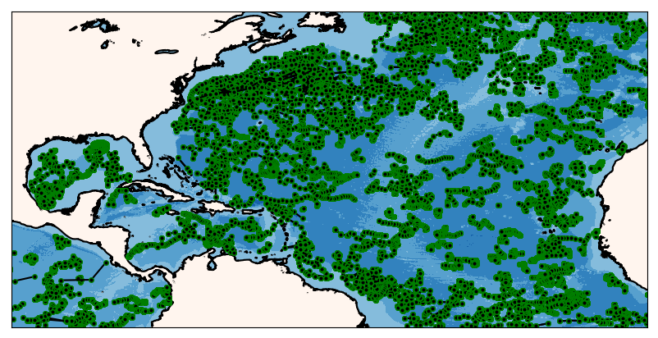
Argo Floats
During the 2018 Hurricane Season
Argo floats mostly occupy the open ocean
One vertical profile every ten days
Notes:
One of the most abundant subsurface observations is the ARGO floats. They are mostly found in open ocean, they usually do not cross the continental shelf and take one vertical profile every 10 days.

Slide 14
Argo Floats
During the 2018 Hurricane Season
Glider observations are mostly in the shelf
Tens of profiles per day
Notes:
On the other hand, Gliders are commonly deployed in the continental shelf, so they are complementary to the ARGO floats and can take tens of profiles per day.

Slide 15
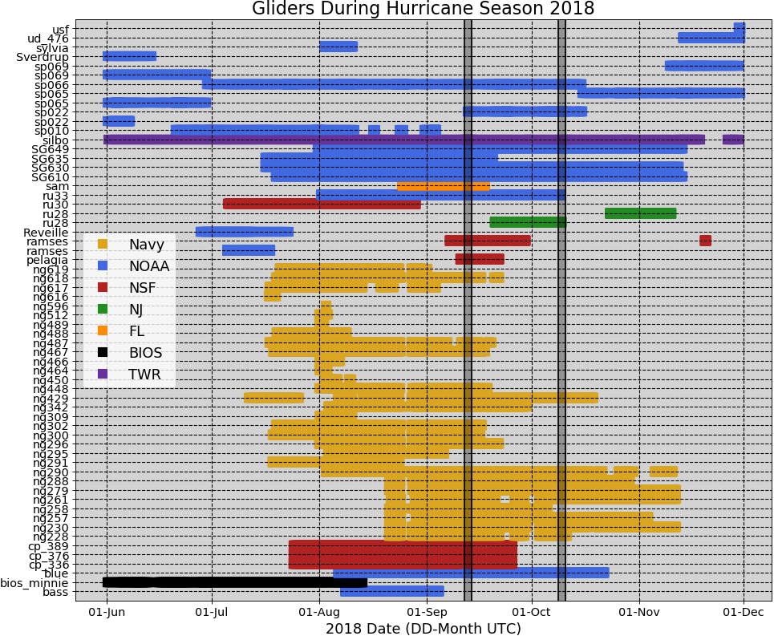
62 Gliders in the IOOS Glider Data Assembly
Center (DAC) During Hurricane Season 2018
Notes:
During the past hurricane season there were 62 gliders reporting to the IOOS glider data assembly center. All those about half were Navy gliders and 20 were sponsored by NOAA. All the data that is reported to the glider DAC is sent to the Global Telecommunication System (GTS) that is a data repository where a number of numerical model can access the data for data assimilation purposes.

Slide 16
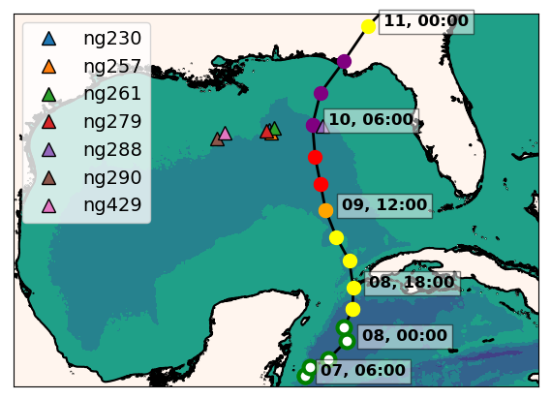
Hurricane Michael
ng288
Seven Navy gliders reporting to the glider DAC
in the GoM during hurricane Michael
Ng288 was at 36 km from the eye
of hurricane Michael
Notes:
During the passage of hurricane Michael, there were 7 Navy gliders in the Gulf of Mexico. One of them ng288 was 36 km away of the hurricane eye

Slide 17
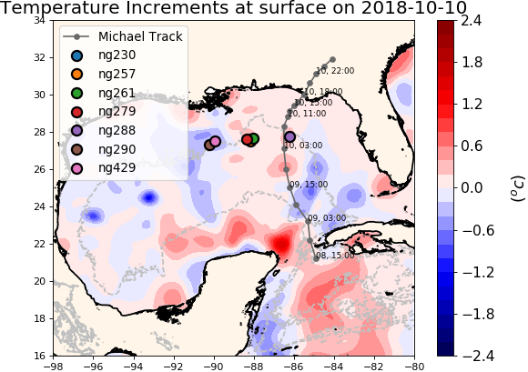
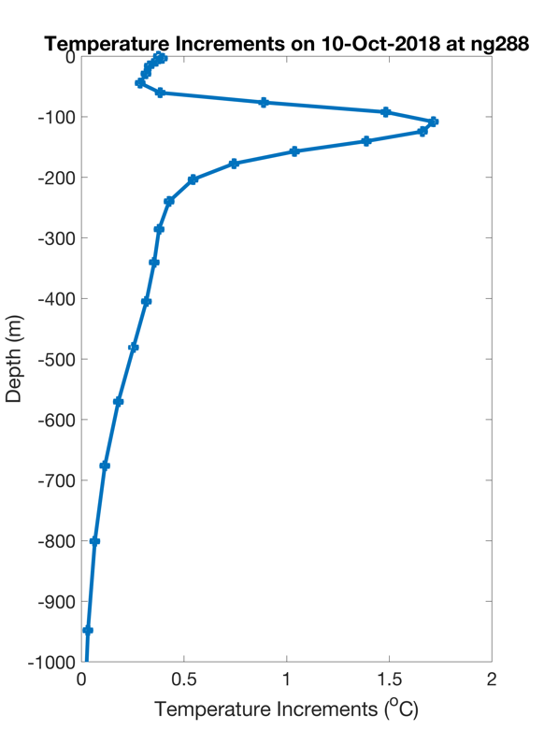
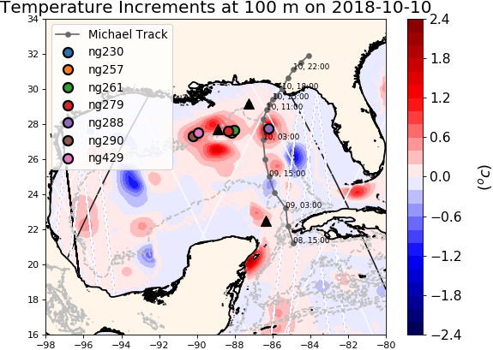
NCODA Temperature Increments
Argo
Jason 2
CryoSat
The increment is the change made to the model state at the end of the previous assimilation cycle
Notes:
The data from these gliders was assimilated by the navy operational ocean model GOFS. These figures show the temperature increments that are calculated by NCODA, the data assimilation system within GOFS. In the data assimilation jargon, the increments is the change made to the model when compared to the previous assimilation cycle. At the surface the temperature increments have a moderate value but most of the correction happens at depth around the locations of the gliders.

Slide 18
Hurricane Michael
Increments
Insertion Window
Increments
Insertion Window
Increments
Insertion Window
The assimilation of glider data days ahead of Michael corrected
the position of the thermocline
Notes:
This is the temperature transect from ng288 and we also have the temperature transect form the GOFS 3.1 following ng288 glider track. When we look back 5 days before the passage of Michael, we observe that in GOFS 3.1 after every increment insertion window, the thermocline is pulled down to match the depth of the thermocline from the glider data until it settles down at the right depth. This highlights the importance of having a continuous glider presence so when a storm strikes, the model ocean has a most realistic vertical stratification.

Slide 19
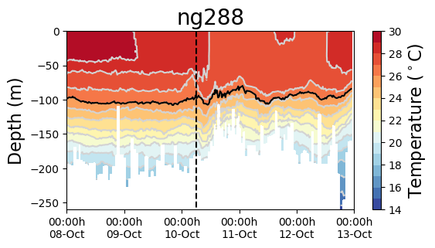
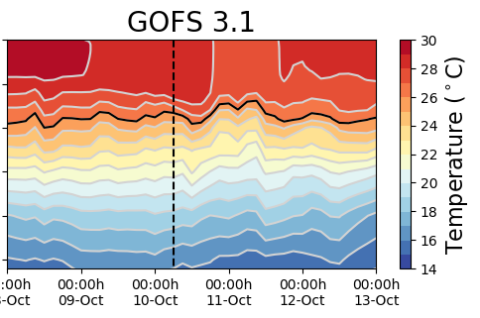
Hurricane Michael
Increments
Insertion Window
Increments
Insertion Window
The modeled SST increased after the passage of Michael: the ocean response is faster than the 1-day
assimilation cycle
Notes:
The bottom figure shows a temperature time series for the glider and GOFS. The grey rectangles show the time window when the temperature increments are inserted into the ocean model. Before the passage of Michael, the model is following the observations, but right after the eye passage the SST decreases more rapidly in the observations, however after the insertion window the model temperature jumps abruptly. We think that the reason for that is that in the current NCODA setup, the assimilation cycle is one day. But the ocean is responding much more rapidly to the passage of the hurricane and therefore the 1 day cycle is inadequate to capture the rapid ocean response.

Slide 20
Glider Data vs Operational Models: Michael
Notes:
We also had access to the ocean models underneath the NOAA hurricane forecasting models in the North Atlantic thanks to our collaborator at NCEP. Both, the HMON/HYCOM model and the HWRF/POM have a thermocline that is 50 meters shallower than the observations. So clearly the effects of the data assimilation in GOFS 3.1 did not make through the ocean model underneath the hurricane model. This is an aspect that we will investigate with our partners at NCEP.

Slide 21
Glider Data vs Operational Models: Michael
The ocean under the operational hurricane models have a thermocline that is too shallow and does not completely capture the magnitude and timing of cooling and subsequent mixing

Slide 22
Ongoing and Future Work
Ongoing collaboration with NCEP
2018100718 Forecast
2018100718 Forecast
Avichal Mehra and Hyun-Sook Kim

Slide 23
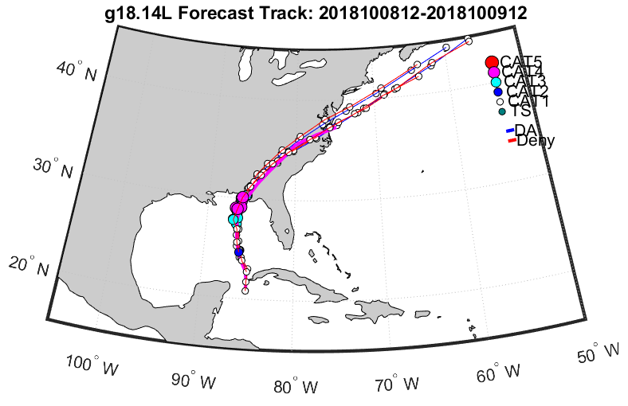
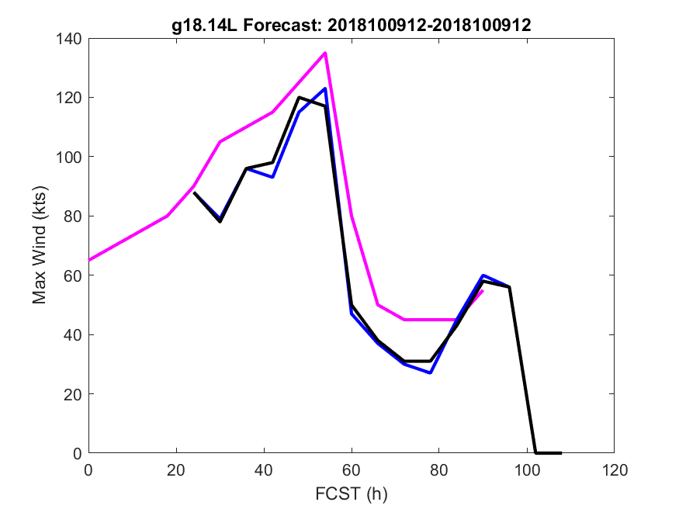
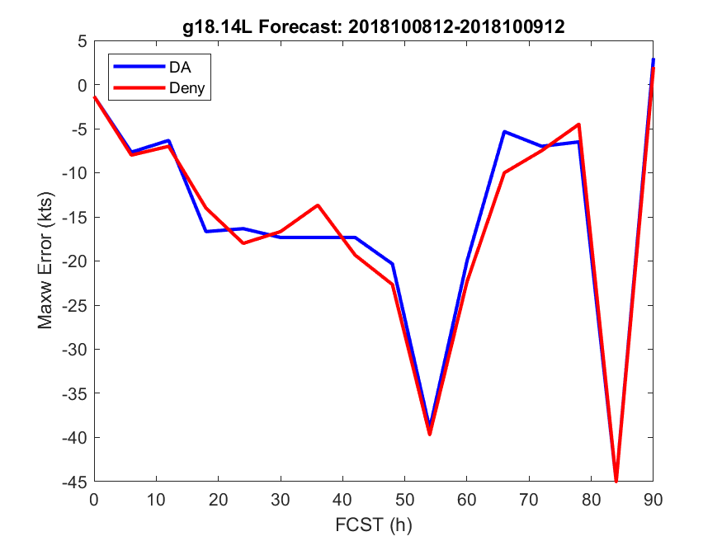
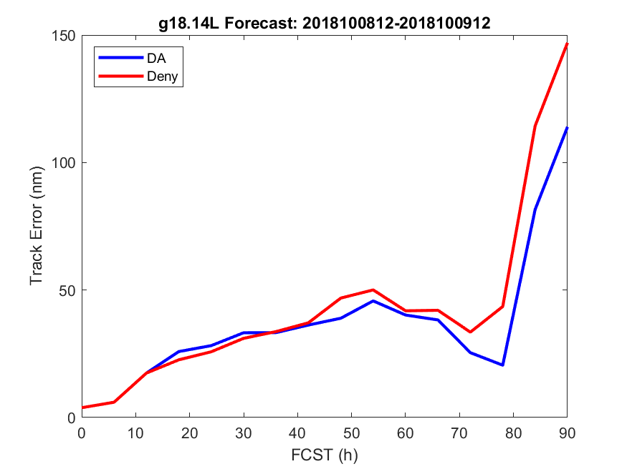
Ongoing and Future Work
Quantify Impact of glider observations on operational hurricane model
2018100912 forecast
Observation
DA, gliders
COAMPS-TC forecast intensity was weaker than the real-time best track
Assimilating the gliders improved the Hurricane Michael’s track forecast
DA, no gliders

Slide 24
Conclusions
The data assimilation ahead of a storm is critical to ensure that the models have the right initial vertical stratification
The length of the assimilation cycle in NCODA needs to be short enough to be able to capture the rapid ocean response during a hurricane
The ocean models underneath the NOAA hurricane forecasting models are not getting the benefit of DA though GOFS/NCODA
We will continue collaborating with NCEP and NRL during the 2019 hurricane season

