Slide 1
Kinston, NC
after Hurricane Florence
Category 1 at landfall
Rainfall was ~ 36 inches, the forth worse in the USA
Total cost estimated as $20 billion
Notes:
Cat 1 storm at landfall. Rainfall was ~ 36 inches, the fourth worth in the usa.Total cost ~ $20 billion

Slide 2
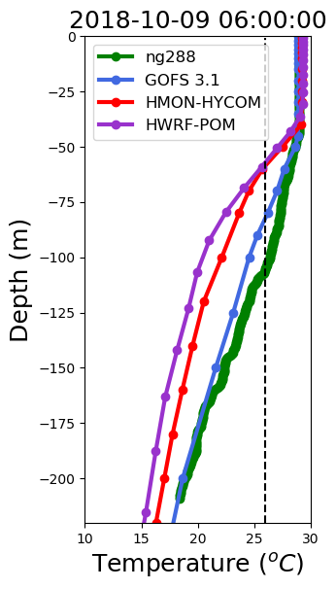
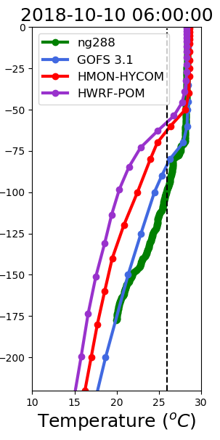
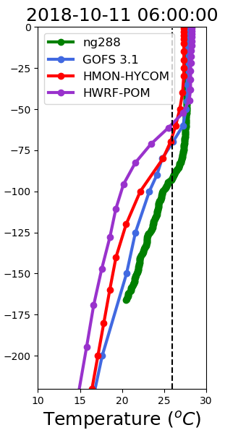
Vertical Profiles of Temperature
1 day before
During Michael
1 day after
Deepening
of mixed layer
Mixed layer
remains deep

Slide 3
Vertical Profiles of Temperature
1 day before
During Michael
1 day after
Deepening
of mixed layer
Mixed layer
remains deep
The data assimilative model GOFS 3.1, does the best at capturing the deepening of the surface layer

Slide 4
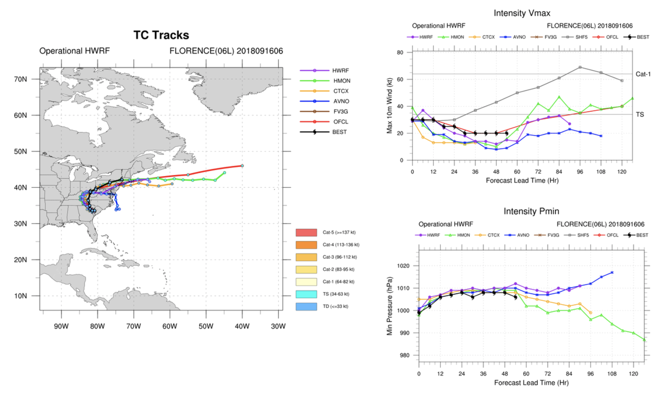

Slide 5
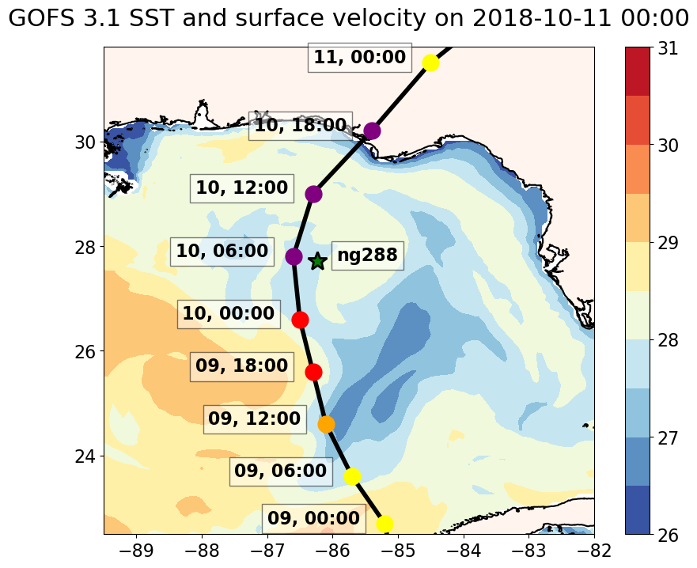
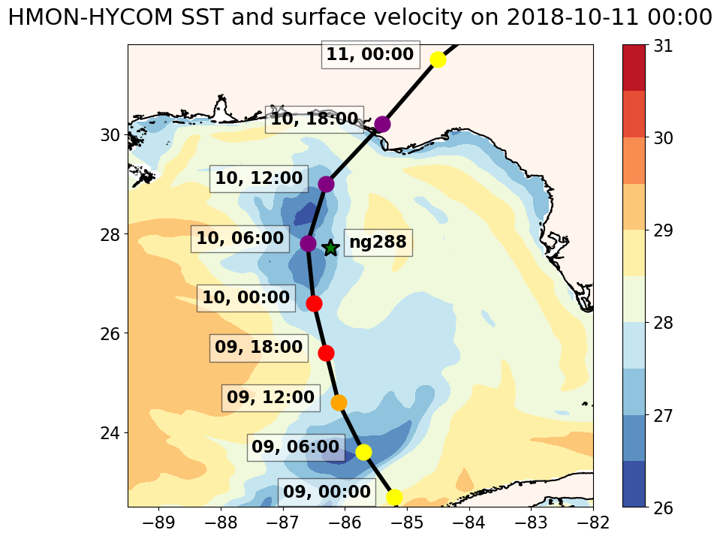
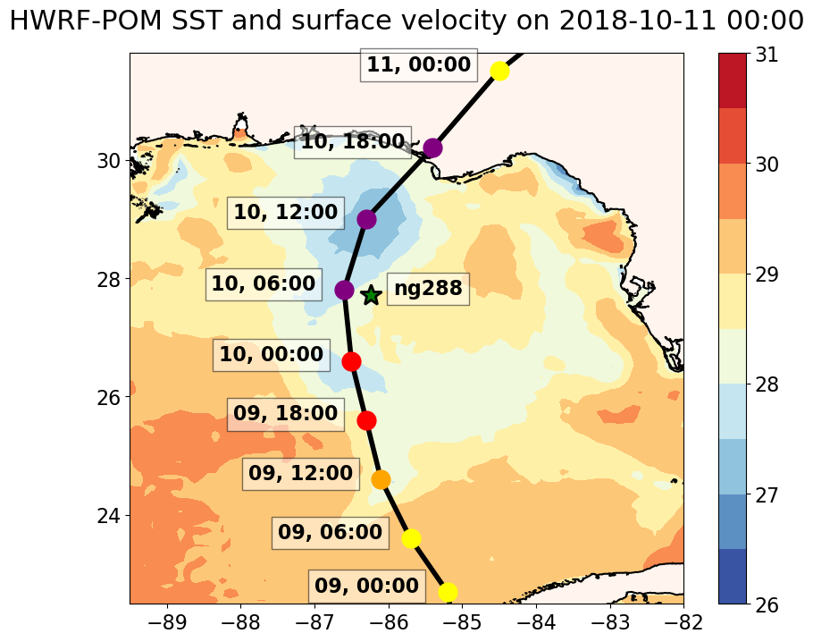
Surface Fields from on 2018-10-11 During Michael
GOFS 3.1
HMON-HYCOM
HWRF-POM

Slide 6
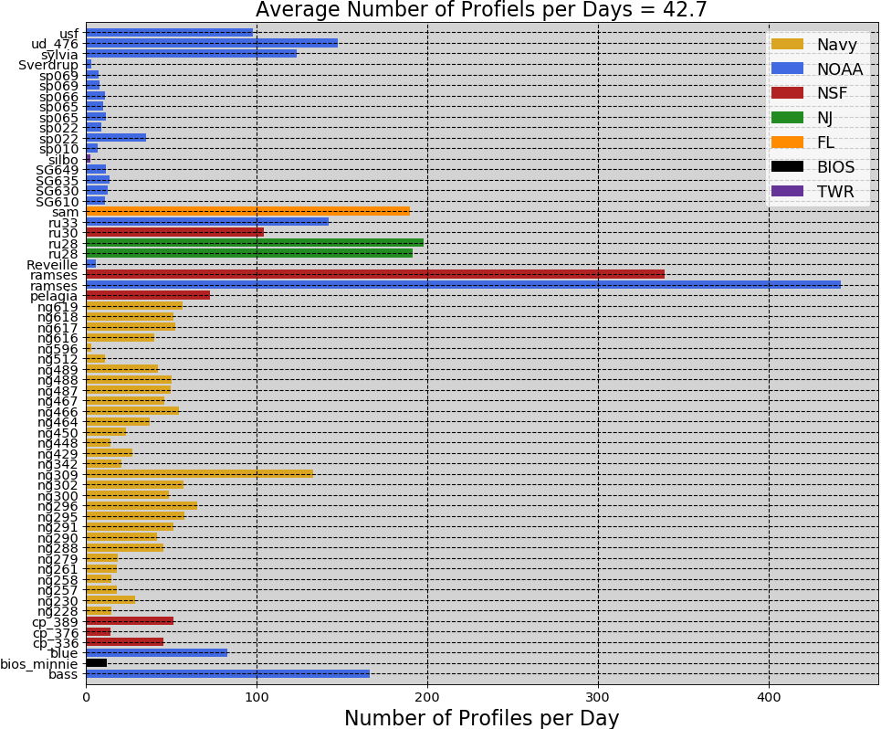

Slide 7
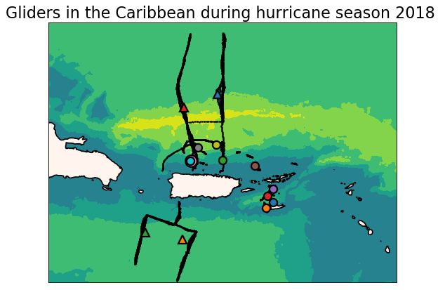
Heat Transport through the Anegada Passage

Slide 8
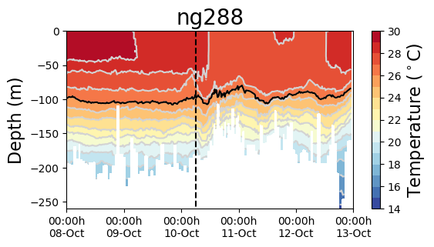
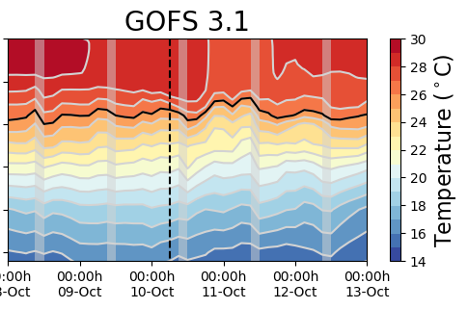
Hurricane Michael
Increments
Insertion Window
Increments
Insertion Window
mkkk

Slide 9
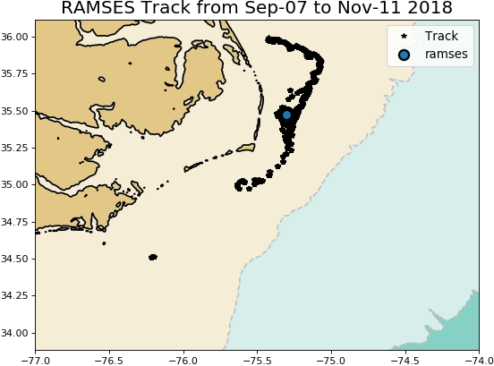
Middle/South Atlantic Bight Transition Zone
Florence

Slide 10
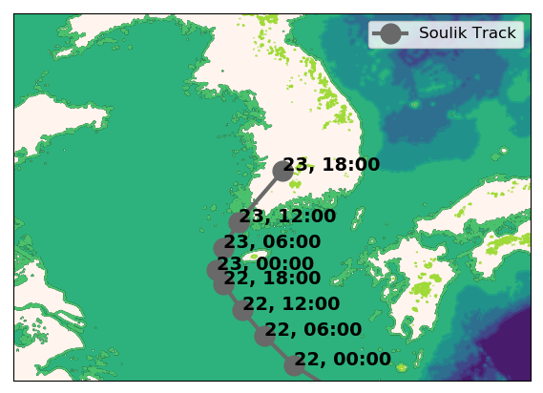
Typhoon Soulik

Slide 11
Typhoon Soulik
First Incremental Insertion Window
There is cooling ahead of eye during Typhoon Soulik
GOFS 3.1 fails to reproduce the SST cooling by 6 degrees

Slide 12
Typhoon Soulik
The correction of the salinity field in GOFS 3.1 after the glider data is assimilated for the first time is remarkable
First Incremental
Insertion Window
Typhoon Soulik

Slide 13
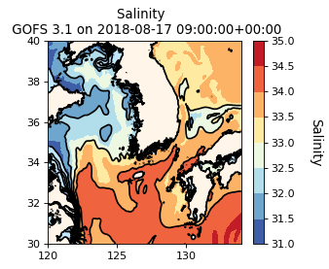
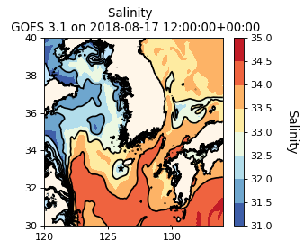
First Incremental Insertion Window

Slide 14
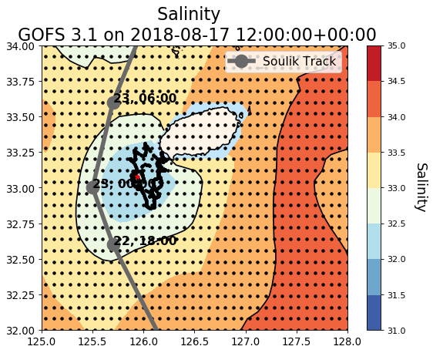
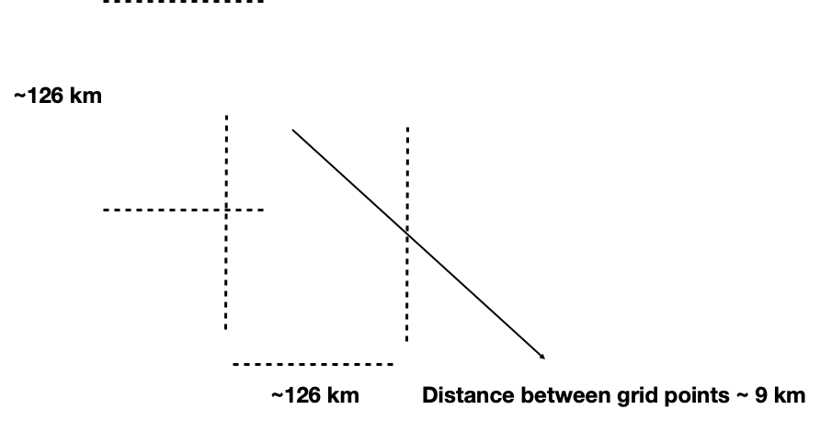
The salinity correction has an spatial extend of about 120 km

Slide 15
NOAA Hurricane Forecasting Models
HWRF/HYCOM
HMON/HYCOM
HWRF/POM
West/South Pacific, South/North Indian Ocean
North Atlantic,
East/Central Pacific
North
Atlantic
East/Central
Pacific
IC come from climatology and the POM (w/ feature model only in the GoM)
IC and BC from
Global RTOFS spun up from the global
GOFS 3.1/NCODA
IC from Global RTOFS nowcast

Slide 16
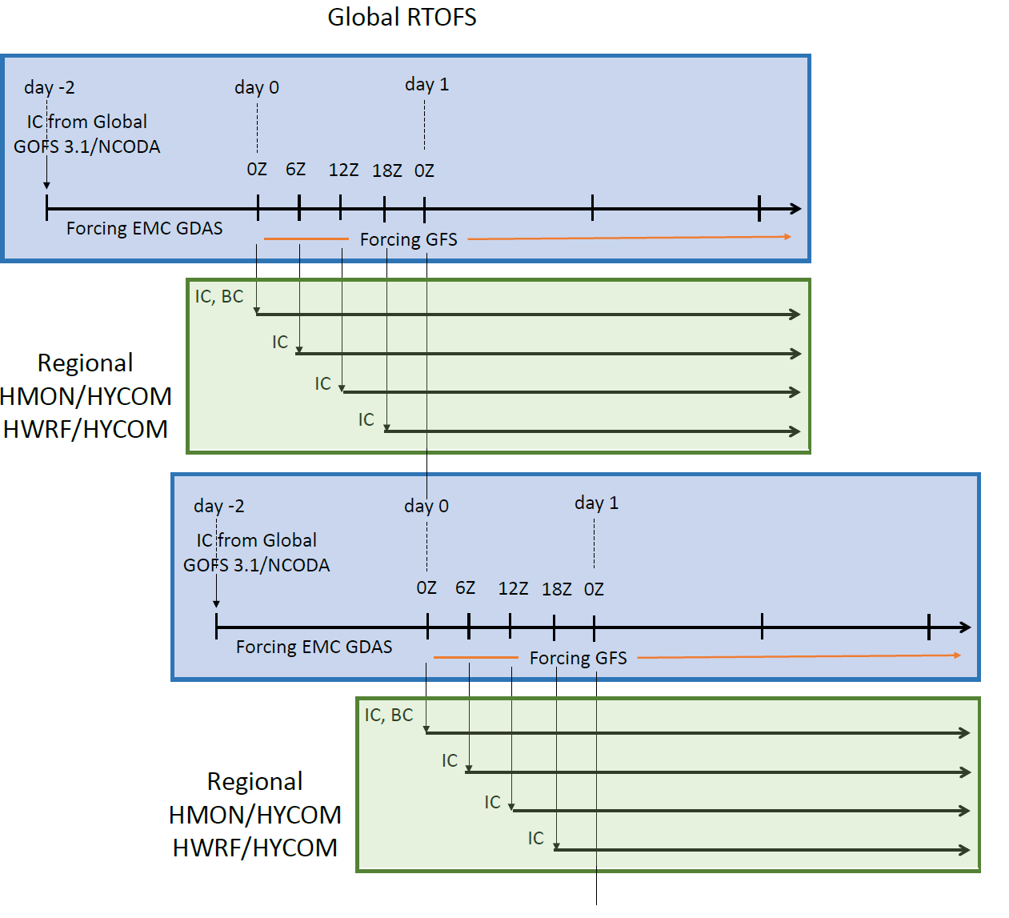

Slide 17
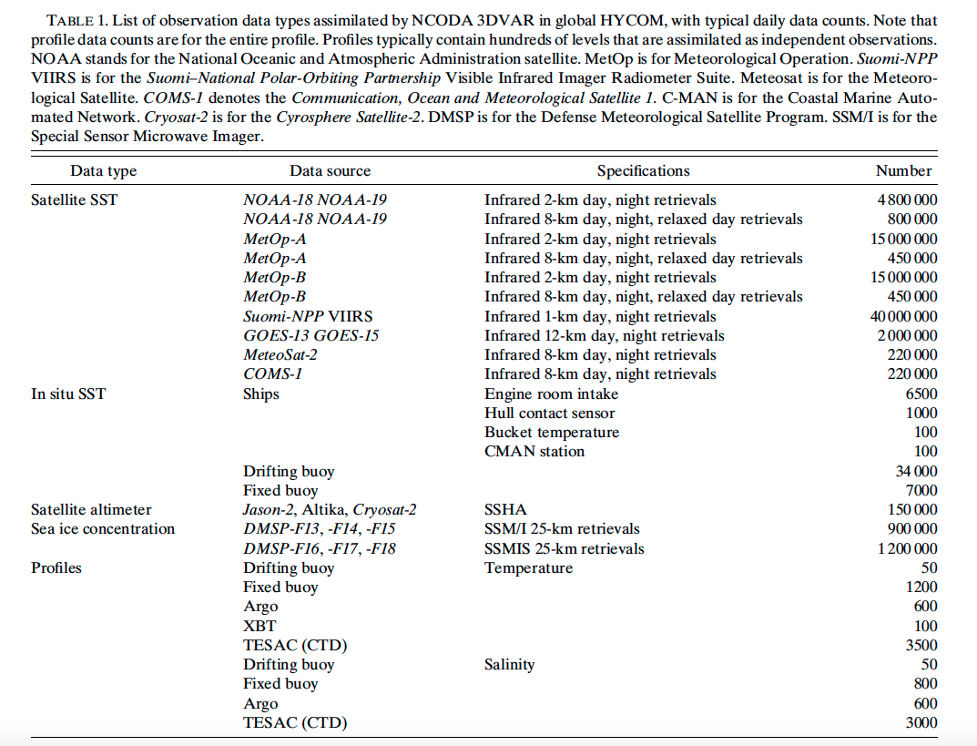
Cummings and Smedstad 2014

