Slide 1

Impact of Glider Data Assimilation on Operational Ocean Models During
the 2018 Hurricane Season
Maria Aristizabal
Travis Miles
Scott Glen
Pat Hogan
Gregg Jacobs
Sue Chen
Avichal Mehra
Hyun-Sook Kim

Slide 2
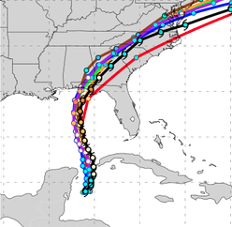
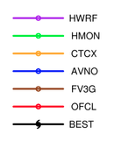
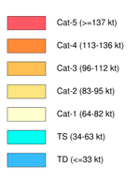
Motivation
Assess the impact of glider data assimilation on the operational hurricane models
Hurricane Michael Forecast
https://www.emc.ncep.noaa.gov/gc_wmb/vxt/HWRF/index.php

Slide 3
Mexico Beach
After Hurricane Michael
Category 4 at landfall
Storm surge 7.7 feet
Total cost estimated as $16 billion
Notes:
Cat 5 at landfall (category was updated to cat 5 about 1 month ago). 7.7 foot storm surge. Total cost was estimated as $16 billion

Slide 4
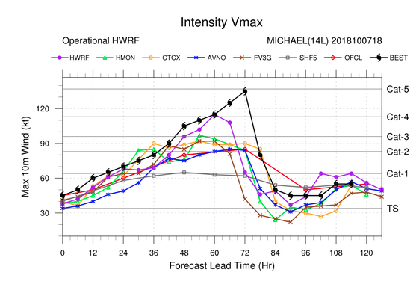
Forecast Guidance for Storm Michael
Oct 8/2018
https://www.emc.ncep.noaa.gov/
https://www.emc.ncep.noaa.gov/gc_wmb/vxt/HWRF/index.php
None of the models forecasted the rapid intensification
Official forecast predicted a cat 2 at landfall

Slide 5
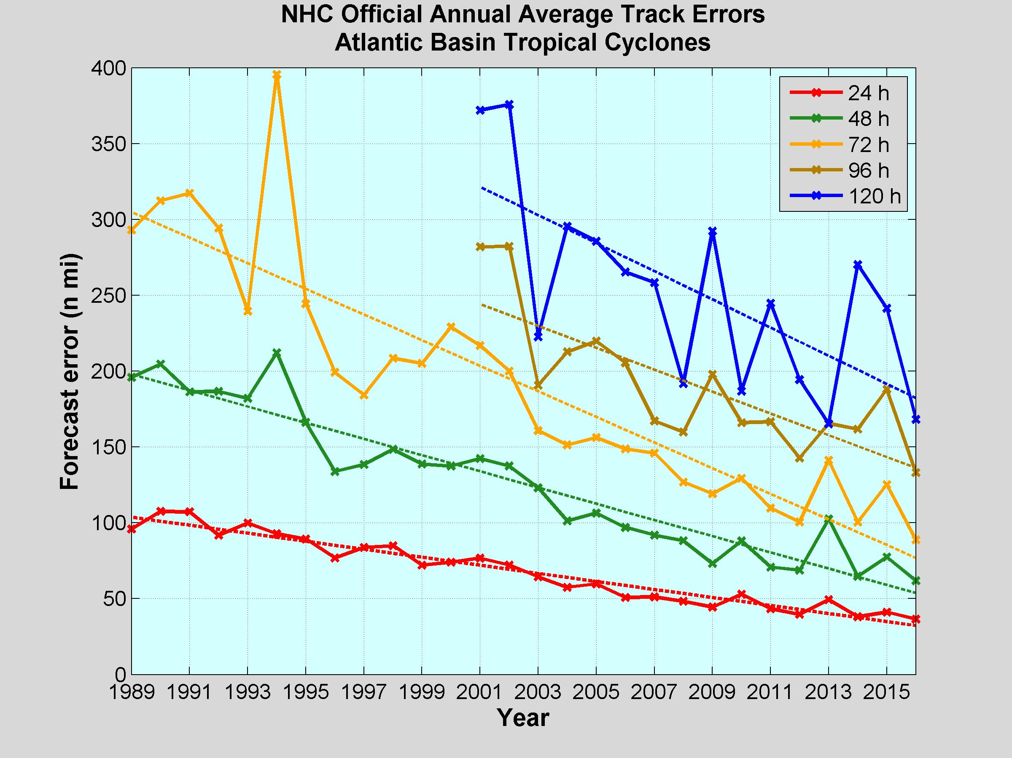
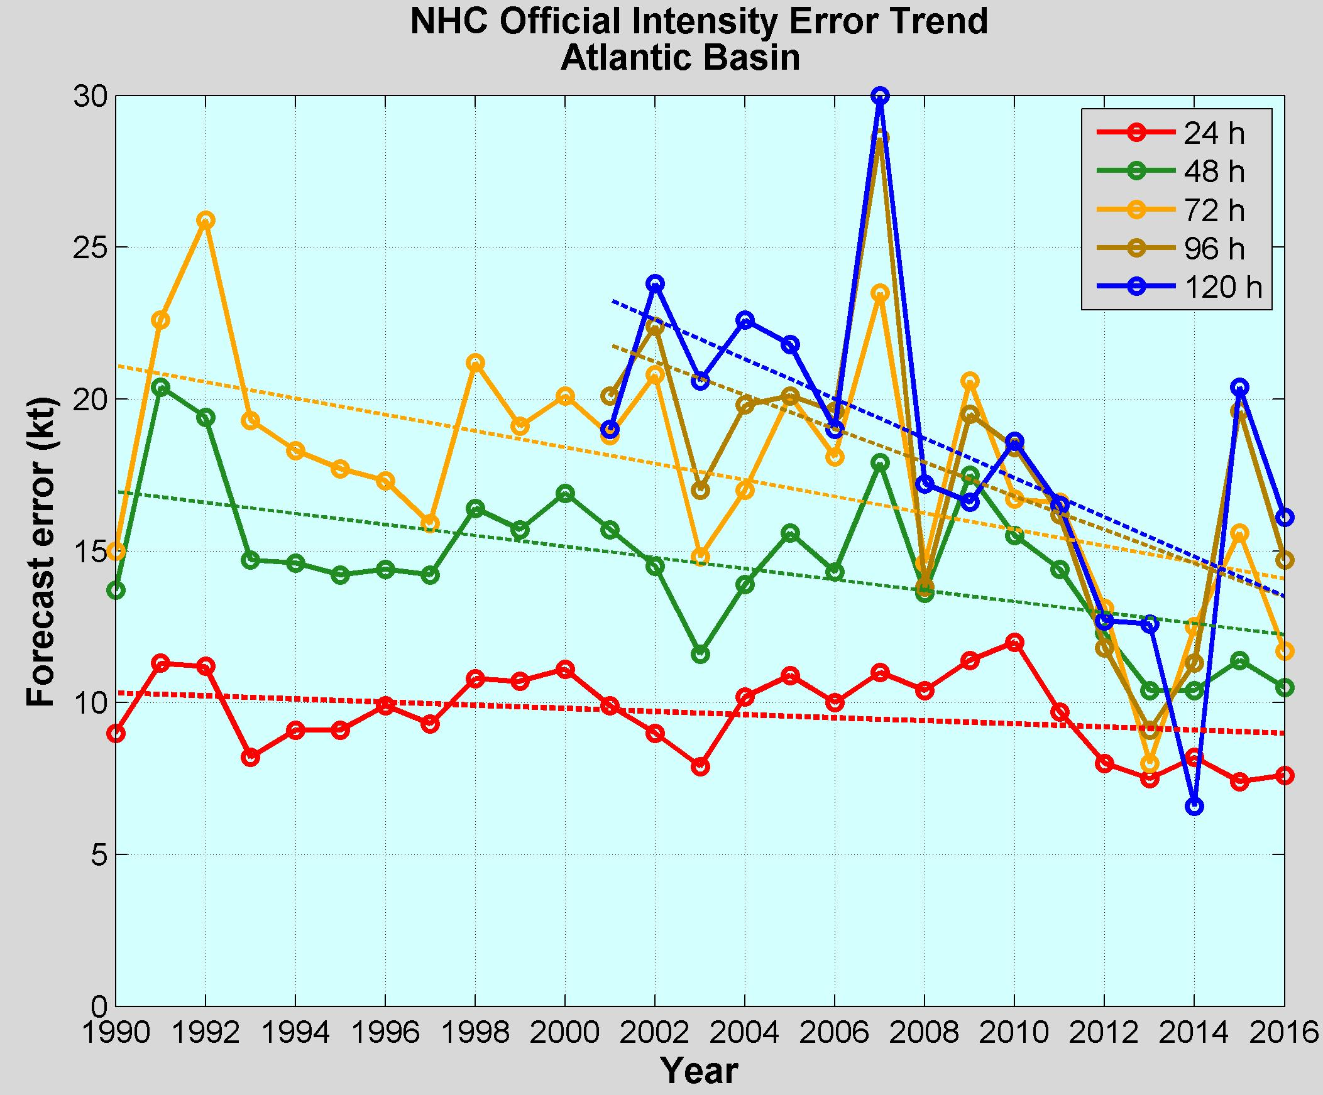
NOAA Annual Operational
Suite Review
~ 50%j
~ 15 %j
Limitations on Hurricane Intensity Improvement
Computing resources and model resolution (Rotunno et al., 2009)
Poor understanding of the atmospheric boundary layer (Nolan et al., 2009; Andreas et al., 2015)
Difficulty in modeling the upper ocean response to storm forcing (Yablonsky and Ginis, 2009).

Slide 6
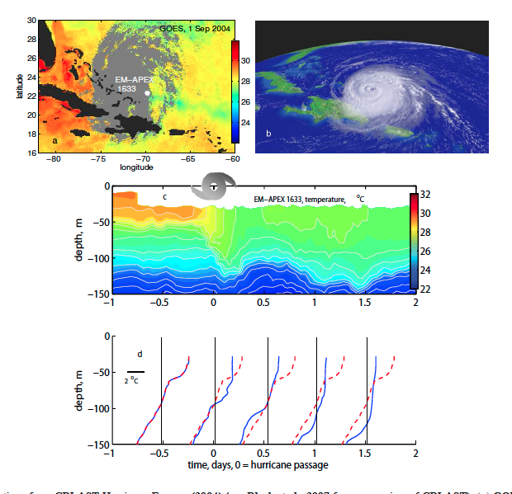
Upper Ocean Response
Temperature and humidity differences at the air-sea interface control the heat fluxes. SST is a relevant ocean quantity
During a storm, SST is manly controlled by the storm-induced vertical mixing and the strength of the vertical stratification
Hurricane Francis
2004
Price 2009
Notes:
Heat fluxes between the sea surface and the low atmosphere are controlled by the temperature and humidity differences between the two
It is critical to correctly estimate the SST as it determines the heat fluxes
at the air-sea interface
The vertical stratification and vertical mixing are key to correctly estimate SST
during the passage of a hurricane
At the shelf, there are other physical processes (enhanced vertical mixing due to
vertical velocity shear ahead of the eye, upwelling/downwelling circulation depending
on the incident angle of the storm) that take place and are difficult to model if the
vertical and/or horizontal resolution are not adequate
To capture the upper ocean response in the shelf is critical because the SST at the shelf will determine if the hurricane will intensify or weaken before landfall

Slide 7
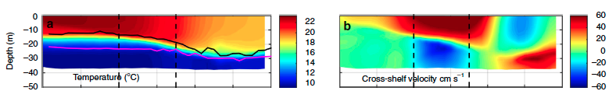
Upper Ocean Response
In the continental shelf, there are other physical processes that control SST during storms: shear-induced vertical mixing due to wind-forced two-layer circulation (Glenn et al 2016), upwelling/downwelling circulation depending on the incident angle of the storm (Miles et al 2017)
Hurricane Irene (Glenn et al 2016)
On Shore
Off Shore
To capture the upper ocean response in the shelf is critical because the SST at the shelf will determine if a hurricane will intensify or weaken before landfall
Notes:
It is critical to correctly estimate the SST as it determines the heat fluxes
at the air-sea interface
The vertical stratification and vertical mixing are key to correctly estimate SST
during the passage of a hurricane
At the shelf, there are other physical processes (enhanced vertical mixing due to
vertical velocity shear ahead of the eye, upwelling/downwelling circulation depending
on the incident angle of the storm) that take place and are difficult to model if the
vertical and/or horizontal resolution are not adequate
To capture the upper ocean response in the shelf is critical because the SST at the shelf will determine if the hurricane will intensify or weaken before landfall

Slide 8
How to Improve the Modeling of the Upper Ocean Response
During a Hurricane on the continental shelf?
Improve the subsurface initial conditions in the operational ocean models: right initial vertical stratification, better evolution of the SST during storms , better heat fluxes estimates
Notes:
Better parameterization of air-sea heat fluxes

Slide 9
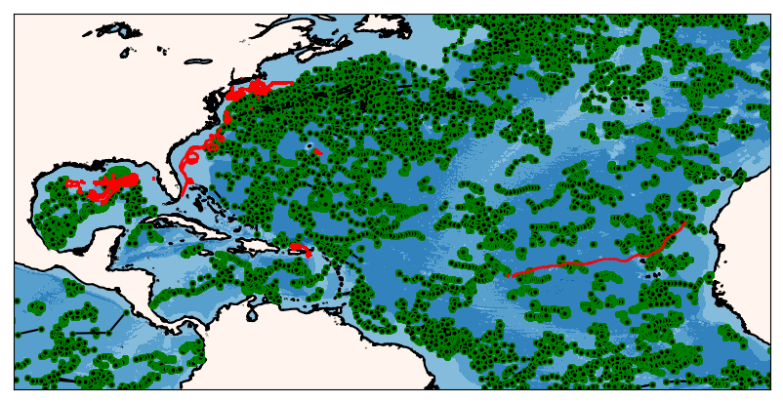
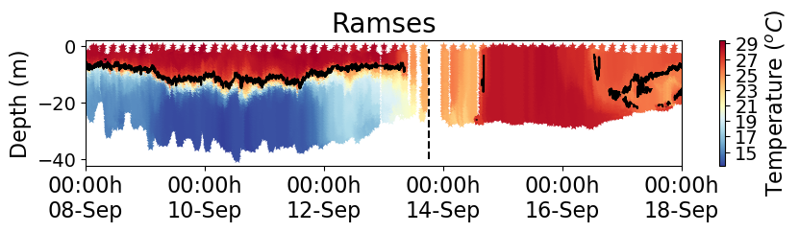
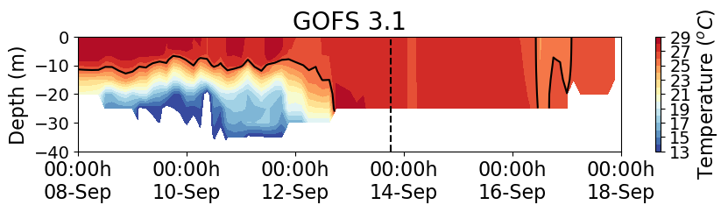

How to Improve the Modeling of the Upper Ocean Response
During a Hurricane on the continental shelf?
Improve the subsurface initial conditions in the operational ocean models: right initial vertical stratification, better evolution of the SST during storms , better heat fluxes estimates
Ocean Data Assimilation
Notes:
Better parameterization of air-sea heat fluxes

Slide 10
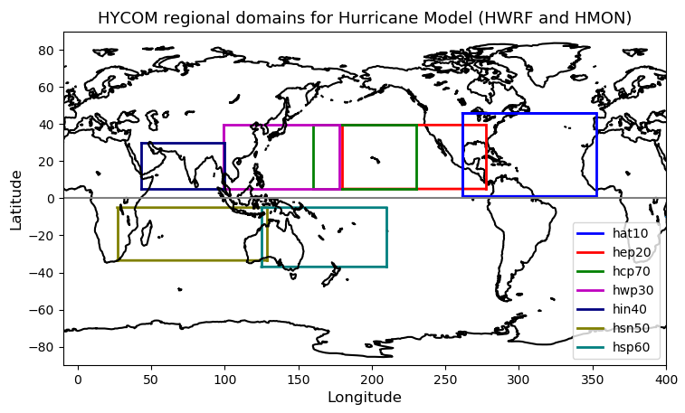
NOAA Hurricane Forecasting Models
HWRF/HYCOM
HMON/HYCOM
HWRF/POM
West
Pacific
Central
Pacific
East
Pacific
North
Atlantic
North
Indian
South
Indian
South
Pacific
HWRF – Hurricane Weather Research Forecasting Model
HYCOM – Hybrid Coordinate Ocean Model
HMON - Hurricanes in a Multi-scale Ocean-coupled Non- hydrostatic model
POM – Princeton Ocean Model

Slide 11
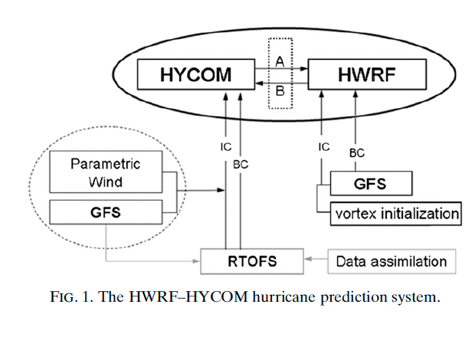
Hurricane Coupled Ocean-Atmosphere
Forecasting Model: HWRF-HYCOM System
IC
IC
Kim et al. 2014
GOFS/NCODA
RTOFS – Real Time Ocean Forecasting System
GFS – Global Forecasting System

Slide 12
Global Ocean Forecasting System (GOFS) /
Navy Coupled Ocean Data Assimilation System (NCODA)
Surface Data
Subsurface Temperature and Salinity
Satellite SST
Drifting buoys
Fixed buoys
Argo Floats
In Situ SST
GOFS/NCODA
Gliders
TESAC
Satellite Altimeter
XBTs (only temp.)

Slide 13
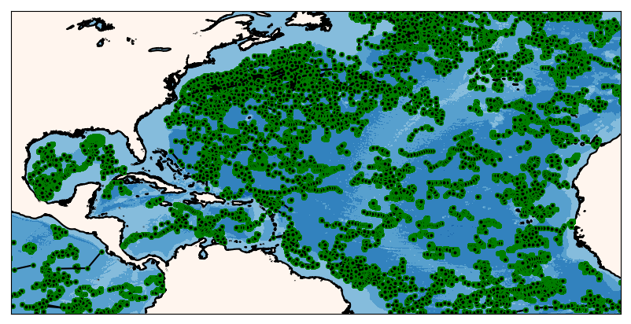
ARGO Floats
During the 2018 Hurricane Season
Argo floats mostly occupy the open ocean
One vertical profile every ten days

Slide 14
ARGO Floats and Gliders
During the 2018 Hurricane Season
Glider observations are mostly in the shelf
Tens of profiles per day

Slide 15
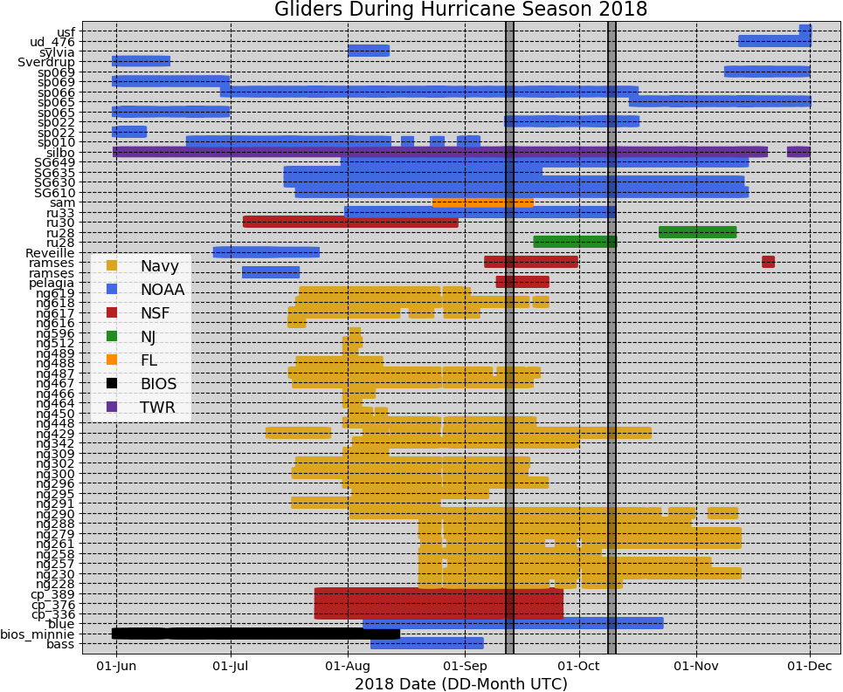
62 Gliders in the IOOS Glider Data
Assembly Center (DAC) During Hurricane Season 2018
Notes:
There were 61 gliders that reported data to the IOSS glider DAC during the 2018 hurricane season. All these data was pushed into the GTS (Global Telecommunication System) once a day. Once in the GTS, the data was accessed by a number of operational ocean models that use data assimilation: GOFS, European model ……

Slide 16
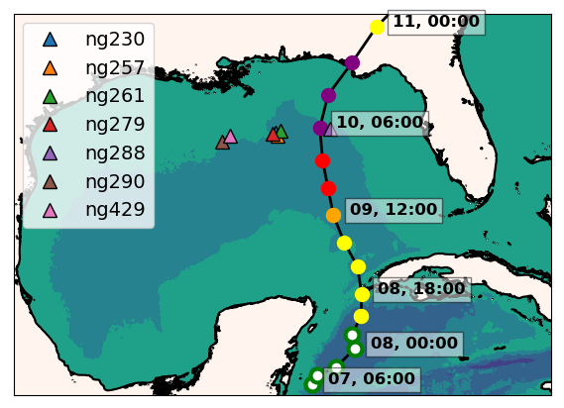
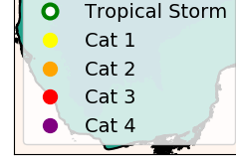
Hurricane Michael
ng288
Seven Navy gliders reporting to the glider DAC
in the GoM during hurricane Michael
Ng288 was at 36 km from the eye of hurricane Michael

Slide 17
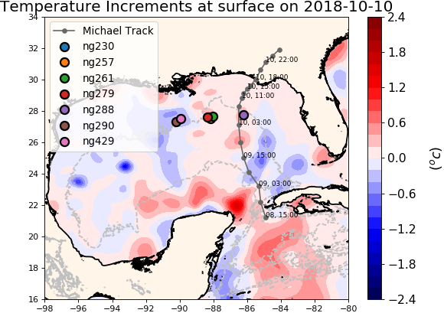
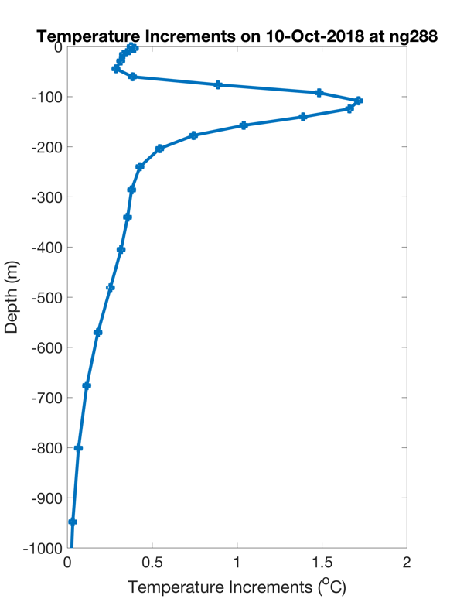
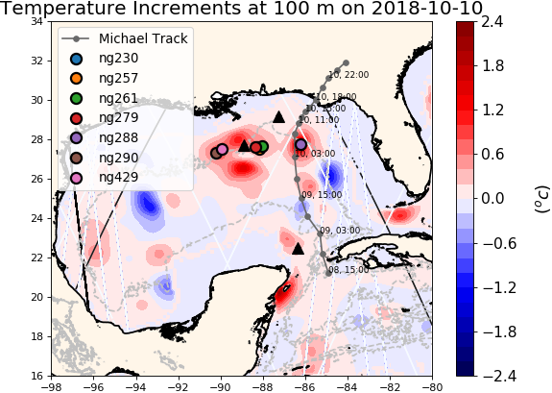
NCODA Temperature Increments
Argo
Jason 2
CryoSat
The increment is the change made to the model state at the end of the previous assimilation cycle
Notes:
The increment is the change made to the model state at the end of the previous assimilation cycle.

Slide 18
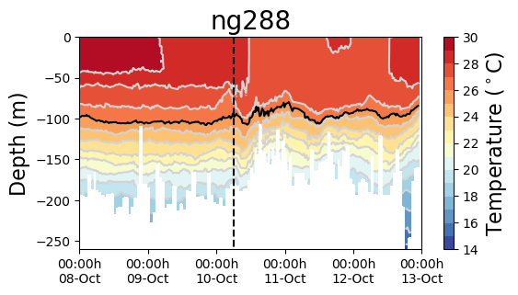
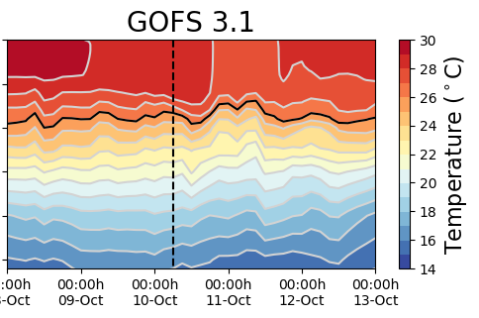
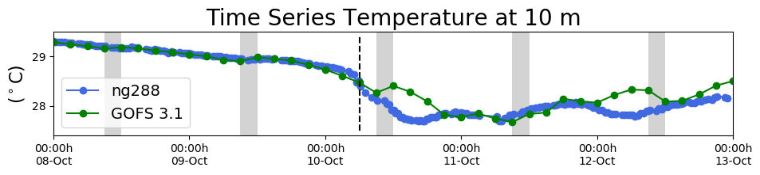
Hurricane Michael
Increments
Insertion Window
Increments
Insertion Window
The modeled SST increased after the passage of Michael: the ocean response is faster than the 1-day assimilation cycle

Slide 19
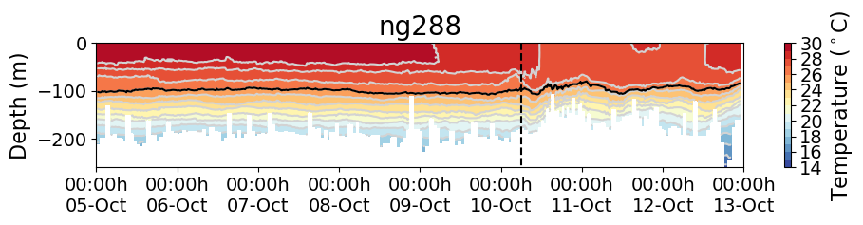
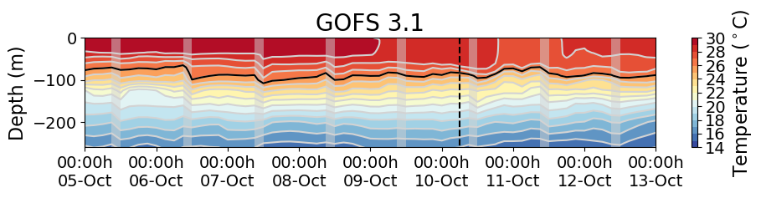
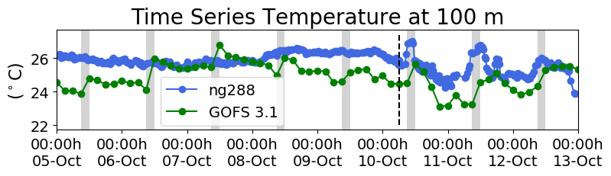
Hurricane Michael
Increments
Insertion Window
Increments
Insertion Window
The assimilation of glider data days ahead of Michael corrected
the position of the thermocline

Slide 20
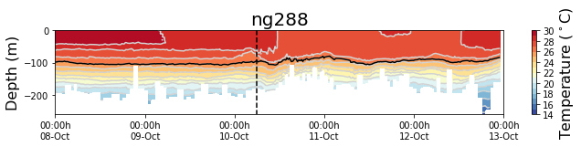
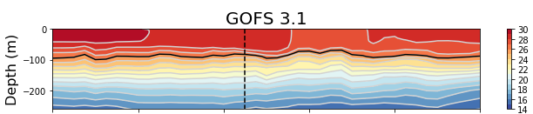
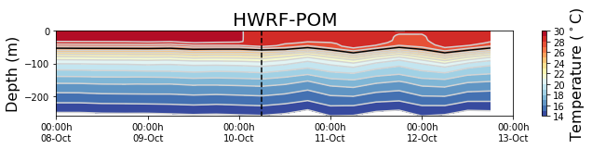
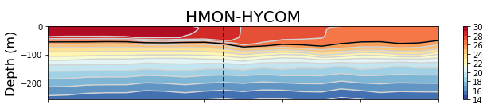
Glider Data vs
Operational Models During Michael

Slide 21
Glider Data vs
Operational Models During Michael
The ocean under the operational hurricane models have a thermocline that is too shallow and does not completely capture the magnitude and timing of cooling and subsequent mixing

Slide 22
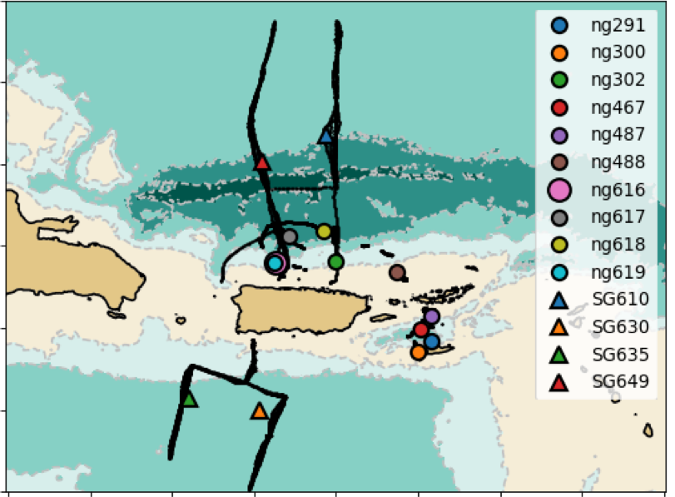
Heat Transport in the Caribbean
14 Gliders in the Caribbean During the 2018 Hurricane Season

Slide 23
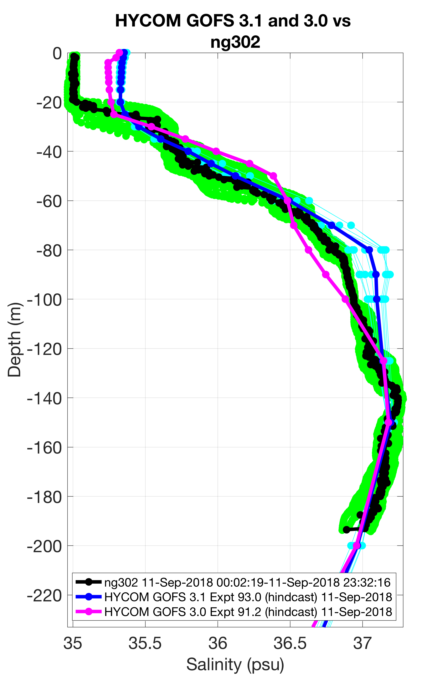
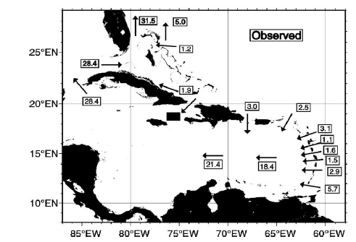
Why is important to get the right heat transport ?
Tracks of North Atlantic Tropical Cyclones
(1851 – 2012)
Barrier Layer
Johns et al. 2002
Transport through the island passages can affect the heat contents and SST
of the barrier layer and change vertical water stability under hurricanes

Slide 24
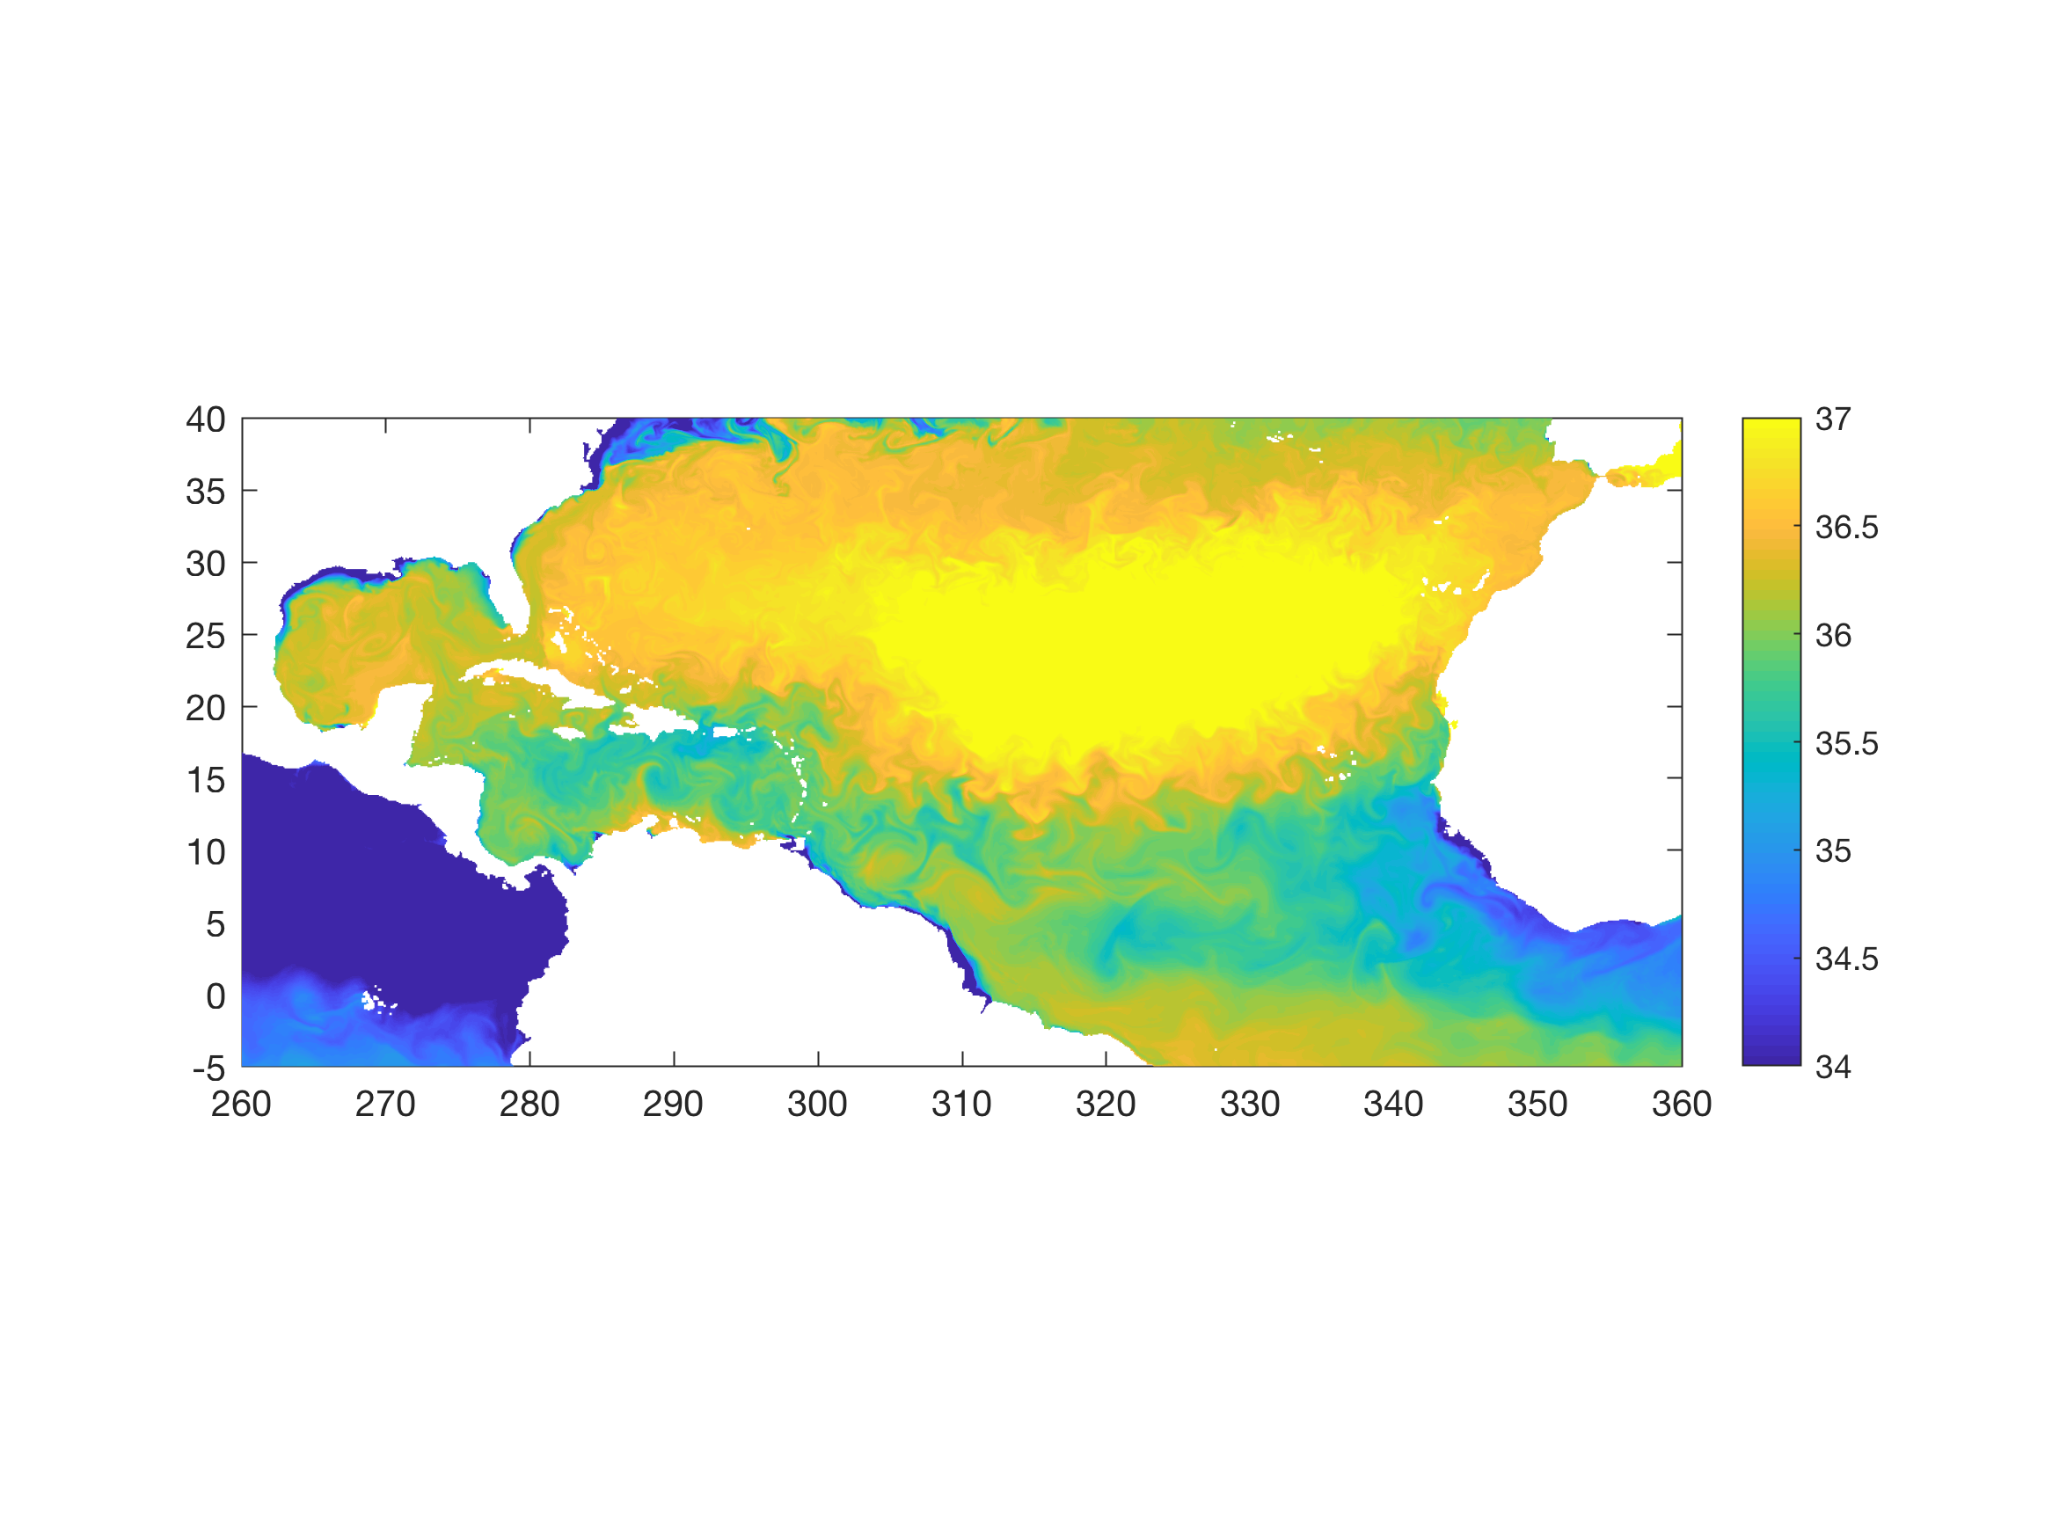
Why is important to get the right heat transport ?
Barrier Layer
Salinity
Orinoco
Amazon
Johns et al. 2002
Transport through the island passages can affect the heat contents and SST
of the barrier layer and change vertical water stability under hurricanes

Slide 25

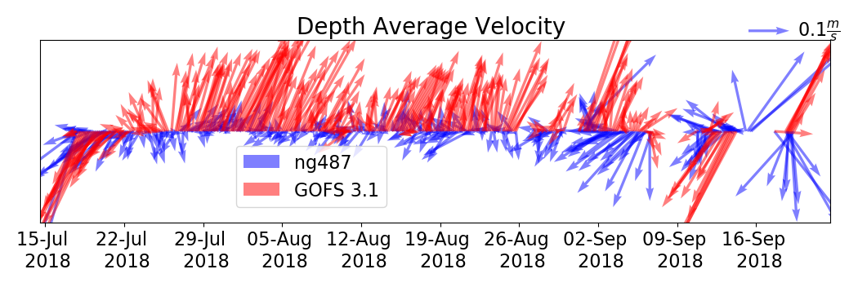
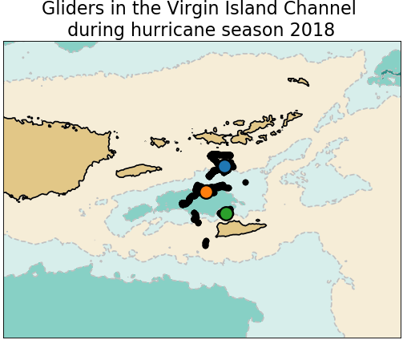
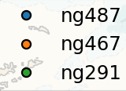
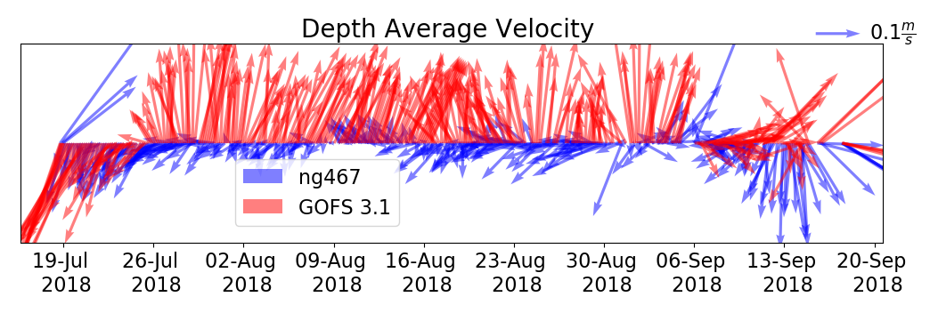
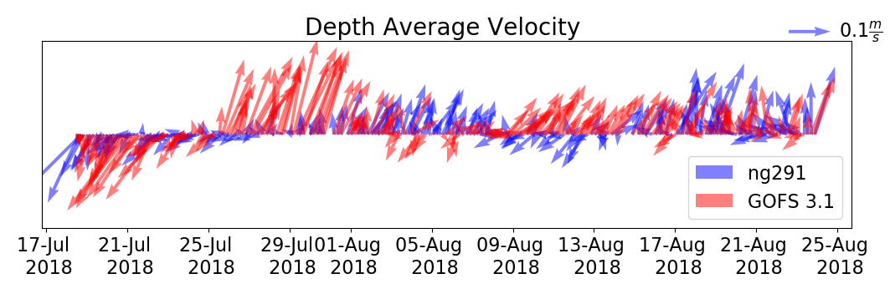
Anegada Passage:
200 M Depth Average Velocity 18 July -17 Sep

Slide 26
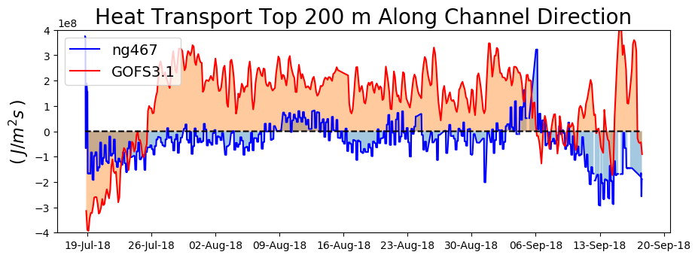
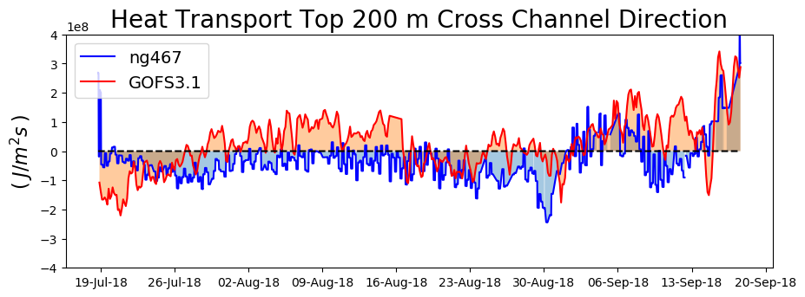
Heat Transport through the Anegada Passage
The model heat transport through the channel has
the opposite direction than the observed heat transport

Slide 27
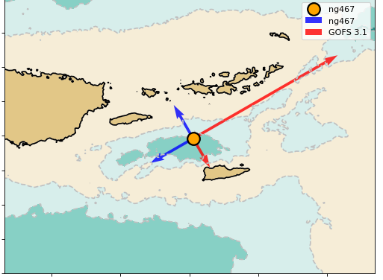

Accumulative Heat Transport through
the Anegada Passage
There is a heat flux into the Caribbean.
The model estimates a heat flux leaving the Caribbean

Slide 28
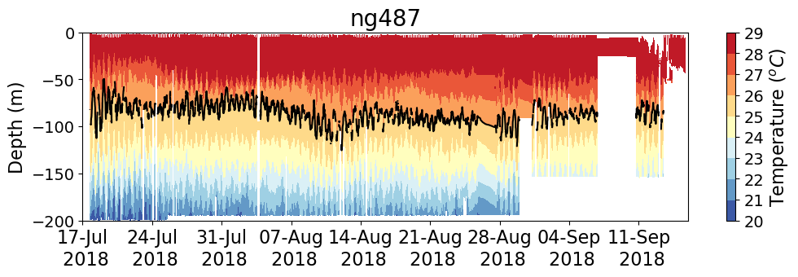
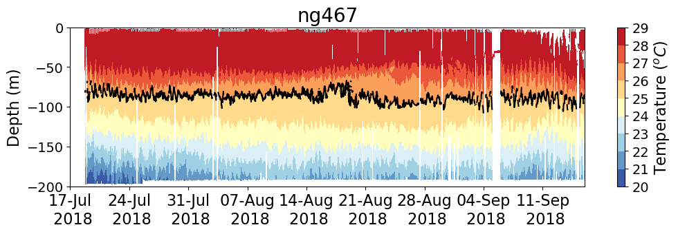
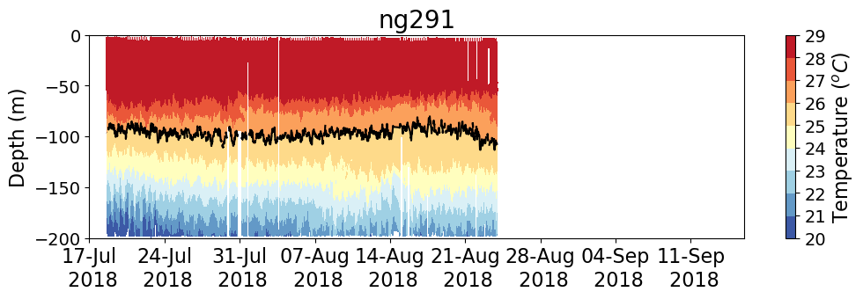
Reconstruction of Velocity Profile

Slide 29
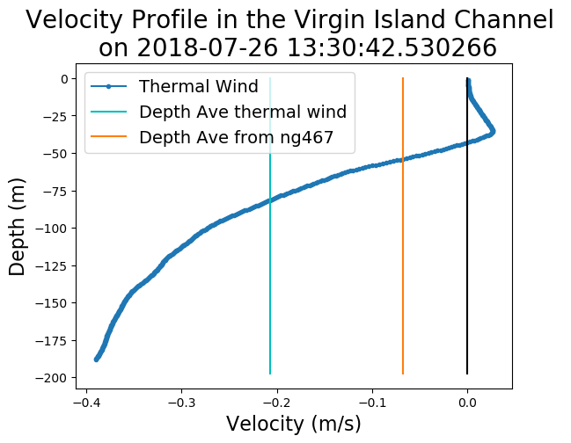
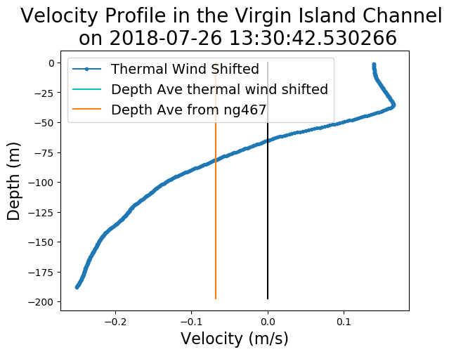
Reconstruction of Velocity Profile
Thermal-Wind
Balance
Shift
Shifted

Slide 30
After taking into account the vertical profile of velocity,
the model heat transport through the channel has
the opposite direction than the observed heat transport
Affect the heat content and ultimately the SST
under hurricanes

Slide 31
Conclusions
We identify areas where the data assimilative ocean model GOFS 3.1 and two ocean models underneath hurricane forecasting models can improve in order to correctly capture key ocean processes, SST and vertical stratification, that affect hurricane intensity
The length of the assimilation cycle has to be short enough to be
able to capture the rapid ocean response during a hurricane
The data assimilation ahead of a storm is critical to ensure that the
model has the right initial vertical stratification
The ocean models underneath the NOAA hurricane forecast models
for hurricane Michael have a thermocline that is too shallow
There is a positive heat transport into the Caribbean Ocean during
the hurricane season 2018. GOFS 3.1 does not capture this positive
heat transport. This can have consequences for the modeled
available heat content to storms and vertical stratification in this area

Slide 32
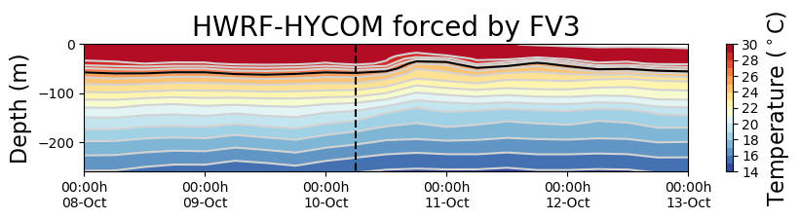
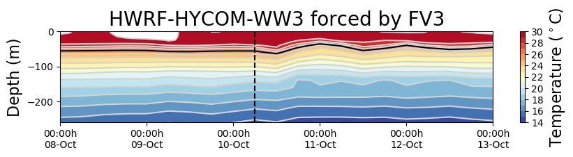
Ongoing and Future Work
Ongoing collaboration with NCEP
Avichal Mehra
Hyun-Sook Kim
2018100718 Forecast

Slide 33

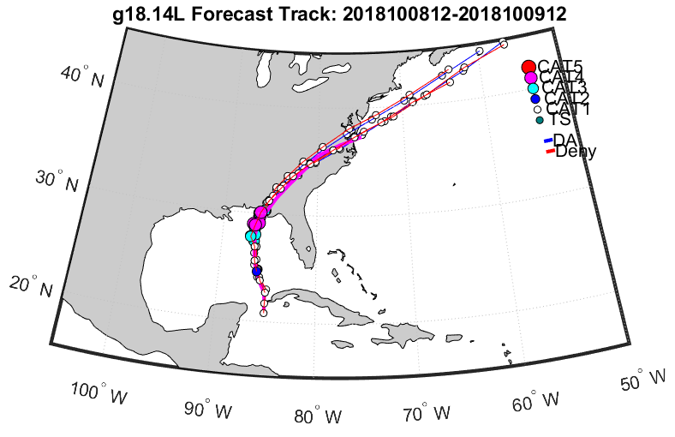



Ongoing and Future Work
Quantify Impact of glider observations on operational hurricane models
2018100912 forecast
Observation
DA, gliders
COAMPS-TC forecast intensity was weaker than the real-time best track
Assimilating the gliders improved the Hurricane Michael’s track forecast
DA, no gliders

Slide 34
Questions?

