Slide 1


Impact of Glider Data Assimilation
on Operational Models during
Hurricane Michael and Hurricane Dorian
Maria Aristizabal
Scott Glenn
Travis Miles
Hyun-Sook Kim
Avichal Mehra
Extreme Events Ocean Observations Call
Dec 1 2020
Pat Hogan

Slide 2
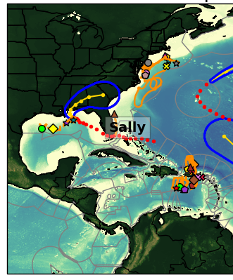
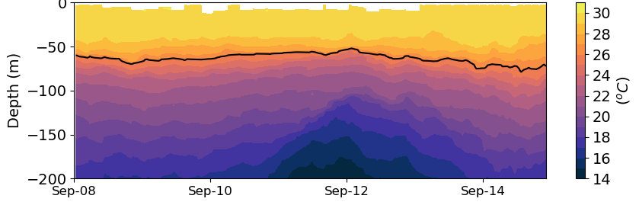
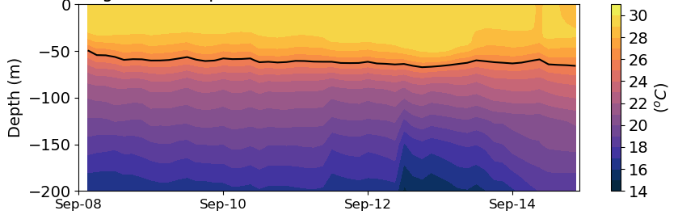
Motivation
Reduce the hurricane intensity forecast error in operational hurricane models
Improve the performance of the operational ocean models that provide the ocean initial conditions to the operational hurricane forecasting models
Ocean Data Assimilation
Glider SG601
GOFS 3.1

Slide 3
Objective
Assess the impact of glider data assimilation on the operational ocean models that provide the initial conditions to the NOAA operational hurricane forecasting systems
Design a glider observing system that has the largest positive impact on the hurricane intensity forecast of the operational hurricane models

Slide 4
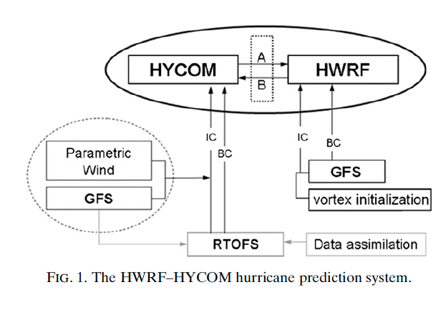
Hurricane Forecasting System
Forecasting Model: HWRF-HYCOM System
Kim et al. 2014
NOAA operational
Ocean model
IC
IC
Navy operational
Ocean model
GOFS/NCODA
RTOFS – Real Time Ocean Forecasting System
GFS – Global Forecasting System
GOFS –Global Ocean Forecasting System
Notes:
This is a schematic of the workflow for the HWRF/HYCOM system. The right side shows the atmospheric component and the left side is the oceanic component. The IC and BC for the regional HYCOM come from the global RTOFS, that is the NOAA operational ocean model. At the same time, the IC for the global RTOFS comes from Global Ocean Forecasting System GOFS that is the Navy operational ocean model and implements data assimilation though NCODA that is the Navy coupled ocean data assimilations system. So in its current state, the NOAA hurricane forecasting models incorporates ocean data assimilation through the IC to their own global ocean model. NCEP is currently working to implement data assimilation directly into RTOFS.

Slide 5
Hurricane Forecasting System
Forecasting Model: HWRF-HYCOM System
Kim et al. 2014
NOAA operational
Ocean model
IC
RTOFS/DA
IC
Navy operational
Ocean model
GOFS/NCODA
RTOFS – Real Time Ocean Forecasting System
GFS – Global Forecasting System
GOFS –Global Ocean Forecasting System
Notes:
This is a schematic of the workflow for the HWRF/HYCOM system. The right side shows the atmospheric component and the left side is the oceanic component. The IC and BC for the regional HYCOM come from the global RTOFS, that is the NOAA operational ocean model. At the same time, the IC for the global RTOFS comes from Global Ocean Forecasting System GOFS that is the Navy operational ocean model and implements data assimilation though NCODA that is the Navy coupled ocean data assimilations system. So in its current state, the NOAA hurricane forecasting models incorporates ocean data assimilation through the IC to their own global ocean model. NCEP is currently working to implement data assimilation directly into RTOFS.

Slide 6
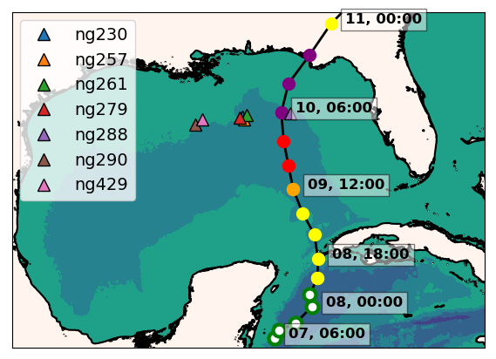
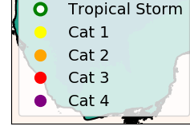
Hurricane Michael (2018)
ng288
Seven Navy gliders reporting to the glider DAC
in the GoM during hurricane Michael
Ng288 was at 36 km from the eye
of hurricane Michael

Slide 7
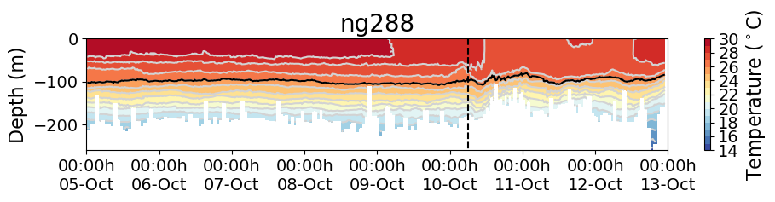
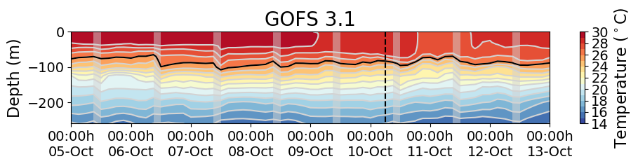
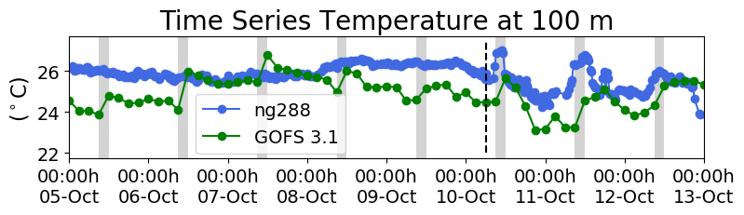
Hurricane Michael
Incremental
Insertion Window
Increments
Insertion Window
Increments
Insertion Window
The assimilation of glider data days ahead of Michael corrected
the position of the thermocline
Notes:
This is the temperature transect from ng288 and we also have the temperature transect form the GOFS 3.1 following ng288 glider track. When we look back 5 days before the passage of Michael, we observe that in GOFS 3.1 after every increment insertion window, the thermocline is pulled down to match the depth of the thermocline from the glider data until it settles down at the right depth. This highlights the importance of having a continuous glider presence so when a storm strikes, the model ocean has a most realistic vertical stratification.
Incremental insertion window is the period when the analysis increments are incorporated into the model in a gradual way.
The IAU (incremental analysis updating) process incorporates analysis increments into a model integration in a gradual manner. It does this by using analysis increments as constant forcings in a model's prognostic equations over a 6-h period centered on an analysis time. (Bloom, S.C., L.L. Takacs, A.M. da Silva and D. Ledvina. 1996. Data assimilation using incremental analysis updates. Mon. Wea. Rev. 124:1256–1271. )

Slide 8
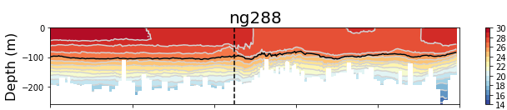
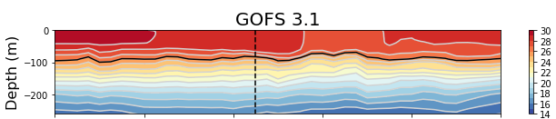
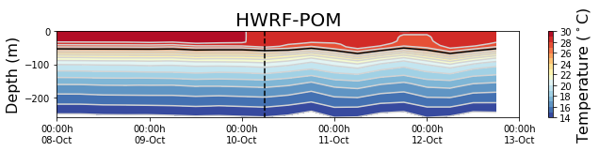
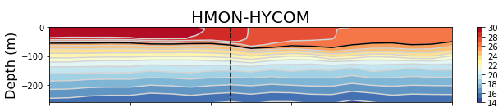
Glider Data vs Operational Models: Michael
The ocean under the operational hurricane models have a thermocline that is too shallow and does not completely capture the magnitude and timing of the mixing and sea surface cooling

Slide 9
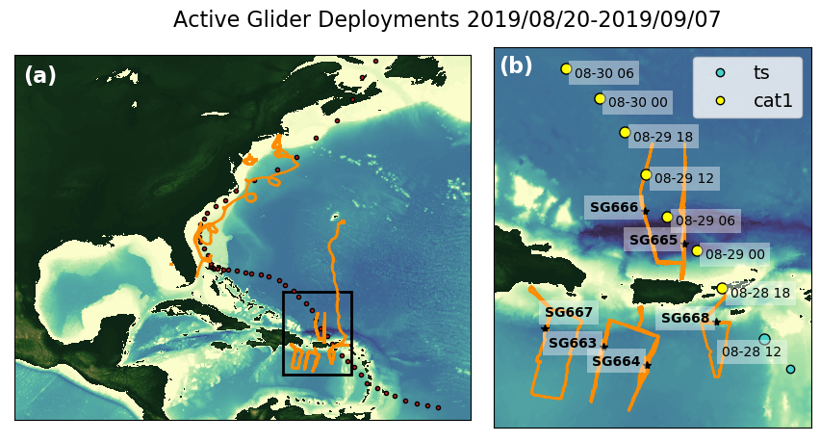
Hurricane Dorian (2019)

Slide 10
Numerical Models
HWRF2019-POM: One of the operational NOAA hurricane forecasting system during 2019. IC from climatology and a feature-based model
HWRF2020-POM: Experimental system. IC from RTOFS
HWRF2020-HYCOM: Experimental system. IC from RTOFS
GOFS 3.1: Navy operational ocean model. Implements data assimilation. https://tds.hycom.org/thredds/

Slide 11
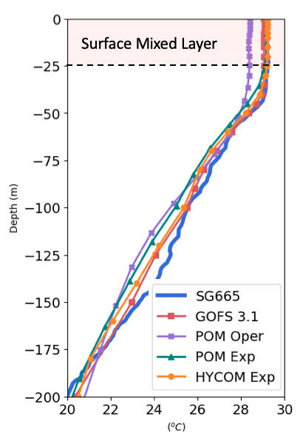
Upper Ocean Metrics
Temperature in the surface mixed layer (Temp ML)
Density Criteria:
Ocean Heat Content (OHC)
Depth average temperature
top 100 m. (T100)

Slide 12
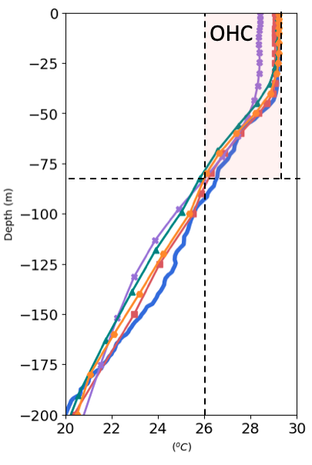
Upper Ocean Metrics
Temperature in the surface mixed layer (Temp ML)
Ocean Heat Content (OHC)
Depth average temperature
top 100 m. (T100)

Slide 13
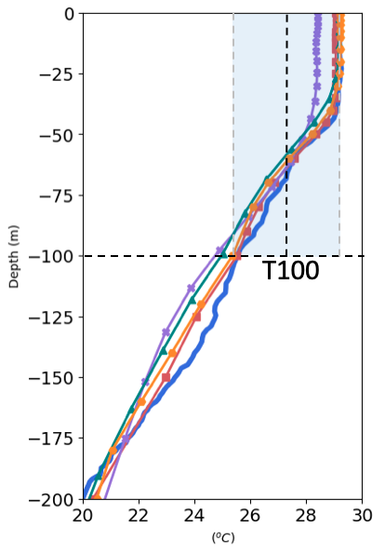
Upper Ocean Metrics
Temperature in the surface mixed layer (Temp ML)
Ocean Heat Content (OHC)
Depth average temperature
top 100 meters (T100)

Slide 14
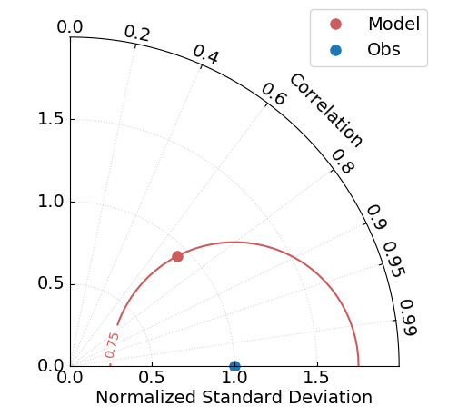
Taylor Diagram
Accurate
model

Slide 15
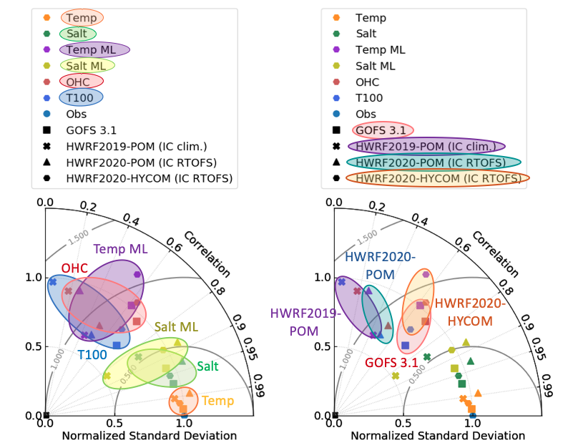
Model’s Skill

Slide 16
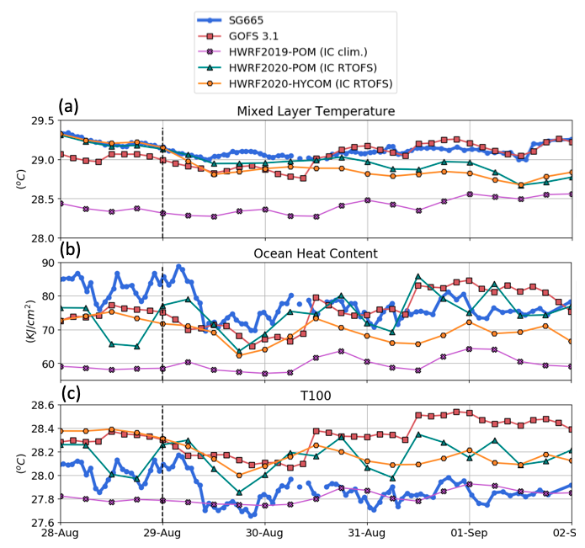
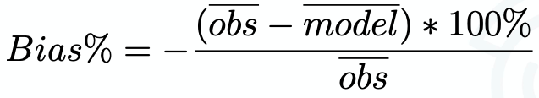
Mean Bias
 | GOFS | POM Oper | POM Exp | HYCOM Exp
T ML | -0.40% | -3.0% | -0.94% | -0.62%
OHC | -3.6% | -22% | -17% | -8.7%
T100 | 1.4% | -0.46% | 0.49% | 1.2%
IC Clim.
All models are colder in the surface mixed layer
All models have a deficit in the OHC

Slide 17
Conclusions and Future Work
Glider data assimilation ahead of a storm is critical to ensure that the ocean models have the right vertical stratification
The ocean models underneath the NOAA hurricane forecasting models did not get the benefit of ocean DA though GOFS/NCODA in previous seasons. In 2021 RTOFS-DA will provide the ocean initial conditions to the NOAA hurricane forecasting models.
Operational ocean models and the ocean models coupled to the hurricane forecasting models still need to improve their representation of processes that are relevant to the air-sea heat fluxes
HRWR2020-HYCOM is the hurricane forecasting model that best represents the upper ocean metrics that are important for the air-sea heat fluxes
We will continue collaborating with NOAA/NCEP. We will also continue evaluating RTOFS-DA.

