Slide 1
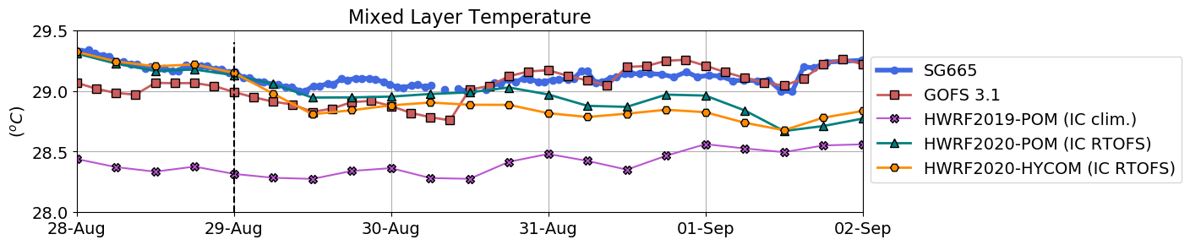
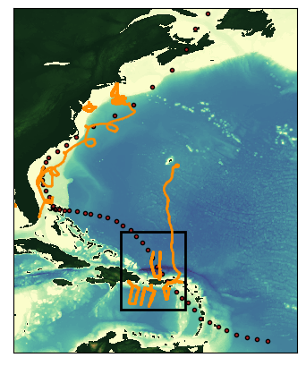
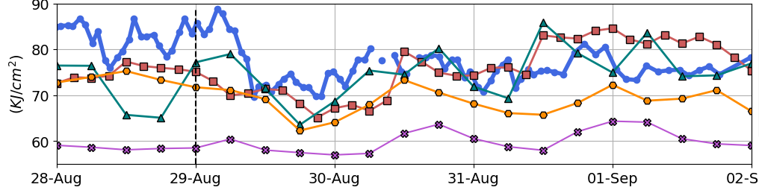
Hurricane Dorian 2019
Glider Data
Operational Navy Ocean Model
Operational NOAA Hurricane Model 2019
Experimental NOAA Hurricane Model
Experimental NOAA Hurricane Model
Sea Surface Temperature
One of NOAA’s operational hurricane forecasting model in 2019 has
sea surface temperature that is significantly colder than temperature
from glider observations.
Ocean Heat Content
As a consequence, the ocean heat content of the operational model is
much lower than the observed value and below the threshold value for
intensification of tropical cyclones.

Slide 2
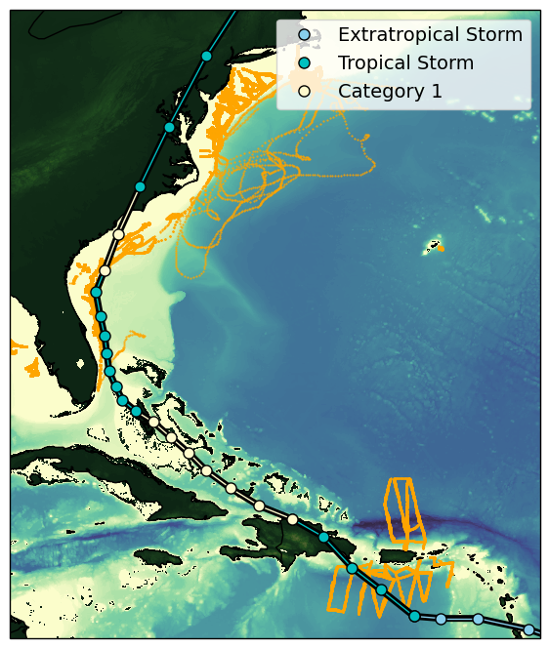
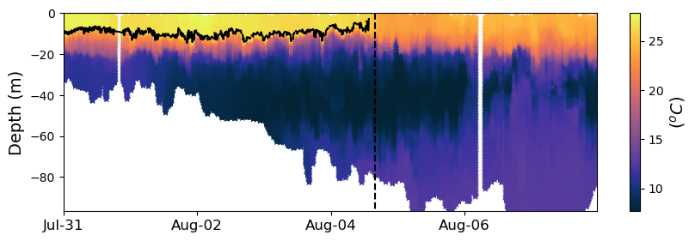
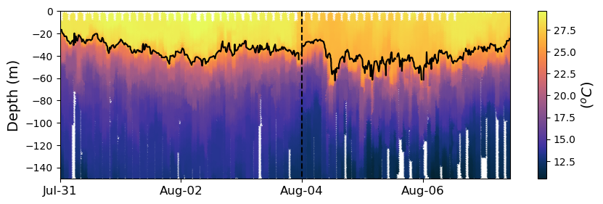
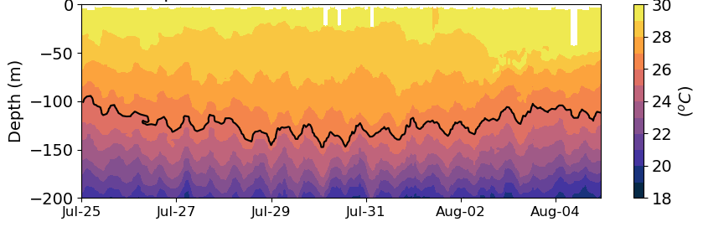
Hurricane Isaias 2020
Impact Zone: Mid Atlantic Bight
Very cold subsurface waters are vertically mixed by strong winds.
Cold Pool
Intensification Zone: Gulf Stream
Warm surface waters
Strong vertical stratification prevents vertical mixing and enhances intensification.
Formation Zone: Caribbean
Deep warm ocean layer allows the storm to form and evolve.

Slide 3
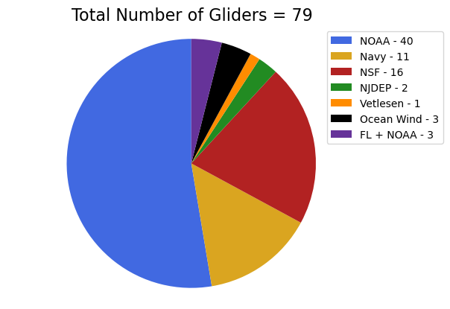
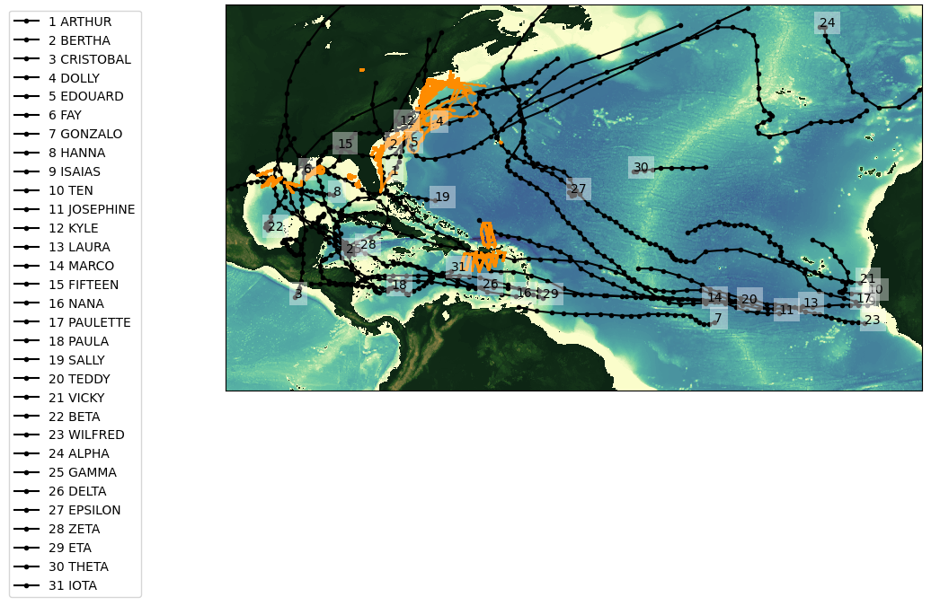
2020 Glider Picket line and Hurricane Tracks
Total number of gliders = 79
Total number of glider profiles = 183377

Slide 4
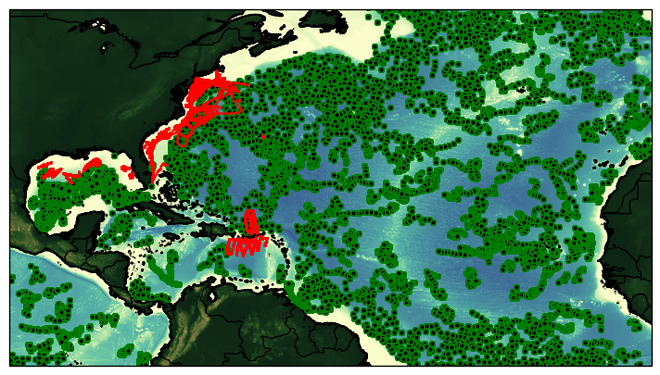
Glider Tracks and ARGO Floats
During the 2020 Hurricane Season
Total number of glider profiles = 183377
Total number of Argo profiles = 9025

