Slide 1
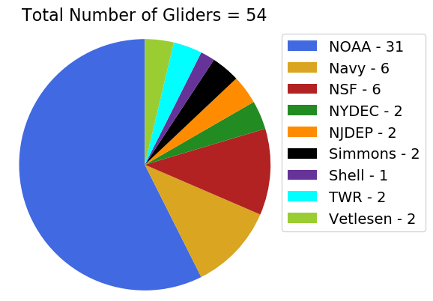
2019 Glider Picket Line & Hurricanes
Total number of Gliders = 54 (~1/2 volunteer)
Total number of Glider data profiles = 103,511
Glider Data Flow:
Operators >
IOOS Glider DAC >
NDBC > GTS >
Ops Centers

Slide 2
