Slide 1
Pre-Brief: Hurricane Gliders
March 15, 2019

Slide 2
Underwater Glider Overview

Slide 3
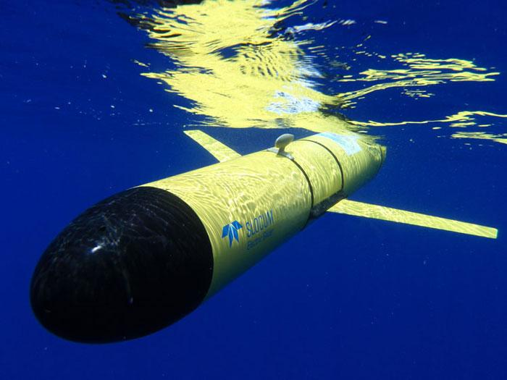
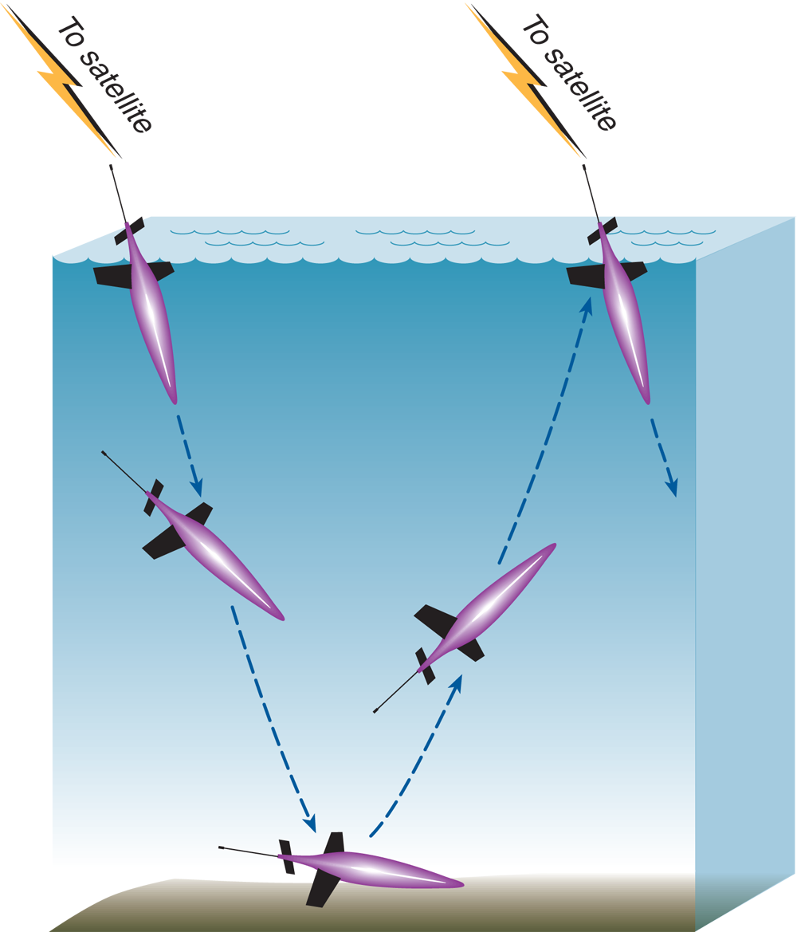
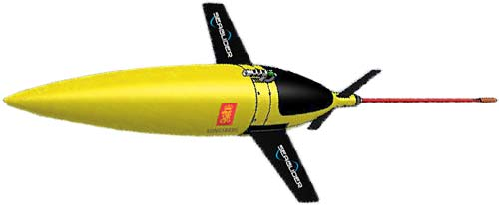
Underwater Autonomous Gliders
A unique observation platform:
Sample across/into currents
Sustain operations for 100+ days
Dive to >1000m
Transmit data in near real time for use in forecast models
Can carry multiple sensor payloads
Utilize ballasting for propulsion
Notes:
Underwater Gliders are a novel, low cost, and reliable way to collect subsurface data. They are a type of autonomous underwater vehicle (AUV) that uses small changes in buoyancy in order to move up and down in the ocean like a profiling float. Unlike a float, a glider uses wings to convert that vertical motion to horizontal motion, propelling itself forward with very low power consumption.
They transmit this data in near real-time to shore. Unlike fixed moorings or drifters, gliders can collect data across or into currents and are sometimes used in extreme environments like under ice or hurricanes.
Gliders profile from the surface to depth (up to 1000m+) repeatedly and can cover 20km a day or operate in a stationary position. Deployments of up to 6 months are routine. During a few minutes on the surface, gliders obtain location by GPS, transmit their data, and receive new commands.
Sensors on gliders can measure:
Physical variables - pressure, noise (background, ambient, ships, marine mammal calls, etc.), temperature, salinity, current, optical backscatter, bottom depth
Biological variables - relevant to the abundance of phytoplankton and zooplankton
Chemical variables - such as dissolved oxygen and nitrate. As pH sensors continue to mature, gliders will provide excellent platforms for monitoring ocean acidification
Gliders may be deployed and recovered from a wide range of platforms, including small boats and chartered fishing vessels. And in the past decade their use has steadily increased as the systems have become more versatile and reliable, to the point now that much of the work they do can be called routine.

Slide 4
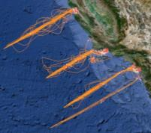
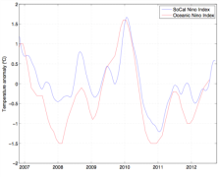
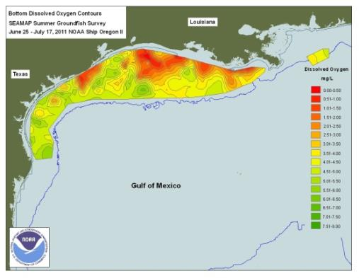
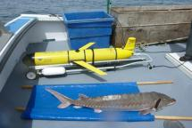
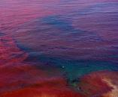
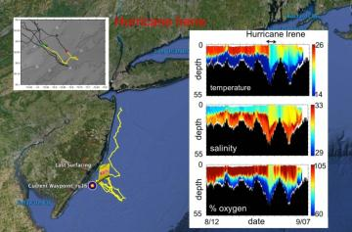
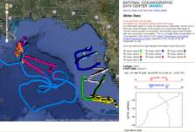
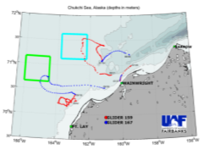
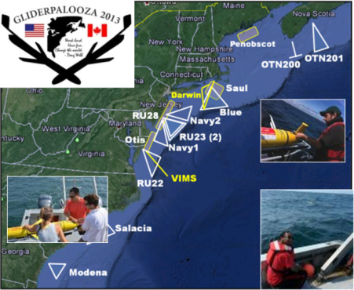
Glider Missions
Climate/Ecosystem/Fisheries Management/Water Quality
HAB
CalCOFI
Fish Tracking
Hypoxia
SoCal Niño Index
Hurricane Forecasting
Exercising the
Network
Response to Oil Spill
Deep Water Horizon
Alaska
https://gliders.ioos.us/
Notes:
Able to be outfitted with a myriad of sensors, gliders are able to meet the needs of multiple missions. Missions range from longer term monitoring like the California Cooperative Oceanic Fisheries Investigations (CalCOFI) to quick response to events like oil spills and Harmful Algal Blooms (HABs).
Common Missions Profiles:
Ecosystem dynamics monitoring
Fish stock mapping
Harmful Algal Bloom (HAB) mapping
Hydrographic mapping
Ocean acidification sampling
Climate monitoring
Listening to tagged fish, whale acoustics
Sustained and targeted ocean observations for improving tropical cyclone intensity and hurricane seasonal forecasts
Oil spill response

Slide 5
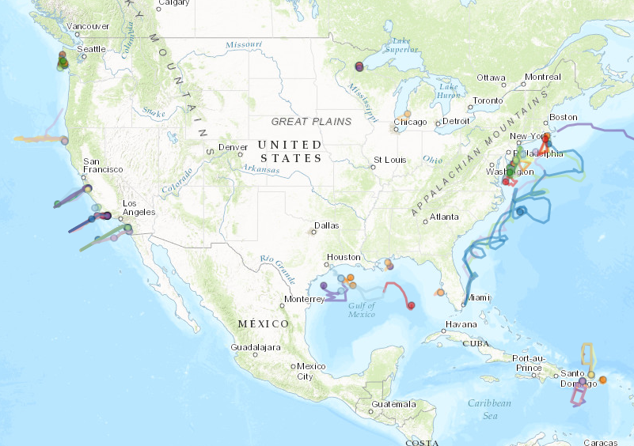
IOOS Glider DAC
> 60,000 glider days with capabilities in all 11 IOOS regional associations
Sustained climate and ecosystem monitoring
Understanding the ocean’s role in hurricane intensification
Fast response to crisis: Deepwater Horizon

Slide 6
Glider History and IOOS Role
2005-06: Navy funded Glider Technology Centers
200x: IOOS Regional Associations provide glider observations and worked to advance the technology.
2009: RU27: MARACOOS/Rutgers - Crossing the Atlantic
2012: Held first national glider meeting
2013: Established a National Glider Data Assembly Center (NGDAC)
2014: Released a Glider Network White Paper
2015: Established an IOOC Glider Task team
2017: Established Underwater Glider User Group (UG²)
6
Notes:
Gliders were first conceptualized in the 1960s, but did not take off until the early 2000s when the US Navy funded a major effort to develop the technology. From this effort, three major designs were developed; the University of Washington’s Seaglider, Scripps institute of Oceanography’s Spray, and Teledyne Webb’s Slocum.
During this time, IOOS Regional Associations along with partners from both academia and across government, played a vital role in fielding and helping to develop this technology. These experiences gained IOOS valuable expertise with the technology and positioned us as a leader in the community. This was demonstrated in 2009 when Dr Glenn and his team at Rutgers University made the first Transatlantic crossing with a glider.
Over the last decade, IOOS has continued to play a leadership role in the glider community. By bringing the US Glider community together through national meetings, developing the National Glider Data Assembly Center (NGDAC), and establishing the US Glider User Group (UG2); IOOS continues to drive the use and application of this technology forward.
This work ensures that glider expertise from across Government, private sector, and academia is shared and promotes improvements to the technology and its applications.

Slide 7
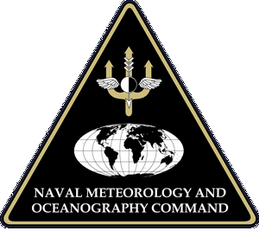
Glider Expertise
IOOS Regional Associations
OOI glider data managers
Canada glider operators
AOML
NSF
Navy
JCOMM
WHOI (OOI and Coop Institute)
https://gliders.ioos.us/
Notes:
This expertise spans a vast range of partners.

Slide 8
Hurricane Glider Overview

Slide 9
The Challenge of Intensity
US Hurricanes Since 1980
$919.7 Billion in Damages
6,487 Deaths (49% from storm surge)
55% of Billion Dollar Disasters
Track Error
Improvement: Factor of 2-4
Intensity Error
Improvement: Marginal
Ocean heat modulates hurricane intensity.
Essential Ocean Features play a critical role in this process, but remain challenging for forecast models to get right.
To improve intensity forecasts we need to represent these features well.
Preparedness and risk reduction
Safe and efficient transportation and commerce

Slide 10
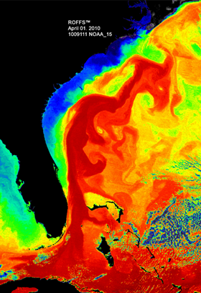
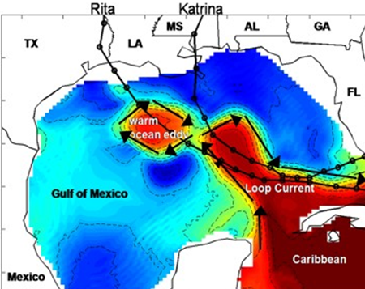
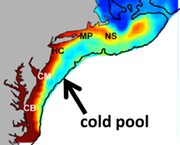
The Ocean Effects Hurricanes
Essential Ocean Features
Known to cause rapid intensification and de-intensification
Occur close to populated and vulnerable coastlines
Challenging for models to get right due to dynamic nature and limited observations
Examples
Loop Current
Atlantic Warm Pool
Gulf Stream
Mid-Atlantic Cold Pool
Notes:
Features such as the Atlantic Warm Pool, Gulf Stream, Loop Current, and Mid-Atlantic Cold Pool present major challenges for improving hurricane intensity forecasts. These features also reside in historic hurricane pathways and lie in close proximity to densely populated and often vulnerable coastal communities.
Current research emphasizes the value of sustained and targeted ocean observations to resolve these features and improve the models forecasts of them.
However, the challenge is that there are only a few upper ocean thermal observations carried out each year in these regions.

Slide 11
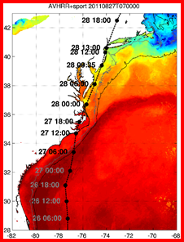
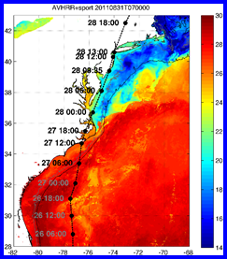
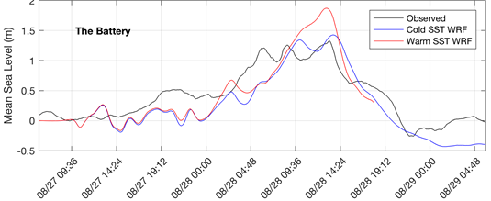
One Example: Hurricane Irene
Getting the Mid-Atlantic Cold Pool Right
Forecasted
Warm Ocean
CAT 1
Max Water Level: 1.9m
Rain: 130mm
Actual
Cold Ocean
Tropical Storm
Max Water Level: 1.3m
Rain: 92.5mm
~0.5 m difference in forecasted water level and rainfall.
Notes:
In August of 2011, Hurricane Irene was projected to approach the Eastern Seaboard. 65 million people from the Carolinas to northern New England were estimated to be at risk. Forecast models predicted the storm would intensify as it moved over what were forecasted to be warm waters in the Mid-Atlantic.
States of emergency and hurricane warnings were declared for much of the East Coast. In advance of the storm, hundreds of thousands of people evacuated near coastal areas.
Based on the track and intensity forecast the Governor of NY ordered a mandatory evacuation order for low-lying areas of NY City.
The storm weakened as it passed over the Mid-Atlantic Cold Pool and made landfall in the NY/NJ area as a tropical storm.
Model sensitivity studies have shown that if the models resolved the Mid-Atlantic Cold pool correctly, the water level and rainfall predictions at the NY Battery would have been almost exactly what was observed.

Slide 12
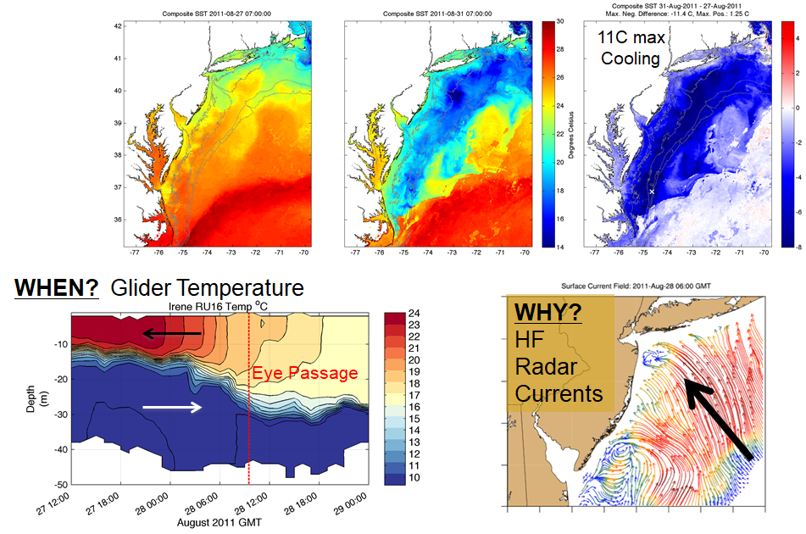
Hurricane Irene: The Glider Caught It!

Slide 13
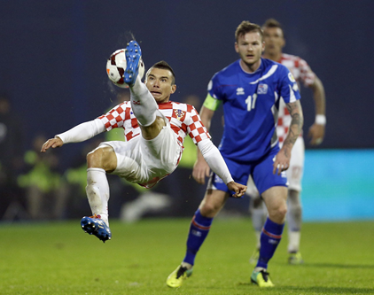
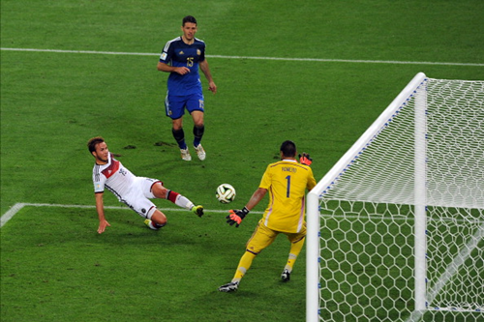
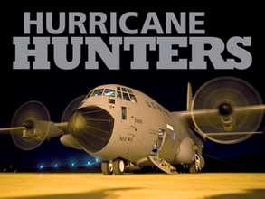
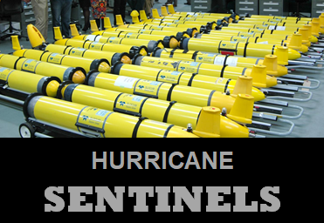
Gliders are the Defense
Gliders are uniquely skilled at collecting the critically needed data to keep the models on track and help resolve these features
Two Main Purposes:
Keep models on track (sustained)
Show upper ocean response; before, during, and after a hurricane (opportunistic)
Key Point
Gliders are best utilized on sustained missions and not as “quick” deployment tools to chase hurricanes.
Notes:
Gliders are uniquely skilled at collecting the critically needed data to help keep models on track. Much like a soccer team, hurricane hunters are the offense. They go out and after the storm. Hurricane Gliders are defensive like a goalie. They lie in waiting in these dynamic areas, collecting data to keep the models on track. When a storm approaches they can be maneuvered to areas of high model uncertainty.
Since models will often not respond well to data that suddenly disrupts its anticipated conditions, gliders provide the maximum benefit when they are used in sustained observation schemes. This is what we mean when we say; “Keeping the models on track”.
Only deploying gliders when a hurricane approaches only satisfy purpose 2. It is important they are in place throughout the hurricane season to provide the best chance of improvement.

Slide 14
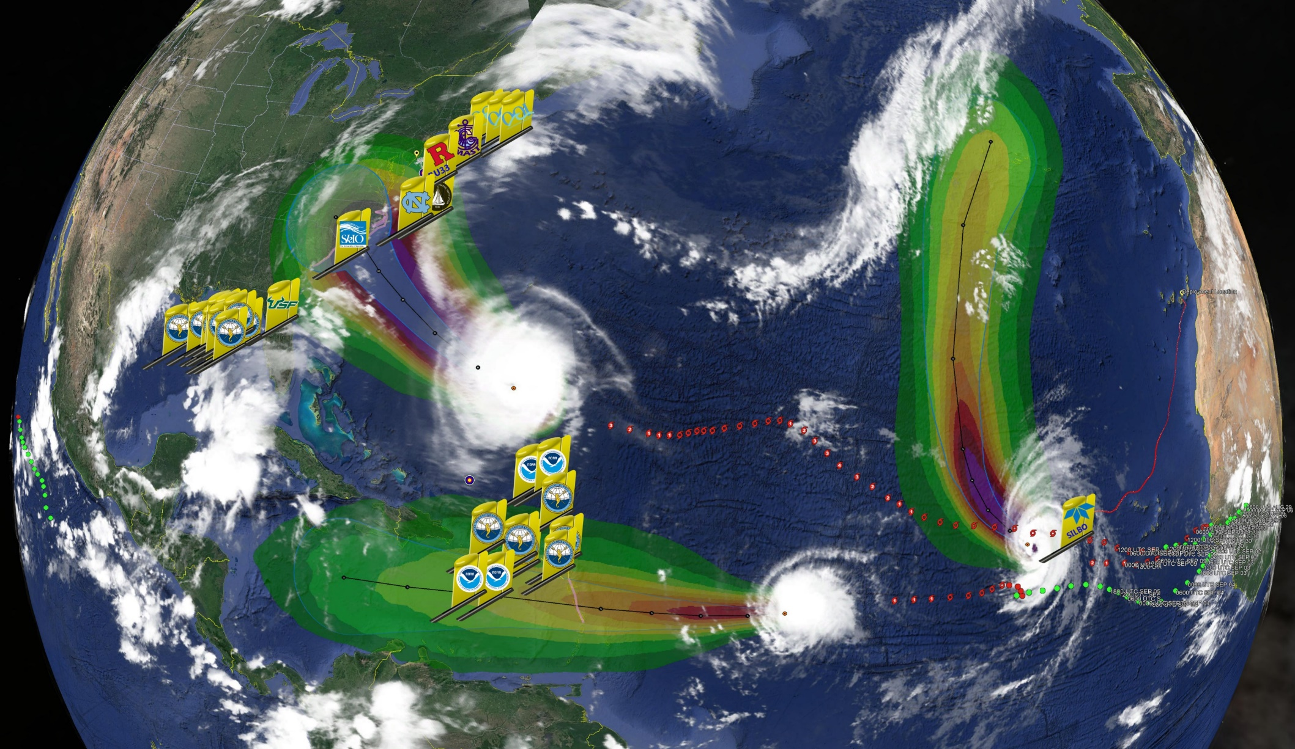
2018 Hurricane Glider “Picket” Lines
Florence
Helene
Isaac
>30 Hurricane Sentinel Gliders from the Navy, NOAA, NSF, Academic & Industry Partners
reporting ocean conditions through the U.S. IOOS Glider Data Assembly Center (DAC)
ahead of Hurricanes Florence, Isaac and Helene on September 11, 2018.
Notes:
2018 was the largest Picket Line to date
30 Navy Gliders (10 Loaned to NOAA for the Caribbean)
Data collected for hurricanes Florence, Michael, Isaac, Helene
IOOS Post-Doc at Rutgers is running model comparisons

Slide 15
Backup Slides

Slide 16
Glider Data Flow to Forecast Models
Hurricane Model Data Flow
Glider Data Collected by Provider
Observations transmitted to GDAC
US IOOS Glider Data Assembly Center
(GDAC)
Archived and publicly available at National Centers for Environmental Information (NCEI)
National Data Buoy Center (NDBC)
Operational
Global Telecommunication System (GTS)
National Centers for Environmental Prediction (NCEP)
Data Tanks
Navy Coupled Ocean Data Assimilation (NCODA)
Navy
Boundary & Initial Conditions for Navy Models:
Global Ocean Forecast System (GOFS)
Hybrid Coordinate Ocean Model (HYCOM)
Navy’s Coastal Ocean Model (NCOM)
Boundary & Initial Conditions for NOAA Model:
Global Real-Time Ocean Forecast System (RTOFS)
NOAA
Boundary & Initial Conditions for Coupled Hurricane Models: (in select regions)
HMON
HWRF
Notes:
Currently, the Navy does the data assimilation for NOAA’s global ocean model through the Navy Coupled Ocean Data Assimilation (NCODA)
NCODA feeds observations to NOAA’s Global Real-Time Ocean Forecast System (RTOFS)
RTOFS is a clone of the Navy’s global ocean model Global Ocean Forecast System (GOFS)
NOAA’s RTOFS model is the ocean component of NOAA’s operational coupled (ocean/atmosphere) hurricane forecast models; HMON & HWRF (in most regions)
NOAA is in the process of transitioning the NCODA system from Navy to NOAA.
This will allow us to have more ability to optimize this system for glider data use.

Slide 17
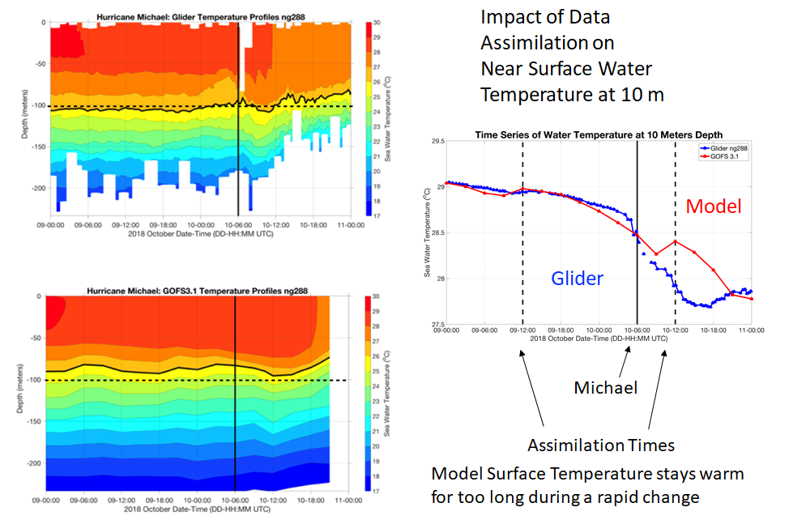
Example Slides

Slide 18
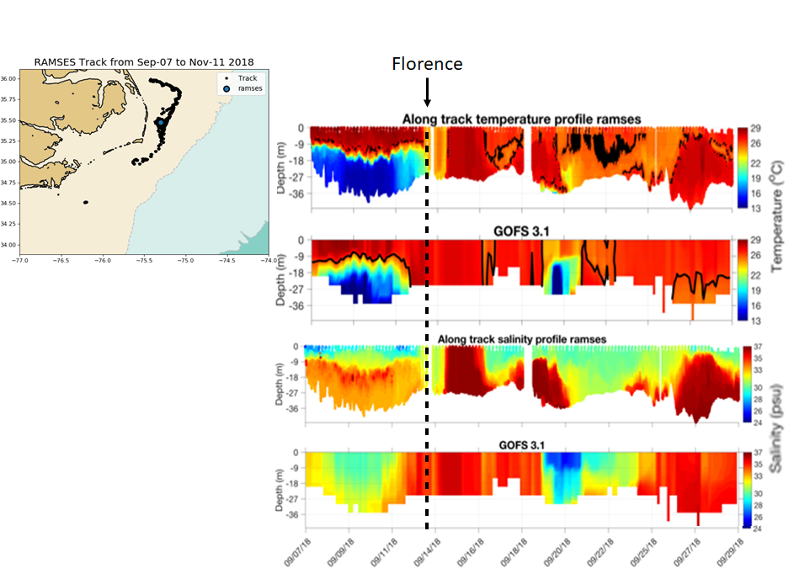
Example Slides

Slide 19
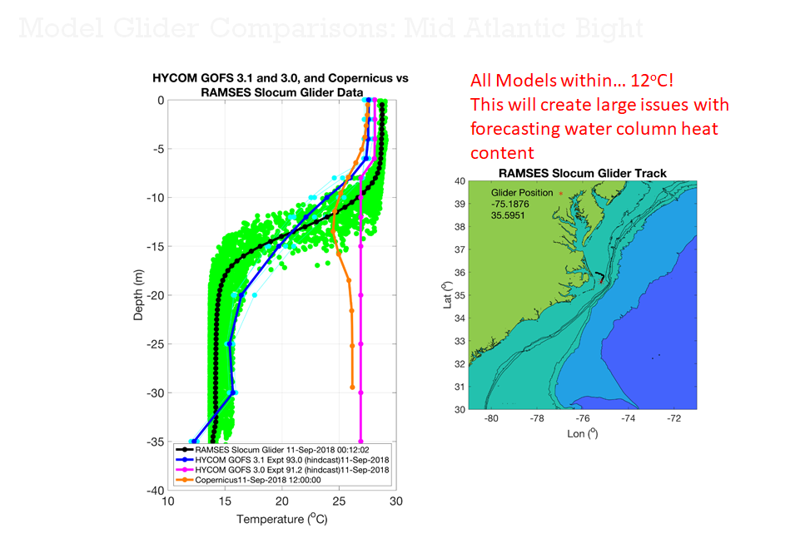
Example Slides

Slide 20
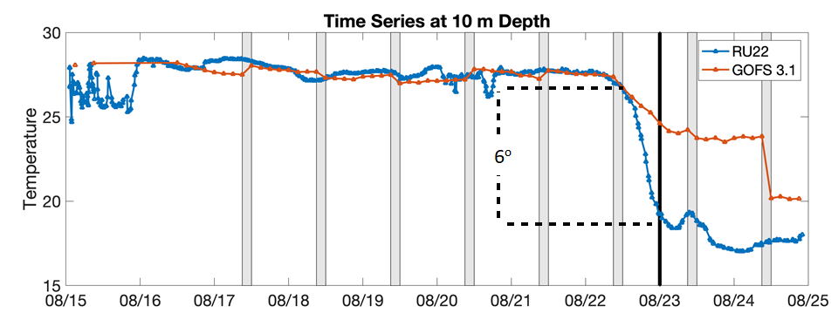
Example Slides

Slide 21
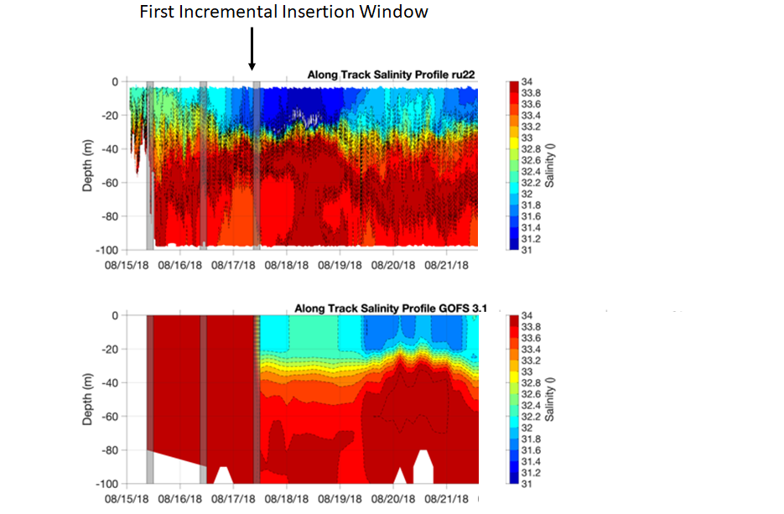
Example Slides

