Slide 1
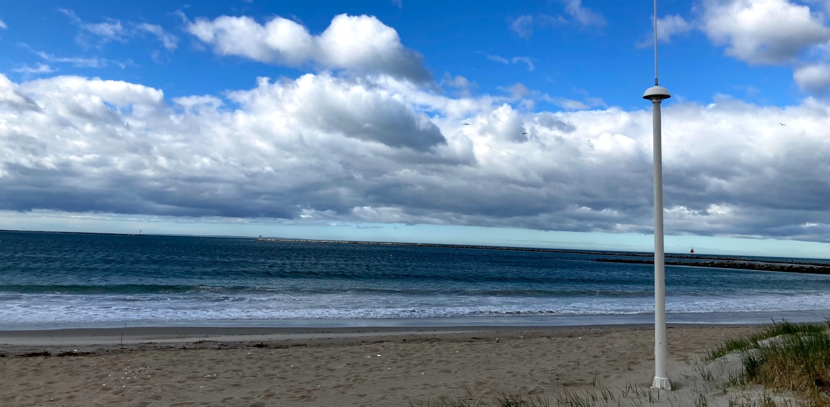
30 Years of Coastal Ocean Data
Hugh Roarty, Ethan Handel, Mike Smith, Tim Stolarz
Sage Lichtenwalner, Laura Nazzaro Josh Kohut, Scott Glenn
Rutgers University Center for Ocean Observing Leadership (RU-COOL)
Department of Marine and Coastal Sciences
hroarty@Rutgers.edu 908-208-2970

Slide 2
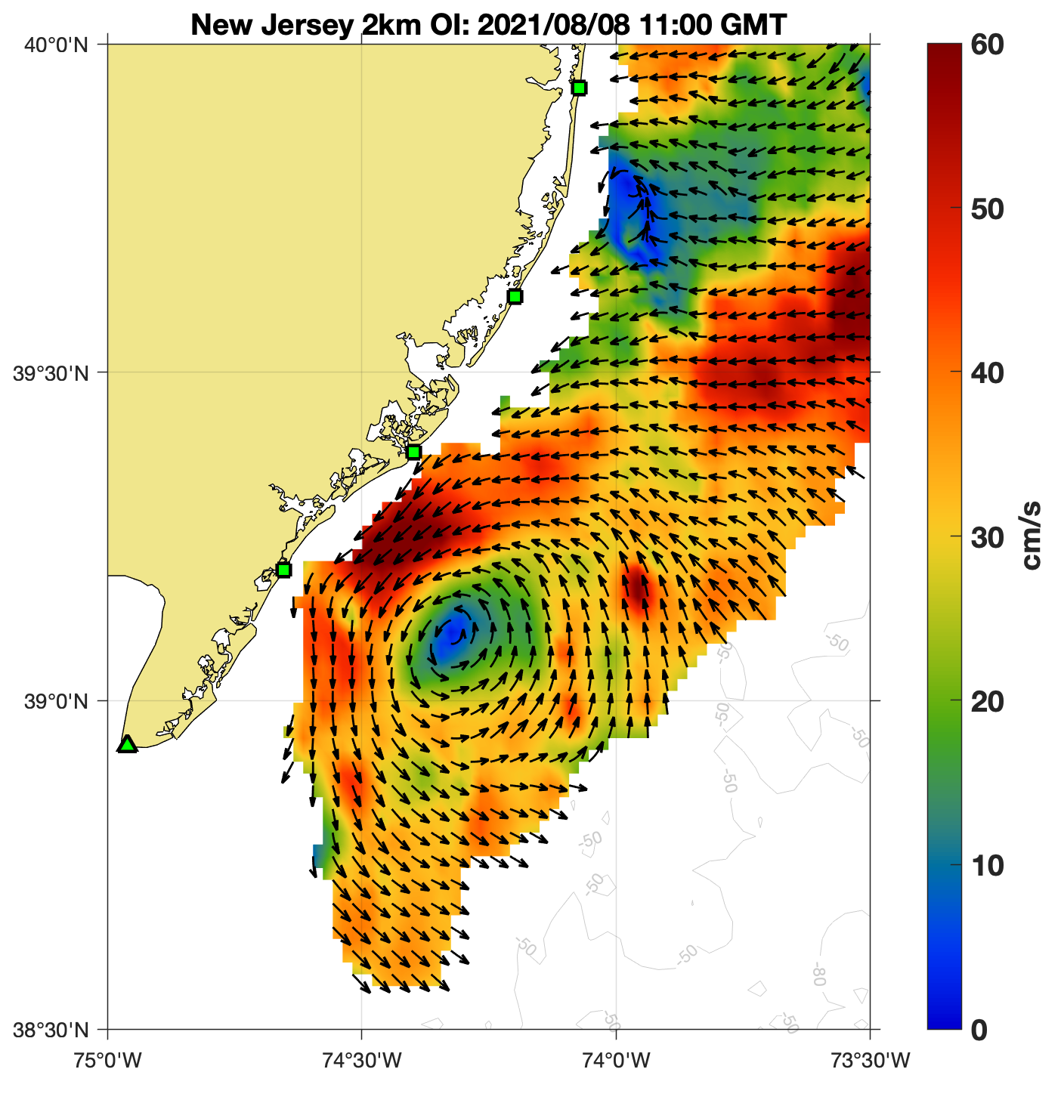
30 Years of Coastal Ocean Data
Level 0,1
Level 2
Level 3
Radars on the Beach
Radial Measurements
Maps of Currents

Slide 3
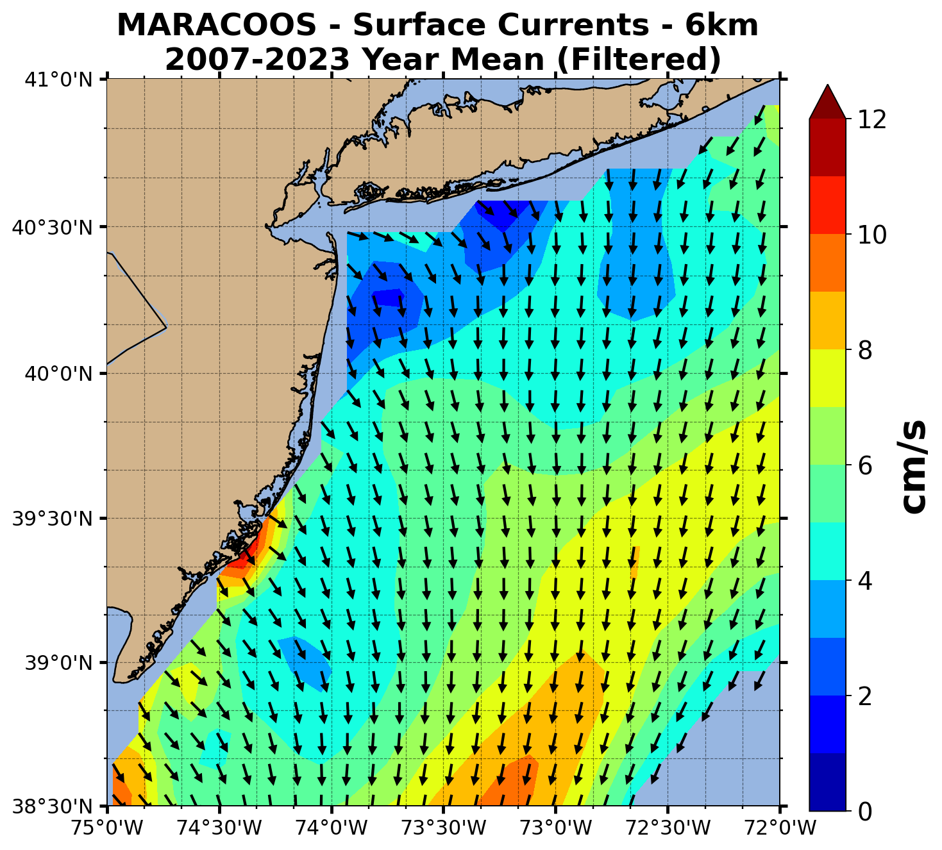
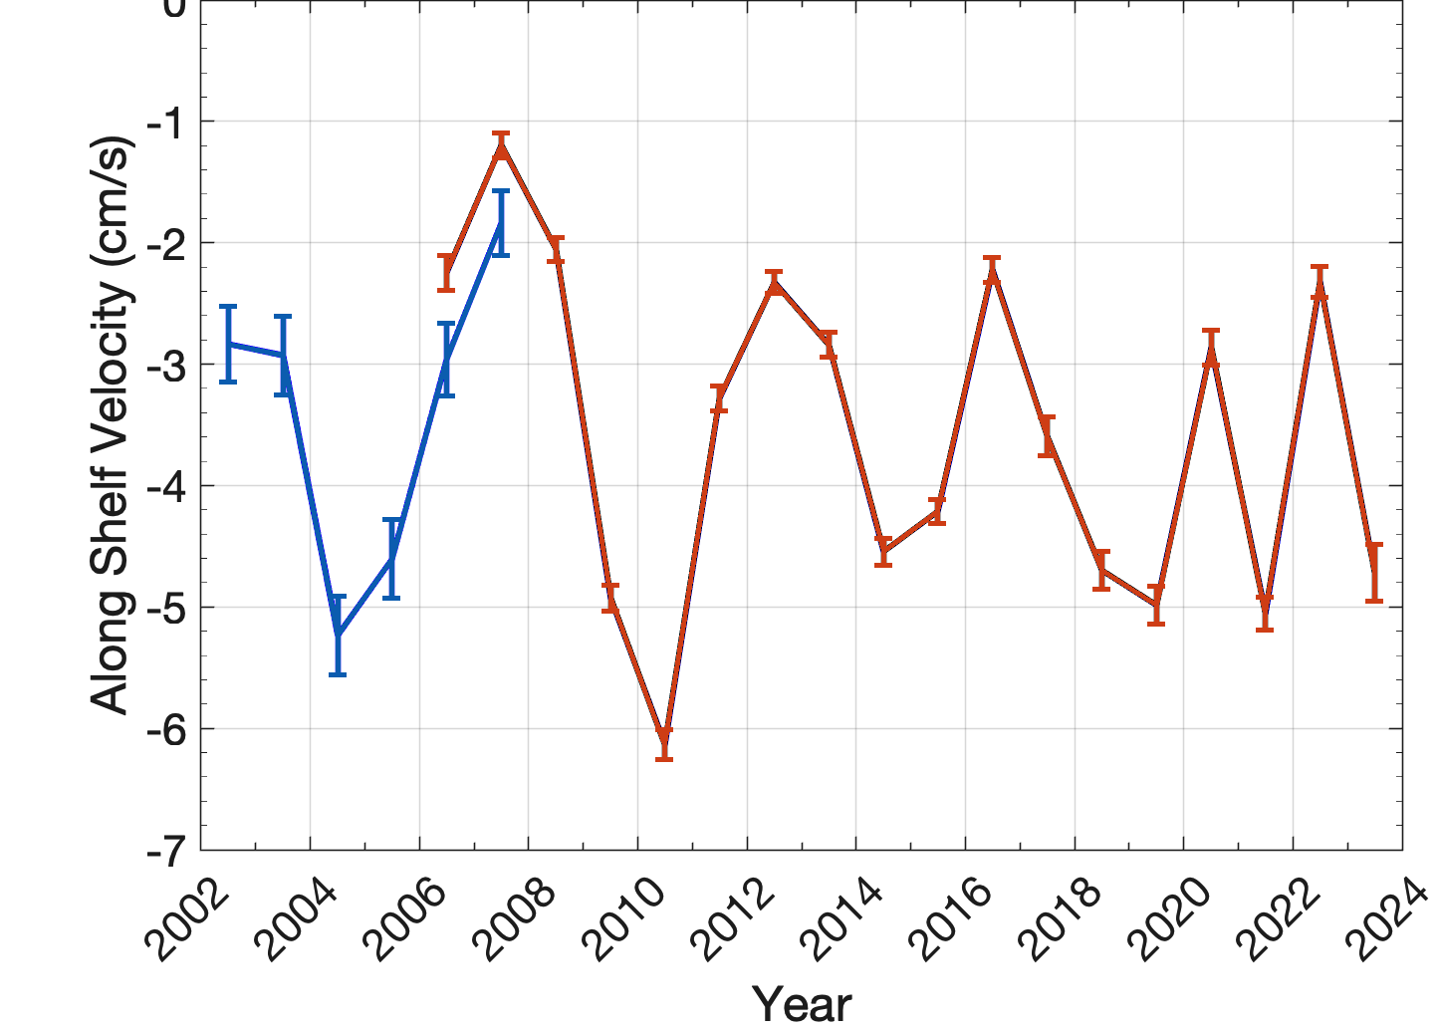
30 Years of Coastal Ocean Data
Alongshelf Yearly Mean
+ Cross
Shelf
+ Alongshelf
Velocity (cm/s)
Alongshelf Current
Gong et al. (2010)
Roarty et al. (2020)

